Slide 1
Data Pipeline
ETL to Augment UTM (Urchin tracking parameters)

Slide 2
Business Requirement
Input data format : CSV (Batch data)
Augment the data with the following additional fields:
utm_source
utm_medium
path
Analyse the top utm_source , utm_medium
Generate output in the form of JSONL file for subset of records with distinct user count along with time data
UTM Data Reference : https://www.semrush.com/blog/use-utm-tracking-codes-google-analytics/

Slide 3
Technical Design
Programming Language : Python 3.7
etl_main.ipynb : The executable file
get_data.py : Loads input file to pandas data frame as passes back to main class
transformation.py :
Convert Unix time column in to a human readable format.
Extract medium ,source and path from URL.
Output : Returns 3 data frame (summary data ) to the main class
Top count medium and source.
Distinct users count, min time , max time for a subset of records.
Distinct users count by day.
load_output.py : Generate output in the form of CSV , JSON or Parquet file for the summary data

Slide 4
Implementation
Python Package Module :
etl_main.py : The main executable file
logging_class.py : Logs output to file etl_log.out in the directory of execution
get_data.py
transformation.py
load_output.py
config_data.json : Configuration file for source data and output type

Slide 5
Technical Flow
Executable | Module | Output
python etl_main.y | Getdata. ReadCSVData() | Returns data in pandas dataframe
 | Transformation. set_time_readable() | Formats time in the source dataframe
 | Transformation. set_medium_source_path() | Extracts source and medium for URL
 | Transformation. final_dataframe() | Returns Transformed dataframe
 | Transformation. execute_metrics(10000) | Window set for record count and returns dataframe with minimum , maximum time with distinct count of users
 | Transformation. calc_distinctusers_perday() | Distinct count of users per day
 | SaveOutput.save_data() | Summarized data gets saved.

Slide 6
Transformation using Spark
Problem description : When the Source data volume increases , panda struggles to keep the dataframe in memory .
Alternative solution :
Split source file to smaller size (not practical and is not scalable)
Use distributed data framework.
Script name : pyspark/pyspark-utm.ipynb
Read data using spark.read and convert to parquet . The file gets split using automatic partition
Using spark sql to perform transformation.
Test metrics : ( Single server in a cluster)
Size reduced by 60% prior compression
Massive parallel operation benefits . The transformation time < 10% of actual time taken compared to single python script.
Spark SQL offers easy transformation

Slide 7
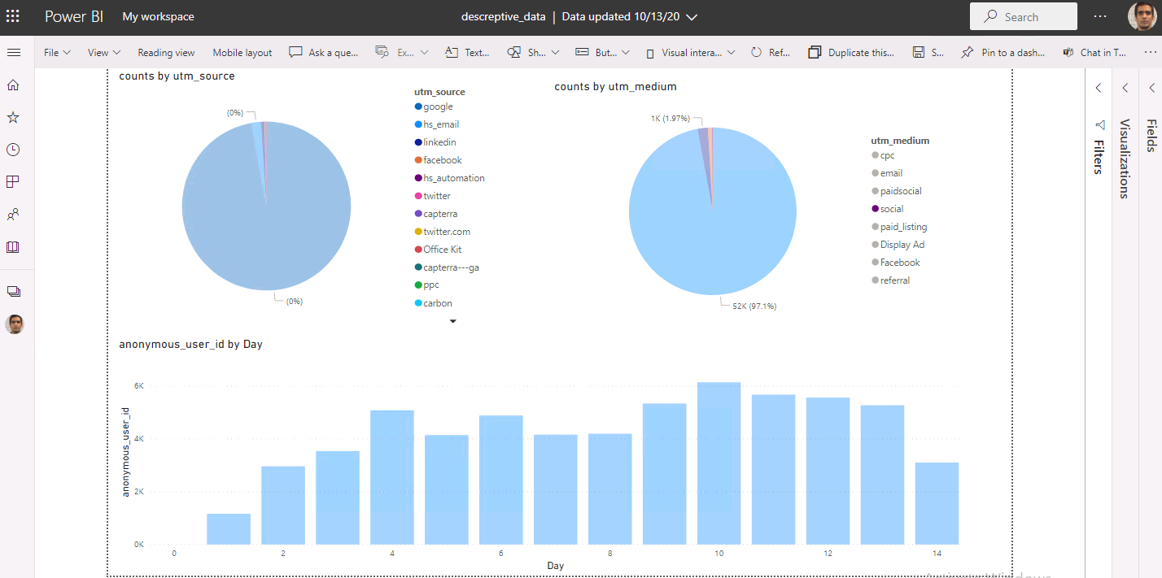
Visual of summary data
Note : I cannot share the dashboard to web. Attached .pbx file.

