Slide 1

BUILDIND A SMARTER AI-POWER SPAM CLASSIFIER TEAM LEADER 912421104036:SAJITHA PARVEEN .P PHASE 2 SUBMISSION DOCUMENT INNOVATIVE TECHNIQUES TO BUID SPAM CLASSIFIER
PROJECT:

Slide 2
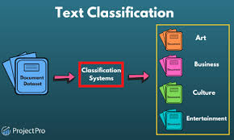


Slide 3
Building an effective spam classifier requires innovative techniques and approaches to stay ahead of evolving spam tactics. Here are some innovative strategies you can explore:
Deep Learning and Neural Networks
Transformer-Based Models
Ensemble Methods
Transfer Learning
Active Learning
Explainable AI (XAI)
Multi-Modal Learning
Privacy-Preserving Techniques
Cross-Lingual Spam Detection
Behavioral Analysis
Graph-Based Approaches
Natural Language Generation (NLG) Detection
Zero-shot Learning
Examine Time Series Data
Anomaly Detection
Human-AI Collaboration
Continuous Monitoring and Updates
Domain-Specific Knowledge
Examine Message Metadata
Feedback Mechanism

Slide 4
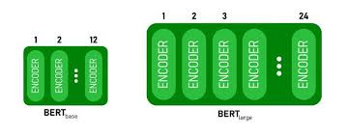
1.Deep Learning and Neural Networks:
Deep learning is a subset of machine learning that utilizes neural networks with multiple layers to model and solve complex tasks, mimicking the human brain's structure.
2.Transformer-Based Models:
Transformer-based models, like the BERT and GPT architectures, have revolutionized natural language processing tasks by using self-attention mechanisms to capture contextual information efficiently.

Slide 5
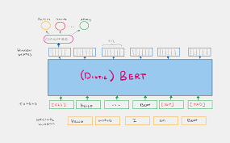
BERT FOR FEATURE EXTRACTION

Slide 6
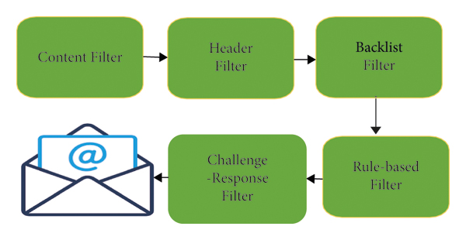
STANDARD SPAM FILTERING

Slide 7
3.Ensemble Methods:
Ensemble methods combine multiple machine learning models to improve overall predictive performance by leveraging the strengths of different models.
4.Transfer Learning:
Transfer learning involves using pre-trained models on one task to enhance the performance of a related task, reducing the need for extensive training data.

Slide 8
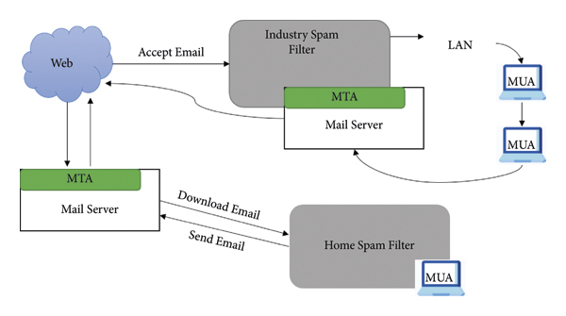
CLIENT BASED SPAM FILTERING

Slide 9
5.Active Learning:
Active learning is a strategy where a model interacts with a human annotator to select and label the most informative data points, reducing the labeling effort required.
6.Explainable AI (XAI):
Explainable AI focuses on making machine learning models and their decisions more interpretable and transparent, enabling users to understand why a model makes specific predictions

Slide 10
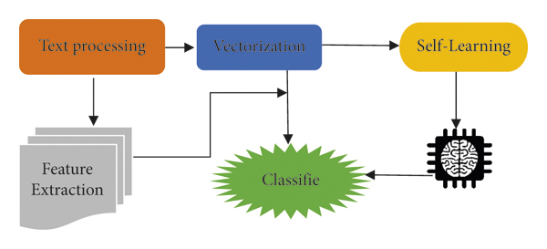
CASE BASED SPAM FILTERING

Slide 11
7.Multi-Modal Learning:
Multi-modal learning combines information from different data types, such as text, images, and audio, to improve model performance and understanding.
8.Privacy-Preserving Techniques:
These methods protect sensitive data during machine learning by applying encryption, anonymization, or differential privacy.

Slide 12
9.Cross-Lingual Spam Detection:
Techniques for detecting and filtering spam content in multiple languages, often using NLP and machine learning methods.
10.Behavioral Analysis:
This involves studying patterns in human behavior, often with the assistance of machine learning models, to gain insights or detect anomalies.

Slide 13
11.Graph-Based Approaches:
Graph-based models use network structures to represent and analyze relationships between data points, making them useful for tasks involving complex connections.
12.Natural Language Generation (NLG) Detection:
NLG detection aims to distinguish between human-generated and machine-generated text, often used to combat misinformation.

Slide 14
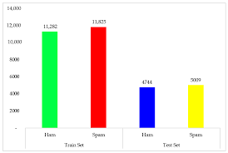
Graph based approach

Slide 15
13.Zero-shot Learning:
Zero-shot learning enables a model to make predictions on classes or tasks it has never seen during training, relying on generalized knowledge.
14.Examine Time Series Data:
Time series data analysis involves studying data points collected over time to uncover patterns, trends, or anomalies.

Slide 16
15.Anomaly Detection:
Anomaly detection identifies abnormal or unexpected patterns or data points within a dataset, which can be crucial for fraud detection or system monitoring.
16.Human-AI Collaboration:
This concept emphasizes the partnership between humans and AI systems, combining the strengths of both to achieve better results.

Slide 17
17.Continuous Monitoring and Updates:
This involves regularly assessing and updating machine learning models to adapt to changing data distributions and maintain accuracy.
18.Domain-Specific Knowledge:
Incorporating domain-specific knowledge into machine learning models helps improve their performance on specialized tasks.

Slide 18
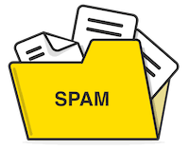
19.Examine Message Metadata:
Analyzing message metadata, such as timestamps, sender information, and routing details, can provide insights into communication patterns.
20.Feedback Mechanism:
A feedback mechanism allows a model to improve its predictions based on user feedback, promoting iterative learning and refinement.

Slide 19


