Slide 1
INCTRODUCTION

Slide 2
UI & UX
SAJITHA.V
BSC AI AND ML

Slide 3
What is UI ?
UI means user Inter face
It is the visual part of an app or website.
Buttons , icons , search ,bar , images and menus.
Example :

Slide 4


Slide 5
What is UX ?
UX means User Experience.
It is the experience a user gets while using an
app or website.
Example :
Easy navigation , fast search and smooth ordering.

Slide 6


Slide 7
UI(user inter face)
UX(user experience)
Focuses on appearance .
Focuses on user experience .
Includes colours , buttons , icons , images.
Includes navigation , speed and usability.
Makes the app attractive .
Makes the app comfortable to use .
Example : Beautiful app screen .
Example : finding and ordering a product easily.

Slide 8
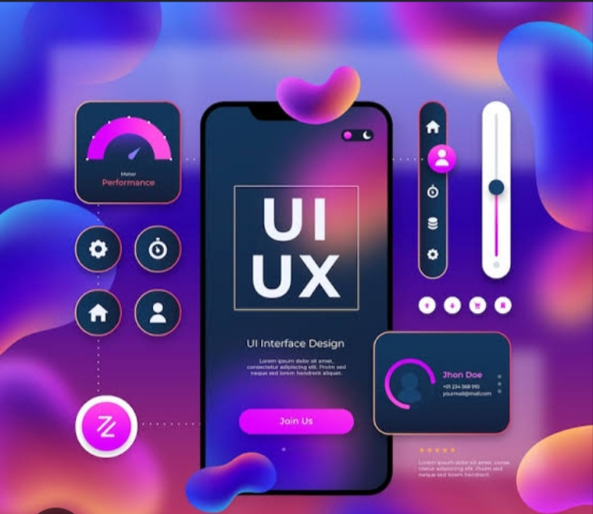


Slide 9
UI & UX CONCEPT
UI : The visual design of the app .
UX : The user’s overall experience while using the app .

Slide 10
EXAMPLE
A food delivery app with attractive buttons and easy ordering.

Slide 11

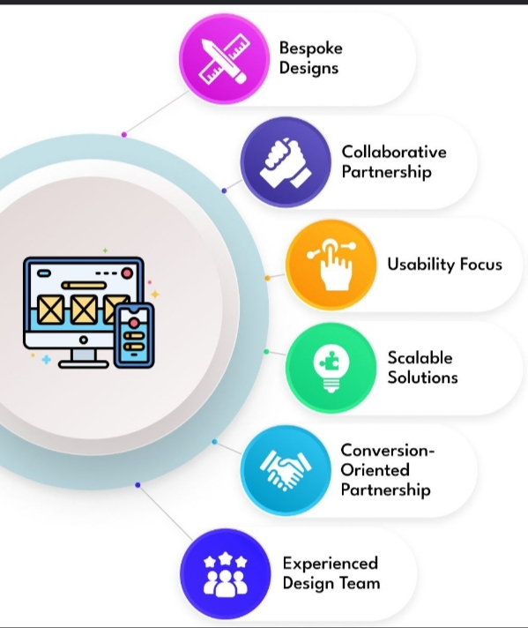

Slide 12
Thank You

