Slide 1
Tennis & Bootstrap Confidence Intervals
Edgar Vidriales
Anish Ravirjj,
Sajith Gowthaman
Nima Razavi

Slide 2
Data taken from Kaggle (coming from ATP website)
Data included years for various ATP seasons. Data from the 2018 and 2016 seasons were used.
Variables used:
w_ace (ace count for winner of match)
surface (which surface the match was played on
best_of (how many sets the match was played out of)
height (players height in centimeters).
An ace is a valid serve that the receiver does not make contact with.

Slide 3
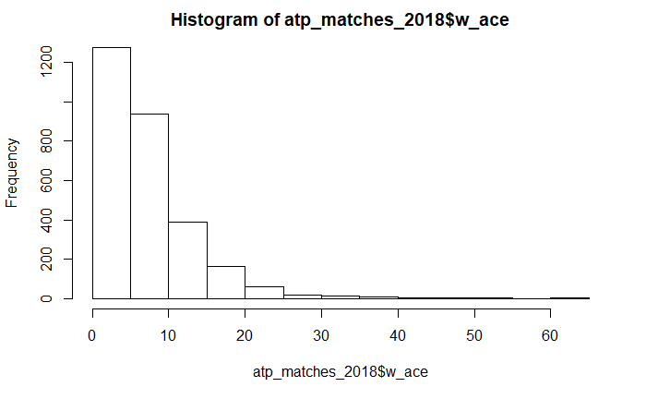
STARTING DISTRIBUTION FOR WINNER’S ACE COUNT

Slide 4
Winner’s ACE
library(tidyverse)
WinnerACE18<-atp_matches_2018 %>% select(w_ace, best_of)
WinnerACE18<-filter(WinnerACE18, best_of=="3") we drop the 5 set matches
summary(WinnerACE18$w_ace)
WinnerACE18<-na.omit(WinnerACE18) Remove the missing values
quantile(WinnerACE18$w_ace,c(.1, .9))
WinnerACE18<-filter(WinnerACE18, w_ace<16, w_ace>2) trimming 10% off the ends

Slide 5
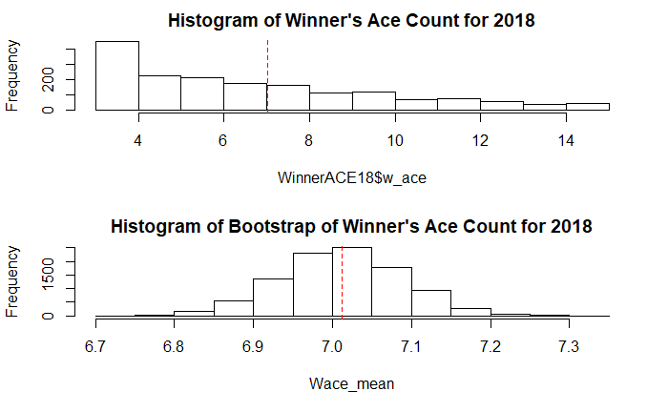
BEFORE AND AFTER BOOTSTRAPPING
Actual mean
[1] 7.012865
Bootstrap mean
[1] 7.013187

Slide 6
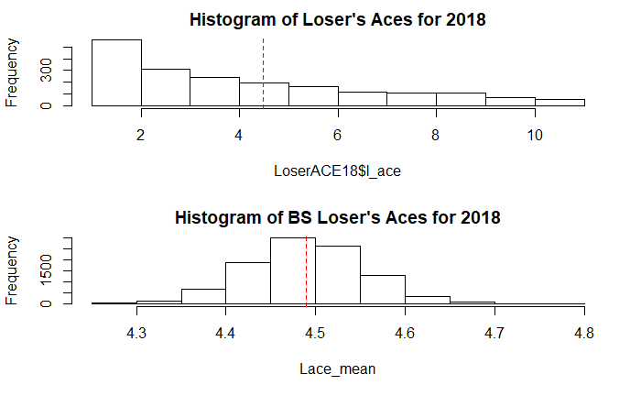
LOSER’S ACE COUNT DISTRIBUTION
Actual mean
4.490155
Bootstrap mean
4.489127

Slide 7
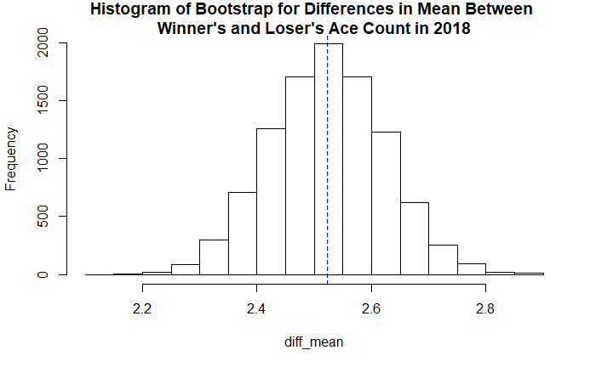
(SAJITH) WINNER VS LOSER ACE COUNT
Is there a difference between ace
Count for winners and losers?
2.5% 97.5%
2.329841 2.717696

Slide 8
R-code:
B=10^4
diff_mean=numeric(B) #Same as using NULL
for(i in 1:B)
{
w.sample=sample(WinnerACE18$w_ace, 1710, T)
l.sample=sample(LoserACE18$l_ace, 1930, T)
diff_mean[i]=mean(w.sample)- mean(l.sample)
}
hist(diff_mean, main = "Histogram of Bootstrap for Differences in Mean Between \nWinner's and Loser's Ace Count in 2018")
abline(v=mean(WinnerACE18$w_ace)-mean(LoserACE18$l_ace), col="blue", lty=2)
quantile(diff_mean, c(0.025, 0.975)) #95% BS Percentile CI
Based on the Bootstrap percentile confidence interval, we are 95% confident that, on average, winner’s have an ace count that is between 2.329 and 2.7 higher than the loser of the match.

Slide 9
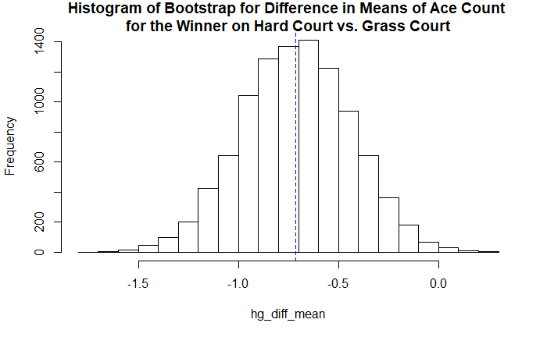
HARD VS. GRASS COURT
2.5% 97.5%
-1.2452228 -0.1838069
Grass court more aces than Hard

Slide 10
B=10^4
hg_diff_mean=numeric(B) #Same as using NULL
for(i in 1:B)
{
hard.sample=sample(hard18$w_ace, 1359, T)
grass.sample=sample(grass18$w_ace, 165, T)
hg_diff_mean[i]=mean(hard.sample)- mean(grass.sample)
}
hist(hg_diff_mean, main="Histogram of Bootstrap for Difference in Means of Ace Count \nfor the Winner on Hard Court vs. Grass Court")
quantile(hg_diff_mean, c(0.025, 0.975)) #95% BS Percentile CI
We are 95% confident that, on average, winner’s on grass court have an ace count that is between 0.183 and 1.245 higher than winner’s on hard courts.

Slide 11
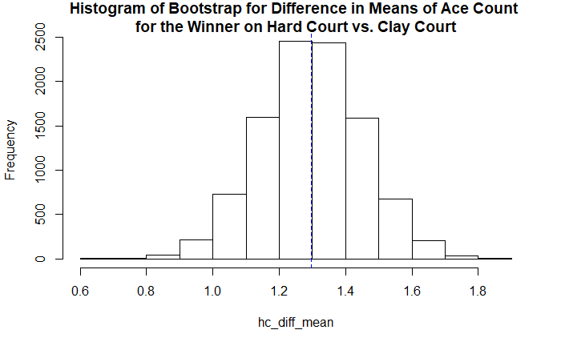
(ANISH)HARD VS. CLAY COURT
2.5% 97.5%
0.997758 1.599589
Hard courts have more
aces

Slide 12
```{r}
B=10^4
hc_diff_mean=numeric(B) #Same as using NULL
for(i in 1:B)
{
hard.sample=sample(hard18$w_ace, 1359, T)
clay.sample=sample(clay18$w_ace, 536, T)
hc_diff_mean[i]=mean(hard.sample)- mean(clay.sample)
}
hist(hc_diff_mean, main="Histogram of Bootstrap for Difference in Means of Ace Count \nfor the Winner on Hard Court vs. Clay Court")
quantile(hc_diff_mean, c(0.025, 0.975)) #95% BS Percentile CI
We do have significant evidence of there being a difference between the mean amount of aces for the winner of a hard court match and the winner on a clay court. We are 95% that, on average, the winner of a hard court will have between 0.997 and 1.59 more aces than the winner of a clay court match.

Slide 13
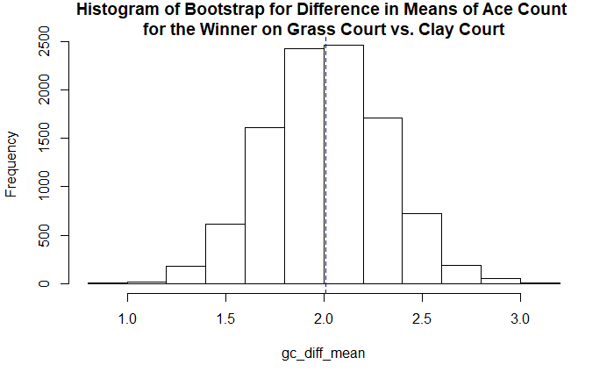
GRASS VS. CLAY
2.5% 97.5%
1.435738 2.596812
Grass more aces than
clay

Slide 14
B=10^4
gc_diff_mean=numeric(B) #Same as using NULL
for(i in 1:B)
{
grass.sample=sample(grass18$w_ace, 150, T)
clay.sample=sample(clay18$w_ace, 536, T)
gc_diff_mean[i]=mean(grass.sample)- mean(clay.sample)
}
hist(gc_diff_mean, main="Histogram of Bootstrap for Difference in Means of Ace Count \nfor the Winner on Grass Court vs. Clay Court")
quantile(gc_diff_mean, c(0.025, 0.975)) #95% BS Percentile CI
We do have significant evidence of there being a different between the mean amount of aces for the winner of a hard court match and te winner on a clay court. We are 95% that, on average, the winner of a grass court will have between 1.43 and 2.59 aces than the winner of a clay court match. (Biggest difference between courts)

Slide 15
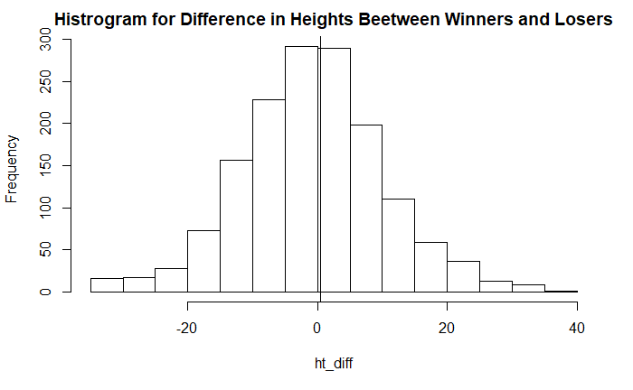
Height difference between the winner and loser of a match.
Actual mean: 0.387541cm
n=1525

Slide 16
mu0 <-mean(ht_diff) #mean of original sample
Shat <- sd(ht_diff)/sqrt(1525)
thetas <- NULL
tstar <- NULL
set.seed(100)
for (i in 1:1000)
{
x_sample <- sample(ht_diff, 1525, replace = TRUE) #new resample
mu <- mean(x_sample) #estimate
thetas[i] <-mu #save
tstar[i] <- (mu - mu0)/(sd(x_sample)/sqrt(1525)) #pivotal quantity
}
c(mu0, mean(thetas))
c(Shat, sd(thetas))
quantile(tstar, probs = c(0.025,0.975)) #quantiles from bootstrap percentile t
qt(c(0.025, 0.975), 1524)
mu0 + quantile(tstar, probs = c(0.025,0.975))*Shat #quantiles from bootstrap percentile t
mu0 + qt(c(0.025,0.975), 1524) * Shat #student t confidence interval for comparison

Slide 17
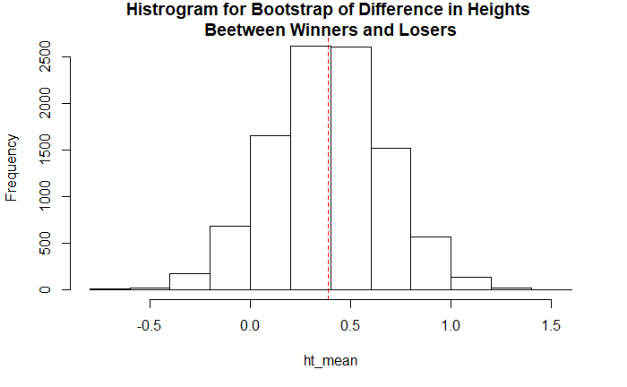
2.5% 97.5%
-0.1876835 0.9327655 Quantiles from bootstrap percentile t
-0.1678993 0.9429813 Student t confidence interval
Zero is in our confidence interval, so we
do not have statistically significant
evidence that the mean difference in
height between winners and losers is
different from zero.
Student t confidence interval
slightly smaller.

