Slide 1
Profiling and Debugging Microservices with AWS X-Ray
Sajith Weerakoon

Slide 2
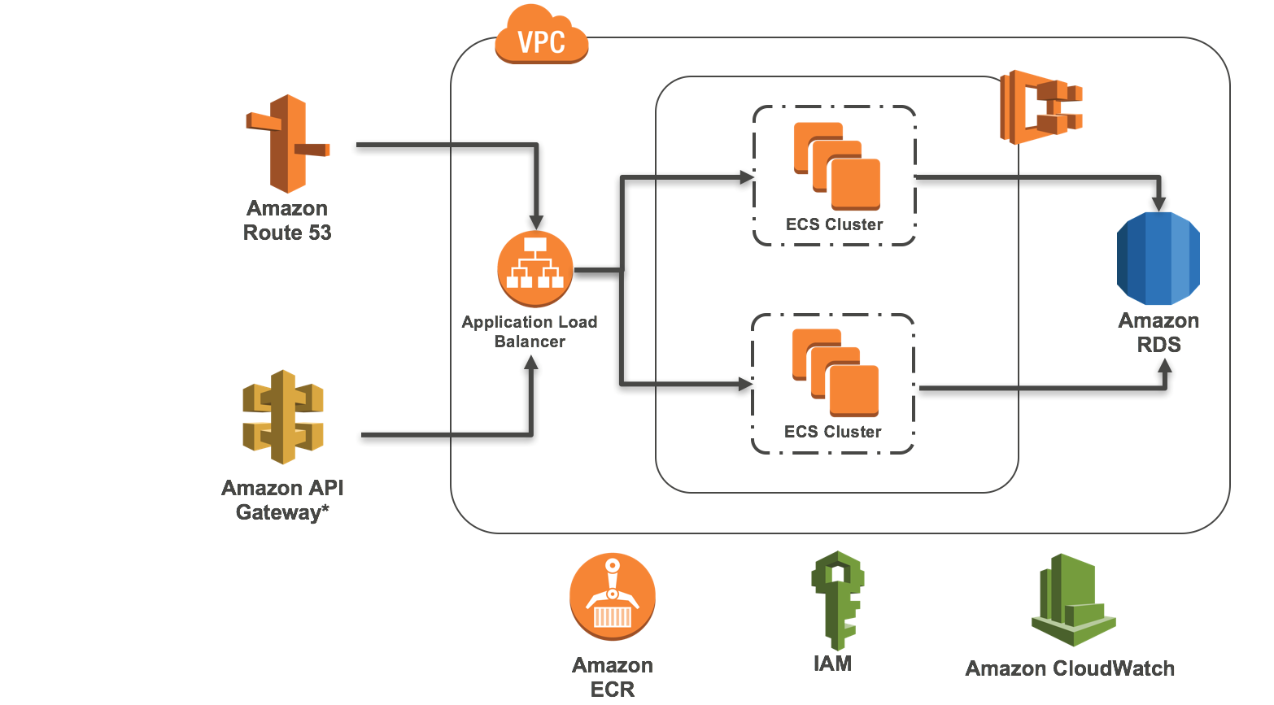
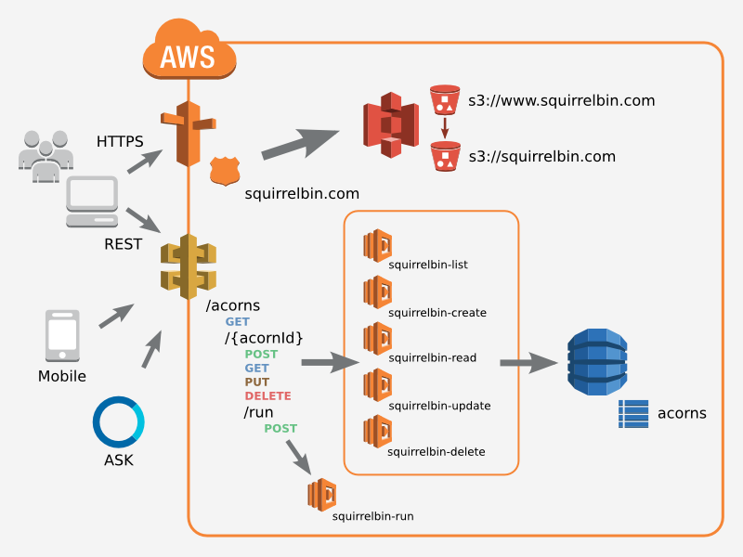
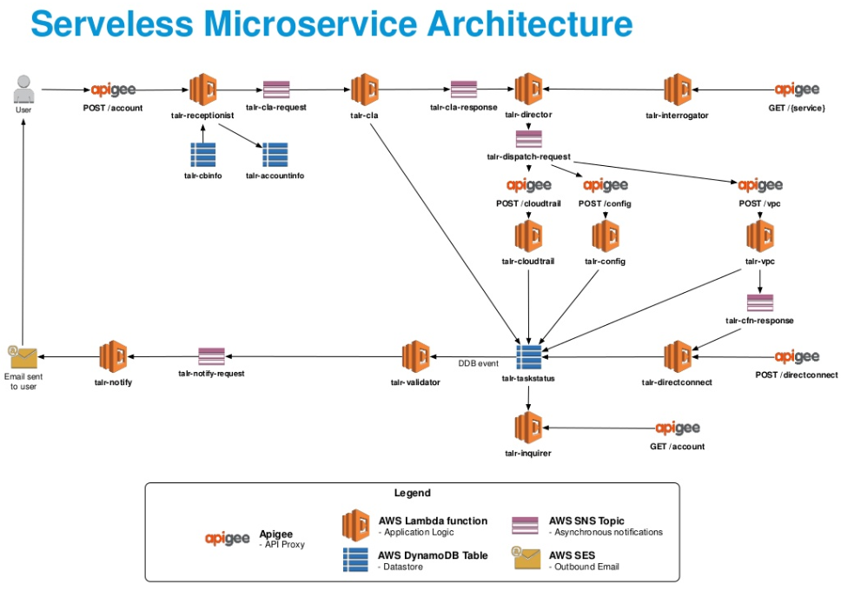
Microservices – Ain’t it fun?

Slide 3


Well, its not always fun

Slide 4
Microservices are,
Hard to profile
Hard to debug
Hard to analyze
Mostly impossible to know what is happening inside

Slide 5
Introducing AWS X-Ray
Runs on AWS
Helps to Analyze and Debug distributed applications
Trace requests -> record traces -> analyze them

Slide 6
Let’s get to the code
What does the code do?
Fetches weather data from a remote service
Formats the data using an internal service
Inserts data to the database
Publishes data to an SNS channel which triggers an email

Slide 7
Data Driven Development
Design
Build
Run
Analyze

Slide 8
Resources
Code and the presentation,
https://github.com/sajithvim/aws-xray-sample

