Slide 1

COMETLABS PRESENTATION
Team :
Arnav Mago, Balakumar Velayutham, Sajja Patel, Aishani Pandey

Slide 2
OVERVIEW
The client’s current website has frontend design components from the Material UI library. The library is very heavy and causes a significant slowing down of the loading speeds for the webpages, this happens on essential pages like the sign in page, profile page etc., which are accessed by every single user irrespective of their purpose of using the website.
This causes a rendering of the skeleton pages which are plain HTML based and ruin the user experience (and since the users can also be recruiters who can easily use a different avenue, this constitutes a big problem)
So, our main task is to change the material UI based frontend design components to a lighter framework like Material Tailwind, Daisy UI or Vanilla CSS (Mention change from tailwind to css so no more inline and can make and import css styles)

Slide 3
DEVELOPMENT TIMELINE
Sprint 1 :
Understand the existing codebase for the frontend of the website (Feb 3 - Feb 17)
Create issues in areas we find bugs or redundancy (Feb 17 – Feb 24)
Familiarize ourselves with NextJS, Tailwind CSS, TypeScript to begin modifying the codebase (Feb 24 – March 6)
Sprint 2 :
Convert components in the Sign-in page (March 6 – March 14)
Sprint 3 :
Convert the components in the Profile page (March 14 – March 21)

Slide 4
Sprint 4:
Convert Link component across the website (March 23 – March 28)
Sprint 5:
Convert Icon Button component across the website (April 1 – April 8)
Sprint 6 & 7:
Convert Typography component across the website (April 5 – April 20)
Convert TextField component and write the required verification functions (April 8 – April 18)
Sprint 8:
Convert Button component across the website (April 20 – April 24)
Convert Paper component across the website (April 19 – April 24)

Slide 5
COMPLETED & PENDING TASKS

Slide 6
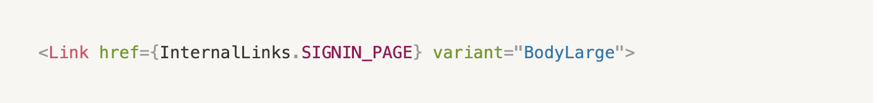
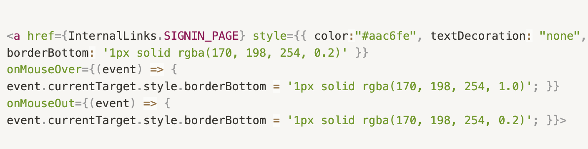
LINK COMPONENT
Initially was:
Changed to:

Slide 7
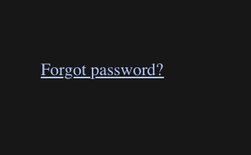
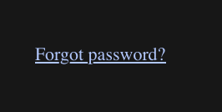

Slide 8
Stats:
signup.tsx - changed 3 instances
Company.tsx - changed 2 instances
ContactUs.tsx - changed 2 instances
ReviewsPress.tsx - changed 2 instances
ChangeLog.tsx - changed 2 instances
Extensions.tsx - changed 2 instances
Playground.tsx - changed 2 instances
RequestFeature.tsx - changed 2 instances
Status.tsx - changed 2 instances
FourSections.tsx - changed 2 instances
SignInArea.tsx - changed 1 instance
Typo - the paragraph had ‘communityofcommunity’ which was changed to ‘community of 7000 engineers

Slide 9
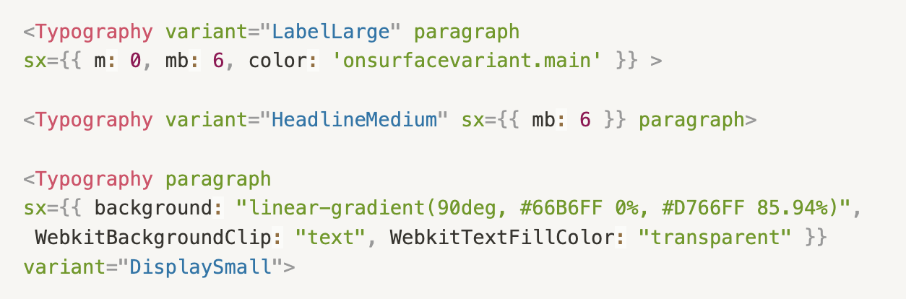
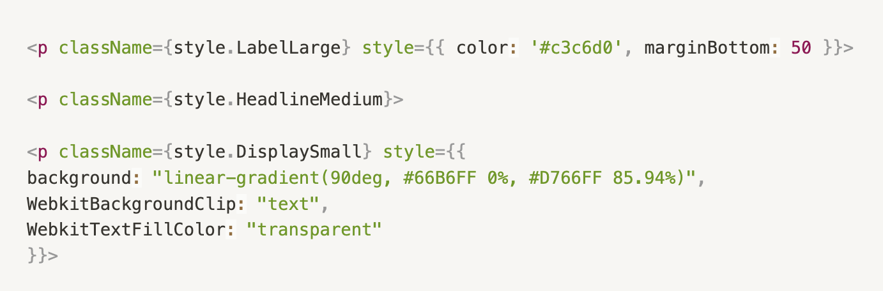
TYPOGRAPHY COMPONENT
Before modification
After modification

Slide 10
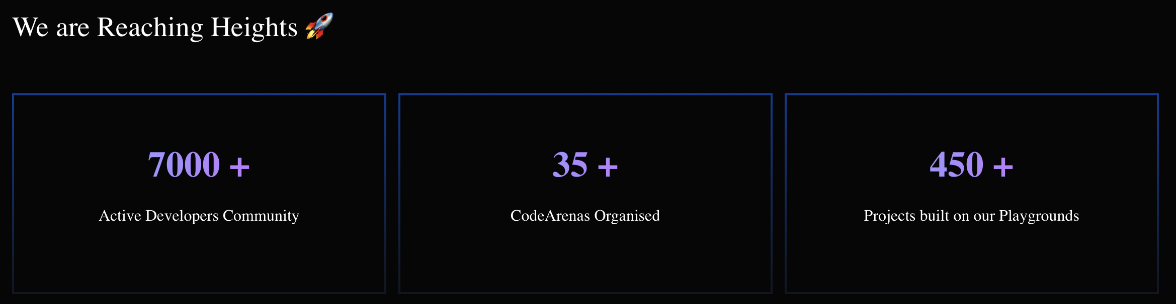
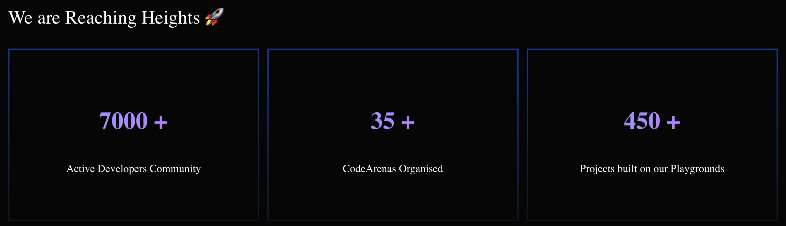
Actual Website:
Modified Website:

Slide 11
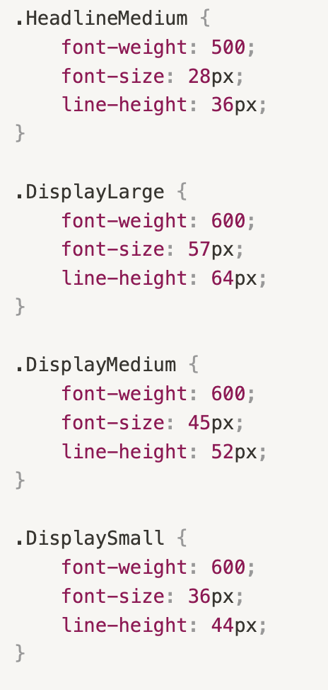
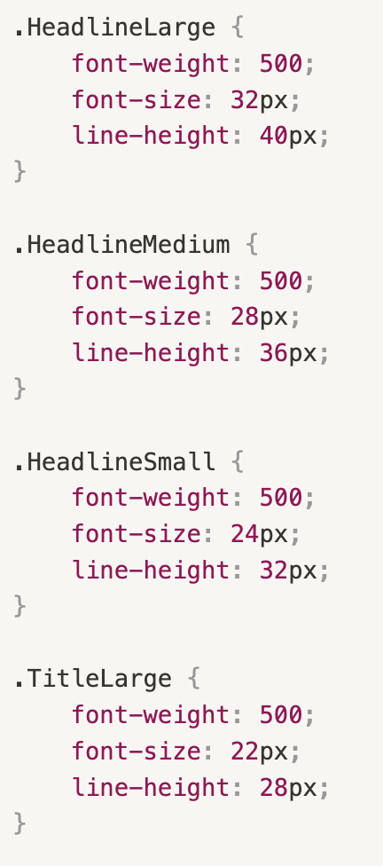
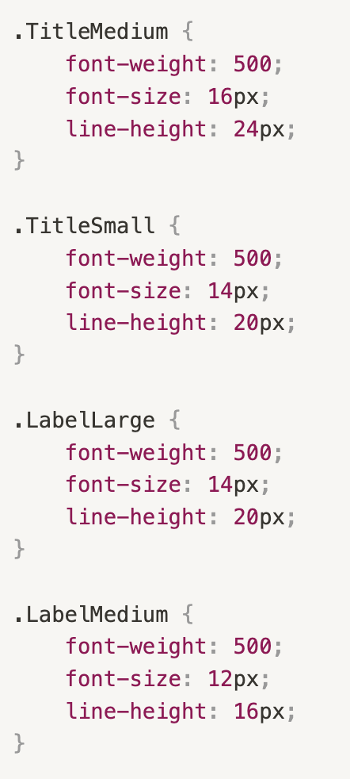
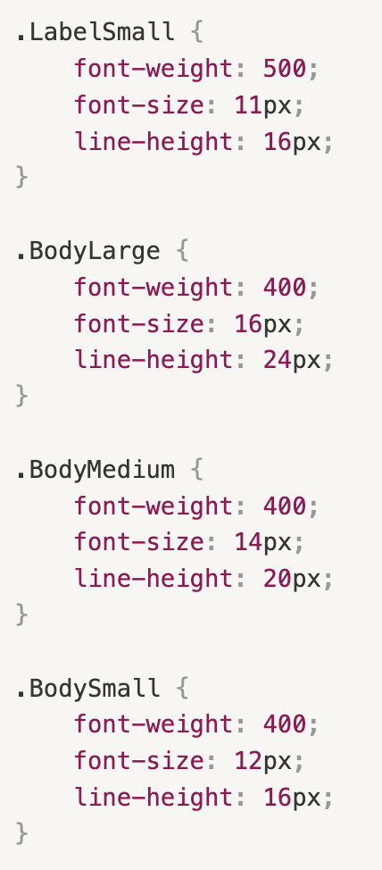
Custom CSS classes to mimic MUI Component props

Slide 12
Stats:
ActiveRepos.tsx- changed 3 instances
Faq.tsx - changed 2 instances
GitArea.tsx- changed 9 instances
FourSections.tsx - changed 26 instances
CareerBanner.tsx- changed 2 instances
CodeArenaBanner.tsx- changed 8 instances
CommunityBanner.tsx- changed 8 instances
LandingBanner.tsx- changed 8 instances
TrackBanner.tsx- changed 2 instances
BuildFirstHackArea.tsx- changed 17 instances
JobArea.tsx- changed 2 instances
JobCardArea.tsx- changed 9 instances
JoinUsArea.tsx- changed 3 instances
Modals.tsx- changed 1 instance
SigninArea.tsx- changed 10 instances
NewsCarousel.tsx- changed 2 instances
PasswordSignin.tsx- changed 2 instances
PlaygroundArea.tsx- changed 3 instances
StoryArea.tsx- changed 5 instances
Team.tsx- changed 4 instances
index.tsx- changed 3 instances (in src/components/Organiser/index.tsx)
Copyright.tsx- changed 3 instances
Dashboard.tsx- changed 11 instances
Footer.tsx- changed 4 instances
Header.tsx- changed 2 instances
Envangelists.tsx- changed 4 instances
GetHired.tsx - changed 4 instances
ChangeLog.tsx- changed 43 instances
Extensions.tsx- changed 43 instances
Playground.tsx- changed 43 instances
RequestFeature.tsx- changed 43 instances
Status.tsx- changed 43 instances
ShowcaseBigger.tsx- changed 1 instance
ShowcaseBiggest.tsx- changed 1 instance
ShowcaseMedium.tsx- changed 1 instance
ShowcaseSmall.tsx- changed 1 instance
ShowcaseSmall2.tsx- changed 1 instance
ShowcaseSmaller.tsx- changed 1 instance
FetchQtnSolution.tsx- changed 8 instances
NewQuestion.tsx- changed 2 instances
ProblemsPage.tsx- changed 2 instances
Questions.tsx- changed 1 instance
TopBar.tsx- changed 5 instances
BarChart.tsx- changed 1 instance
index.tsx-changed 10 instances (in src/components/User/Analytics/index.tsx)
LineChart.tsx- changed 1 instance
PieChart.tsx-changed 1 instance
StraightLineChart.tsx- changed 1 instance
FreeLabs.tsx- changed 4 instances
Projects.tsx- changed 11 instances
HeaderLabs.tsx- changed 5 instances
HeaderMenu.tsx- changed 5 instances
ReviewsPress.tsx- changed 32 instances
Achievements.tsx- changed 8 instances
onboarding.tsx- changed 9 instances
ProfileCard.tsx- changed 5 instances
ProfileDetails.tsx- changed 3 instances
Profiles.tsx- changed 3 instances
Resume.tsx- changed 5 instances
ResumeDetails.tsx- changed 25 instances
Settings.tsx- changed 10 instances
Gethired.tsx- changed 4 instances
community.tsx- changed 4 instances
CometProfile.tsx- changed 4 instances
admin.tsx- changed 1 instance
CometProfile.tsx- changed 4 instances
Logo.tsx- changed 2 instances

Slide 13
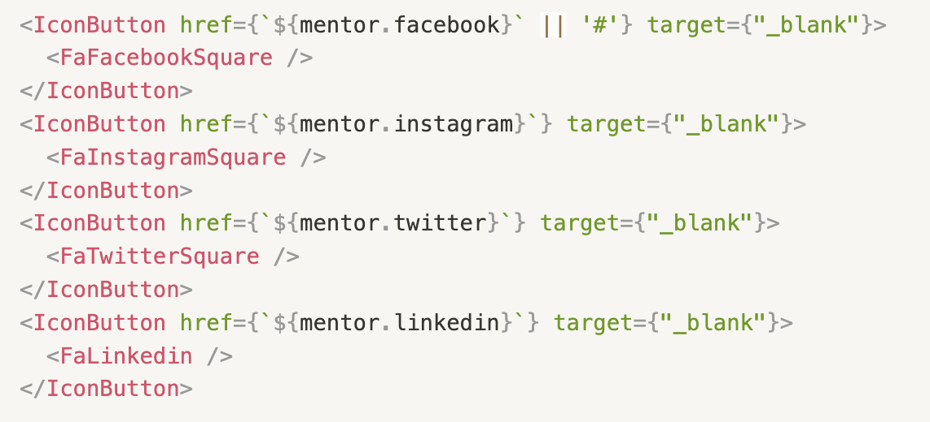
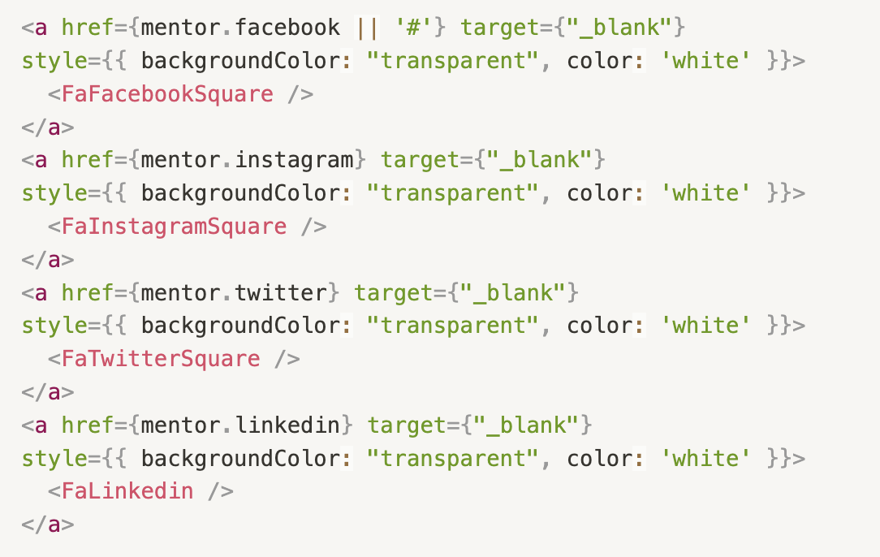
ICONBUTTON COMPONENT
Before modification
After modification

Slide 14


Actual Website:
Modified Website:

Slide 15
Stats:
Footer.tsx - changed 5 instances
Extensions.tsx - changed 7 instances
Playground.tsx - changed 7 instances
Status.tsx - changed 7 instances
RequestFeature.tsx - changed 7 instances
SignUp.tsx - changed 4 instances
Company.tsx - changed 7 instances
ContactUs.tsx - changed 7 instances
ChangeLog.tsx - changed 7 instances
ReviewsPress.tsx - changed 7 instances
[id].tsx - changed 1 instance
ShowcaseMedium.tsx - changed 2 instances
ShowcaseSmallest.tsx - changed 2 instances
ArenaDetails.tsx - changed 1 instance
ArenaOrganiser.tsx - changed 4 instances
ArenaPrize.tsx - changed 3 instances
ArenaSponsor.tsx - changed 1 instance
Card.tsx - changed 2 instances
CardAdmin.tsx - changed 2 instances
FetchQtnSolution.tsx - changed 2 instances
ShowcaseBigger.tsx - changed 2 instances
ShowcaseBiggest.tsx - changed 2 instances
ShowcaseBig.tsx - changed 2 instances

Slide 16
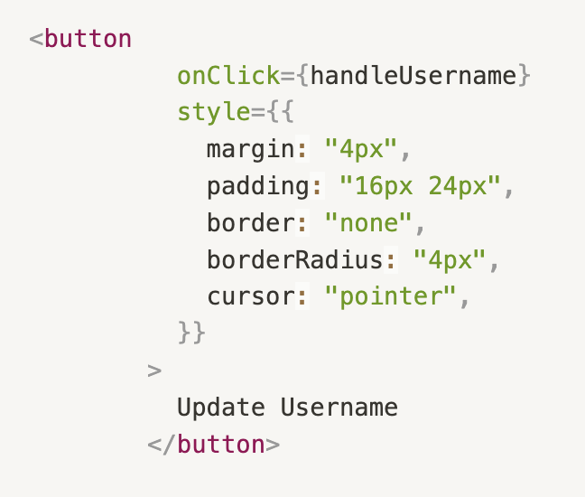
BUTTON COMPONENT
Before modification :
After modification :

Slide 17

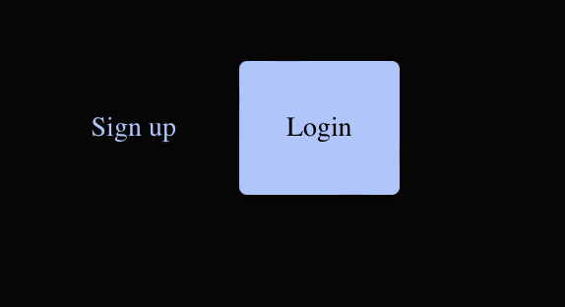
Actual Website:
Modified Website:

Slide 18
Note:
24th is the end of Sprint 8 where we are working on Button component.
We are currently wrapping up on this component and will be done by R2 evals.
Stats:
JobsCardArea.tsx - changed 1 instances
Account.tsx- changed 3 instances
TrackCard.tsx-changed 1 instances

Slide 19
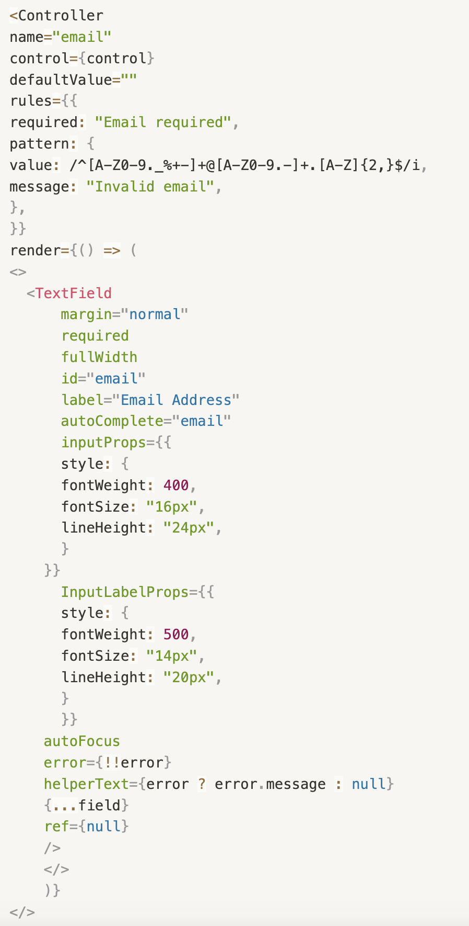
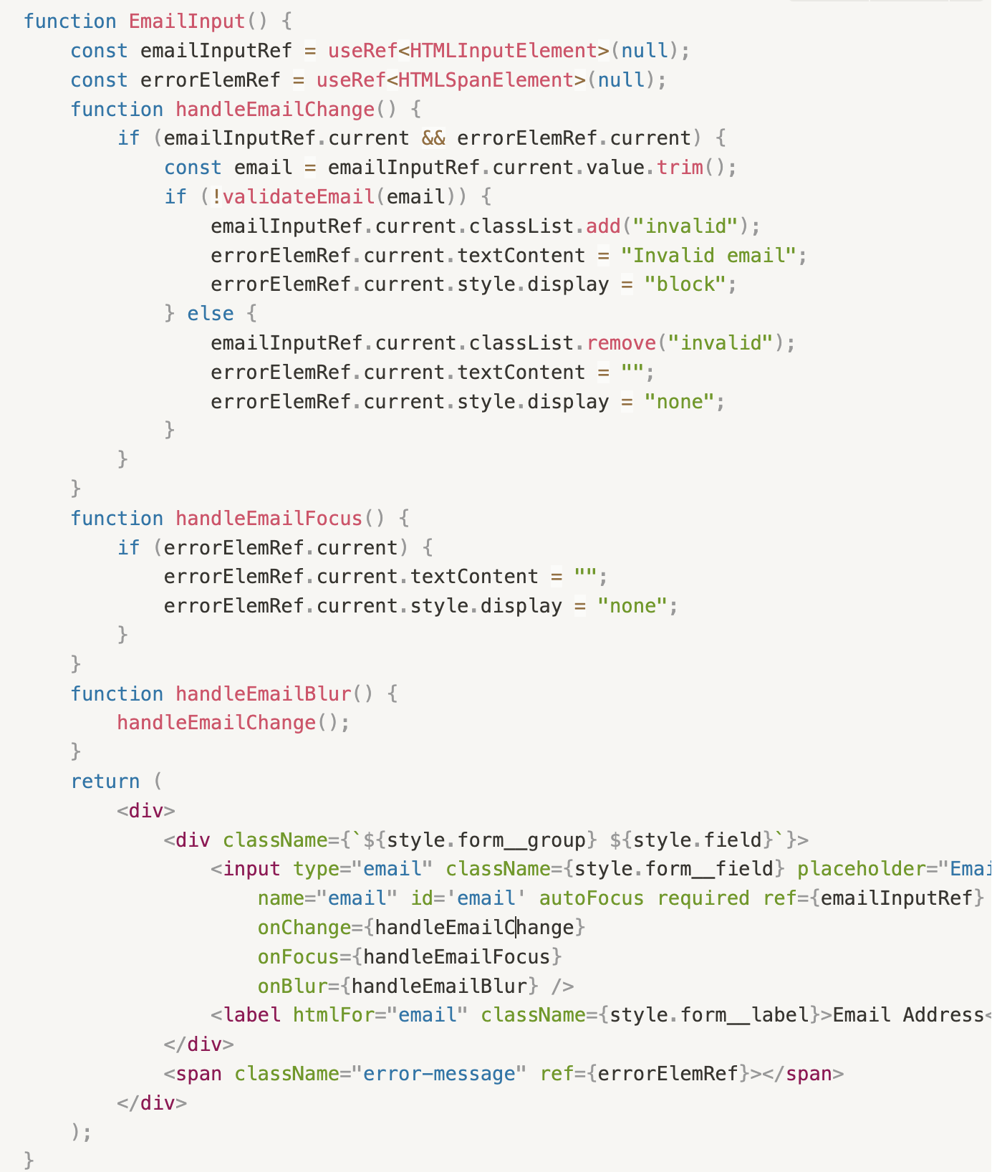
TEXTFIELD COMPONENT

Slide 20
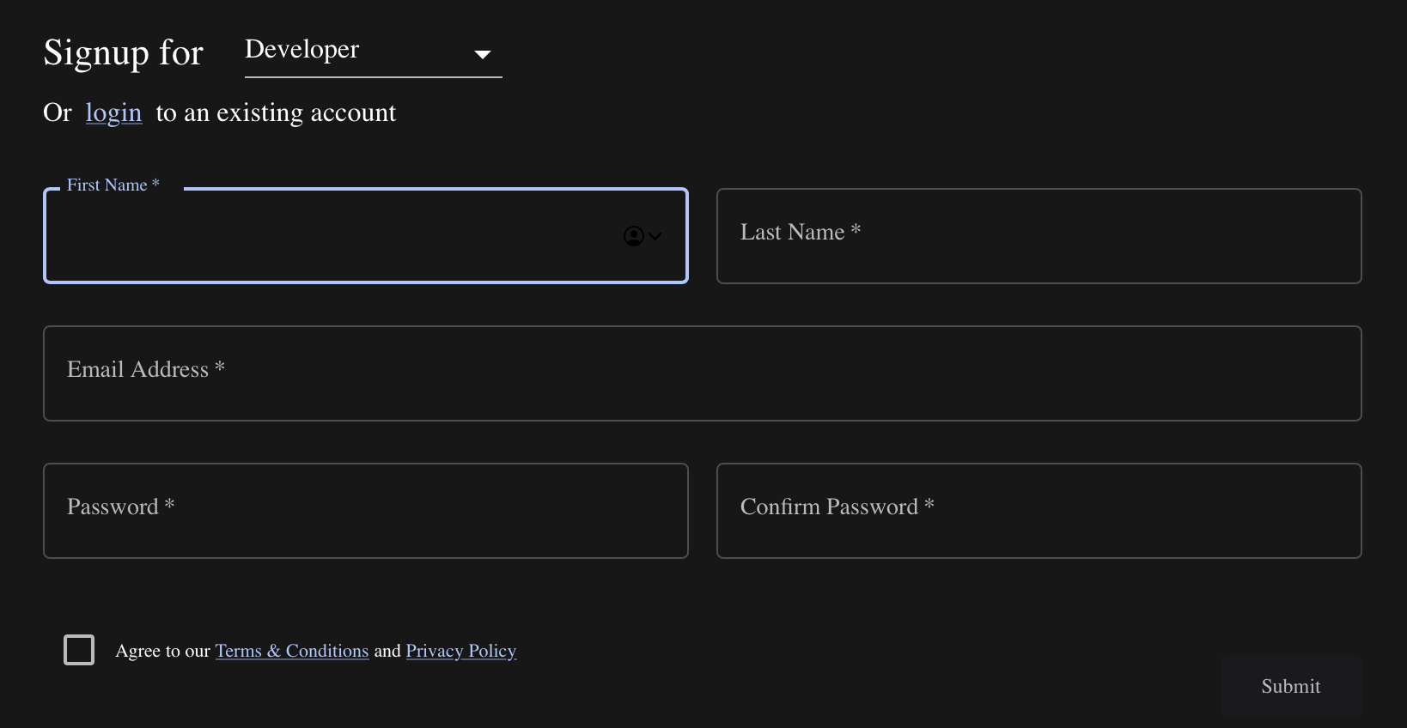
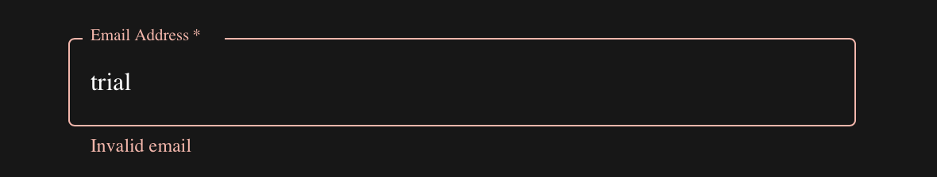
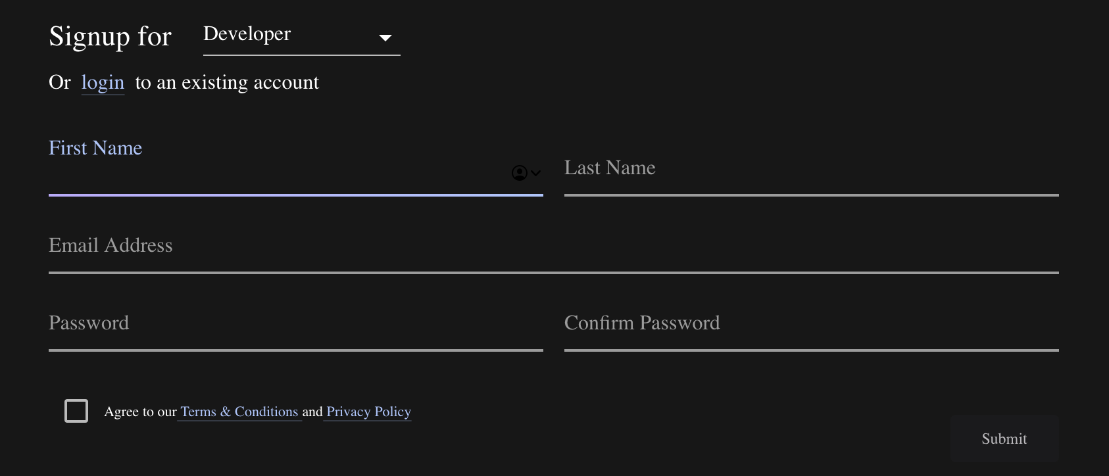
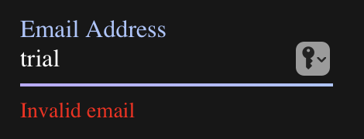

Slide 21
ArenaTracks.tsx – changed 2 instances
NewArenaCard.tsx – changed 3 instances
Register.tsx – changed 1 instance
CreateTeam.tsx – changed 5 instances
Invite.tsx – changed 1 instance
Details.tsx – changed 4 instances
Links.tsx – changed 3 instances
Problems.tsx – changed 3 instances
GitArea.tsx – changed 3 instances
ProfileDetails.tsx – changed 10 instances
Stats:
SigninArea.tsx – changed 2 instances
Signup.tsx – changed 5 instances
ArenaDescription.tsx – changed 1 instance
ArenaDetails.tsx – changed 4 instances
ArenaOrganiser.tsx – changed 8 instances
ArenaPrize.tsx – changed 1 instance
ArenaSponsor.tsx – changed 2 instance
ArenaSponsor.tsx – changed 2 instances
ArenaTiciket.tsx – changed 2 instance

Slide 22
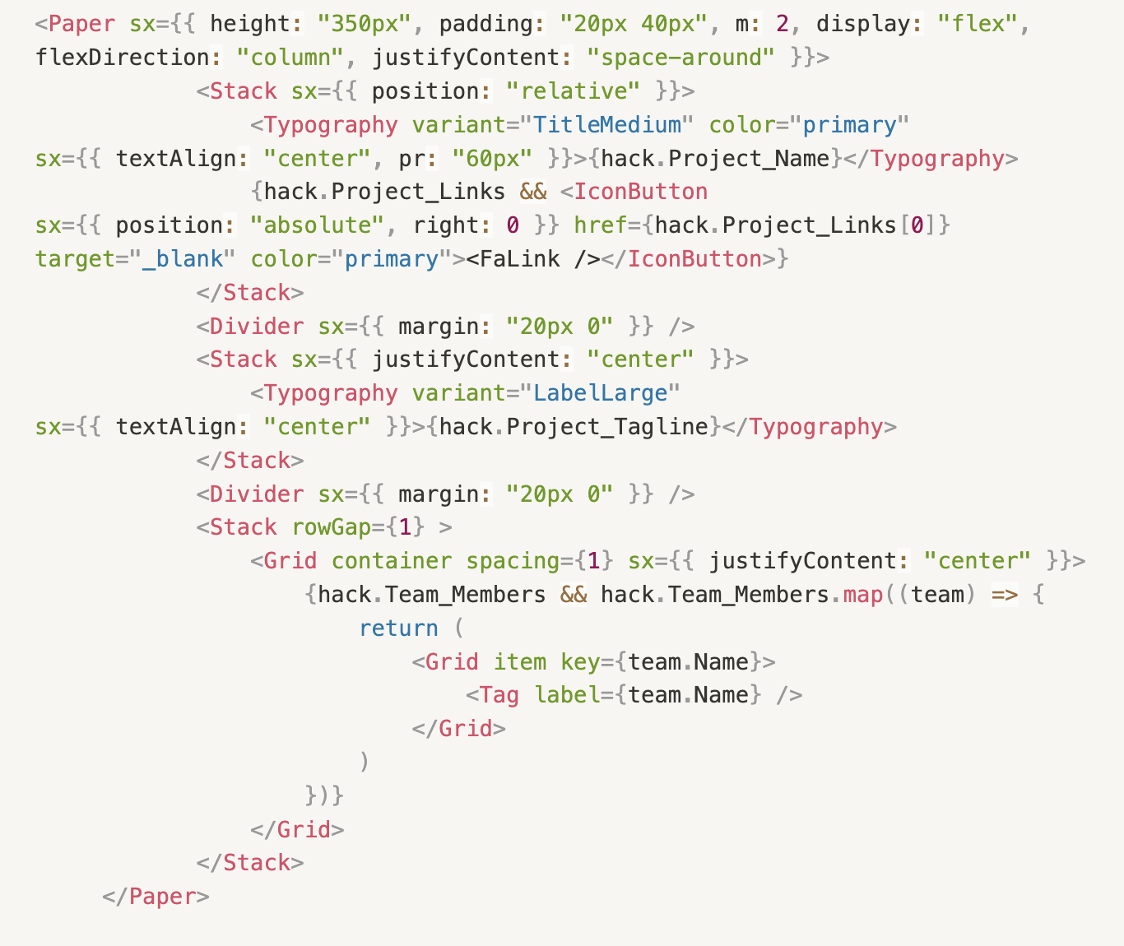
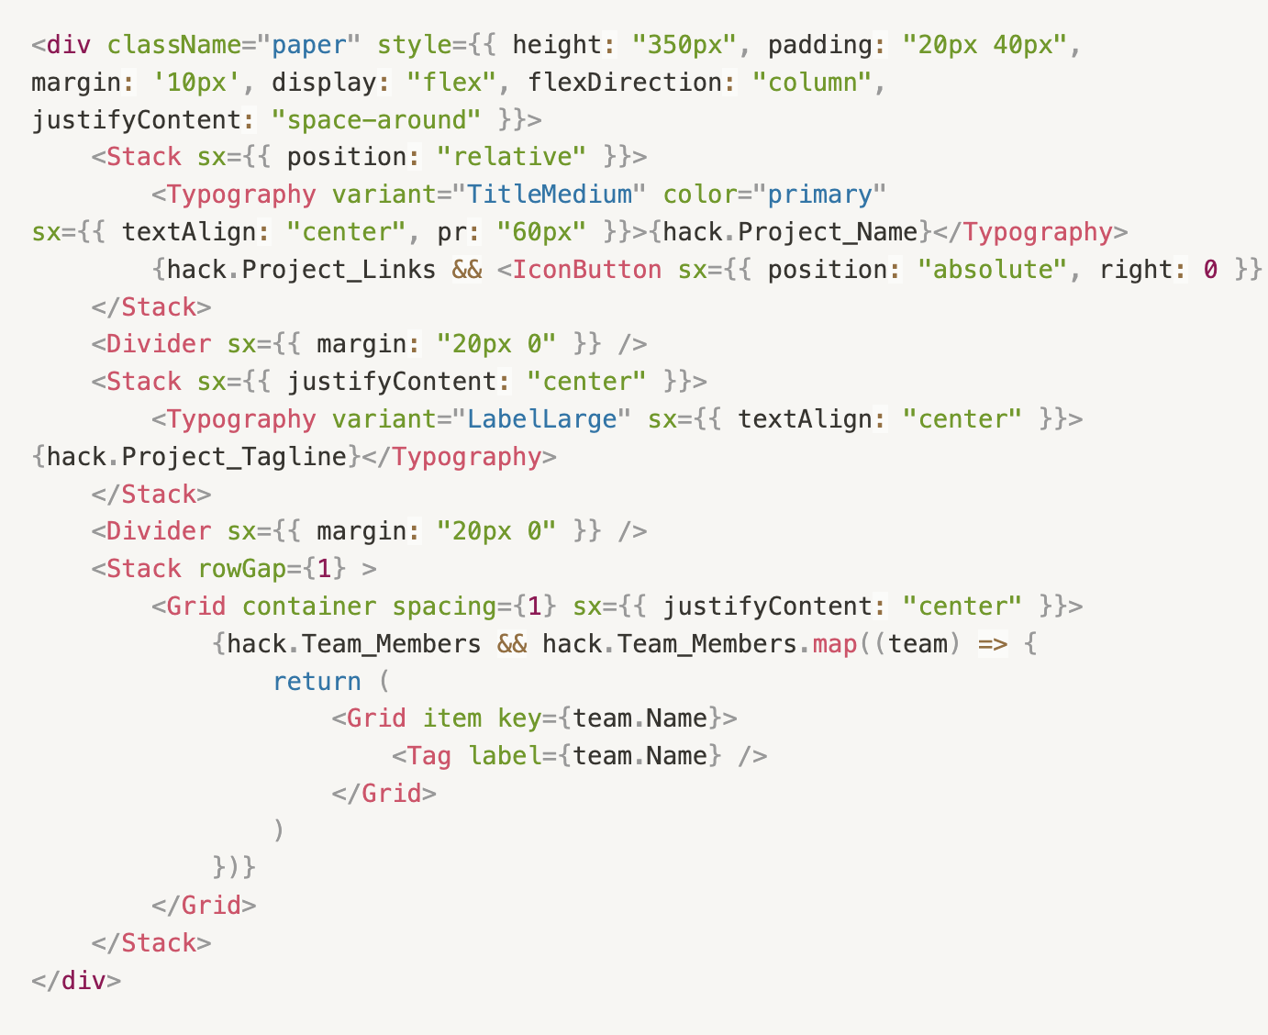
PAPER COMPONENT

Slide 23
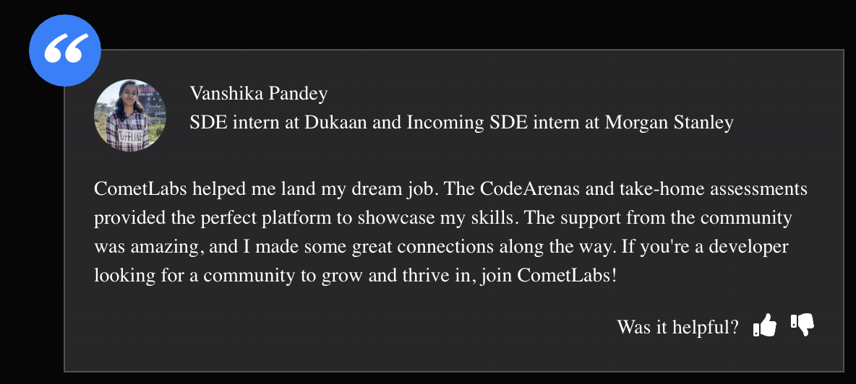

Actual Website:
Modified Website:

Slide 24
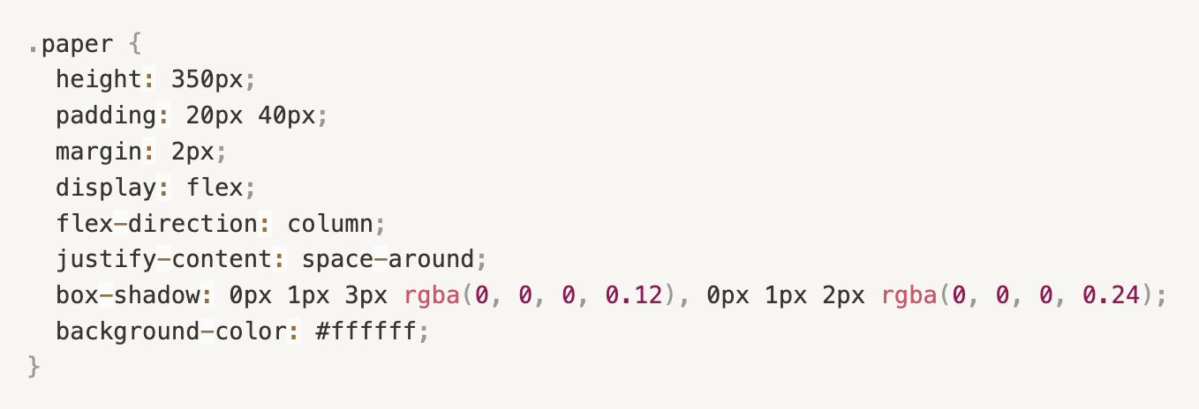
Custom CSS paper class to mimic MUI Component

Slide 25
Stats:
AllSubmissions.tsx – changed 1 instances
onboarding.tsx – changed 6 instances
FetchQtnSolution.tsx – changed 1 instance

Slide 26
TECH STACK & RESEARCH
Tech stack:
NextJS
Typescript
Tailwind CSS
Material Tailwind
ReactJS
Daisy UI
Research:
Familiarizing ourselves with NextJS led us to find how routing was done – by adding directories & files to the page directory. (found out a repo problem this way)
We dug up on Material Tailwind library which provides component replacements which is coded up using Tailwind CSS & MUI. (efficient alternative for only MUI components).
We explored Daisy UI library which provides components coded in Tailwind CSS. (efficient alternative for writing Tailwind CSS from scratch)
Explored LightHouse Reports in depth to analyze the extent to which our replacements made progress on various facets of page load.
Learnt about React’s build optimization to check how efficient our modified files had become.

Slide 27
IMPROVEMENTS – LIGHTHOUSE REPORTS

Slide 28
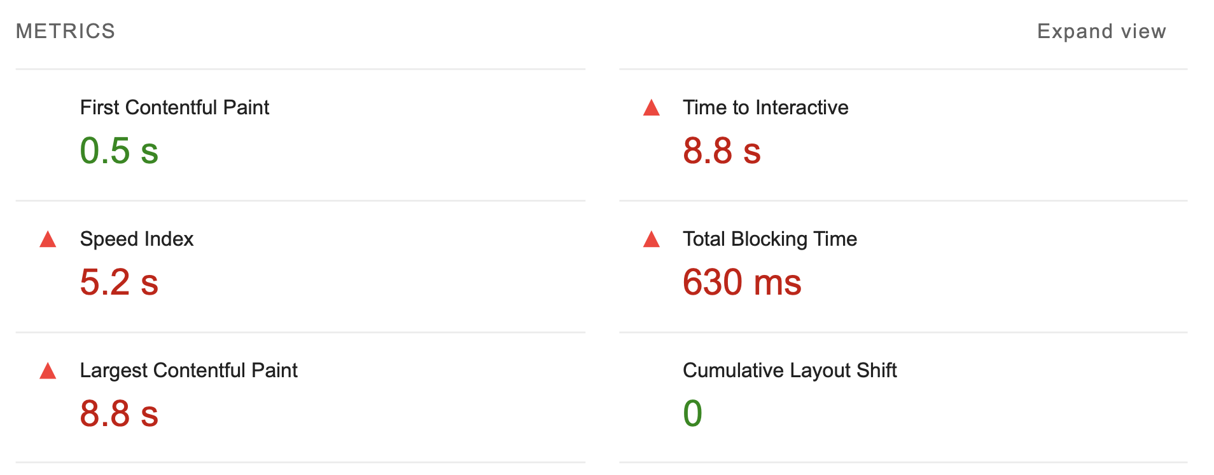
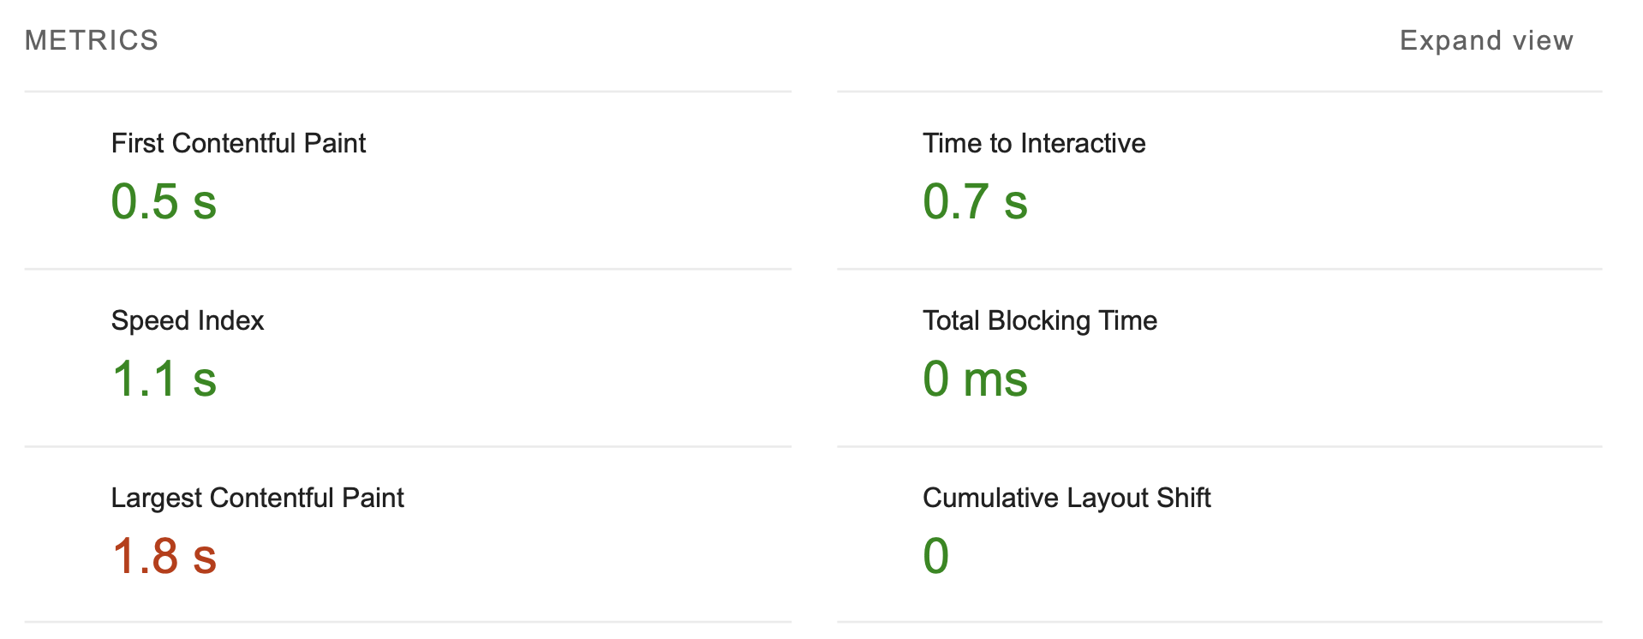
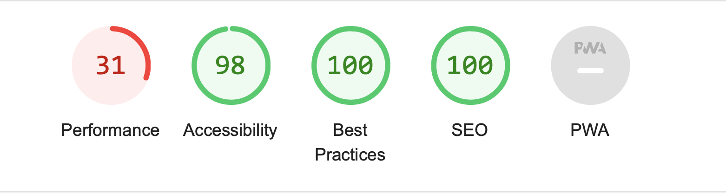
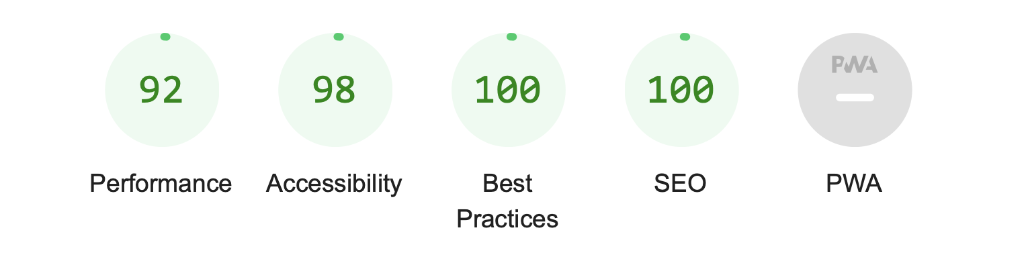
SIGN-IN PAGE
Dev version
Optimized build

Slide 29
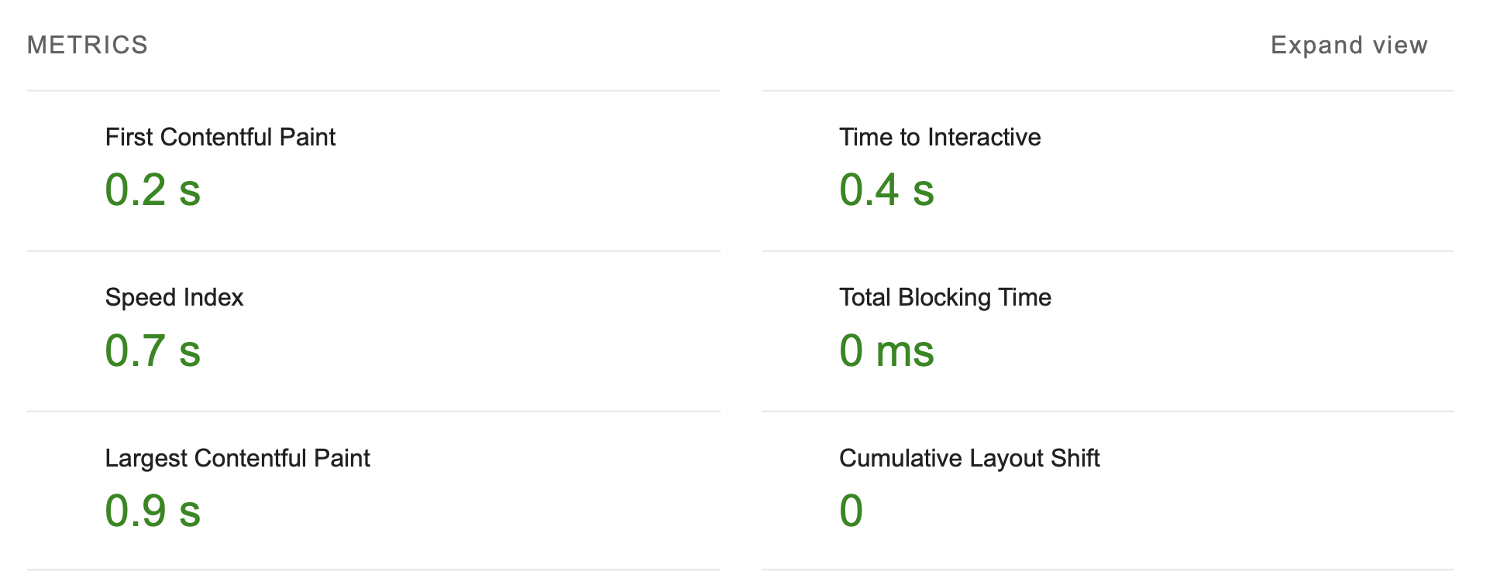
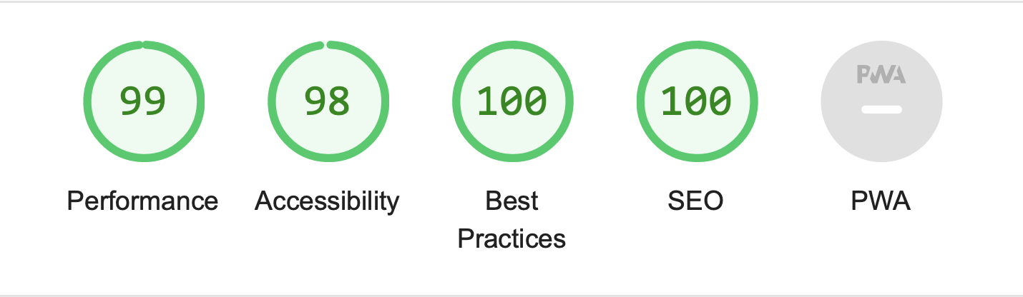
SIGN-IN PAGE
Optimized build
Modified + optimized build

Slide 30
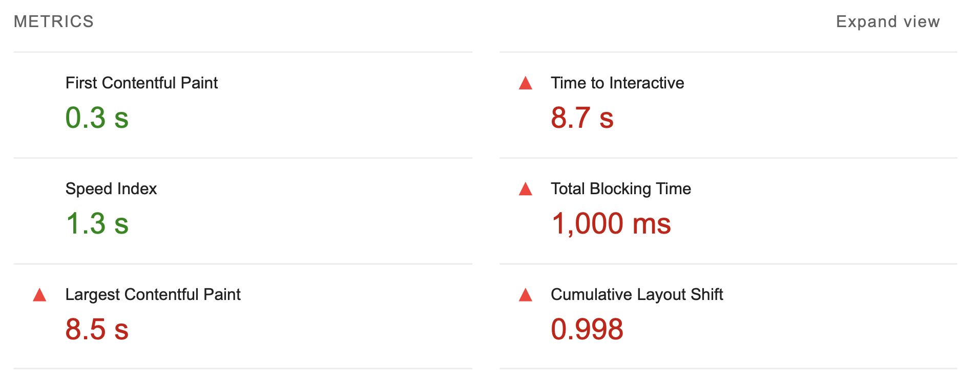
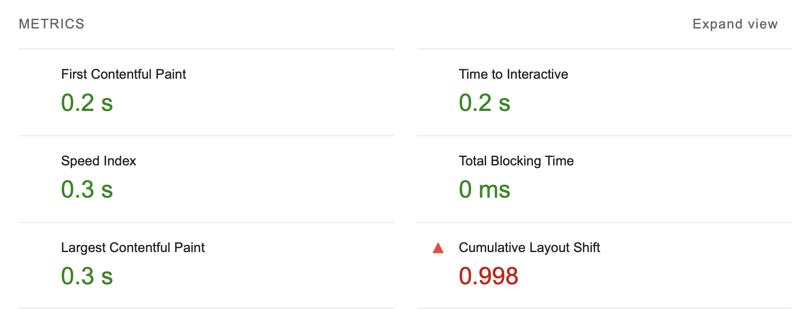
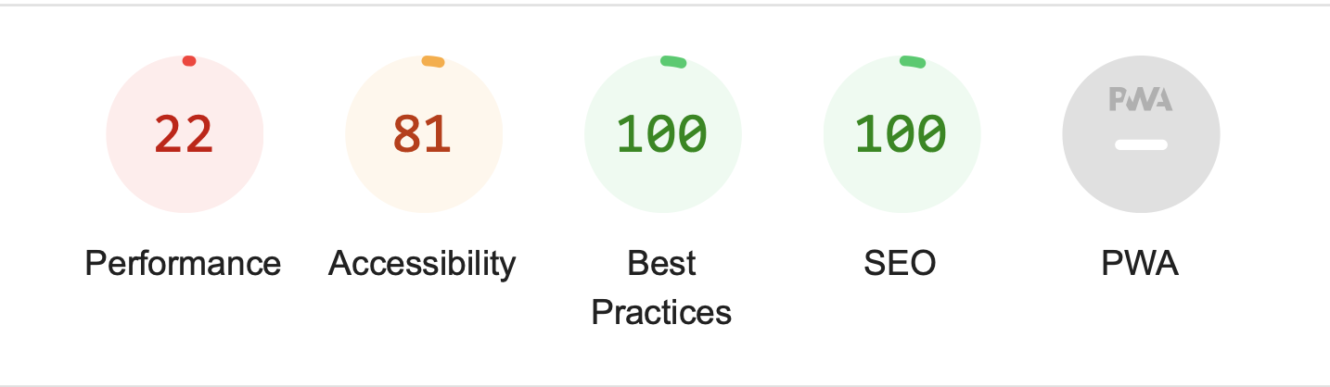
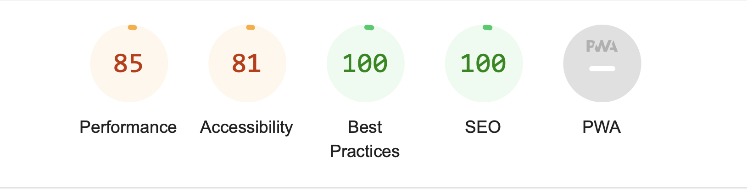
SIGN-UP PAGE
Dev version
Optimized build

Slide 31
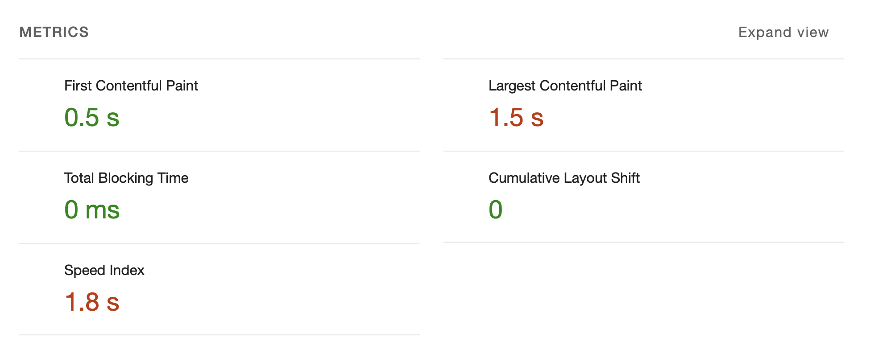
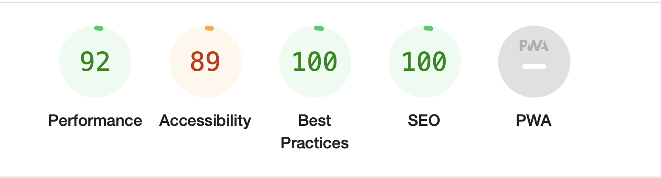
SIGN-UP PAGE
Optimized build
Modified + Optimized build

Slide 32
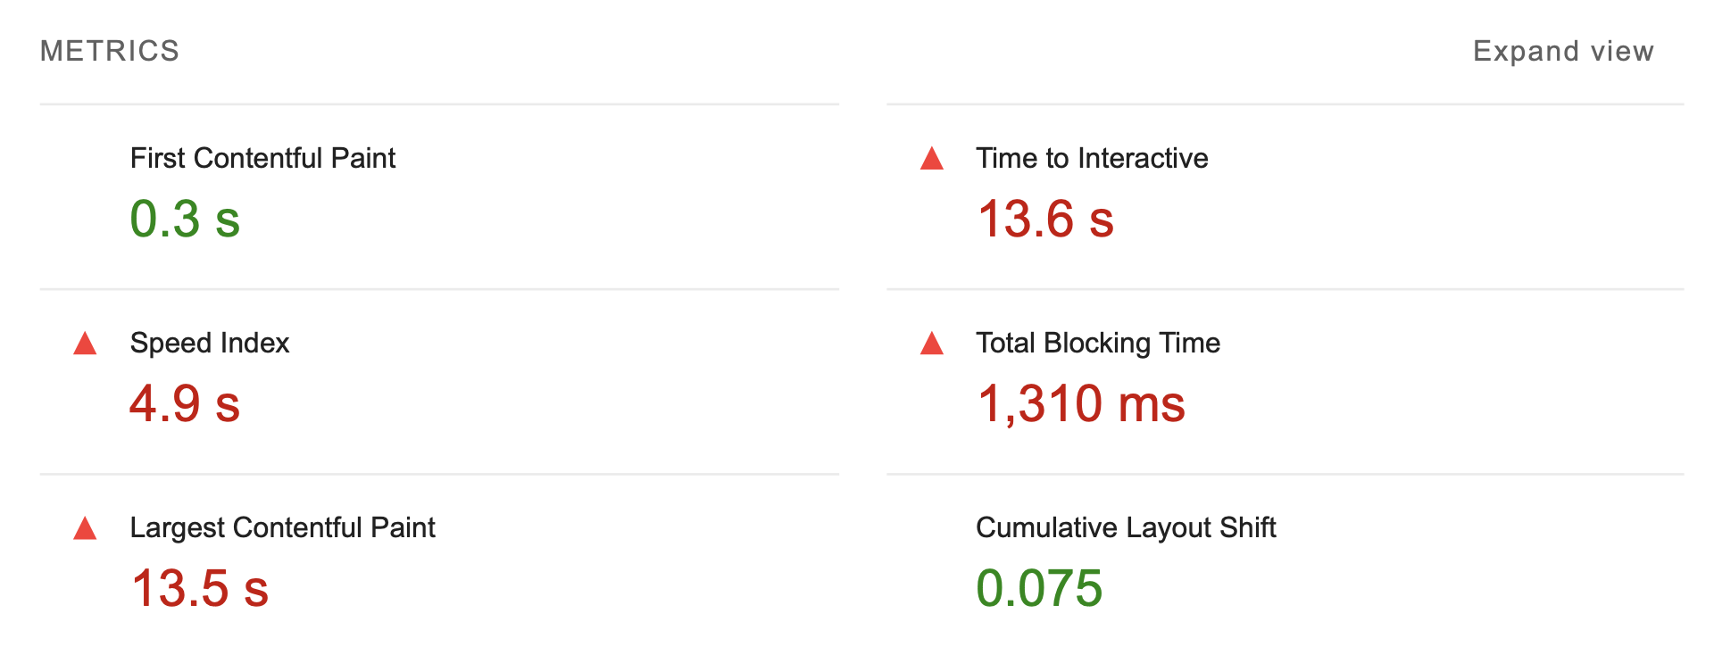
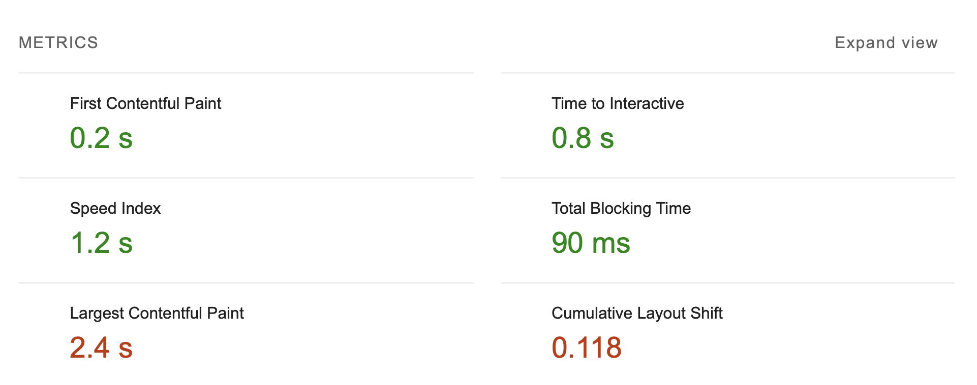
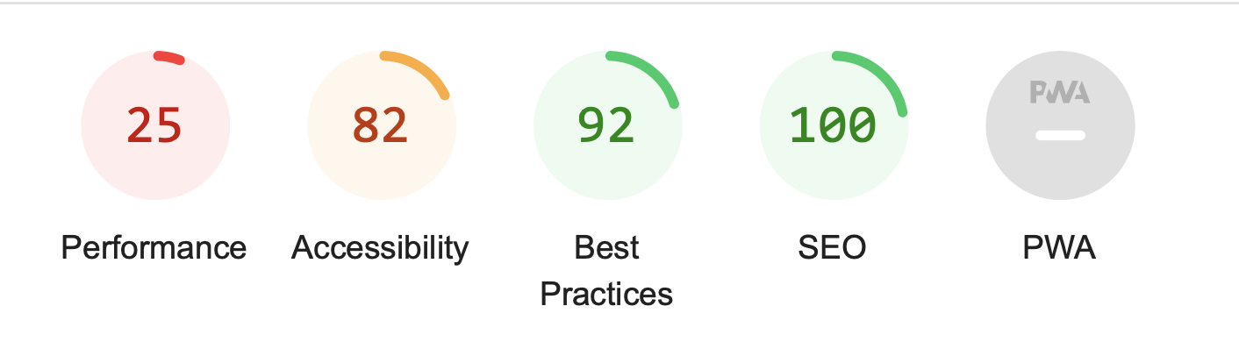
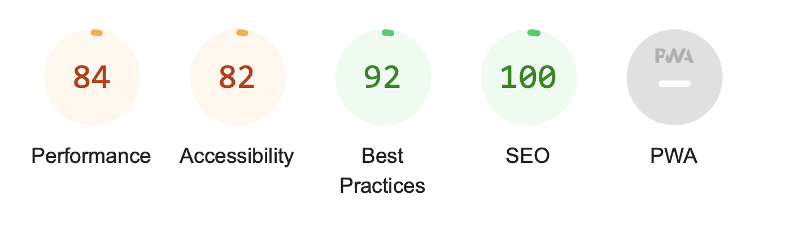
PROFILE PAGE
Dev version
Optimized build

Slide 33
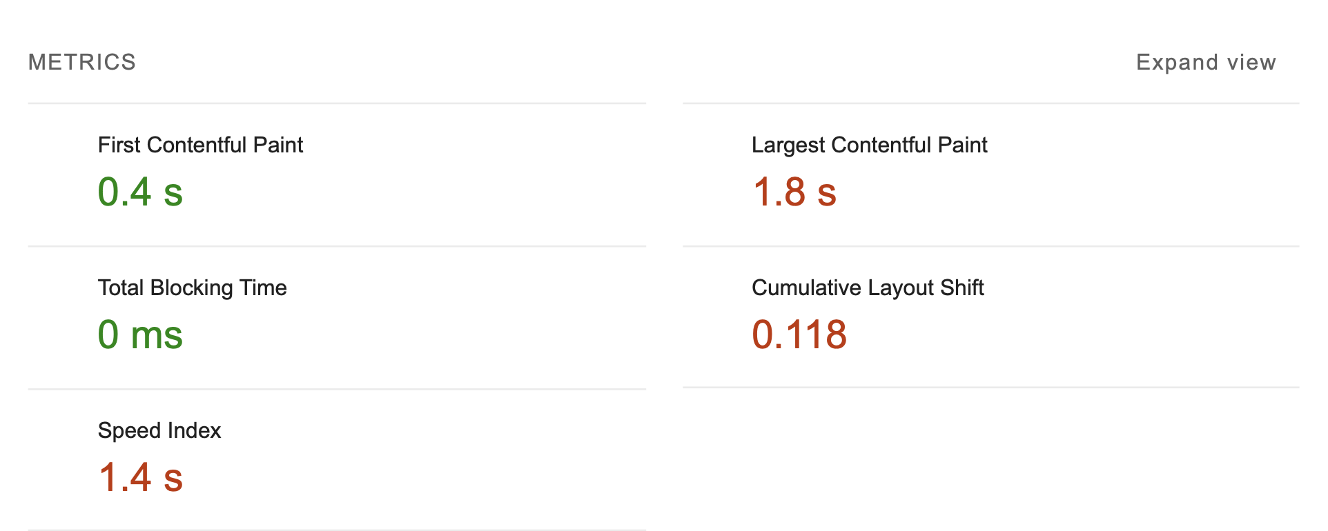
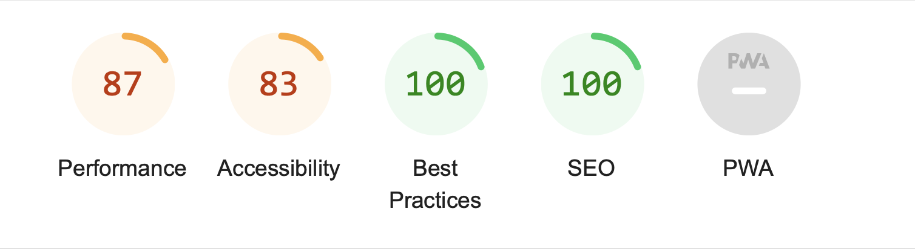
PROFILE PAGE
Optimized build
Modified + Optimized build

Slide 34
CHALLENGES FACED

Slide 35
Existing Material UI Components such as Grid, Stack had numerous overwritings + props that could not be modified or built from scratch using Tailwind/Vanila CSS.
Custom writing functions to replace the simple ‘rules’ field provided by Material UI, was difficult and had to be accurate to represent the existing functionality.
To make our changes modular, we had to write CSS files that could aid the client if he wishes to modify other pages or create new ones with the modified components.
Dependency issues present in the existing codebase led us to spend time figuring out compatible library versions.

