Slide 1
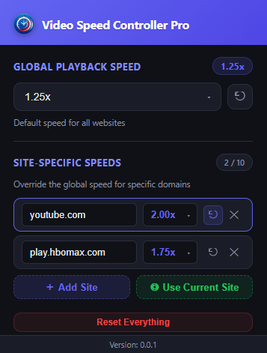
Control Global Speed & Site-wise Speed seamlessly

Slide 2
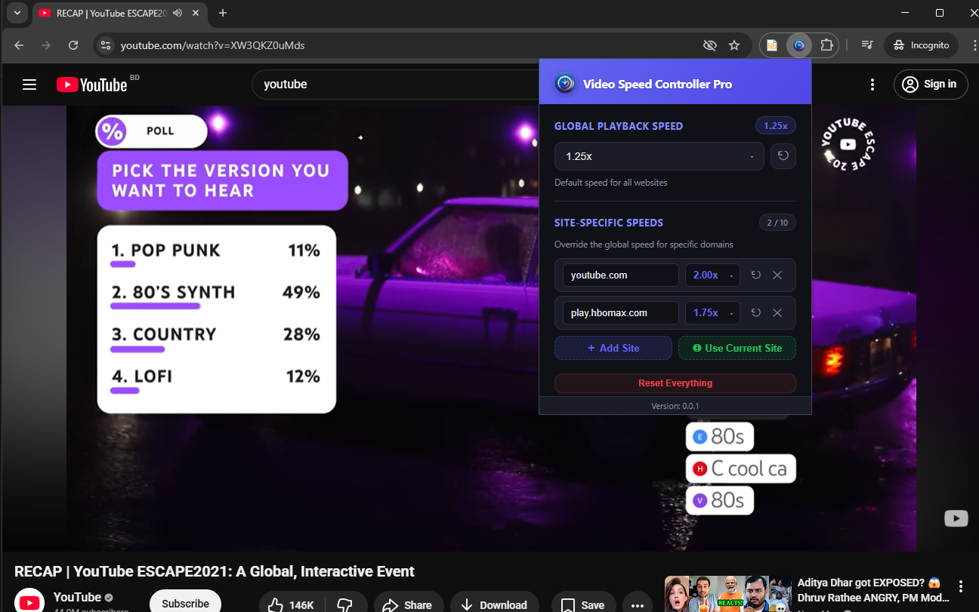
Just pin it to the toolbar and use it on any site

