Slide 1
Learning with Identification Trees
Artificial Intelligence
CMSC 25000
February 7, 2002

Slide 2
Agenda
Midterm results
Learning from examples
  Nearest Neighbor reminder
  Identification Trees:
    Basic characteristics
    Sunburn example
    From trees to rules
    Learning by minimizing heterogeneity
    Analysis: Pros & Cons

Slide 3
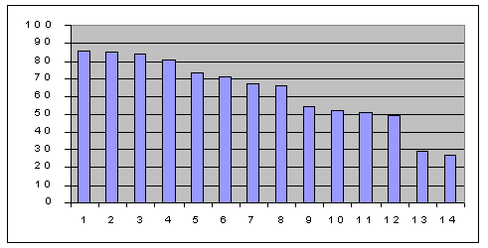
Midterm Results
Mean: 62.5; Std. Dev. : 19.5

Slide 4
Machine Learning: Review
Learning:
  Automatically acquire a function from inputs to output values, based on previously seen inputs and output values.
  Input: Vector of feature values
  Output: Value
Examples: Word pronunciation, robot motion, speech recognition

Slide 5
Machine Learning: Review
Key contrasts:
  Supervised versus Unsupervised
    With or without labeled examples (known outputs)
  Classification versus Regression
    Output values: Discrete versus continuous-valued
  Types of functions learned
    aka “Inductive Bias”
    Learning algorithm restricts things that can be learned

Slide 6
Machine Learning: Review
Key issues:
  Feature selection:
    What features should be used?
    How do they relate to each other?
    How sensitive is the technique to feature selection?
      Irrelevant, noisy, absent feature; feature types
  Complexity & Generalization
    Tension between
      Matching training data
      Performing well on NEW UNSEEN inputs

Slide 7
Learning: Nearest Neighbor
Supervised, Classification or Regression, Vornoi diagrams
Training:
  Record input vectors and associated outputs
Prediction:
  Find “nearest” training vector to NEW input
  Return associated output value
Advantages: Fast training, Very general
Disadvantages: Expensive prediction, definition of distance is complex, sensitive to feature & classification noise

Slide 8
Learning: Identification Trees
(aka Decision Trees)
Supervised learning
Primarily classification
Rectangular decision boundaries
  More restrictive than nearest neighbor
Robust to irrelevant attributes, noise
Fast prediction

Slide 9
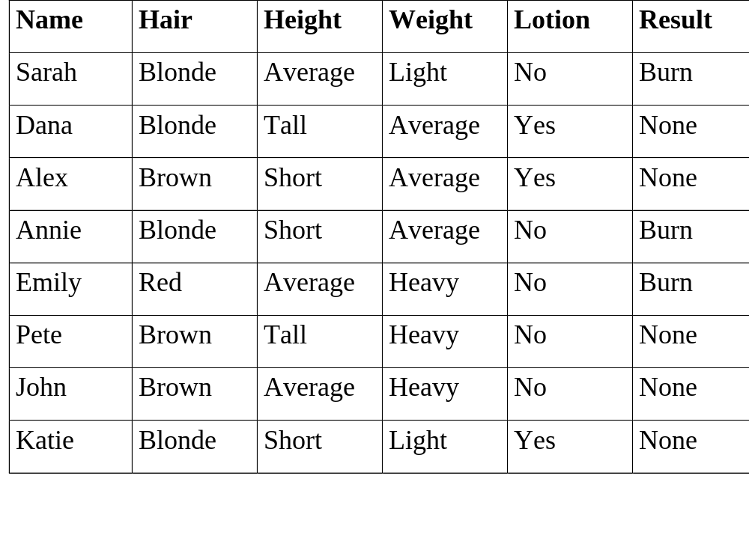
Sunburn Example

Slide 10
Learning about Sunburn
Goal:
  Train on labeled examples
  Predict Burn/None for new instances
Solution??
  Exact match: same features, same output
    Problem: 2*3^3 feature combinations
      Could be much worse
  Nearest Neighbor style
    Problem: What’s close? Which features matter?
      Many match on two features but differ on result

Slide 11
Learning about Sunburn
Better Solution:
  Identification tree:
  Training:
    Divide examples into subsets based on feature tests
    Sets of samples at leaves define classification
  Prediction:
    Route NEW instance through tree to leaf based on feature tests
    Assign same value as samples at leaf

Slide 12
Sunburn Identification Tree
Hair Color
Blonde
Brown
Red
Lotion Used
Emily: Burn
Alex: None
John: None
Pete: None
No
Yes
Sarah: Burn
Annie: Burn
Katie: None
Dana: None

Slide 13
Simplicity
Occam’s Razor:
  Simplest explanation that covers the data is best
Occam’s Razor for ID trees:
  Smallest tree consistent with samples will be best predictor for new data
Problem:
  Finding all trees & finding smallest: Expensive!
Solution:
  Greedily build a small tree

Slide 14
Building ID Trees
Goal: Build a small tree such that all samples at leaves have same class
Greedy solution:
  At each node, pick test such that branches are closest to having same class
    Split into subsets with least “disorder”
      (Disorder ~ Entropy)
  Find test that minimizes disorder

Slide 15
Minimizing Disorder
Hair Color
Height
Blonde
Brown
Tall
Short
Red
Average
Sarah: B
Dana: N
Annie: B
Katie: N
Alex: N
Pete: N
John: N
Alex:N
Annie:B
Katie:N
Sarah:B
Emily:B
John:N
Dana:N
Pete:N
Emily: B
Lotion
Weight
No
Yes
Light
Heavy
Average
Sarah:B
Annie:B
Emily:B
Pete:N
John:N
Dana:N
Alex:N
Katie:N
Sarah:B
Katie:N
Dana:N
Alex:N
Annie:B
Emily:B
Pete:N
John:N

Slide 16
Minimizing Disorder
Height
Tall
Short
Average
Annie:B
Katie:N
Sarah:B
Dana:N
Lotion
Weight
No
Yes
Light
Heavy
Average
Sarah:B
Annie:B
Dana:N
Katie:N
Sarah:B
Katie:N
Dana:N
Annie:B

Slide 17
Measuring Disorder
Problem:
  In general, tests on large DB’s don’t yield homogeneous subsets
Solution:
  General information theoretic measure of disorder
  Desired features:
    Homogeneous set: least disorder = 0
    Even split: most disorder = 1

Slide 18
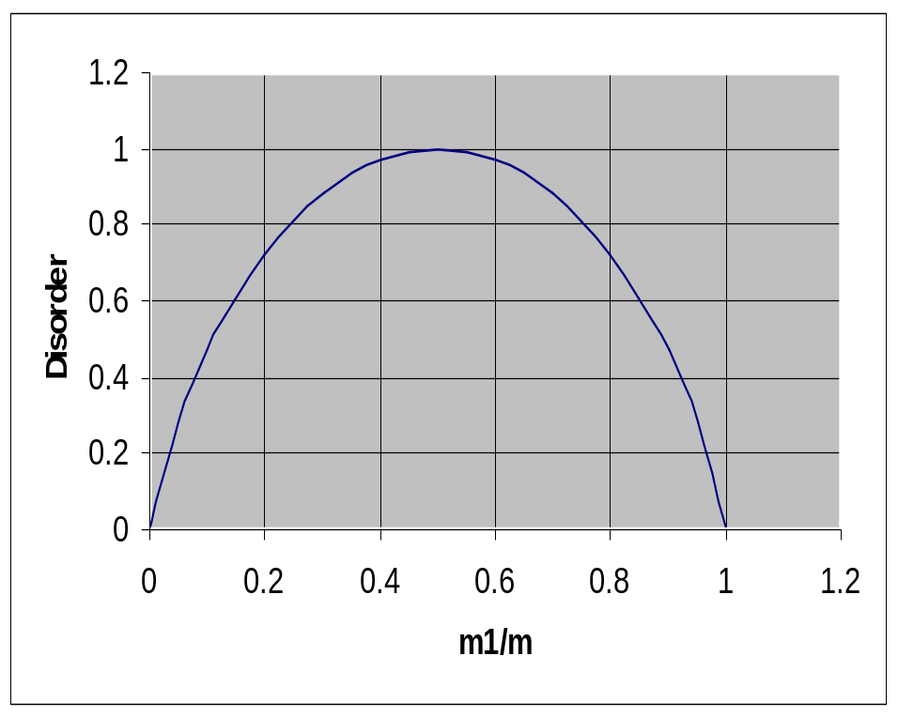
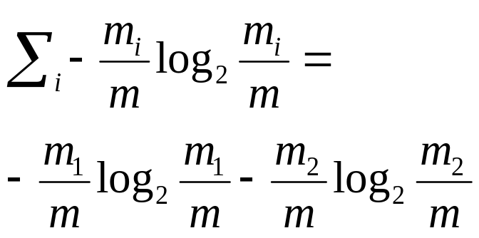
Measuring Entropy
If split m objects into 2 bins size m1 & m2, what is the entropy?

Slide 19
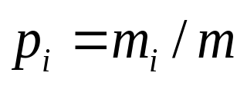
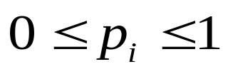
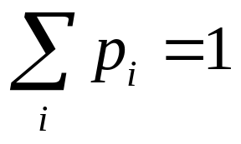
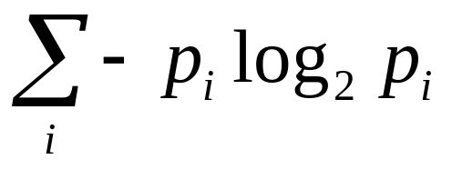
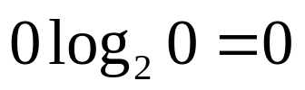
Measuring Disorder
Entropy
the probability of being in bin i
Entropy (disorder) of a split
Assume
p₁
p₂
Entropy
1
0
-1log₂1 - 0log₂0 = 0 - 0 = 0
½
½
-½ log₂½ - ½ log₂½ = ½ +½ = 1
¼
¾
-¼ log₂¼ - ¾ log₂¾ = 0.5 + 0.311 = 0.811

Slide 20
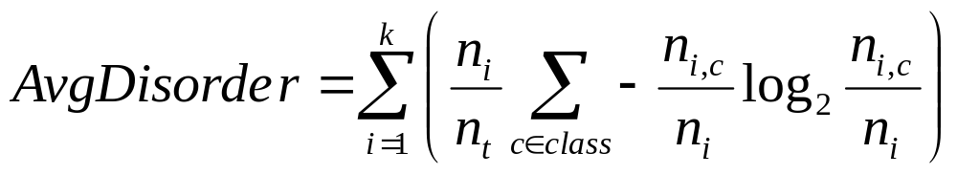
Computing Disorder
N instances
Branch1
Branch 2
N1 a
N1 b
N2 a
N2 b
Fraction of samples down branch i
Disorder of class distribution on branch i

Slide 21
Entropy in Sunburn Example
Hair color = 4/8(-2/4 log 2/4 - 2/4log2/4) + 1/8*0 + 3/8 *0
= 0.5
Height = 0.69
Weight = 0.94
Lotion = 0.61

Slide 22
Entropy in Sunburn Example
Height = 2/4(-1/2log1/2-1/2log1/2) + 1/4*0+1/4*0 = 0.5
Weight = 2/4(-1/2log1/2-1/2log1/2) +2/4(-1/2log1/2-1/2log1/2) = 1
Lotion = 0

Slide 23
Building ID Trees with Disorder
Until each leaf is as homogeneous as possible
  Select an inhomogeneous leaf node
  Replace that leaf node by a test node creating subsets with least average disorder
Effectively creates set of rectangular regions
  Repeatedly draws lines in different axes

Slide 24
Features in ID Trees: Pros
Feature selection:
  Tests features that yield low disorder
    E.g. selects features that are important!
  Ignores irrelevant features
Feature type handling:
  Discrete type: 1 branch per value
  Continuous type: Branch on >= value
    Need to search to find best breakpoint
Absent features: Distribute uniformly

Slide 25
Features in ID Trees: Cons
Features
  Assumed independent
  If want group effect, must model explicitly
    E.g. make new feature AorB
Feature tests conjunctive

Slide 26
From Trees to Rules
Tree:
  Branches from root to leaves =
  Tests => classifications
  Tests = if antecedents; Leaf labels= consequent
  All ID trees-> rules; Not all rules as trees

Slide 27
From ID Trees to Rules
Hair Color
Blonde
Brown
Red
Lotion Used
Emily: Burn
Alex: None
John: None
Pete: None
No
Yes
Sarah: Burn
Annie: Burn
Katie: None
Dana: None
(if (equal haircolor blonde) (equal lotionused yes) (then None))
(if (equal haircolor blonde) (equal lotionused no) (then Burn))
(if (equal haircolor red) (then Burn))
(if (equal haircolor brown) (then None))

Slide 28
Identification Trees
Train:
  Build tree by forming subsets of least disorder
Predict:
  Traverse tree based on feature tests
  Assign leaf node sample label
Pros: Robust to irrelevant features, some noise, fast prediction, perspicuous rule reading
Cons: Poor feature combination, dependency, optimal tree build intractable

