Slide 1
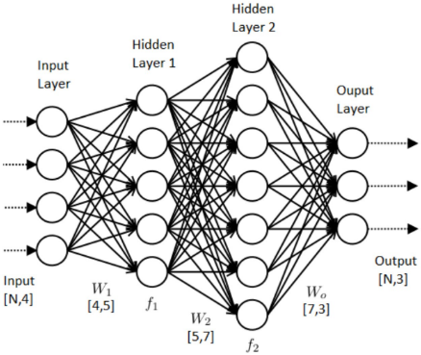

Slide 2
X
*
net1
f
out1
*
net2
f
out2
*
net3
f
out3
W1
W2
W3

Slide 3
net1
out1
net2
out2
net3
out3
X
*
+
f
*
+
f
*
+
f
W1
W2
W3
B1
B2
B3

