Slide 1
PROJECT HANDOVER
Chiller Project Completion
TECHNICAL
Delivery, testing, redundancy and handover summary
TECHNICAL TRAINING RESOURCE
Notes:
[Sources]
- User-provided controlled technical document
Training interpretation only. Verify against the current controlled record, OEM documentation, approved PTW/LOTO, risk assessment and site procedures.

Slide 2
PROJECT HANDOVER
Source to practice
Evidence, interpretation and technician application
02
Notes:
[Sources]
- User-provided controlled technical document
Training interpretation only. Verify against the current controlled record, OEM documentation, approved PTW/LOTO, risk assessment and site procedures.

Slide 3
KEY EVIDENCE
The project progressed from March to August 2025
24 Mar
4 Aug
CH-03
Recorded project start
Recorded completion
New Trane chiller arrangement
TECHNICAL RESOURCE | Project Handover
03
Notes:
[Sources]
- User-provided controlled technical document
Training interpretation only. Verify against the current controlled record, OEM documentation, approved PTW/LOTO, risk assessment and site procedures.

Slide 4
TECHNICAL REVIEW
The project added capacity and operational redundancy
• Existing Carrier chillers were operating near full summer load. • There was no flexibility for preventive or corrective maintenance.
• A third chiller and changeover arrangement improved backup capability. • Available power permits only two chillers to operate at one time.
TECHNICAL RESOURCE | Project Handover
04
Notes:
[Sources]
- User-provided controlled technical document
Training interpretation only. Verify against the current controlled record, OEM documentation, approved PTW/LOTO, risk assessment and site procedures.

Slide 5
TECHNICAL REVIEW
The schedule combined civil, mechanical and electrical work
• Foundation and chiller delivery began in March 2025. • Cable tray, piping supports, headers and valve package followed in April.
• Pressure testing, flushing, insulation and MTS work were completed before commissioning. • Testing and commissioning were recorded on 29 April with handover planned for 30 April.
TECHNICAL RESOURCE | Project Handover
05
Notes:
[Sources]
- User-provided controlled technical document
Training interpretation only. Verify against the current controlled record, OEM documentation, approved PTW/LOTO, risk assessment and site procedures.

Slide 6
TECHNICAL REVIEW
Handover must reconcile the later completion date
• The report records project completion as 4 August 2025. • The detailed schedule records a 30 April handover milestone.
• Retain evidence of post-commissioning snags, training and document closure. • Confirm the final acceptance date used for warranty commencement.
TECHNICAL RESOURCE | Project Handover
06
Notes:
[Sources]
- User-provided controlled technical document
Training interpretation only. Verify against the current controlled record, OEM documentation, approved PTW/LOTO, risk assessment and site procedures.

Slide 7
TECHNICAL REVIEW
The operational benefit is maintenance flexibility
• A standby arrangement reduces cooling-loss exposure during breakdowns. • Planned chiller PPM can proceed without shutting all cooling loads.
• Working-area temperature control should become more consistent. • Dry-cleaning equipment receives improved cooling-system resilience.
TECHNICAL RESOURCE | Project Handover
07
Notes:
[Sources]
- User-provided controlled technical document
Training interpretation only. Verify against the current controlled record, OEM documentation, approved PTW/LOTO, risk assessment and site procedures.

Slide 8
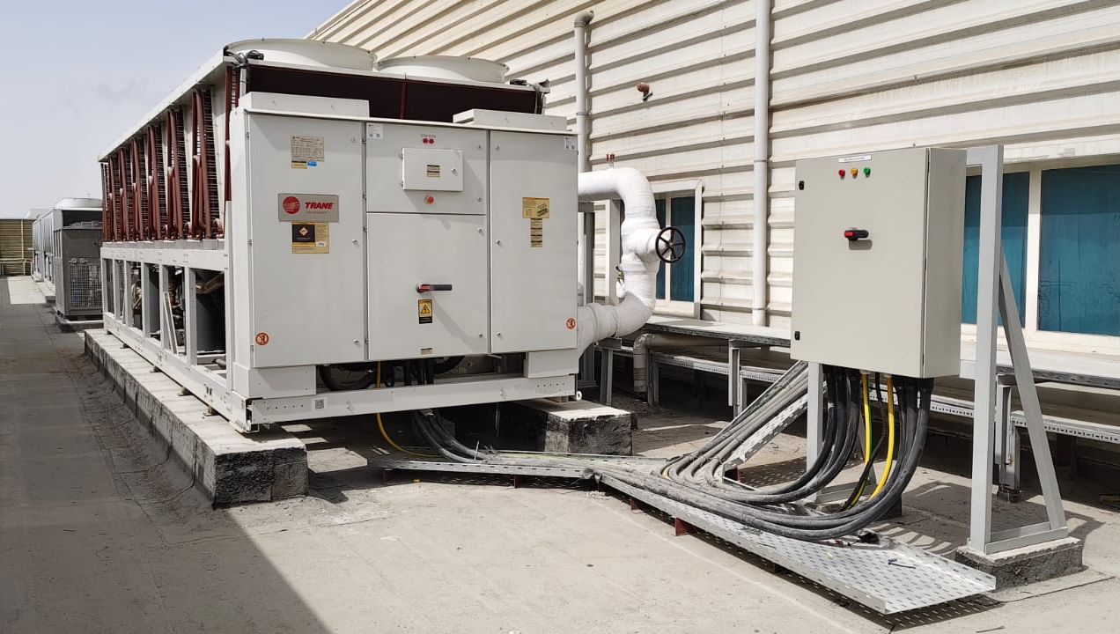
PROJECT PHOTOGRAPH
Installed chiller project evidence
• Confirm equipment identification and access clearances. • Inspect pipework, supports, insulation and service access. • Retain photograph with date and location metadata.
TECHNICAL RESOURCE | Project Handover
08
Notes:
[Sources]
- User-provided controlled technical document
- Evidence reference: Embedded project-completion photograph
Training interpretation only. Verify against the current controlled record, OEM documentation, approved PTW/LOTO, risk assessment and site procedures.

Slide 9
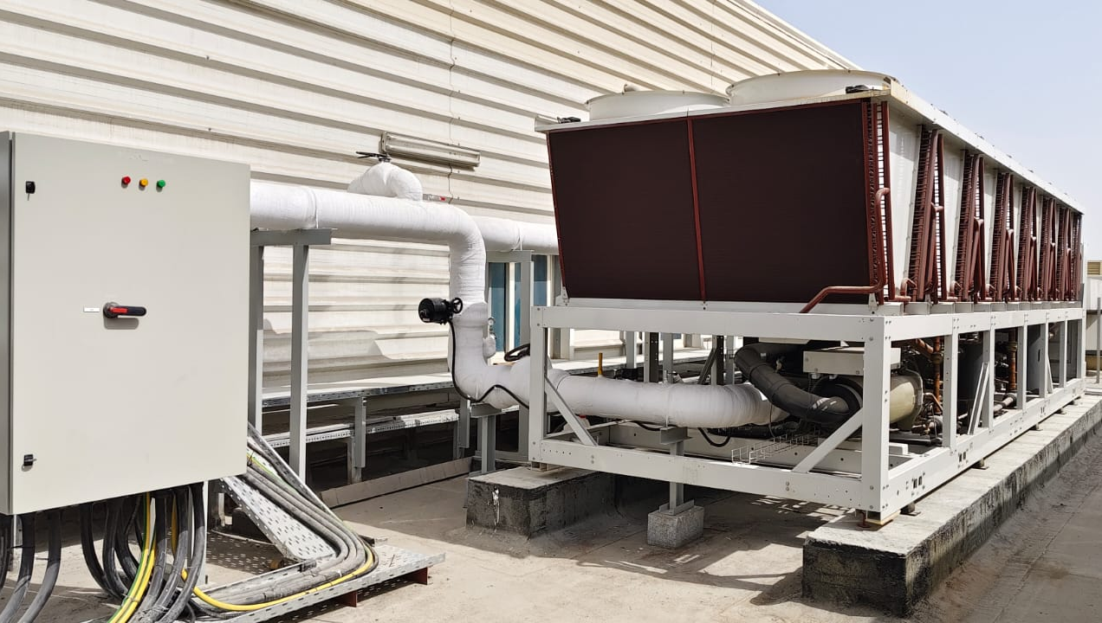
PROJECT PHOTOGRAPH
Completion photograph and site condition
• Use photographs to support snag closure. • Compare completed installation with approved drawings. • Record any later modification through change control.
TECHNICAL RESOURCE | Project Handover
09
Notes:
[Sources]
- User-provided controlled technical document
- Evidence reference: Embedded project-completion photograph
Training interpretation only. Verify against the current controlled record, OEM documentation, approved PTW/LOTO, risk assessment and site procedures.

Slide 10
COMPETENCY CHECK
What technicians must retain
• Identify the correct controlled source before work. • Verify readings, configuration and acceptance criteria.
• Preserve evidence and escalate unresolved deviations. • Complete safe isolation, functional testing and handover records.
TECHNICAL RESOURCE | Project Handover
10
Notes:
[Sources]
- User-provided controlled technical document
Training interpretation only. Verify against the current controlled record, OEM documentation, approved PTW/LOTO, risk assessment and site procedures.

