Slide 1

MF-250E V2 • INSTALLATION
MF-250E-V2 Installation Manual
Revision-specific installation and machine setup
TECHNICAL TRAINING RESOURCE
Notes:
[Sources]
- User-provided controlled technical document
Training interpretation only. Verify against the current controlled record, OEM documentation, approved PTW/LOTO, risk assessment and site procedures.

Slide 2
MF-250E V2 • INSTALLATION
Source to practice
Evidence, interpretation and technician application
02
Notes:
[Sources]
- User-provided controlled technical document
Training interpretation only. Verify against the current controlled record, OEM documentation, approved PTW/LOTO, risk assessment and site procedures.

Slide 3
KEY EVIDENCE
A controlled technical reference for safe maintenance
16
MF-250E-V2
V2.2
Installation-manual pages
Machine revision
Uploaded installation file
TECHNICAL RESOURCE | MF-250E V2 • Installation
03
Notes:
[Sources]
- User-provided controlled technical document
Training interpretation only. Verify against the current controlled record, OEM documentation, approved PTW/LOTO, risk assessment and site procedures.

Slide 4
TECHNICAL REVIEW
Use the manual as a machine-specific working reference
• Verify size, weight, lifting and installation space. • Fix the machine according to the approved method.
• Install hanging metal, clamp-cylinder and mirror assemblies. • Complete utilities and functional checks before release.
TECHNICAL RESOURCE | MF-250E V2 • Installation
04
Notes:
[Sources]
- User-provided controlled technical document
Training interpretation only. Verify against the current controlled record, OEM documentation, approved PTW/LOTO, risk assessment and site procedures.

Slide 5
TECHNICAL REVIEW
Apply a consistent safe-work sequence
• Confirm machine identity, model and document revision. • Isolate all energy sources and prove a safe state before access.
• Inspect, measure and diagnose before replacing components. • Function-test safeguards and record the completed work.
TECHNICAL RESOURCE | MF-250E V2 • Installation
05
Notes:
[Sources]
- User-provided controlled technical document
Training interpretation only. Verify against the current controlled record, OEM documentation, approved PTW/LOTO, risk assessment and site procedures.

Slide 6
TECHNICAL REVIEW
Parts and settings require configuration control
• Record original settings and connections before adjustment. • Use exact part numbers or approved supersessions.
• Preserve firmware, program and parameter backups where applicable. • Update the maintenance history after each intervention.
TECHNICAL RESOURCE | MF-250E V2 • Installation
06
Notes:
[Sources]
- User-provided controlled technical document
Training interpretation only. Verify against the current controlled record, OEM documentation, approved PTW/LOTO, risk assessment and site procedures.

Slide 7
SOURCE EVIDENCE
Manual evidence 1
Source page 1
Use the current controlled document for detailed readings, revision status and formal acceptance.
TECHNICAL RESOURCE | MF-250E V2 • Installation
07
Notes:
[Sources]
- User-provided controlled technical document
- Evidence reference: Source page 1
Training interpretation only. Verify against the current controlled record, OEM documentation, approved PTW/LOTO, risk assessment and site procedures.

Slide 8
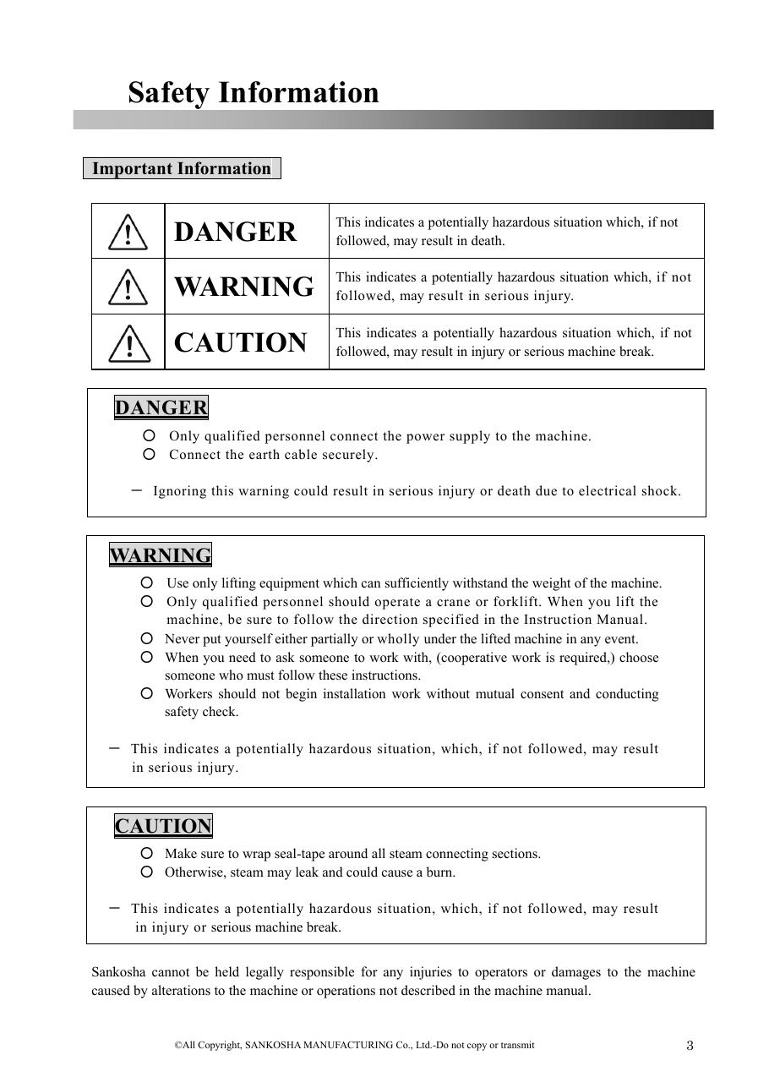
SOURCE EVIDENCE
Manual evidence 2
Source page 3
Use the current controlled document for detailed readings, revision status and formal acceptance.
TECHNICAL RESOURCE | MF-250E V2 • Installation
08
Notes:
[Sources]
- User-provided controlled technical document
- Evidence reference: Source page 3
Training interpretation only. Verify against the current controlled record, OEM documentation, approved PTW/LOTO, risk assessment and site procedures.

Slide 9
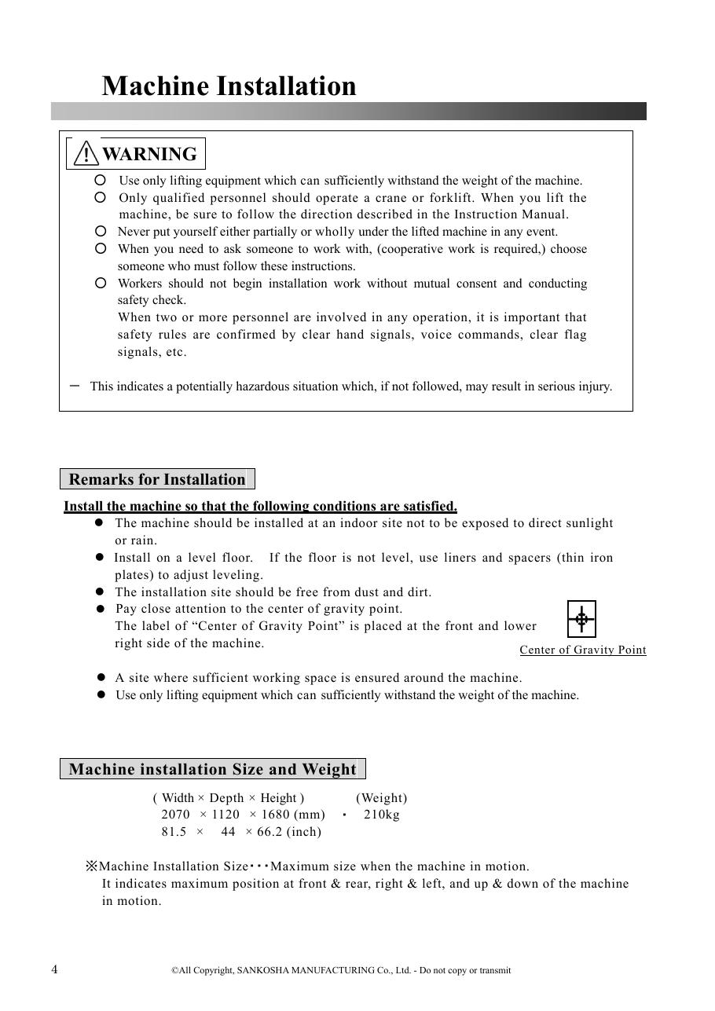
SOURCE EVIDENCE
Manual evidence 3
Source page 4
Use the current controlled document for detailed readings, revision status and formal acceptance.
TECHNICAL RESOURCE | MF-250E V2 • Installation
09
Notes:
[Sources]
- User-provided controlled technical document
- Evidence reference: Source page 4
Training interpretation only. Verify against the current controlled record, OEM documentation, approved PTW/LOTO, risk assessment and site procedures.

Slide 10
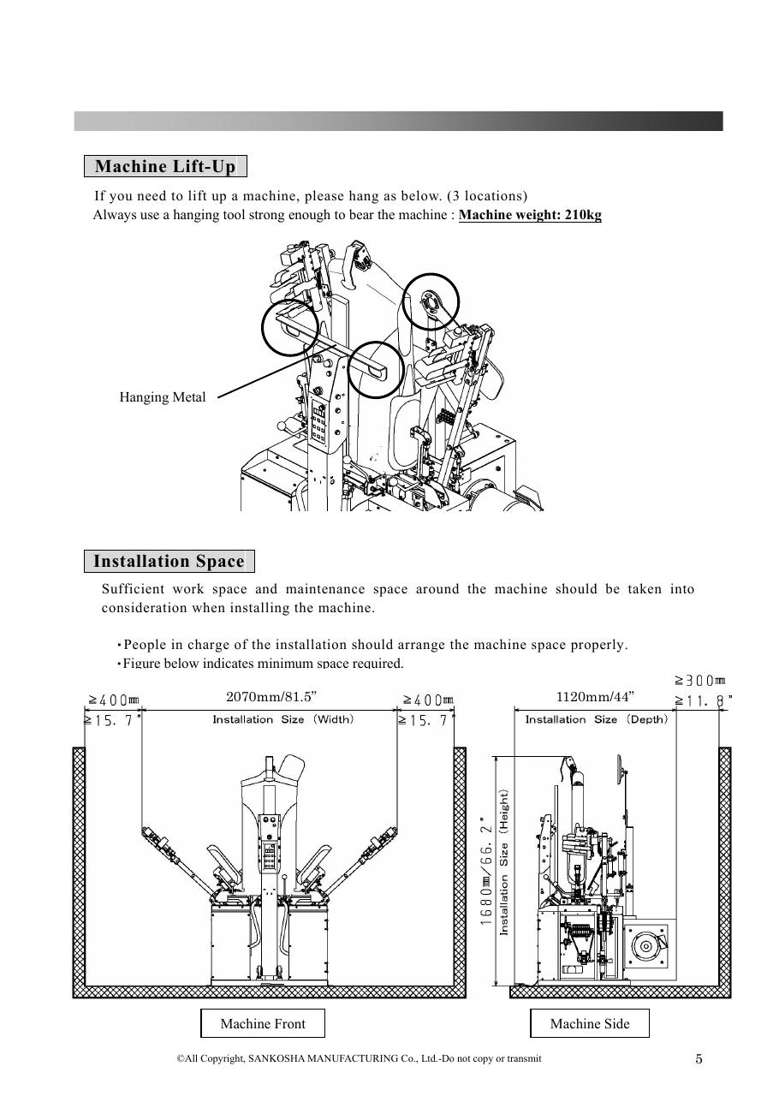
SOURCE EVIDENCE
Manual evidence 4
Source page 5
Use the current controlled document for detailed readings, revision status and formal acceptance.
TECHNICAL RESOURCE | MF-250E V2 • Installation
10
Notes:
[Sources]
- User-provided controlled technical document
- Evidence reference: Source page 5
Training interpretation only. Verify against the current controlled record, OEM documentation, approved PTW/LOTO, risk assessment and site procedures.

Slide 11
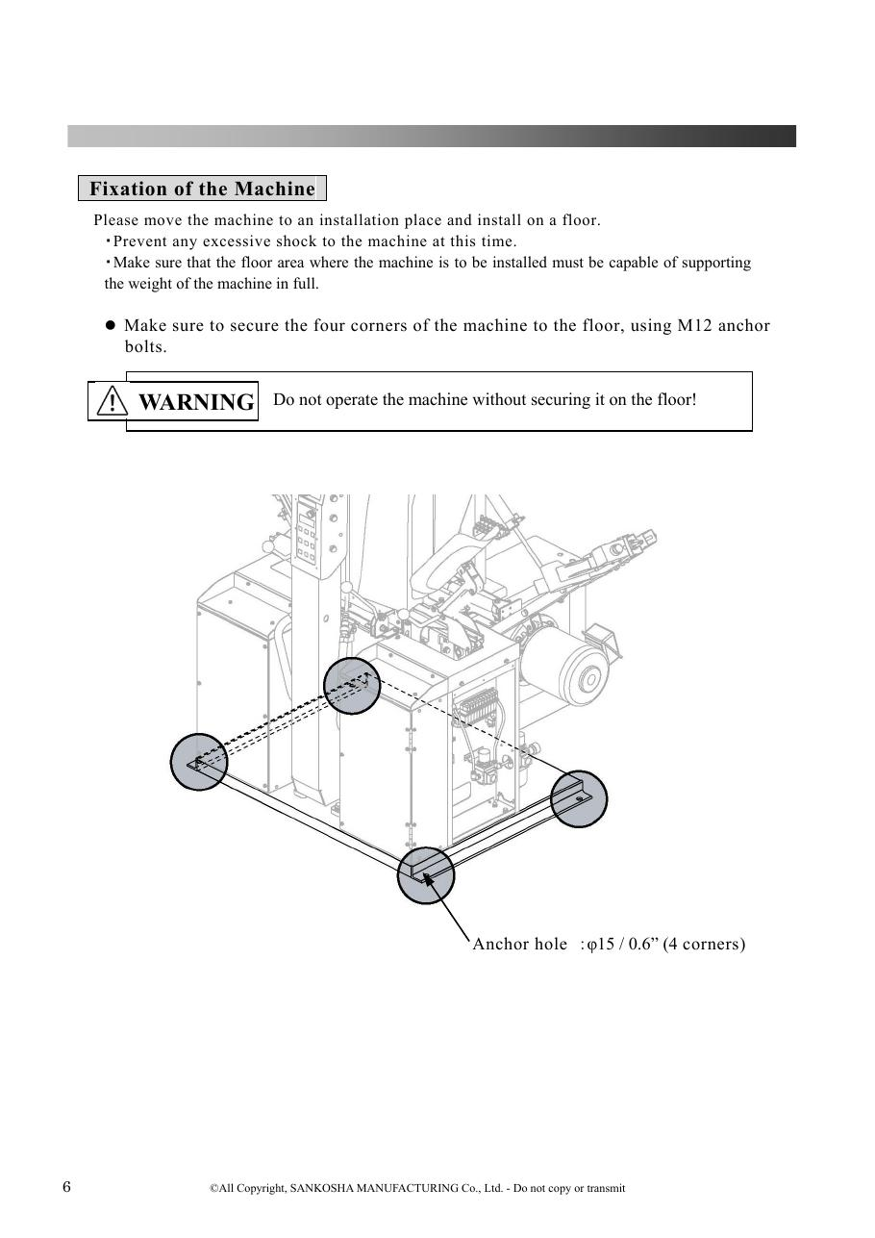
SOURCE EVIDENCE
Manual evidence 5
Source page 6
Use the current controlled document for detailed readings, revision status and formal acceptance.
TECHNICAL RESOURCE | MF-250E V2 • Installation
11
Notes:
[Sources]
- User-provided controlled technical document
- Evidence reference: Source page 6
Training interpretation only. Verify against the current controlled record, OEM documentation, approved PTW/LOTO, risk assessment and site procedures.

Slide 12
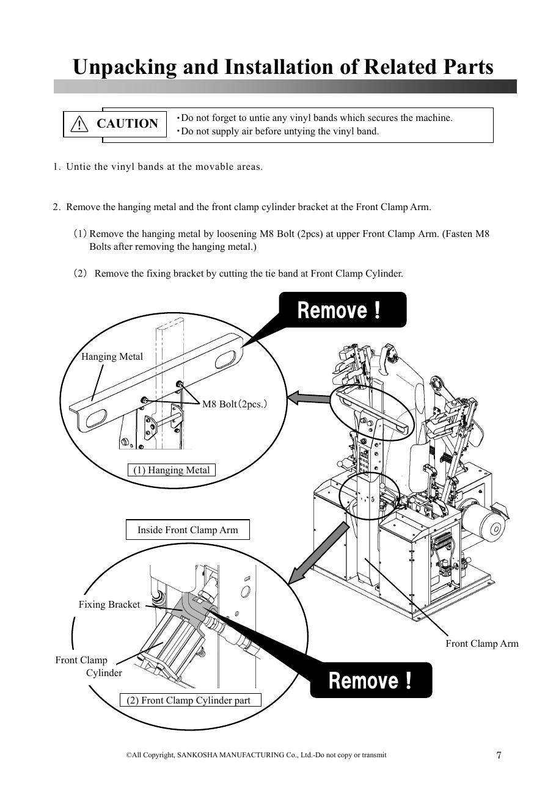
SOURCE EVIDENCE
Manual evidence 6
Source page 7
Use the current controlled document for detailed readings, revision status and formal acceptance.
TECHNICAL RESOURCE | MF-250E V2 • Installation
12
Notes:
[Sources]
- User-provided controlled technical document
- Evidence reference: Source page 7
Training interpretation only. Verify against the current controlled record, OEM documentation, approved PTW/LOTO, risk assessment and site procedures.

Slide 13
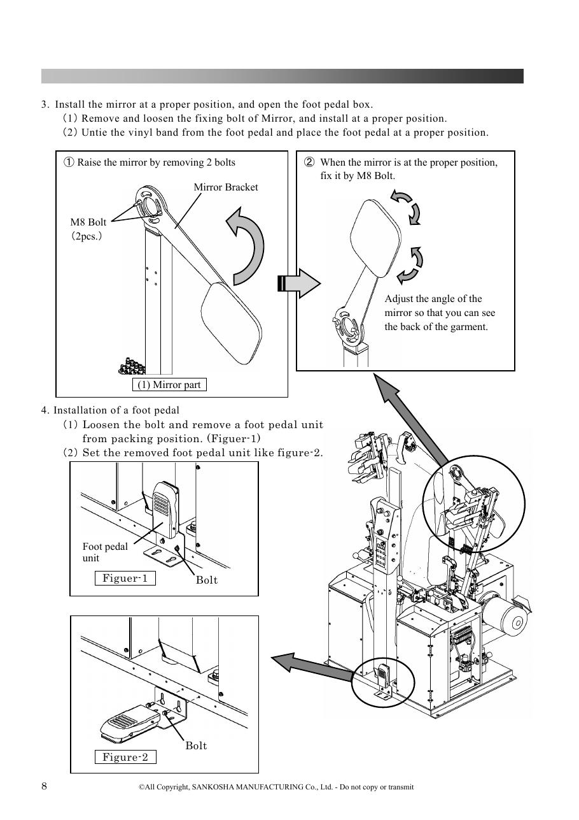
SOURCE EVIDENCE
Manual evidence 7
Source page 8
Use the current controlled document for detailed readings, revision status and formal acceptance.
TECHNICAL RESOURCE | MF-250E V2 • Installation
13
Notes:
[Sources]
- User-provided controlled technical document
- Evidence reference: Source page 8
Training interpretation only. Verify against the current controlled record, OEM documentation, approved PTW/LOTO, risk assessment and site procedures.

Slide 14
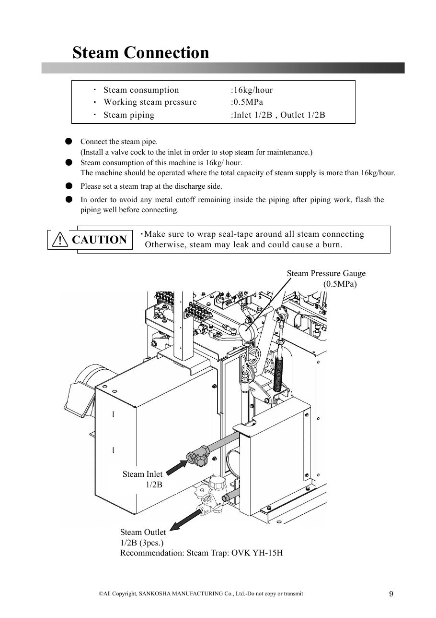
SOURCE EVIDENCE
Manual evidence 8
Source page 9
Use the current controlled document for detailed readings, revision status and formal acceptance.
TECHNICAL RESOURCE | MF-250E V2 • Installation
14
Notes:
[Sources]
- User-provided controlled technical document
- Evidence reference: Source page 9
Training interpretation only. Verify against the current controlled record, OEM documentation, approved PTW/LOTO, risk assessment and site procedures.

Slide 15
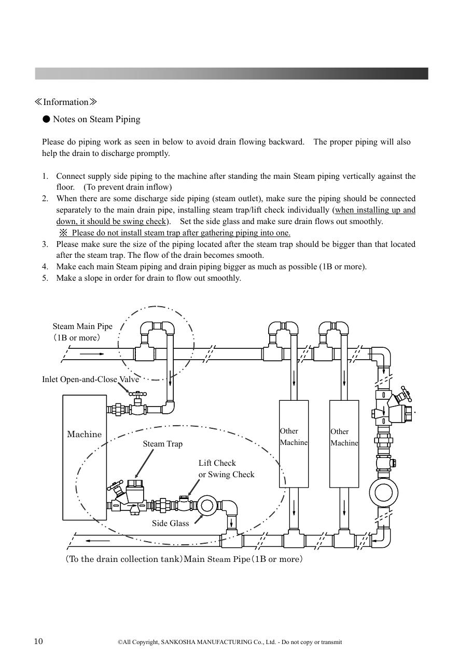
SOURCE EVIDENCE
Manual evidence 9
Source page 10
Use the current controlled document for detailed readings, revision status and formal acceptance.
TECHNICAL RESOURCE | MF-250E V2 • Installation
15
Notes:
[Sources]
- User-provided controlled technical document
- Evidence reference: Source page 10
Training interpretation only. Verify against the current controlled record, OEM documentation, approved PTW/LOTO, risk assessment and site procedures.

Slide 16
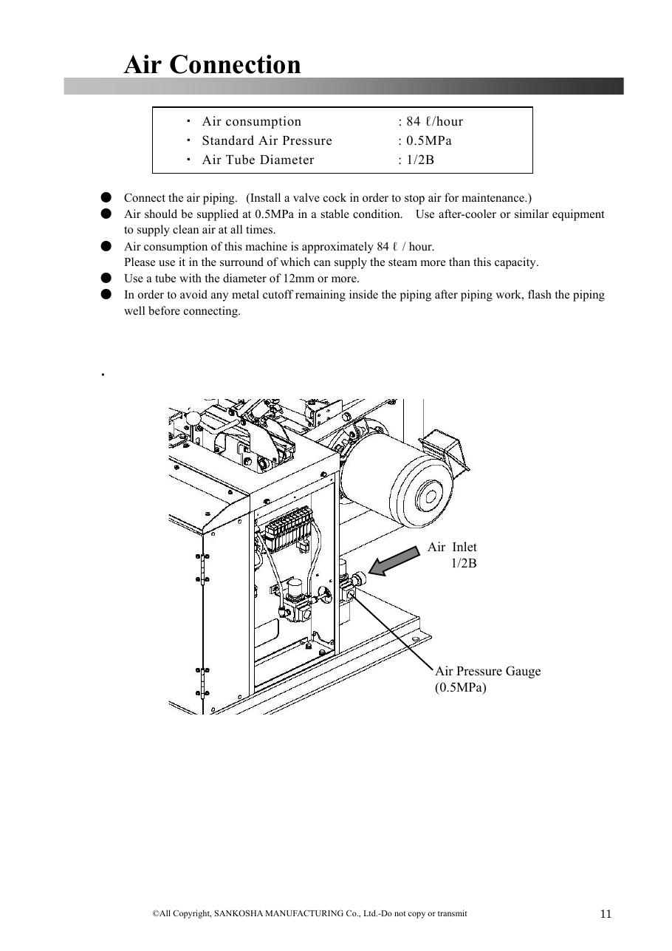
SOURCE EVIDENCE
Manual evidence 10
Source page 11
Use the current controlled document for detailed readings, revision status and formal acceptance.
TECHNICAL RESOURCE | MF-250E V2 • Installation
16
Notes:
[Sources]
- User-provided controlled technical document
- Evidence reference: Source page 11
Training interpretation only. Verify against the current controlled record, OEM documentation, approved PTW/LOTO, risk assessment and site procedures.

Slide 17
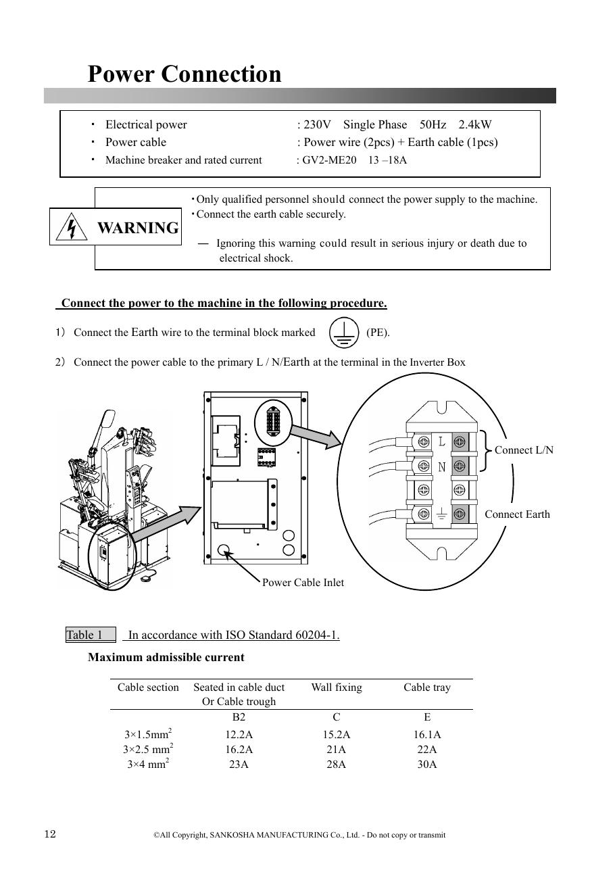
SOURCE EVIDENCE
Manual evidence 11
Source page 12
Use the current controlled document for detailed readings, revision status and formal acceptance.
TECHNICAL RESOURCE | MF-250E V2 • Installation
17
Notes:
[Sources]
- User-provided controlled technical document
- Evidence reference: Source page 12
Training interpretation only. Verify against the current controlled record, OEM documentation, approved PTW/LOTO, risk assessment and site procedures.

Slide 18
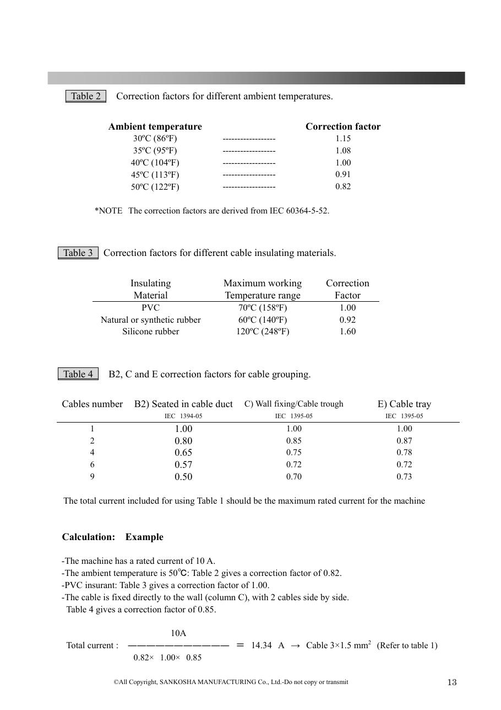
SOURCE EVIDENCE
Manual evidence 12
Source page 13
Use the current controlled document for detailed readings, revision status and formal acceptance.
TECHNICAL RESOURCE | MF-250E V2 • Installation
18
Notes:
[Sources]
- User-provided controlled technical document
- Evidence reference: Source page 13
Training interpretation only. Verify against the current controlled record, OEM documentation, approved PTW/LOTO, risk assessment and site procedures.

Slide 19
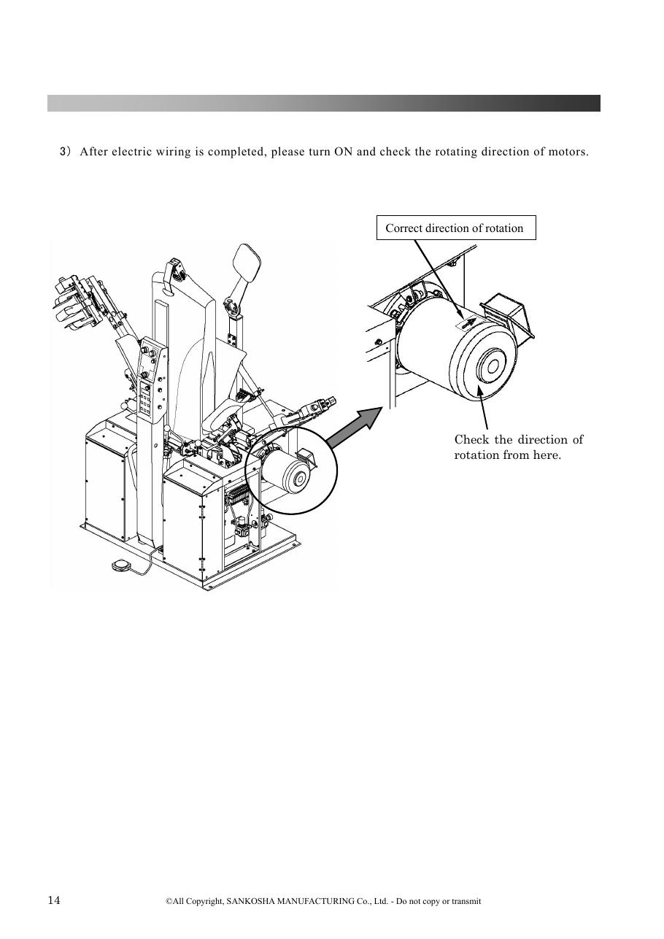
SOURCE EVIDENCE
Manual evidence 13
Source page 14
Use the current controlled document for detailed readings, revision status and formal acceptance.
TECHNICAL RESOURCE | MF-250E V2 • Installation
19
Notes:
[Sources]
- User-provided controlled technical document
- Evidence reference: Source page 14
Training interpretation only. Verify against the current controlled record, OEM documentation, approved PTW/LOTO, risk assessment and site procedures.

Slide 20

SOURCE EVIDENCE
Manual evidence 14
Source page 15
Use the current controlled document for detailed readings, revision status and formal acceptance.
TECHNICAL RESOURCE | MF-250E V2 • Installation
20
Notes:
[Sources]
- User-provided controlled technical document
- Evidence reference: Source page 15
Training interpretation only. Verify against the current controlled record, OEM documentation, approved PTW/LOTO, risk assessment and site procedures.

Slide 21

SOURCE EVIDENCE
Manual evidence 15
Source page 16
Use the current controlled document for detailed readings, revision status and formal acceptance.
TECHNICAL RESOURCE | MF-250E V2 • Installation
21
Notes:
[Sources]
- User-provided controlled technical document
- Evidence reference: Source page 16
Training interpretation only. Verify against the current controlled record, OEM documentation, approved PTW/LOTO, risk assessment and site procedures.

Slide 22
COMPETENCY CHECK
What technicians must retain
• Identify the correct controlled source before work. • Verify readings, configuration and acceptance criteria.
• Preserve evidence and escalate unresolved deviations. • Complete safe isolation, functional testing and handover records.
TECHNICAL RESOURCE | MF-250E V2 • Installation
22
Notes:
[Sources]
- User-provided controlled technical document
Training interpretation only. Verify against the current controlled record, OEM documentation, approved PTW/LOTO, risk assessment and site procedures.

