Slide 1

MF-250E V2 • OPERATION
MF-250E-V2 Instruction Manual
Higher-capacity operation, maintenance and fault response
TECHNICAL TRAINING RESOURCE
Notes:
[Sources]
- User-provided controlled technical document
Training interpretation only. Verify against the current controlled record, OEM documentation, approved PTW/LOTO, risk assessment and site procedures.

Slide 2
MF-250E V2 • OPERATION
Source to practice
Evidence, interpretation and technician application
02
Notes:
[Sources]
- User-provided controlled technical document
Training interpretation only. Verify against the current controlled record, OEM documentation, approved PTW/LOTO, risk assessment and site procedures.

Slide 3
KEY EVIDENCE
A controlled technical reference for safe maintenance
66
40/h
0.5 MPa
Instruction-manual pages
Rated capacity up to shirts/hour
Air and steam pressure
TECHNICAL RESOURCE | MF-250E V2 • Operation
03
Notes:
[Sources]
- User-provided controlled technical document
Training interpretation only. Verify against the current controlled record, OEM documentation, approved PTW/LOTO, risk assessment and site procedures.

Slide 4
TECHNICAL REVIEW
Use the manual as a machine-specific working reference
• Use V2-specific controls and operating instructions. • Verify air, steam, clamps and finishing-form condition.
• Follow model-specific maintenance and troubleshooting tables. • Do not transfer legacy MF-250E settings without verification.
TECHNICAL RESOURCE | MF-250E V2 • Operation
04
Notes:
[Sources]
- User-provided controlled technical document
Training interpretation only. Verify against the current controlled record, OEM documentation, approved PTW/LOTO, risk assessment and site procedures.

Slide 5
TECHNICAL REVIEW
Apply a consistent safe-work sequence
• Confirm machine identity, model and document revision. • Isolate all energy sources and prove a safe state before access.
• Inspect, measure and diagnose before replacing components. • Function-test safeguards and record the completed work.
TECHNICAL RESOURCE | MF-250E V2 • Operation
05
Notes:
[Sources]
- User-provided controlled technical document
Training interpretation only. Verify against the current controlled record, OEM documentation, approved PTW/LOTO, risk assessment and site procedures.

Slide 6
TECHNICAL REVIEW
Parts and settings require configuration control
• Record original settings and connections before adjustment. • Use exact part numbers or approved supersessions.
• Preserve firmware, program and parameter backups where applicable. • Update the maintenance history after each intervention.
TECHNICAL RESOURCE | MF-250E V2 • Operation
06
Notes:
[Sources]
- User-provided controlled technical document
Training interpretation only. Verify against the current controlled record, OEM documentation, approved PTW/LOTO, risk assessment and site procedures.

Slide 7
SOURCE EVIDENCE
Manual evidence 1
Source page 1
Use the current controlled document for detailed readings, revision status and formal acceptance.
TECHNICAL RESOURCE | MF-250E V2 • Operation
07
Notes:
[Sources]
- User-provided controlled technical document
- Evidence reference: Source page 1
Training interpretation only. Verify against the current controlled record, OEM documentation, approved PTW/LOTO, risk assessment and site procedures.

Slide 8
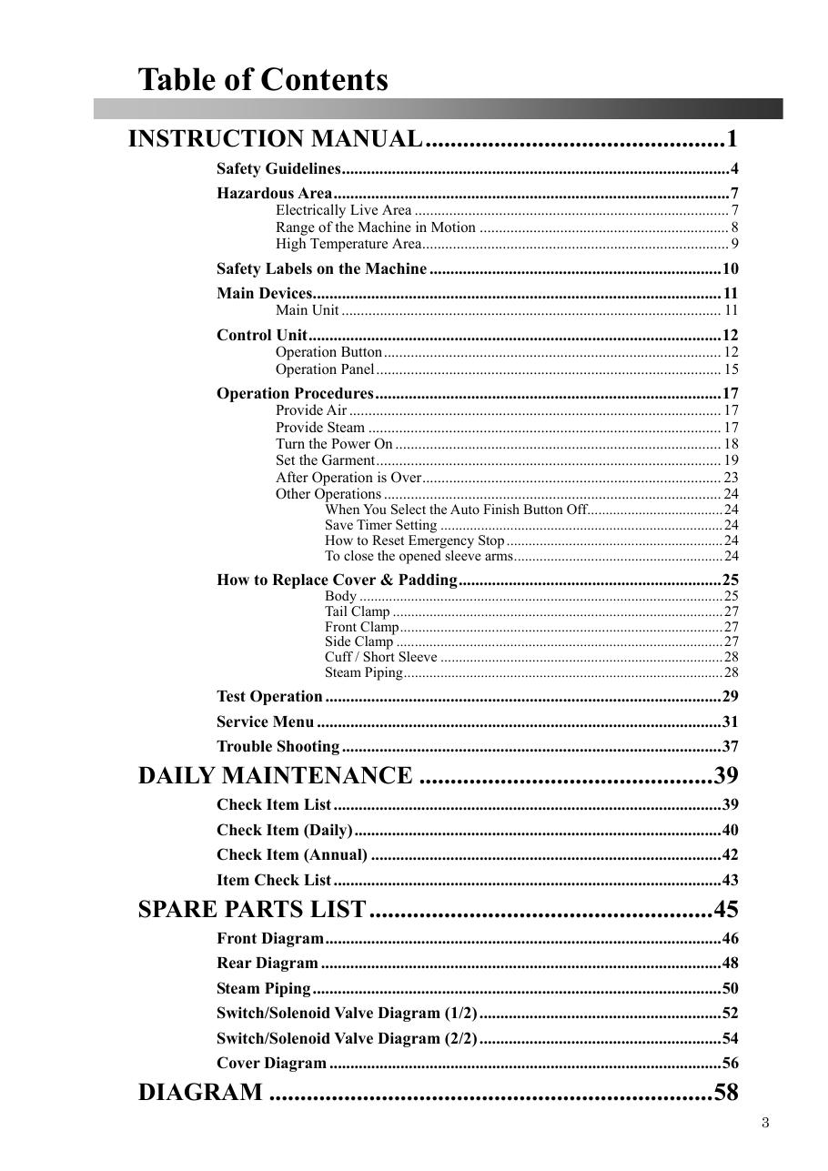
SOURCE EVIDENCE
Manual evidence 2
Source page 3
Use the current controlled document for detailed readings, revision status and formal acceptance.
TECHNICAL RESOURCE | MF-250E V2 • Operation
08
Notes:
[Sources]
- User-provided controlled technical document
- Evidence reference: Source page 3
Training interpretation only. Verify against the current controlled record, OEM documentation, approved PTW/LOTO, risk assessment and site procedures.

Slide 9
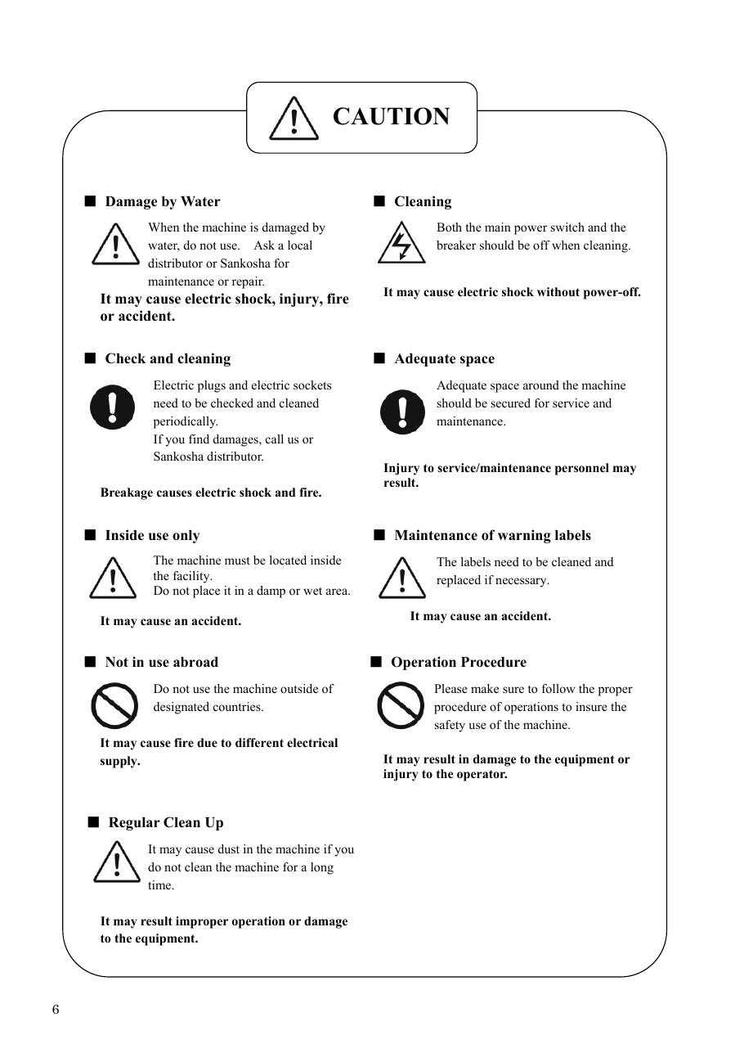
SOURCE EVIDENCE
Manual evidence 3
Source page 6
Use the current controlled document for detailed readings, revision status and formal acceptance.
TECHNICAL RESOURCE | MF-250E V2 • Operation
09
Notes:
[Sources]
- User-provided controlled technical document
- Evidence reference: Source page 6
Training interpretation only. Verify against the current controlled record, OEM documentation, approved PTW/LOTO, risk assessment and site procedures.

Slide 10
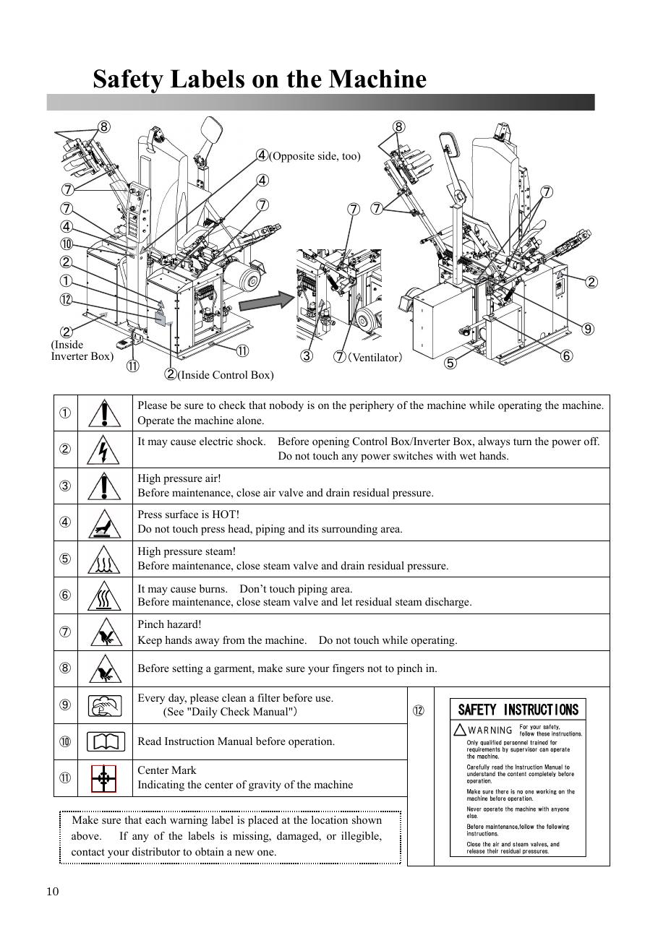
SOURCE EVIDENCE
Manual evidence 4
Source page 10
Use the current controlled document for detailed readings, revision status and formal acceptance.
TECHNICAL RESOURCE | MF-250E V2 • Operation
10
Notes:
[Sources]
- User-provided controlled technical document
- Evidence reference: Source page 10
Training interpretation only. Verify against the current controlled record, OEM documentation, approved PTW/LOTO, risk assessment and site procedures.

Slide 11
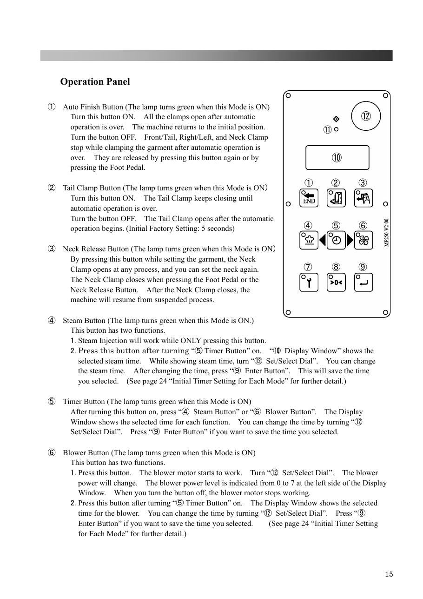
SOURCE EVIDENCE
Manual evidence 5
Source page 15
Use the current controlled document for detailed readings, revision status and formal acceptance.
TECHNICAL RESOURCE | MF-250E V2 • Operation
11
Notes:
[Sources]
- User-provided controlled technical document
- Evidence reference: Source page 15
Training interpretation only. Verify against the current controlled record, OEM documentation, approved PTW/LOTO, risk assessment and site procedures.

Slide 12
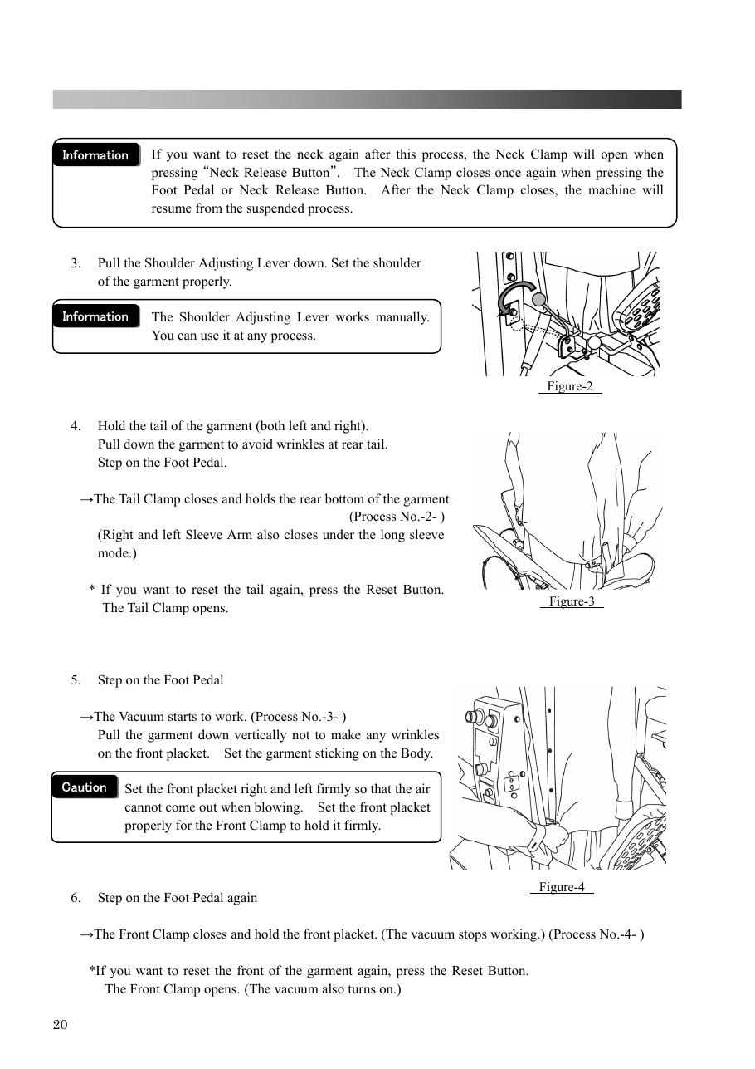
SOURCE EVIDENCE
Manual evidence 6
Source page 20
Use the current controlled document for detailed readings, revision status and formal acceptance.
TECHNICAL RESOURCE | MF-250E V2 • Operation
12
Notes:
[Sources]
- User-provided controlled technical document
- Evidence reference: Source page 20
Training interpretation only. Verify against the current controlled record, OEM documentation, approved PTW/LOTO, risk assessment and site procedures.

Slide 13
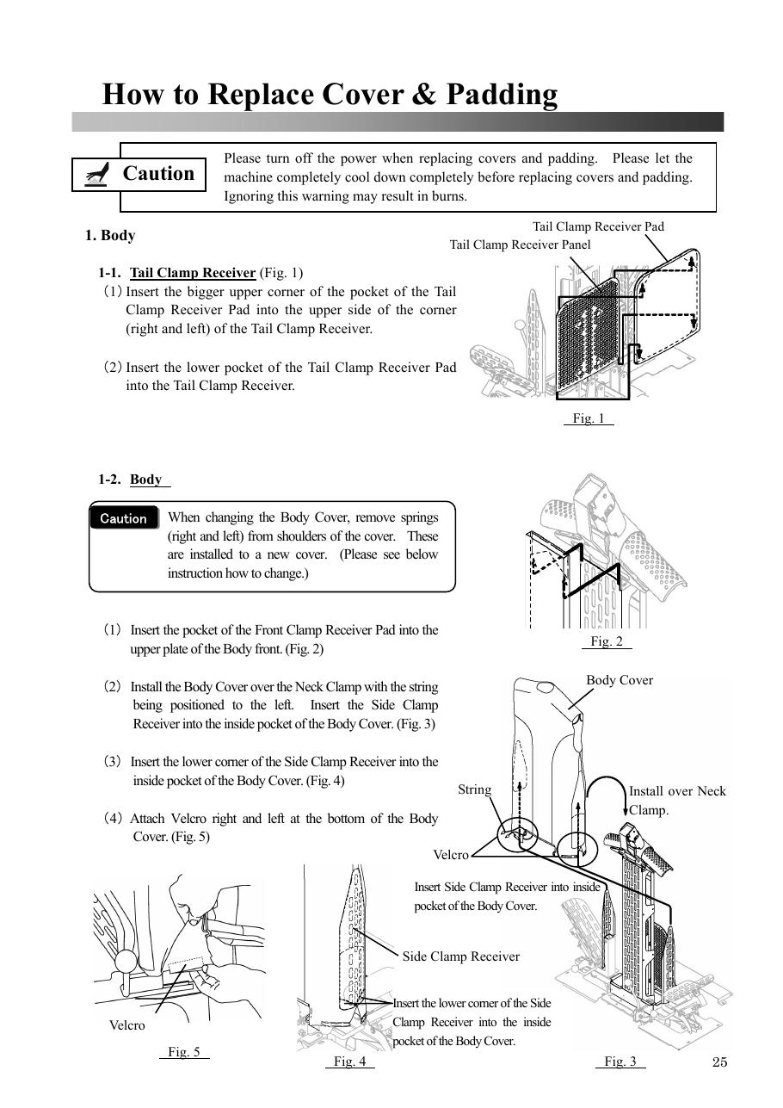
SOURCE EVIDENCE
Manual evidence 7
Source page 25
Use the current controlled document for detailed readings, revision status and formal acceptance.
TECHNICAL RESOURCE | MF-250E V2 • Operation
13
Notes:
[Sources]
- User-provided controlled technical document
- Evidence reference: Source page 25
Training interpretation only. Verify against the current controlled record, OEM documentation, approved PTW/LOTO, risk assessment and site procedures.

Slide 14
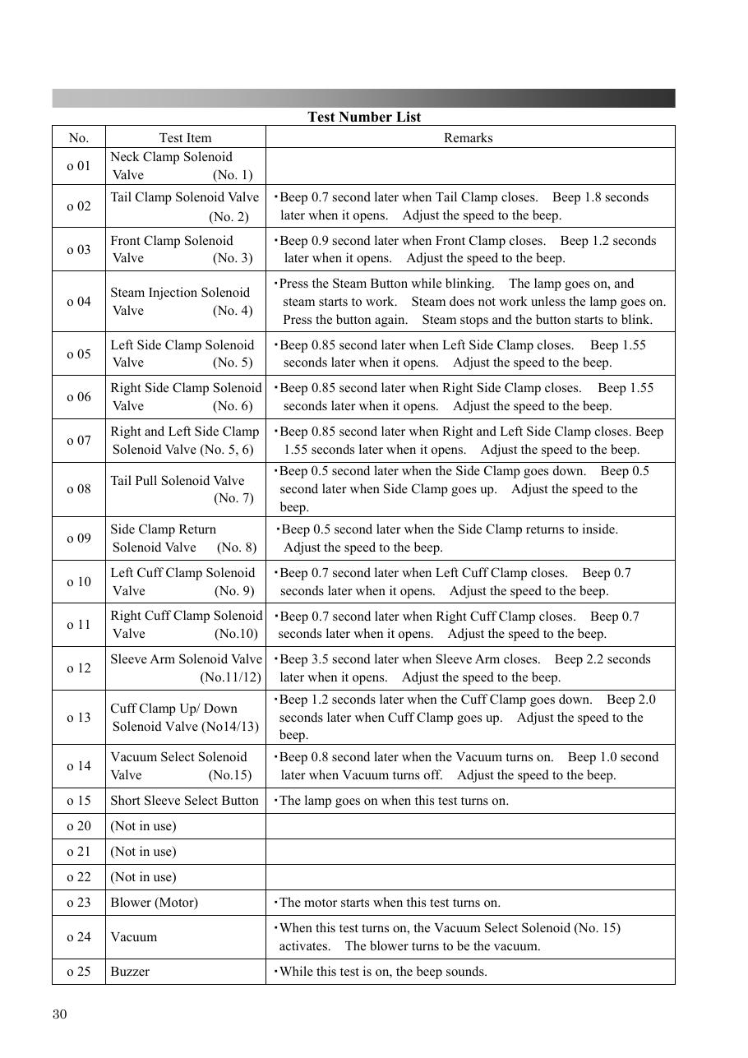
SOURCE EVIDENCE
Manual evidence 8
Source page 30
Use the current controlled document for detailed readings, revision status and formal acceptance.
TECHNICAL RESOURCE | MF-250E V2 • Operation
14
Notes:
[Sources]
- User-provided controlled technical document
- Evidence reference: Source page 30
Training interpretation only. Verify against the current controlled record, OEM documentation, approved PTW/LOTO, risk assessment and site procedures.

Slide 15
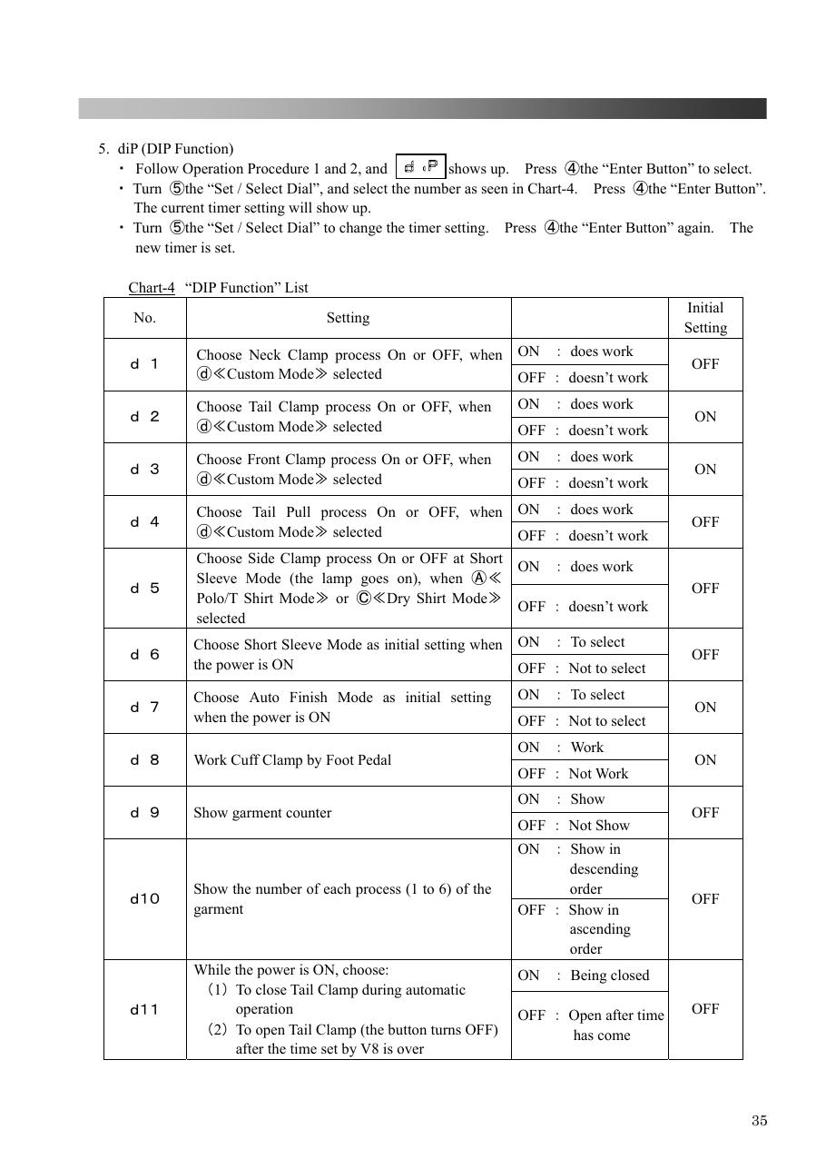
SOURCE EVIDENCE
Manual evidence 9
Source page 35
Use the current controlled document for detailed readings, revision status and formal acceptance.
TECHNICAL RESOURCE | MF-250E V2 • Operation
15
Notes:
[Sources]
- User-provided controlled technical document
- Evidence reference: Source page 35
Training interpretation only. Verify against the current controlled record, OEM documentation, approved PTW/LOTO, risk assessment and site procedures.

Slide 16
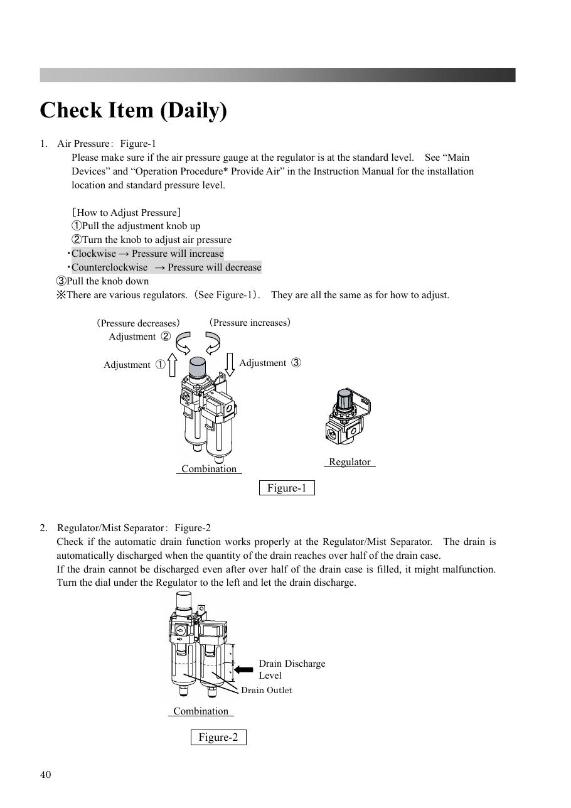
SOURCE EVIDENCE
Manual evidence 10
Source page 40
Use the current controlled document for detailed readings, revision status and formal acceptance.
TECHNICAL RESOURCE | MF-250E V2 • Operation
16
Notes:
[Sources]
- User-provided controlled technical document
- Evidence reference: Source page 40
Training interpretation only. Verify against the current controlled record, OEM documentation, approved PTW/LOTO, risk assessment and site procedures.

Slide 17
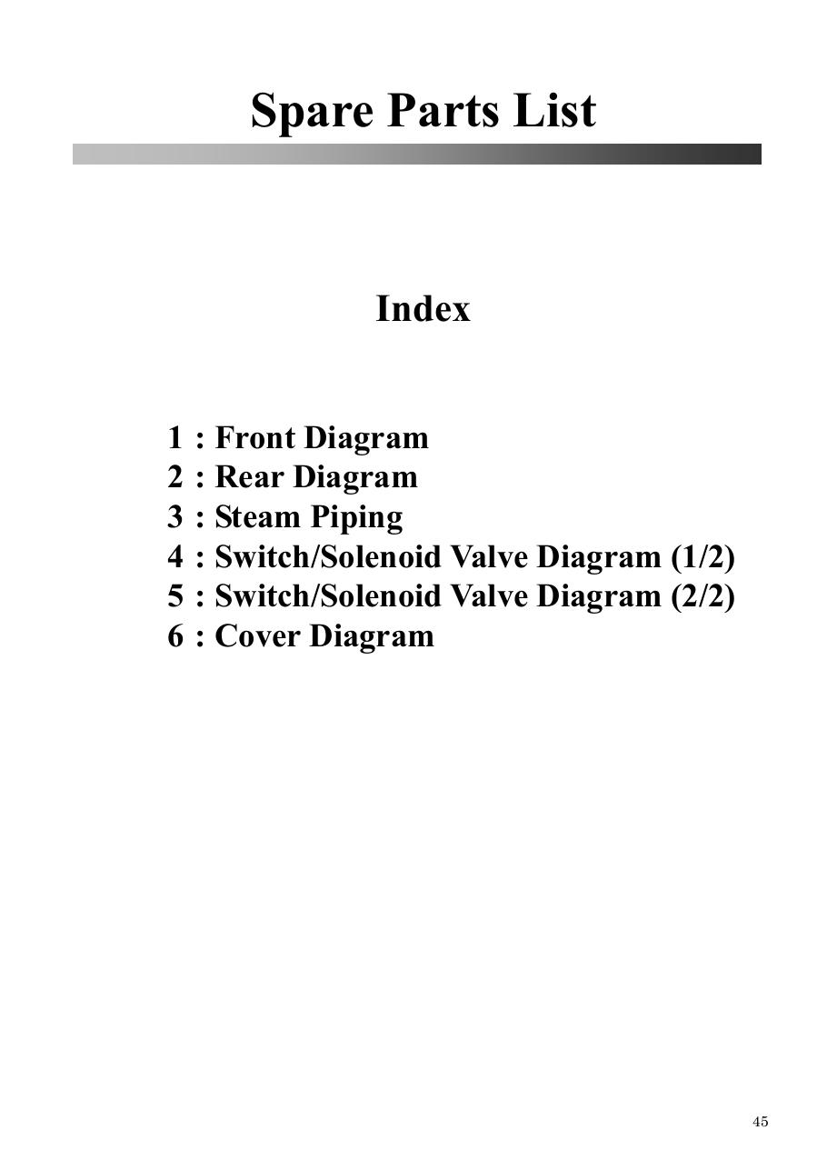
SOURCE EVIDENCE
Manual evidence 11
Source page 45
Use the current controlled document for detailed readings, revision status and formal acceptance.
TECHNICAL RESOURCE | MF-250E V2 • Operation
17
Notes:
[Sources]
- User-provided controlled technical document
- Evidence reference: Source page 45
Training interpretation only. Verify against the current controlled record, OEM documentation, approved PTW/LOTO, risk assessment and site procedures.

Slide 18
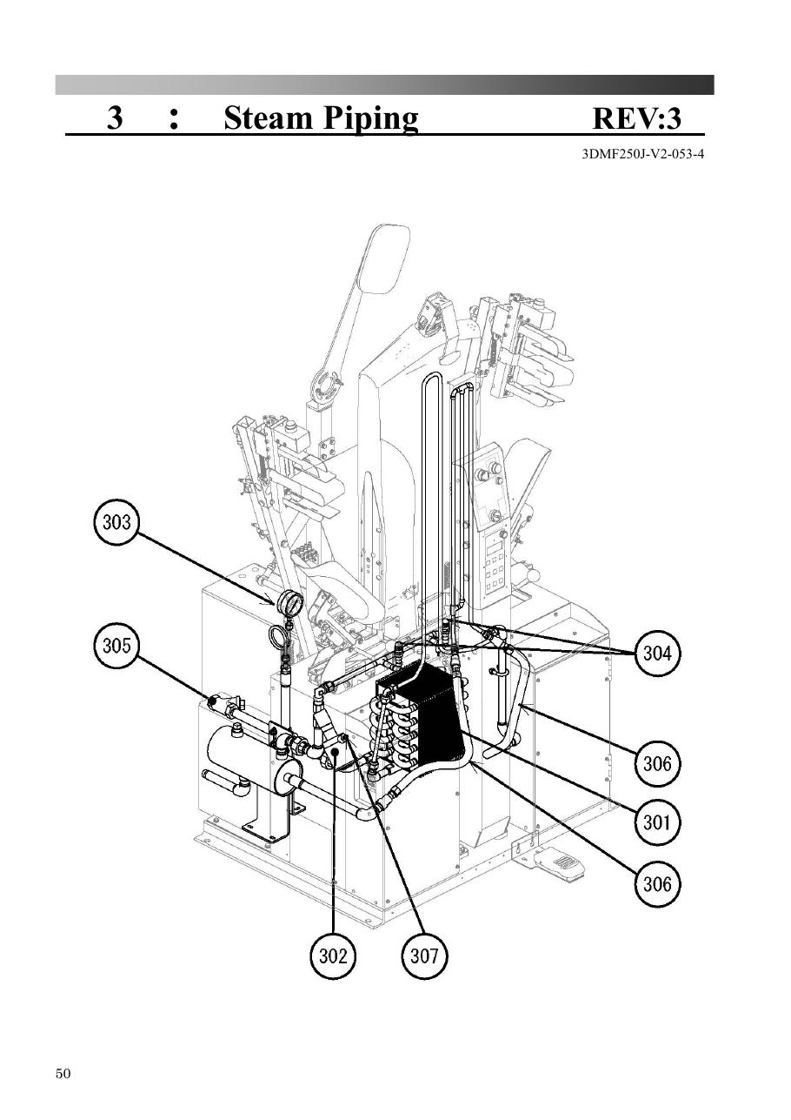
SOURCE EVIDENCE
Manual evidence 12
Source page 50
Use the current controlled document for detailed readings, revision status and formal acceptance.
TECHNICAL RESOURCE | MF-250E V2 • Operation
18
Notes:
[Sources]
- User-provided controlled technical document
- Evidence reference: Source page 50
Training interpretation only. Verify against the current controlled record, OEM documentation, approved PTW/LOTO, risk assessment and site procedures.

Slide 19
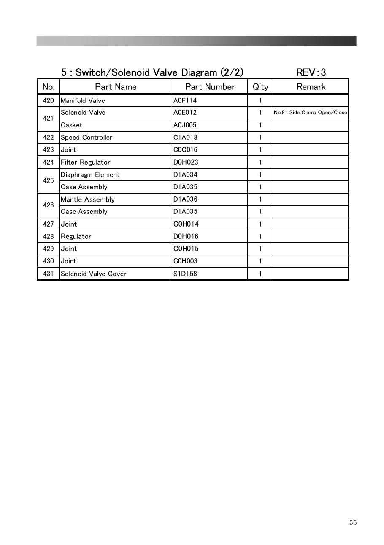
SOURCE EVIDENCE
Manual evidence 13
Source page 55
Use the current controlled document for detailed readings, revision status and formal acceptance.
TECHNICAL RESOURCE | MF-250E V2 • Operation
19
Notes:
[Sources]
- User-provided controlled technical document
- Evidence reference: Source page 55
Training interpretation only. Verify against the current controlled record, OEM documentation, approved PTW/LOTO, risk assessment and site procedures.

Slide 20
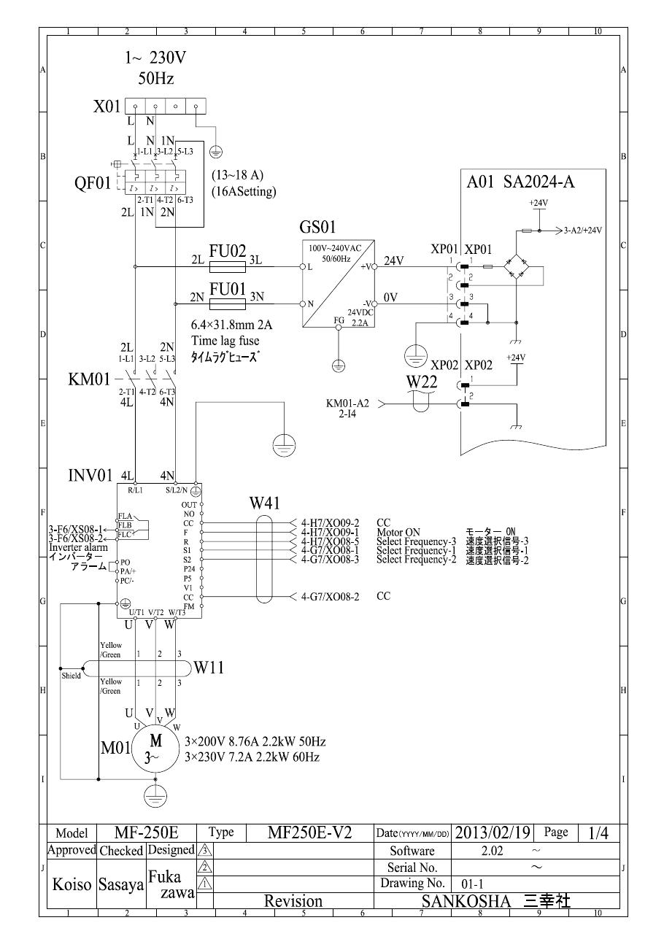
SOURCE EVIDENCE
Manual evidence 14
Source page 60
Use the current controlled document for detailed readings, revision status and formal acceptance.
TECHNICAL RESOURCE | MF-250E V2 • Operation
20
Notes:
[Sources]
- User-provided controlled technical document
- Evidence reference: Source page 60
Training interpretation only. Verify against the current controlled record, OEM documentation, approved PTW/LOTO, risk assessment and site procedures.

Slide 21

SOURCE EVIDENCE
Manual evidence 15
Source page 66
Use the current controlled document for detailed readings, revision status and formal acceptance.
TECHNICAL RESOURCE | MF-250E V2 • Operation
21
Notes:
[Sources]
- User-provided controlled technical document
- Evidence reference: Source page 66
Training interpretation only. Verify against the current controlled record, OEM documentation, approved PTW/LOTO, risk assessment and site procedures.

Slide 22
COMPETENCY CHECK
What technicians must retain
• Identify the correct controlled source before work. • Verify readings, configuration and acceptance criteria.
• Preserve evidence and escalate unresolved deviations. • Complete safe isolation, functional testing and handover records.
TECHNICAL RESOURCE | MF-250E V2 • Operation
22
Notes:
[Sources]
- User-provided controlled technical document
Training interpretation only. Verify against the current controlled record, OEM documentation, approved PTW/LOTO, risk assessment and site procedures.

