Slide 1

VEIT • ELECTRICAL
VEIT 8657 Electrical Drawings
Circuit diagrams for the tunnel-finisher control system
TECHNICAL TRAINING RESOURCE
Notes:
[Sources]
- User-provided controlled technical document
Training interpretation only. Verify against the current controlled record, OEM documentation, approved PTW/LOTO, risk assessment and site procedures.

Slide 2
VEIT • ELECTRICAL
Source to practice
Evidence, interpretation and technician application
02
Notes:
[Sources]
- User-provided controlled technical document
Training interpretation only. Verify against the current controlled record, OEM documentation, approved PTW/LOTO, risk assessment and site procedures.

Slide 3
KEY EVIDENCE
A controlled technical reference for safe maintenance
46
8657
LOTO
Circuit-diagram pages
Tunnel finisher model
Required before panel access
TECHNICAL RESOURCE | VEIT • Electrical
03
Notes:
[Sources]
- User-provided controlled technical document
Training interpretation only. Verify against the current controlled record, OEM documentation, approved PTW/LOTO, risk assessment and site procedures.

Slide 4
TECHNICAL REVIEW
Use the manual as a machine-specific working reference
• Trace power, control and safety circuits from the approved drawings. • Verify terminal, wire and device identifiers at the physical panel.
• Record voltage and continuity evidence before replacing parts. • Mark approved field modifications through drawing revision control.
TECHNICAL RESOURCE | VEIT • Electrical
04
Notes:
[Sources]
- User-provided controlled technical document
Training interpretation only. Verify against the current controlled record, OEM documentation, approved PTW/LOTO, risk assessment and site procedures.

Slide 5
TECHNICAL REVIEW
Apply a consistent safe-work sequence
• Confirm machine identity, model and document revision. • Isolate all energy sources and prove a safe state before access.
• Inspect, measure and diagnose before replacing components. • Function-test safeguards and record the completed work.
TECHNICAL RESOURCE | VEIT • Electrical
05
Notes:
[Sources]
- User-provided controlled technical document
Training interpretation only. Verify against the current controlled record, OEM documentation, approved PTW/LOTO, risk assessment and site procedures.

Slide 6
TECHNICAL REVIEW
Parts and settings require configuration control
• Record original settings and connections before adjustment. • Use exact part numbers or approved supersessions.
• Preserve firmware, program and parameter backups where applicable. • Update the maintenance history after each intervention.
TECHNICAL RESOURCE | VEIT • Electrical
06
Notes:
[Sources]
- User-provided controlled technical document
Training interpretation only. Verify against the current controlled record, OEM documentation, approved PTW/LOTO, risk assessment and site procedures.

Slide 7
SOURCE EVIDENCE
Manual evidence 1
Source page 1
Use the current controlled document for detailed readings, revision status and formal acceptance.
TECHNICAL RESOURCE | VEIT • Electrical
07
Notes:
[Sources]
- User-provided controlled technical document
- Evidence reference: Source page 1
Training interpretation only. Verify against the current controlled record, OEM documentation, approved PTW/LOTO, risk assessment and site procedures.

Slide 8
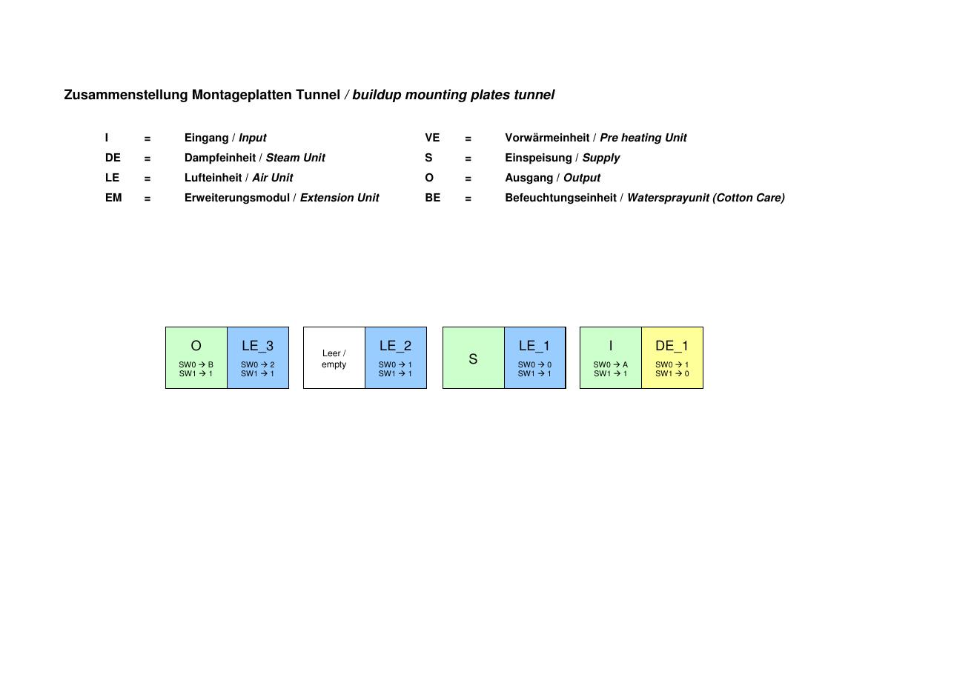
SOURCE EVIDENCE
Manual evidence 2
Source page 3
Use the current controlled document for detailed readings, revision status and formal acceptance.
TECHNICAL RESOURCE | VEIT • Electrical
08
Notes:
[Sources]
- User-provided controlled technical document
- Evidence reference: Source page 3
Training interpretation only. Verify against the current controlled record, OEM documentation, approved PTW/LOTO, risk assessment and site procedures.

Slide 9
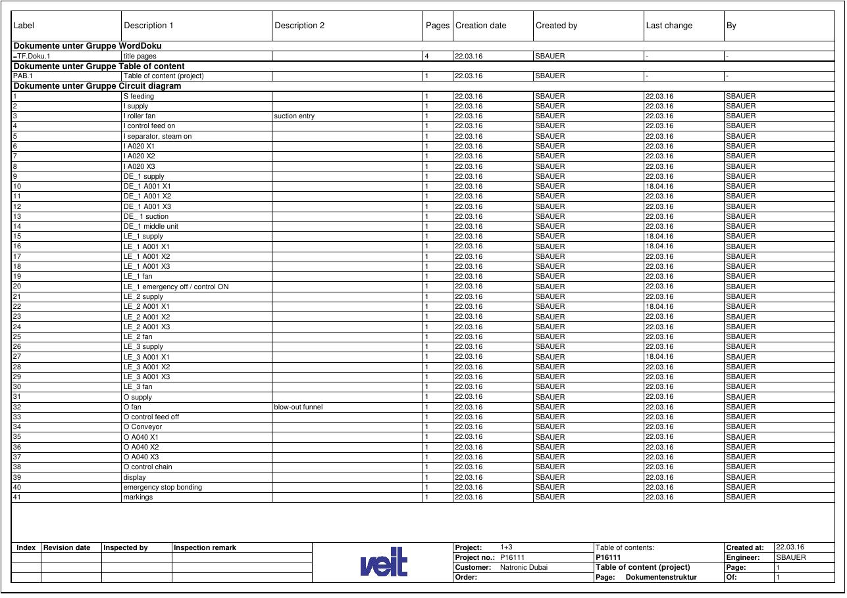
SOURCE EVIDENCE
Manual evidence 3
Source page 5
Use the current controlled document for detailed readings, revision status and formal acceptance.
TECHNICAL RESOURCE | VEIT • Electrical
09
Notes:
[Sources]
- User-provided controlled technical document
- Evidence reference: Source page 5
Training interpretation only. Verify against the current controlled record, OEM documentation, approved PTW/LOTO, risk assessment and site procedures.

Slide 10
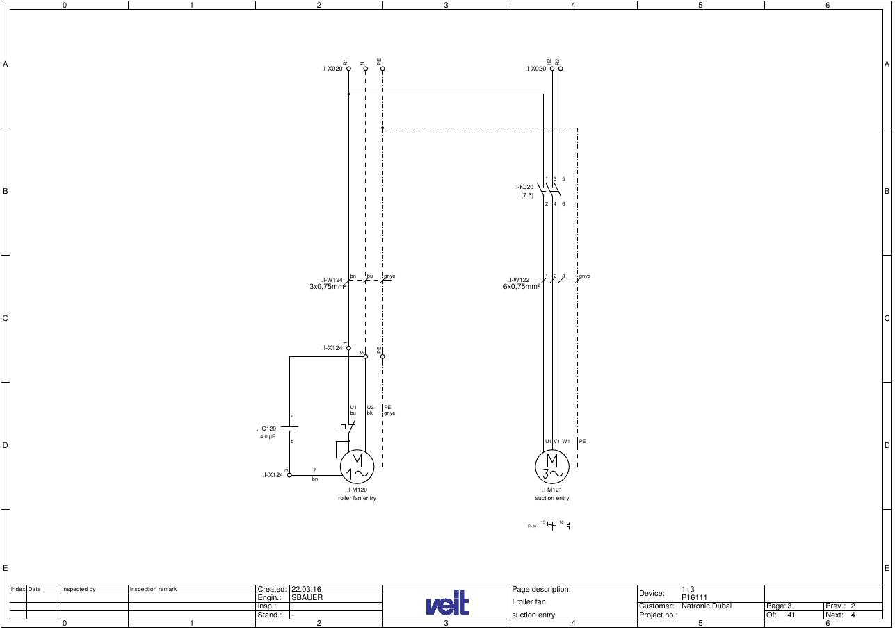
SOURCE EVIDENCE
Manual evidence 4
Source page 8
Use the current controlled document for detailed readings, revision status and formal acceptance.
TECHNICAL RESOURCE | VEIT • Electrical
10
Notes:
[Sources]
- User-provided controlled technical document
- Evidence reference: Source page 8
Training interpretation only. Verify against the current controlled record, OEM documentation, approved PTW/LOTO, risk assessment and site procedures.

Slide 11
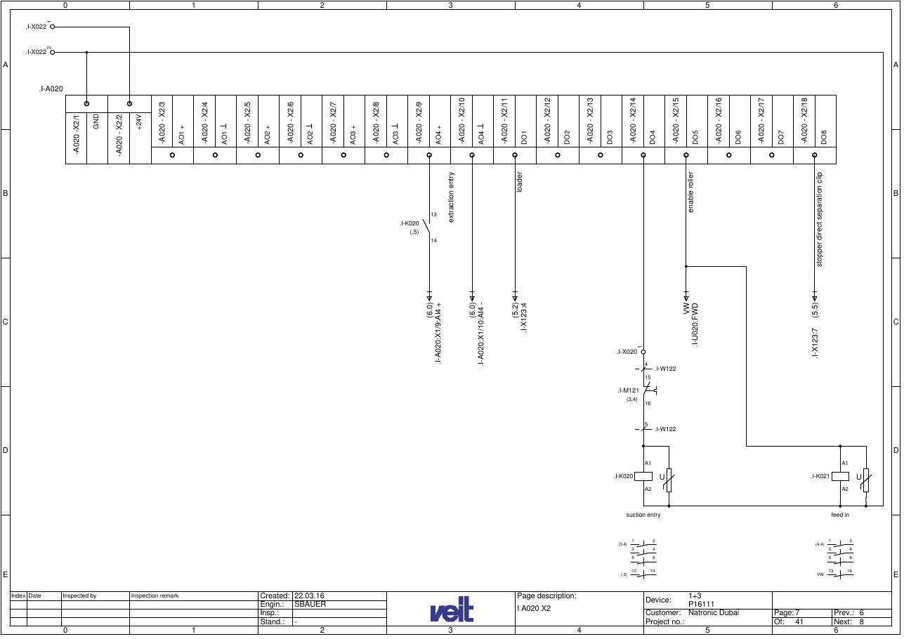
SOURCE EVIDENCE
Manual evidence 5
Source page 12
Use the current controlled document for detailed readings, revision status and formal acceptance.
TECHNICAL RESOURCE | VEIT • Electrical
11
Notes:
[Sources]
- User-provided controlled technical document
- Evidence reference: Source page 12
Training interpretation only. Verify against the current controlled record, OEM documentation, approved PTW/LOTO, risk assessment and site procedures.

Slide 12
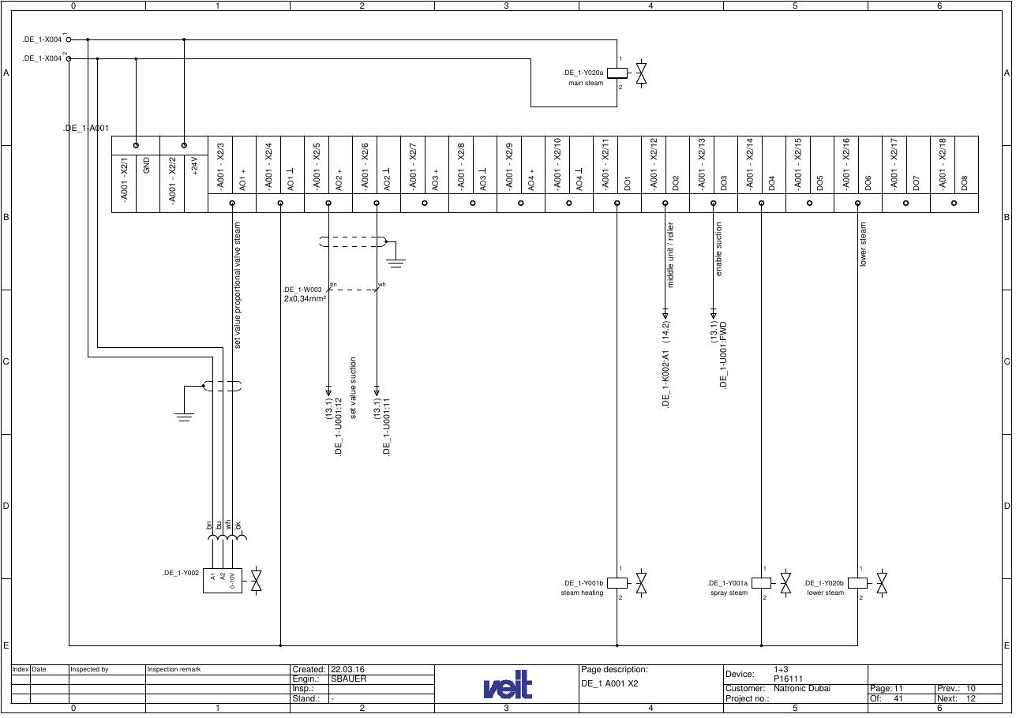
SOURCE EVIDENCE
Manual evidence 6
Source page 16
Use the current controlled document for detailed readings, revision status and formal acceptance.
TECHNICAL RESOURCE | VEIT • Electrical
12
Notes:
[Sources]
- User-provided controlled technical document
- Evidence reference: Source page 16
Training interpretation only. Verify against the current controlled record, OEM documentation, approved PTW/LOTO, risk assessment and site procedures.

Slide 13
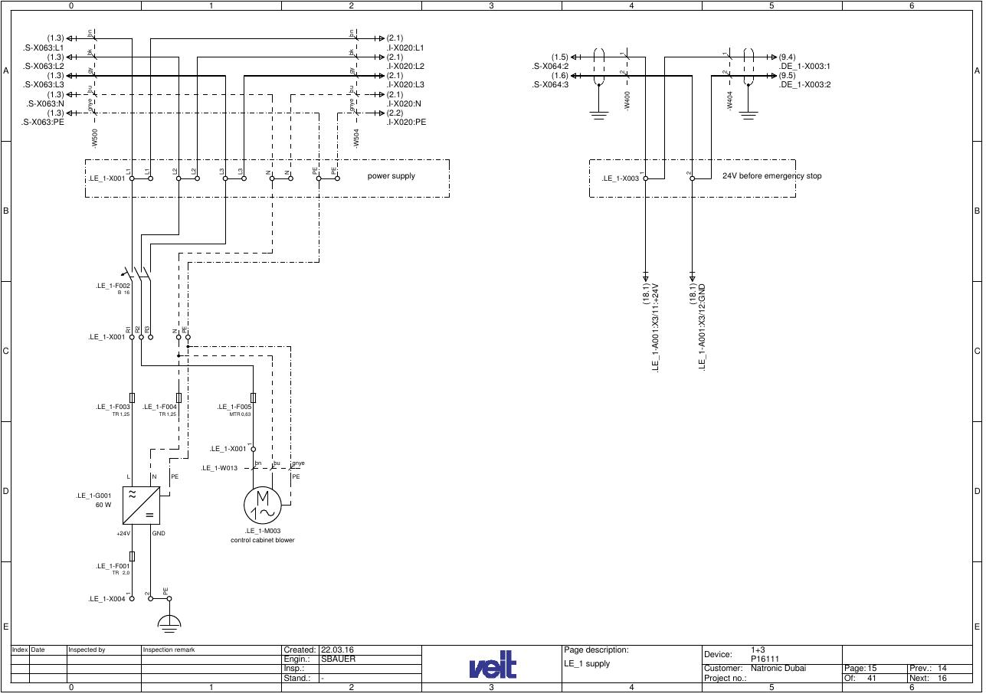
SOURCE EVIDENCE
Manual evidence 7
Source page 20
Use the current controlled document for detailed readings, revision status and formal acceptance.
TECHNICAL RESOURCE | VEIT • Electrical
13
Notes:
[Sources]
- User-provided controlled technical document
- Evidence reference: Source page 20
Training interpretation only. Verify against the current controlled record, OEM documentation, approved PTW/LOTO, risk assessment and site procedures.

Slide 14
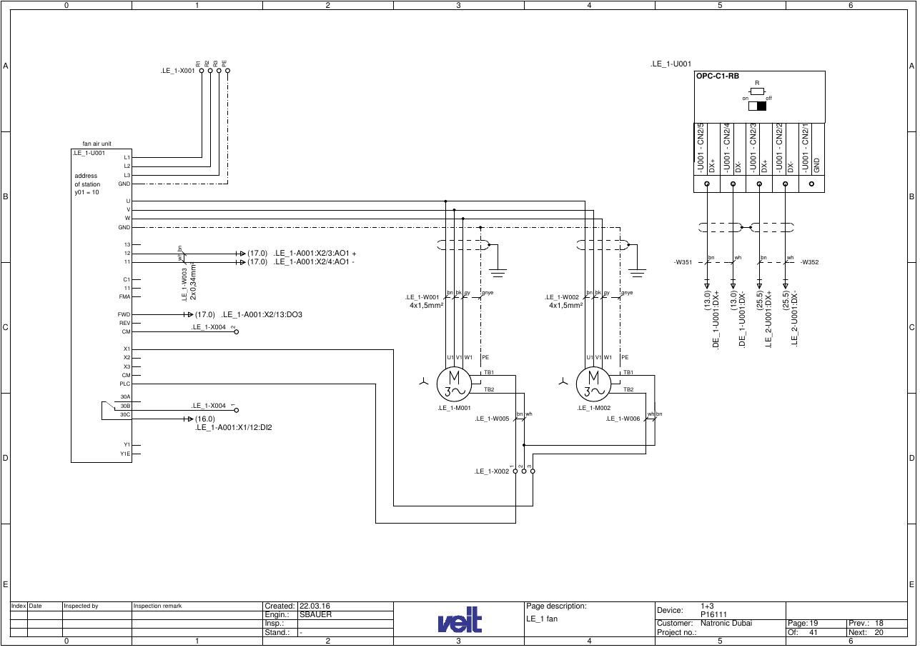
SOURCE EVIDENCE
Manual evidence 8
Source page 24
Use the current controlled document for detailed readings, revision status and formal acceptance.
TECHNICAL RESOURCE | VEIT • Electrical
14
Notes:
[Sources]
- User-provided controlled technical document
- Evidence reference: Source page 24
Training interpretation only. Verify against the current controlled record, OEM documentation, approved PTW/LOTO, risk assessment and site procedures.

Slide 15
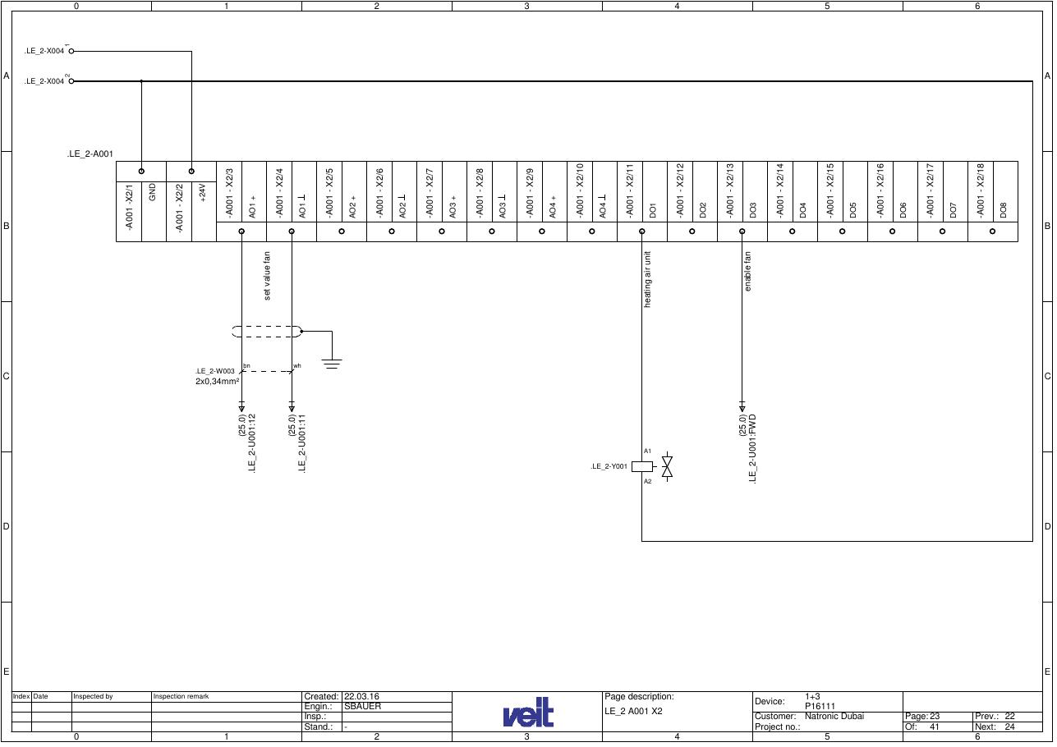
SOURCE EVIDENCE
Manual evidence 9
Source page 28
Use the current controlled document for detailed readings, revision status and formal acceptance.
TECHNICAL RESOURCE | VEIT • Electrical
15
Notes:
[Sources]
- User-provided controlled technical document
- Evidence reference: Source page 28
Training interpretation only. Verify against the current controlled record, OEM documentation, approved PTW/LOTO, risk assessment and site procedures.

Slide 16
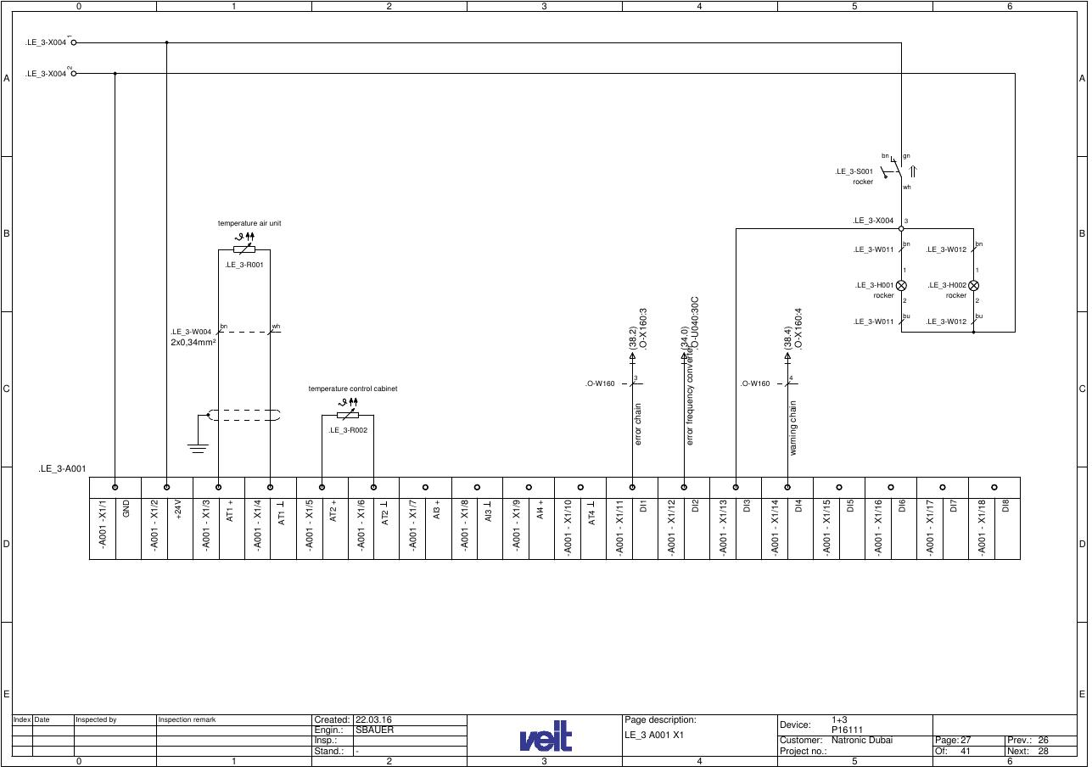
SOURCE EVIDENCE
Manual evidence 10
Source page 32
Use the current controlled document for detailed readings, revision status and formal acceptance.
TECHNICAL RESOURCE | VEIT • Electrical
16
Notes:
[Sources]
- User-provided controlled technical document
- Evidence reference: Source page 32
Training interpretation only. Verify against the current controlled record, OEM documentation, approved PTW/LOTO, risk assessment and site procedures.

Slide 17
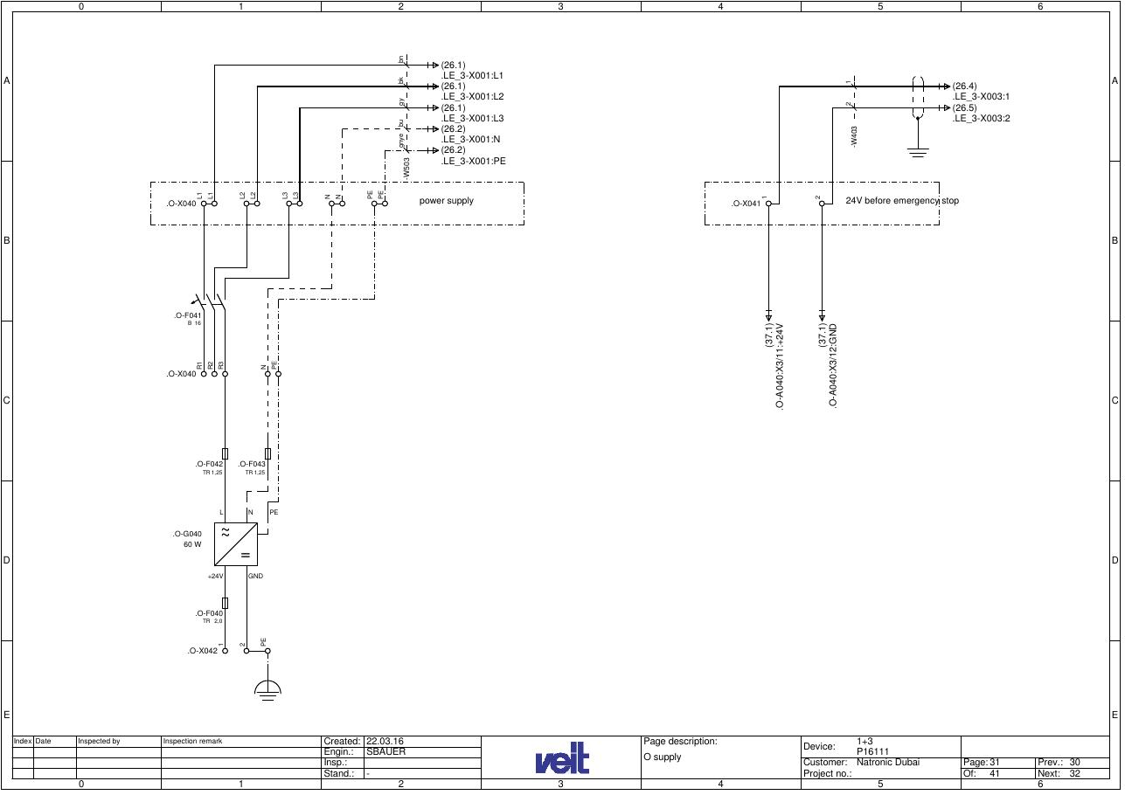
SOURCE EVIDENCE
Manual evidence 11
Source page 36
Use the current controlled document for detailed readings, revision status and formal acceptance.
TECHNICAL RESOURCE | VEIT • Electrical
17
Notes:
[Sources]
- User-provided controlled technical document
- Evidence reference: Source page 36
Training interpretation only. Verify against the current controlled record, OEM documentation, approved PTW/LOTO, risk assessment and site procedures.

Slide 18
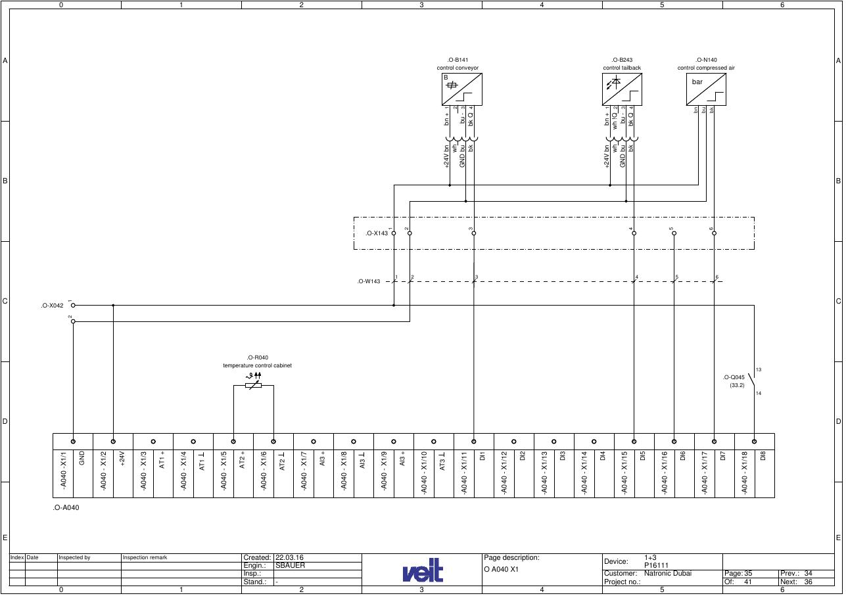
SOURCE EVIDENCE
Manual evidence 12
Source page 40
Use the current controlled document for detailed readings, revision status and formal acceptance.
TECHNICAL RESOURCE | VEIT • Electrical
18
Notes:
[Sources]
- User-provided controlled technical document
- Evidence reference: Source page 40
Training interpretation only. Verify against the current controlled record, OEM documentation, approved PTW/LOTO, risk assessment and site procedures.

Slide 19
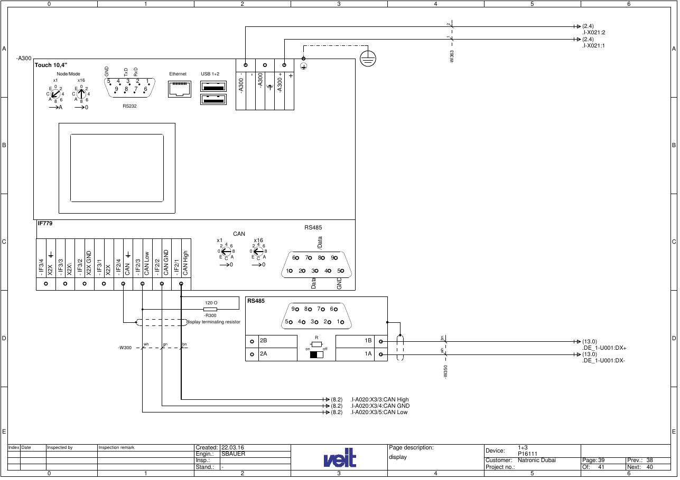
SOURCE EVIDENCE
Manual evidence 13
Source page 44
Use the current controlled document for detailed readings, revision status and formal acceptance.
TECHNICAL RESOURCE | VEIT • Electrical
19
Notes:
[Sources]
- User-provided controlled technical document
- Evidence reference: Source page 44
Training interpretation only. Verify against the current controlled record, OEM documentation, approved PTW/LOTO, risk assessment and site procedures.

Slide 20
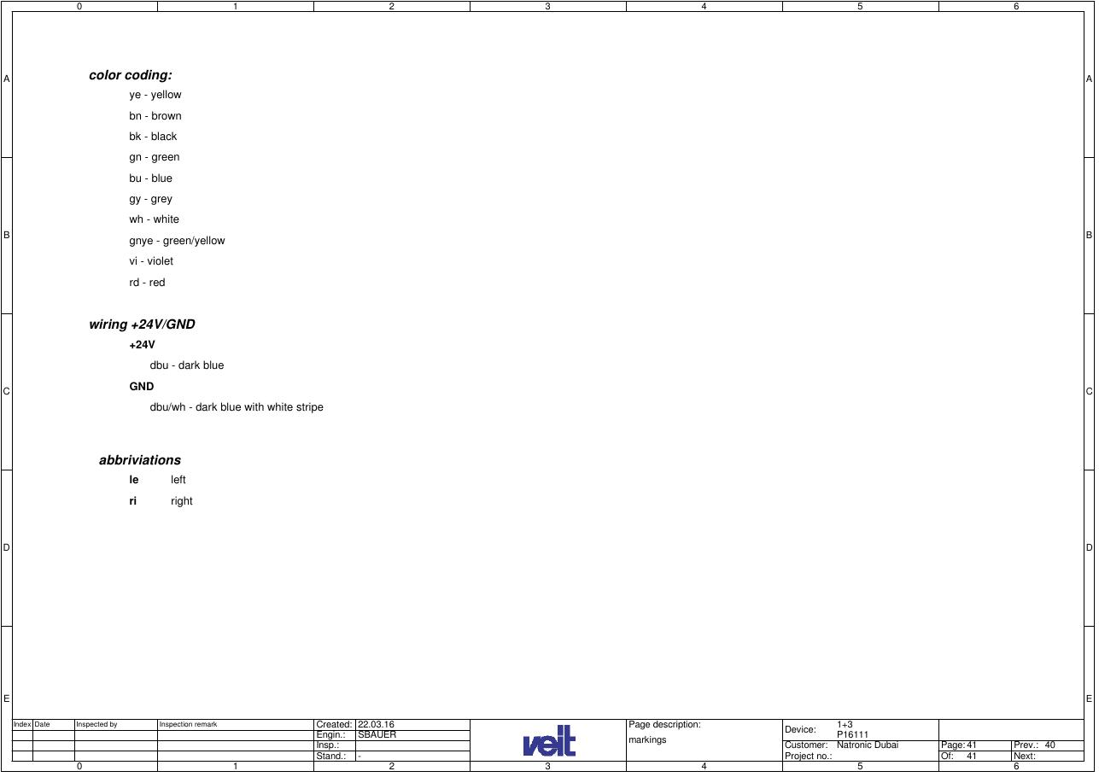
SOURCE EVIDENCE
Manual evidence 14
Source page 46
Use the current controlled document for detailed readings, revision status and formal acceptance.
TECHNICAL RESOURCE | VEIT • Electrical
20
Notes:
[Sources]
- User-provided controlled technical document
- Evidence reference: Source page 46
Training interpretation only. Verify against the current controlled record, OEM documentation, approved PTW/LOTO, risk assessment and site procedures.

Slide 21
COMPETENCY CHECK
What technicians must retain
• Identify the correct controlled source before work. • Verify readings, configuration and acceptance criteria.
• Preserve evidence and escalate unresolved deviations. • Complete safe isolation, functional testing and handover records.
TECHNICAL RESOURCE | VEIT • Electrical
21
Notes:
[Sources]
- User-provided controlled technical document
Training interpretation only. Verify against the current controlled record, OEM documentation, approved PTW/LOTO, risk assessment and site procedures.

