Slide 1

VEIT • TUNNEL FINISHER
VEIT 8657 Tunnel Finisher
Original operating instructions — P16111 Project Configuration
TECHNICAL TRAINING RESOURCE
Notes:
[Sources]
- User-provided controlled technical document
Training interpretation only. Verify against the current controlled record, OEM documentation, approved PTW/LOTO, risk assessment and site procedures.

Slide 2
VEIT • TUNNEL FINISHER
Source to practice
Evidence, interpretation and technician application
02
Notes:
[Sources]
- User-provided controlled technical document
Training interpretation only. Verify against the current controlled record, OEM documentation, approved PTW/LOTO, risk assessment and site procedures.

Slide 3
KEY EVIDENCE
A controlled technical reference for safe maintenance
332
8657
v2.00
Operating-instruction pages
Tunnel finisher model
Document version
TECHNICAL RESOURCE | VEIT • Tunnel Finisher
03
Notes:
[Sources]
- User-provided controlled technical document
Training interpretation only. Verify against the current controlled record, OEM documentation, approved PTW/LOTO, risk assessment and site procedures.

Slide 4
TECHNICAL REVIEW
Use the manual as a machine-specific working reference
• Identify safety signs, hazards and emergency response. • Follow startup, operation, shutdown and cleaning instructions.
• Use machine diagrams to locate physical assemblies and service points. • Apply the project-specific P16111 configuration information.
TECHNICAL RESOURCE | VEIT • Tunnel Finisher
04
Notes:
[Sources]
- User-provided controlled technical document
Training interpretation only. Verify against the current controlled record, OEM documentation, approved PTW/LOTO, risk assessment and site procedures.

Slide 5
TECHNICAL REVIEW
Apply a consistent safe-work sequence
• Confirm machine identity, model and document revision. • Isolate all energy sources and prove a safe state before access.
• Inspect, measure and diagnose before replacing components. • Function-test safeguards and record the completed work.
TECHNICAL RESOURCE | VEIT • Tunnel Finisher
05
Notes:
[Sources]
- User-provided controlled technical document
Training interpretation only. Verify against the current controlled record, OEM documentation, approved PTW/LOTO, risk assessment and site procedures.

Slide 6
TECHNICAL REVIEW
Parts and settings require configuration control
• Record original settings and connections before adjustment. • Use exact part numbers or approved supersessions.
• Preserve firmware, program and parameter backups where applicable. • Update the maintenance history after each intervention.
TECHNICAL RESOURCE | VEIT • Tunnel Finisher
06
Notes:
[Sources]
- User-provided controlled technical document
Training interpretation only. Verify against the current controlled record, OEM documentation, approved PTW/LOTO, risk assessment and site procedures.

Slide 7
SOURCE EVIDENCE
Manual evidence 1
Source page 1
Use the current controlled document for detailed readings, revision status and formal acceptance.
TECHNICAL RESOURCE | VEIT • Tunnel Finisher
07
Notes:
[Sources]
- User-provided controlled technical document
- Evidence reference: Source page 1
Training interpretation only. Verify against the current controlled record, OEM documentation, approved PTW/LOTO, risk assessment and site procedures.

Slide 8
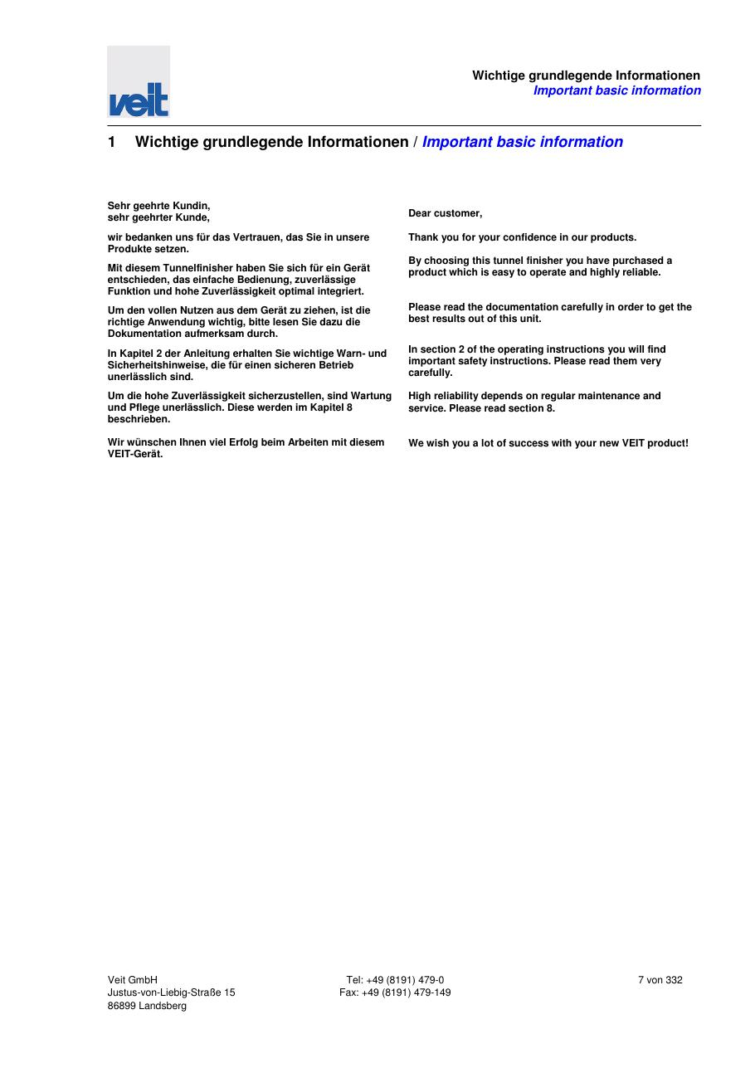
SOURCE EVIDENCE
Manual evidence 2
Source page 7
Use the current controlled document for detailed readings, revision status and formal acceptance.
TECHNICAL RESOURCE | VEIT • Tunnel Finisher
08
Notes:
[Sources]
- User-provided controlled technical document
- Evidence reference: Source page 7
Training interpretation only. Verify against the current controlled record, OEM documentation, approved PTW/LOTO, risk assessment and site procedures.

Slide 9
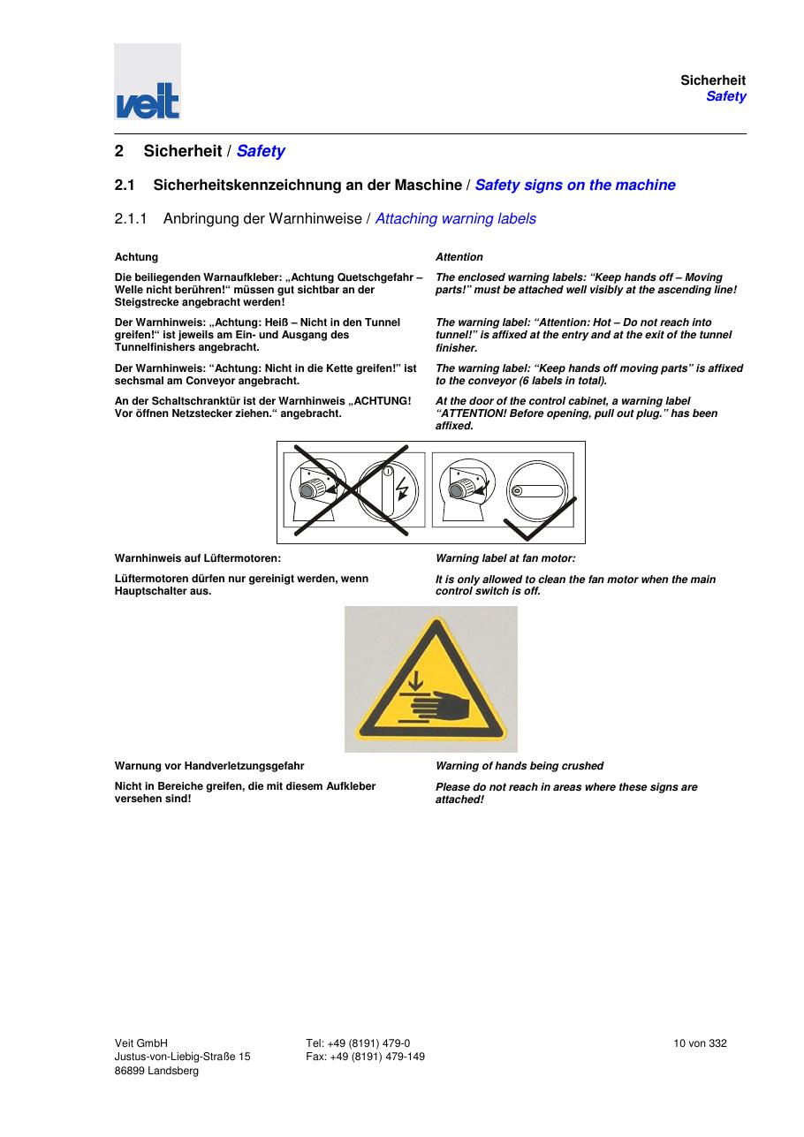
SOURCE EVIDENCE
Manual evidence 3
Source page 10
Use the current controlled document for detailed readings, revision status and formal acceptance.
TECHNICAL RESOURCE | VEIT • Tunnel Finisher
09
Notes:
[Sources]
- User-provided controlled technical document
- Evidence reference: Source page 10
Training interpretation only. Verify against the current controlled record, OEM documentation, approved PTW/LOTO, risk assessment and site procedures.

Slide 10
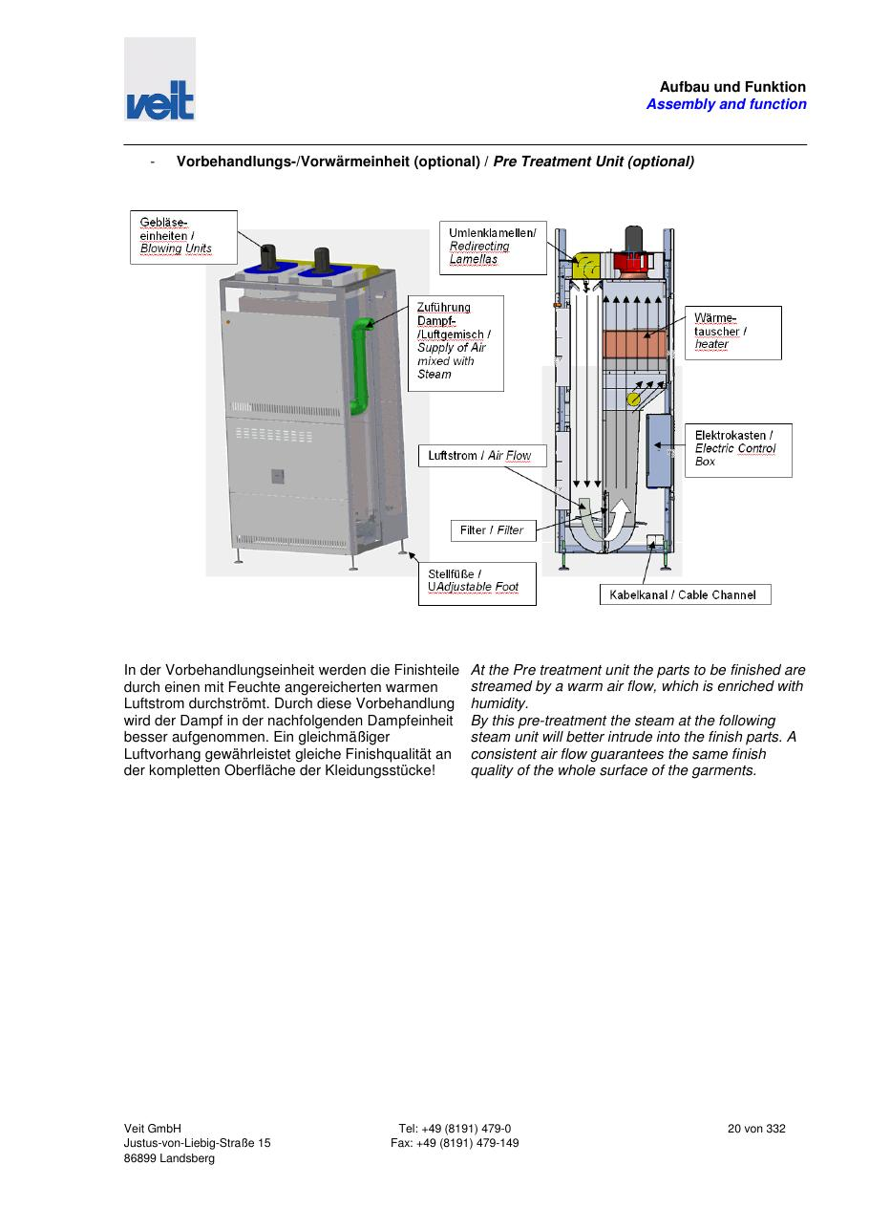
SOURCE EVIDENCE
Manual evidence 4
Source page 20
Use the current controlled document for detailed readings, revision status and formal acceptance.
TECHNICAL RESOURCE | VEIT • Tunnel Finisher
10
Notes:
[Sources]
- User-provided controlled technical document
- Evidence reference: Source page 20
Training interpretation only. Verify against the current controlled record, OEM documentation, approved PTW/LOTO, risk assessment and site procedures.

Slide 11
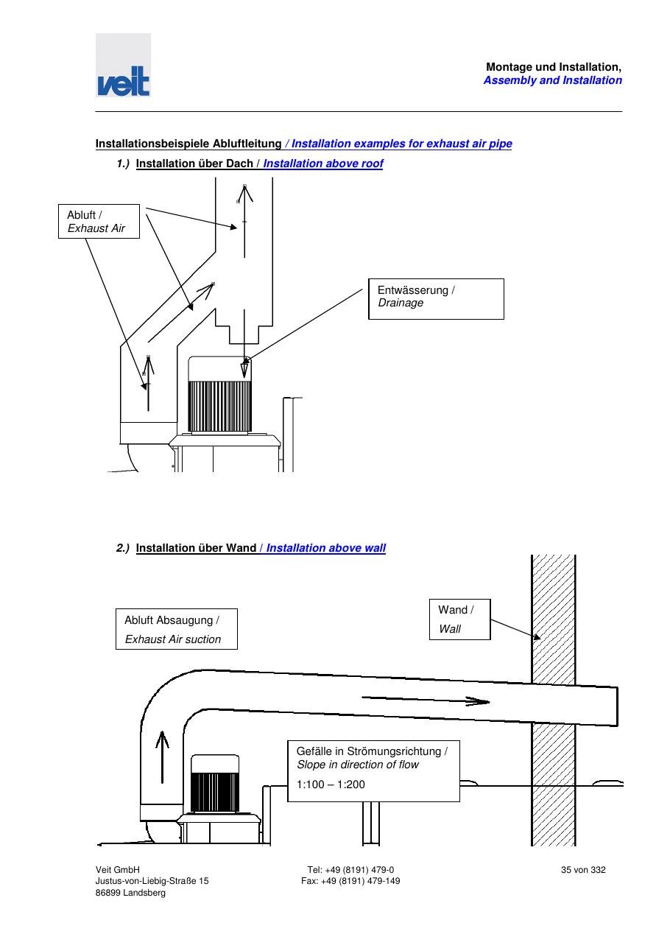
SOURCE EVIDENCE
Manual evidence 5
Source page 35
Use the current controlled document for detailed readings, revision status and formal acceptance.
TECHNICAL RESOURCE | VEIT • Tunnel Finisher
11
Notes:
[Sources]
- User-provided controlled technical document
- Evidence reference: Source page 35
Training interpretation only. Verify against the current controlled record, OEM documentation, approved PTW/LOTO, risk assessment and site procedures.

Slide 12
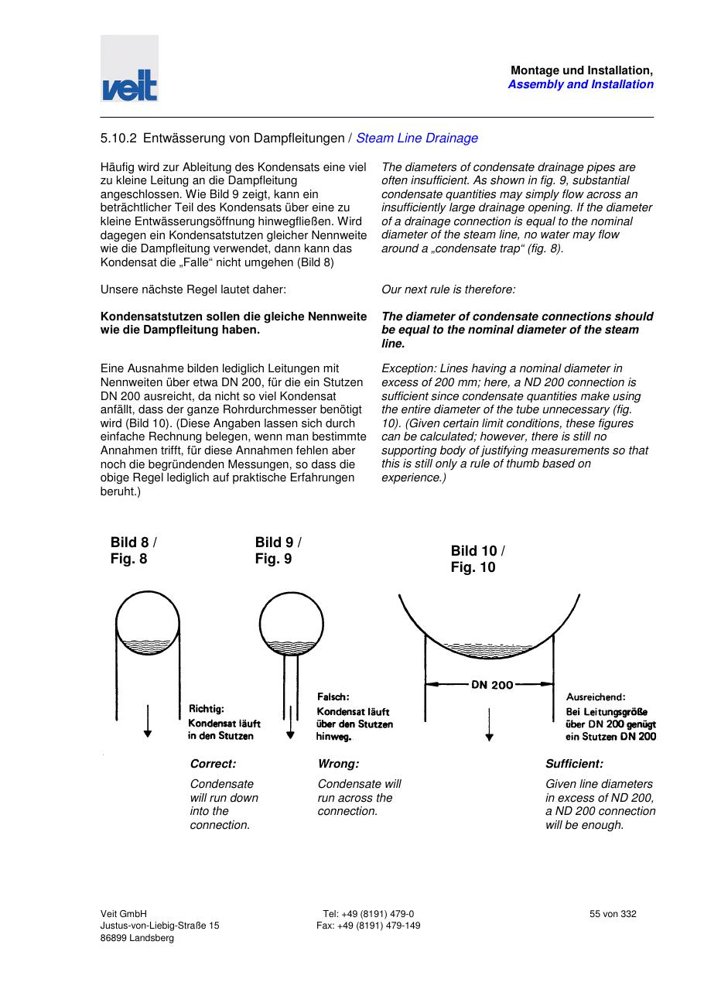
SOURCE EVIDENCE
Manual evidence 6
Source page 55
Use the current controlled document for detailed readings, revision status and formal acceptance.
TECHNICAL RESOURCE | VEIT • Tunnel Finisher
12
Notes:
[Sources]
- User-provided controlled technical document
- Evidence reference: Source page 55
Training interpretation only. Verify against the current controlled record, OEM documentation, approved PTW/LOTO, risk assessment and site procedures.

Slide 13
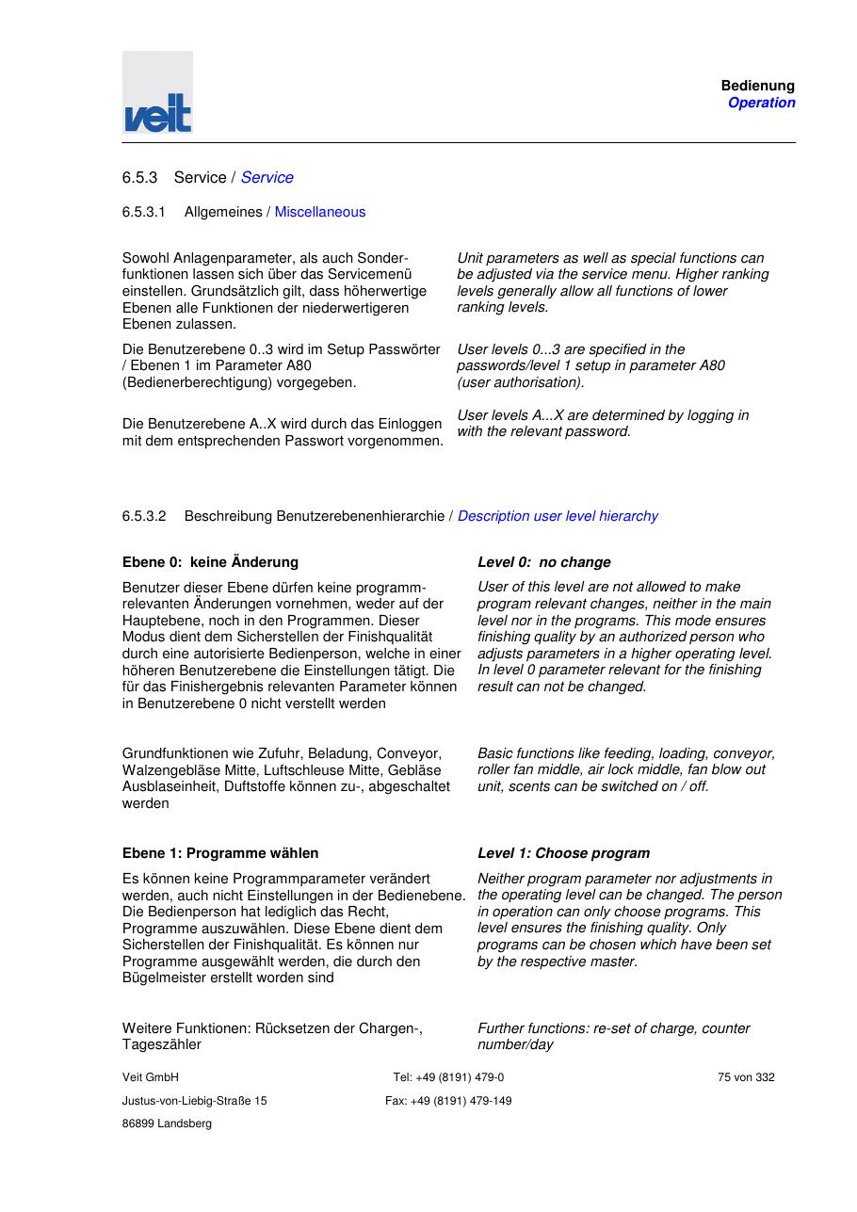
SOURCE EVIDENCE
Manual evidence 7
Source page 75
Use the current controlled document for detailed readings, revision status and formal acceptance.
TECHNICAL RESOURCE | VEIT • Tunnel Finisher
13
Notes:
[Sources]
- User-provided controlled technical document
- Evidence reference: Source page 75
Training interpretation only. Verify against the current controlled record, OEM documentation, approved PTW/LOTO, risk assessment and site procedures.

Slide 14
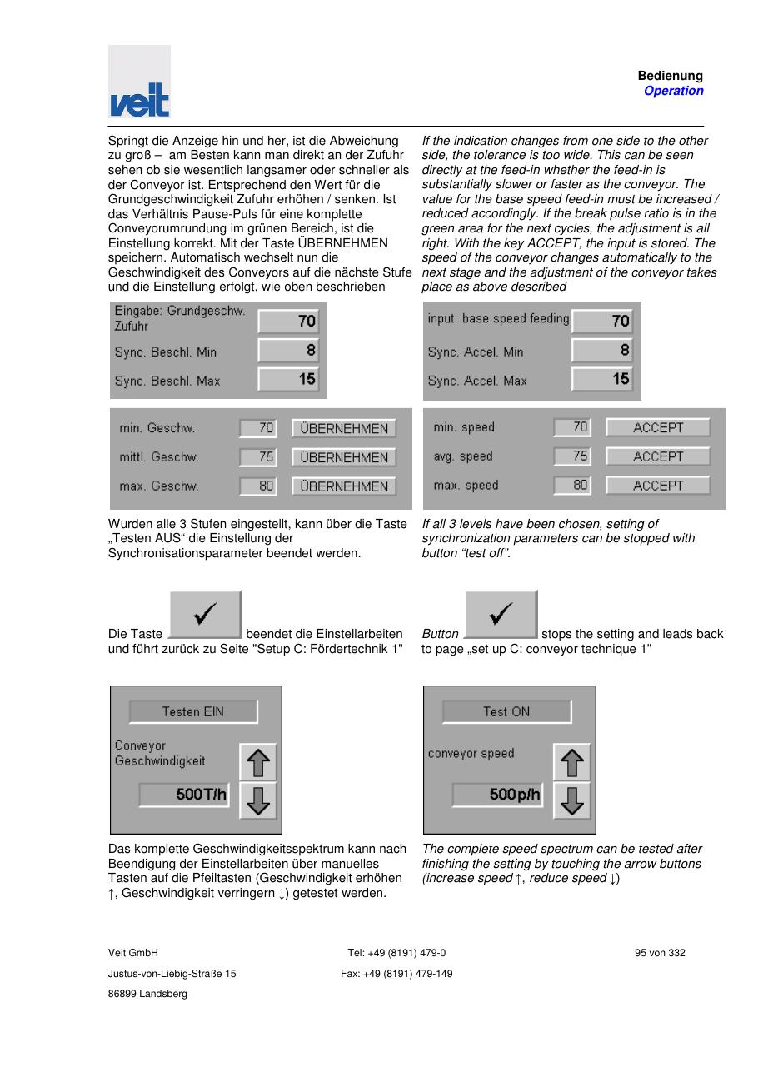
SOURCE EVIDENCE
Manual evidence 8
Source page 95
Use the current controlled document for detailed readings, revision status and formal acceptance.
TECHNICAL RESOURCE | VEIT • Tunnel Finisher
14
Notes:
[Sources]
- User-provided controlled technical document
- Evidence reference: Source page 95
Training interpretation only. Verify against the current controlled record, OEM documentation, approved PTW/LOTO, risk assessment and site procedures.

Slide 15
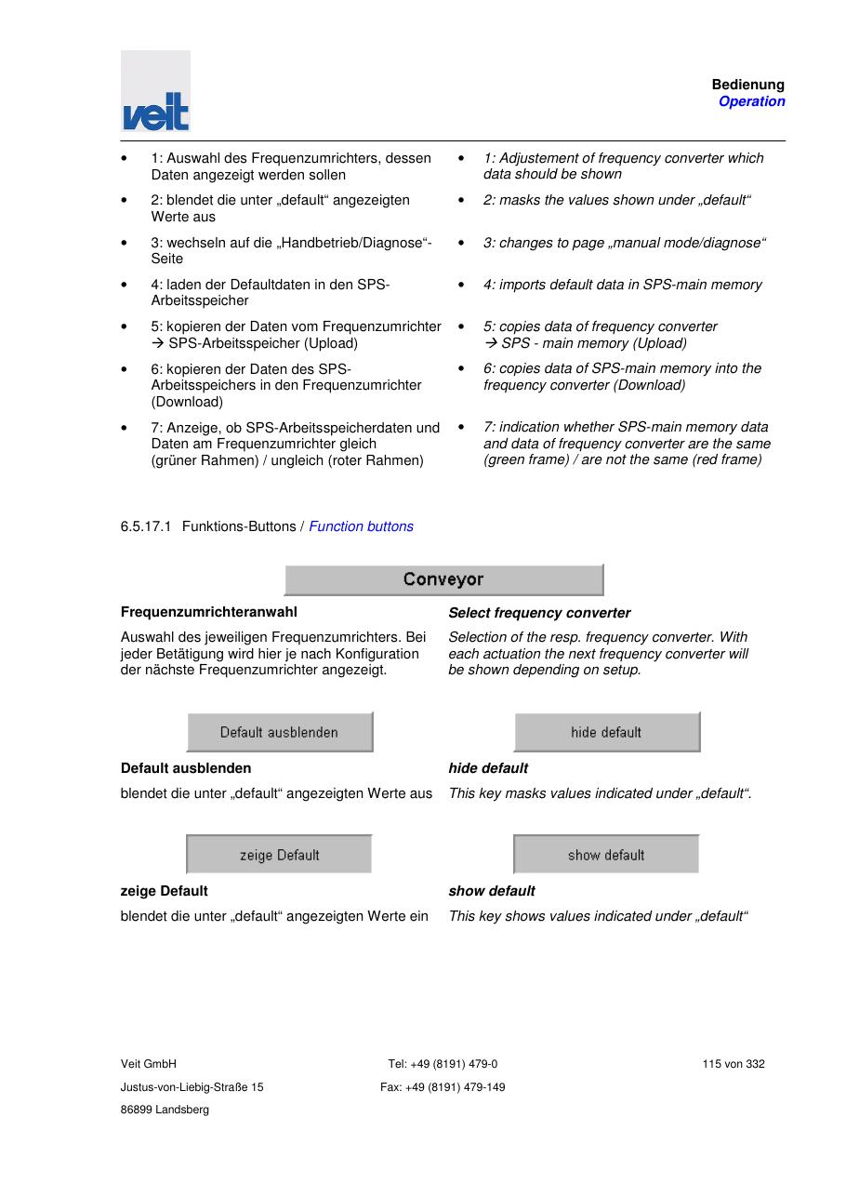
SOURCE EVIDENCE
Manual evidence 9
Source page 115
Use the current controlled document for detailed readings, revision status and formal acceptance.
TECHNICAL RESOURCE | VEIT • Tunnel Finisher
15
Notes:
[Sources]
- User-provided controlled technical document
- Evidence reference: Source page 115
Training interpretation only. Verify against the current controlled record, OEM documentation, approved PTW/LOTO, risk assessment and site procedures.

Slide 16
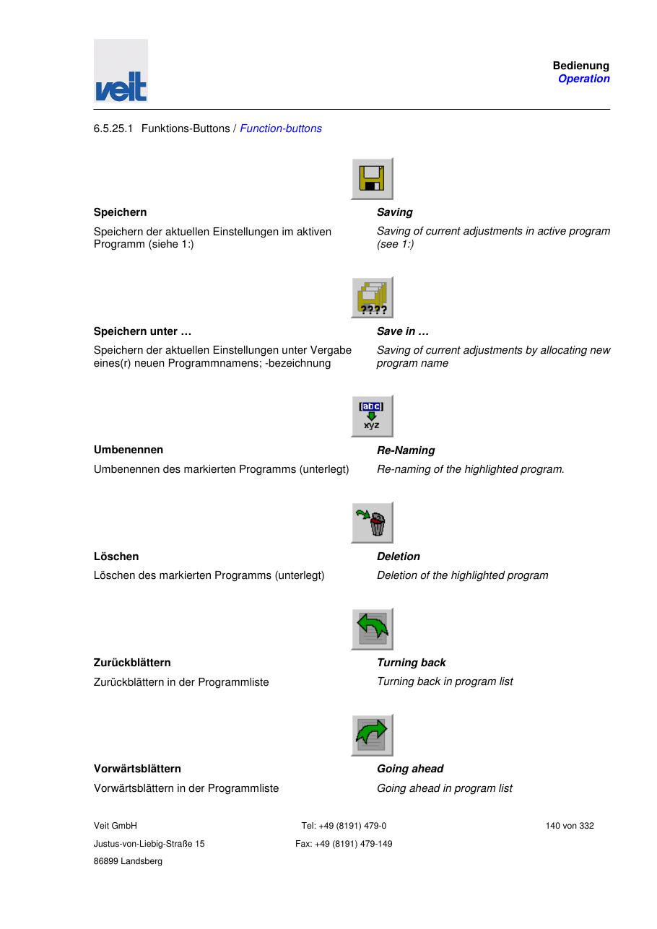
SOURCE EVIDENCE
Manual evidence 10
Source page 140
Use the current controlled document for detailed readings, revision status and formal acceptance.
TECHNICAL RESOURCE | VEIT • Tunnel Finisher
16
Notes:
[Sources]
- User-provided controlled technical document
- Evidence reference: Source page 140
Training interpretation only. Verify against the current controlled record, OEM documentation, approved PTW/LOTO, risk assessment and site procedures.

Slide 17
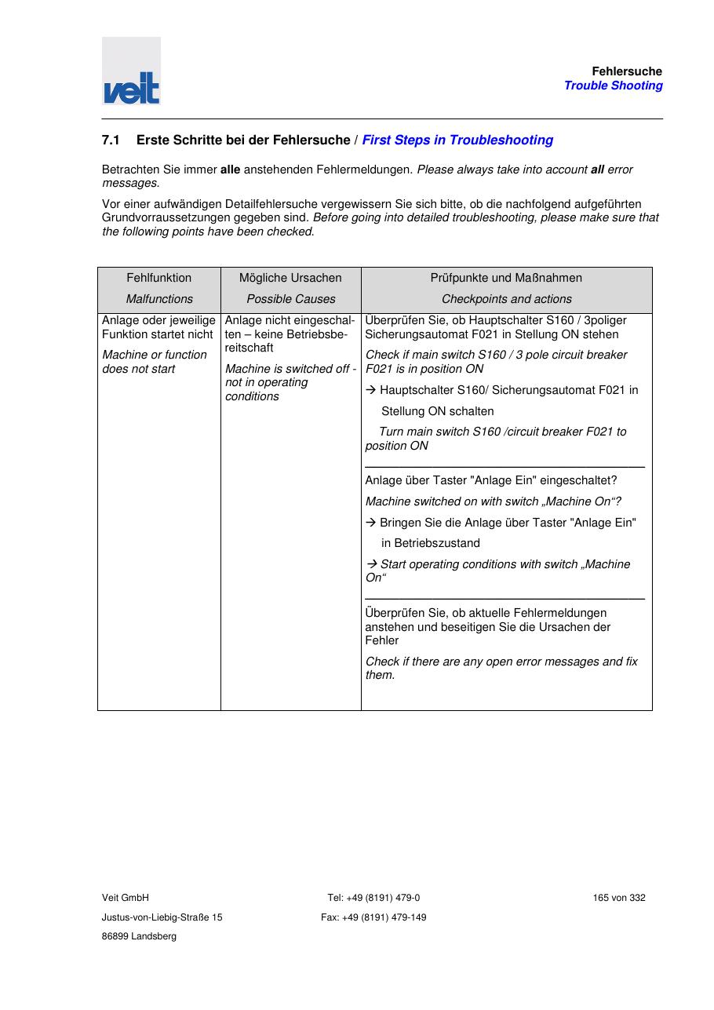
SOURCE EVIDENCE
Manual evidence 11
Source page 165
Use the current controlled document for detailed readings, revision status and formal acceptance.
TECHNICAL RESOURCE | VEIT • Tunnel Finisher
17
Notes:
[Sources]
- User-provided controlled technical document
- Evidence reference: Source page 165
Training interpretation only. Verify against the current controlled record, OEM documentation, approved PTW/LOTO, risk assessment and site procedures.

Slide 18
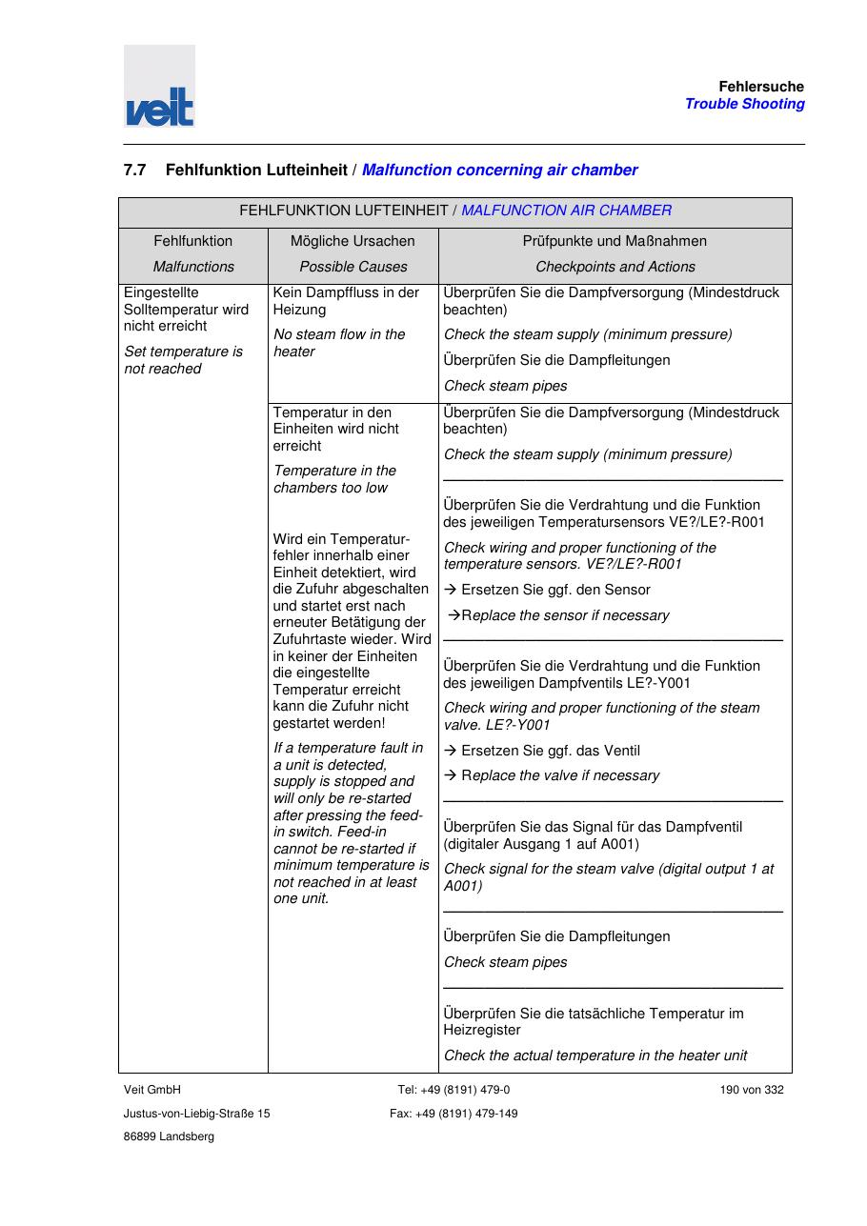
SOURCE EVIDENCE
Manual evidence 12
Source page 190
Use the current controlled document for detailed readings, revision status and formal acceptance.
TECHNICAL RESOURCE | VEIT • Tunnel Finisher
18
Notes:
[Sources]
- User-provided controlled technical document
- Evidence reference: Source page 190
Training interpretation only. Verify against the current controlled record, OEM documentation, approved PTW/LOTO, risk assessment and site procedures.

Slide 19
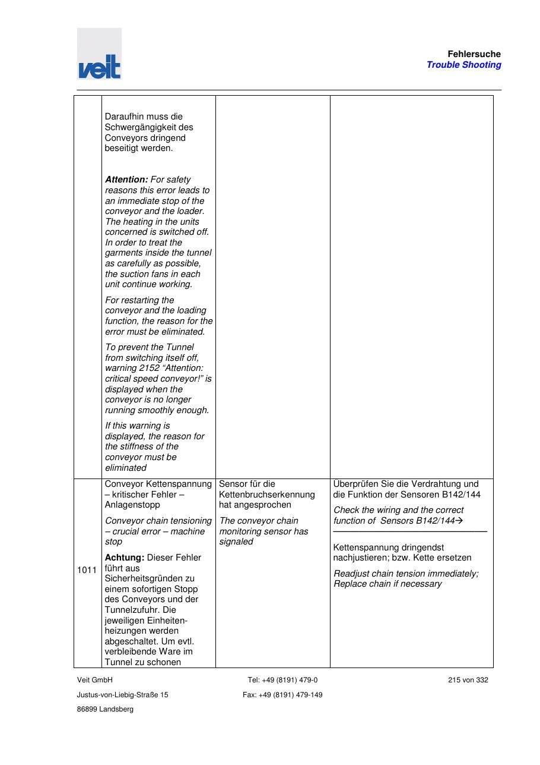
SOURCE EVIDENCE
Manual evidence 13
Source page 215
Use the current controlled document for detailed readings, revision status and formal acceptance.
TECHNICAL RESOURCE | VEIT • Tunnel Finisher
19
Notes:
[Sources]
- User-provided controlled technical document
- Evidence reference: Source page 215
Training interpretation only. Verify against the current controlled record, OEM documentation, approved PTW/LOTO, risk assessment and site procedures.

Slide 20
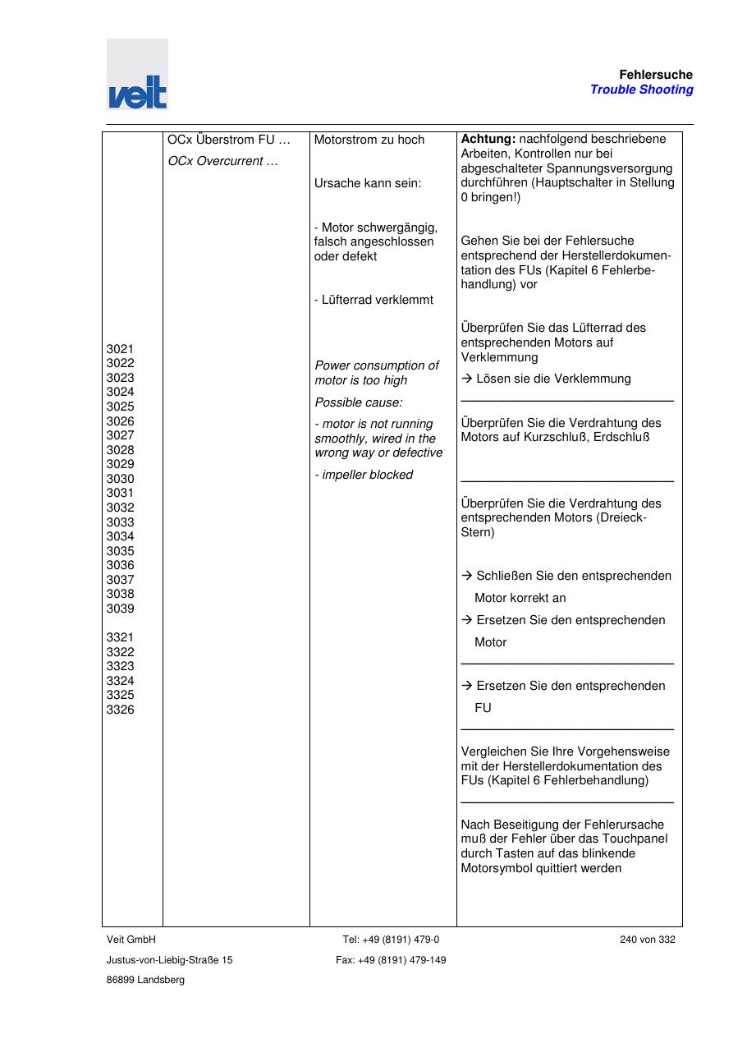
SOURCE EVIDENCE
Manual evidence 14
Source page 240
Use the current controlled document for detailed readings, revision status and formal acceptance.
TECHNICAL RESOURCE | VEIT • Tunnel Finisher
20
Notes:
[Sources]
- User-provided controlled technical document
- Evidence reference: Source page 240
Training interpretation only. Verify against the current controlled record, OEM documentation, approved PTW/LOTO, risk assessment and site procedures.

Slide 21
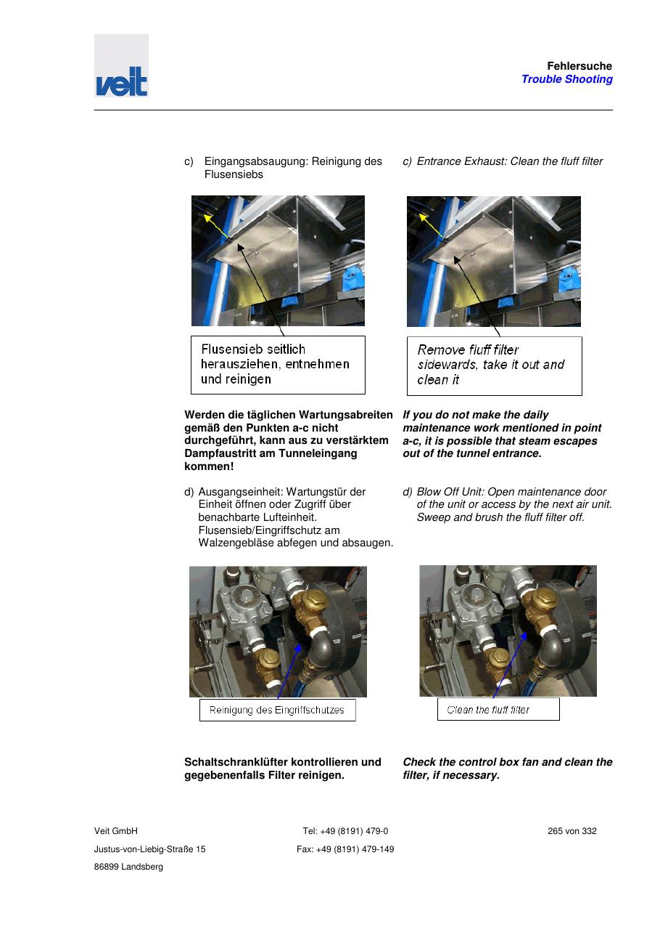
SOURCE EVIDENCE
Manual evidence 15
Source page 265
Use the current controlled document for detailed readings, revision status and formal acceptance.
TECHNICAL RESOURCE | VEIT • Tunnel Finisher
21
Notes:
[Sources]
- User-provided controlled technical document
- Evidence reference: Source page 265
Training interpretation only. Verify against the current controlled record, OEM documentation, approved PTW/LOTO, risk assessment and site procedures.

Slide 22
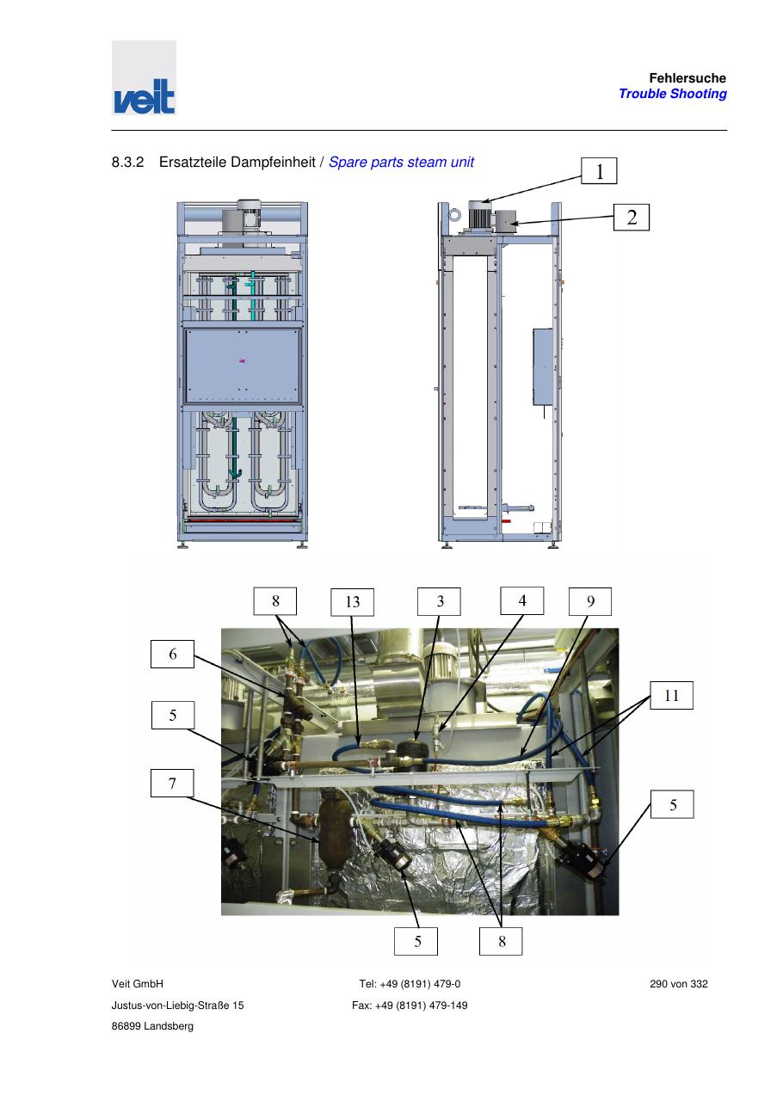
SOURCE EVIDENCE
Manual evidence 16
Source page 290
Use the current controlled document for detailed readings, revision status and formal acceptance.
TECHNICAL RESOURCE | VEIT • Tunnel Finisher
22
Notes:
[Sources]
- User-provided controlled technical document
- Evidence reference: Source page 290
Training interpretation only. Verify against the current controlled record, OEM documentation, approved PTW/LOTO, risk assessment and site procedures.

Slide 23
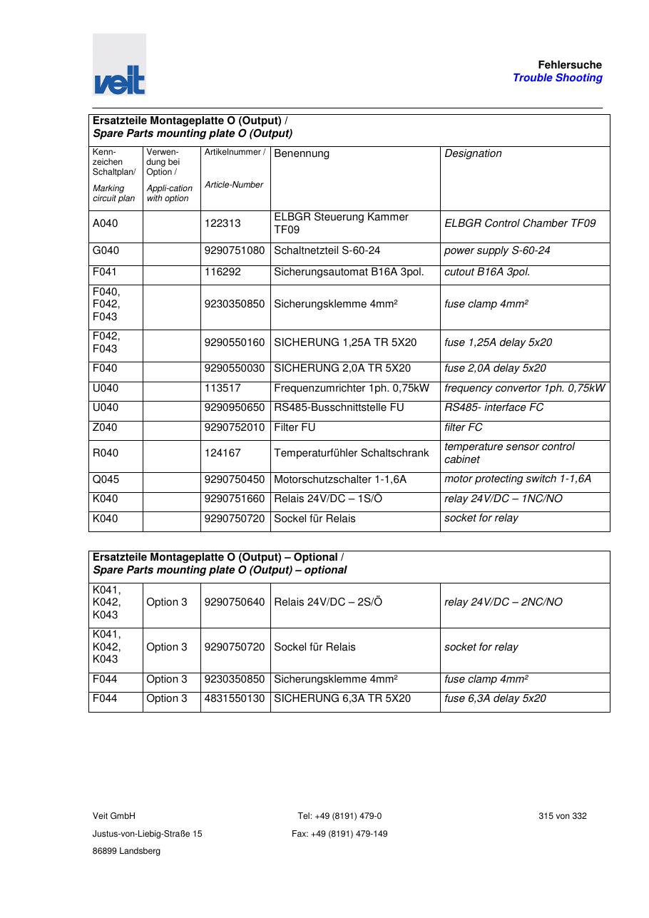
SOURCE EVIDENCE
Manual evidence 17
Source page 315
Use the current controlled document for detailed readings, revision status and formal acceptance.
TECHNICAL RESOURCE | VEIT • Tunnel Finisher
23
Notes:
[Sources]
- User-provided controlled technical document
- Evidence reference: Source page 315
Training interpretation only. Verify against the current controlled record, OEM documentation, approved PTW/LOTO, risk assessment and site procedures.

Slide 24
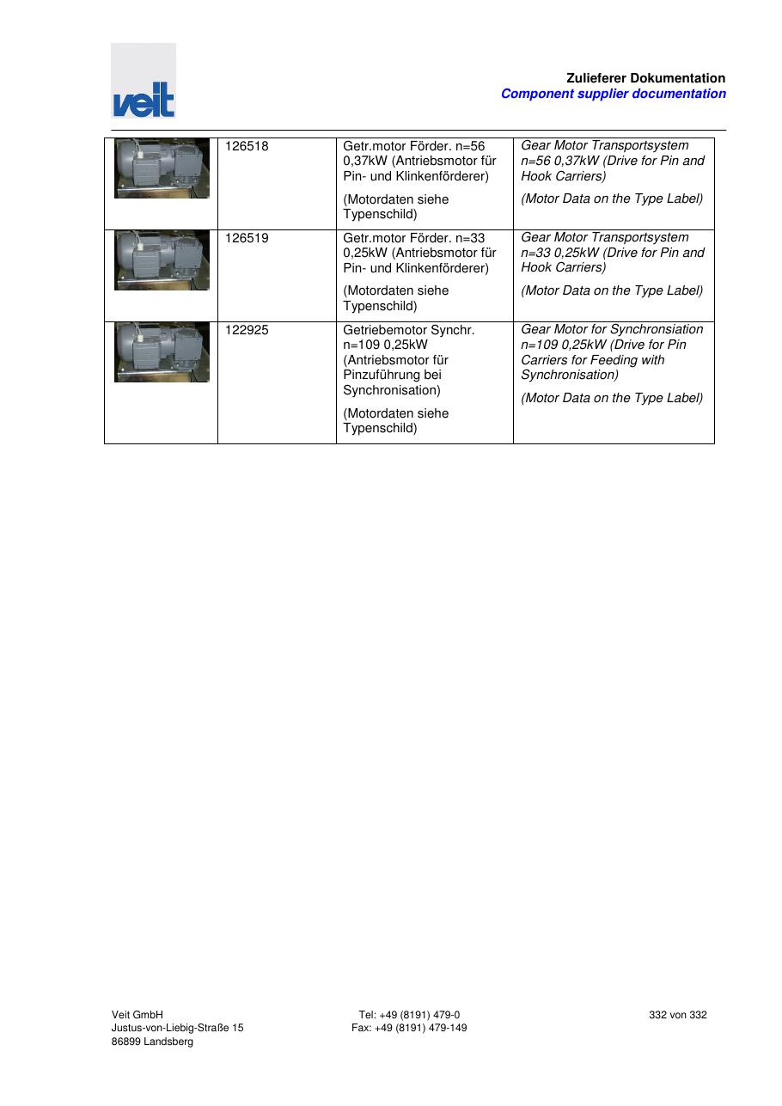
SOURCE EVIDENCE
Manual evidence 18
Source page 332
Use the current controlled document for detailed readings, revision status and formal acceptance.
TECHNICAL RESOURCE | VEIT • Tunnel Finisher
24
Notes:
[Sources]
- User-provided controlled technical document
- Evidence reference: Source page 332
Training interpretation only. Verify against the current controlled record, OEM documentation, approved PTW/LOTO, risk assessment and site procedures.

Slide 25
COMPETENCY CHECK
What technicians must retain
• Identify the correct controlled source before work. • Verify readings, configuration and acceptance criteria.
• Preserve evidence and escalate unresolved deviations. • Complete safe isolation, functional testing and handover records.
TECHNICAL RESOURCE | VEIT • Tunnel Finisher
25
Notes:
[Sources]
- User-provided controlled technical document
Training interpretation only. Verify against the current controlled record, OEM documentation, approved PTW/LOTO, risk assessment and site procedures.

