Slide 1
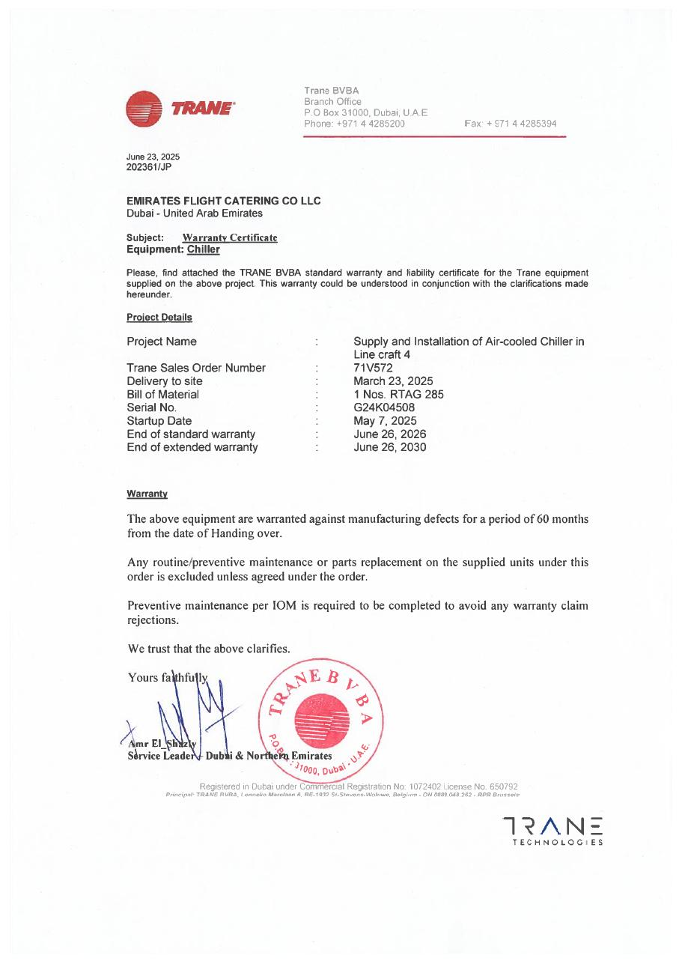
PROJECT HANDOVER
LC4 Asset Record 71V572
Project equipment record and source-document evidence
SAJJAD ENGINEERING ACADEMY
Notes:
[Sources]
- User-provided source: 71V572 EKFC LINENCRAFT 4.pdf
Training interpretation only. Verify against the controlled project record, current OEM documentation, approved PTW/LOTO, risk assessment and site procedures.

Slide 2
PROJECT HANDOVER
Source to practice
Evidence, interpretation and technician application
02
Notes:
[Sources]
- User-provided source: 71V572 EKFC LINENCRAFT 4.pdf
Training interpretation only. Verify against the controlled project record, current OEM documentation, approved PTW/LOTO, risk assessment and site procedures.

Slide 3
KEY EVIDENCE
A controlled technical reference for safe maintenance
71V572
LC4
1
Asset/document reference
Linen Craft 4 location
Source page
LC4 AIR-COOLED CHILLER | Project Handover
03
Notes:
[Sources]
- User-provided source: 71V572 EKFC LINENCRAFT 4.pdf
Training interpretation only. Verify against the controlled project record, current OEM documentation, approved PTW/LOTO, risk assessment and site procedures.

Slide 4
TECHNICAL REVIEW
Use the manual as a machine-specific working reference
• Confirm the record against the installed nameplate.
• Use the controlled source for signatures and exact identifiers.
• Link the record to commissioning and warranty files.
• Update the asset register after approved changes.
LC4 AIR-COOLED CHILLER | Project Handover
04
Notes:
[Sources]
- User-provided source: 71V572 EKFC LINENCRAFT 4.pdf
Training interpretation only. Verify against the controlled project record, current OEM documentation, approved PTW/LOTO, risk assessment and site procedures.

Slide 5
TECHNICAL REVIEW
Apply a consistent safe-work sequence
• Confirm machine identity, model and document revision.
• Isolate all energy sources and prove a safe state before access.
• Inspect, measure and diagnose before replacing components.
• Function-test safeguards and record the completed work.
LC4 AIR-COOLED CHILLER | Project Handover
05
Notes:
[Sources]
- User-provided source: 71V572 EKFC LINENCRAFT 4.pdf
Training interpretation only. Verify against the controlled project record, current OEM documentation, approved PTW/LOTO, risk assessment and site procedures.

Slide 6
TECHNICAL REVIEW
Parts and settings require configuration control
• Record original settings and connections before adjustment.
• Use exact part numbers or approved supersessions.
• Preserve firmware, program and parameter backups where applicable.
• Update the maintenance history after each intervention.
LC4 AIR-COOLED CHILLER | Project Handover
06
Notes:
[Sources]
- User-provided source: 71V572 EKFC LINENCRAFT 4.pdf
Training interpretation only. Verify against the controlled project record, current OEM documentation, approved PTW/LOTO, risk assessment and site procedures.

Slide 7
SOURCE EVIDENCE
Manual evidence 1
Source page 1
Use the original report for signatures, detailed readings, revision status and formal acceptance.
LC4 AIR-COOLED CHILLER | Project Handover
07
Notes:
[Sources]
- User-provided source: 71V572 EKFC LINENCRAFT 4.pdf
- Evidence reference: Source page 1
Training interpretation only. Verify against the controlled project record, current OEM documentation, approved PTW/LOTO, risk assessment and site procedures.

Slide 8
COMPETENCY CHECK
What technicians must retain
• Identify the correct controlled source before work.
• Verify readings, configuration and acceptance criteria.
• Preserve evidence and escalate unresolved deviations.
• Complete safe isolation, functional testing and handover records.
LC4 AIR-COOLED CHILLER | Project Handover
08
Notes:
[Sources]
- User-provided source: 71V572 EKFC LINENCRAFT 4.pdf
Training interpretation only. Verify against the controlled project record, current OEM documentation, approved PTW/LOTO, risk assessment and site procedures.

