Slide 1
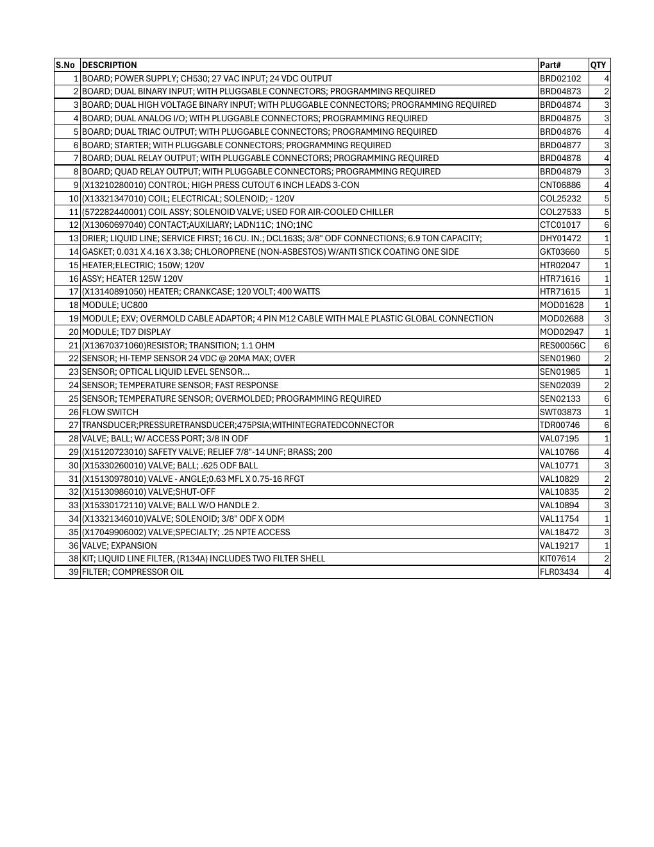
SPARE PARTS
RTAG Critical Spares
Recommended readiness stock for controls, sensors and refrigeration components
SAJJAD ENGINEERING ACADEMY
Notes:
[Sources]
- User-provided source: RTAG Critical Spares.pdf
Training interpretation only. Verify against the controlled project record, current OEM documentation, approved PTW/LOTO, risk assessment and site procedures.

Slide 2
SPARE PARTS
Source to practice
Evidence, interpretation and technician application
02
Notes:
[Sources]
- User-provided source: RTAG Critical Spares.pdf
Training interpretation only. Verify against the controlled project record, current OEM documentation, approved PTW/LOTO, risk assessment and site procedures.

Slide 3
KEY EVIDENCE
The list contains 39 numbered critical-spares lines
7
6
4
Control-board types
Pressure transducers listed
Compressor oil filters listed
LC4 AIR-COOLED CHILLER | Spare Parts
03
Notes:
[Sources]
- User-provided source: RTAG Critical Spares.pdf
Training interpretation only. Verify against the controlled project record, current OEM documentation, approved PTW/LOTO, risk assessment and site procedures.

Slide 4
TECHNICAL REVIEW
Controls and interface modules dominate the critical list
• CH530 power-supply and I/O boards are included.
• UC800 and TD7 display modules are included.
• Some boards and sensors require programming after installation.
• Preserve firmware, configuration and commissioning records with stocked modules.
LC4 AIR-COOLED CHILLER | Spare Parts
04
Notes:
[Sources]
- User-provided source: RTAG Critical Spares.pdf
Training interpretation only. Verify against the controlled project record, current OEM documentation, approved PTW/LOTO, risk assessment and site procedures.

Slide 5
TECHNICAL REVIEW
Sensors and protective devices support rapid fault recovery
• High-pressure cutout, temperature sensors and optical liquid-level sensor are listed.
• Flow switch and pressure transducer are included.
• Safety and relief components require exact pressure and connection verification.
• Do not substitute a similar-looking device without OEM confirmation.
LC4 AIR-COOLED CHILLER | Spare Parts
05
Notes:
[Sources]
- User-provided source: RTAG Critical Spares.pdf
Training interpretation only. Verify against the controlled project record, current OEM documentation, approved PTW/LOTO, risk assessment and site procedures.

Slide 6
TECHNICAL REVIEW
Refrigeration service parts require controlled storage
• Liquid-line driers, expansion valve, solenoid valves and coils are included.
• Crankcase heaters and compressor oil filters are included.
• Keep parts sealed, dry, identified and protected from contamination.
• Track shelf life, storage condition and installed-machine compatibility.
LC4 AIR-COOLED CHILLER | Spare Parts
06
Notes:
[Sources]
- User-provided source: RTAG Critical Spares.pdf
Training interpretation only. Verify against the controlled project record, current OEM documentation, approved PTW/LOTO, risk assessment and site procedures.

Slide 7
TECHNICAL REVIEW
Stock policy should combine criticality with lead time
• Rank parts by safety, downtime consequence and probability of failure.
• Validate quantities against the number of installed chillers.
• Record min/max stock, reorder point, supplier lead time and preservation needs.
• Review consumption after breakdowns and annual shutdowns.
LC4 AIR-COOLED CHILLER | Spare Parts
07
Notes:
[Sources]
- User-provided source: RTAG Critical Spares.pdf
Training interpretation only. Verify against the controlled project record, current OEM documentation, approved PTW/LOTO, risk assessment and site procedures.

Slide 8
SOURCE EVIDENCE
OEM critical-spares schedule
Part numbers and recommended quantities
Use the original report for signatures, detailed readings, revision status and formal acceptance.
LC4 AIR-COOLED CHILLER | Spare Parts
08
Notes:
[Sources]
- User-provided source: RTAG Critical Spares.pdf
- Evidence reference: Part numbers and recommended quantities
Training interpretation only. Verify against the controlled project record, current OEM documentation, approved PTW/LOTO, risk assessment and site procedures.

Slide 9
COMPETENCY CHECK
What technicians must retain
• Identify the correct controlled source before work.
• Verify readings, configuration and acceptance criteria.
• Preserve evidence and escalate unresolved deviations.
• Complete safe isolation, functional testing and handover records.
LC4 AIR-COOLED CHILLER | Spare Parts
09
Notes:
[Sources]
- User-provided source: RTAG Critical Spares.pdf
Training interpretation only. Verify against the controlled project record, current OEM documentation, approved PTW/LOTO, risk assessment and site procedures.

