Slide 1
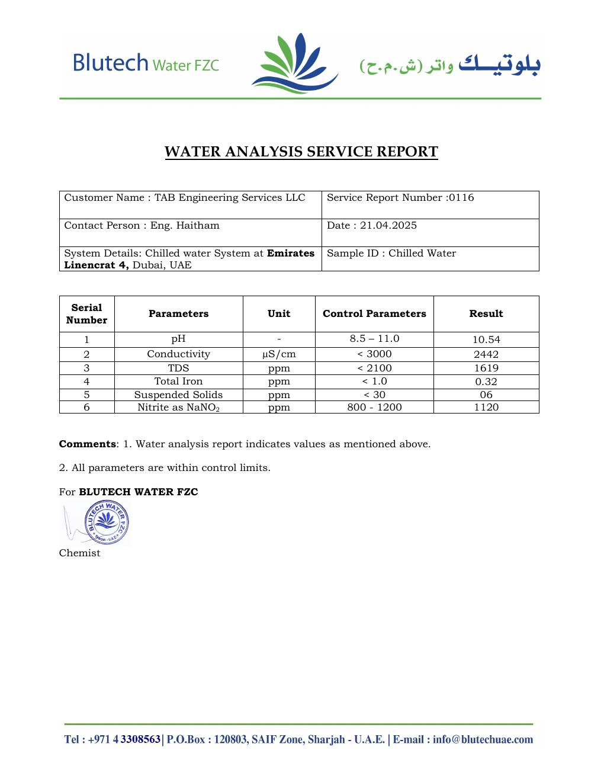
COMMISSIONING & TESTING
Chilled-Water Flushing & Analysis
LC4 water-quality acceptance evidence
SAJJAD ENGINEERING ACADEMY
Notes:
[Sources]
- User-provided source: Flushing Smaple Report .pdf
Training interpretation only. Verify against the controlled project record, current OEM documentation, approved PTW/LOTO, risk assessment and site procedures.

Slide 2
COMMISSIONING & TESTING
Source to practice
Evidence, interpretation and technician application
02
Notes:
[Sources]
- User-provided source: Flushing Smaple Report .pdf
Training interpretation only. Verify against the controlled project record, current OEM documentation, approved PTW/LOTO, risk assessment and site procedures.

Slide 3
KEY EVIDENCE
All six tested parameters were reported within control limits
10.54
2442
1120
pH (control 8.5-11.0)
Conductivity, µS/cm (<3000)
Nitrite as NaNO₂, ppm (800-1200)
LC4 AIR-COOLED CHILLER | Commissioning & Testing
03
Notes:
[Sources]
- User-provided source: Flushing Smaple Report .pdf
Training interpretation only. Verify against the controlled project record, current OEM documentation, approved PTW/LOTO, risk assessment and site procedures.

Slide 4
TECHNICAL REVIEW
The sample supports initial chilled-water chemical control
• TDS was 1,619 ppm against a control limit below 2,100 ppm.
• Total iron was 0.32 ppm against a control limit below 1.0 ppm.
• Suspended solids were reported as 6 ppm against a control limit below 30 ppm.
• The laboratory conclusion states that all parameters were within control limits.
LC4 AIR-COOLED CHILLER | Commissioning & Testing
04
Notes:
[Sources]
- User-provided source: Flushing Smaple Report .pdf
Training interpretation only. Verify against the controlled project record, current OEM documentation, approved PTW/LOTO, risk assessment and site procedures.

Slide 5
TECHNICAL REVIEW
A single compliant sample does not replace ongoing water management
• Confirm sampling point, flushing completion and sample date.
• Trend pH, conductivity, TDS, iron, suspended solids and inhibitor concentration.
• Investigate makeup-water ingress, corrosion products and unexplained conductivity rise.
• Retain laboratory reports with chemical dosing and flushing records.
LC4 AIR-COOLED CHILLER | Commissioning & Testing
05
Notes:
[Sources]
- User-provided source: Flushing Smaple Report .pdf
Training interpretation only. Verify against the controlled project record, current OEM documentation, approved PTW/LOTO, risk assessment and site procedures.

Slide 6
SOURCE EVIDENCE
Water-analysis service report
Blutech Water FZC report 0116 - 21 April 2025
Use the original report for signatures, detailed readings, revision status and formal acceptance.
LC4 AIR-COOLED CHILLER | Commissioning & Testing
06
Notes:
[Sources]
- User-provided source: Flushing Smaple Report .pdf
- Evidence reference: Blutech Water FZC report 0116 - 21 April 2025
Training interpretation only. Verify against the controlled project record, current OEM documentation, approved PTW/LOTO, risk assessment and site procedures.

Slide 7
COMPETENCY CHECK
What technicians must retain
• Identify the correct controlled source before work.
• Verify readings, configuration and acceptance criteria.
• Preserve evidence and escalate unresolved deviations.
• Complete safe isolation, functional testing and handover records.
LC4 AIR-COOLED CHILLER | Commissioning & Testing
07
Notes:
[Sources]
- User-provided source: Flushing Smaple Report .pdf
Training interpretation only. Verify against the controlled project record, current OEM documentation, approved PTW/LOTO, risk assessment and site procedures.

