Slide 1
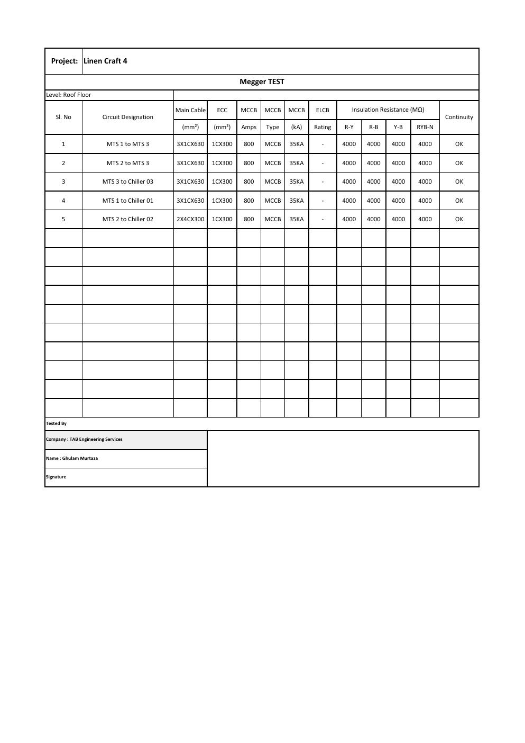
COMMISSIONING & TESTING
Electrical Insulation Resistance Test
MTS and chiller feeder verification
SAJJAD ENGINEERING ACADEMY
Notes:
[Sources]
- User-provided source: Megger.pdf
Training interpretation only. Verify against the controlled project record, current OEM documentation, approved PTW/LOTO, risk assessment and site procedures.

Slide 2
COMMISSIONING & TESTING
Source to practice
Evidence, interpretation and technician application
02
Notes:
[Sources]
- User-provided source: Megger.pdf
Training interpretation only. Verify against the controlled project record, current OEM documentation, approved PTW/LOTO, risk assessment and site procedures.

Slide 3
KEY EVIDENCE
All five tested circuits recorded 4,000 MΩ
5
800 A
OK
Power circuits tested
Recorded MCCB rating
Continuity result
LC4 AIR-COOLED CHILLER | Commissioning & Testing
03
Notes:
[Sources]
- User-provided source: Megger.pdf
Training interpretation only. Verify against the controlled project record, current OEM documentation, approved PTW/LOTO, risk assessment and site procedures.

Slide 4
TECHNICAL REVIEW
The test covered MTS interconnections and all three chiller feeders
• MTS 1 to MTS 3 and MTS 2 to MTS 3 were included.
• MTS 3 to Chiller 03, MTS 1 to Chiller 01 and MTS 2 to Chiller 02 were included.
• R-Y, R-B, Y-B and RYB-N readings were recorded.
• Cable and ECC sizes must remain linked to the approved single-line diagram.
LC4 AIR-COOLED CHILLER | Commissioning & Testing
04
Notes:
[Sources]
- User-provided source: Megger.pdf
Training interpretation only. Verify against the controlled project record, current OEM documentation, approved PTW/LOTO, risk assessment and site procedures.

Slide 5
TECHNICAL REVIEW
Acceptance requires more than a high resistance value
• Verify instrument calibration and test-voltage selection.
• Confirm cables were disconnected from sensitive electronics before testing.
• Record ambient condition, circuit isolation and discharge after testing.
• Retain signed results with termination torque and continuity evidence.
LC4 AIR-COOLED CHILLER | Commissioning & Testing
05
Notes:
[Sources]
- User-provided source: Megger.pdf
Training interpretation only. Verify against the controlled project record, current OEM documentation, approved PTW/LOTO, risk assessment and site procedures.

Slide 6
SOURCE EVIDENCE
Megger test schedule
TAB Engineering Services - LC4 roof-level circuits
Use the original report for signatures, detailed readings, revision status and formal acceptance.
LC4 AIR-COOLED CHILLER | Commissioning & Testing
06
Notes:
[Sources]
- User-provided source: Megger.pdf
- Evidence reference: TAB Engineering Services - LC4 roof-level circuits
Training interpretation only. Verify against the controlled project record, current OEM documentation, approved PTW/LOTO, risk assessment and site procedures.

Slide 7
COMPETENCY CHECK
What technicians must retain
• Identify the correct controlled source before work.
• Verify readings, configuration and acceptance criteria.
• Preserve evidence and escalate unresolved deviations.
• Complete safe isolation, functional testing and handover records.
LC4 AIR-COOLED CHILLER | Commissioning & Testing
07
Notes:
[Sources]
- User-provided source: Megger.pdf
Training interpretation only. Verify against the controlled project record, current OEM documentation, approved PTW/LOTO, risk assessment and site procedures.

