Slide 1
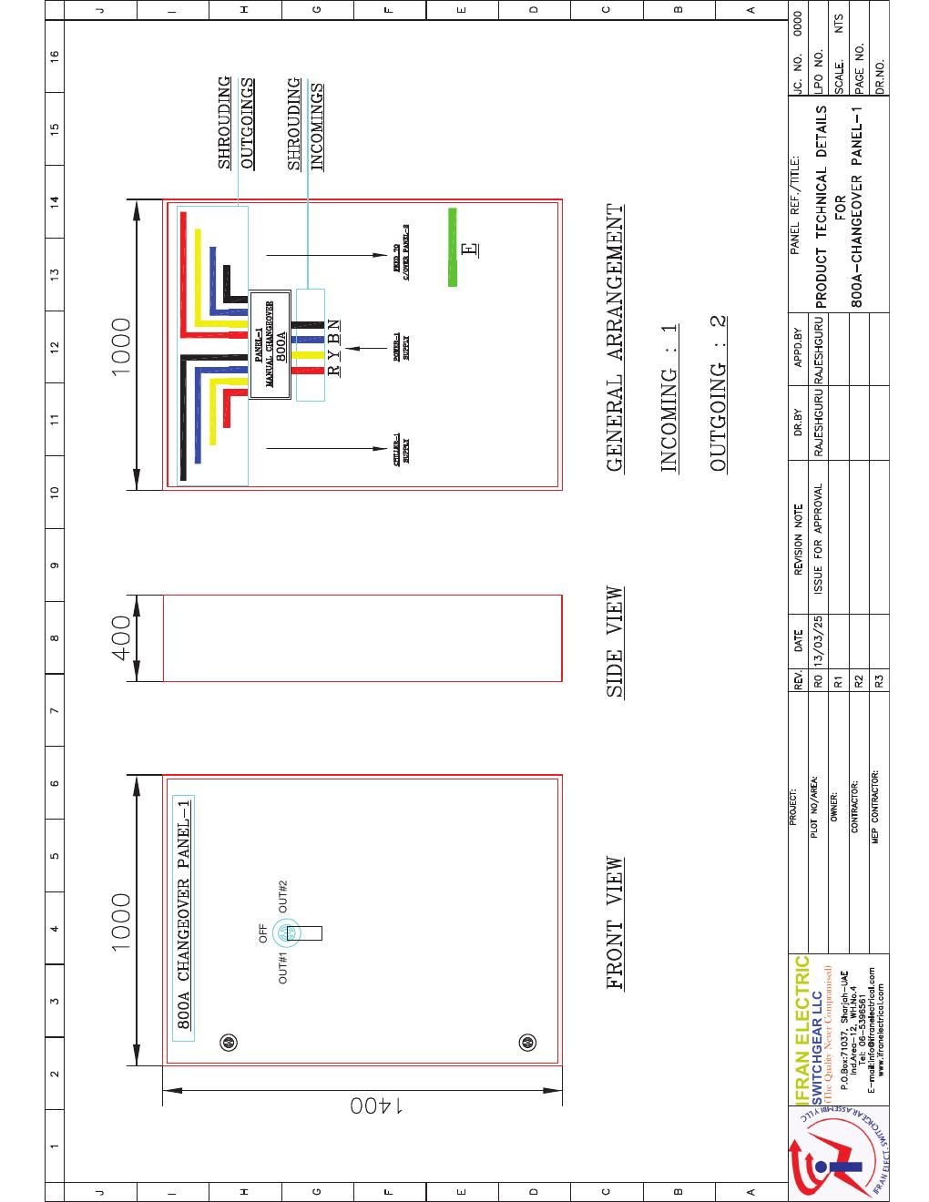
ELECTRICAL SYSTEMS
MTS Changeover Panel
800 A manual transfer arrangement and component documentation
SAJJAD ENGINEERING ACADEMY
Notes:
[Sources]
- User-provided source: MTS Panel-.pdf
Training interpretation only. Verify against the controlled project record, current OEM documentation, approved PTW/LOTO, risk assessment and site procedures.

Slide 2
ELECTRICAL SYSTEMS
Source to practice
Evidence, interpretation and technician application
02
Notes:
[Sources]
- User-provided source: MTS Panel-.pdf
Training interpretation only. Verify against the controlled project record, current OEM documentation, approved PTW/LOTO, risk assessment and site procedures.

Slide 3
KEY EVIDENCE
The principal changeover device is rated 800 A and four pole
800 A
4 pole
I-0-II
Changeover switch rating
Switched conductors
Manual operating positions
LC4 AIR-COOLED CHILLER | Electrical Systems
03
Notes:
[Sources]
- User-provided source: MTS Panel-.pdf
Training interpretation only. Verify against the controlled project record, current OEM documentation, approved PTW/LOTO, risk assessment and site procedures.

Slide 4
TECHNICAL REVIEW
The MTS preserves a controlled selection between available supplies
• The ABB OT800E04CP is a manual changeover switch.
• The handle is padlockable in the OFF position.
• Door interlocking is provided in operating positions.
• Only authorized switching sequences should be used.
LC4 AIR-COOLED CHILLER | Electrical Systems
04
Notes:
[Sources]
- User-provided source: MTS Panel-.pdf
Training interpretation only. Verify against the controlled project record, current OEM documentation, approved PTW/LOTO, risk assessment and site procedures.

Slide 5
TECHNICAL REVIEW
Safe switching begins with load and source verification
• Confirm the receiving chiller is ready and permitted to run.
• Verify source voltage, phase sequence and protection status.
• Move through OFF; never force the mechanism.
• Record switching, abnormal indications and restored configuration.
LC4 AIR-COOLED CHILLER | Electrical Systems
05
Notes:
[Sources]
- User-provided source: MTS Panel-.pdf
Training interpretation only. Verify against the controlled project record, current OEM documentation, approved PTW/LOTO, risk assessment and site procedures.

Slide 6
TECHNICAL REVIEW
Panel maintenance must address mechanical and electrical condition
• Inspect terminations, discoloration, heat damage and contamination.
• Verify operating shaft, handle, interlock and padlocking function.
• Thermographic inspections should be performed under representative load.
• Isolation and proving dead are required before internal access.
LC4 AIR-COOLED CHILLER | Electrical Systems
06
Notes:
[Sources]
- User-provided source: MTS Panel-.pdf
Training interpretation only. Verify against the controlled project record, current OEM documentation, approved PTW/LOTO, risk assessment and site procedures.

Slide 7
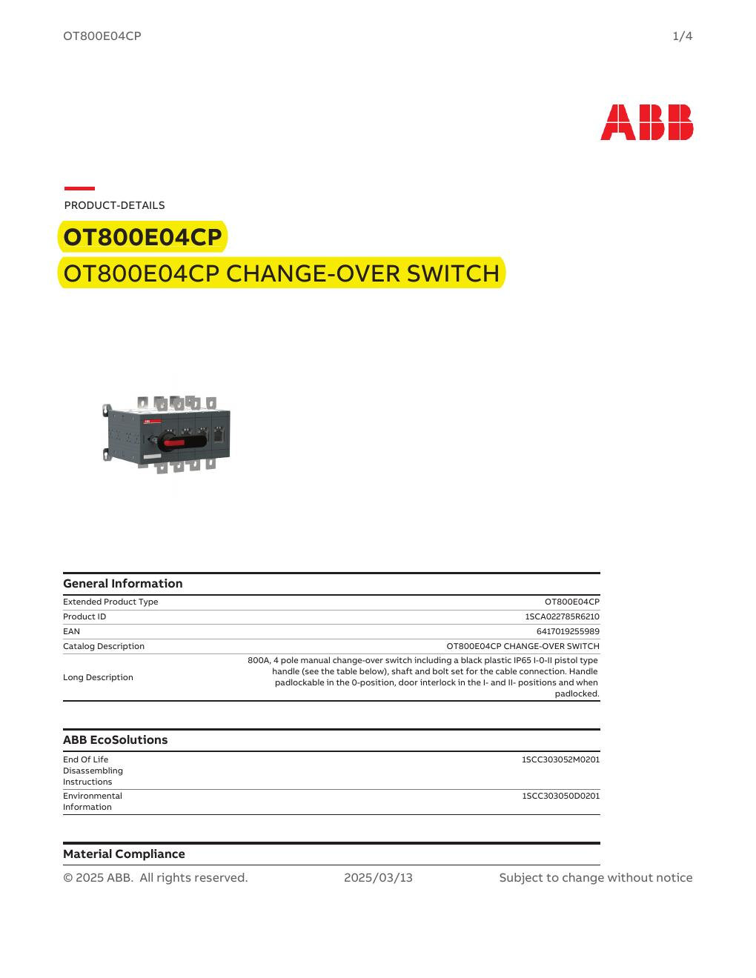
SOURCE EVIDENCE
MTS technical evidence 1
MTS Panel document - source page 4
Use the original report for signatures, detailed readings, revision status and formal acceptance.
LC4 AIR-COOLED CHILLER | Electrical Systems
07
Notes:
[Sources]
- User-provided source: MTS Panel-.pdf
- Evidence reference: MTS Panel document - source page 4
Training interpretation only. Verify against the controlled project record, current OEM documentation, approved PTW/LOTO, risk assessment and site procedures.

Slide 8

SOURCE EVIDENCE
MTS technical evidence 2
MTS Panel document - source page 8
Use the original report for signatures, detailed readings, revision status and formal acceptance.
LC4 AIR-COOLED CHILLER | Electrical Systems
08
Notes:
[Sources]
- User-provided source: MTS Panel-.pdf
- Evidence reference: MTS Panel document - source page 8
Training interpretation only. Verify against the controlled project record, current OEM documentation, approved PTW/LOTO, risk assessment and site procedures.

Slide 9
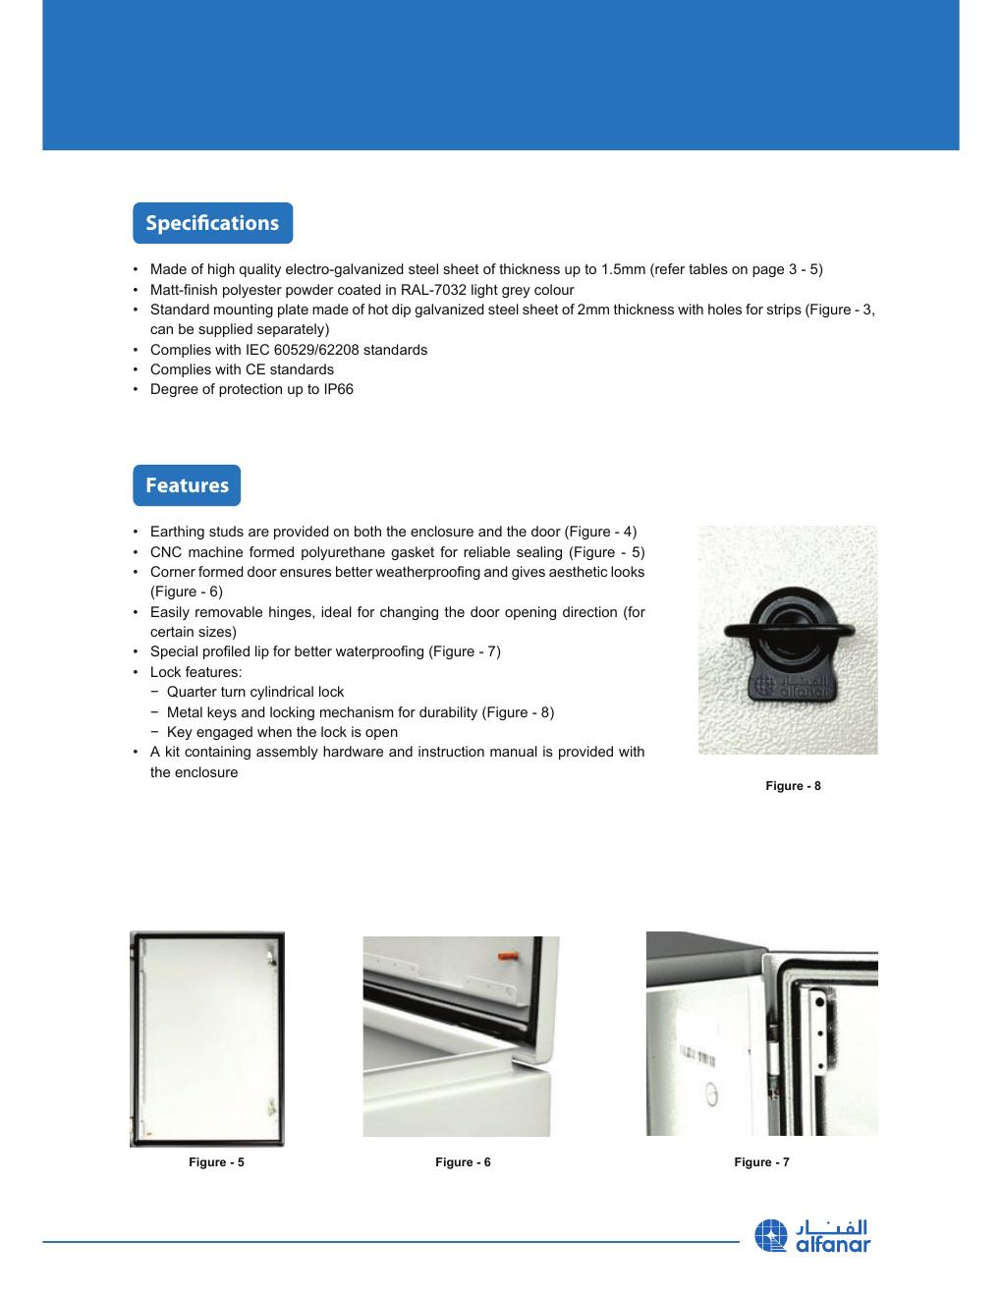
SOURCE EVIDENCE
MTS technical evidence 3
MTS Panel document - source page 12
Use the original report for signatures, detailed readings, revision status and formal acceptance.
LC4 AIR-COOLED CHILLER | Electrical Systems
09
Notes:
[Sources]
- User-provided source: MTS Panel-.pdf
- Evidence reference: MTS Panel document - source page 12
Training interpretation only. Verify against the controlled project record, current OEM documentation, approved PTW/LOTO, risk assessment and site procedures.

Slide 10
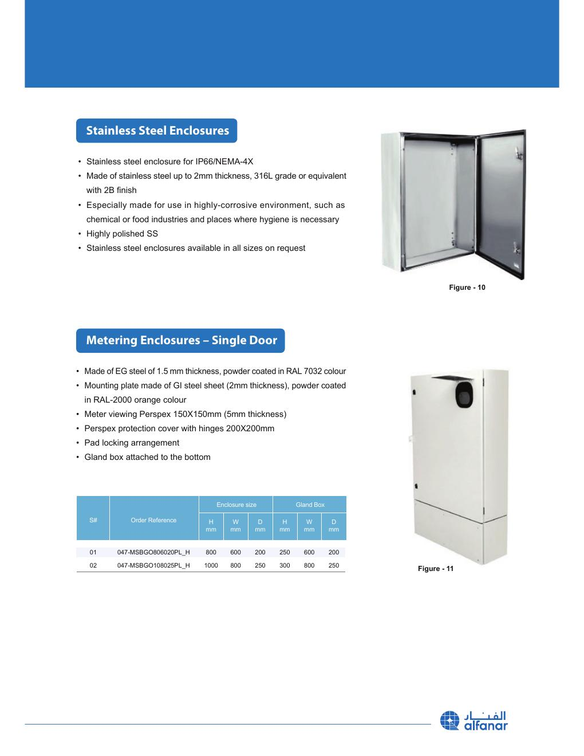
SOURCE EVIDENCE
MTS technical evidence 4
MTS Panel document - source page 16
Use the original report for signatures, detailed readings, revision status and formal acceptance.
LC4 AIR-COOLED CHILLER | Electrical Systems
10
Notes:
[Sources]
- User-provided source: MTS Panel-.pdf
- Evidence reference: MTS Panel document - source page 16
Training interpretation only. Verify against the controlled project record, current OEM documentation, approved PTW/LOTO, risk assessment and site procedures.

Slide 11
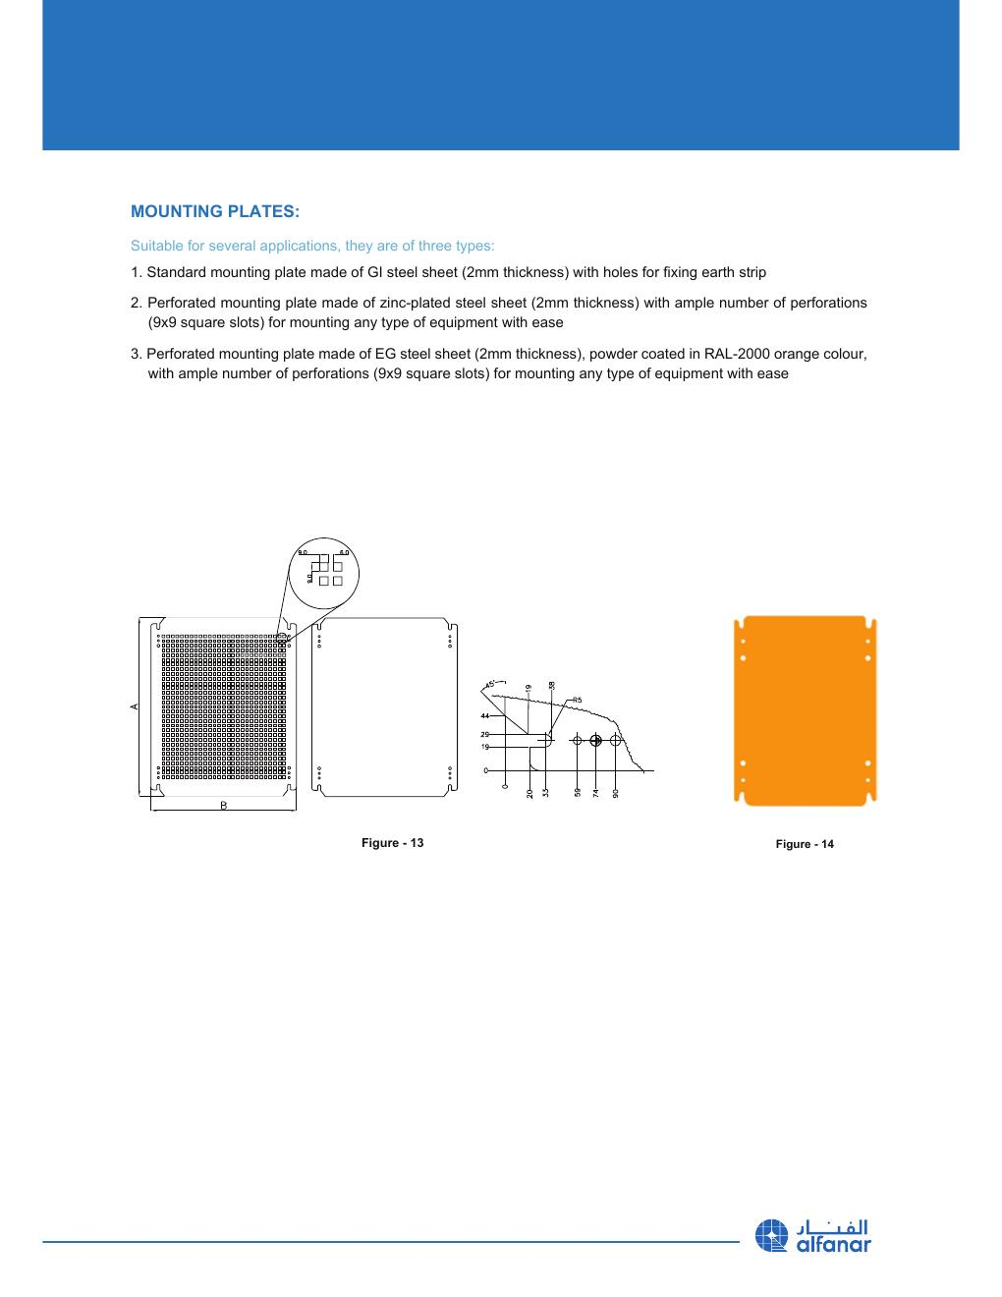
SOURCE EVIDENCE
MTS technical evidence 5
MTS Panel document - source page 20
Use the original report for signatures, detailed readings, revision status and formal acceptance.
LC4 AIR-COOLED CHILLER | Electrical Systems
11
Notes:
[Sources]
- User-provided source: MTS Panel-.pdf
- Evidence reference: MTS Panel document - source page 20
Training interpretation only. Verify against the controlled project record, current OEM documentation, approved PTW/LOTO, risk assessment and site procedures.

Slide 12
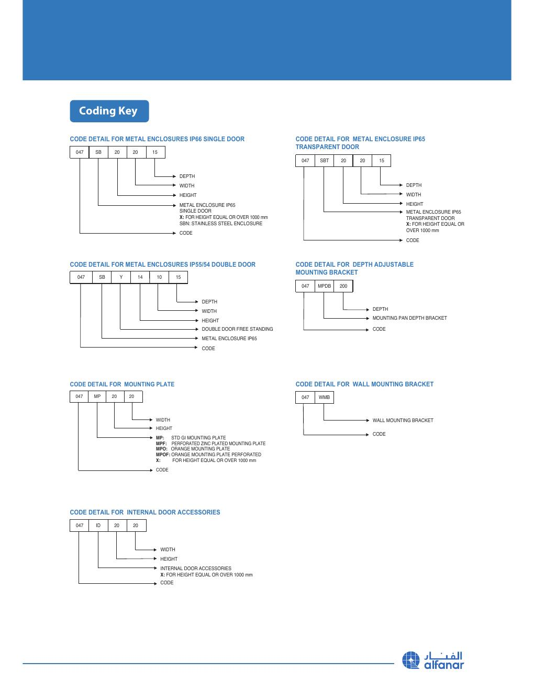
SOURCE EVIDENCE
MTS technical evidence 6
MTS Panel document - source page 24
Use the original report for signatures, detailed readings, revision status and formal acceptance.
LC4 AIR-COOLED CHILLER | Electrical Systems
12
Notes:
[Sources]
- User-provided source: MTS Panel-.pdf
- Evidence reference: MTS Panel document - source page 24
Training interpretation only. Verify against the controlled project record, current OEM documentation, approved PTW/LOTO, risk assessment and site procedures.

Slide 13
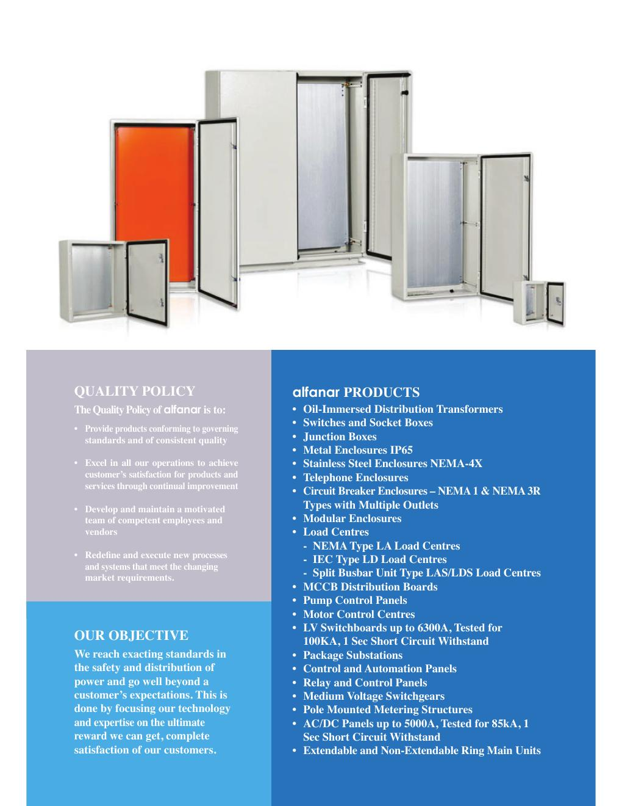
SOURCE EVIDENCE
MTS technical evidence 7
MTS Panel document - source page 27
Use the original report for signatures, detailed readings, revision status and formal acceptance.
LC4 AIR-COOLED CHILLER | Electrical Systems
13
Notes:
[Sources]
- User-provided source: MTS Panel-.pdf
- Evidence reference: MTS Panel document - source page 27
Training interpretation only. Verify against the controlled project record, current OEM documentation, approved PTW/LOTO, risk assessment and site procedures.

Slide 14
COMPETENCY CHECK
What technicians must retain
• Identify the correct controlled source before work.
• Verify readings, configuration and acceptance criteria.
• Preserve evidence and escalate unresolved deviations.
• Complete safe isolation, functional testing and handover records.
LC4 AIR-COOLED CHILLER | Electrical Systems
14
Notes:
[Sources]
- User-provided source: MTS Panel-.pdf
Training interpretation only. Verify against the controlled project record, current OEM documentation, approved PTW/LOTO, risk assessment and site procedures.

