Slide 1
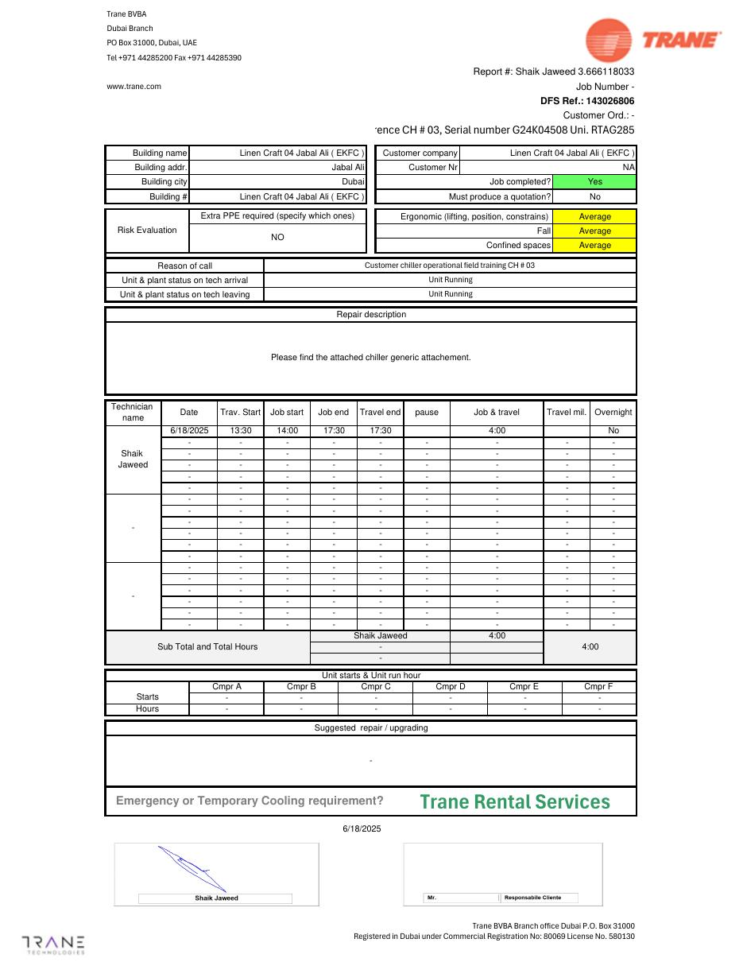
TRAINING RECORDS
RTAG285 Operator Training — 18 June 2025
Field training and inspection service record
SAJJAD ENGINEERING ACADEMY
Notes:
[Sources]
- User-provided source: DUB143026806 26 Linen Craft 04 Jabal Ali ( EKFC ) G24K04508 Shaik Jaweed 18062025 UADUB - INSP JRRY V138.pdf
Training interpretation only. Verify against the controlled project record, current OEM documentation, approved PTW/LOTO, risk assessment and site procedures.

Slide 2
TRAINING RECORDS
Source to practice
Evidence, interpretation and technician application
02
Notes:
[Sources]
- User-provided source: DUB143026806 26 Linen Craft 04 Jabal Ali ( EKFC ) G24K04508 Shaik Jaweed 18062025 UADUB - INSP JRRY V138.pdf
Training interpretation only. Verify against the controlled project record, current OEM documentation, approved PTW/LOTO, risk assessment and site procedures.

Slide 3
KEY EVIDENCE
A controlled technical reference for safe maintenance
CH-03
Running
5
Trained equipment
Arrival and leaving status
Report pages
LC4 AIR-COOLED CHILLER | Training Records
03
Notes:
[Sources]
- User-provided source: DUB143026806 26 Linen Craft 04 Jabal Ali ( EKFC ) G24K04508 Shaik Jaweed 18062025 UADUB - INSP JRRY V138.pdf
Training interpretation only. Verify against the controlled project record, current OEM documentation, approved PTW/LOTO, risk assessment and site procedures.

Slide 4
TECHNICAL REVIEW
Use the manual as a machine-specific working reference
• Training covered the operational field context for Chiller 03.
• Verify attendee names and competency sign-off in the original.
• Include alarms, normal checks and emergency response in refresher training.
• Retain the record with the project handover file.
LC4 AIR-COOLED CHILLER | Training Records
04
Notes:
[Sources]
- User-provided source: DUB143026806 26 Linen Craft 04 Jabal Ali ( EKFC ) G24K04508 Shaik Jaweed 18062025 UADUB - INSP JRRY V138.pdf
Training interpretation only. Verify against the controlled project record, current OEM documentation, approved PTW/LOTO, risk assessment and site procedures.

Slide 5
TECHNICAL REVIEW
Apply a consistent safe-work sequence
• Confirm machine identity, model and document revision.
• Isolate all energy sources and prove a safe state before access.
• Inspect, measure and diagnose before replacing components.
• Function-test safeguards and record the completed work.
LC4 AIR-COOLED CHILLER | Training Records
05
Notes:
[Sources]
- User-provided source: DUB143026806 26 Linen Craft 04 Jabal Ali ( EKFC ) G24K04508 Shaik Jaweed 18062025 UADUB - INSP JRRY V138.pdf
Training interpretation only. Verify against the controlled project record, current OEM documentation, approved PTW/LOTO, risk assessment and site procedures.

Slide 6
TECHNICAL REVIEW
Parts and settings require configuration control
• Record original settings and connections before adjustment.
• Use exact part numbers or approved supersessions.
• Preserve firmware, program and parameter backups where applicable.
• Update the maintenance history after each intervention.
LC4 AIR-COOLED CHILLER | Training Records
06
Notes:
[Sources]
- User-provided source: DUB143026806 26 Linen Craft 04 Jabal Ali ( EKFC ) G24K04508 Shaik Jaweed 18062025 UADUB - INSP JRRY V138.pdf
Training interpretation only. Verify against the controlled project record, current OEM documentation, approved PTW/LOTO, risk assessment and site procedures.

Slide 7
SOURCE EVIDENCE
Manual evidence 1
Source page 1
Use the original report for signatures, detailed readings, revision status and formal acceptance.
LC4 AIR-COOLED CHILLER | Training Records
07
Notes:
[Sources]
- User-provided source: DUB143026806 26 Linen Craft 04 Jabal Ali ( EKFC ) G24K04508 Shaik Jaweed 18062025 UADUB - INSP JRRY V138.pdf
- Evidence reference: Source page 1
Training interpretation only. Verify against the controlled project record, current OEM documentation, approved PTW/LOTO, risk assessment and site procedures.

Slide 8
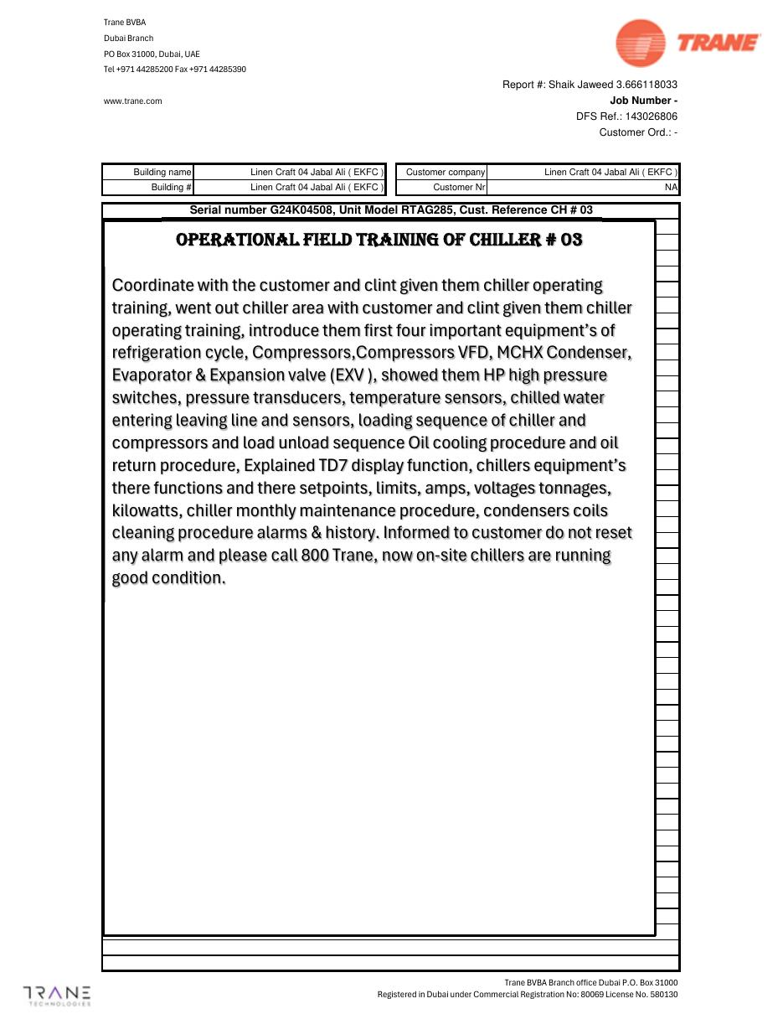
SOURCE EVIDENCE
Manual evidence 2
Source page 2
Use the original report for signatures, detailed readings, revision status and formal acceptance.
LC4 AIR-COOLED CHILLER | Training Records
08
Notes:
[Sources]
- User-provided source: DUB143026806 26 Linen Craft 04 Jabal Ali ( EKFC ) G24K04508 Shaik Jaweed 18062025 UADUB - INSP JRRY V138.pdf
- Evidence reference: Source page 2
Training interpretation only. Verify against the controlled project record, current OEM documentation, approved PTW/LOTO, risk assessment and site procedures.

Slide 9
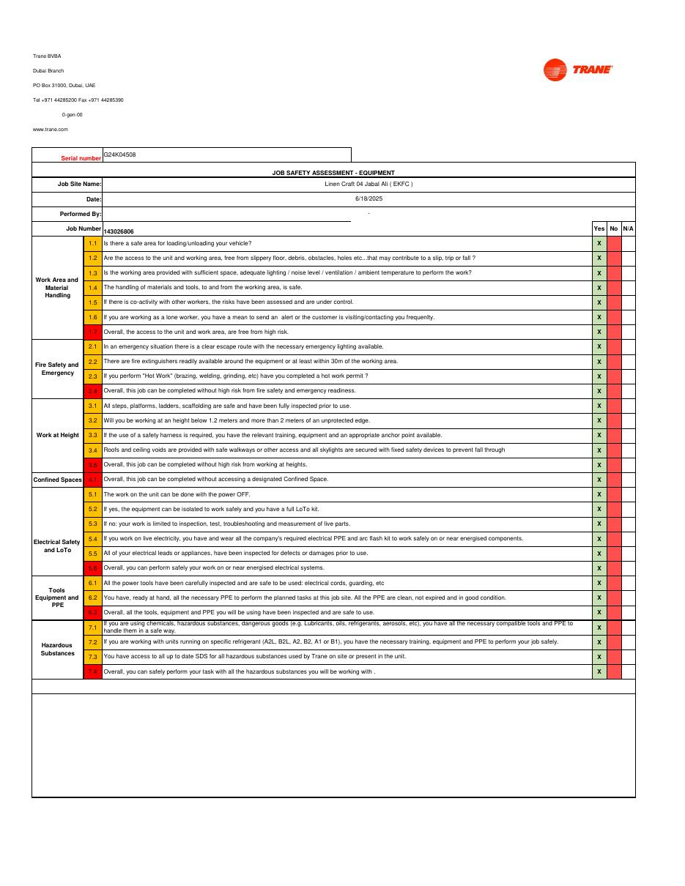
SOURCE EVIDENCE
Manual evidence 3
Source page 3
Use the original report for signatures, detailed readings, revision status and formal acceptance.
LC4 AIR-COOLED CHILLER | Training Records
09
Notes:
[Sources]
- User-provided source: DUB143026806 26 Linen Craft 04 Jabal Ali ( EKFC ) G24K04508 Shaik Jaweed 18062025 UADUB - INSP JRRY V138.pdf
- Evidence reference: Source page 3
Training interpretation only. Verify against the controlled project record, current OEM documentation, approved PTW/LOTO, risk assessment and site procedures.

Slide 10
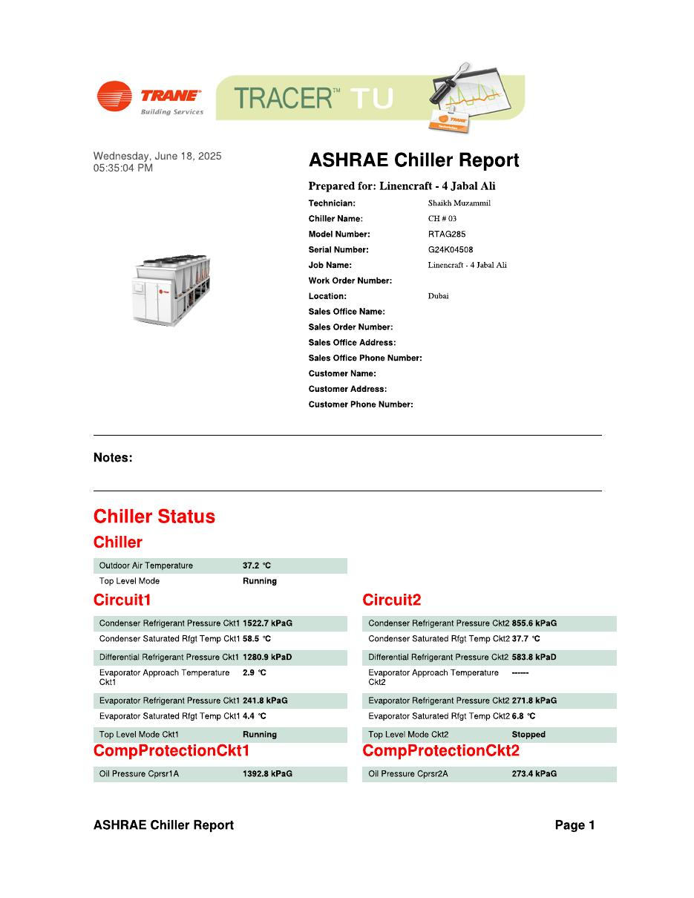
SOURCE EVIDENCE
Manual evidence 4
Source page 4
Use the original report for signatures, detailed readings, revision status and formal acceptance.
LC4 AIR-COOLED CHILLER | Training Records
10
Notes:
[Sources]
- User-provided source: DUB143026806 26 Linen Craft 04 Jabal Ali ( EKFC ) G24K04508 Shaik Jaweed 18062025 UADUB - INSP JRRY V138.pdf
- Evidence reference: Source page 4
Training interpretation only. Verify against the controlled project record, current OEM documentation, approved PTW/LOTO, risk assessment and site procedures.

Slide 11
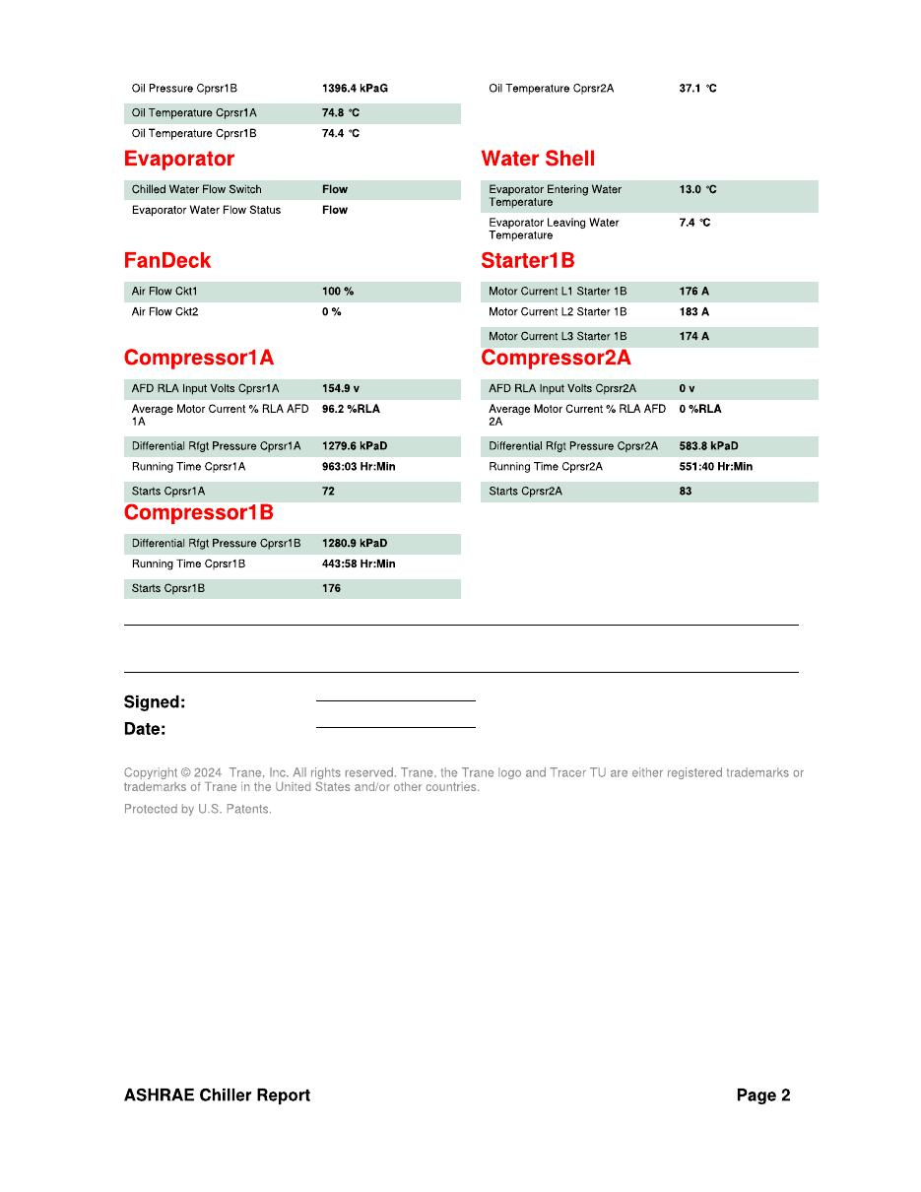
SOURCE EVIDENCE
Manual evidence 5
Source page 5
Use the original report for signatures, detailed readings, revision status and formal acceptance.
LC4 AIR-COOLED CHILLER | Training Records
11
Notes:
[Sources]
- User-provided source: DUB143026806 26 Linen Craft 04 Jabal Ali ( EKFC ) G24K04508 Shaik Jaweed 18062025 UADUB - INSP JRRY V138.pdf
- Evidence reference: Source page 5
Training interpretation only. Verify against the controlled project record, current OEM documentation, approved PTW/LOTO, risk assessment and site procedures.

Slide 12
COMPETENCY CHECK
What technicians must retain
• Identify the correct controlled source before work.
• Verify readings, configuration and acceptance criteria.
• Preserve evidence and escalate unresolved deviations.
• Complete safe isolation, functional testing and handover records.
LC4 AIR-COOLED CHILLER | Training Records
12
Notes:
[Sources]
- User-provided source: DUB143026806 26 Linen Craft 04 Jabal Ali ( EKFC ) G24K04508 Shaik Jaweed 18062025 UADUB - INSP JRRY V138.pdf
Training interpretation only. Verify against the controlled project record, current OEM documentation, approved PTW/LOTO, risk assessment and site procedures.

