Slide 1
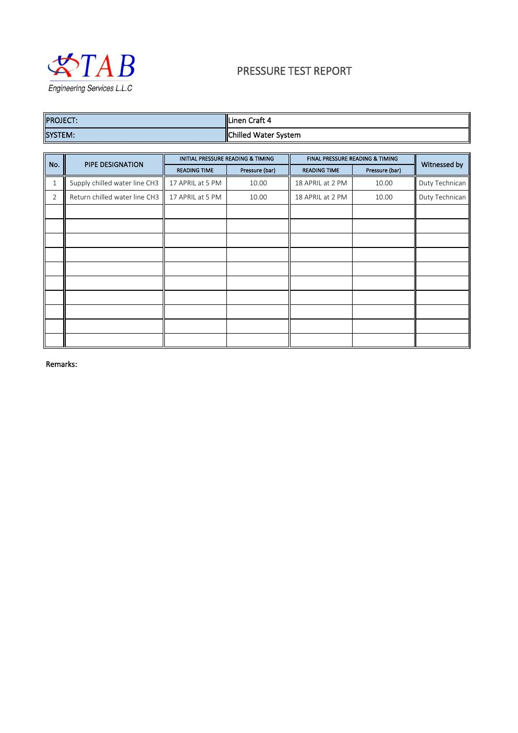
COMMISSIONING & TESTING
Chilled-Water Pressure Test
Supply and return piping integrity evidence
SAJJAD ENGINEERING ACADEMY
Notes:
[Sources]
- User-provided source: Pressure Test report.pdf
Training interpretation only. Verify against the controlled project record, current OEM documentation, approved PTW/LOTO, risk assessment and site procedures.

Slide 2
COMMISSIONING & TESTING
Source to practice
Evidence, interpretation and technician application
02
Notes:
[Sources]
- User-provided source: Pressure Test report.pdf
Training interpretation only. Verify against the controlled project record, current OEM documentation, approved PTW/LOTO, risk assessment and site procedures.

Slide 3
KEY EVIDENCE
Pressure remained at 10 bar for both CH3 lines
10.00
10.00
21 h
Initial pressure, bar
Final pressure, bar
Recorded test duration
LC4 AIR-COOLED CHILLER | Commissioning & Testing
03
Notes:
[Sources]
- User-provided source: Pressure Test report.pdf
Training interpretation only. Verify against the controlled project record, current OEM documentation, approved PTW/LOTO, risk assessment and site procedures.

Slide 4
TECHNICAL REVIEW
The report records no pressure decay across the test window
• Supply chilled-water line CH3 was tested.
• Return chilled-water line CH3 was tested.
• Initial readings were taken 17 April at 5 PM.
• Final readings were taken 18 April at 2 PM.
LC4 AIR-COOLED CHILLER | Commissioning & Testing
04
Notes:
[Sources]
- User-provided source: Pressure Test report.pdf
Training interpretation only. Verify against the controlled project record, current OEM documentation, approved PTW/LOTO, risk assessment and site procedures.

Slide 5
TECHNICAL REVIEW
Closeout should confirm the complete pressure-test boundary
• Identify isolated valves, blanking points and tested pipe sections.
• Verify gauge range, calibration and elevation correction where applicable.
• Record leak inspection results at joints, valves and equipment connections.
• Confirm safe depressurization and reinstatement after acceptance.
LC4 AIR-COOLED CHILLER | Commissioning & Testing
05
Notes:
[Sources]
- User-provided source: Pressure Test report.pdf
Training interpretation only. Verify against the controlled project record, current OEM documentation, approved PTW/LOTO, risk assessment and site procedures.

Slide 6
SOURCE EVIDENCE
Pressure-test report
LC4 chilled-water supply and return lines CH3
Use the original report for signatures, detailed readings, revision status and formal acceptance.
LC4 AIR-COOLED CHILLER | Commissioning & Testing
06
Notes:
[Sources]
- User-provided source: Pressure Test report.pdf
- Evidence reference: LC4 chilled-water supply and return lines CH3
Training interpretation only. Verify against the controlled project record, current OEM documentation, approved PTW/LOTO, risk assessment and site procedures.

Slide 7
COMPETENCY CHECK
What technicians must retain
• Identify the correct controlled source before work.
• Verify readings, configuration and acceptance criteria.
• Preserve evidence and escalate unresolved deviations.
• Complete safe isolation, functional testing and handover records.
LC4 AIR-COOLED CHILLER | Commissioning & Testing
07
Notes:
[Sources]
- User-provided source: Pressure Test report.pdf
Training interpretation only. Verify against the controlled project record, current OEM documentation, approved PTW/LOTO, risk assessment and site procedures.

