Slide 1
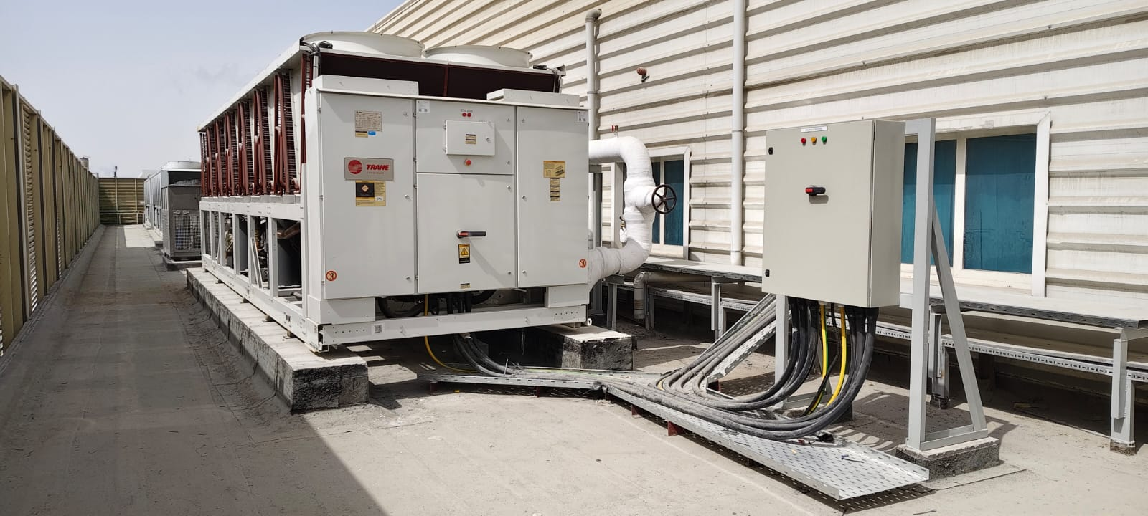
PROJECT HANDOVER
LC4 Chiller Project Completion
Delivery, testing, redundancy and handover summary
SAJJAD ENGINEERING ACADEMY
Notes:
[Sources]
- User-provided source: Project Completion Report - LC4 - Supply and Installation of Air-cooled Chiller.docx
Training interpretation only. Verify against the controlled project record, current OEM documentation, approved PTW/LOTO, risk assessment and site procedures.

Slide 2
PROJECT HANDOVER
Source to practice
Evidence, interpretation and technician application
02
Notes:
[Sources]
- User-provided source: Project Completion Report - LC4 - Supply and Installation of Air-cooled Chiller.docx
Training interpretation only. Verify against the controlled project record, current OEM documentation, approved PTW/LOTO, risk assessment and site procedures.

Slide 3
KEY EVIDENCE
The project progressed from March to August 2025
24 Mar
4 Aug
CH-03
Recorded project start
Recorded completion
New Trane chiller arrangement
LC4 AIR-COOLED CHILLER | Project Handover
03
Notes:
[Sources]
- User-provided source: Project Completion Report - LC4 - Supply and Installation of Air-cooled Chiller.docx
Training interpretation only. Verify against the controlled project record, current OEM documentation, approved PTW/LOTO, risk assessment and site procedures.

Slide 4
TECHNICAL REVIEW
The project added capacity and operational redundancy
• Existing Carrier chillers were operating near full summer load.
• There was no flexibility for preventive or corrective maintenance.
• A third chiller and changeover arrangement improved backup capability.
• Available power permits only two chillers to operate at one time.
LC4 AIR-COOLED CHILLER | Project Handover
04
Notes:
[Sources]
- User-provided source: Project Completion Report - LC4 - Supply and Installation of Air-cooled Chiller.docx
Training interpretation only. Verify against the controlled project record, current OEM documentation, approved PTW/LOTO, risk assessment and site procedures.

Slide 5
TECHNICAL REVIEW
The schedule combined civil, mechanical and electrical work
• Foundation and chiller delivery began in March 2025.
• Cable tray, piping supports, headers and valve package followed in April.
• Pressure testing, flushing, insulation and MTS work were completed before commissioning.
• Testing and commissioning were recorded on 29 April with handover planned for 30 April.
LC4 AIR-COOLED CHILLER | Project Handover
05
Notes:
[Sources]
- User-provided source: Project Completion Report - LC4 - Supply and Installation of Air-cooled Chiller.docx
Training interpretation only. Verify against the controlled project record, current OEM documentation, approved PTW/LOTO, risk assessment and site procedures.

Slide 6
TECHNICAL REVIEW
Handover must reconcile the later completion date
• The report records project completion as 4 August 2025.
• The detailed schedule records a 30 April handover milestone.
• Retain evidence of post-commissioning snags, training and document closure.
• Confirm the final acceptance date used for warranty commencement.
LC4 AIR-COOLED CHILLER | Project Handover
06
Notes:
[Sources]
- User-provided source: Project Completion Report - LC4 - Supply and Installation of Air-cooled Chiller.docx
Training interpretation only. Verify against the controlled project record, current OEM documentation, approved PTW/LOTO, risk assessment and site procedures.

Slide 7
TECHNICAL REVIEW
The operational benefit is maintenance flexibility
• A standby arrangement reduces cooling-loss exposure during breakdowns.
• Planned chiller PPM can proceed without shutting all cooling loads.
• Working-area temperature control should become more consistent.
• Dry-cleaning equipment receives improved cooling-system resilience.
LC4 AIR-COOLED CHILLER | Project Handover
07
Notes:
[Sources]
- User-provided source: Project Completion Report - LC4 - Supply and Installation of Air-cooled Chiller.docx
Training interpretation only. Verify against the controlled project record, current OEM documentation, approved PTW/LOTO, risk assessment and site procedures.

Slide 8
PROJECT PHOTOGRAPH
Installed chiller project evidence
• Confirm equipment identification and access clearances.
• Inspect pipework, supports, insulation and service access.
• Retain photograph with date and location metadata.
LC4 AIR-COOLED CHILLER | Project Handover
08
Notes:
[Sources]
- User-provided source: Project Completion Report - LC4 - Supply and Installation of Air-cooled Chiller.docx
- Evidence reference: Embedded project-completion photograph
Training interpretation only. Verify against the controlled project record, current OEM documentation, approved PTW/LOTO, risk assessment and site procedures.

Slide 9
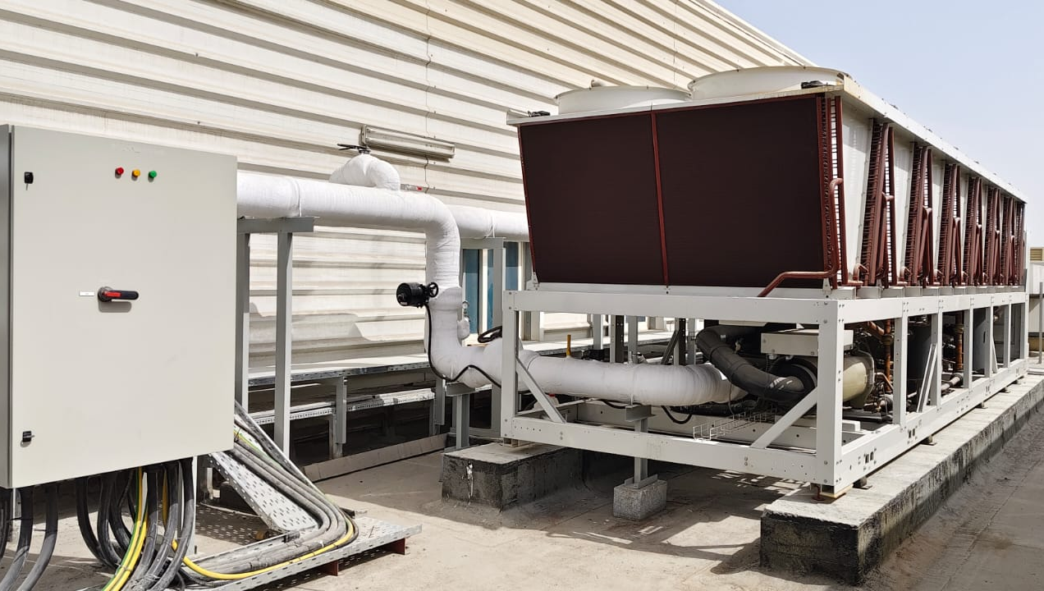
PROJECT PHOTOGRAPH
Completion photograph and site condition
• Use photographs to support snag closure.
• Compare completed installation with approved drawings.
• Record any later modification through change control.
LC4 AIR-COOLED CHILLER | Project Handover
09
Notes:
[Sources]
- User-provided source: Project Completion Report - LC4 - Supply and Installation of Air-cooled Chiller.docx
- Evidence reference: Embedded project-completion photograph
Training interpretation only. Verify against the controlled project record, current OEM documentation, approved PTW/LOTO, risk assessment and site procedures.

Slide 10
COMPETENCY CHECK
What technicians must retain
• Identify the correct controlled source before work.
• Verify readings, configuration and acceptance criteria.
• Preserve evidence and escalate unresolved deviations.
• Complete safe isolation, functional testing and handover records.
LC4 AIR-COOLED CHILLER | Project Handover
10
Notes:
[Sources]
- User-provided source: Project Completion Report - LC4 - Supply and Installation of Air-cooled Chiller.docx
Training interpretation only. Verify against the controlled project record, current OEM documentation, approved PTW/LOTO, risk assessment and site procedures.

