Slide 1

SPARE PARTS
RTAG285IUP5 Spare Parts
Model-specific parts identification and ordering control
SAJJAD ENGINEERING ACADEMY
Notes:
[Sources]
- User-provided source: RTAG285IUP5 - Spare Parts List.pdf
Training interpretation only. Verify against the controlled project record, current OEM documentation, approved PTW/LOTO, risk assessment and site procedures.

Slide 2
SPARE PARTS
Source to practice
Evidence, interpretation and technician application
02
Notes:
[Sources]
- User-provided source: RTAG285IUP5 - Spare Parts List.pdf
Training interpretation only. Verify against the controlled project record, current OEM documentation, approved PTW/LOTO, risk assessment and site procedures.

Slide 3
KEY EVIDENCE
The catalogue is tied to one complete RTAG285 model string
99
RTAG285
IUP5
Catalogue pages
Unit family
Parts-list reference
LC4 AIR-COOLED CHILLER | Spare Parts
03
Notes:
[Sources]
- User-provided source: RTAG285IUP5 - Spare Parts List.pdf
Training interpretation only. Verify against the controlled project record, current OEM documentation, approved PTW/LOTO, risk assessment and site procedures.

Slide 4
TECHNICAL REVIEW
Correct ordering starts with complete machine identity
• Use the full model number and unit serial number.
• Confirm design revision and installed options.
• Match drawing reference numbers to the physical assembly.
• Record superseded part numbers and OEM-approved substitutions.
LC4 AIR-COOLED CHILLER | Spare Parts
04
Notes:
[Sources]
- User-provided source: RTAG285IUP5 - Spare Parts List.pdf
Training interpretation only. Verify against the controlled project record, current OEM documentation, approved PTW/LOTO, risk assessment and site procedures.

Slide 5
TECHNICAL REVIEW
Part quantity in a drawing is not automatically the stock quantity
• Distinguish quantity per assembly from quantity per machine.
• Separate consumables, repair kits and complete assemblies.
• Use failure history and lead time to define local stock.
• Preserve warranty and traceability records after installation.
LC4 AIR-COOLED CHILLER | Spare Parts
05
Notes:
[Sources]
- User-provided source: RTAG285IUP5 - Spare Parts List.pdf
Training interpretation only. Verify against the controlled project record, current OEM documentation, approved PTW/LOTO, risk assessment and site procedures.

Slide 6

SOURCE EVIDENCE
Parts catalogue reference 1
RTAG285IUP5 - source page 5
Use the original report for signatures, detailed readings, revision status and formal acceptance.
LC4 AIR-COOLED CHILLER | Spare Parts
06
Notes:
[Sources]
- User-provided source: RTAG285IUP5 - Spare Parts List.pdf
- Evidence reference: RTAG285IUP5 - source page 5
Training interpretation only. Verify against the controlled project record, current OEM documentation, approved PTW/LOTO, risk assessment and site procedures.

Slide 7

SOURCE EVIDENCE
Parts catalogue reference 2
RTAG285IUP5 - source page 11
Use the original report for signatures, detailed readings, revision status and formal acceptance.
LC4 AIR-COOLED CHILLER | Spare Parts
07
Notes:
[Sources]
- User-provided source: RTAG285IUP5 - Spare Parts List.pdf
- Evidence reference: RTAG285IUP5 - source page 11
Training interpretation only. Verify against the controlled project record, current OEM documentation, approved PTW/LOTO, risk assessment and site procedures.

Slide 8

SOURCE EVIDENCE
Parts catalogue reference 3
RTAG285IUP5 - source page 13
Use the original report for signatures, detailed readings, revision status and formal acceptance.
LC4 AIR-COOLED CHILLER | Spare Parts
08
Notes:
[Sources]
- User-provided source: RTAG285IUP5 - Spare Parts List.pdf
- Evidence reference: RTAG285IUP5 - source page 13
Training interpretation only. Verify against the controlled project record, current OEM documentation, approved PTW/LOTO, risk assessment and site procedures.

Slide 9

SOURCE EVIDENCE
Parts catalogue reference 4
RTAG285IUP5 - source page 21
Use the original report for signatures, detailed readings, revision status and formal acceptance.
LC4 AIR-COOLED CHILLER | Spare Parts
09
Notes:
[Sources]
- User-provided source: RTAG285IUP5 - Spare Parts List.pdf
- Evidence reference: RTAG285IUP5 - source page 21
Training interpretation only. Verify against the controlled project record, current OEM documentation, approved PTW/LOTO, risk assessment and site procedures.

Slide 10

SOURCE EVIDENCE
Parts catalogue reference 5
RTAG285IUP5 - source page 31
Use the original report for signatures, detailed readings, revision status and formal acceptance.
LC4 AIR-COOLED CHILLER | Spare Parts
10
Notes:
[Sources]
- User-provided source: RTAG285IUP5 - Spare Parts List.pdf
- Evidence reference: RTAG285IUP5 - source page 31
Training interpretation only. Verify against the controlled project record, current OEM documentation, approved PTW/LOTO, risk assessment and site procedures.

Slide 11

SOURCE EVIDENCE
Parts catalogue reference 6
RTAG285IUP5 - source page 41
Use the original report for signatures, detailed readings, revision status and formal acceptance.
LC4 AIR-COOLED CHILLER | Spare Parts
11
Notes:
[Sources]
- User-provided source: RTAG285IUP5 - Spare Parts List.pdf
- Evidence reference: RTAG285IUP5 - source page 41
Training interpretation only. Verify against the controlled project record, current OEM documentation, approved PTW/LOTO, risk assessment and site procedures.

Slide 12
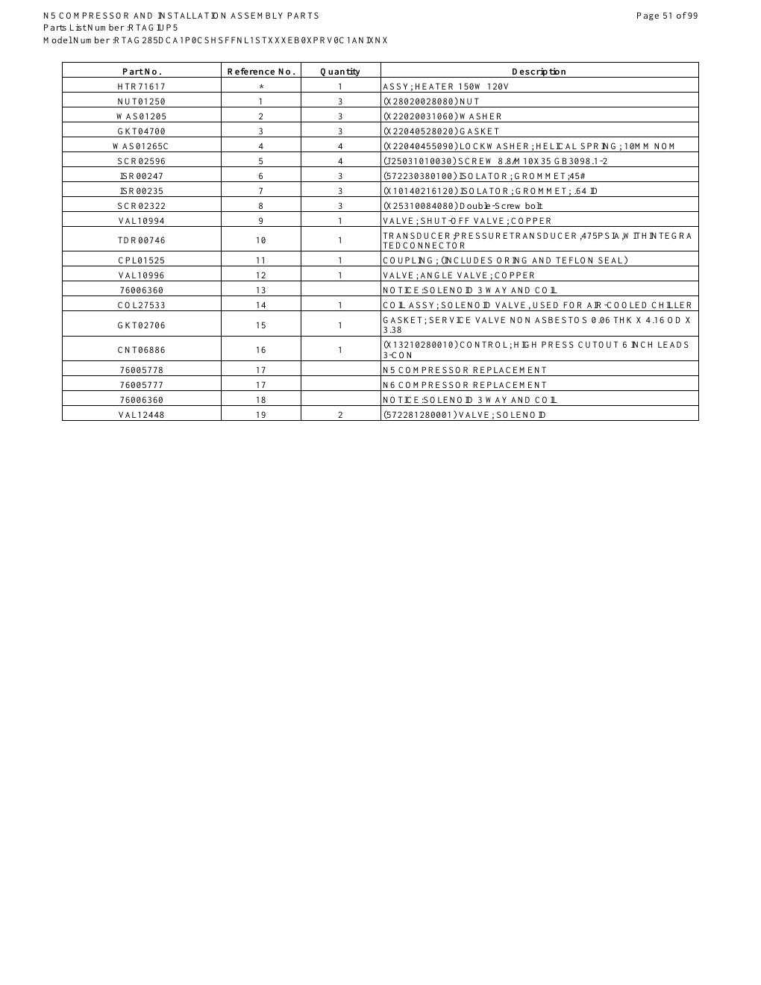
SOURCE EVIDENCE
Parts catalogue reference 7
RTAG285IUP5 - source page 51
Use the original report for signatures, detailed readings, revision status and formal acceptance.
LC4 AIR-COOLED CHILLER | Spare Parts
12
Notes:
[Sources]
- User-provided source: RTAG285IUP5 - Spare Parts List.pdf
- Evidence reference: RTAG285IUP5 - source page 51
Training interpretation only. Verify against the controlled project record, current OEM documentation, approved PTW/LOTO, risk assessment and site procedures.

Slide 13

SOURCE EVIDENCE
Parts catalogue reference 8
RTAG285IUP5 - source page 61
Use the original report for signatures, detailed readings, revision status and formal acceptance.
LC4 AIR-COOLED CHILLER | Spare Parts
13
Notes:
[Sources]
- User-provided source: RTAG285IUP5 - Spare Parts List.pdf
- Evidence reference: RTAG285IUP5 - source page 61
Training interpretation only. Verify against the controlled project record, current OEM documentation, approved PTW/LOTO, risk assessment and site procedures.

Slide 14
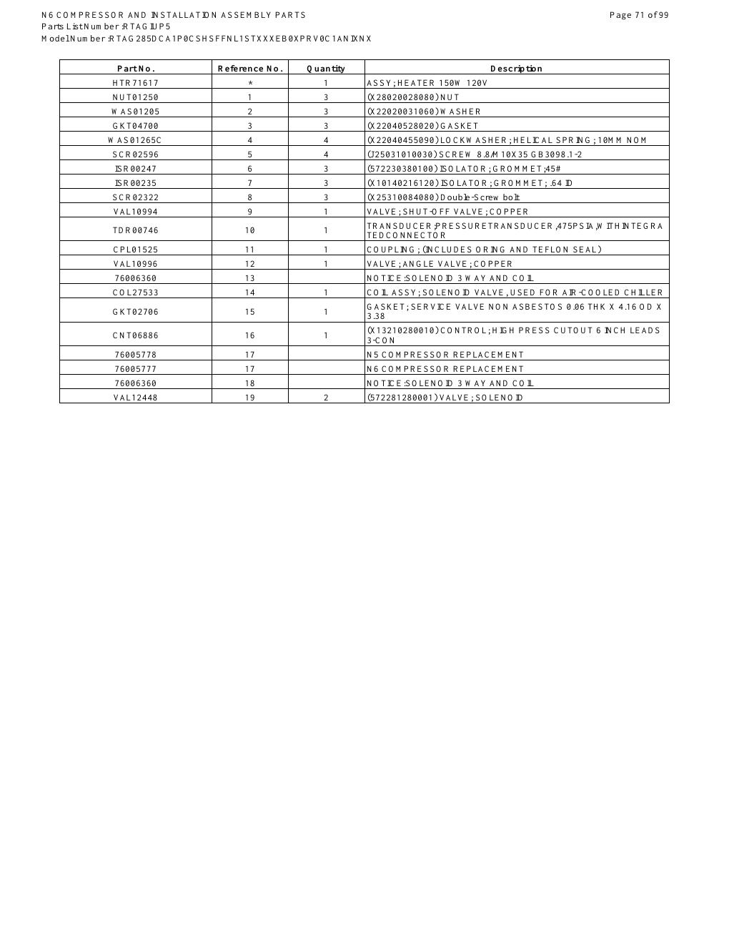
SOURCE EVIDENCE
Parts catalogue reference 9
RTAG285IUP5 - source page 71
Use the original report for signatures, detailed readings, revision status and formal acceptance.
LC4 AIR-COOLED CHILLER | Spare Parts
14
Notes:
[Sources]
- User-provided source: RTAG285IUP5 - Spare Parts List.pdf
- Evidence reference: RTAG285IUP5 - source page 71
Training interpretation only. Verify against the controlled project record, current OEM documentation, approved PTW/LOTO, risk assessment and site procedures.

Slide 15

SOURCE EVIDENCE
Parts catalogue reference 10
RTAG285IUP5 - source page 81
Use the original report for signatures, detailed readings, revision status and formal acceptance.
LC4 AIR-COOLED CHILLER | Spare Parts
15
Notes:
[Sources]
- User-provided source: RTAG285IUP5 - Spare Parts List.pdf
- Evidence reference: RTAG285IUP5 - source page 81
Training interpretation only. Verify against the controlled project record, current OEM documentation, approved PTW/LOTO, risk assessment and site procedures.

Slide 16
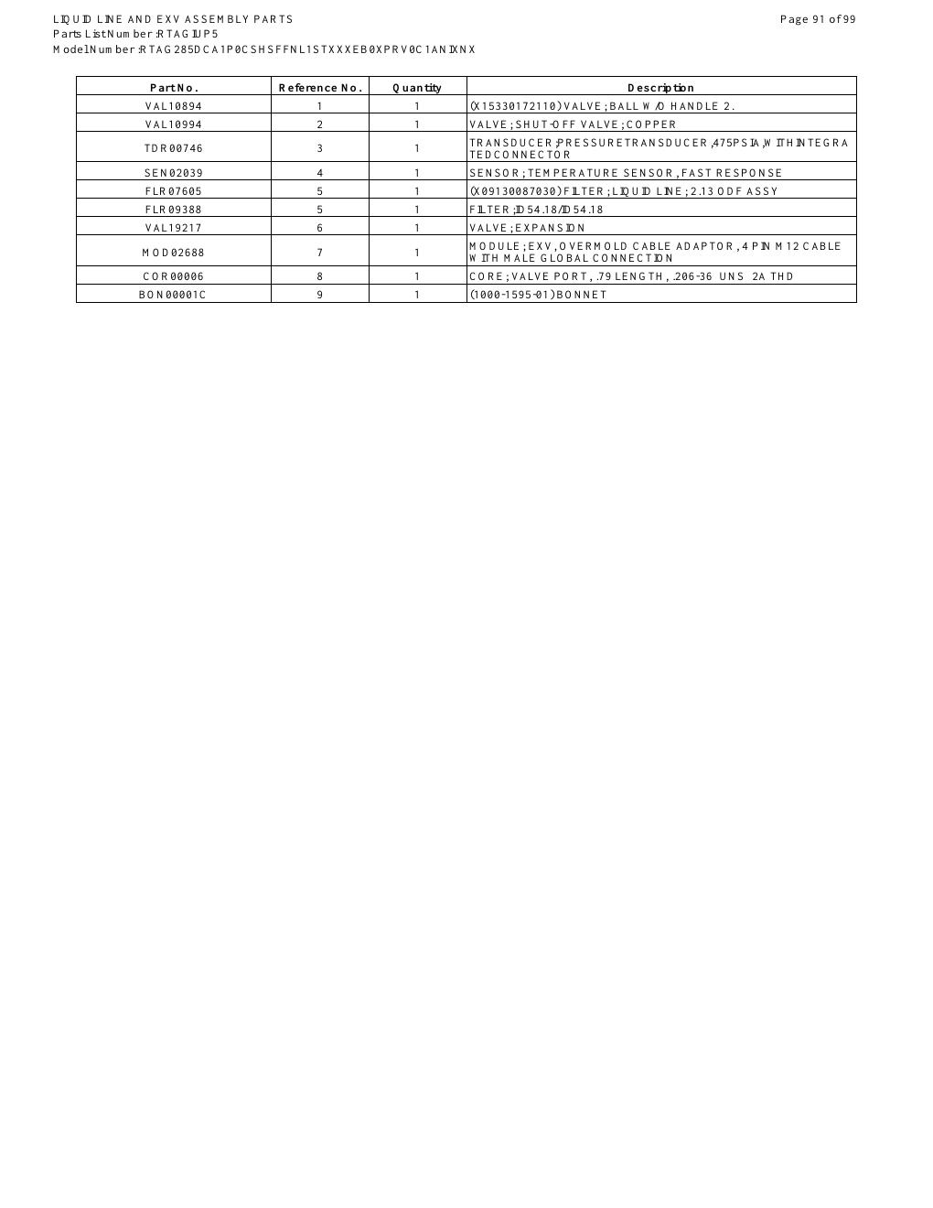
SOURCE EVIDENCE
Parts catalogue reference 11
RTAG285IUP5 - source page 91
Use the original report for signatures, detailed readings, revision status and formal acceptance.
LC4 AIR-COOLED CHILLER | Spare Parts
16
Notes:
[Sources]
- User-provided source: RTAG285IUP5 - Spare Parts List.pdf
- Evidence reference: RTAG285IUP5 - source page 91
Training interpretation only. Verify against the controlled project record, current OEM documentation, approved PTW/LOTO, risk assessment and site procedures.

Slide 17

SOURCE EVIDENCE
Parts catalogue reference 12
RTAG285IUP5 - source page 99
Use the original report for signatures, detailed readings, revision status and formal acceptance.
LC4 AIR-COOLED CHILLER | Spare Parts
17
Notes:
[Sources]
- User-provided source: RTAG285IUP5 - Spare Parts List.pdf
- Evidence reference: RTAG285IUP5 - source page 99
Training interpretation only. Verify against the controlled project record, current OEM documentation, approved PTW/LOTO, risk assessment and site procedures.

Slide 18
COMPETENCY CHECK
What technicians must retain
• Identify the correct controlled source before work.
• Verify readings, configuration and acceptance criteria.
• Preserve evidence and escalate unresolved deviations.
• Complete safe isolation, functional testing and handover records.
LC4 AIR-COOLED CHILLER | Spare Parts
18
Notes:
[Sources]
- User-provided source: RTAG285IUP5 - Spare Parts List.pdf
Training interpretation only. Verify against the controlled project record, current OEM documentation, approved PTW/LOTO, risk assessment and site procedures.

