Slide 1
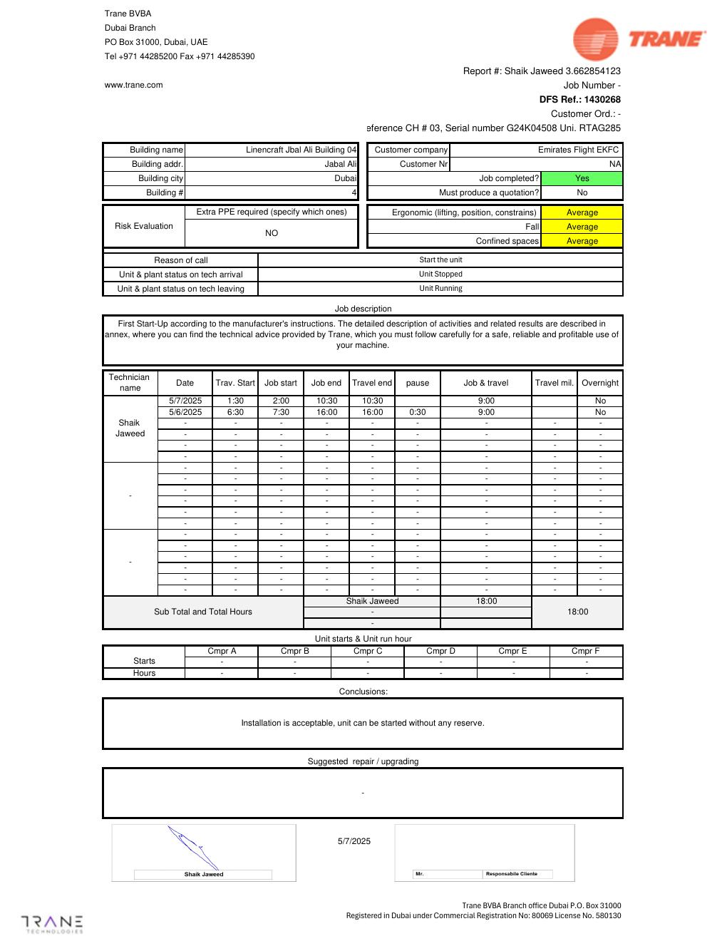
COMMISSIONING & TESTING
RTAG285 Chiller 03 Startup
First-start commissioning evidence - serial G24K04508
SAJJAD ENGINEERING ACADEMY
Notes:
[Sources]
- User-provided source: Start Up Report-1430268 86 Linencraft Jbal Ali Building 04 G24K04508 Shaik Jaweed 07052025 UADUB - SUP JRRY V138.pdf
Training interpretation only. Verify against the controlled project record, current OEM documentation, approved PTW/LOTO, risk assessment and site procedures.

Slide 2
COMMISSIONING & TESTING
Source to practice
Evidence, interpretation and technician application
02
Notes:
[Sources]
- User-provided source: Start Up Report-1430268 86 Linencraft Jbal Ali Building 04 G24K04508 Shaik Jaweed 07052025 UADUB - SUP JRRY V138.pdf
Training interpretation only. Verify against the controlled project record, current OEM documentation, approved PTW/LOTO, risk assessment and site procedures.

Slide 3
KEY EVIDENCE
The startup report records an acceptable installation and running unit
RTAG285
G24K04508
18 h
Unit model
Serial number
Recorded technician time
LC4 AIR-COOLED CHILLER | Commissioning & Testing
03
Notes:
[Sources]
- User-provided source: Start Up Report-1430268 86 Linencraft Jbal Ali Building 04 G24K04508 Shaik Jaweed 07052025 UADUB - SUP JRRY V138.pdf
Training interpretation only. Verify against the controlled project record, current OEM documentation, approved PTW/LOTO, risk assessment and site procedures.

Slide 4
TECHNICAL REVIEW
The service visit moved the unit from stopped to running
• The reason for call was to start the unit.
• The plant status on arrival was recorded as stopped.
• The plant status on leaving was recorded as running.
• The report states that startup followed manufacturer instructions.
LC4 AIR-COOLED CHILLER | Commissioning & Testing
04
Notes:
[Sources]
- User-provided source: Start Up Report-1430268 86 Linencraft Jbal Ali Building 04 G24K04508 Shaik Jaweed 07052025 UADUB - SUP JRRY V138.pdf
Training interpretation only. Verify against the controlled project record, current OEM documentation, approved PTW/LOTO, risk assessment and site procedures.

Slide 5
TECHNICAL REVIEW
The conclusion permits startup without reservation
• The installation was recorded as acceptable.
• The report states that the unit could be started without reserve.
• The job was marked completed with no quotation required.
• Acceptance should remain linked to annex readings and open snags.
LC4 AIR-COOLED CHILLER | Commissioning & Testing
05
Notes:
[Sources]
- User-provided source: Start Up Report-1430268 86 Linencraft Jbal Ali Building 04 G24K04508 Shaik Jaweed 07052025 UADUB - SUP JRRY V138.pdf
Training interpretation only. Verify against the controlled project record, current OEM documentation, approved PTW/LOTO, risk assessment and site procedures.

Slide 6
TECHNICAL REVIEW
Commissioning records form the future performance baseline
• Retain temperatures, pressures, currents, flow and control settings.
• Record compressor starts and hours when available.
• Confirm alarm history and sensor plausibility.
• Use the baseline during warranty and repeat-failure investigation.
LC4 AIR-COOLED CHILLER | Commissioning & Testing
06
Notes:
[Sources]
- User-provided source: Start Up Report-1430268 86 Linencraft Jbal Ali Building 04 G24K04508 Shaik Jaweed 07052025 UADUB - SUP JRRY V138.pdf
Training interpretation only. Verify against the controlled project record, current OEM documentation, approved PTW/LOTO, risk assessment and site procedures.

Slide 7
SOURCE EVIDENCE
Startup report evidence 1
Trane startup report - source page 1
Use the original report for signatures, detailed readings, revision status and formal acceptance.
LC4 AIR-COOLED CHILLER | Commissioning & Testing
07
Notes:
[Sources]
- User-provided source: Start Up Report-1430268 86 Linencraft Jbal Ali Building 04 G24K04508 Shaik Jaweed 07052025 UADUB - SUP JRRY V138.pdf
- Evidence reference: Trane startup report - source page 1
Training interpretation only. Verify against the controlled project record, current OEM documentation, approved PTW/LOTO, risk assessment and site procedures.

Slide 8
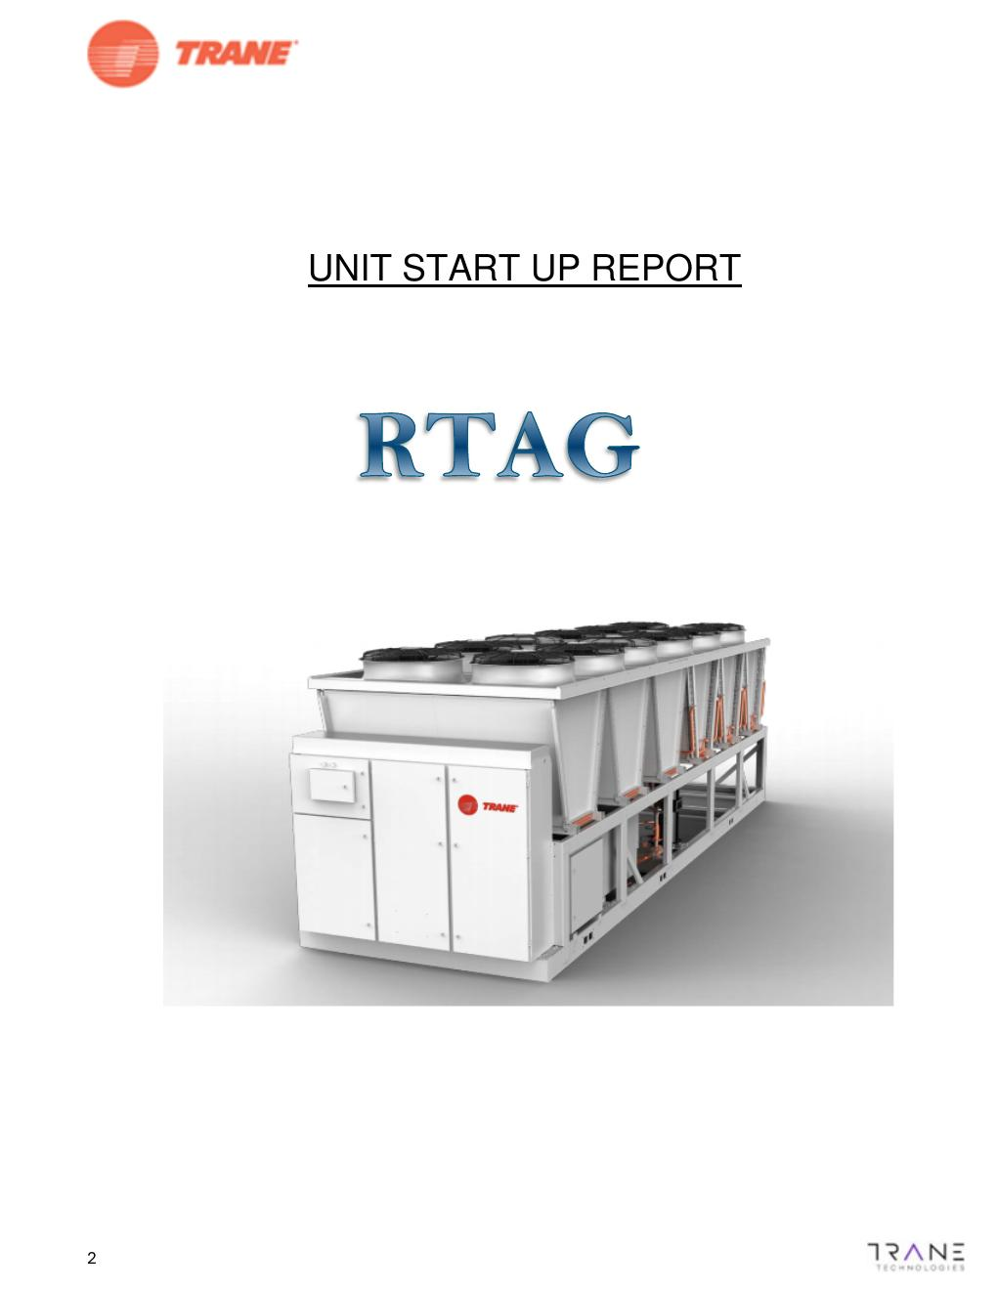
SOURCE EVIDENCE
Startup report evidence 2
Trane startup report - source page 2
Use the original report for signatures, detailed readings, revision status and formal acceptance.
LC4 AIR-COOLED CHILLER | Commissioning & Testing
08
Notes:
[Sources]
- User-provided source: Start Up Report-1430268 86 Linencraft Jbal Ali Building 04 G24K04508 Shaik Jaweed 07052025 UADUB - SUP JRRY V138.pdf
- Evidence reference: Trane startup report - source page 2
Training interpretation only. Verify against the controlled project record, current OEM documentation, approved PTW/LOTO, risk assessment and site procedures.

Slide 9
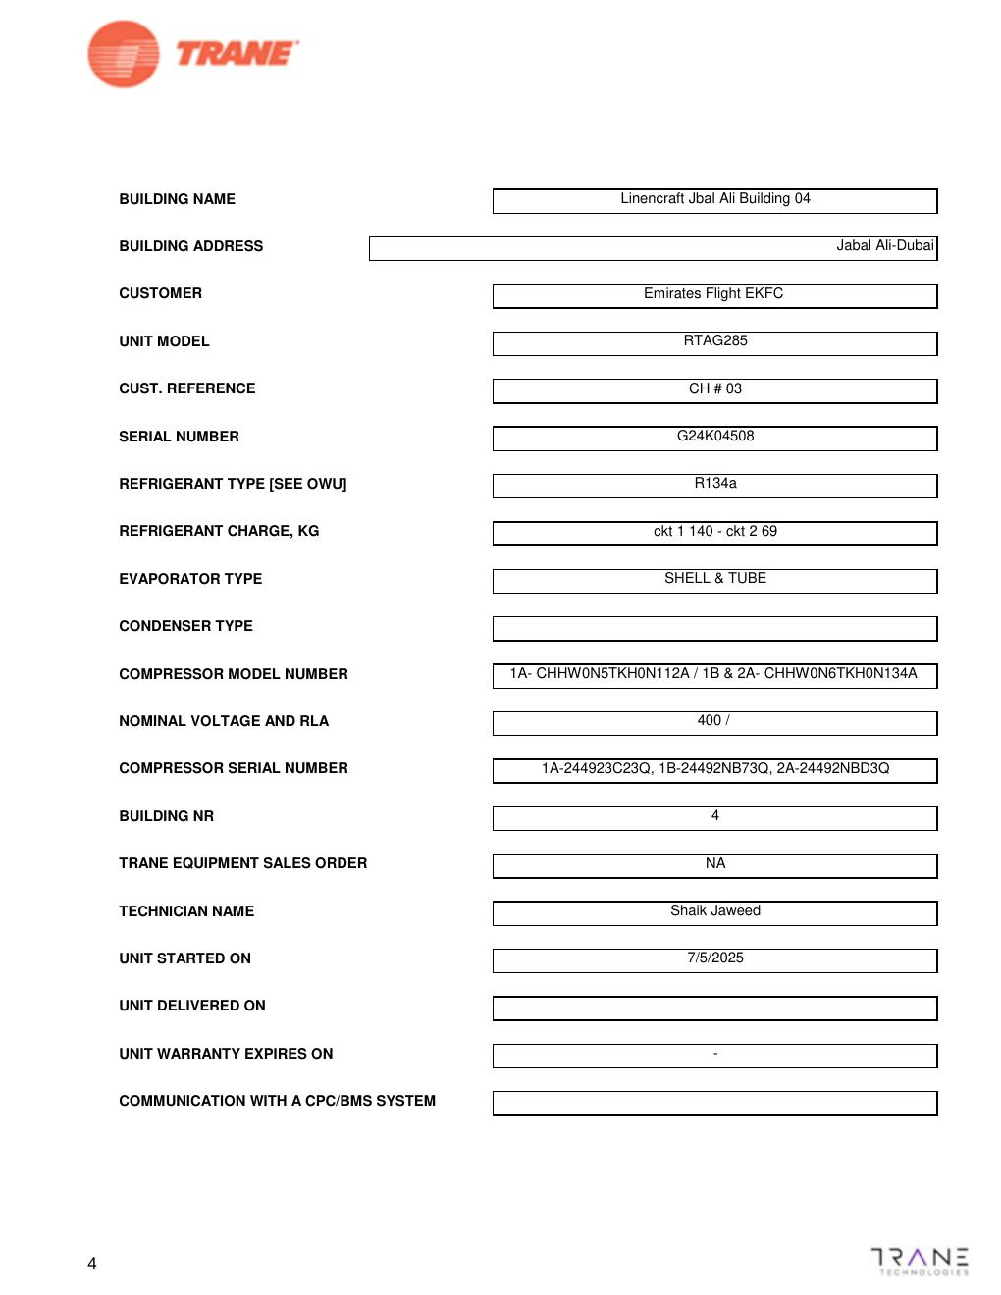
SOURCE EVIDENCE
Startup report evidence 3
Trane startup report - source page 4
Use the original report for signatures, detailed readings, revision status and formal acceptance.
LC4 AIR-COOLED CHILLER | Commissioning & Testing
09
Notes:
[Sources]
- User-provided source: Start Up Report-1430268 86 Linencraft Jbal Ali Building 04 G24K04508 Shaik Jaweed 07052025 UADUB - SUP JRRY V138.pdf
- Evidence reference: Trane startup report - source page 4
Training interpretation only. Verify against the controlled project record, current OEM documentation, approved PTW/LOTO, risk assessment and site procedures.

Slide 10
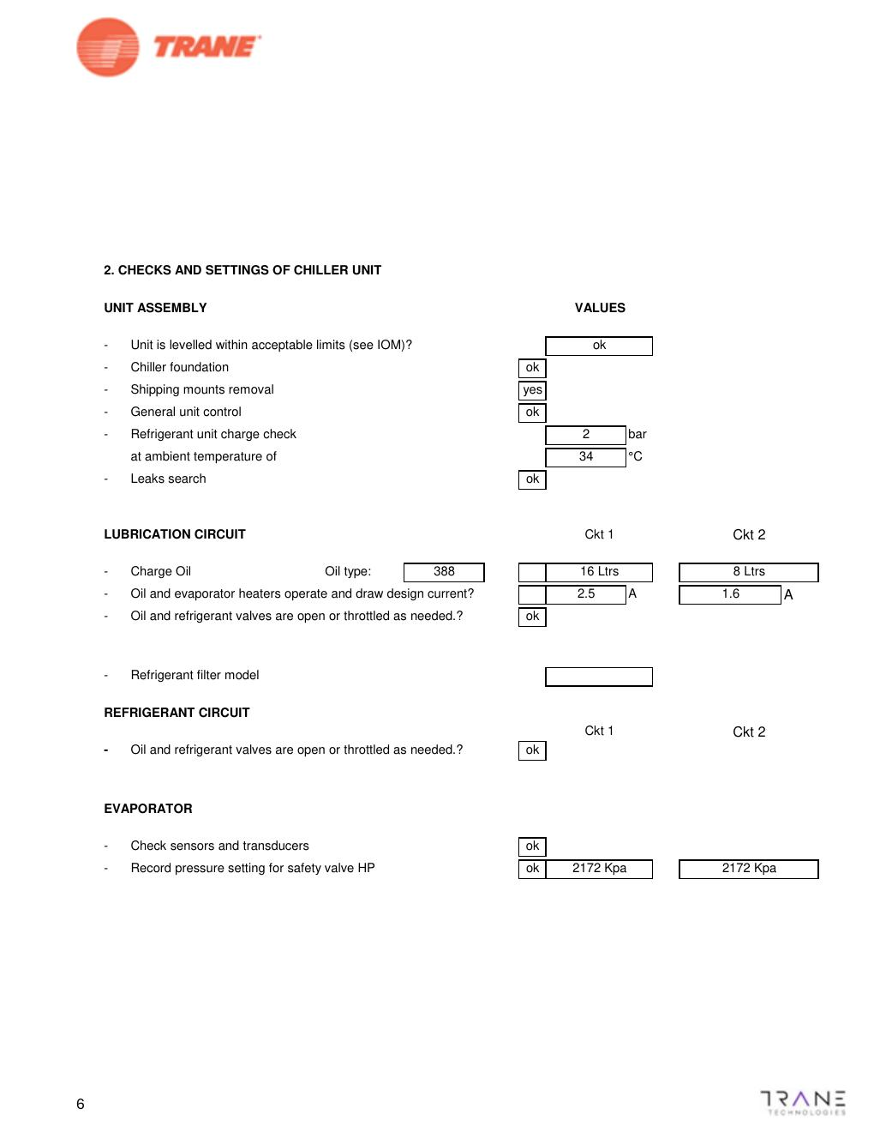
SOURCE EVIDENCE
Startup report evidence 4
Trane startup report - source page 6
Use the original report for signatures, detailed readings, revision status and formal acceptance.
LC4 AIR-COOLED CHILLER | Commissioning & Testing
10
Notes:
[Sources]
- User-provided source: Start Up Report-1430268 86 Linencraft Jbal Ali Building 04 G24K04508 Shaik Jaweed 07052025 UADUB - SUP JRRY V138.pdf
- Evidence reference: Trane startup report - source page 6
Training interpretation only. Verify against the controlled project record, current OEM documentation, approved PTW/LOTO, risk assessment and site procedures.

Slide 11
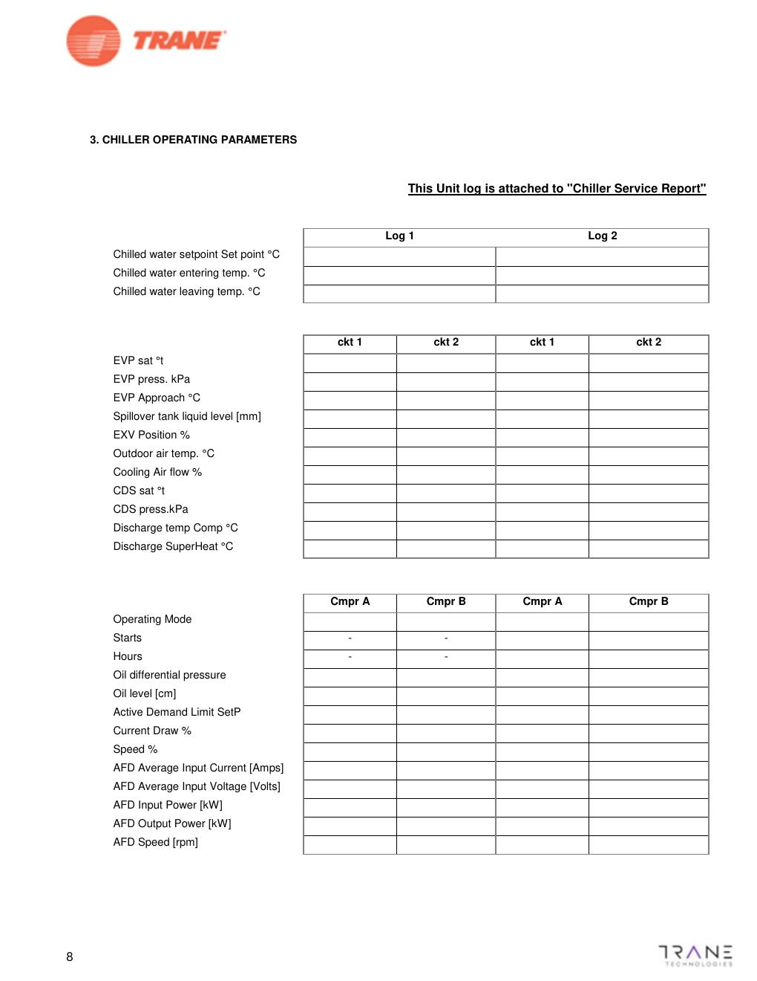
SOURCE EVIDENCE
Startup report evidence 5
Trane startup report - source page 8
Use the original report for signatures, detailed readings, revision status and formal acceptance.
LC4 AIR-COOLED CHILLER | Commissioning & Testing
11
Notes:
[Sources]
- User-provided source: Start Up Report-1430268 86 Linencraft Jbal Ali Building 04 G24K04508 Shaik Jaweed 07052025 UADUB - SUP JRRY V138.pdf
- Evidence reference: Trane startup report - source page 8
Training interpretation only. Verify against the controlled project record, current OEM documentation, approved PTW/LOTO, risk assessment and site procedures.

Slide 12
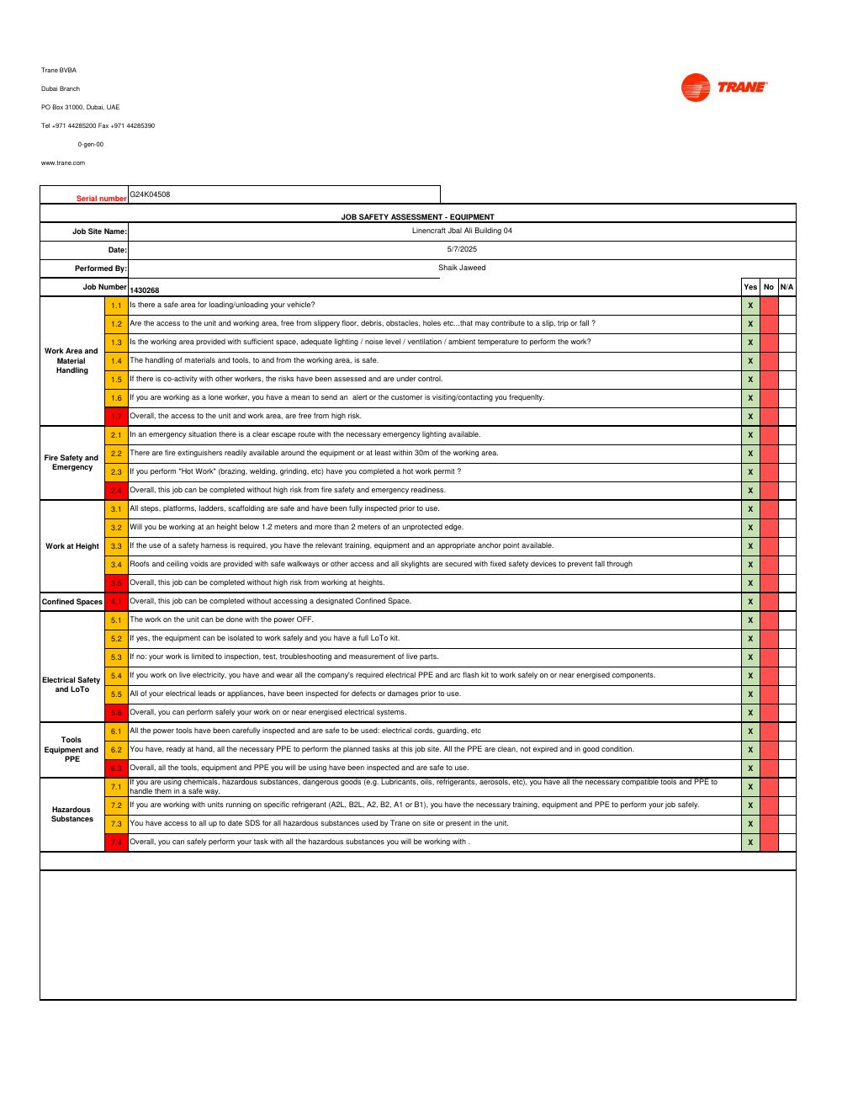
SOURCE EVIDENCE
Startup report evidence 6
Trane startup report - source page 10
Use the original report for signatures, detailed readings, revision status and formal acceptance.
LC4 AIR-COOLED CHILLER | Commissioning & Testing
12
Notes:
[Sources]
- User-provided source: Start Up Report-1430268 86 Linencraft Jbal Ali Building 04 G24K04508 Shaik Jaweed 07052025 UADUB - SUP JRRY V138.pdf
- Evidence reference: Trane startup report - source page 10
Training interpretation only. Verify against the controlled project record, current OEM documentation, approved PTW/LOTO, risk assessment and site procedures.

Slide 13
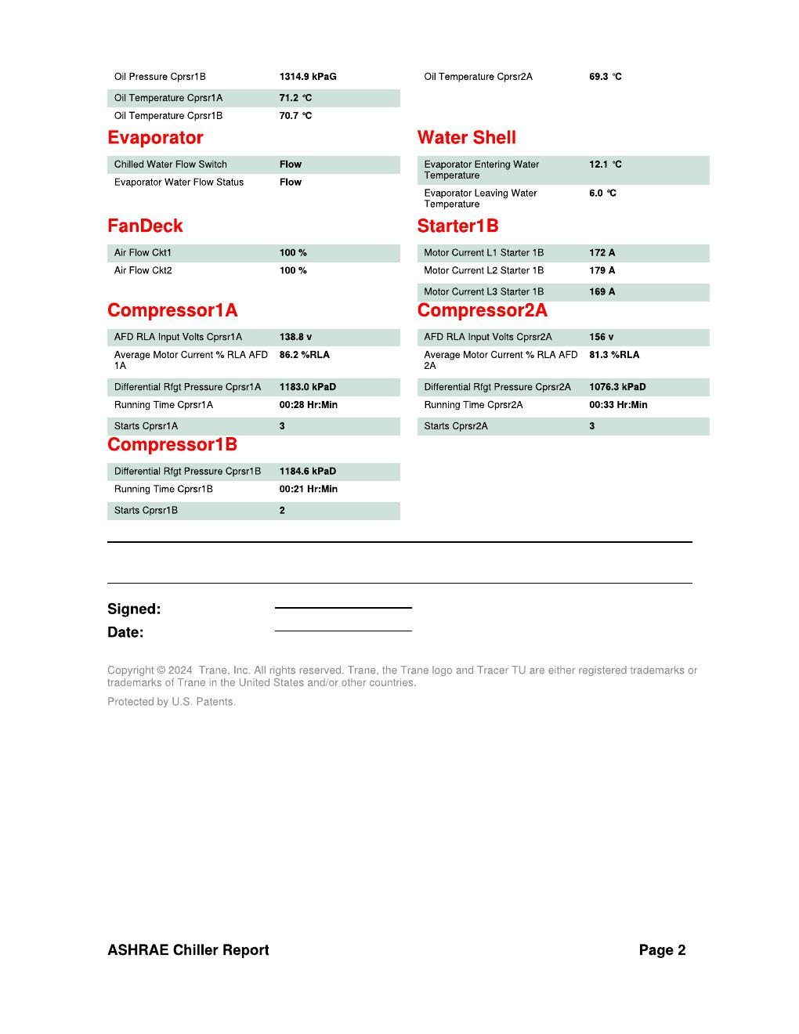
SOURCE EVIDENCE
Startup report evidence 7
Trane startup report - source page 12
Use the original report for signatures, detailed readings, revision status and formal acceptance.
LC4 AIR-COOLED CHILLER | Commissioning & Testing
13
Notes:
[Sources]
- User-provided source: Start Up Report-1430268 86 Linencraft Jbal Ali Building 04 G24K04508 Shaik Jaweed 07052025 UADUB - SUP JRRY V138.pdf
- Evidence reference: Trane startup report - source page 12
Training interpretation only. Verify against the controlled project record, current OEM documentation, approved PTW/LOTO, risk assessment and site procedures.

Slide 14
COMPETENCY CHECK
What technicians must retain
• Identify the correct controlled source before work.
• Verify readings, configuration and acceptance criteria.
• Preserve evidence and escalate unresolved deviations.
• Complete safe isolation, functional testing and handover records.
LC4 AIR-COOLED CHILLER | Commissioning & Testing
14
Notes:
[Sources]
- User-provided source: Start Up Report-1430268 86 Linencraft Jbal Ali Building 04 G24K04508 Shaik Jaweed 07052025 UADUB - SUP JRRY V138.pdf
Training interpretation only. Verify against the controlled project record, current OEM documentation, approved PTW/LOTO, risk assessment and site procedures.

