Slide 1
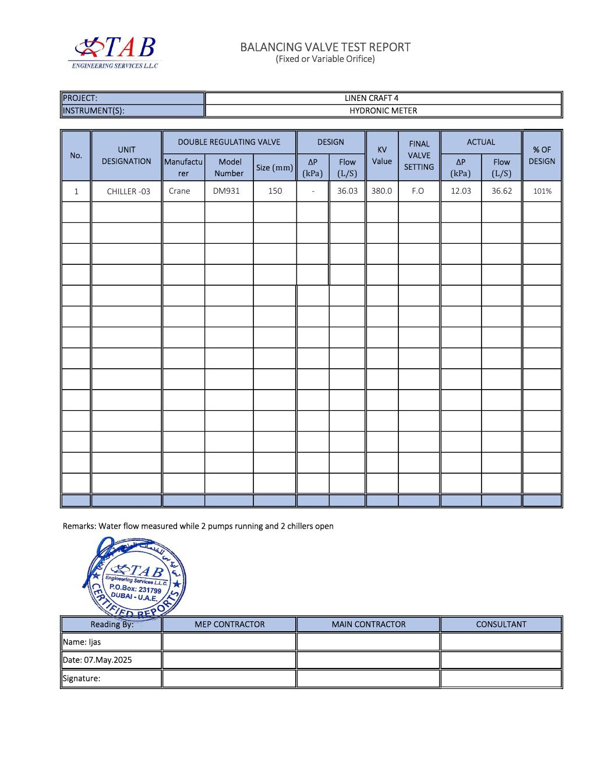
COMMISSIONING & TESTING
Chilled-Water Balancing Test
Chiller 03 flow verification
SAJJAD ENGINEERING ACADEMY
Notes:
[Sources]
- User-provided source: Water balancing .pdf
Training interpretation only. Verify against the controlled project record, current OEM documentation, approved PTW/LOTO, risk assessment and site procedures.

Slide 2
COMMISSIONING & TESTING
Source to practice
Evidence, interpretation and technician application
02
Notes:
[Sources]
- User-provided source: Water balancing .pdf
Training interpretation only. Verify against the controlled project record, current OEM documentation, approved PTW/LOTO, risk assessment and site procedures.

Slide 3
KEY EVIDENCE
Measured flow achieved 101% of design
36.03
36.62
12.03
Design flow, L/s
Actual flow, L/s
Measured differential pressure, kPa
LC4 AIR-COOLED CHILLER | Commissioning & Testing
03
Notes:
[Sources]
- User-provided source: Water balancing .pdf
Training interpretation only. Verify against the controlled project record, current OEM documentation, approved PTW/LOTO, risk assessment and site procedures.

Slide 4
TECHNICAL REVIEW
The balancing valve was recorded fully open during testing
• Chiller 03 used a Crane DM931, 150 mm double-regulating valve.
• The report records a design Kv value of 380.0.
• The reading was taken using a hydronic meter on 7 May 2025.
• The stated operating condition was two pumps running with two chillers open.
LC4 AIR-COOLED CHILLER | Commissioning & Testing
04
Notes:
[Sources]
- User-provided source: Water balancing .pdf
Training interpretation only. Verify against the controlled project record, current OEM documentation, approved PTW/LOTO, risk assessment and site procedures.

Slide 5
TECHNICAL REVIEW
The operating condition must be reproduced when comparing future flow
• Confirm pump combination and chiller valve positions.
• Verify strainers, air removal and differential-pressure sensor accuracy.
• Compare flow against current load, chilled-water temperature difference and pump speed.
• Rebalance after material piping, valve or pump changes.
LC4 AIR-COOLED CHILLER | Commissioning & Testing
05
Notes:
[Sources]
- User-provided source: Water balancing .pdf
Training interpretation only. Verify against the controlled project record, current OEM documentation, approved PTW/LOTO, risk assessment and site procedures.

Slide 6
SOURCE EVIDENCE
Balancing-valve test report
Chiller 03 - 101% of design flow
Use the original report for signatures, detailed readings, revision status and formal acceptance.
LC4 AIR-COOLED CHILLER | Commissioning & Testing
06
Notes:
[Sources]
- User-provided source: Water balancing .pdf
- Evidence reference: Chiller 03 - 101% of design flow
Training interpretation only. Verify against the controlled project record, current OEM documentation, approved PTW/LOTO, risk assessment and site procedures.

Slide 7
COMPETENCY CHECK
What technicians must retain
• Identify the correct controlled source before work.
• Verify readings, configuration and acceptance criteria.
• Preserve evidence and escalate unresolved deviations.
• Complete safe isolation, functional testing and handover records.
LC4 AIR-COOLED CHILLER | Commissioning & Testing
07
Notes:
[Sources]
- User-provided source: Water balancing .pdf
Training interpretation only. Verify against the controlled project record, current OEM documentation, approved PTW/LOTO, risk assessment and site procedures.

