Slide 1
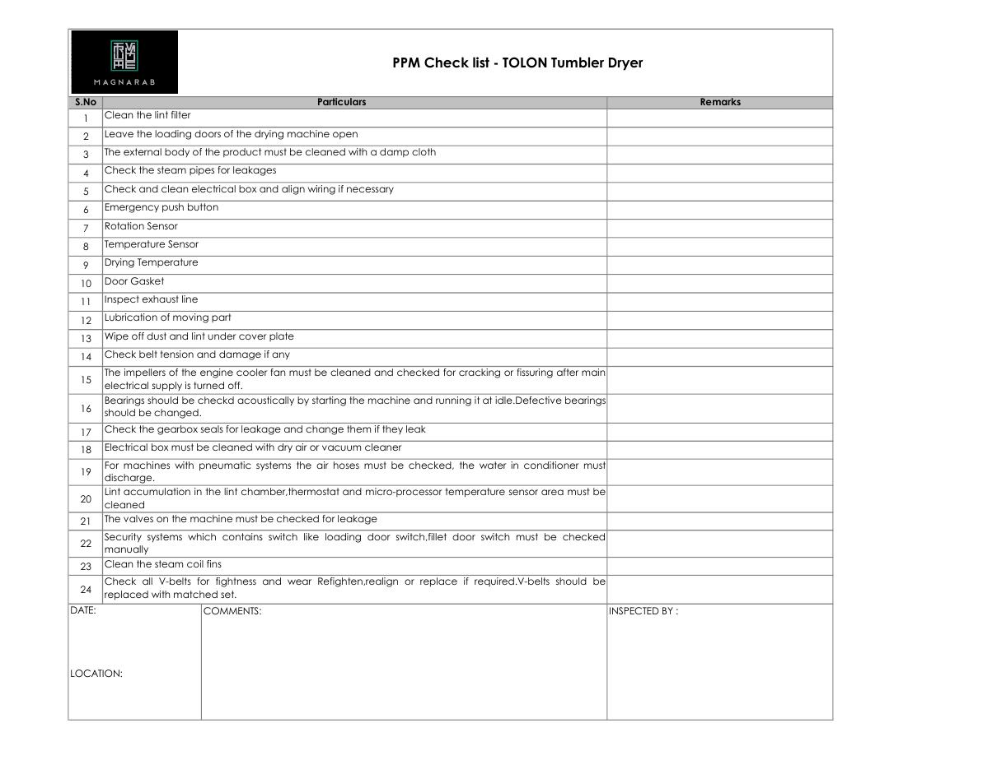
TOLON • DRYER PPM
TOLON Tumbler Dryer PPM
Practical preventive-maintenance checklist
SAJJAD ENGINEERING ACADEMY
Notes:
[Sources]
- User-provided source: PPM Check list - TOLON Tumbler Dryer.pdf
Training interpretation only. Verify against the controlled project record, current OEM documentation, approved PTW/LOTO, risk assessment and site procedures.

Slide 2
TOLON • DRYER PPM
Source to practice
Evidence, interpretation and technician application
02
Notes:
[Sources]
- User-provided source: PPM Check list - TOLON Tumbler Dryer.pdf
Training interpretation only. Verify against the controlled project record, current OEM documentation, approved PTW/LOTO, risk assessment and site procedures.

Slide 3
KEY EVIDENCE
A controlled technical reference for safe maintenance
11
Lint
Safety
Checklist items
Primary cleaning focus
Emergency and sensor checks
LC4 AIR-COOLED CHILLER | TOLON • Dryer PPM
03
Notes:
[Sources]
- User-provided source: PPM Check list - TOLON Tumbler Dryer.pdf
Training interpretation only. Verify against the controlled project record, current OEM documentation, approved PTW/LOTO, risk assessment and site procedures.

Slide 4
TECHNICAL REVIEW
Use the manual as a machine-specific working reference
• Clean the lint filter and inspect the exhaust line.
• Check steam piping, electrical box and wiring condition.
• Test emergency stop, rotation sensor and temperature sensor.
• Inspect door gasket and confirm drying temperature.
LC4 AIR-COOLED CHILLER | TOLON • Dryer PPM
04
Notes:
[Sources]
- User-provided source: PPM Check list - TOLON Tumbler Dryer.pdf
Training interpretation only. Verify against the controlled project record, current OEM documentation, approved PTW/LOTO, risk assessment and site procedures.

Slide 5
TECHNICAL REVIEW
Apply a consistent safe-work sequence
• Confirm machine identity, model and document revision.
• Isolate all energy sources and prove a safe state before access.
• Inspect, measure and diagnose before replacing components.
• Function-test safeguards and record the completed work.
LC4 AIR-COOLED CHILLER | TOLON • Dryer PPM
05
Notes:
[Sources]
- User-provided source: PPM Check list - TOLON Tumbler Dryer.pdf
Training interpretation only. Verify against the controlled project record, current OEM documentation, approved PTW/LOTO, risk assessment and site procedures.

Slide 6
TECHNICAL REVIEW
Parts and settings require configuration control
• Record original settings and connections before adjustment.
• Use exact part numbers or approved supersessions.
• Preserve firmware, program and parameter backups where applicable.
• Update the maintenance history after each intervention.
LC4 AIR-COOLED CHILLER | TOLON • Dryer PPM
06
Notes:
[Sources]
- User-provided source: PPM Check list - TOLON Tumbler Dryer.pdf
Training interpretation only. Verify against the controlled project record, current OEM documentation, approved PTW/LOTO, risk assessment and site procedures.

Slide 7
SOURCE EVIDENCE
Manual evidence 1
Source page 1
Use the original report for signatures, detailed readings, revision status and formal acceptance.
LC4 AIR-COOLED CHILLER | TOLON • Dryer PPM
07
Notes:
[Sources]
- User-provided source: PPM Check list - TOLON Tumbler Dryer.pdf
- Evidence reference: Source page 1
Training interpretation only. Verify against the controlled project record, current OEM documentation, approved PTW/LOTO, risk assessment and site procedures.

Slide 8
COMPETENCY CHECK
What technicians must retain
• Identify the correct controlled source before work.
• Verify readings, configuration and acceptance criteria.
• Preserve evidence and escalate unresolved deviations.
• Complete safe isolation, functional testing and handover records.
LC4 AIR-COOLED CHILLER | TOLON • Dryer PPM
08
Notes:
[Sources]
- User-provided source: PPM Check list - TOLON Tumbler Dryer.pdf
Training interpretation only. Verify against the controlled project record, current OEM documentation, approved PTW/LOTO, risk assessment and site procedures.

