Slide 1
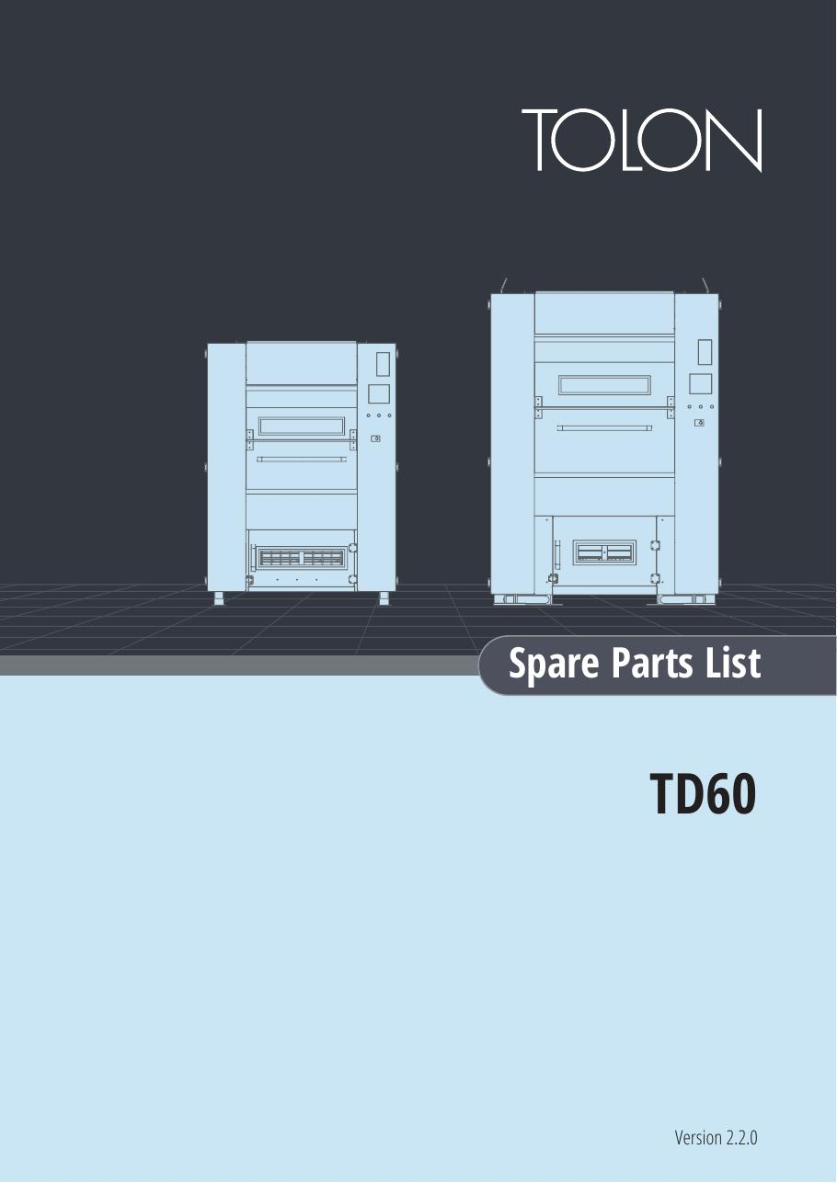
TOLON • SPARE PARTS
TOLON TTD60 Spare Parts
Model-specific illustrated parts reference
SAJJAD ENGINEERING ACADEMY
Notes:
[Sources]
- User-provided source: TTD60 Spare Parts Lists v.2.2.1.pdf
Training interpretation only. Verify against the controlled project record, current OEM documentation, approved PTW/LOTO, risk assessment and site procedures.

Slide 2
TOLON • SPARE PARTS
Source to practice
Evidence, interpretation and technician application
02
Notes:
[Sources]
- User-provided source: TTD60 Spare Parts Lists v.2.2.1.pdf
Training interpretation only. Verify against the controlled project record, current OEM documentation, approved PTW/LOTO, risk assessment and site procedures.

Slide 3
KEY EVIDENCE
A controlled technical reference for safe maintenance
TTD60
v2.2
28
Machine model
Catalogue family
Catalogue pages
LC4 AIR-COOLED CHILLER | TOLON • Spare Parts
03
Notes:
[Sources]
- User-provided source: TTD60 Spare Parts Lists v.2.2.1.pdf
Training interpretation only. Verify against the controlled project record, current OEM documentation, approved PTW/LOTO, risk assessment and site procedures.

Slide 4
TECHNICAL REVIEW
Use the manual as a machine-specific working reference
• Match exploded-view callouts to exact part numbers.
• Confirm serial and revision before ordering.
• Record approved supersessions.
• Preserve removed-part evidence for repeat failures.
LC4 AIR-COOLED CHILLER | TOLON • Spare Parts
04
Notes:
[Sources]
- User-provided source: TTD60 Spare Parts Lists v.2.2.1.pdf
Training interpretation only. Verify against the controlled project record, current OEM documentation, approved PTW/LOTO, risk assessment and site procedures.

Slide 5
TECHNICAL REVIEW
Apply a consistent safe-work sequence
• Confirm machine identity, model and document revision.
• Isolate all energy sources and prove a safe state before access.
• Inspect, measure and diagnose before replacing components.
• Function-test safeguards and record the completed work.
LC4 AIR-COOLED CHILLER | TOLON • Spare Parts
05
Notes:
[Sources]
- User-provided source: TTD60 Spare Parts Lists v.2.2.1.pdf
Training interpretation only. Verify against the controlled project record, current OEM documentation, approved PTW/LOTO, risk assessment and site procedures.

Slide 6
TECHNICAL REVIEW
Parts and settings require configuration control
• Record original settings and connections before adjustment.
• Use exact part numbers or approved supersessions.
• Preserve firmware, program and parameter backups where applicable.
• Update the maintenance history after each intervention.
LC4 AIR-COOLED CHILLER | TOLON • Spare Parts
06
Notes:
[Sources]
- User-provided source: TTD60 Spare Parts Lists v.2.2.1.pdf
Training interpretation only. Verify against the controlled project record, current OEM documentation, approved PTW/LOTO, risk assessment and site procedures.

Slide 7
SOURCE EVIDENCE
Manual evidence 1
Source page 1
Use the original report for signatures, detailed readings, revision status and formal acceptance.
LC4 AIR-COOLED CHILLER | TOLON • Spare Parts
07
Notes:
[Sources]
- User-provided source: TTD60 Spare Parts Lists v.2.2.1.pdf
- Evidence reference: Source page 1
Training interpretation only. Verify against the controlled project record, current OEM documentation, approved PTW/LOTO, risk assessment and site procedures.

Slide 8
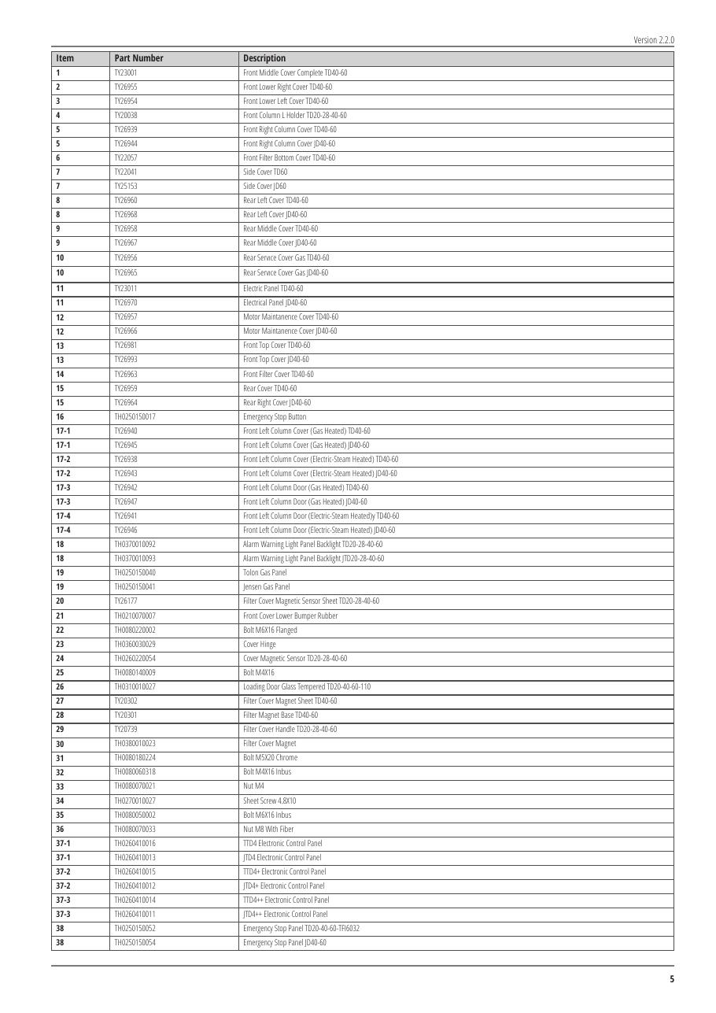
SOURCE EVIDENCE
Manual evidence 2
Source page 5
Use the original report for signatures, detailed readings, revision status and formal acceptance.
LC4 AIR-COOLED CHILLER | TOLON • Spare Parts
08
Notes:
[Sources]
- User-provided source: TTD60 Spare Parts Lists v.2.2.1.pdf
- Evidence reference: Source page 5
Training interpretation only. Verify against the controlled project record, current OEM documentation, approved PTW/LOTO, risk assessment and site procedures.

Slide 9
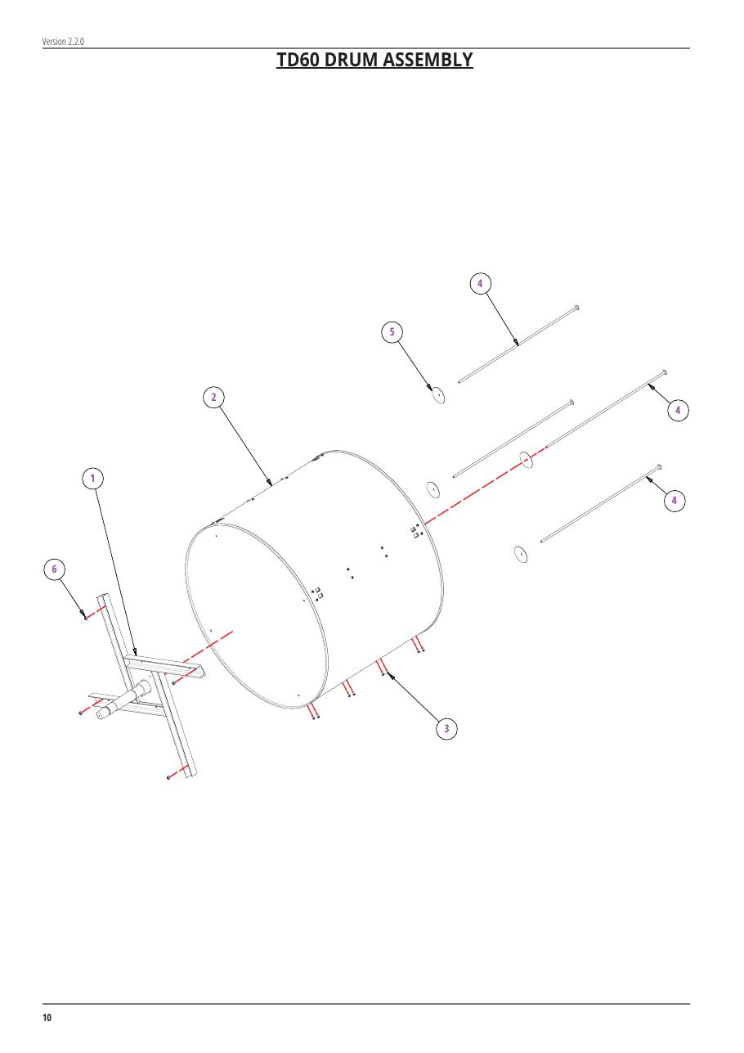
SOURCE EVIDENCE
Manual evidence 3
Source page 10
Use the original report for signatures, detailed readings, revision status and formal acceptance.
LC4 AIR-COOLED CHILLER | TOLON • Spare Parts
09
Notes:
[Sources]
- User-provided source: TTD60 Spare Parts Lists v.2.2.1.pdf
- Evidence reference: Source page 10
Training interpretation only. Verify against the controlled project record, current OEM documentation, approved PTW/LOTO, risk assessment and site procedures.

Slide 10
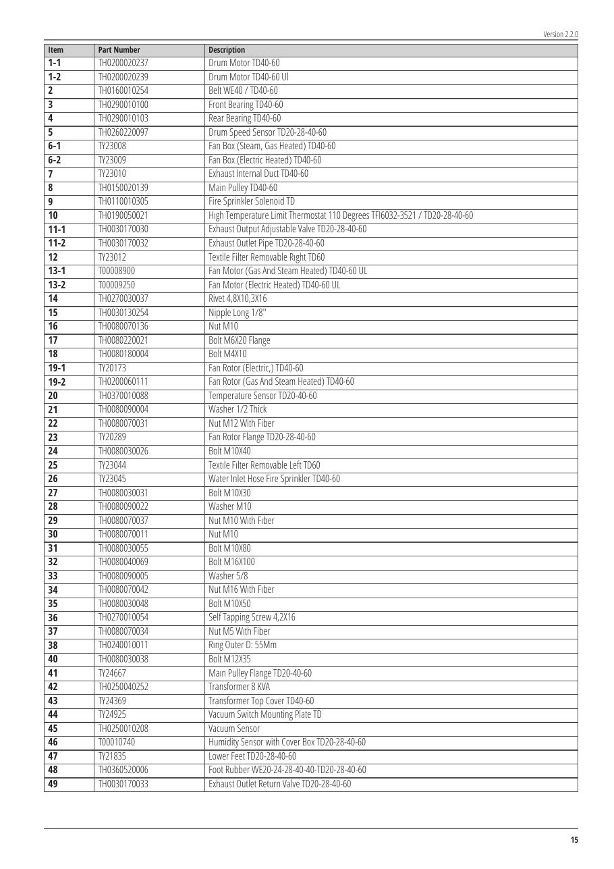
SOURCE EVIDENCE
Manual evidence 4
Source page 15
Use the original report for signatures, detailed readings, revision status and formal acceptance.
LC4 AIR-COOLED CHILLER | TOLON • Spare Parts
10
Notes:
[Sources]
- User-provided source: TTD60 Spare Parts Lists v.2.2.1.pdf
- Evidence reference: Source page 15
Training interpretation only. Verify against the controlled project record, current OEM documentation, approved PTW/LOTO, risk assessment and site procedures.

Slide 11
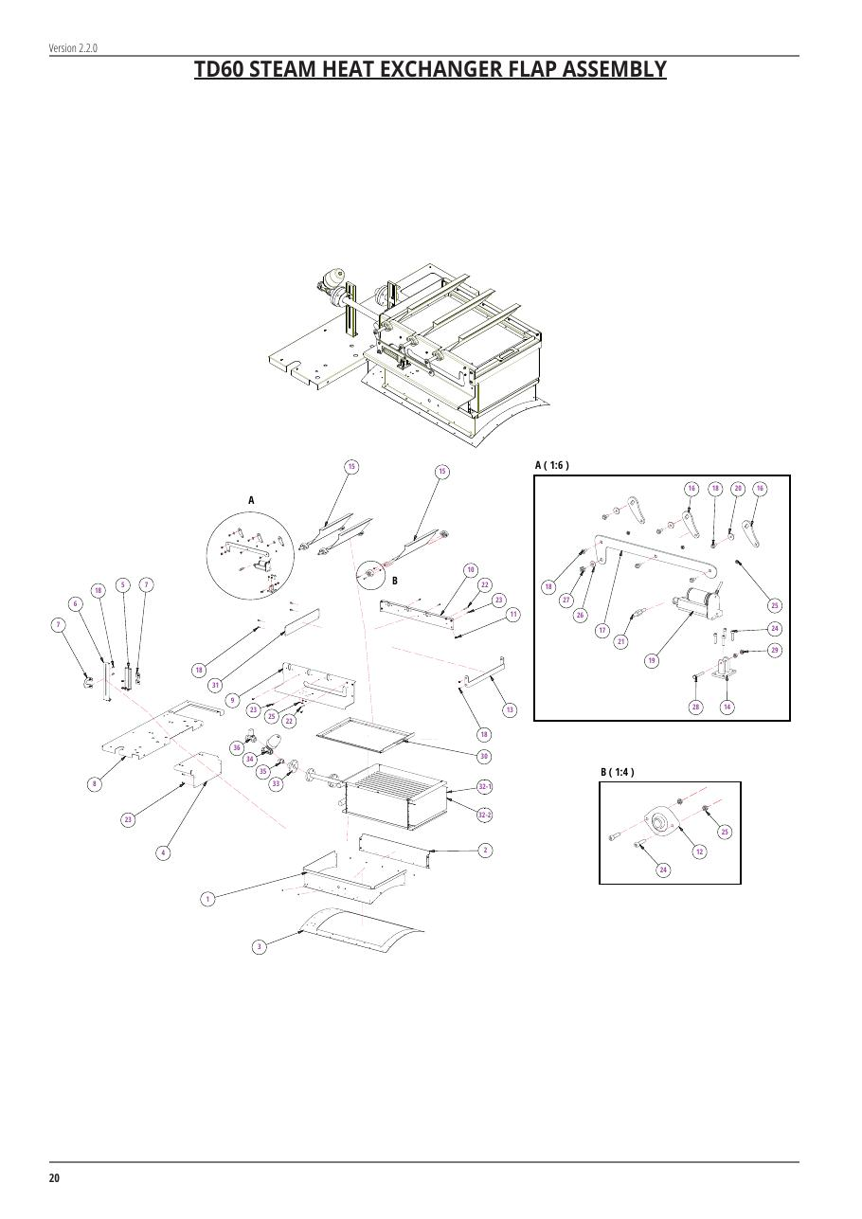
SOURCE EVIDENCE
Manual evidence 5
Source page 20
Use the original report for signatures, detailed readings, revision status and formal acceptance.
LC4 AIR-COOLED CHILLER | TOLON • Spare Parts
11
Notes:
[Sources]
- User-provided source: TTD60 Spare Parts Lists v.2.2.1.pdf
- Evidence reference: Source page 20
Training interpretation only. Verify against the controlled project record, current OEM documentation, approved PTW/LOTO, risk assessment and site procedures.

Slide 12
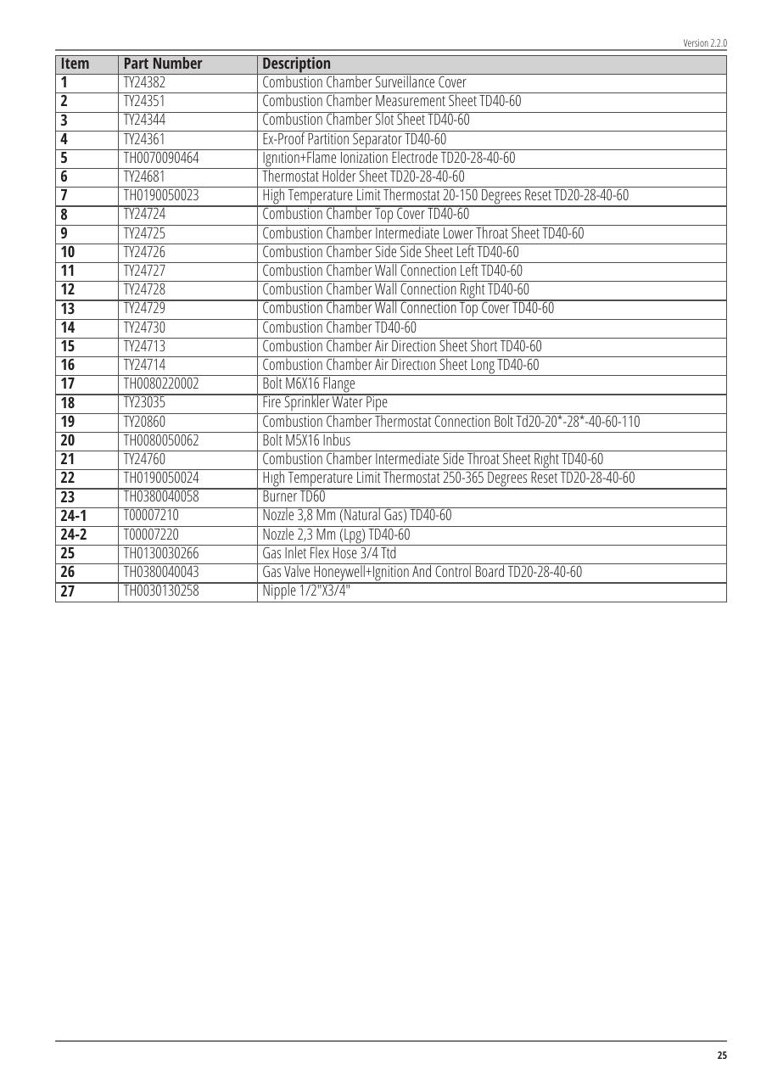
SOURCE EVIDENCE
Manual evidence 6
Source page 25
Use the original report for signatures, detailed readings, revision status and formal acceptance.
LC4 AIR-COOLED CHILLER | TOLON • Spare Parts
12
Notes:
[Sources]
- User-provided source: TTD60 Spare Parts Lists v.2.2.1.pdf
- Evidence reference: Source page 25
Training interpretation only. Verify against the controlled project record, current OEM documentation, approved PTW/LOTO, risk assessment and site procedures.

Slide 13

SOURCE EVIDENCE
Manual evidence 7
Source page 28
Use the original report for signatures, detailed readings, revision status and formal acceptance.
LC4 AIR-COOLED CHILLER | TOLON • Spare Parts
13
Notes:
[Sources]
- User-provided source: TTD60 Spare Parts Lists v.2.2.1.pdf
- Evidence reference: Source page 28
Training interpretation only. Verify against the controlled project record, current OEM documentation, approved PTW/LOTO, risk assessment and site procedures.

Slide 14
COMPETENCY CHECK
What technicians must retain
• Identify the correct controlled source before work.
• Verify readings, configuration and acceptance criteria.
• Preserve evidence and escalate unresolved deviations.
• Complete safe isolation, functional testing and handover records.
LC4 AIR-COOLED CHILLER | TOLON • Spare Parts
14
Notes:
[Sources]
- User-provided source: TTD60 Spare Parts Lists v.2.2.1.pdf
Training interpretation only. Verify against the controlled project record, current OEM documentation, approved PTW/LOTO, risk assessment and site procedures.

