Slide 1
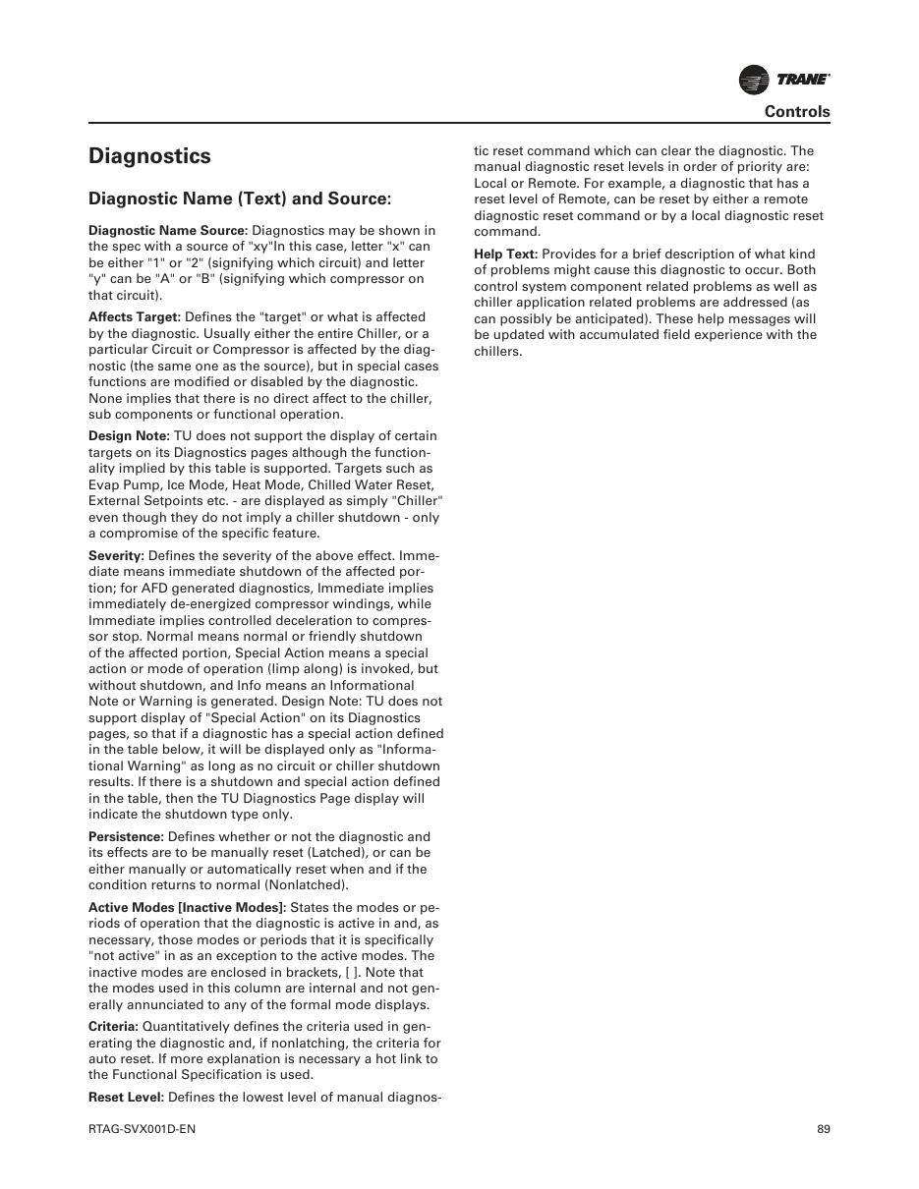
SEQUENCE & DIAGNOSTICS
RTAG Diagnostics Guide
Diagnostic targets, reset levels and cause-based troubleshooting
SAJJAD ENGINEERING ACADEMY
Notes:
[Sources]
- User-provided source: RTAG_Diagnostic.pdf
Training interpretation only. Verify against the controlled project record, current OEM documentation, approved PTW/LOTO, risk assessment and site procedures.

Slide 2
SEQUENCE & DIAGNOSTICS
Source to practice
Evidence, interpretation and technician application
02
Notes:
[Sources]
- User-provided source: RTAG_Diagnostic.pdf
Training interpretation only. Verify against the controlled project record, current OEM documentation, approved PTW/LOTO, risk assessment and site procedures.

Slide 3
KEY EVIDENCE
A controlled technical reference for safe maintenance
Local/Remote
Cause → Effect
16
Diagnostic reset levels
Troubleshooting method
Source pages
LC4 AIR-COOLED CHILLER | Sequence & Diagnostics
03
Notes:
[Sources]
- User-provided source: RTAG_Diagnostic.pdf
Training interpretation only. Verify against the controlled project record, current OEM documentation, approved PTW/LOTO, risk assessment and site procedures.

Slide 4
TECHNICAL REVIEW
Use the manual as a machine-specific working reference
• Record diagnostic name, source and affected target.
• Respect reset priority and investigate before clearing.
• Check both control-system and application causes.
• Prove recovery and monitor for recurrence.
LC4 AIR-COOLED CHILLER | Sequence & Diagnostics
04
Notes:
[Sources]
- User-provided source: RTAG_Diagnostic.pdf
Training interpretation only. Verify against the controlled project record, current OEM documentation, approved PTW/LOTO, risk assessment and site procedures.

Slide 5
TECHNICAL REVIEW
Apply a consistent safe-work sequence
• Confirm machine identity, model and document revision.
• Isolate all energy sources and prove a safe state before access.
• Inspect, measure and diagnose before replacing components.
• Function-test safeguards and record the completed work.
LC4 AIR-COOLED CHILLER | Sequence & Diagnostics
05
Notes:
[Sources]
- User-provided source: RTAG_Diagnostic.pdf
Training interpretation only. Verify against the controlled project record, current OEM documentation, approved PTW/LOTO, risk assessment and site procedures.

Slide 6
TECHNICAL REVIEW
Parts and settings require configuration control
• Record original settings and connections before adjustment.
• Use exact part numbers or approved supersessions.
• Preserve firmware, program and parameter backups where applicable.
• Update the maintenance history after each intervention.
LC4 AIR-COOLED CHILLER | Sequence & Diagnostics
06
Notes:
[Sources]
- User-provided source: RTAG_Diagnostic.pdf
Training interpretation only. Verify against the controlled project record, current OEM documentation, approved PTW/LOTO, risk assessment and site procedures.

Slide 7
SOURCE EVIDENCE
Manual evidence 1
Source page 1
Use the original report for signatures, detailed readings, revision status and formal acceptance.
LC4 AIR-COOLED CHILLER | Sequence & Diagnostics
07
Notes:
[Sources]
- User-provided source: RTAG_Diagnostic.pdf
- Evidence reference: Source page 1
Training interpretation only. Verify against the controlled project record, current OEM documentation, approved PTW/LOTO, risk assessment and site procedures.

Slide 8
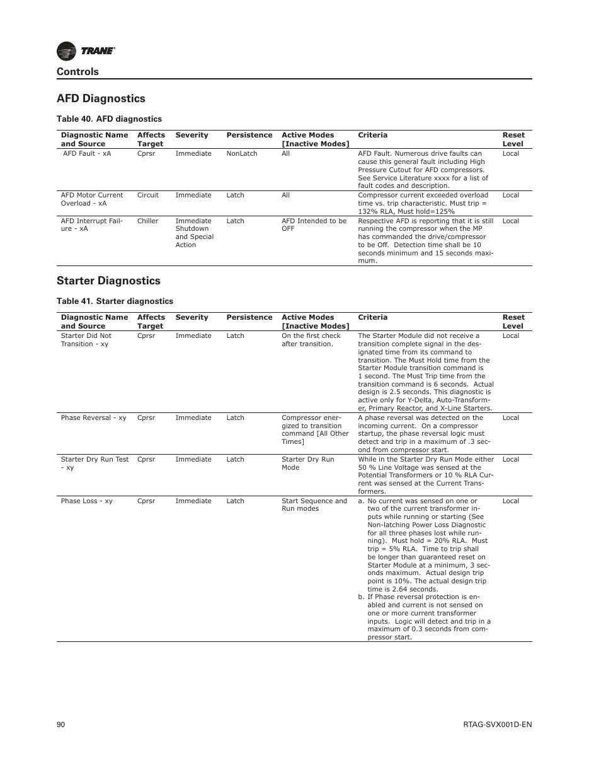
SOURCE EVIDENCE
Manual evidence 2
Source page 2
Use the original report for signatures, detailed readings, revision status and formal acceptance.
LC4 AIR-COOLED CHILLER | Sequence & Diagnostics
08
Notes:
[Sources]
- User-provided source: RTAG_Diagnostic.pdf
- Evidence reference: Source page 2
Training interpretation only. Verify against the controlled project record, current OEM documentation, approved PTW/LOTO, risk assessment and site procedures.

Slide 9
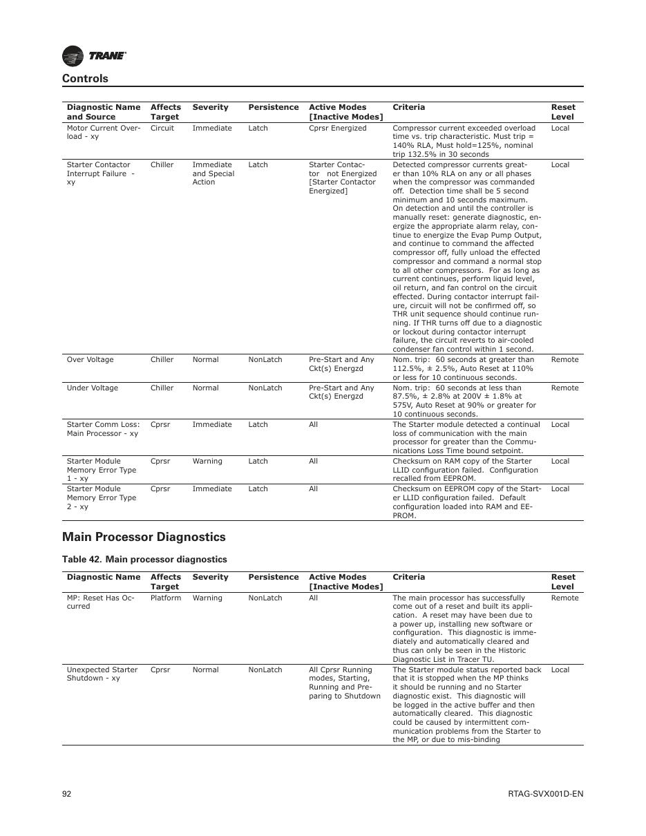
SOURCE EVIDENCE
Manual evidence 3
Source page 4
Use the original report for signatures, detailed readings, revision status and formal acceptance.
LC4 AIR-COOLED CHILLER | Sequence & Diagnostics
09
Notes:
[Sources]
- User-provided source: RTAG_Diagnostic.pdf
- Evidence reference: Source page 4
Training interpretation only. Verify against the controlled project record, current OEM documentation, approved PTW/LOTO, risk assessment and site procedures.

Slide 10
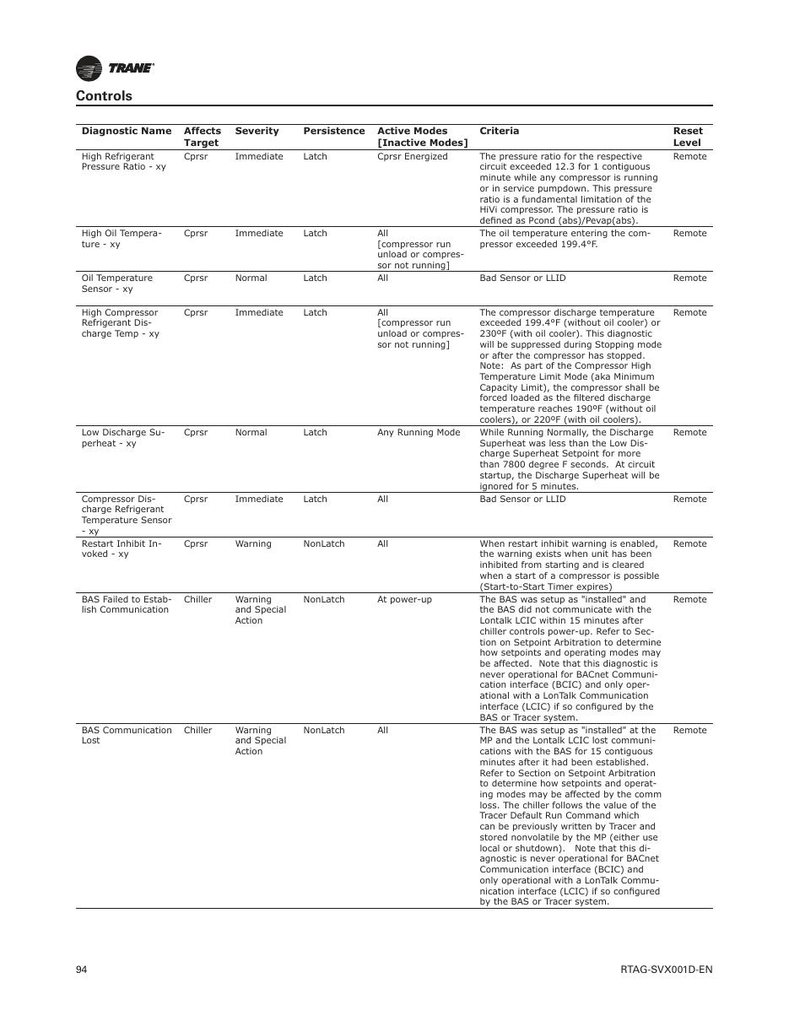
SOURCE EVIDENCE
Manual evidence 4
Source page 6
Use the original report for signatures, detailed readings, revision status and formal acceptance.
LC4 AIR-COOLED CHILLER | Sequence & Diagnostics
10
Notes:
[Sources]
- User-provided source: RTAG_Diagnostic.pdf
- Evidence reference: Source page 6
Training interpretation only. Verify against the controlled project record, current OEM documentation, approved PTW/LOTO, risk assessment and site procedures.

Slide 11
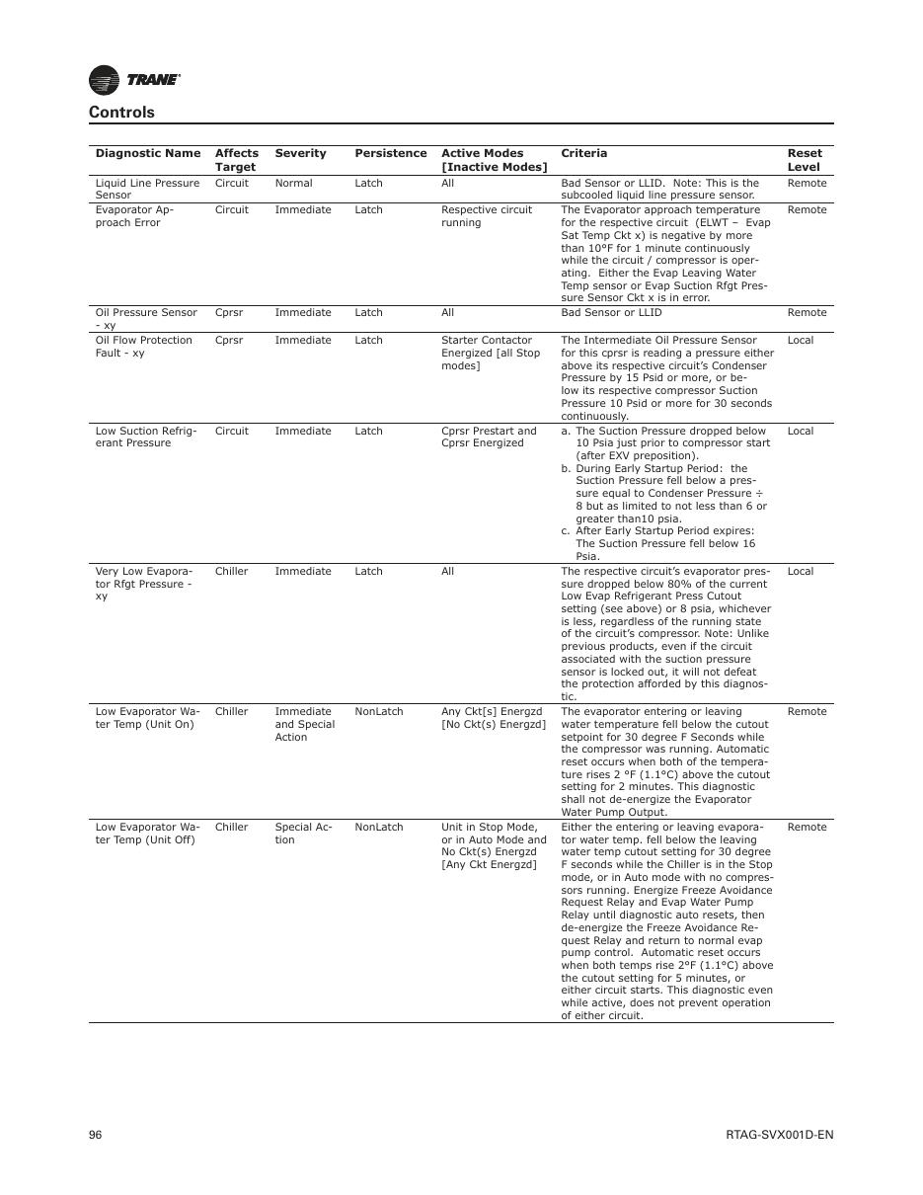
SOURCE EVIDENCE
Manual evidence 5
Source page 8
Use the original report for signatures, detailed readings, revision status and formal acceptance.
LC4 AIR-COOLED CHILLER | Sequence & Diagnostics
11
Notes:
[Sources]
- User-provided source: RTAG_Diagnostic.pdf
- Evidence reference: Source page 8
Training interpretation only. Verify against the controlled project record, current OEM documentation, approved PTW/LOTO, risk assessment and site procedures.

Slide 12
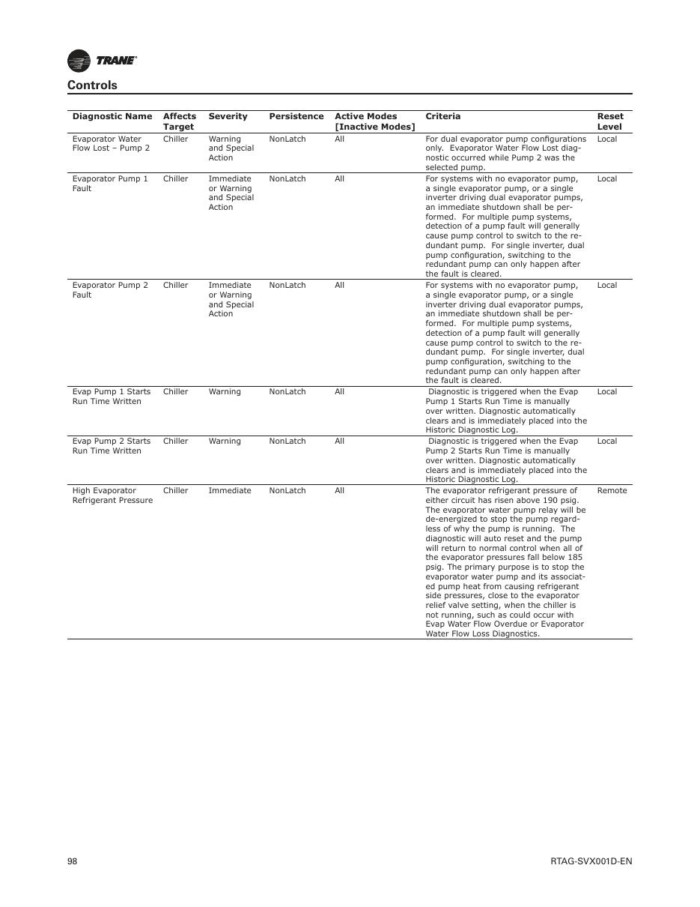
SOURCE EVIDENCE
Manual evidence 6
Source page 10
Use the original report for signatures, detailed readings, revision status and formal acceptance.
LC4 AIR-COOLED CHILLER | Sequence & Diagnostics
12
Notes:
[Sources]
- User-provided source: RTAG_Diagnostic.pdf
- Evidence reference: Source page 10
Training interpretation only. Verify against the controlled project record, current OEM documentation, approved PTW/LOTO, risk assessment and site procedures.

Slide 13
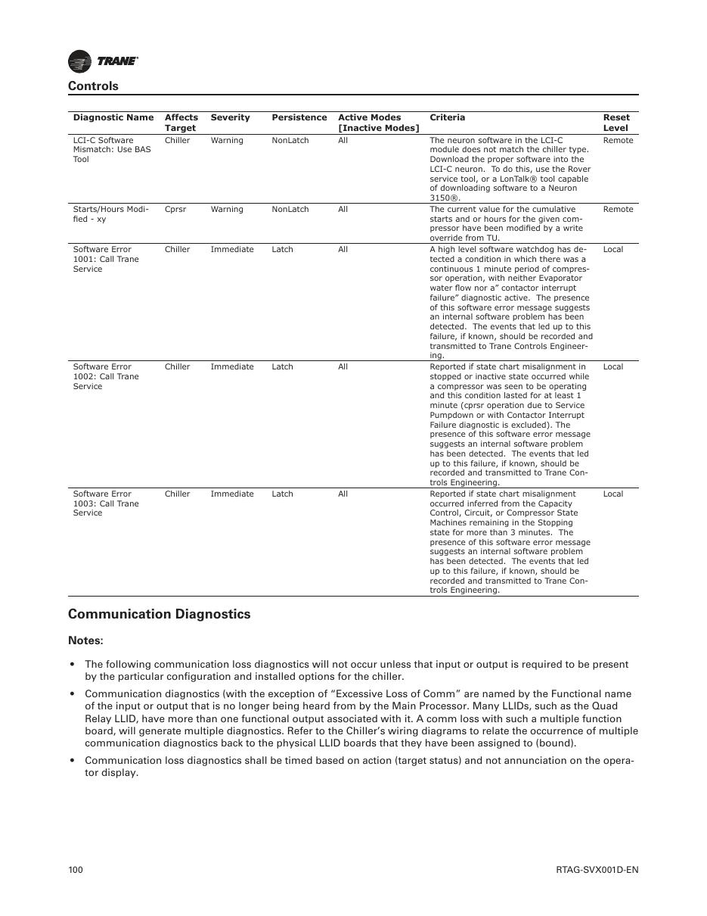
SOURCE EVIDENCE
Manual evidence 7
Source page 12
Use the original report for signatures, detailed readings, revision status and formal acceptance.
LC4 AIR-COOLED CHILLER | Sequence & Diagnostics
13
Notes:
[Sources]
- User-provided source: RTAG_Diagnostic.pdf
- Evidence reference: Source page 12
Training interpretation only. Verify against the controlled project record, current OEM documentation, approved PTW/LOTO, risk assessment and site procedures.

Slide 14
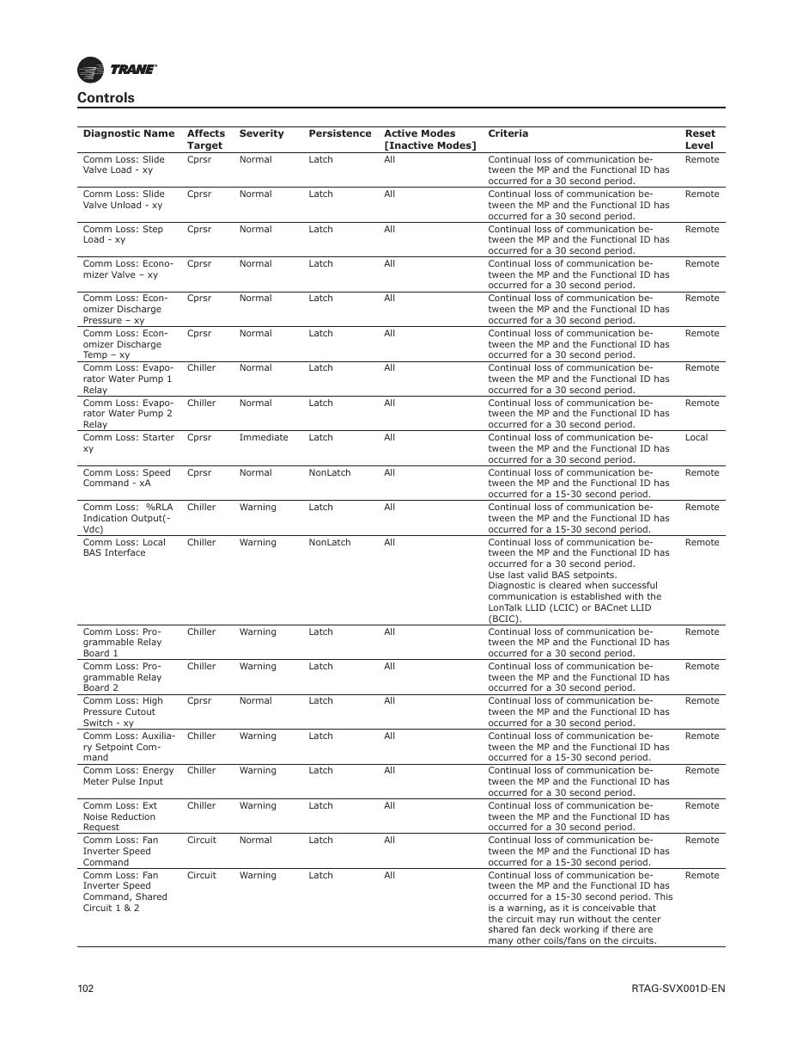
SOURCE EVIDENCE
Manual evidence 8
Source page 14
Use the original report for signatures, detailed readings, revision status and formal acceptance.
LC4 AIR-COOLED CHILLER | Sequence & Diagnostics
14
Notes:
[Sources]
- User-provided source: RTAG_Diagnostic.pdf
- Evidence reference: Source page 14
Training interpretation only. Verify against the controlled project record, current OEM documentation, approved PTW/LOTO, risk assessment and site procedures.

Slide 15
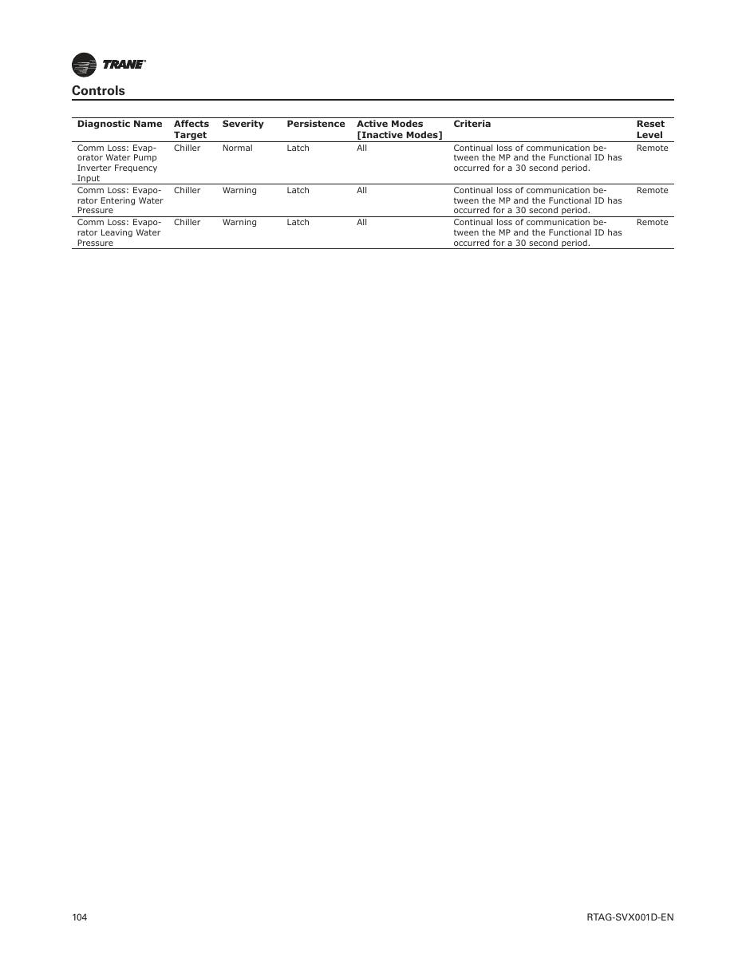
SOURCE EVIDENCE
Manual evidence 9
Source page 16
Use the original report for signatures, detailed readings, revision status and formal acceptance.
LC4 AIR-COOLED CHILLER | Sequence & Diagnostics
15
Notes:
[Sources]
- User-provided source: RTAG_Diagnostic.pdf
- Evidence reference: Source page 16
Training interpretation only. Verify against the controlled project record, current OEM documentation, approved PTW/LOTO, risk assessment and site procedures.

Slide 16
COMPETENCY CHECK
What technicians must retain
• Identify the correct controlled source before work.
• Verify readings, configuration and acceptance criteria.
• Preserve evidence and escalate unresolved deviations.
• Complete safe isolation, functional testing and handover records.
LC4 AIR-COOLED CHILLER | Sequence & Diagnostics
16
Notes:
[Sources]
- User-provided source: RTAG_Diagnostic.pdf
Training interpretation only. Verify against the controlled project record, current OEM documentation, approved PTW/LOTO, risk assessment and site procedures.

