Slide 1

O&M MANUALS
RTAG Air-Cooled Chiller IOM
Installation, operation and maintenance training reference
SAJJAD ENGINEERING ACADEMY
Notes:
[Sources]
- User-provided source: RTAG IOM.pdf
Training interpretation only. Verify against the controlled project record, current OEM documentation, approved PTW/LOTO, risk assessment and site procedures.

Slide 2
O&M MANUALS
Source to practice
Evidence, interpretation and technician application
02
Notes:
[Sources]
- User-provided source: RTAG IOM.pdf
Training interpretation only. Verify against the controlled project record, current OEM documentation, approved PTW/LOTO, risk assessment and site procedures.

Slide 3
KEY EVIDENCE
The manual covers RTAG 085-440 ton 50 Hz units
243
RTAG
2020
Manual pages
Helical rotary liquid chiller
Manual release year
LC4 AIR-COOLED CHILLER | O&M Manuals
03
Notes:
[Sources]
- User-provided source: RTAG IOM.pdf
Training interpretation only. Verify against the controlled project record, current OEM documentation, approved PTW/LOTO, risk assessment and site procedures.

Slide 4
TECHNICAL REVIEW
The manual is the primary reference for safe technical work
• Read warnings, cautions and notices before operation or service.
• Confirm the complete unit model number and installed options.
• Use current electrical, refrigerant and water-side information.
• Apply local regulations and site procedures in addition to OEM requirements.
LC4 AIR-COOLED CHILLER | O&M Manuals
04
Notes:
[Sources]
- User-provided source: RTAG IOM.pdf
Training interpretation only. Verify against the controlled project record, current OEM documentation, approved PTW/LOTO, risk assessment and site procedures.

Slide 5
TECHNICAL REVIEW
Installation quality determines long-term reliability
• Verify foundations, clearances, lifting and structural support.
• Confirm chilled-water piping, strainers, vents, drains and insulation.
• Check electrical supply, earthing, protection and field wiring.
• Complete pre-start checks before energizing or enabling compressors.
LC4 AIR-COOLED CHILLER | O&M Manuals
05
Notes:
[Sources]
- User-provided source: RTAG IOM.pdf
Training interpretation only. Verify against the controlled project record, current OEM documentation, approved PTW/LOTO, risk assessment and site procedures.

Slide 6
TECHNICAL REVIEW
Operation requires evidence from both controls and physical condition
• Use the unit interface to review status, setpoints, alarms and trends.
• Monitor entering/leaving water temperatures and calculated load behaviour.
• Check refrigerant pressures, oil condition, fan operation and vibration.
• Escalate repeated alarms instead of normalizing resets.
LC4 AIR-COOLED CHILLER | O&M Manuals
06
Notes:
[Sources]
- User-provided source: RTAG IOM.pdf
Training interpretation only. Verify against the controlled project record, current OEM documentation, approved PTW/LOTO, risk assessment and site procedures.

Slide 7
TECHNICAL REVIEW
Preventive maintenance should protect heat transfer and compressor life
• Keep condenser coils clean and airflow unobstructed.
• Inspect fans, motors, guards and electrical connections.
• Maintain chilled-water quality, flow and evaporator protection.
• Trend approach temperatures, pressure, current and operating hours.
LC4 AIR-COOLED CHILLER | O&M Manuals
07
Notes:
[Sources]
- User-provided source: RTAG IOM.pdf
Training interpretation only. Verify against the controlled project record, current OEM documentation, approved PTW/LOTO, risk assessment and site procedures.

Slide 8
TECHNICAL REVIEW
Troubleshooting should follow cause-and-effect logic
• Capture the first alarm and operating conditions before reset.
• Separate water-side, air-side, electrical, control and refrigerant causes.
• Verify sensors and wiring before replacing controllers or modules.
• Prove repair effectiveness under a controlled operating test.
LC4 AIR-COOLED CHILLER | O&M Manuals
08
Notes:
[Sources]
- User-provided source: RTAG IOM.pdf
Training interpretation only. Verify against the controlled project record, current OEM documentation, approved PTW/LOTO, risk assessment and site procedures.

Slide 9
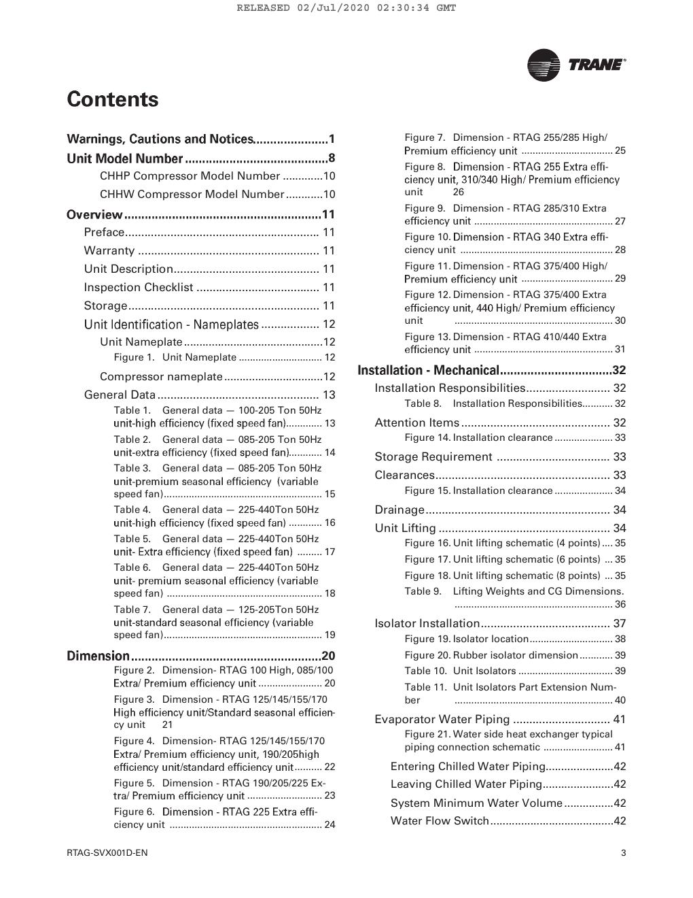
SOURCE EVIDENCE
RTAG IOM reference 1
RTAG IOM - source page 4
Use the original report for signatures, detailed readings, revision status and formal acceptance.
LC4 AIR-COOLED CHILLER | O&M Manuals
09
Notes:
[Sources]
- User-provided source: RTAG IOM.pdf
- Evidence reference: RTAG IOM - source page 4
Training interpretation only. Verify against the controlled project record, current OEM documentation, approved PTW/LOTO, risk assessment and site procedures.

Slide 10
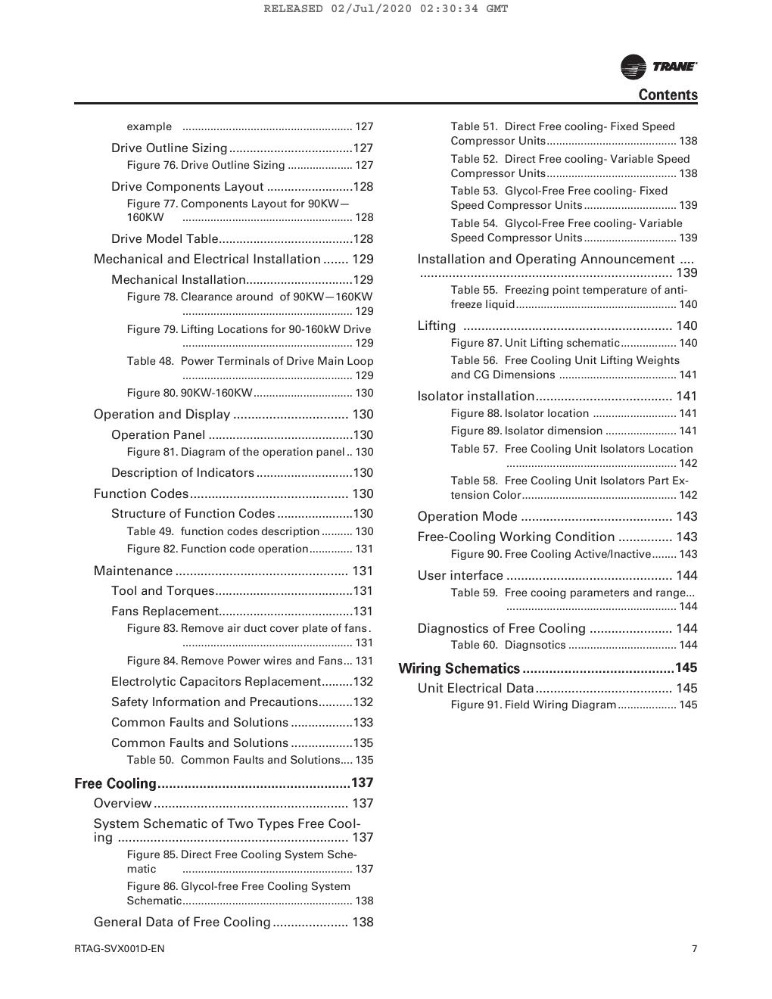
SOURCE EVIDENCE
RTAG IOM reference 2
RTAG IOM - source page 8
Use the original report for signatures, detailed readings, revision status and formal acceptance.
LC4 AIR-COOLED CHILLER | O&M Manuals
10
Notes:
[Sources]
- User-provided source: RTAG IOM.pdf
- Evidence reference: RTAG IOM - source page 8
Training interpretation only. Verify against the controlled project record, current OEM documentation, approved PTW/LOTO, risk assessment and site procedures.

Slide 11
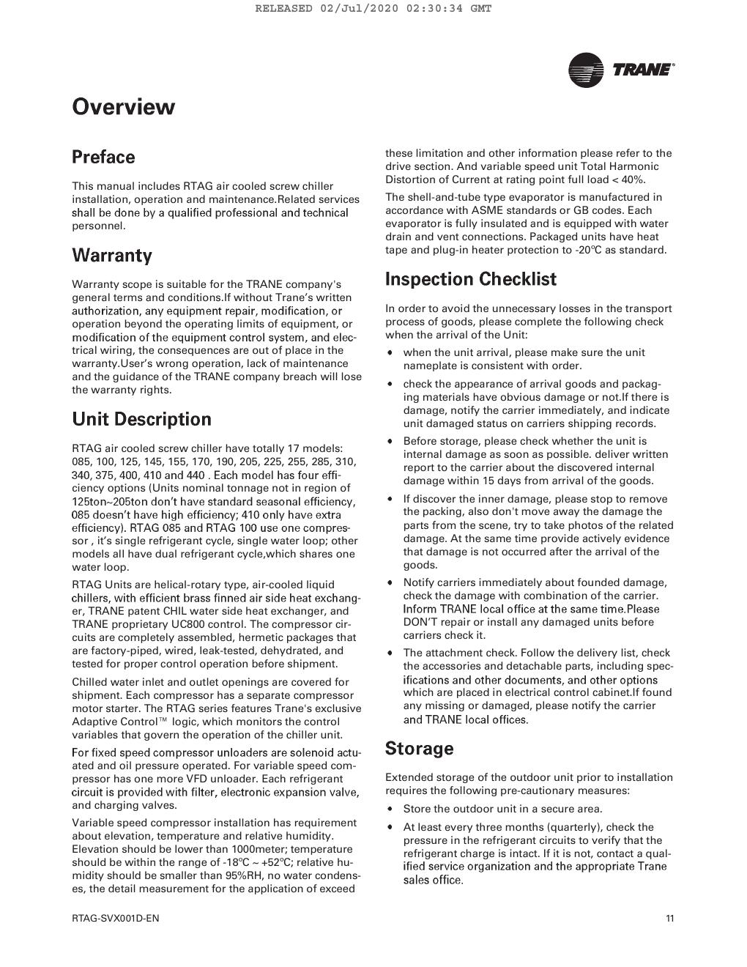
SOURCE EVIDENCE
RTAG IOM reference 3
RTAG IOM - source page 12
Use the original report for signatures, detailed readings, revision status and formal acceptance.
LC4 AIR-COOLED CHILLER | O&M Manuals
11
Notes:
[Sources]
- User-provided source: RTAG IOM.pdf
- Evidence reference: RTAG IOM - source page 12
Training interpretation only. Verify against the controlled project record, current OEM documentation, approved PTW/LOTO, risk assessment and site procedures.

Slide 12
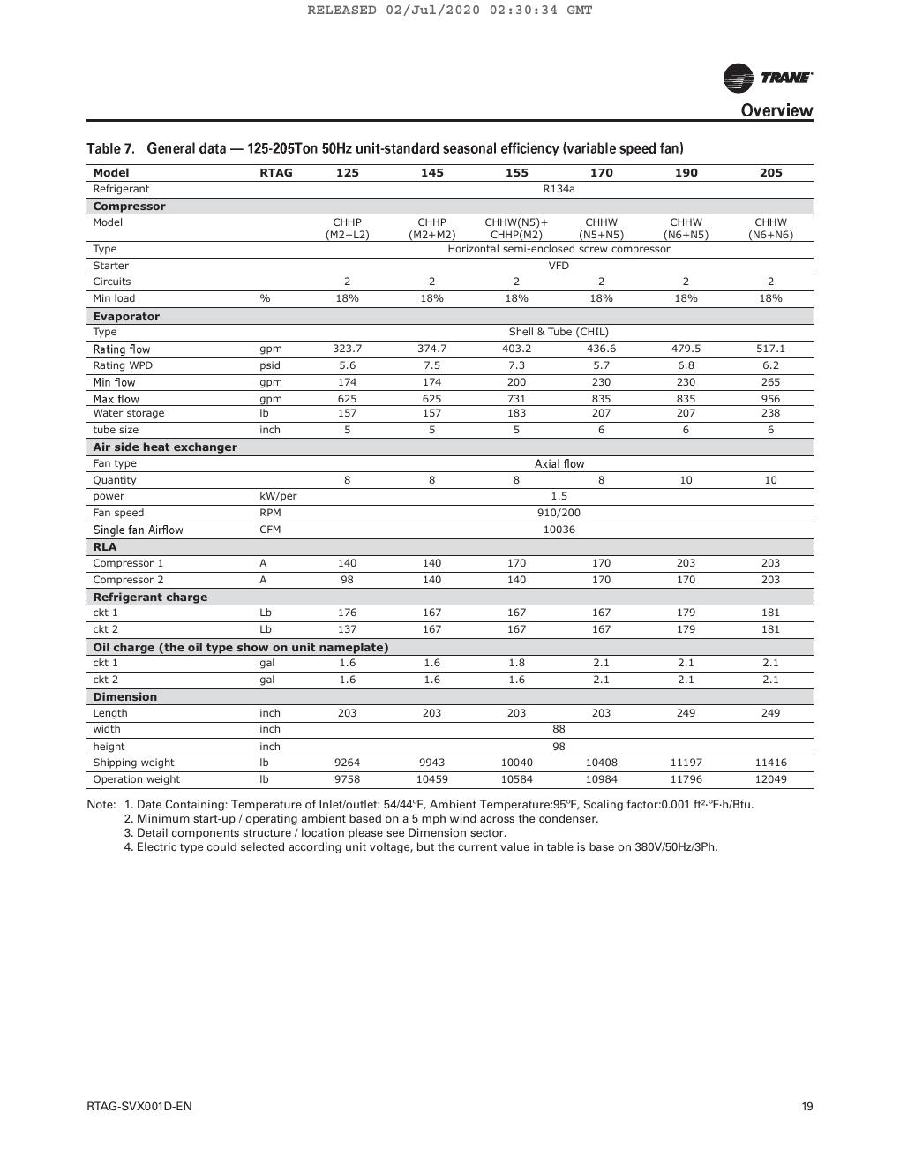
SOURCE EVIDENCE
RTAG IOM reference 4
RTAG IOM - source page 20
Use the original report for signatures, detailed readings, revision status and formal acceptance.
LC4 AIR-COOLED CHILLER | O&M Manuals
12
Notes:
[Sources]
- User-provided source: RTAG IOM.pdf
- Evidence reference: RTAG IOM - source page 20
Training interpretation only. Verify against the controlled project record, current OEM documentation, approved PTW/LOTO, risk assessment and site procedures.

Slide 13
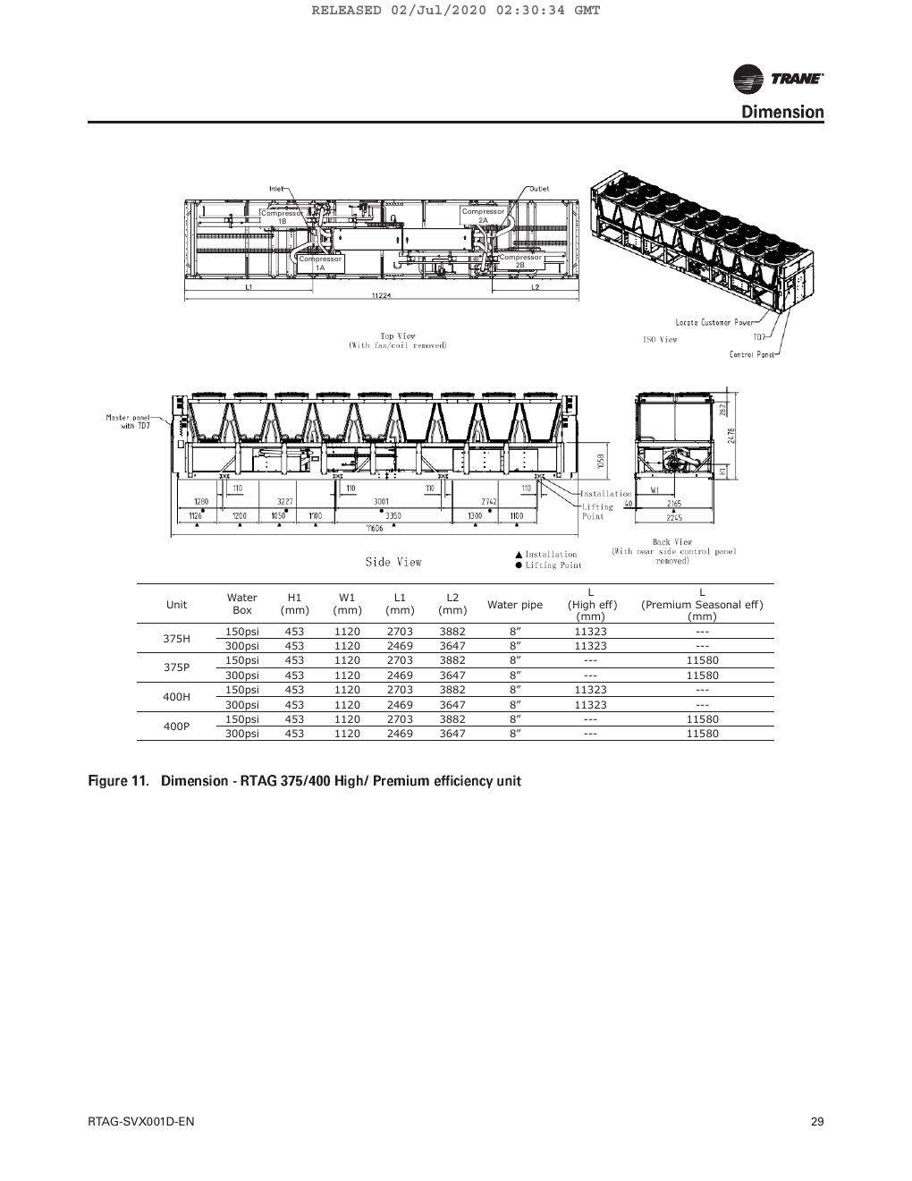
SOURCE EVIDENCE
RTAG IOM reference 5
RTAG IOM - source page 30
Use the original report for signatures, detailed readings, revision status and formal acceptance.
LC4 AIR-COOLED CHILLER | O&M Manuals
13
Notes:
[Sources]
- User-provided source: RTAG IOM.pdf
- Evidence reference: RTAG IOM - source page 30
Training interpretation only. Verify against the controlled project record, current OEM documentation, approved PTW/LOTO, risk assessment and site procedures.

Slide 14
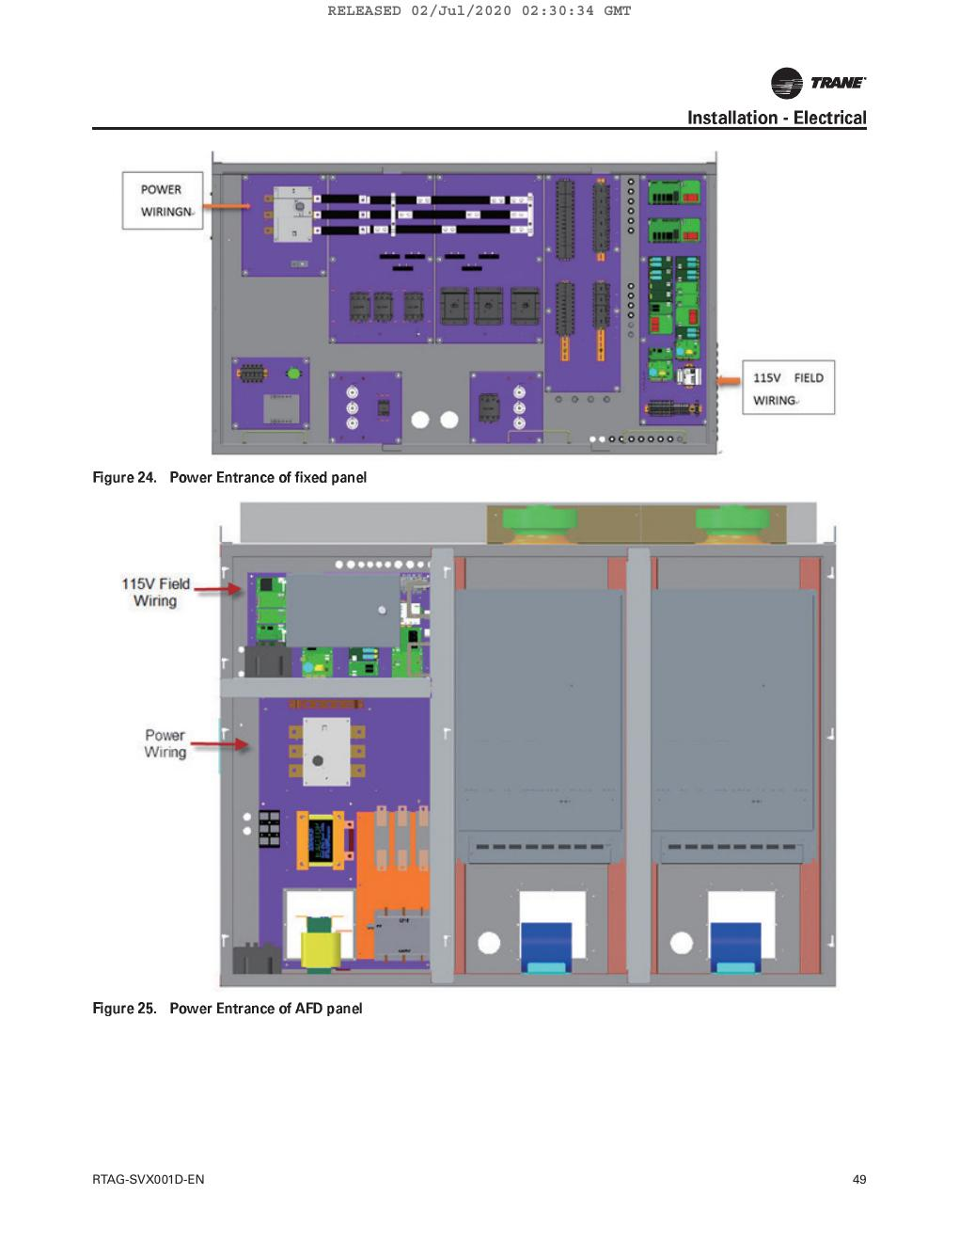
SOURCE EVIDENCE
RTAG IOM reference 6
RTAG IOM - source page 50
Use the original report for signatures, detailed readings, revision status and formal acceptance.
LC4 AIR-COOLED CHILLER | O&M Manuals
14
Notes:
[Sources]
- User-provided source: RTAG IOM.pdf
- Evidence reference: RTAG IOM - source page 50
Training interpretation only. Verify against the controlled project record, current OEM documentation, approved PTW/LOTO, risk assessment and site procedures.

Slide 15
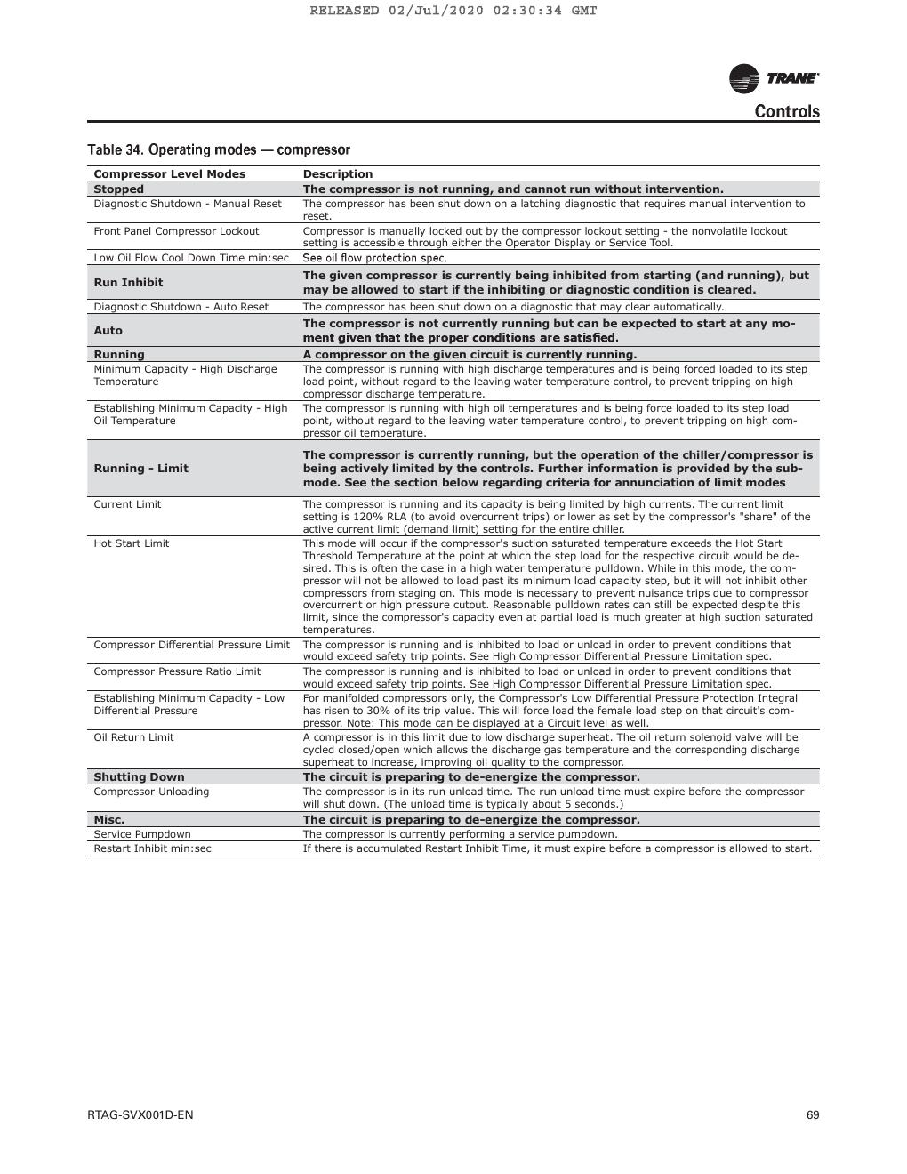
SOURCE EVIDENCE
RTAG IOM reference 7
RTAG IOM - source page 70
Use the original report for signatures, detailed readings, revision status and formal acceptance.
LC4 AIR-COOLED CHILLER | O&M Manuals
15
Notes:
[Sources]
- User-provided source: RTAG IOM.pdf
- Evidence reference: RTAG IOM - source page 70
Training interpretation only. Verify against the controlled project record, current OEM documentation, approved PTW/LOTO, risk assessment and site procedures.

Slide 16
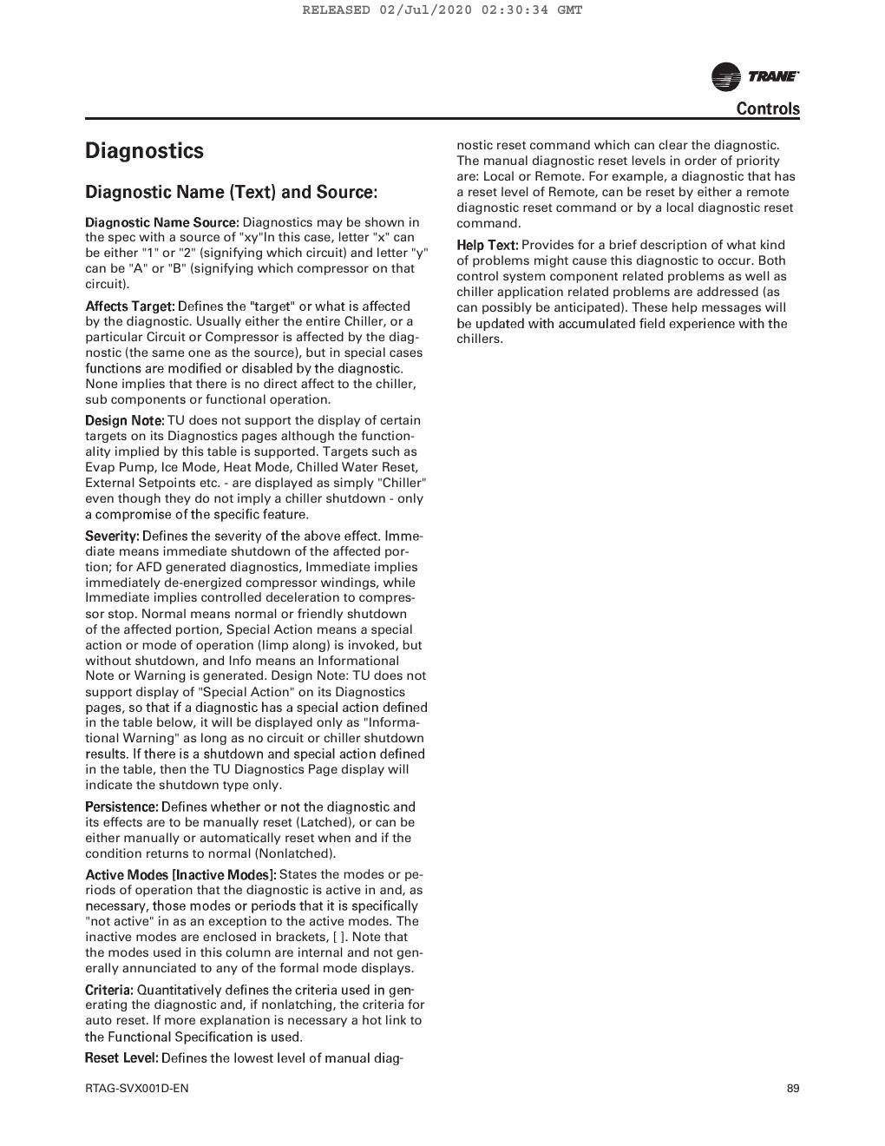
SOURCE EVIDENCE
RTAG IOM reference 8
RTAG IOM - source page 90
Use the original report for signatures, detailed readings, revision status and formal acceptance.
LC4 AIR-COOLED CHILLER | O&M Manuals
16
Notes:
[Sources]
- User-provided source: RTAG IOM.pdf
- Evidence reference: RTAG IOM - source page 90
Training interpretation only. Verify against the controlled project record, current OEM documentation, approved PTW/LOTO, risk assessment and site procedures.

Slide 17
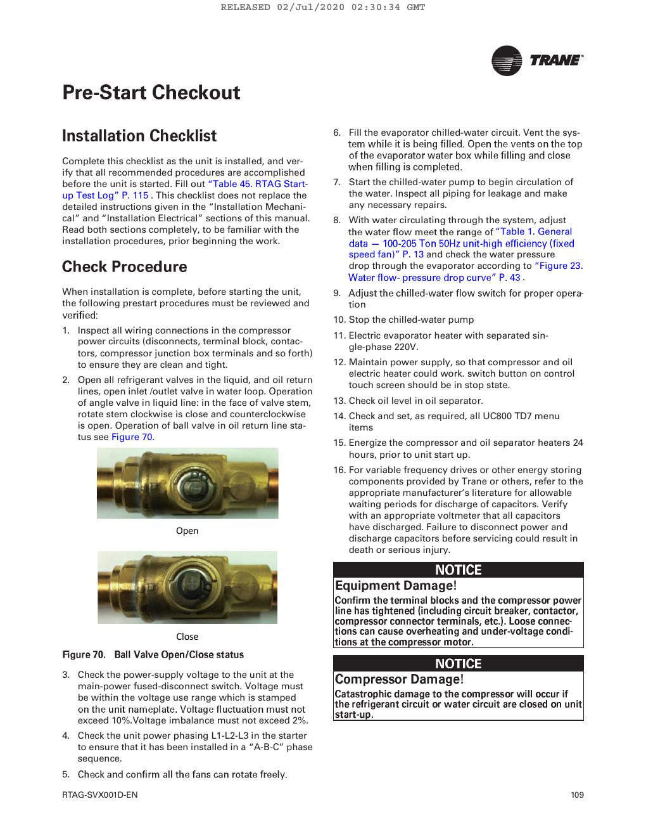
SOURCE EVIDENCE
RTAG IOM reference 9
RTAG IOM - source page 110
Use the original report for signatures, detailed readings, revision status and formal acceptance.
LC4 AIR-COOLED CHILLER | O&M Manuals
17
Notes:
[Sources]
- User-provided source: RTAG IOM.pdf
- Evidence reference: RTAG IOM - source page 110
Training interpretation only. Verify against the controlled project record, current OEM documentation, approved PTW/LOTO, risk assessment and site procedures.

Slide 18
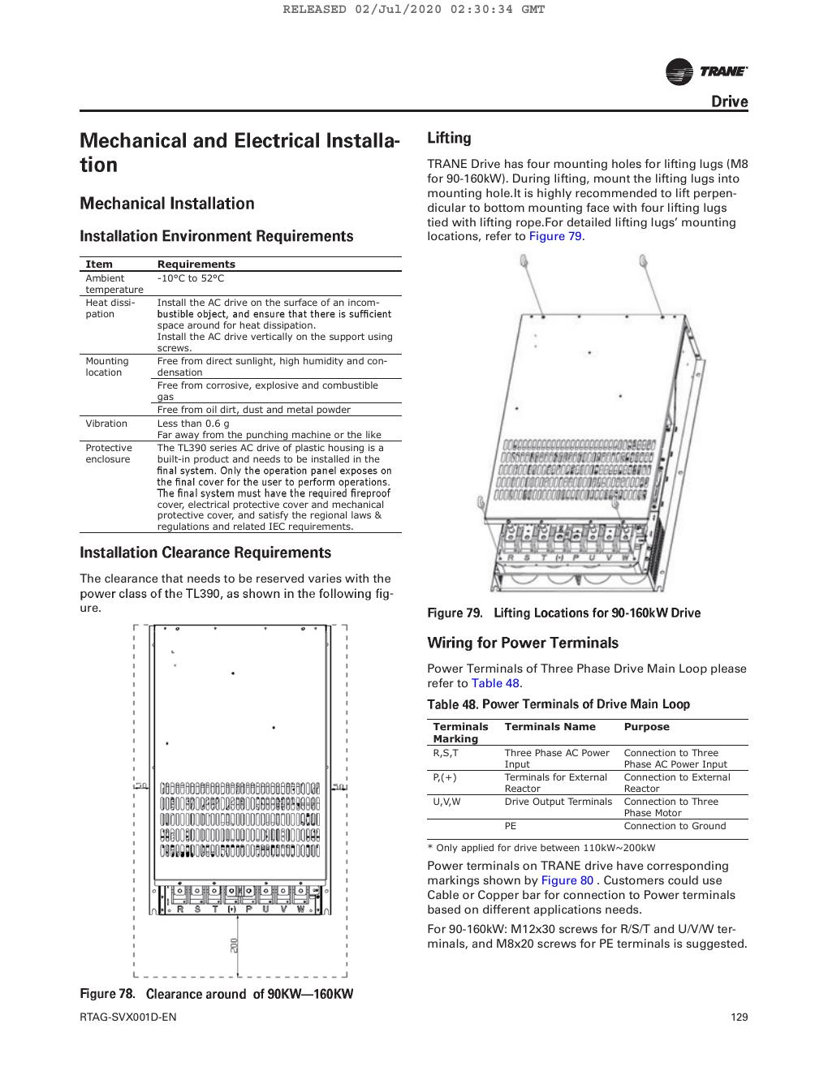
SOURCE EVIDENCE
RTAG IOM reference 10
RTAG IOM - source page 130
Use the original report for signatures, detailed readings, revision status and formal acceptance.
LC4 AIR-COOLED CHILLER | O&M Manuals
18
Notes:
[Sources]
- User-provided source: RTAG IOM.pdf
- Evidence reference: RTAG IOM - source page 130
Training interpretation only. Verify against the controlled project record, current OEM documentation, approved PTW/LOTO, risk assessment and site procedures.

Slide 19
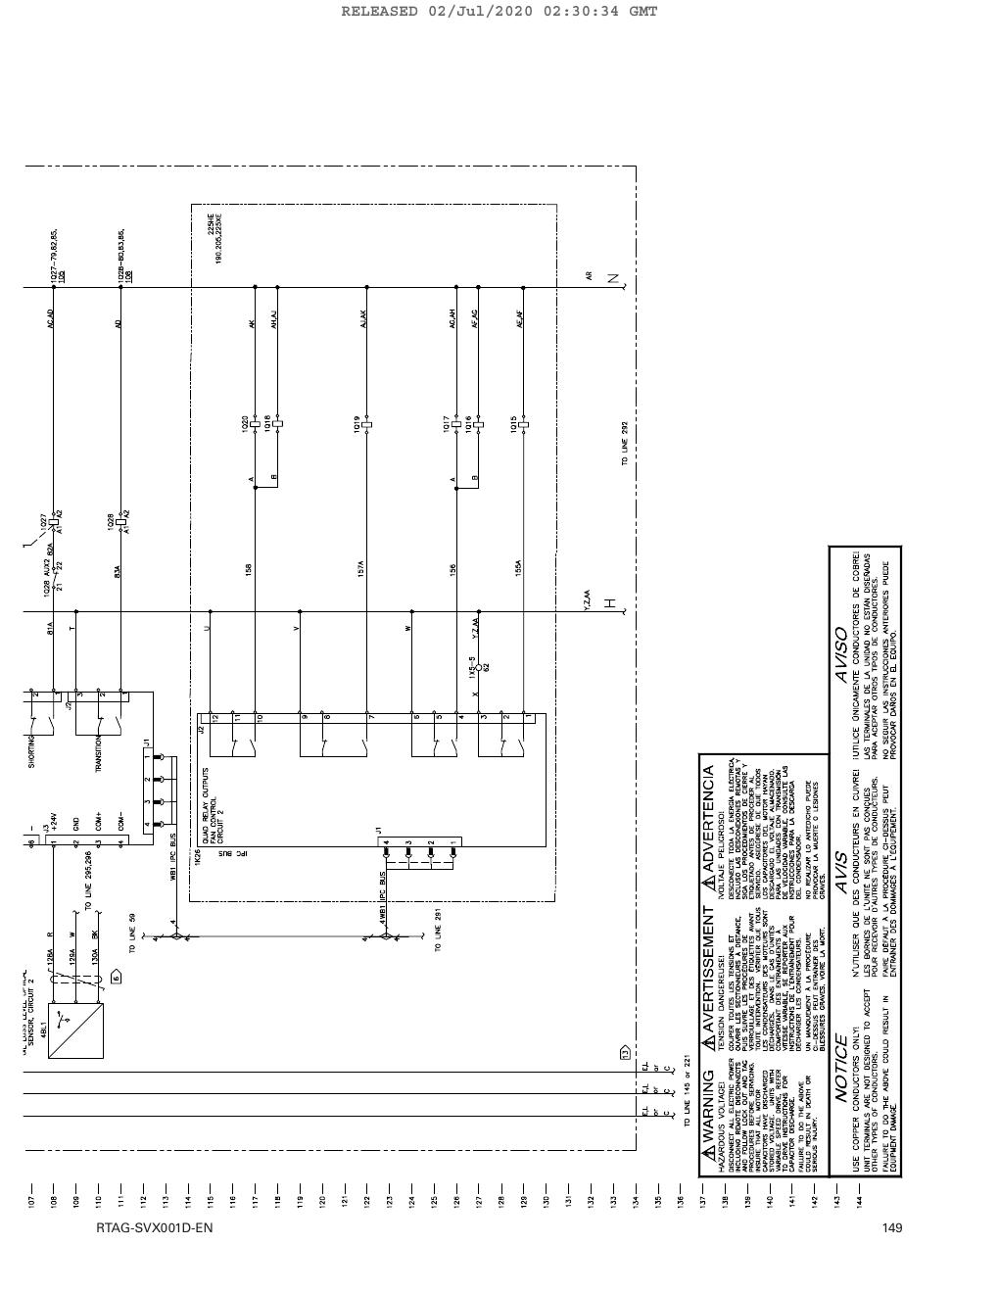
SOURCE EVIDENCE
RTAG IOM reference 11
RTAG IOM - source page 150
Use the original report for signatures, detailed readings, revision status and formal acceptance.
LC4 AIR-COOLED CHILLER | O&M Manuals
19
Notes:
[Sources]
- User-provided source: RTAG IOM.pdf
- Evidence reference: RTAG IOM - source page 150
Training interpretation only. Verify against the controlled project record, current OEM documentation, approved PTW/LOTO, risk assessment and site procedures.

Slide 20
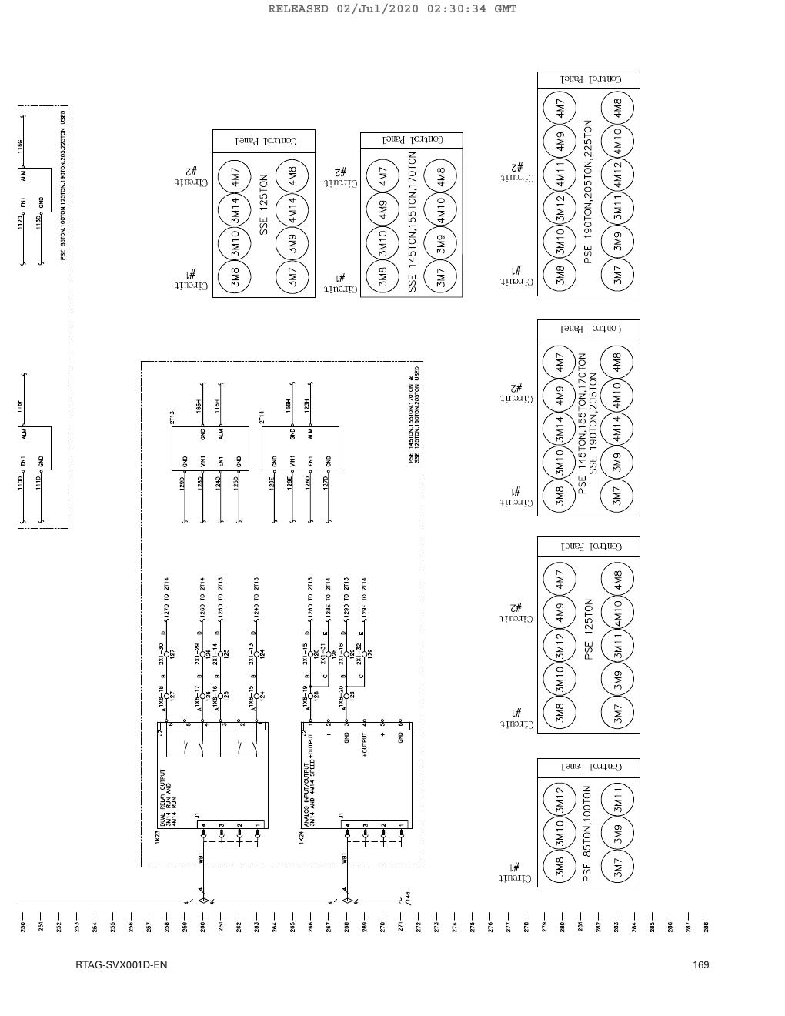
SOURCE EVIDENCE
RTAG IOM reference 12
RTAG IOM - source page 170
Use the original report for signatures, detailed readings, revision status and formal acceptance.
LC4 AIR-COOLED CHILLER | O&M Manuals
20
Notes:
[Sources]
- User-provided source: RTAG IOM.pdf
- Evidence reference: RTAG IOM - source page 170
Training interpretation only. Verify against the controlled project record, current OEM documentation, approved PTW/LOTO, risk assessment and site procedures.

Slide 21
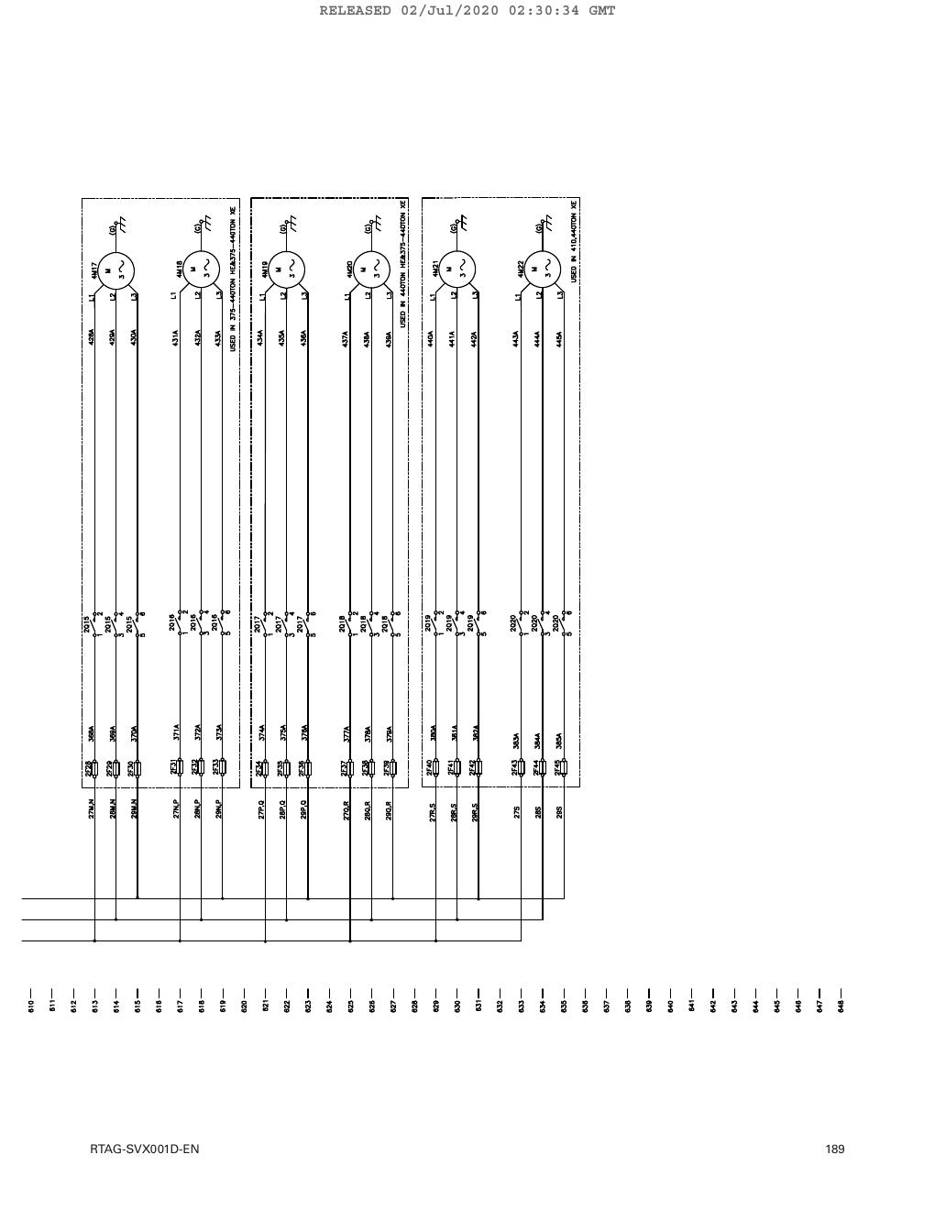
SOURCE EVIDENCE
RTAG IOM reference 13
RTAG IOM - source page 190
Use the original report for signatures, detailed readings, revision status and formal acceptance.
LC4 AIR-COOLED CHILLER | O&M Manuals
21
Notes:
[Sources]
- User-provided source: RTAG IOM.pdf
- Evidence reference: RTAG IOM - source page 190
Training interpretation only. Verify against the controlled project record, current OEM documentation, approved PTW/LOTO, risk assessment and site procedures.

Slide 22
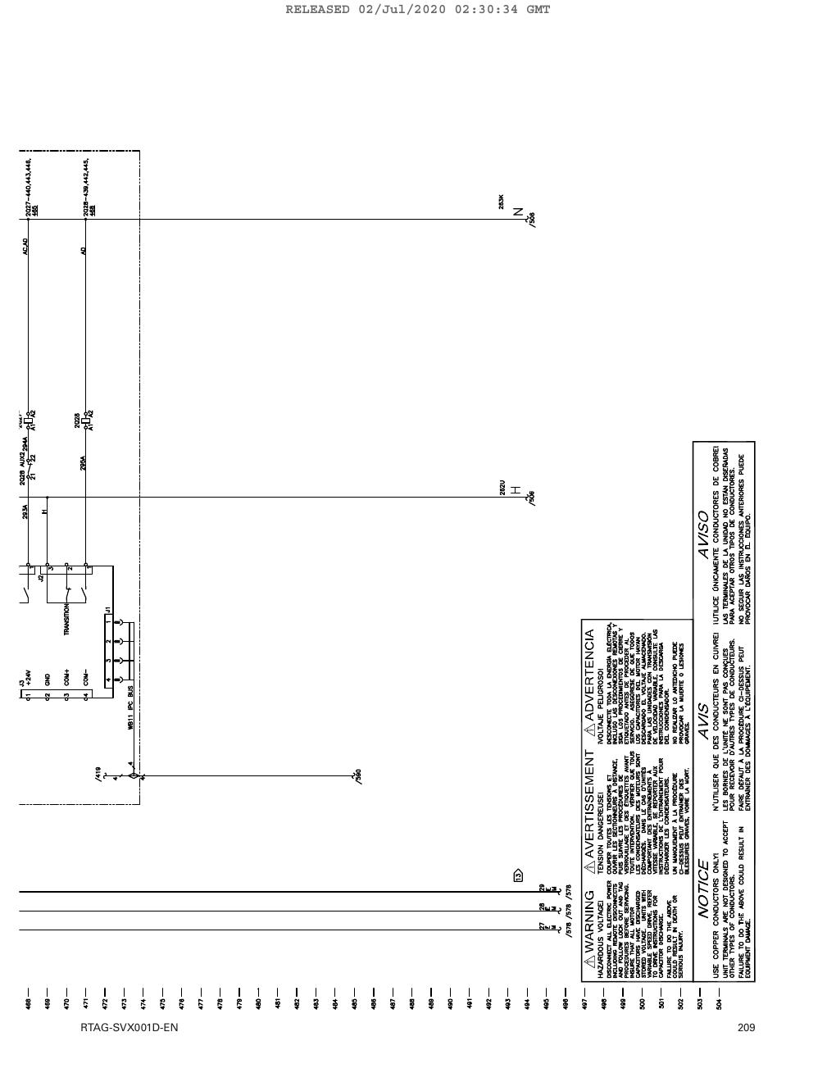
SOURCE EVIDENCE
RTAG IOM reference 14
RTAG IOM - source page 210
Use the original report for signatures, detailed readings, revision status and formal acceptance.
LC4 AIR-COOLED CHILLER | O&M Manuals
22
Notes:
[Sources]
- User-provided source: RTAG IOM.pdf
- Evidence reference: RTAG IOM - source page 210
Training interpretation only. Verify against the controlled project record, current OEM documentation, approved PTW/LOTO, risk assessment and site procedures.

Slide 23
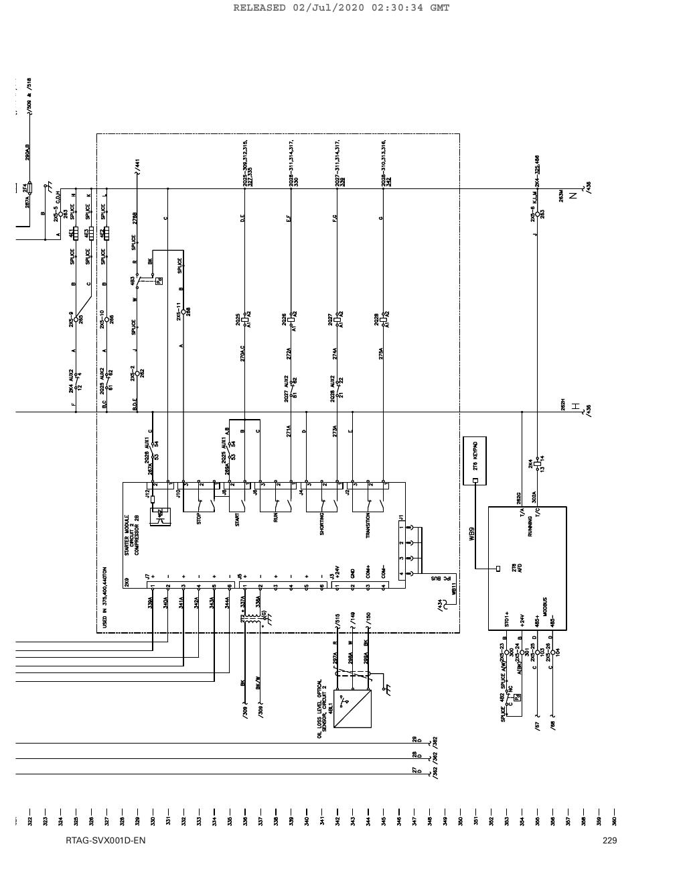
SOURCE EVIDENCE
RTAG IOM reference 15
RTAG IOM - source page 230
Use the original report for signatures, detailed readings, revision status and formal acceptance.
LC4 AIR-COOLED CHILLER | O&M Manuals
23
Notes:
[Sources]
- User-provided source: RTAG IOM.pdf
- Evidence reference: RTAG IOM - source page 230
Training interpretation only. Verify against the controlled project record, current OEM documentation, approved PTW/LOTO, risk assessment and site procedures.

Slide 24

SOURCE EVIDENCE
RTAG IOM reference 16
RTAG IOM - source page 243
Use the original report for signatures, detailed readings, revision status and formal acceptance.
LC4 AIR-COOLED CHILLER | O&M Manuals
24
Notes:
[Sources]
- User-provided source: RTAG IOM.pdf
- Evidence reference: RTAG IOM - source page 243
Training interpretation only. Verify against the controlled project record, current OEM documentation, approved PTW/LOTO, risk assessment and site procedures.

Slide 25
COMPETENCY CHECK
What technicians must retain
• Identify the correct controlled source before work.
• Verify readings, configuration and acceptance criteria.
• Preserve evidence and escalate unresolved deviations.
• Complete safe isolation, functional testing and handover records.
LC4 AIR-COOLED CHILLER | O&M Manuals
25
Notes:
[Sources]
- User-provided source: RTAG IOM.pdf
Training interpretation only. Verify against the controlled project record, current OEM documentation, approved PTW/LOTO, risk assessment and site procedures.

