Slide 1
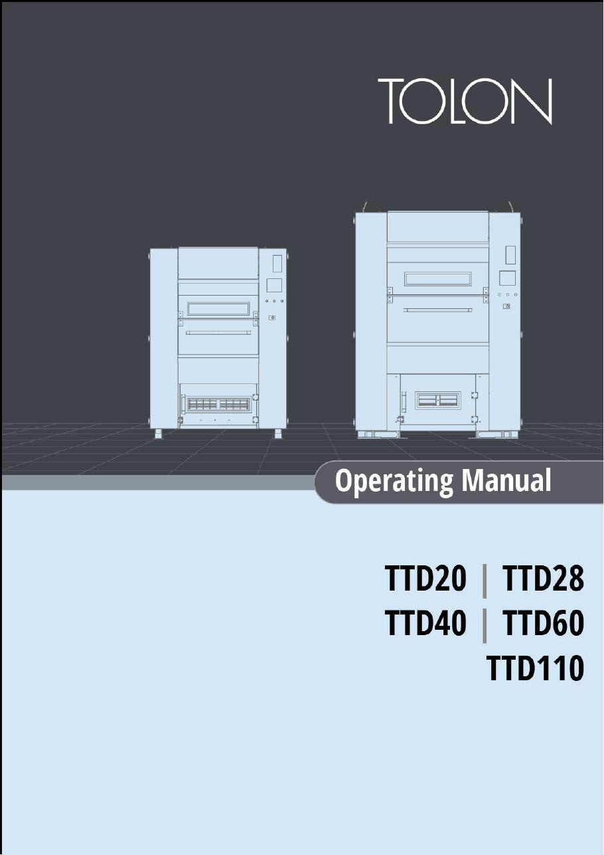
TOLON • DRYER MANUALS
TOLON Tumbler Dryer Operating Manual
TTD20, TTD28, TTD40, TTD60 and TTD110
SAJJAD ENGINEERING ACADEMY
Notes:
[Sources]
- User-provided source: Tolon_TD_Operating.Manual.ENG.v.2.1.1.pdf
Training interpretation only. Verify against the controlled project record, current OEM documentation, approved PTW/LOTO, risk assessment and site procedures.

Slide 2
TOLON • DRYER MANUALS
Source to practice
Evidence, interpretation and technician application
02
Notes:
[Sources]
- User-provided source: Tolon_TD_Operating.Manual.ENG.v.2.1.1.pdf
Training interpretation only. Verify against the controlled project record, current OEM documentation, approved PTW/LOTO, risk assessment and site procedures.

Slide 3
KEY EVIDENCE
A controlled technical reference for safe maintenance
158
5
Safety
Manual pages
Dryer model families
Operation and maintenance focus
LC4 AIR-COOLED CHILLER | TOLON • Dryer Manuals
03
Notes:
[Sources]
- User-provided source: Tolon_TD_Operating.Manual.ENG.v.2.1.1.pdf
Training interpretation only. Verify against the controlled project record, current OEM documentation, approved PTW/LOTO, risk assessment and site procedures.

Slide 4
TECHNICAL REVIEW
Use the manual as a machine-specific working reference
• Identify exterior components and required clearances.
• Follow emergency-stop and fundamental safety precautions.
• Use model-specific operating and maintenance instructions.
• Troubleshoot only after isolation and evidence capture.
LC4 AIR-COOLED CHILLER | TOLON • Dryer Manuals
04
Notes:
[Sources]
- User-provided source: Tolon_TD_Operating.Manual.ENG.v.2.1.1.pdf
Training interpretation only. Verify against the controlled project record, current OEM documentation, approved PTW/LOTO, risk assessment and site procedures.

Slide 5
TECHNICAL REVIEW
Apply a consistent safe-work sequence
• Confirm machine identity, model and document revision.
• Isolate all energy sources and prove a safe state before access.
• Inspect, measure and diagnose before replacing components.
• Function-test safeguards and record the completed work.
LC4 AIR-COOLED CHILLER | TOLON • Dryer Manuals
05
Notes:
[Sources]
- User-provided source: Tolon_TD_Operating.Manual.ENG.v.2.1.1.pdf
Training interpretation only. Verify against the controlled project record, current OEM documentation, approved PTW/LOTO, risk assessment and site procedures.

Slide 6
TECHNICAL REVIEW
Parts and settings require configuration control
• Record original settings and connections before adjustment.
• Use exact part numbers or approved supersessions.
• Preserve firmware, program and parameter backups where applicable.
• Update the maintenance history after each intervention.
LC4 AIR-COOLED CHILLER | TOLON • Dryer Manuals
06
Notes:
[Sources]
- User-provided source: Tolon_TD_Operating.Manual.ENG.v.2.1.1.pdf
Training interpretation only. Verify against the controlled project record, current OEM documentation, approved PTW/LOTO, risk assessment and site procedures.

Slide 7
SOURCE EVIDENCE
Manual evidence 1
Source page 1
Use the original report for signatures, detailed readings, revision status and formal acceptance.
LC4 AIR-COOLED CHILLER | TOLON • Dryer Manuals
07
Notes:
[Sources]
- User-provided source: Tolon_TD_Operating.Manual.ENG.v.2.1.1.pdf
- Evidence reference: Source page 1
Training interpretation only. Verify against the controlled project record, current OEM documentation, approved PTW/LOTO, risk assessment and site procedures.

Slide 8
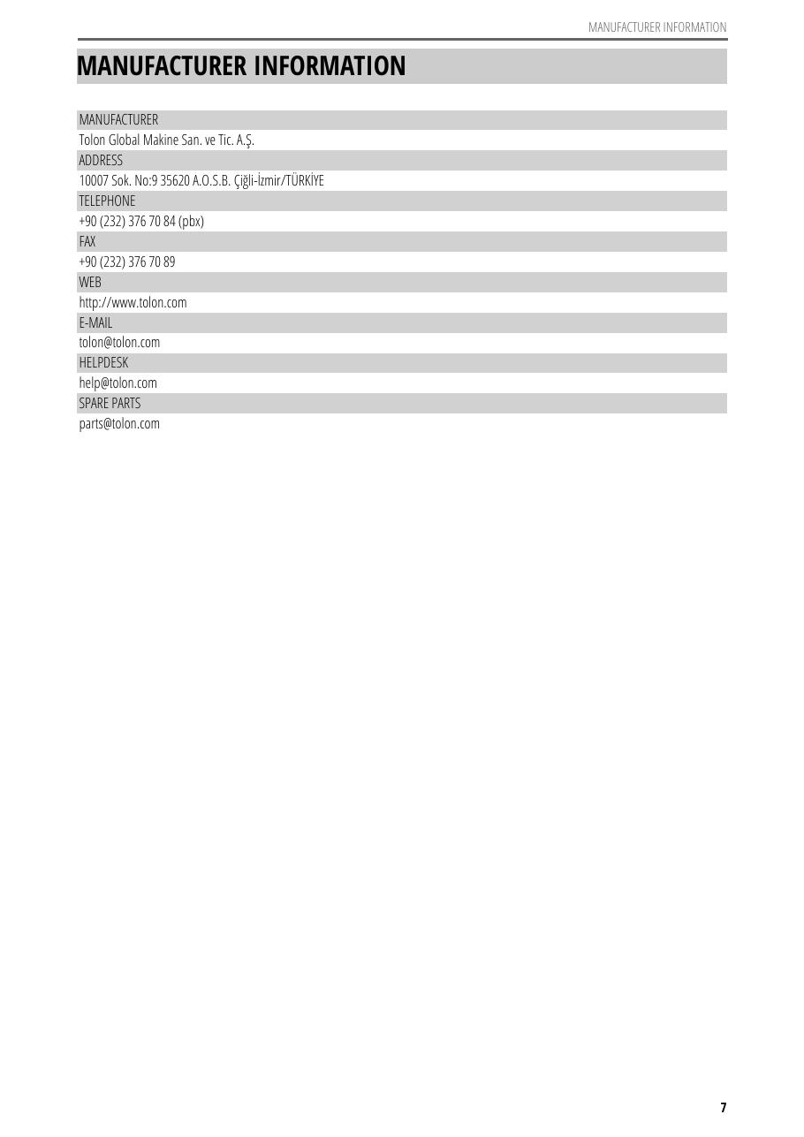
SOURCE EVIDENCE
Manual evidence 2
Source page 9
Use the original report for signatures, detailed readings, revision status and formal acceptance.
LC4 AIR-COOLED CHILLER | TOLON • Dryer Manuals
08
Notes:
[Sources]
- User-provided source: Tolon_TD_Operating.Manual.ENG.v.2.1.1.pdf
- Evidence reference: Source page 9
Training interpretation only. Verify against the controlled project record, current OEM documentation, approved PTW/LOTO, risk assessment and site procedures.

Slide 9
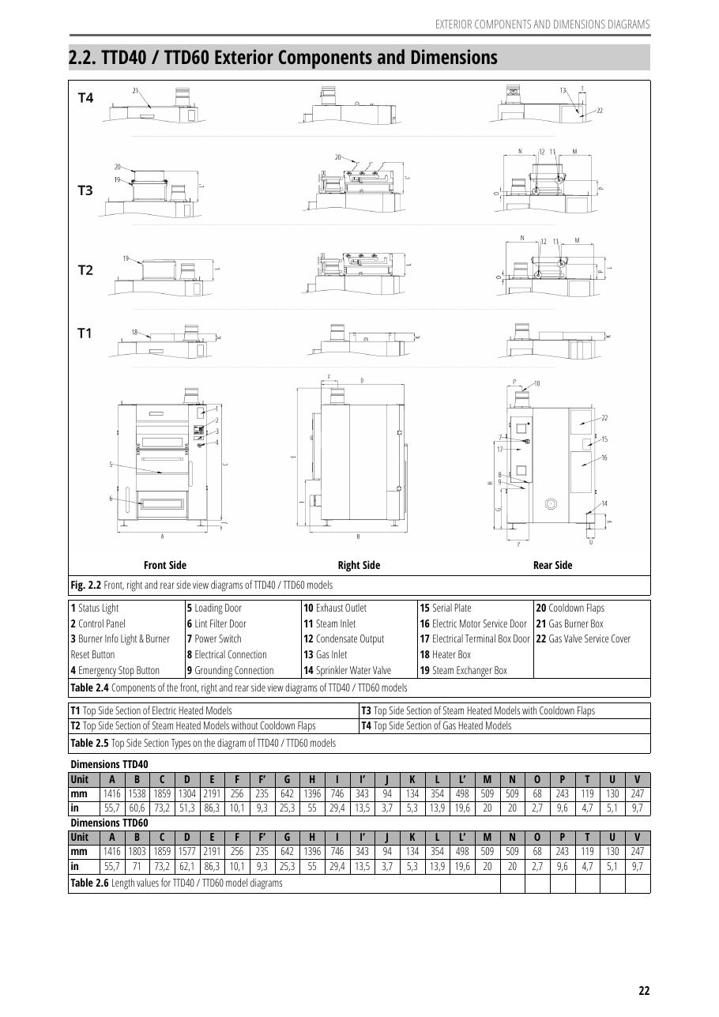
SOURCE EVIDENCE
Manual evidence 3
Source page 21
Use the original report for signatures, detailed readings, revision status and formal acceptance.
LC4 AIR-COOLED CHILLER | TOLON • Dryer Manuals
09
Notes:
[Sources]
- User-provided source: Tolon_TD_Operating.Manual.ENG.v.2.1.1.pdf
- Evidence reference: Source page 21
Training interpretation only. Verify against the controlled project record, current OEM documentation, approved PTW/LOTO, risk assessment and site procedures.

Slide 10
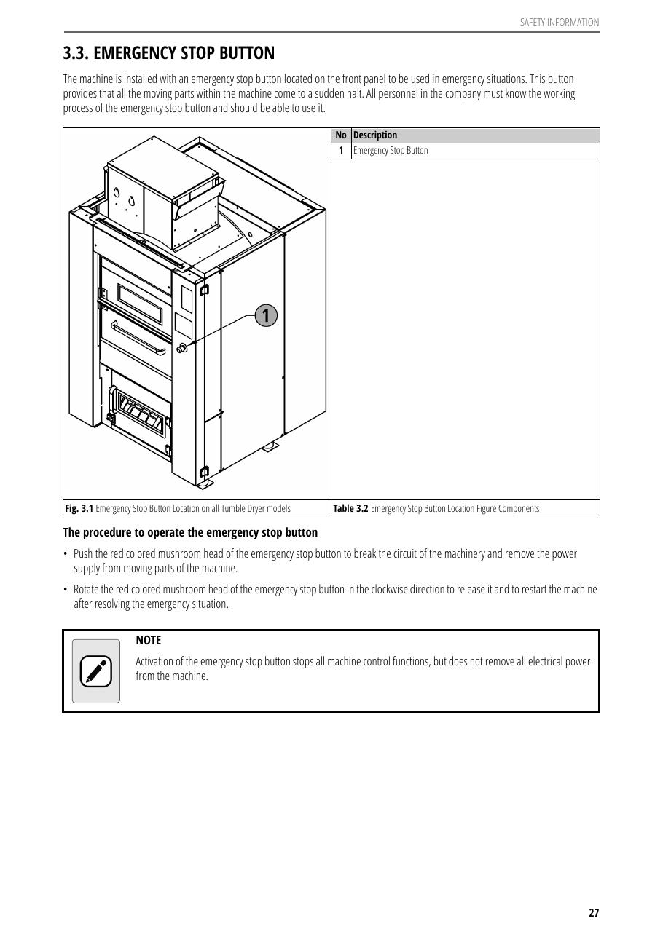
SOURCE EVIDENCE
Manual evidence 4
Source page 25
Use the original report for signatures, detailed readings, revision status and formal acceptance.
LC4 AIR-COOLED CHILLER | TOLON • Dryer Manuals
10
Notes:
[Sources]
- User-provided source: Tolon_TD_Operating.Manual.ENG.v.2.1.1.pdf
- Evidence reference: Source page 25
Training interpretation only. Verify against the controlled project record, current OEM documentation, approved PTW/LOTO, risk assessment and site procedures.

Slide 11
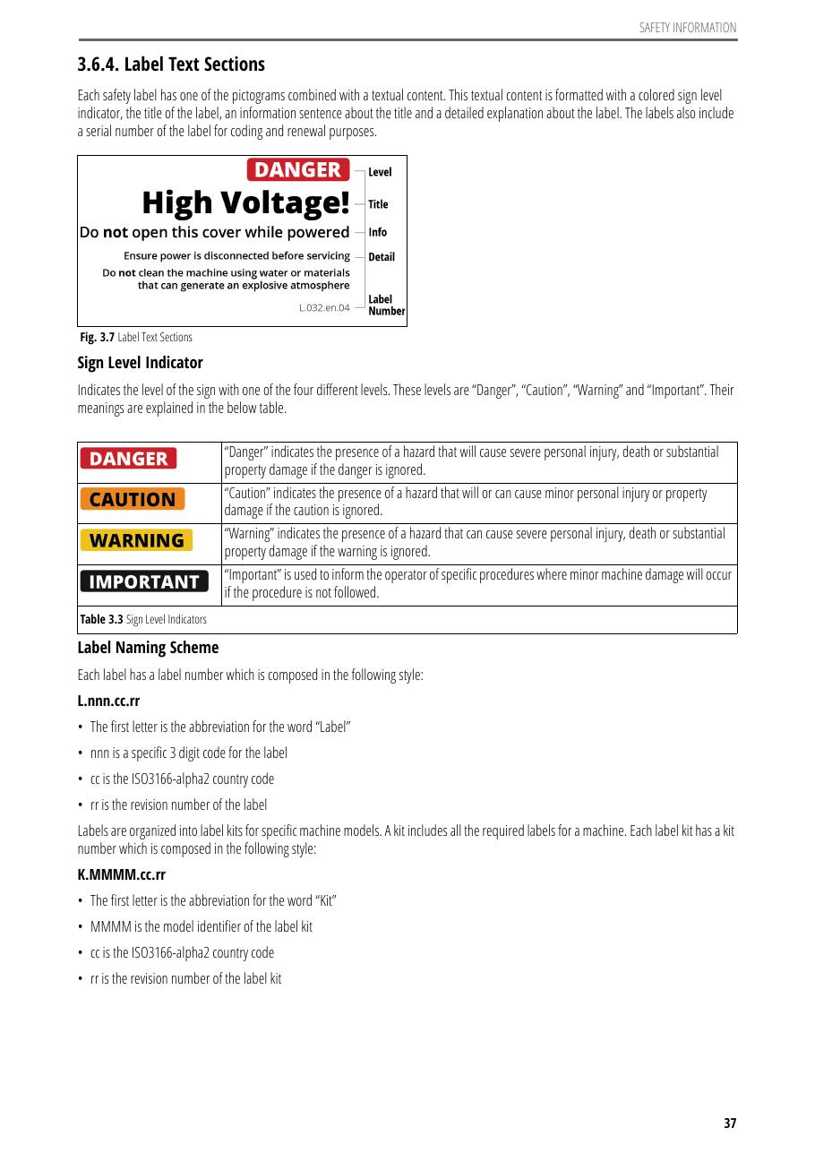
SOURCE EVIDENCE
Manual evidence 5
Source page 35
Use the original report for signatures, detailed readings, revision status and formal acceptance.
LC4 AIR-COOLED CHILLER | TOLON • Dryer Manuals
11
Notes:
[Sources]
- User-provided source: Tolon_TD_Operating.Manual.ENG.v.2.1.1.pdf
- Evidence reference: Source page 35
Training interpretation only. Verify against the controlled project record, current OEM documentation, approved PTW/LOTO, risk assessment and site procedures.

Slide 12

SOURCE EVIDENCE
Manual evidence 6
Source page 50
Use the original report for signatures, detailed readings, revision status and formal acceptance.
LC4 AIR-COOLED CHILLER | TOLON • Dryer Manuals
12
Notes:
[Sources]
- User-provided source: Tolon_TD_Operating.Manual.ENG.v.2.1.1.pdf
- Evidence reference: Source page 50
Training interpretation only. Verify against the controlled project record, current OEM documentation, approved PTW/LOTO, risk assessment and site procedures.

Slide 13
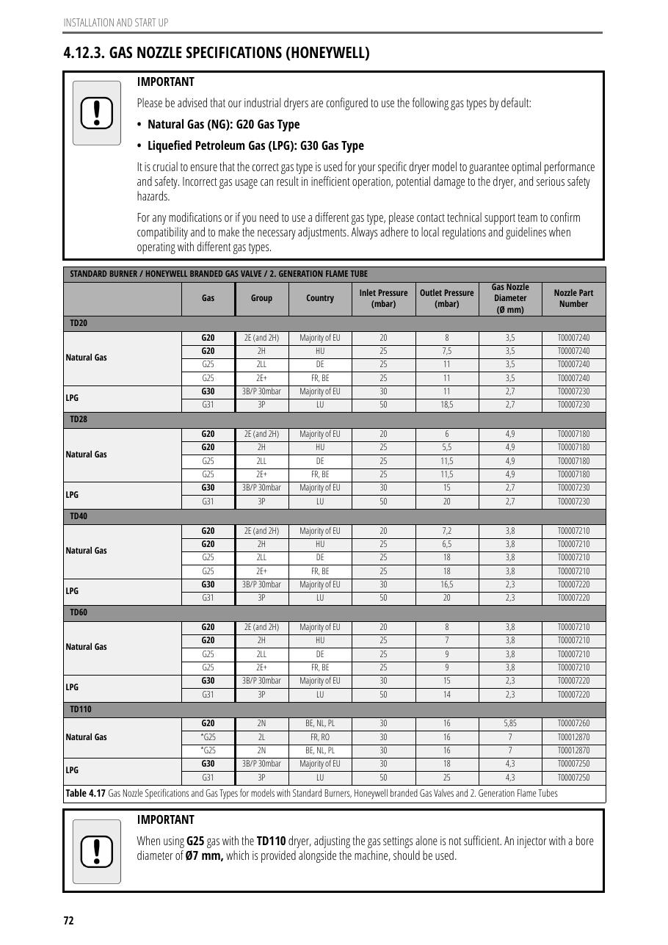
SOURCE EVIDENCE
Manual evidence 7
Source page 70
Use the original report for signatures, detailed readings, revision status and formal acceptance.
LC4 AIR-COOLED CHILLER | TOLON • Dryer Manuals
13
Notes:
[Sources]
- User-provided source: Tolon_TD_Operating.Manual.ENG.v.2.1.1.pdf
- Evidence reference: Source page 70
Training interpretation only. Verify against the controlled project record, current OEM documentation, approved PTW/LOTO, risk assessment and site procedures.

Slide 14
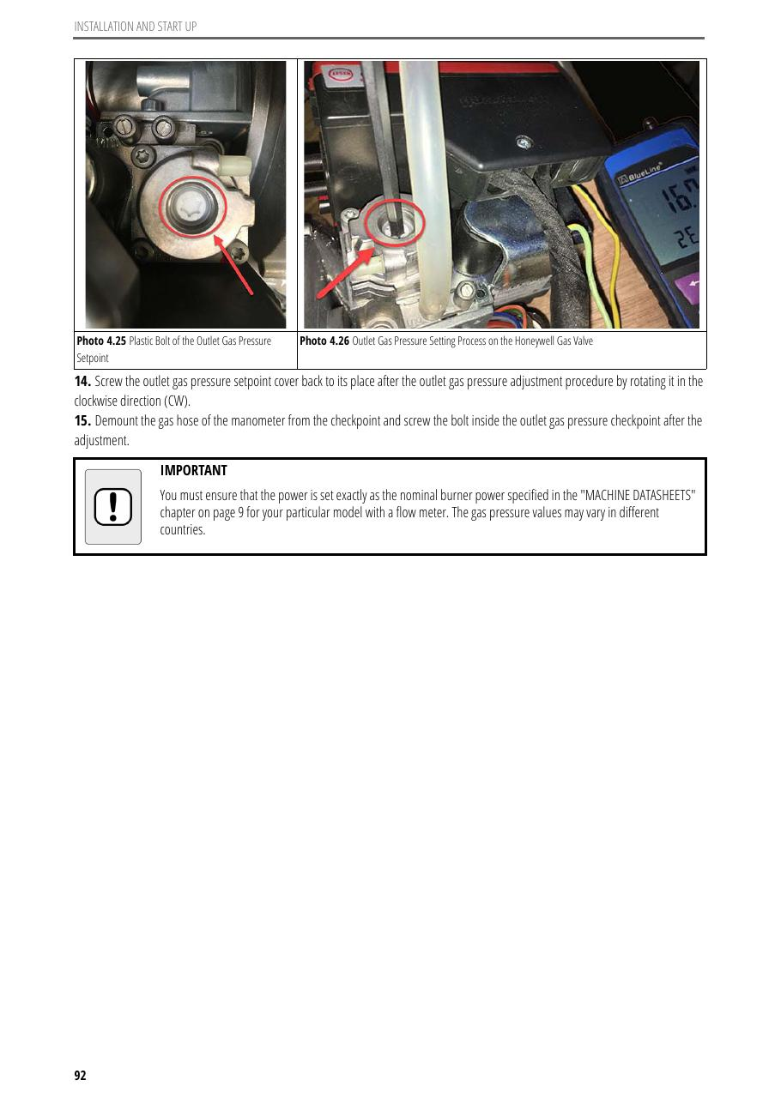
SOURCE EVIDENCE
Manual evidence 8
Source page 90
Use the original report for signatures, detailed readings, revision status and formal acceptance.
LC4 AIR-COOLED CHILLER | TOLON • Dryer Manuals
14
Notes:
[Sources]
- User-provided source: Tolon_TD_Operating.Manual.ENG.v.2.1.1.pdf
- Evidence reference: Source page 90
Training interpretation only. Verify against the controlled project record, current OEM documentation, approved PTW/LOTO, risk assessment and site procedures.

Slide 15
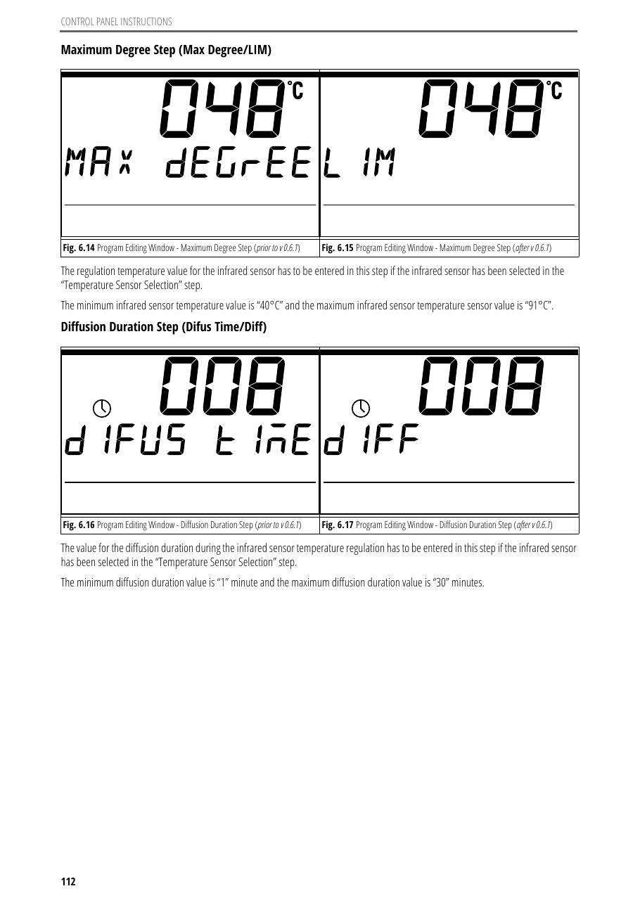
SOURCE EVIDENCE
Manual evidence 9
Source page 110
Use the original report for signatures, detailed readings, revision status and formal acceptance.
LC4 AIR-COOLED CHILLER | TOLON • Dryer Manuals
15
Notes:
[Sources]
- User-provided source: Tolon_TD_Operating.Manual.ENG.v.2.1.1.pdf
- Evidence reference: Source page 110
Training interpretation only. Verify against the controlled project record, current OEM documentation, approved PTW/LOTO, risk assessment and site procedures.

Slide 16
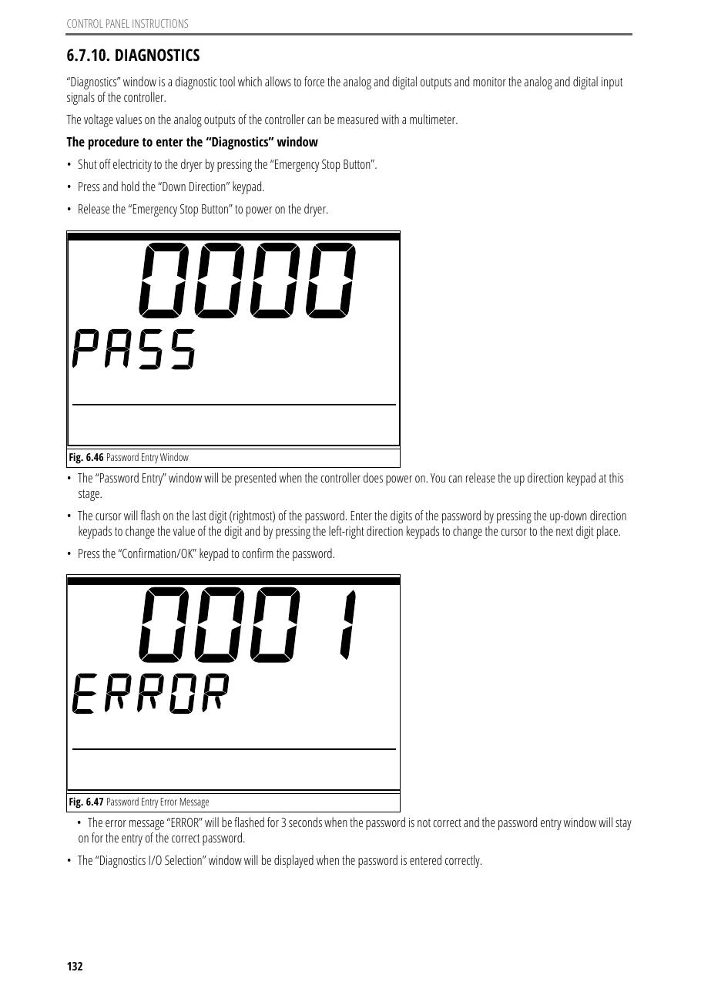
SOURCE EVIDENCE
Manual evidence 10
Source page 130
Use the original report for signatures, detailed readings, revision status and formal acceptance.
LC4 AIR-COOLED CHILLER | TOLON • Dryer Manuals
16
Notes:
[Sources]
- User-provided source: Tolon_TD_Operating.Manual.ENG.v.2.1.1.pdf
- Evidence reference: Source page 130
Training interpretation only. Verify against the controlled project record, current OEM documentation, approved PTW/LOTO, risk assessment and site procedures.

Slide 17
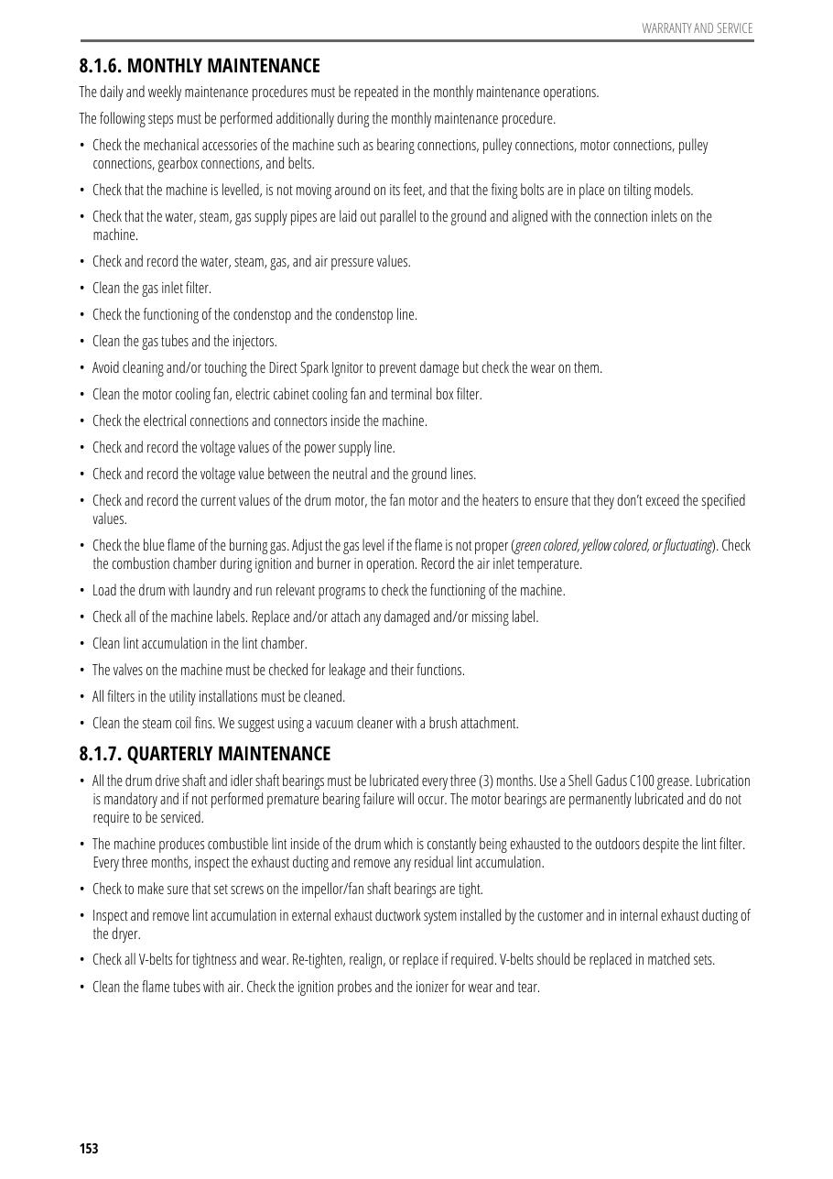
SOURCE EVIDENCE
Manual evidence 11
Source page 150
Use the original report for signatures, detailed readings, revision status and formal acceptance.
LC4 AIR-COOLED CHILLER | TOLON • Dryer Manuals
17
Notes:
[Sources]
- User-provided source: Tolon_TD_Operating.Manual.ENG.v.2.1.1.pdf
- Evidence reference: Source page 150
Training interpretation only. Verify against the controlled project record, current OEM documentation, approved PTW/LOTO, risk assessment and site procedures.

Slide 18
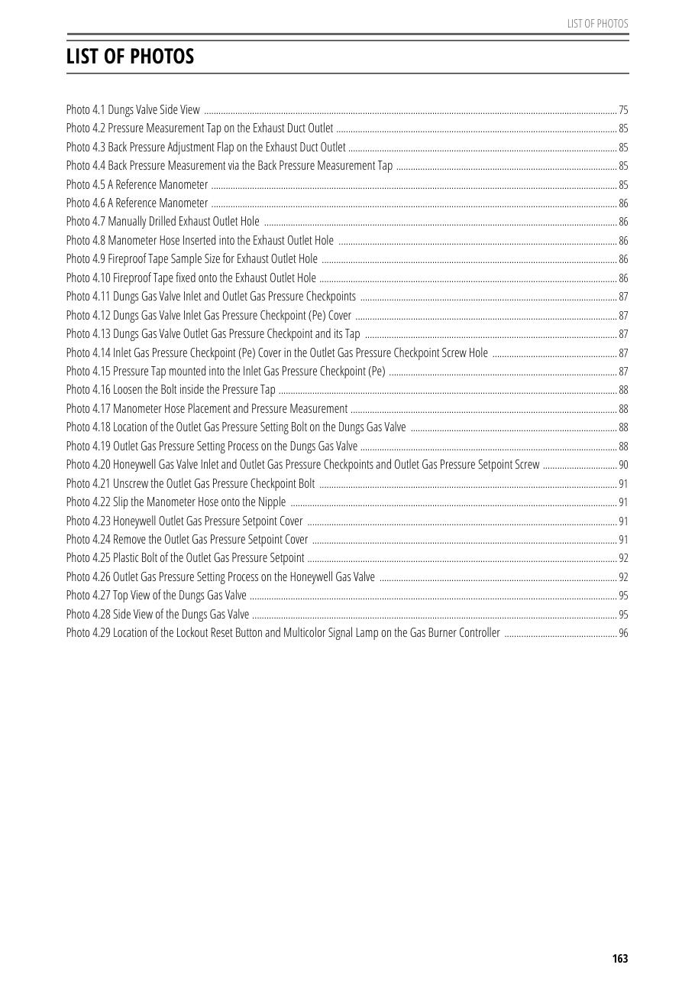
SOURCE EVIDENCE
Manual evidence 12
Source page 158
Use the original report for signatures, detailed readings, revision status and formal acceptance.
LC4 AIR-COOLED CHILLER | TOLON • Dryer Manuals
18
Notes:
[Sources]
- User-provided source: Tolon_TD_Operating.Manual.ENG.v.2.1.1.pdf
- Evidence reference: Source page 158
Training interpretation only. Verify against the controlled project record, current OEM documentation, approved PTW/LOTO, risk assessment and site procedures.

Slide 19
COMPETENCY CHECK
What technicians must retain
• Identify the correct controlled source before work.
• Verify readings, configuration and acceptance criteria.
• Preserve evidence and escalate unresolved deviations.
• Complete safe isolation, functional testing and handover records.
LC4 AIR-COOLED CHILLER | TOLON • Dryer Manuals
19
Notes:
[Sources]
- User-provided source: Tolon_TD_Operating.Manual.ENG.v.2.1.1.pdf
Training interpretation only. Verify against the controlled project record, current OEM documentation, approved PTW/LOTO, risk assessment and site procedures.

