Slide 1
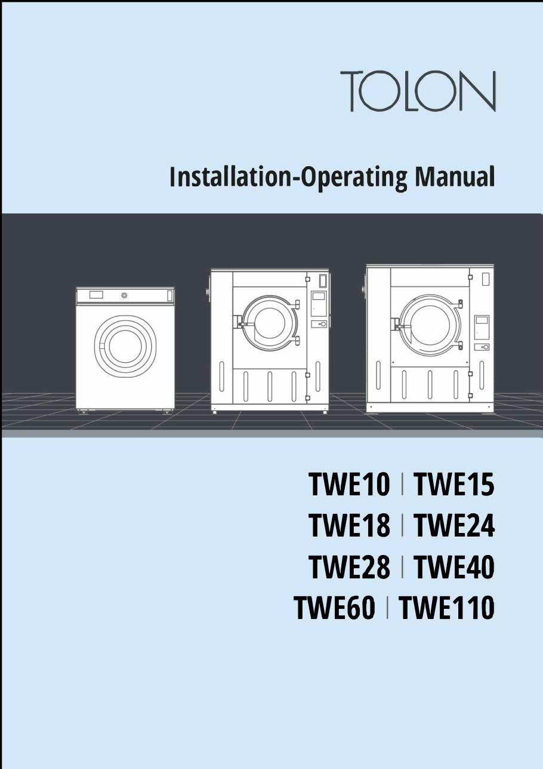
TOLON • WASHER MANUALS
TOLON Washer Installation & Operation
TWE10 through TWE110 installation-operating manual
SAJJAD ENGINEERING ACADEMY
Notes:
[Sources]
- User-provided source: Tolon_WE_Installation.Operating.Manual.ENG.v.2.0.0 (1) (3).pdf
Training interpretation only. Verify against the controlled project record, current OEM documentation, approved PTW/LOTO, risk assessment and site procedures.

Slide 2
TOLON • WASHER MANUALS
Source to practice
Evidence, interpretation and technician application
02
Notes:
[Sources]
- User-provided source: Tolon_WE_Installation.Operating.Manual.ENG.v.2.0.0 (1) (3).pdf
Training interpretation only. Verify against the controlled project record, current OEM documentation, approved PTW/LOTO, risk assessment and site procedures.

Slide 3
KEY EVIDENCE
A controlled technical reference for safe maintenance
111
TWE10-110
Install + Run
Manual pages
Covered model range
Lifecycle scope
LC4 AIR-COOLED CHILLER | TOLON • Washer Manuals
03
Notes:
[Sources]
- User-provided source: Tolon_WE_Installation.Operating.Manual.ENG.v.2.0.0 (1) (3).pdf
Training interpretation only. Verify against the controlled project record, current OEM documentation, approved PTW/LOTO, risk assessment and site procedures.

Slide 4
TECHNICAL REVIEW
Use the manual as a machine-specific working reference
• Verify foundations, anchoring, utilities and service clearances.
• Identify exterior components before commissioning.
• Complete safety and pre-operation checks.
• Retain setup values and commissioning evidence.
LC4 AIR-COOLED CHILLER | TOLON • Washer Manuals
04
Notes:
[Sources]
- User-provided source: Tolon_WE_Installation.Operating.Manual.ENG.v.2.0.0 (1) (3).pdf
Training interpretation only. Verify against the controlled project record, current OEM documentation, approved PTW/LOTO, risk assessment and site procedures.

Slide 5
TECHNICAL REVIEW
Apply a consistent safe-work sequence
• Confirm machine identity, model and document revision.
• Isolate all energy sources and prove a safe state before access.
• Inspect, measure and diagnose before replacing components.
• Function-test safeguards and record the completed work.
LC4 AIR-COOLED CHILLER | TOLON • Washer Manuals
05
Notes:
[Sources]
- User-provided source: Tolon_WE_Installation.Operating.Manual.ENG.v.2.0.0 (1) (3).pdf
Training interpretation only. Verify against the controlled project record, current OEM documentation, approved PTW/LOTO, risk assessment and site procedures.

Slide 6
TECHNICAL REVIEW
Parts and settings require configuration control
• Record original settings and connections before adjustment.
• Use exact part numbers or approved supersessions.
• Preserve firmware, program and parameter backups where applicable.
• Update the maintenance history after each intervention.
LC4 AIR-COOLED CHILLER | TOLON • Washer Manuals
06
Notes:
[Sources]
- User-provided source: Tolon_WE_Installation.Operating.Manual.ENG.v.2.0.0 (1) (3).pdf
Training interpretation only. Verify against the controlled project record, current OEM documentation, approved PTW/LOTO, risk assessment and site procedures.

Slide 7
SOURCE EVIDENCE
Manual evidence 1
Source page 1
Use the original report for signatures, detailed readings, revision status and formal acceptance.
LC4 AIR-COOLED CHILLER | TOLON • Washer Manuals
07
Notes:
[Sources]
- User-provided source: Tolon_WE_Installation.Operating.Manual.ENG.v.2.0.0 (1) (3).pdf
- Evidence reference: Source page 1
Training interpretation only. Verify against the controlled project record, current OEM documentation, approved PTW/LOTO, risk assessment and site procedures.

Slide 8
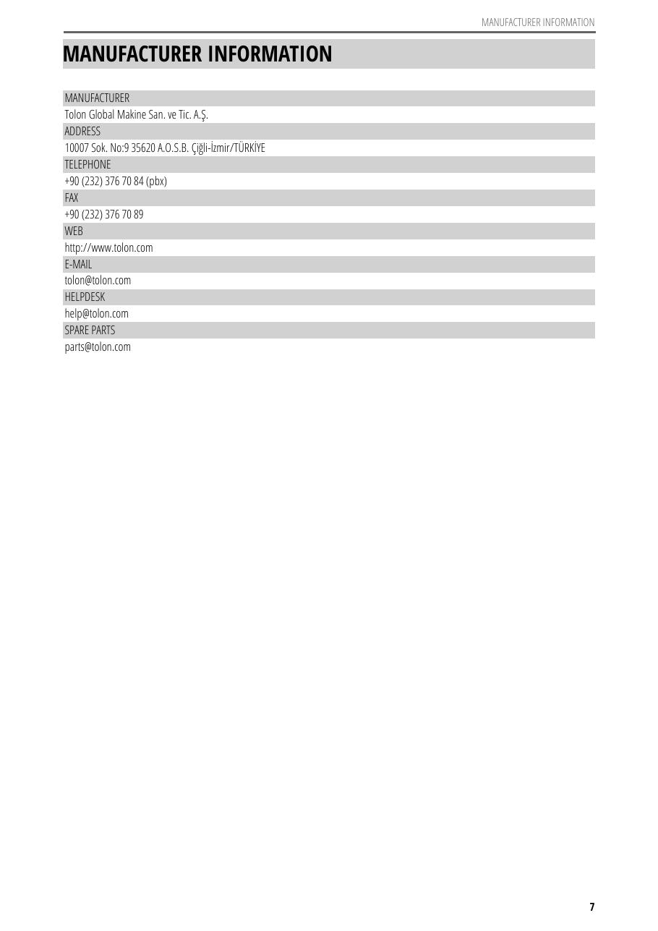
SOURCE EVIDENCE
Manual evidence 2
Source page 9
Use the original report for signatures, detailed readings, revision status and formal acceptance.
LC4 AIR-COOLED CHILLER | TOLON • Washer Manuals
08
Notes:
[Sources]
- User-provided source: Tolon_WE_Installation.Operating.Manual.ENG.v.2.0.0 (1) (3).pdf
- Evidence reference: Source page 9
Training interpretation only. Verify against the controlled project record, current OEM documentation, approved PTW/LOTO, risk assessment and site procedures.

Slide 9
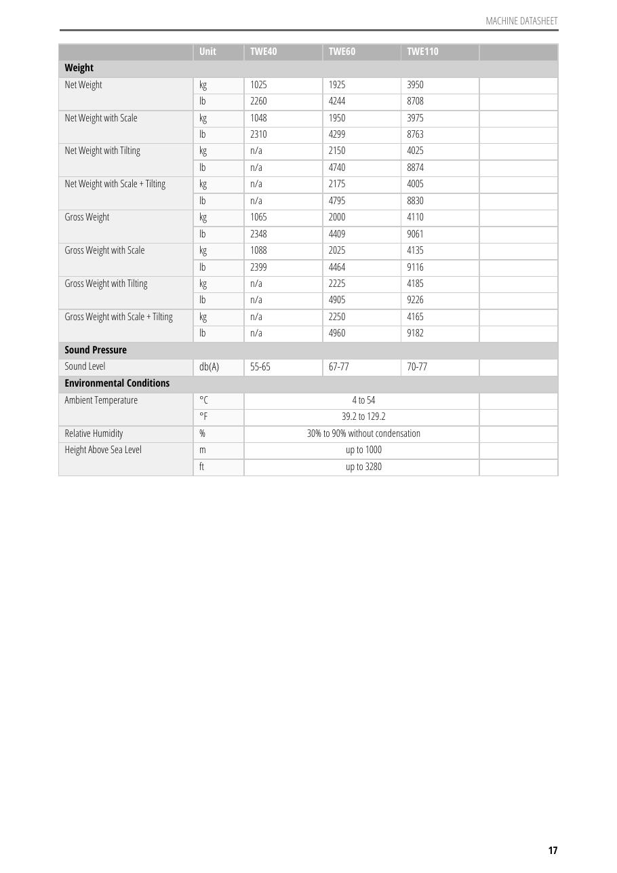
SOURCE EVIDENCE
Manual evidence 3
Source page 19
Use the original report for signatures, detailed readings, revision status and formal acceptance.
LC4 AIR-COOLED CHILLER | TOLON • Washer Manuals
09
Notes:
[Sources]
- User-provided source: Tolon_WE_Installation.Operating.Manual.ENG.v.2.0.0 (1) (3).pdf
- Evidence reference: Source page 19
Training interpretation only. Verify against the controlled project record, current OEM documentation, approved PTW/LOTO, risk assessment and site procedures.

Slide 10
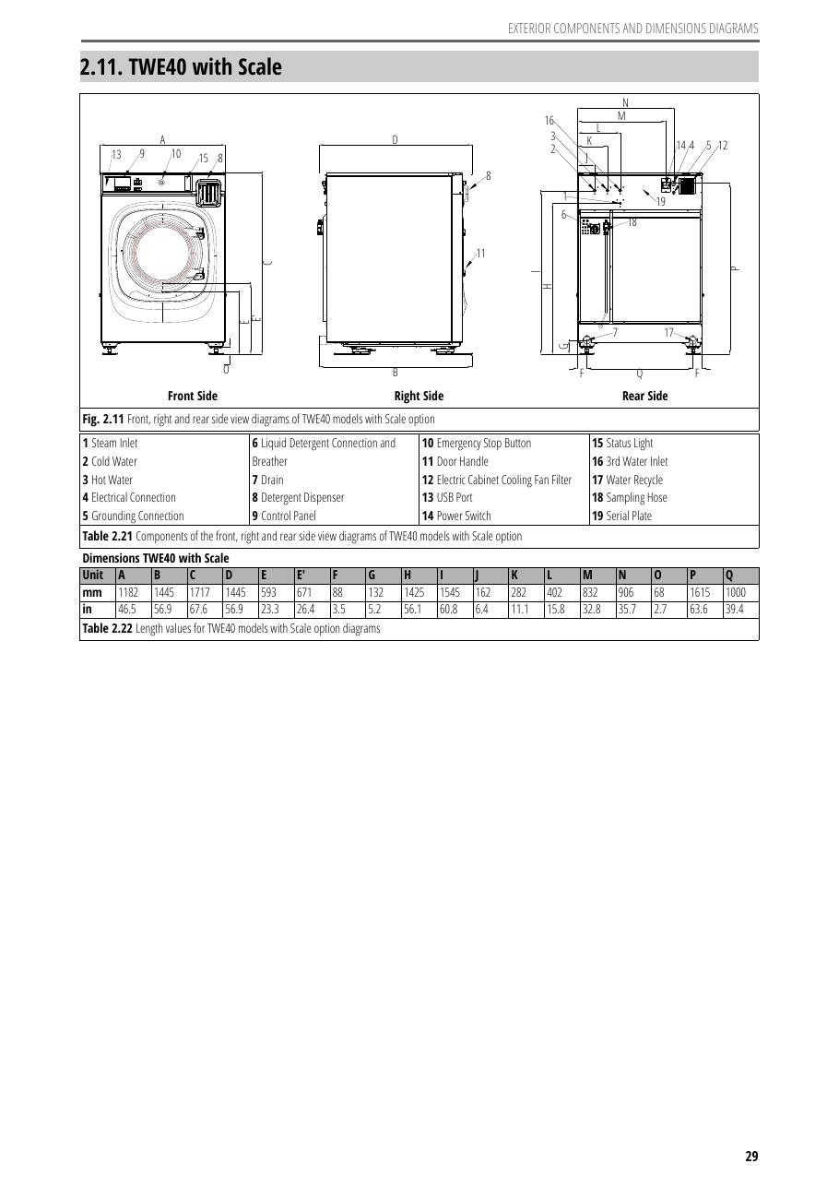
SOURCE EVIDENCE
Manual evidence 4
Source page 30
Use the original report for signatures, detailed readings, revision status and formal acceptance.
LC4 AIR-COOLED CHILLER | TOLON • Washer Manuals
10
Notes:
[Sources]
- User-provided source: Tolon_WE_Installation.Operating.Manual.ENG.v.2.0.0 (1) (3).pdf
- Evidence reference: Source page 30
Training interpretation only. Verify against the controlled project record, current OEM documentation, approved PTW/LOTO, risk assessment and site procedures.

Slide 11
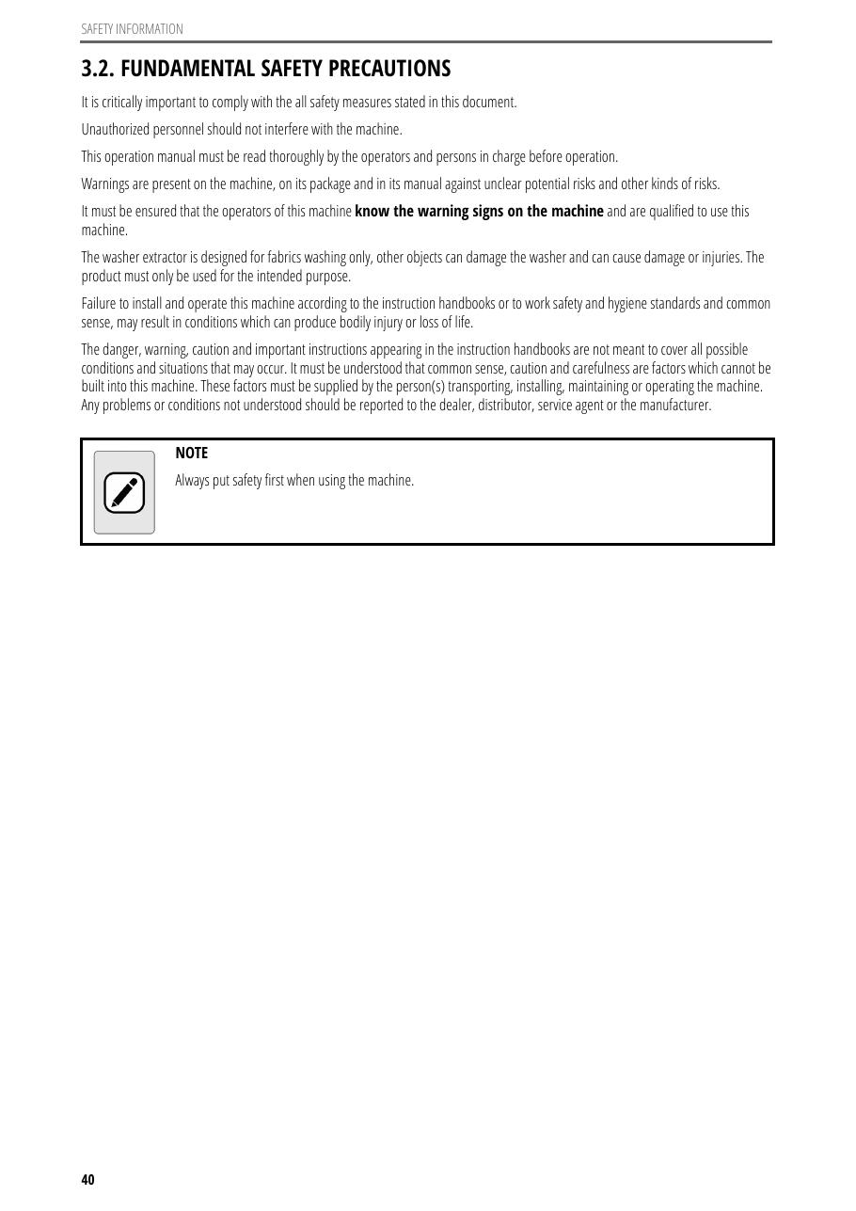
SOURCE EVIDENCE
Manual evidence 5
Source page 40
Use the original report for signatures, detailed readings, revision status and formal acceptance.
LC4 AIR-COOLED CHILLER | TOLON • Washer Manuals
11
Notes:
[Sources]
- User-provided source: Tolon_WE_Installation.Operating.Manual.ENG.v.2.0.0 (1) (3).pdf
- Evidence reference: Source page 40
Training interpretation only. Verify against the controlled project record, current OEM documentation, approved PTW/LOTO, risk assessment and site procedures.

Slide 12
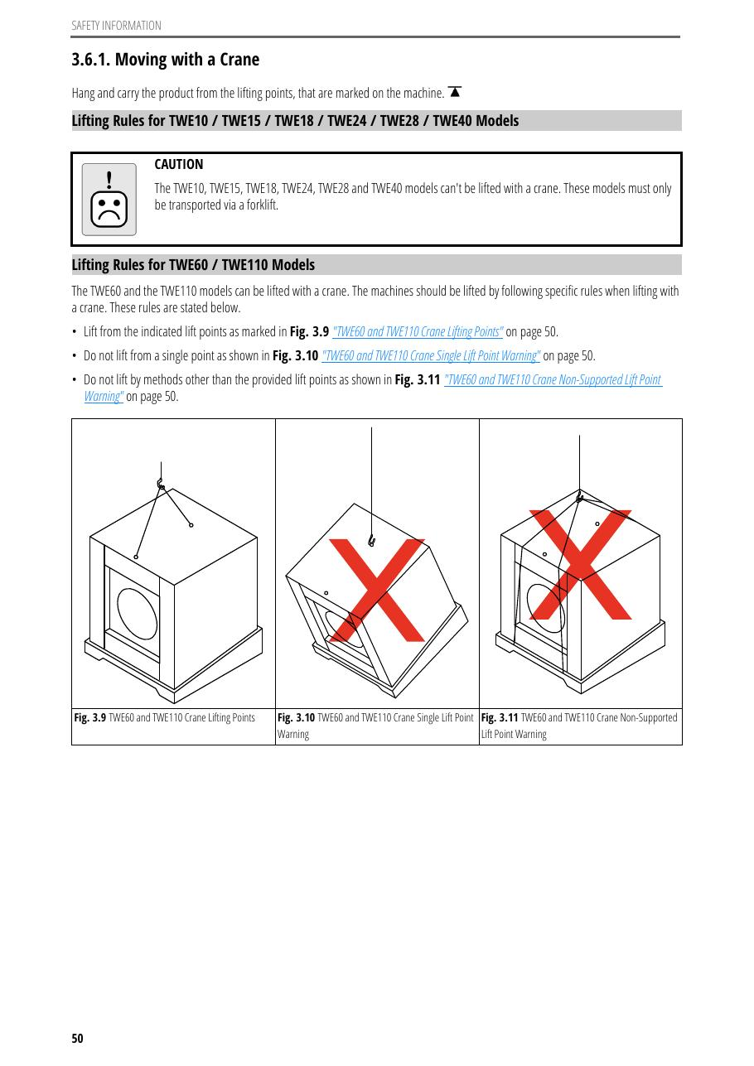
SOURCE EVIDENCE
Manual evidence 6
Source page 50
Use the original report for signatures, detailed readings, revision status and formal acceptance.
LC4 AIR-COOLED CHILLER | TOLON • Washer Manuals
12
Notes:
[Sources]
- User-provided source: Tolon_WE_Installation.Operating.Manual.ENG.v.2.0.0 (1) (3).pdf
- Evidence reference: Source page 50
Training interpretation only. Verify against the controlled project record, current OEM documentation, approved PTW/LOTO, risk assessment and site procedures.

Slide 13
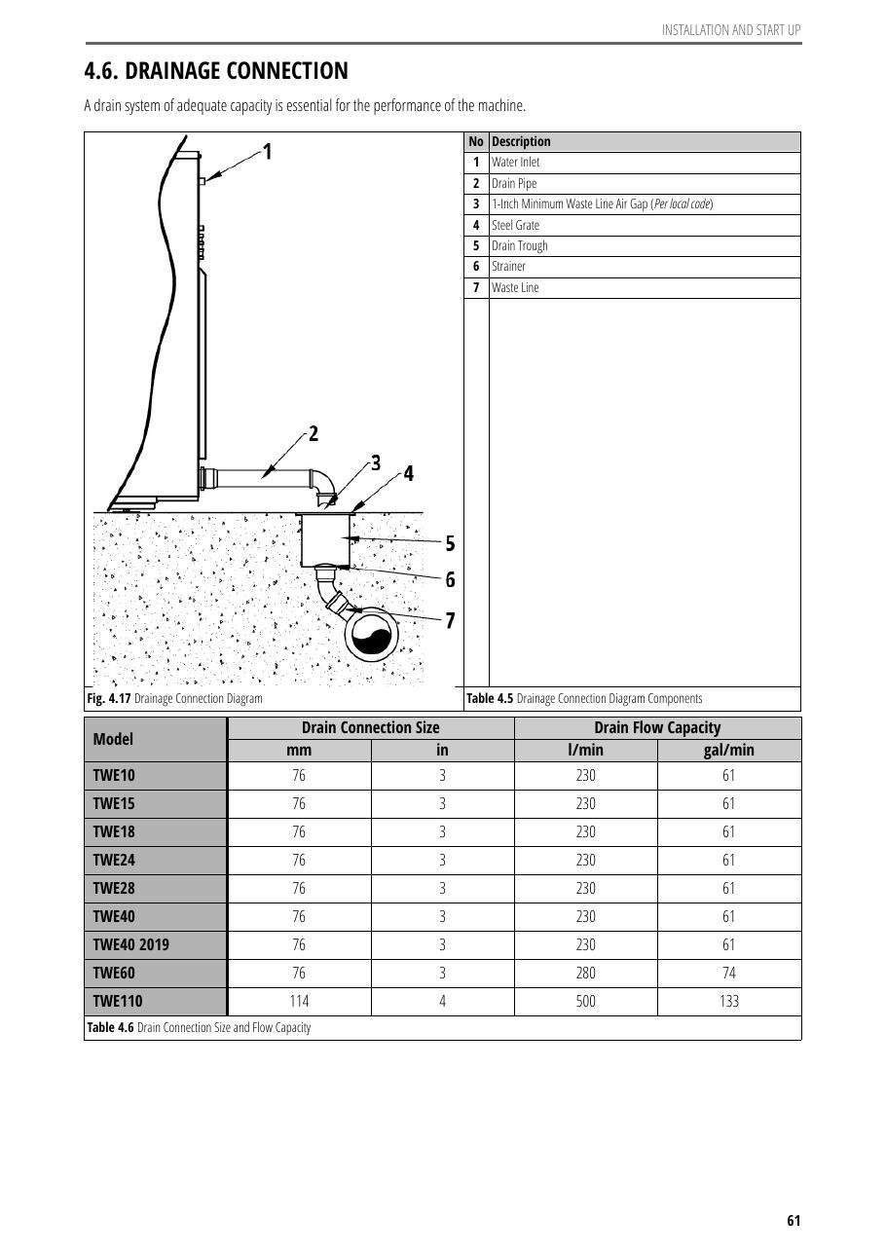
SOURCE EVIDENCE
Manual evidence 7
Source page 60
Use the original report for signatures, detailed readings, revision status and formal acceptance.
LC4 AIR-COOLED CHILLER | TOLON • Washer Manuals
13
Notes:
[Sources]
- User-provided source: Tolon_WE_Installation.Operating.Manual.ENG.v.2.0.0 (1) (3).pdf
- Evidence reference: Source page 60
Training interpretation only. Verify against the controlled project record, current OEM documentation, approved PTW/LOTO, risk assessment and site procedures.

Slide 14
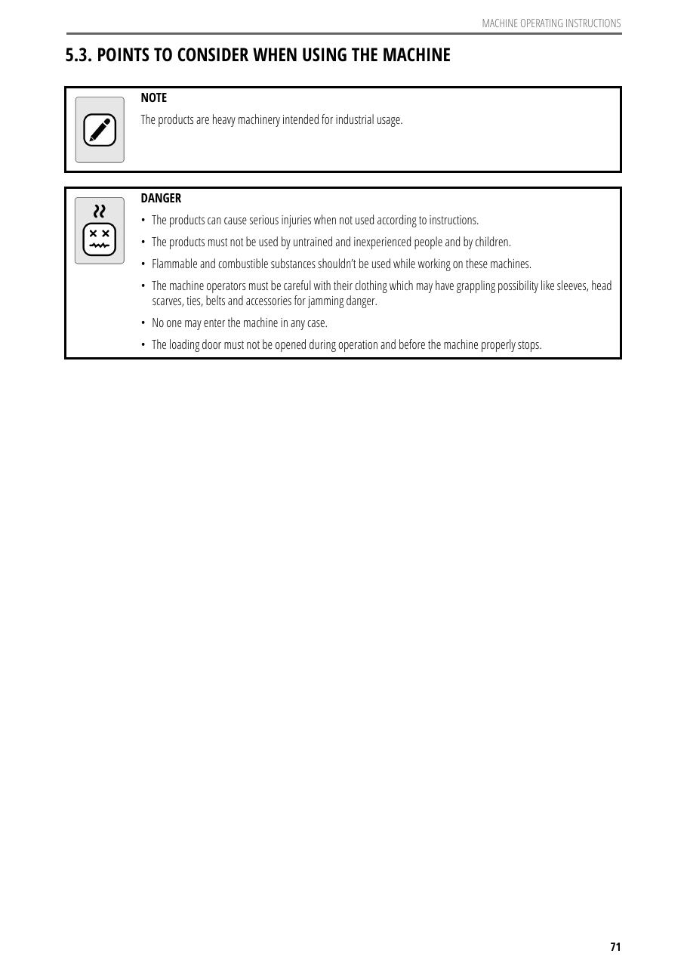
SOURCE EVIDENCE
Manual evidence 8
Source page 70
Use the original report for signatures, detailed readings, revision status and formal acceptance.
LC4 AIR-COOLED CHILLER | TOLON • Washer Manuals
14
Notes:
[Sources]
- User-provided source: Tolon_WE_Installation.Operating.Manual.ENG.v.2.0.0 (1) (3).pdf
- Evidence reference: Source page 70
Training interpretation only. Verify against the controlled project record, current OEM documentation, approved PTW/LOTO, risk assessment and site procedures.

Slide 15
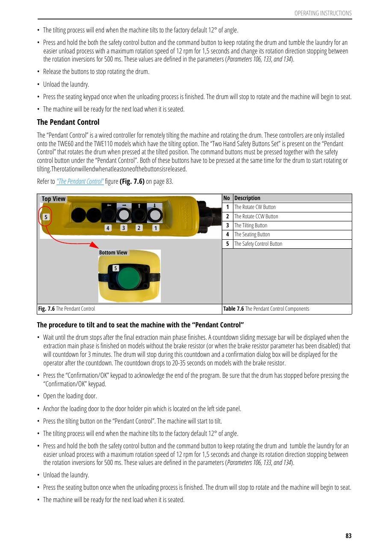
SOURCE EVIDENCE
Manual evidence 9
Source page 80
Use the original report for signatures, detailed readings, revision status and formal acceptance.
LC4 AIR-COOLED CHILLER | TOLON • Washer Manuals
15
Notes:
[Sources]
- User-provided source: Tolon_WE_Installation.Operating.Manual.ENG.v.2.0.0 (1) (3).pdf
- Evidence reference: Source page 80
Training interpretation only. Verify against the controlled project record, current OEM documentation, approved PTW/LOTO, risk assessment and site procedures.

Slide 16
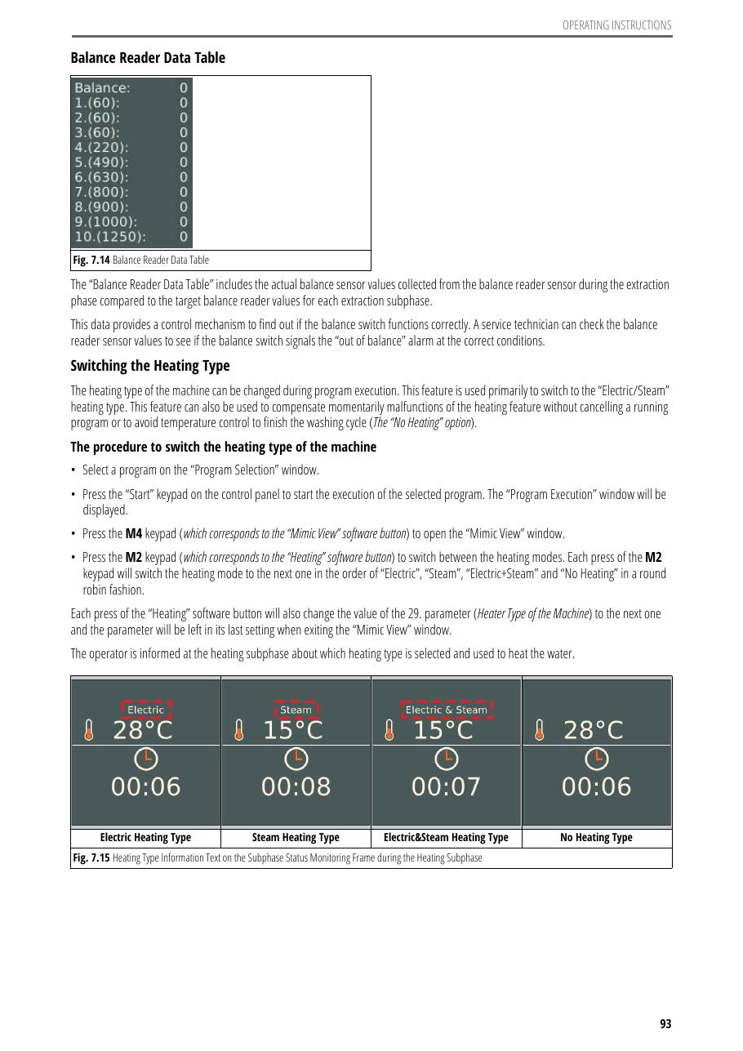
SOURCE EVIDENCE
Manual evidence 10
Source page 90
Use the original report for signatures, detailed readings, revision status and formal acceptance.
LC4 AIR-COOLED CHILLER | TOLON • Washer Manuals
16
Notes:
[Sources]
- User-provided source: Tolon_WE_Installation.Operating.Manual.ENG.v.2.0.0 (1) (3).pdf
- Evidence reference: Source page 90
Training interpretation only. Verify against the controlled project record, current OEM documentation, approved PTW/LOTO, risk assessment and site procedures.

Slide 17
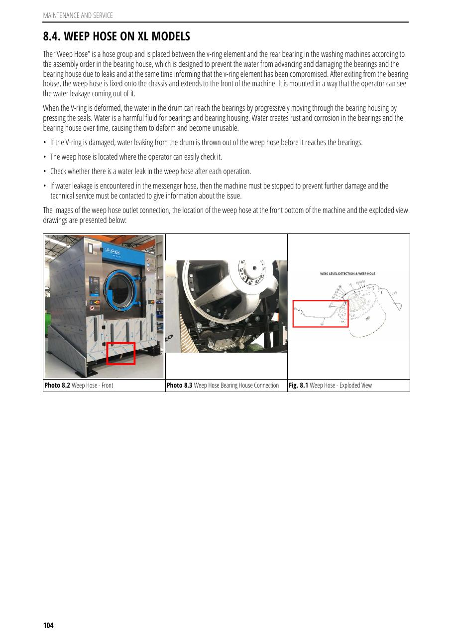
SOURCE EVIDENCE
Manual evidence 11
Source page 100
Use the original report for signatures, detailed readings, revision status and formal acceptance.
LC4 AIR-COOLED CHILLER | TOLON • Washer Manuals
17
Notes:
[Sources]
- User-provided source: Tolon_WE_Installation.Operating.Manual.ENG.v.2.0.0 (1) (3).pdf
- Evidence reference: Source page 100
Training interpretation only. Verify against the controlled project record, current OEM documentation, approved PTW/LOTO, risk assessment and site procedures.

Slide 18
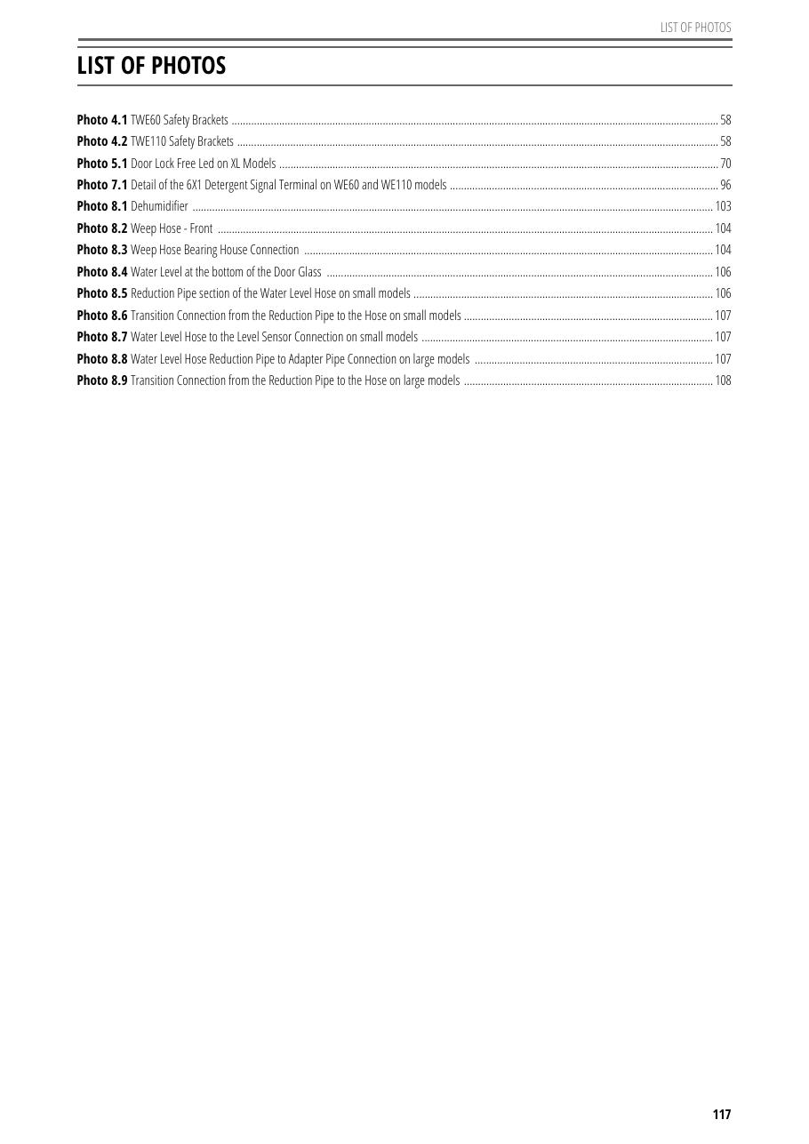
SOURCE EVIDENCE
Manual evidence 12
Source page 111
Use the original report for signatures, detailed readings, revision status and formal acceptance.
LC4 AIR-COOLED CHILLER | TOLON • Washer Manuals
18
Notes:
[Sources]
- User-provided source: Tolon_WE_Installation.Operating.Manual.ENG.v.2.0.0 (1) (3).pdf
- Evidence reference: Source page 111
Training interpretation only. Verify against the controlled project record, current OEM documentation, approved PTW/LOTO, risk assessment and site procedures.

Slide 19
COMPETENCY CHECK
What technicians must retain
• Identify the correct controlled source before work.
• Verify readings, configuration and acceptance criteria.
• Preserve evidence and escalate unresolved deviations.
• Complete safe isolation, functional testing and handover records.
LC4 AIR-COOLED CHILLER | TOLON • Washer Manuals
19
Notes:
[Sources]
- User-provided source: Tolon_WE_Installation.Operating.Manual.ENG.v.2.0.0 (1) (3).pdf
Training interpretation only. Verify against the controlled project record, current OEM documentation, approved PTW/LOTO, risk assessment and site procedures.

