Slide 1

BÖWE TECHNICAL TRAINING
M30
Multisolvent dry-cleaning machine
Operation • Safety • Functional Systems • Preventive Maintenance • Troubleshooting • Spare Parts
Sajjad's Engineering Academy
114 SLIDES
Notes:
[Sources]
- BÖWE M21-M26-M30 Operating Manual (2018-02), pages 5-7: https://www.ziermann.com/wp-content/uploads/2021/03/BA-Instruction-manual-M21-M26-M30-2018-02.pdf
- BÖWE M21-M26-M30 Spare Parts Catalogue (2019-08): https://www.ziermann.com/wp-content/uploads/2021/03/Ersatzteile-M21-M30-2019-08.pdf
- Practical visual: BÖWE M21-M26-M30 Operating Manual (2018-02), cover page
Training interpretation: confirm the installed machine, current OEM revision, approved site PTW/LOTO, SDS and approved risk assessment before work.

Slide 2
PHYSICAL MACHINE & PARTS
Photo atlas
Real BÖWE machine and component photographs for technician orientation
002
Notes:
[Sources]
- Physical machine/component photograph: BÖWE OEM product pages and cited equipment listings
- BÖWE PremiumLine product information: https://bowe-germany.de/en/premiumline-multisolvent/
- BÖWE M21-M26-M30 Operating Manual (2018-02): https://www.ziermann.com/wp-content/uploads/2021/03/BA-Instruction-manual-M21-M26-M30-2018-02.pdf
Physical-photo reference only. Confirm the installed M30 configuration, serial number, OEM parts catalogue, approved site PTW/LOTO and approved risk assessment before work.

Slide 3
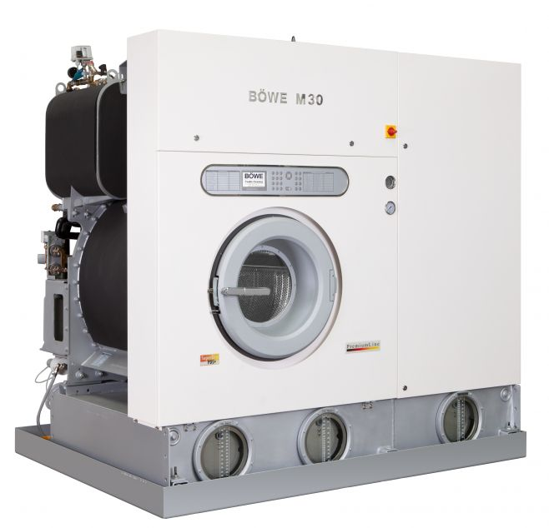
PHYSICAL MACHINE & PARTS
BÖWE M30 — complete physical machine
WHAT TO IDENTIFY
• Front loading door, drum and control interface
• Three lower tank sight-glasses
• CrossLine process equipment is positioned behind/beside the drum module
Physical-photo reference • verify installed configuration
BÖWE M30 | Physical Parts Atlas
003
Notes:
[Sources]
- Physical machine/component photograph: https://bowe-germany.de/en/premiumline-multisolvent/
- BÖWE PremiumLine product information: https://bowe-germany.de/en/premiumline-multisolvent/
- BÖWE M21-M26-M30 Operating Manual (2018-02): https://www.ziermann.com/wp-content/uploads/2021/03/BA-Instruction-manual-M21-M26-M30-2018-02.pdf
Physical-photo reference only. Confirm the installed M30 configuration, serial number, OEM parts catalogue, approved site PTW/LOTO and approved risk assessment before work.

Slide 4
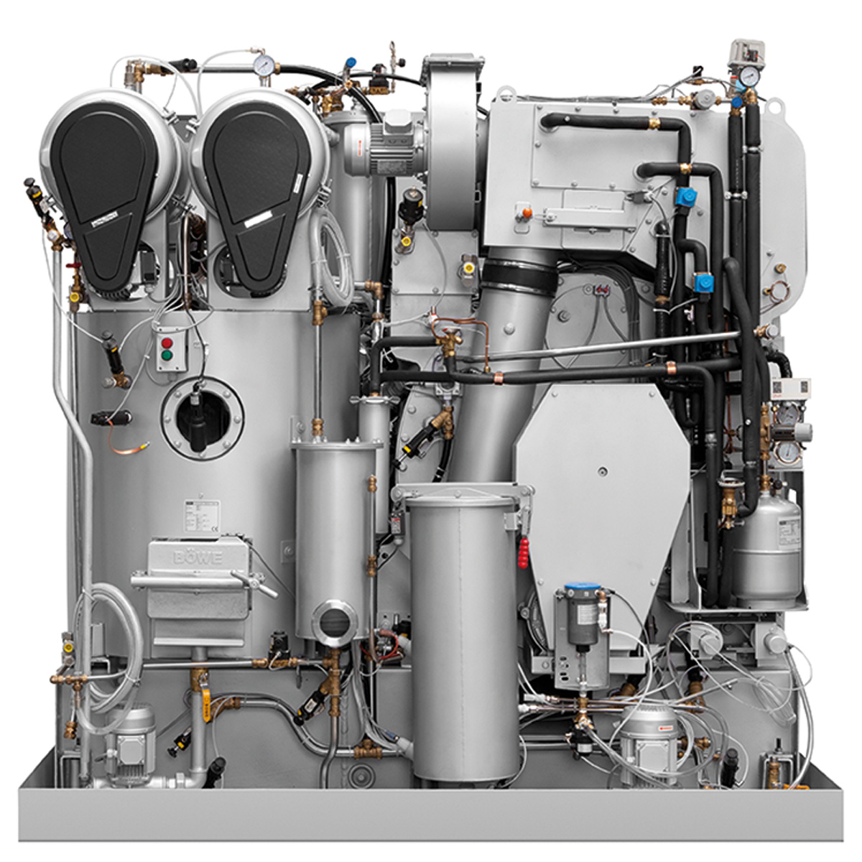
PHYSICAL MACHINE & PARTS
M30 rear service side — physical system layout
WHAT TO IDENTIFY
• Identify service access before isolation
• Trace pumps, piping, filters, air system and distillation interfaces
• Do not infer valve function from appearance alone—use the current schematic
Physical-photo reference • verify installed configuration
BÖWE M30 | Physical Parts Atlas
004
Notes:
[Sources]
- Physical machine/component photograph: https://bowe-germany.de/en/premiumline-multisolvent/
- BÖWE PremiumLine product information: https://bowe-germany.de/en/premiumline-multisolvent/
- BÖWE M21-M26-M30 Operating Manual (2018-02): https://www.ziermann.com/wp-content/uploads/2021/03/BA-Instruction-manual-M21-M26-M30-2018-02.pdf
Physical-photo reference only. Confirm the installed M30 configuration, serial number, OEM parts catalogue, approved site PTW/LOTO and approved risk assessment before work.

Slide 5
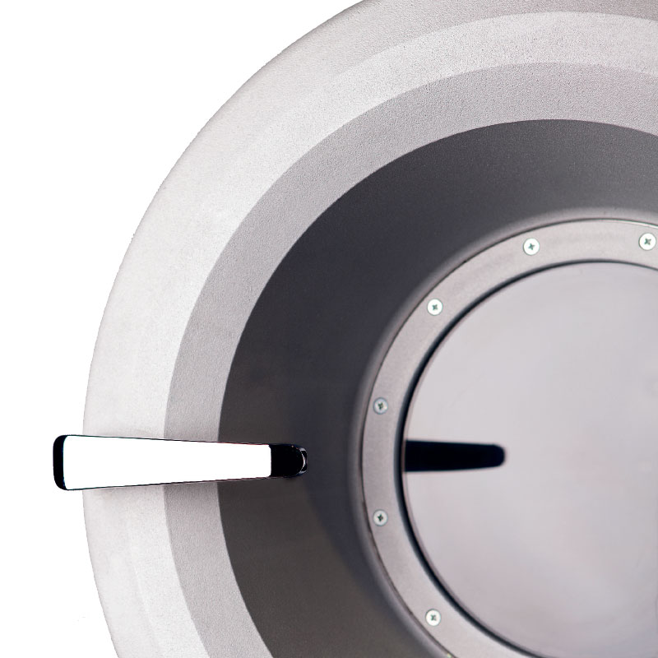
PHYSICAL MACHINE & PARTS
Loading door, seal and drum opening
WHAT TO IDENTIFY
• Inspect gasket condition and seating surface
• Check hinge, handle and interlock operation
• Never bypass the loading-door safety circuit
Physical-photo reference • verify installed configuration
BÖWE M30 | Physical Parts Atlas
005
Notes:
[Sources]
- Physical machine/component photograph: https://bowe-germany.de/en/premiumline-multisolvent/
- BÖWE PremiumLine product information: https://bowe-germany.de/en/premiumline-multisolvent/
- BÖWE M21-M26-M30 Operating Manual (2018-02): https://www.ziermann.com/wp-content/uploads/2021/03/BA-Instruction-manual-M21-M26-M30-2018-02.pdf
Physical-photo reference only. Confirm the installed M30 configuration, serial number, OEM parts catalogue, approved site PTW/LOTO and approved risk assessment before work.

Slide 6
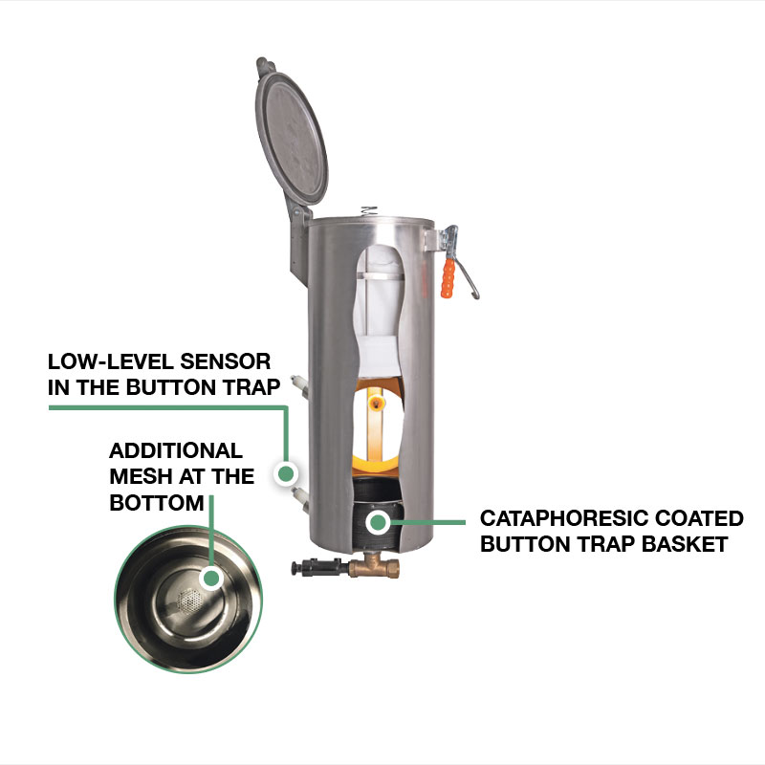
PHYSICAL MACHINE & PARTS
Lint filter — physical maintenance component
WHAT TO IDENTIFY
• Remove lint at the OEM/site interval
• Inspect mesh, seals and correct seating
• Restriction increases drying time and thermal load
Physical-photo reference • verify installed configuration
BÖWE M30 | Physical Parts Atlas
006
Notes:
[Sources]
- Physical machine/component photograph: https://bowe-germany.de/bowe-produkte/flusenfilter-und-nadelfaenger/
- BÖWE PremiumLine product information: https://bowe-germany.de/en/premiumline-multisolvent/
- BÖWE M21-M26-M30 Operating Manual (2018-02): https://www.ziermann.com/wp-content/uploads/2021/03/BA-Instruction-manual-M21-M26-M30-2018-02.pdf
Physical-photo reference only. Confirm the installed M30 configuration, serial number, OEM parts catalogue, approved site PTW/LOTO and approved risk assessment before work.

Slide 7
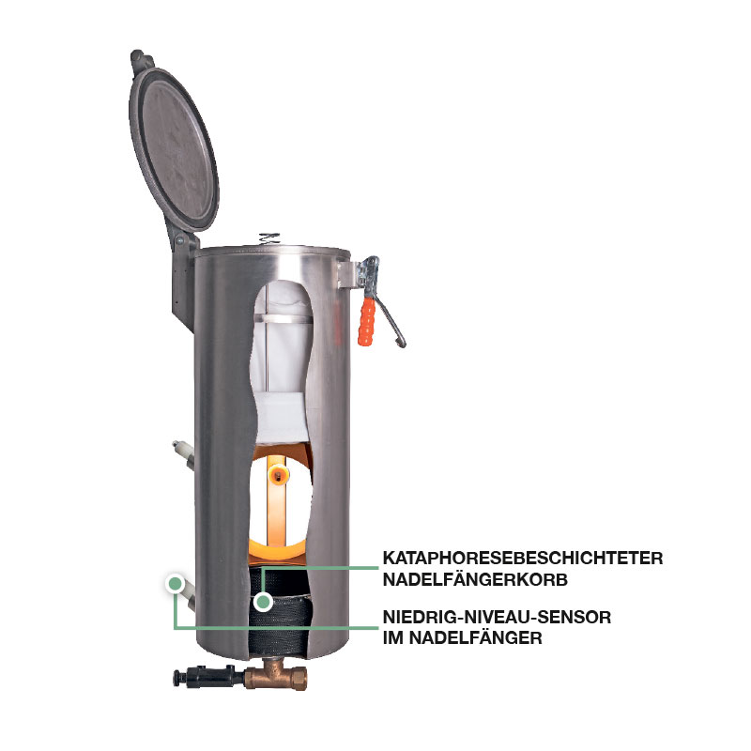
PHYSICAL MACHINE & PARTS
Button trap basket and low-level sensor
WHAT TO IDENTIFY
• Remove coins, needles, buttons and lint safely
• Inspect the additional bottom mesh
• Confirm basket seating and sensor condition before restart
Physical-photo reference • verify installed configuration
BÖWE M30 | Physical Parts Atlas
007
Notes:
[Sources]
- Physical machine/component photograph: https://bowe-germany.de/bowe-produkte/flusenfilter-und-nadelfaenger/
- BÖWE PremiumLine product information: https://bowe-germany.de/en/premiumline-multisolvent/
- BÖWE M21-M26-M30 Operating Manual (2018-02): https://www.ziermann.com/wp-content/uploads/2021/03/BA-Instruction-manual-M21-M26-M30-2018-02.pdf
Physical-photo reference only. Confirm the installed M30 configuration, serial number, OEM parts catalogue, approved site PTW/LOTO and approved risk assessment before work.

Slide 8
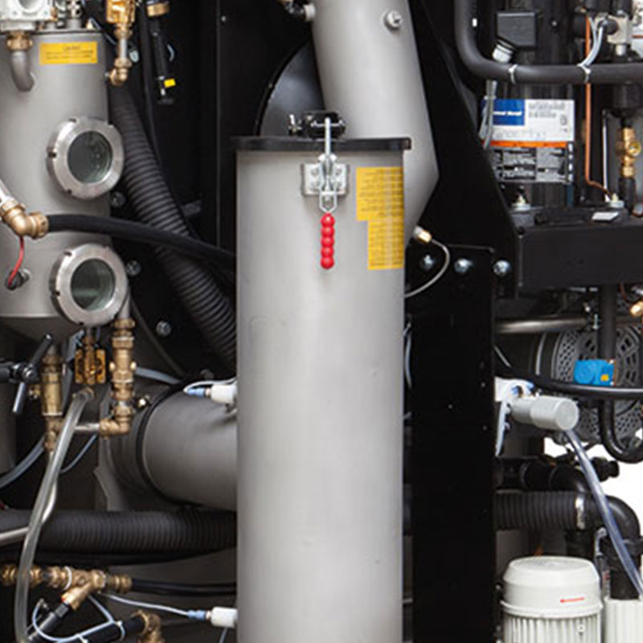
PHYSICAL MACHINE & PARTS
Lint filter and button-trap installed position
WHAT TO IDENTIFY
• Locate the assembly on the actual machine
• Identify connected hoses, valves and access clearances
• Isolate and verify safe condition before opening
Physical-photo reference • verify installed configuration
BÖWE M30 | Physical Parts Atlas
008
Notes:
[Sources]
- Physical machine/component photograph: https://bowe-germany.de/bowe-produkte/flusenfilter-und-nadelfaenger/
- BÖWE PremiumLine product information: https://bowe-germany.de/en/premiumline-multisolvent/
- BÖWE M21-M26-M30 Operating Manual (2018-02): https://www.ziermann.com/wp-content/uploads/2021/03/BA-Instruction-manual-M21-M26-M30-2018-02.pdf
Physical-photo reference only. Confirm the installed M30 configuration, serial number, OEM parts catalogue, approved site PTW/LOTO and approved risk assessment before work.

Slide 9
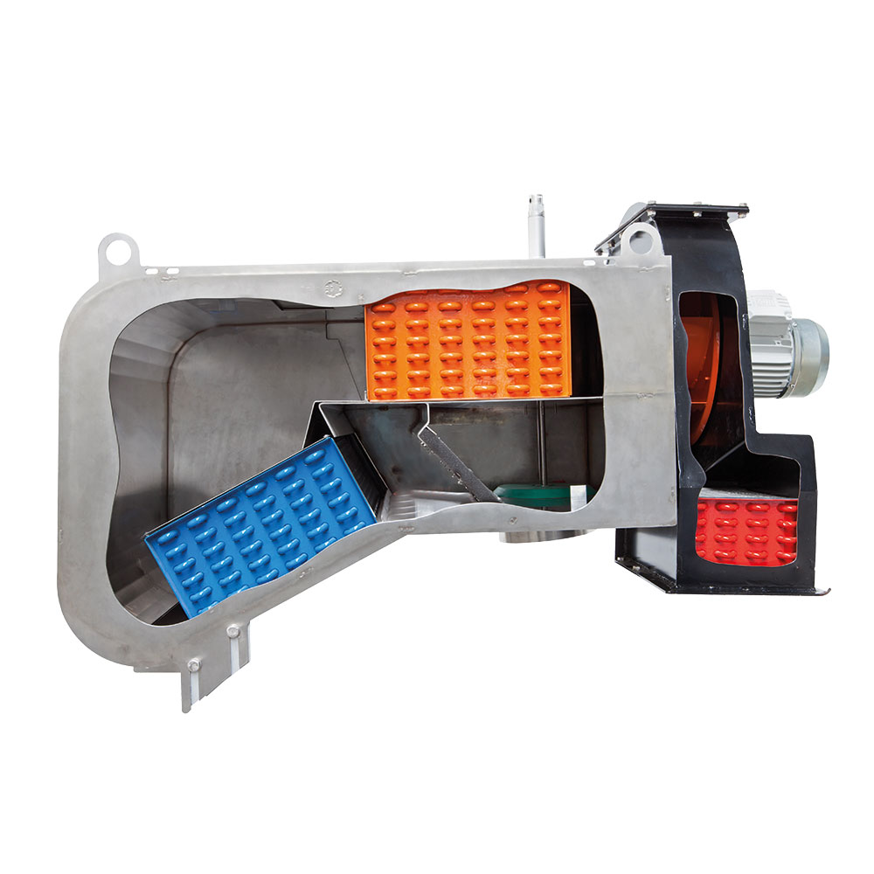
PHYSICAL MACHINE & PARTS
Air blower and drive assembly
WHAT TO IDENTIFY
• Inspect motor, fan housing and mountings
• Check abnormal noise, heat and vibration
• Verify guards and isolation before access
Physical-photo reference • verify installed configuration
BÖWE M30 | Physical Parts Atlas
009
Notes:
[Sources]
- Physical machine/component photograph: https://bowe-germany.de/en/premiumline-multisolvent/
- BÖWE PremiumLine product information: https://bowe-germany.de/en/premiumline-multisolvent/
- BÖWE M21-M26-M30 Operating Manual (2018-02): https://www.ziermann.com/wp-content/uploads/2021/03/BA-Instruction-manual-M21-M26-M30-2018-02.pdf
Physical-photo reference only. Confirm the installed M30 configuration, serial number, OEM parts catalogue, approved site PTW/LOTO and approved risk assessment before work.

Slide 10

PHYSICAL MACHINE & PARTS
Dynamic drying-airflow components
WHAT TO IDENTIFY
• Trace airflow through filter, heater and recovery path
• Inspect flexible connections and sealing
• Poor airflow extends drying and solvent-recovery time
Physical-photo reference • verify installed configuration
BÖWE M30 | Physical Parts Atlas
010
Notes:
[Sources]
- Physical machine/component photograph: https://bowe-germany.de/en/premiumline-multisolvent/
- BÖWE PremiumLine product information: https://bowe-germany.de/en/premiumline-multisolvent/
- BÖWE M21-M26-M30 Operating Manual (2018-02): https://www.ziermann.com/wp-content/uploads/2021/03/BA-Instruction-manual-M21-M26-M30-2018-02.pdf
Physical-photo reference only. Confirm the installed M30 configuration, serial number, OEM parts catalogue, approved site PTW/LOTO and approved risk assessment before work.

Slide 11
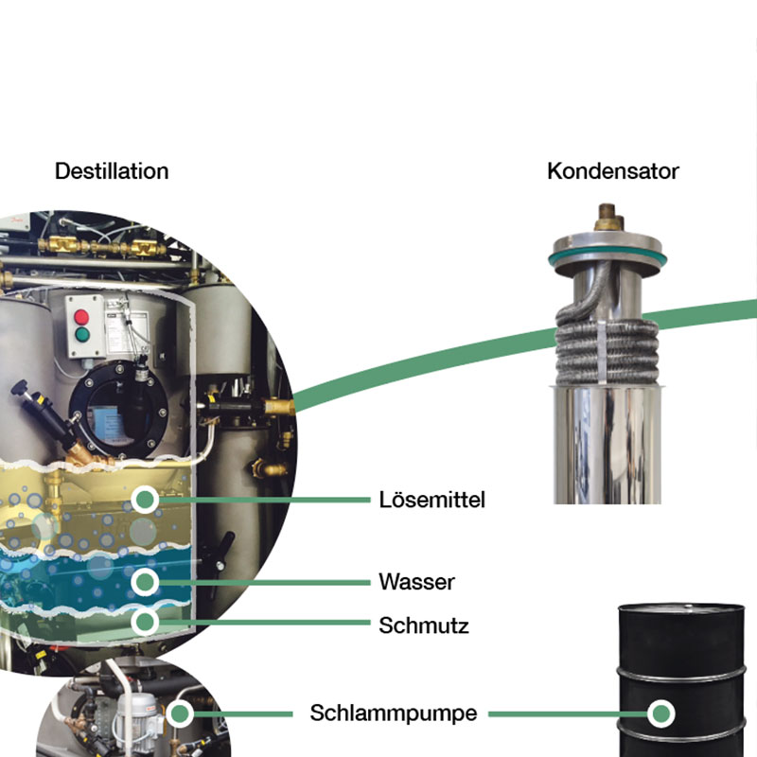
PHYSICAL MACHINE & PARTS
Distillation unit — physical assembly
WHAT TO IDENTIFY
• Identify still body, access and connected pipework
• Allow complete cooling before maintenance
• Residues require controlled hazardous-waste handling
Physical-photo reference • verify installed configuration
BÖWE M30 | Physical Parts Atlas
011
Notes:
[Sources]
- Physical machine/component photograph: https://bowe-germany.de/en/premiumline-multisolvent/
- BÖWE PremiumLine product information: https://bowe-germany.de/en/premiumline-multisolvent/
- BÖWE M21-M26-M30 Operating Manual (2018-02): https://www.ziermann.com/wp-content/uploads/2021/03/BA-Instruction-manual-M21-M26-M30-2018-02.pdf
Physical-photo reference only. Confirm the installed M30 configuration, serial number, OEM parts catalogue, approved site PTW/LOTO and approved risk assessment before work.

Slide 12
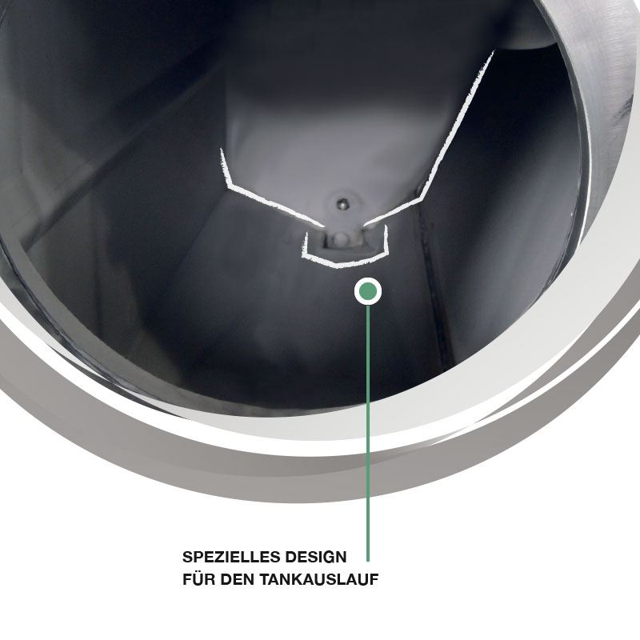
PHYSICAL MACHINE & PARTS
Self-cleaning solvent tank design
WHAT TO IDENTIFY
• Confirm tank duty using the installed schematic
• Inspect sight-glass, level sensing and leakage evidence
• Do not open or enter a tank without the approved procedure
Physical-photo reference • verify installed configuration
BÖWE M30 | Physical Parts Atlas
012
Notes:
[Sources]
- Physical machine/component photograph: https://bowe-germany.de/en/premiumline-multisolvent/
- BÖWE PremiumLine product information: https://bowe-germany.de/en/premiumline-multisolvent/
- BÖWE M21-M26-M30 Operating Manual (2018-02): https://www.ziermann.com/wp-content/uploads/2021/03/BA-Instruction-manual-M21-M26-M30-2018-02.pdf
Physical-photo reference only. Confirm the installed M30 configuration, serial number, OEM parts catalogue, approved site PTW/LOTO and approved risk assessment before work.

Slide 13
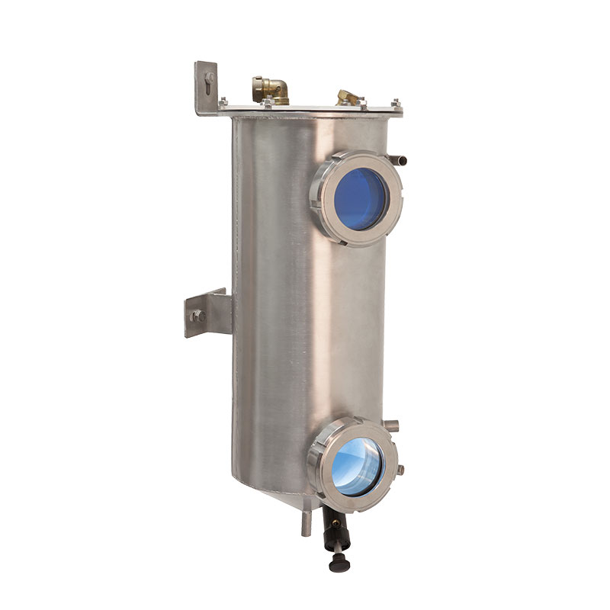
PHYSICAL MACHINE & PARTS
Water separator — physical component
WHAT TO IDENTIFY
• Inspect phase separation through the viewing area
• Check hoses, valves, sensor and signs of contamination
• Follow the automatic/manual maintenance sequence exactly
Physical-photo reference • verify installed configuration
BÖWE M30 | Physical Parts Atlas
013
Notes:
[Sources]
- Physical machine/component photograph: https://bowe-germany.de/en/premiumline-multisolvent/
- BÖWE PremiumLine product information: https://bowe-germany.de/en/premiumline-multisolvent/
- BÖWE M21-M26-M30 Operating Manual (2018-02): https://www.ziermann.com/wp-content/uploads/2021/03/BA-Instruction-manual-M21-M26-M30-2018-02.pdf
Physical-photo reference only. Confirm the installed M30 configuration, serial number, OEM parts catalogue, approved site PTW/LOTO and approved risk assessment before work.

Slide 14
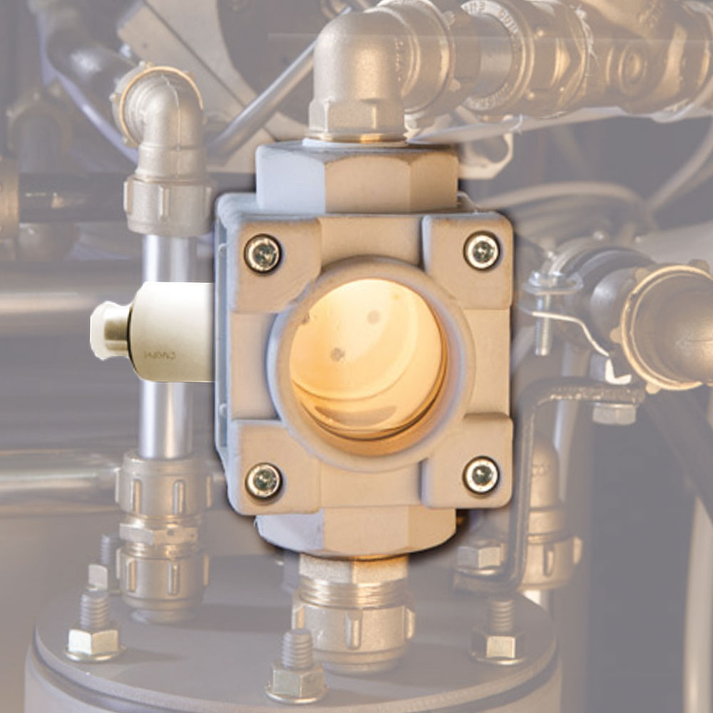
PHYSICAL MACHINE & PARTS
Drying controller capacitive sensor
WHAT TO IDENTIFY
• Keep the sensor face clean and correctly positioned
• Inspect cable and connector condition
• Confirm readings against cycle behaviour before replacement
Physical-photo reference • verify installed configuration
BÖWE M30 | Physical Parts Atlas
014
Notes:
[Sources]
- Physical machine/component photograph: https://bowe-germany.de/en/premiumline-multisolvent/
- BÖWE PremiumLine product information: https://bowe-germany.de/en/premiumline-multisolvent/
- BÖWE M21-M26-M30 Operating Manual (2018-02): https://www.ziermann.com/wp-content/uploads/2021/03/BA-Instruction-manual-M21-M26-M30-2018-02.pdf
Physical-photo reference only. Confirm the installed M30 configuration, serial number, OEM parts catalogue, approved site PTW/LOTO and approved risk assessment before work.

Slide 15
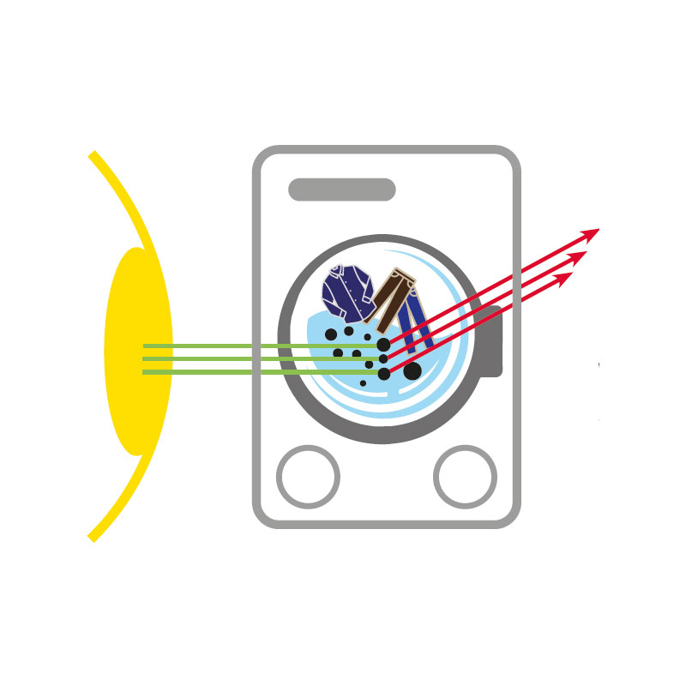
PHYSICAL MACHINE & PARTS
Solvent turbidity measurement component
WHAT TO IDENTIFY
• Keep optical surfaces clean
• Trend readings with solvent condition and filtration
• Verify calibration/diagnostic evidence before condemning the sensor
Physical-photo reference • verify installed configuration
BÖWE M30 | Physical Parts Atlas
015
Notes:
[Sources]
- Physical machine/component photograph: https://bowe-germany.de/en/premiumline-multisolvent/
- BÖWE PremiumLine product information: https://bowe-germany.de/en/premiumline-multisolvent/
- BÖWE M21-M26-M30 Operating Manual (2018-02): https://www.ziermann.com/wp-content/uploads/2021/03/BA-Instruction-manual-M21-M26-M30-2018-02.pdf
Physical-photo reference only. Confirm the installed M30 configuration, serial number, OEM parts catalogue, approved site PTW/LOTO and approved risk assessment before work.

Slide 16
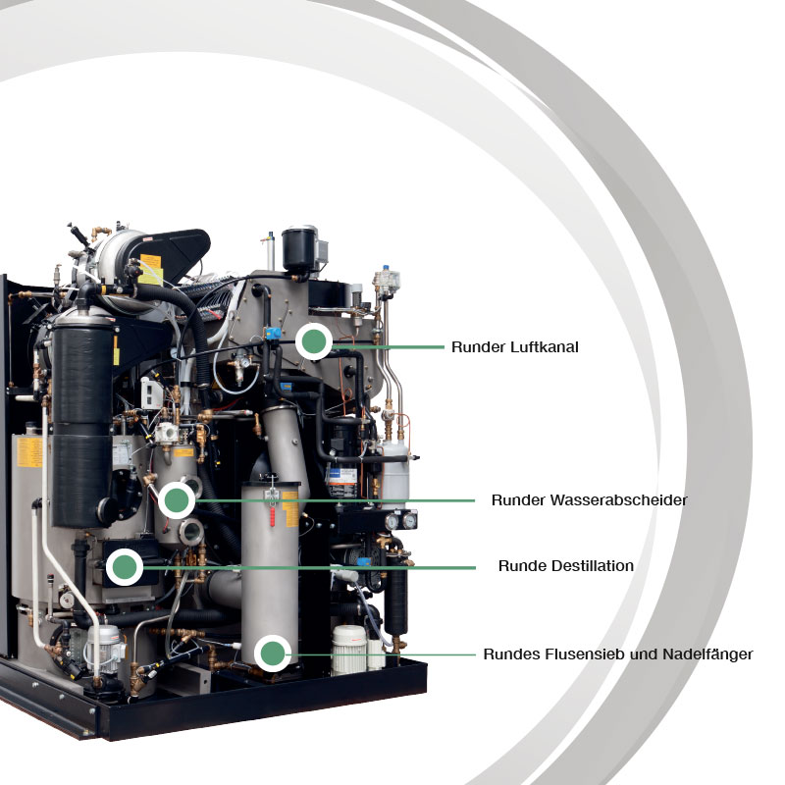
PHYSICAL MACHINE & PARTS
Maintenance access — components behind panels
WHAT TO IDENTIFY
• Remove panels only after verified isolation
• Maintain clear access and good housekeeping
• Reinstall guards, covers and fasteners before test run
Physical-photo reference • verify installed configuration
BÖWE M30 | Physical Parts Atlas
016
Notes:
[Sources]
- Physical machine/component photograph: https://bowe-germany.de/en/premiumline-multisolvent/
- BÖWE PremiumLine product information: https://bowe-germany.de/en/premiumline-multisolvent/
- BÖWE M21-M26-M30 Operating Manual (2018-02): https://www.ziermann.com/wp-content/uploads/2021/03/BA-Instruction-manual-M21-M26-M30-2018-02.pdf
Physical-photo reference only. Confirm the installed M30 configuration, serial number, OEM parts catalogue, approved site PTW/LOTO and approved risk assessment before work.

Slide 17
SECTION 01
Orientation
Build understanding first; then apply it safely on the installed machine.
017
Notes:
[Sources]
- BÖWE M21-M26-M30 Operating Manual (2018-02), pages 5-7: https://www.ziermann.com/wp-content/uploads/2021/03/BA-Instruction-manual-M21-M26-M30-2018-02.pdf
- BÖWE M21-M26-M30 Spare Parts Catalogue (2019-08): https://www.ziermann.com/wp-content/uploads/2021/03/Ersatzteile-M21-M30-2019-08.pdf
Training interpretation: confirm the installed machine, current OEM revision, approved site PTW/LOTO, SDS and approved risk assessment before work.

Slide 18
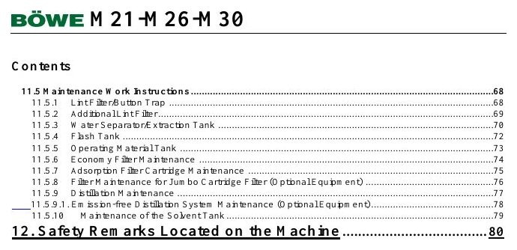
ORIENTATION
How to use this training deck
MACHINE / SYSTEM VIEW
Locate the machine area first, then connect the visible components to the operating sequence.
• Validate all decisions against the installed machine and current controlled documents.
• Capture questions and configuration gaps before practical assessment.
Machine / system reference • operating manual page 9
BÖWE M30 | Orientation
018
Notes:
[Sources]
- BÖWE M21-M26-M30 Operating Manual (2018-02), pages 5-7: https://www.ziermann.com/wp-content/uploads/2021/03/BA-Instruction-manual-M21-M26-M30-2018-02.pdf
- BÖWE M21-M26-M30 Spare Parts Catalogue (2019-08): https://www.ziermann.com/wp-content/uploads/2021/03/Ersatzteile-M21-M30-2019-08.pdf
- Practical visual: BÖWE M21-M26-M30 Operating Manual (2018-02), PDF page 9
Training interpretation: confirm the installed machine, current OEM revision, approved site PTW/LOTO, SDS and approved risk assessment before work.

Slide 19
ORIENTATION
Learning outcomes for technicians
WHY IT MATTERS
SAFE EXECUTION
Use this topic to connect learning outcomes for technicians with safe daily work.
• Validate all decisions against the installed machine and current controlled documents.
• Capture questions and configuration gaps before practical assessment.
BÖWE M30 | Orientation
019
Notes:
[Sources]
- BÖWE M21-M26-M30 Operating Manual (2018-02), pages 5-7: https://www.ziermann.com/wp-content/uploads/2021/03/BA-Instruction-manual-M21-M26-M30-2018-02.pdf
- BÖWE M21-M26-M30 Spare Parts Catalogue (2019-08): https://www.ziermann.com/wp-content/uploads/2021/03/Ersatzteile-M21-M30-2019-08.pdf
Training interpretation: confirm the installed machine, current OEM revision, approved site PTW/LOTO, SDS and approved risk assessment before work.

Slide 20

ORIENTATION
Training scope and limitations
MACHINE / SYSTEM VIEW
Locate the machine area first, then connect the visible components to the operating sequence.
• Validate all decisions against the installed machine and current controlled documents.
• Capture questions and configuration gaps before practical assessment.
Machine / system reference • operating manual page 14
BÖWE M30 | Orientation
020
Notes:
[Sources]
- BÖWE M21-M26-M30 Operating Manual (2018-02), pages 5-7: https://www.ziermann.com/wp-content/uploads/2021/03/BA-Instruction-manual-M21-M26-M30-2018-02.pdf
- BÖWE M21-M26-M30 Spare Parts Catalogue (2019-08): https://www.ziermann.com/wp-content/uploads/2021/03/Ersatzteile-M21-M30-2019-08.pdf
- Practical visual: BÖWE M21-M26-M30 Operating Manual (2018-02), PDF page 14
Training interpretation: confirm the installed machine, current OEM revision, approved site PTW/LOTO, SDS and approved risk assessment before work.

Slide 21
ORIENTATION
Machine identity and serial-number control
Use this topic to connect machine identity and serial-number control with safe daily work.
WHAT TO VERIFY
01 Validate all decisions against the installed machine and current controlled documents.
02 Capture questions and configuration gaps before practical assessment.
BÖWE M30 | Orientation
021
Notes:
[Sources]
- BÖWE M21-M26-M30 Operating Manual (2018-02), pages 5-7: https://www.ziermann.com/wp-content/uploads/2021/03/BA-Instruction-manual-M21-M26-M30-2018-02.pdf
- BÖWE M21-M26-M30 Spare Parts Catalogue (2019-08): https://www.ziermann.com/wp-content/uploads/2021/03/Ersatzteile-M21-M30-2019-08.pdf
Training interpretation: confirm the installed machine, current OEM revision, approved site PTW/LOTO, SDS and approved risk assessment before work.

Slide 22

ORIENTATION
Documentation hierarchy and revision control
MACHINE / SYSTEM VIEW
Locate the machine area first, then connect the visible components to the operating sequence.
• Validate all decisions against the installed machine and current controlled documents.
• Capture questions and configuration gaps before practical assessment.
Machine / system reference • operating manual page 15
BÖWE M30 | Orientation
022
Notes:
[Sources]
- BÖWE M21-M26-M30 Operating Manual (2018-02), pages 5-7: https://www.ziermann.com/wp-content/uploads/2021/03/BA-Instruction-manual-M21-M26-M30-2018-02.pdf
- BÖWE M21-M26-M30 Spare Parts Catalogue (2019-08): https://www.ziermann.com/wp-content/uploads/2021/03/Ersatzteile-M21-M30-2019-08.pdf
- Practical visual: BÖWE M21-M26-M30 Operating Manual (2018-02), PDF page 15
Training interpretation: confirm the installed machine, current OEM revision, approved site PTW/LOTO, SDS and approved risk assessment before work.

Slide 23
SECTION 02
Safety
Build understanding first; then apply it safely on the installed machine.
023
Notes:
[Sources]
- BÖWE M21-M26-M30 Operating Manual (2018-02), pages 8-13: https://www.ziermann.com/wp-content/uploads/2021/03/BA-Instruction-manual-M21-M26-M30-2018-02.pdf
- BÖWE M21-M26-M30 Spare Parts Catalogue (2019-08): https://www.ziermann.com/wp-content/uploads/2021/03/Ersatzteile-M21-M30-2019-08.pdf
Training interpretation: confirm the installed machine, current OEM revision, approved site PTW/LOTO, SDS and approved risk assessment before work.

Slide 24
SAFETY
Safety begins before the machine starts
Recognize how safety begins before the machine starts can affect people, equipment and the environment.
WHAT TO VERIFY
01 Apply the hierarchy of controls: eliminate exposure, isolate energy, verify and protect.
02 Stop and escalate whenever the safe condition cannot be confirmed.
BÖWE M30 | Safety
024
Notes:
[Sources]
- BÖWE M21-M26-M30 Operating Manual (2018-02), pages 8-13: https://www.ziermann.com/wp-content/uploads/2021/03/BA-Instruction-manual-M21-M26-M30-2018-02.pdf
- BÖWE M21-M26-M30 Spare Parts Catalogue (2019-08): https://www.ziermann.com/wp-content/uploads/2021/03/Ersatzteile-M21-M30-2019-08.pdf
Training interpretation: confirm the installed machine, current OEM revision, approved site PTW/LOTO, SDS and approved risk assessment before work.

Slide 25
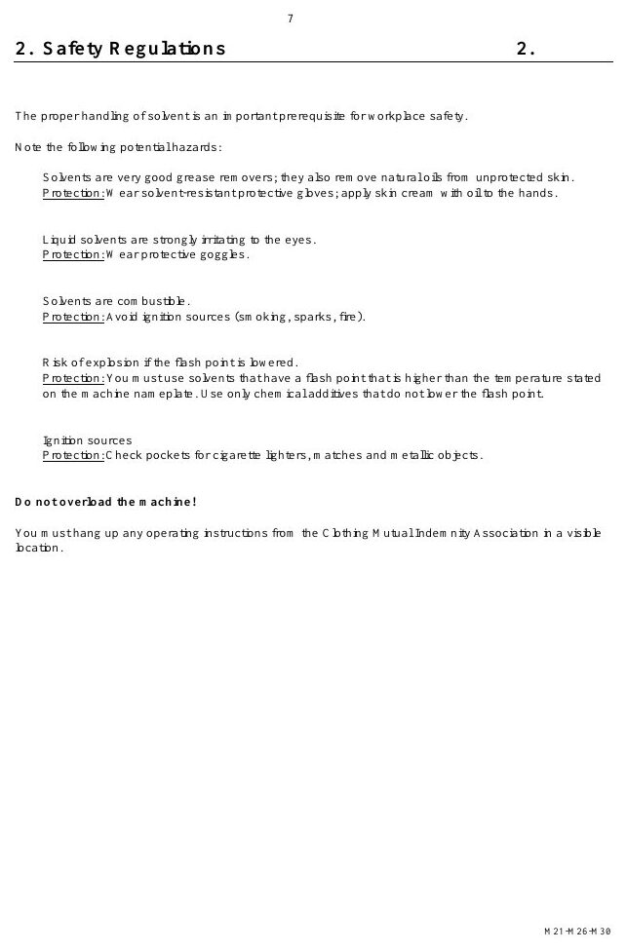
SAFETY
Authorized use defines the safe operating envelope
MACHINE / SYSTEM VIEW
Locate the machine area first, then connect the visible components to the operating sequence.
• Apply the hierarchy of controls: eliminate exposure, isolate energy, verify and protect.
• Stop and escalate whenever the safe condition cannot be confirmed.
Machine / system reference • operating manual page 16
BÖWE M30 | Safety
025
Notes:
[Sources]
- BÖWE M21-M26-M30 Operating Manual (2018-02), pages 8-13: https://www.ziermann.com/wp-content/uploads/2021/03/BA-Instruction-manual-M21-M26-M30-2018-02.pdf
- BÖWE M21-M26-M30 Spare Parts Catalogue (2019-08): https://www.ziermann.com/wp-content/uploads/2021/03/Ersatzteile-M21-M30-2019-08.pdf
- Practical visual: BÖWE M21-M26-M30 Operating Manual (2018-02), PDF page 16
Training interpretation: confirm the installed machine, current OEM revision, approved site PTW/LOTO, SDS and approved risk assessment before work.

Slide 26
SAFETY
Only trained personnel may operate or maintain the machine
• Recognize how only trained personnel may operate or maintain the machine can affect people, equipment and the environment.
• Apply the hierarchy of controls: eliminate exposure, isolate energy, verify and protect.
• Stop and escalate whenever the safe condition cannot be confirmed.
TECHNICIAN CHECK
Can I locate it?
Can I verify it?
Can I make it safe?
Can I document closure?
BÖWE M30 | Safety
026
Notes:
[Sources]
- BÖWE M21-M26-M30 Operating Manual (2018-02), pages 8-13: https://www.ziermann.com/wp-content/uploads/2021/03/BA-Instruction-manual-M21-M26-M30-2018-02.pdf
- BÖWE M21-M26-M30 Spare Parts Catalogue (2019-08): https://www.ziermann.com/wp-content/uploads/2021/03/Ersatzteile-M21-M30-2019-08.pdf
Training interpretation: confirm the installed machine, current OEM revision, approved site PTW/LOTO, SDS and approved risk assessment before work.

Slide 27
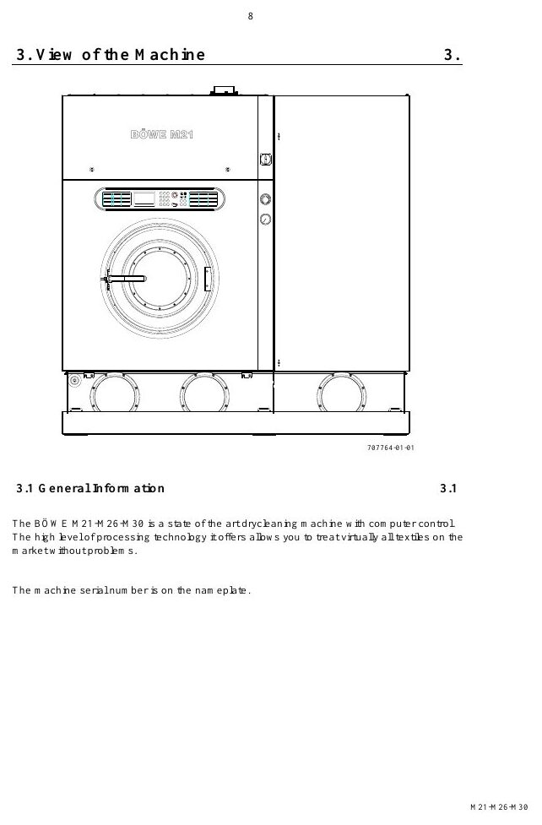
SAFETY
PPE must match the solvent and task
MACHINE / SYSTEM VIEW
Locate the machine area first, then connect the visible components to the operating sequence.
• Apply the hierarchy of controls: eliminate exposure, isolate energy, verify and protect.
• Stop and escalate whenever the safe condition cannot be confirmed.
Machine / system reference • operating manual page 17
BÖWE M30 | Safety
027
Notes:
[Sources]
- BÖWE M21-M26-M30 Operating Manual (2018-02), pages 8-13: https://www.ziermann.com/wp-content/uploads/2021/03/BA-Instruction-manual-M21-M26-M30-2018-02.pdf
- BÖWE M21-M26-M30 Spare Parts Catalogue (2019-08): https://www.ziermann.com/wp-content/uploads/2021/03/Ersatzteile-M21-M30-2019-08.pdf
- Practical visual: BÖWE M21-M26-M30 Operating Manual (2018-02), PDF page 17
Training interpretation: confirm the installed machine, current OEM revision, approved site PTW/LOTO, SDS and approved risk assessment before work.

Slide 28
SAFETY
Ventilation controls routine solvent exposure
WHY IT MATTERS
SAFE EXECUTION
Recognize how ventilation controls routine solvent exposure can affect people, equipment and the environment.
• Apply the hierarchy of controls: eliminate exposure, isolate energy, verify and protect.
• Stop and escalate whenever the safe condition cannot be confirmed.
BÖWE M30 | Safety
028
Notes:
[Sources]
- BÖWE M21-M26-M30 Operating Manual (2018-02), pages 8-13: https://www.ziermann.com/wp-content/uploads/2021/03/BA-Instruction-manual-M21-M26-M30-2018-02.pdf
- BÖWE M21-M26-M30 Spare Parts Catalogue (2019-08): https://www.ziermann.com/wp-content/uploads/2021/03/Ersatzteile-M21-M30-2019-08.pdf
Training interpretation: confirm the installed machine, current OEM revision, approved site PTW/LOTO, SDS and approved risk assessment before work.

Slide 29
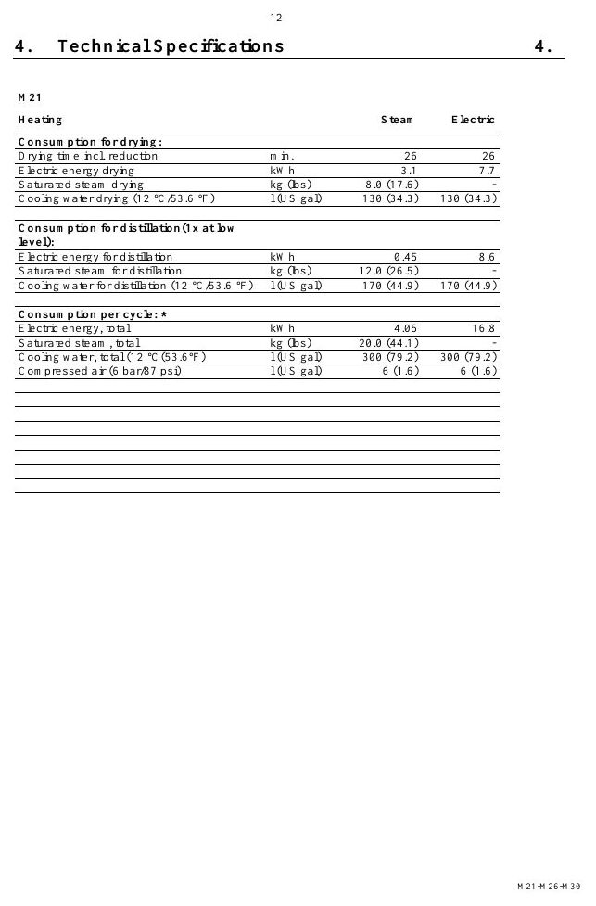
SAFETY
Loading-door venting protects the operator
MACHINE / SYSTEM VIEW
Locate the machine area first, then connect the visible components to the operating sequence.
• Apply the hierarchy of controls: eliminate exposure, isolate energy, verify and protect.
• Stop and escalate whenever the safe condition cannot be confirmed.
Machine / system reference • operating manual page 21
BÖWE M30 | Safety
029
Notes:
[Sources]
- BÖWE M21-M26-M30 Operating Manual (2018-02), pages 8-13: https://www.ziermann.com/wp-content/uploads/2021/03/BA-Instruction-manual-M21-M26-M30-2018-02.pdf
- BÖWE M21-M26-M30 Spare Parts Catalogue (2019-08): https://www.ziermann.com/wp-content/uploads/2021/03/Ersatzteile-M21-M30-2019-08.pdf
- Practical visual: BÖWE M21-M26-M30 Operating Manual (2018-02), PDF page 21
Training interpretation: confirm the installed machine, current OEM revision, approved site PTW/LOTO, SDS and approved risk assessment before work.

Slide 30
SAFETY
Guards and interlocks must never be bypassed
Recognize how guards and interlocks must never be bypassed can affect people, equipment and the environment.
WHAT TO VERIFY
01 Apply the hierarchy of controls: eliminate exposure, isolate energy, verify and protect.
02 Stop and escalate whenever the safe condition cannot be confirmed.
BÖWE M30 | Safety
030
Notes:
[Sources]
- BÖWE M21-M26-M30 Operating Manual (2018-02), pages 8-13: https://www.ziermann.com/wp-content/uploads/2021/03/BA-Instruction-manual-M21-M26-M30-2018-02.pdf
- BÖWE M21-M26-M30 Spare Parts Catalogue (2019-08): https://www.ziermann.com/wp-content/uploads/2021/03/Ersatzteile-M21-M30-2019-08.pdf
Training interpretation: confirm the installed machine, current OEM revision, approved site PTW/LOTO, SDS and approved risk assessment before work.

Slide 31
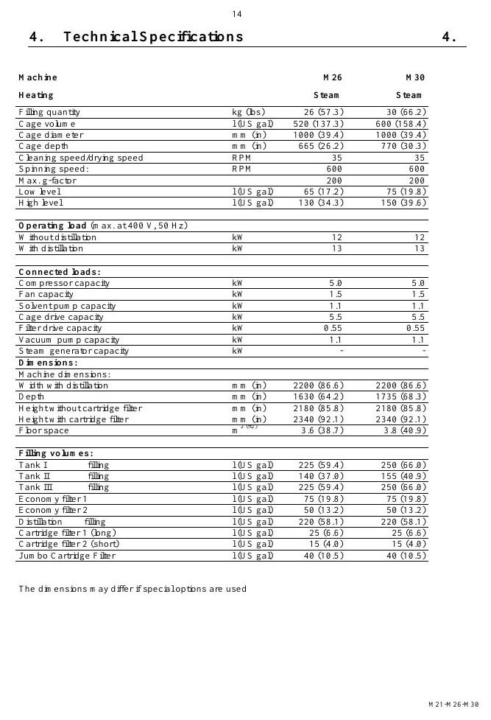
SAFETY
Electrical isolation requires lockout and verification
MACHINE / SYSTEM VIEW
Locate the machine area first, then connect the visible components to the operating sequence.
• Apply the hierarchy of controls: eliminate exposure, isolate energy, verify and protect.
• Stop and escalate whenever the safe condition cannot be confirmed.
Machine / system reference • operating manual page 23
BÖWE M30 | Safety
031
Notes:
[Sources]
- BÖWE M21-M26-M30 Operating Manual (2018-02), pages 8-13: https://www.ziermann.com/wp-content/uploads/2021/03/BA-Instruction-manual-M21-M26-M30-2018-02.pdf
- BÖWE M21-M26-M30 Spare Parts Catalogue (2019-08): https://www.ziermann.com/wp-content/uploads/2021/03/Ersatzteile-M21-M30-2019-08.pdf
- Practical visual: BÖWE M21-M26-M30 Operating Manual (2018-02), PDF page 23
Training interpretation: confirm the installed machine, current OEM revision, approved site PTW/LOTO, SDS and approved risk assessment before work.

Slide 32
SAFETY
Steam isolation must remove pressure and heat
• Recognize how steam isolation must remove pressure and heat can affect people, equipment and the environment.
• Apply the hierarchy of controls: eliminate exposure, isolate energy, verify and protect.
• Stop and escalate whenever the safe condition cannot be confirmed.
TECHNICIAN CHECK
Can I locate it?
Can I verify it?
Can I make it safe?
Can I document closure?
BÖWE M30 | Safety
032
Notes:
[Sources]
- BÖWE M21-M26-M30 Operating Manual (2018-02), pages 8-13: https://www.ziermann.com/wp-content/uploads/2021/03/BA-Instruction-manual-M21-M26-M30-2018-02.pdf
- BÖWE M21-M26-M30 Spare Parts Catalogue (2019-08): https://www.ziermann.com/wp-content/uploads/2021/03/Ersatzteile-M21-M30-2019-08.pdf
Training interpretation: confirm the installed machine, current OEM revision, approved site PTW/LOTO, SDS and approved risk assessment before work.

Slide 33

SAFETY
Compressed air stores hazardous energy
MACHINE / SYSTEM VIEW
Locate the machine area first, then connect the visible components to the operating sequence.
• Apply the hierarchy of controls: eliminate exposure, isolate energy, verify and protect.
• Stop and escalate whenever the safe condition cannot be confirmed.
Machine / system reference • operating manual page 31
BÖWE M30 | Safety
033
Notes:
[Sources]
- BÖWE M21-M26-M30 Operating Manual (2018-02), pages 8-13: https://www.ziermann.com/wp-content/uploads/2021/03/BA-Instruction-manual-M21-M26-M30-2018-02.pdf
- BÖWE M21-M26-M30 Spare Parts Catalogue (2019-08): https://www.ziermann.com/wp-content/uploads/2021/03/Ersatzteile-M21-M30-2019-08.pdf
- Practical visual: BÖWE M21-M26-M30 Operating Manual (2018-02), PDF page 31
Training interpretation: confirm the installed machine, current OEM revision, approved site PTW/LOTO, SDS and approved risk assessment before work.

Slide 34
SAFETY
Refrigeration circuits require specialist competence
WHY IT MATTERS
SAFE EXECUTION
Recognize how refrigeration circuits require specialist competence can affect people, equipment and the environment.
• Apply the hierarchy of controls: eliminate exposure, isolate energy, verify and protect.
• Stop and escalate whenever the safe condition cannot be confirmed.
BÖWE M30 | Safety
034
Notes:
[Sources]
- BÖWE M21-M26-M30 Operating Manual (2018-02), pages 8-13: https://www.ziermann.com/wp-content/uploads/2021/03/BA-Instruction-manual-M21-M26-M30-2018-02.pdf
- BÖWE M21-M26-M30 Spare Parts Catalogue (2019-08): https://www.ziermann.com/wp-content/uploads/2021/03/Ersatzteile-M21-M30-2019-08.pdf
Training interpretation: confirm the installed machine, current OEM revision, approved site PTW/LOTO, SDS and approved risk assessment before work.

Slide 35
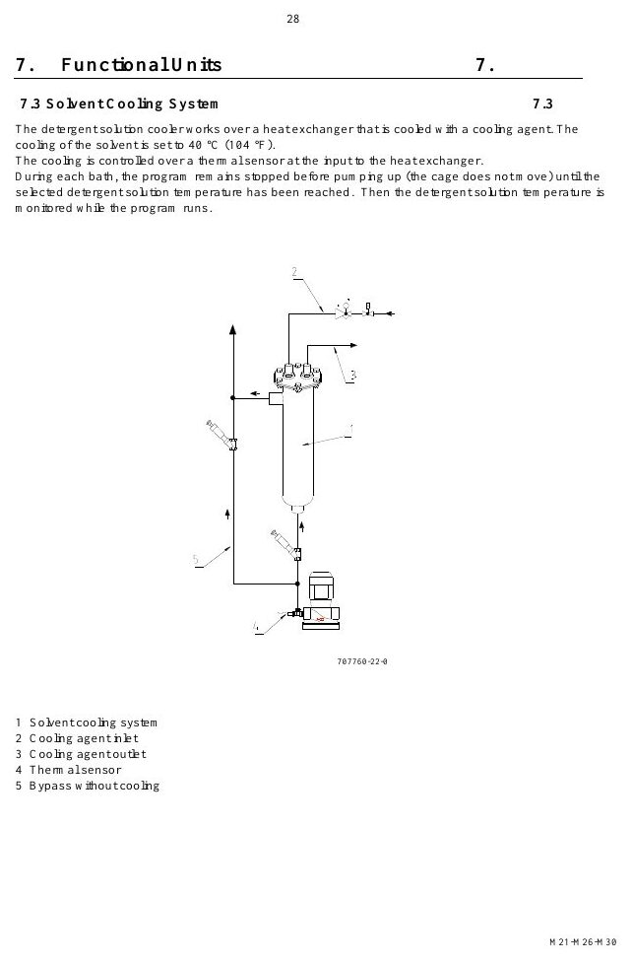
SAFETY
Hot surfaces remain hazardous after shutdown
MACHINE / SYSTEM VIEW
Locate the machine area first, then connect the visible components to the operating sequence.
• Apply the hierarchy of controls: eliminate exposure, isolate energy, verify and protect.
• Stop and escalate whenever the safe condition cannot be confirmed.
Machine / system reference • operating manual page 37
BÖWE M30 | Safety
035
Notes:
[Sources]
- BÖWE M21-M26-M30 Operating Manual (2018-02), pages 8-13: https://www.ziermann.com/wp-content/uploads/2021/03/BA-Instruction-manual-M21-M26-M30-2018-02.pdf
- BÖWE M21-M26-M30 Spare Parts Catalogue (2019-08): https://www.ziermann.com/wp-content/uploads/2021/03/Ersatzteile-M21-M30-2019-08.pdf
- Practical visual: BÖWE M21-M26-M30 Operating Manual (2018-02), PDF page 37
Training interpretation: confirm the installed machine, current OEM revision, approved site PTW/LOTO, SDS and approved risk assessment before work.

Slide 36
SAFETY
Solvent spills require immediate controlled response
Recognize how solvent spills require immediate controlled response can affect people, equipment and the environment.
WHAT TO VERIFY
01 Apply the hierarchy of controls: eliminate exposure, isolate energy, verify and protect.
02 Stop and escalate whenever the safe condition cannot be confirmed.
BÖWE M30 | Safety
036
Notes:
[Sources]
- BÖWE M21-M26-M30 Operating Manual (2018-02), pages 8-13: https://www.ziermann.com/wp-content/uploads/2021/03/BA-Instruction-manual-M21-M26-M30-2018-02.pdf
- BÖWE M21-M26-M30 Spare Parts Catalogue (2019-08): https://www.ziermann.com/wp-content/uploads/2021/03/Ersatzteile-M21-M30-2019-08.pdf
Training interpretation: confirm the installed machine, current OEM revision, approved site PTW/LOTO, SDS and approved risk assessment before work.

Slide 37
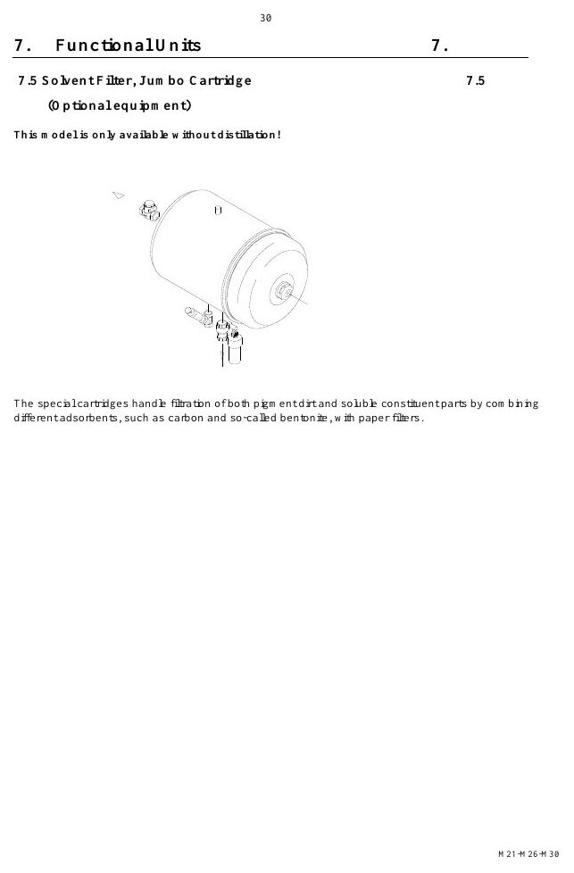
SAFETY
Still residues and process water need compliant disposal
MACHINE / SYSTEM VIEW
Locate the machine area first, then connect the visible components to the operating sequence.
• Apply the hierarchy of controls: eliminate exposure, isolate energy, verify and protect.
• Stop and escalate whenever the safe condition cannot be confirmed.
Machine / system reference • operating manual page 39
BÖWE M30 | Safety
037
Notes:
[Sources]
- BÖWE M21-M26-M30 Operating Manual (2018-02), pages 8-13: https://www.ziermann.com/wp-content/uploads/2021/03/BA-Instruction-manual-M21-M26-M30-2018-02.pdf
- BÖWE M21-M26-M30 Spare Parts Catalogue (2019-08): https://www.ziermann.com/wp-content/uploads/2021/03/Ersatzteile-M21-M30-2019-08.pdf
- Practical visual: BÖWE M21-M26-M30 Operating Manual (2018-02), PDF page 39
Training interpretation: confirm the installed machine, current OEM revision, approved site PTW/LOTO, SDS and approved risk assessment before work.

Slide 38
SAFETY
Emergency response must be understood before work
• Recognize how emergency response must be understood before work can affect people, equipment and the environment.
• Apply the hierarchy of controls: eliminate exposure, isolate energy, verify and protect.
• Stop and escalate whenever the safe condition cannot be confirmed.
TECHNICIAN CHECK
Can I locate it?
Can I verify it?
Can I make it safe?
Can I document closure?
BÖWE M30 | Safety
038
Notes:
[Sources]
- BÖWE M21-M26-M30 Operating Manual (2018-02), pages 8-13: https://www.ziermann.com/wp-content/uploads/2021/03/BA-Instruction-manual-M21-M26-M30-2018-02.pdf
- BÖWE M21-M26-M30 Spare Parts Catalogue (2019-08): https://www.ziermann.com/wp-content/uploads/2021/03/Ersatzteile-M21-M30-2019-08.pdf
Training interpretation: confirm the installed machine, current OEM revision, approved site PTW/LOTO, SDS and approved risk assessment before work.

Slide 39
SECTION 03
Construction
Build understanding first; then apply it safely on the installed machine.
039
Notes:
[Sources]
- BÖWE M21-M26-M30 Operating Manual (2018-02), pages 14-22: https://www.ziermann.com/wp-content/uploads/2021/03/BA-Instruction-manual-M21-M26-M30-2018-02.pdf
- BÖWE M21-M26-M30 Spare Parts Catalogue (2019-08): https://www.ziermann.com/wp-content/uploads/2021/03/Ersatzteile-M21-M30-2019-08.pdf
Training interpretation: confirm the installed machine, current OEM revision, approved site PTW/LOTO, SDS and approved risk assessment before work.

Slide 40
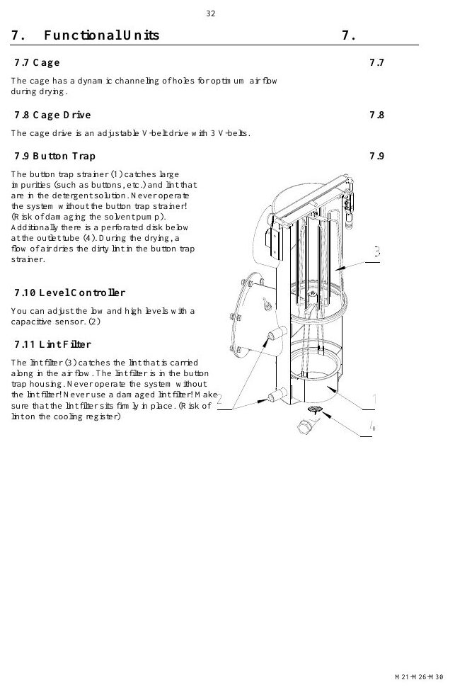
CONSTRUCTION
Read the machine as connected functional systems
MACHINE / SYSTEM VIEW
Locate the machine area first, then connect the visible components to the operating sequence.
• Inspect fasteners, seals, supports, access and surrounding evidence.
• Confirm the exact installed variant before adjustment or replacement.
Machine / system reference • operating manual page 41
BÖWE M30 | Construction
040
Notes:
[Sources]
- BÖWE M21-M26-M30 Operating Manual (2018-02), pages 14-22: https://www.ziermann.com/wp-content/uploads/2021/03/BA-Instruction-manual-M21-M26-M30-2018-02.pdf
- BÖWE M21-M26-M30 Spare Parts Catalogue (2019-08): https://www.ziermann.com/wp-content/uploads/2021/03/Ersatzteile-M21-M30-2019-08.pdf
- Practical visual: BÖWE M21-M26-M30 Operating Manual (2018-02), PDF page 41
Training interpretation: confirm the installed machine, current OEM revision, approved site PTW/LOTO, SDS and approved risk assessment before work.

Slide 41
CONSTRUCTION
Front-side components support operation and monitoring
• Locate the relevant assembly and understand its interfaces.
• Inspect fasteners, seals, supports, access and surrounding evidence.
• Confirm the exact installed variant before adjustment or replacement.
TECHNICIAN CHECK
Can I locate it?
Can I verify it?
Can I make it safe?
Can I document closure?
BÖWE M30 | Construction
041
Notes:
[Sources]
- BÖWE M21-M26-M30 Operating Manual (2018-02), pages 14-22: https://www.ziermann.com/wp-content/uploads/2021/03/BA-Instruction-manual-M21-M26-M30-2018-02.pdf
- BÖWE M21-M26-M30 Spare Parts Catalogue (2019-08): https://www.ziermann.com/wp-content/uploads/2021/03/Ersatzteile-M21-M30-2019-08.pdf
Training interpretation: confirm the installed machine, current OEM revision, approved site PTW/LOTO, SDS and approved risk assessment before work.

Slide 42
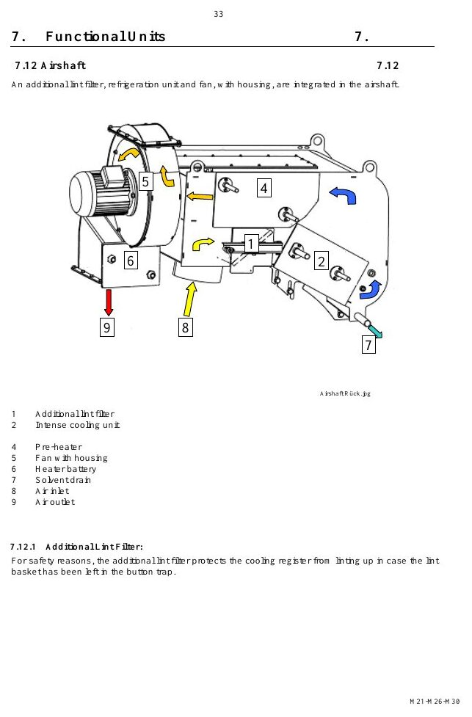
CONSTRUCTION
Rear-side components carry most service interfaces
MACHINE / SYSTEM VIEW
Locate the machine area first, then connect the visible components to the operating sequence.
• Inspect fasteners, seals, supports, access and surrounding evidence.
• Confirm the exact installed variant before adjustment or replacement.
Machine / system reference • operating manual page 42
BÖWE M30 | Construction
042
Notes:
[Sources]
- BÖWE M21-M26-M30 Operating Manual (2018-02), pages 14-22: https://www.ziermann.com/wp-content/uploads/2021/03/BA-Instruction-manual-M21-M26-M30-2018-02.pdf
- BÖWE M21-M26-M30 Spare Parts Catalogue (2019-08): https://www.ziermann.com/wp-content/uploads/2021/03/Ersatzteile-M21-M30-2019-08.pdf
- Practical visual: BÖWE M21-M26-M30 Operating Manual (2018-02), PDF page 42
Training interpretation: confirm the installed machine, current OEM revision, approved site PTW/LOTO, SDS and approved risk assessment before work.

Slide 43
CONSTRUCTION
The cage and housing contain the process load
WHY IT MATTERS
SAFE EXECUTION
Locate the relevant assembly and understand its interfaces.
• Inspect fasteners, seals, supports, access and surrounding evidence.
• Confirm the exact installed variant before adjustment or replacement.
BÖWE M30 | Construction
043
Notes:
[Sources]
- BÖWE M21-M26-M30 Operating Manual (2018-02), pages 14-22: https://www.ziermann.com/wp-content/uploads/2021/03/BA-Instruction-manual-M21-M26-M30-2018-02.pdf
- BÖWE M21-M26-M30 Spare Parts Catalogue (2019-08): https://www.ziermann.com/wp-content/uploads/2021/03/Ersatzteile-M21-M30-2019-08.pdf
Training interpretation: confirm the installed machine, current OEM revision, approved site PTW/LOTO, SDS and approved risk assessment before work.

Slide 44

CONSTRUCTION
The cage drive converts motor power into controlled rotation
MACHINE / SYSTEM VIEW
Locate the machine area first, then connect the visible components to the operating sequence.
• Inspect fasteners, seals, supports, access and surrounding evidence.
• Confirm the exact installed variant before adjustment or replacement.
Machine / system reference • operating manual page 43
BÖWE M30 | Construction
044
Notes:
[Sources]
- BÖWE M21-M26-M30 Operating Manual (2018-02), pages 14-22: https://www.ziermann.com/wp-content/uploads/2021/03/BA-Instruction-manual-M21-M26-M30-2018-02.pdf
- BÖWE M21-M26-M30 Spare Parts Catalogue (2019-08): https://www.ziermann.com/wp-content/uploads/2021/03/Ersatzteile-M21-M30-2019-08.pdf
- Practical visual: BÖWE M21-M26-M30 Operating Manual (2018-02), PDF page 43
Training interpretation: confirm the installed machine, current OEM revision, approved site PTW/LOTO, SDS and approved risk assessment before work.

Slide 45
CONSTRUCTION
The loading door forms a pressure and solvent boundary
Locate the relevant assembly and understand its interfaces.
WHAT TO VERIFY
01 Inspect fasteners, seals, supports, access and surrounding evidence.
02 Confirm the exact installed variant before adjustment or replacement.
BÖWE M30 | Construction
045
Notes:
[Sources]
- BÖWE M21-M26-M30 Operating Manual (2018-02), pages 14-22: https://www.ziermann.com/wp-content/uploads/2021/03/BA-Instruction-manual-M21-M26-M30-2018-02.pdf
- BÖWE M21-M26-M30 Spare Parts Catalogue (2019-08): https://www.ziermann.com/wp-content/uploads/2021/03/Ersatzteile-M21-M30-2019-08.pdf
Training interpretation: confirm the installed machine, current OEM revision, approved site PTW/LOTO, SDS and approved risk assessment before work.

Slide 46
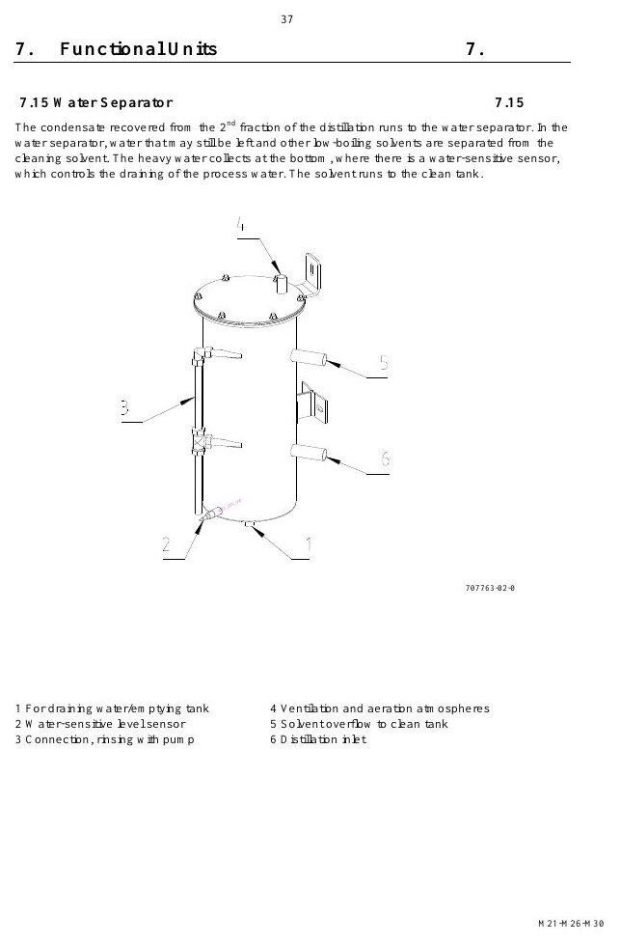
CONSTRUCTION
Tanks separate work, clean and extra solvent duties
MACHINE / SYSTEM VIEW
Locate the machine area first, then connect the visible components to the operating sequence.
• Inspect fasteners, seals, supports, access and surrounding evidence.
• Confirm the exact installed variant before adjustment or replacement.
Machine / system reference • operating manual page 46
BÖWE M30 | Construction
046
Notes:
[Sources]
- BÖWE M21-M26-M30 Operating Manual (2018-02), pages 14-22: https://www.ziermann.com/wp-content/uploads/2021/03/BA-Instruction-manual-M21-M26-M30-2018-02.pdf
- BÖWE M21-M26-M30 Spare Parts Catalogue (2019-08): https://www.ziermann.com/wp-content/uploads/2021/03/Ersatzteile-M21-M30-2019-08.pdf
- Practical visual: BÖWE M21-M26-M30 Operating Manual (2018-02), PDF page 46
Training interpretation: confirm the installed machine, current OEM revision, approved site PTW/LOTO, SDS and approved risk assessment before work.

Slide 47
CONSTRUCTION
Safety troughs contain unintended liquid release
• Locate the relevant assembly and understand its interfaces.
• Inspect fasteners, seals, supports, access and surrounding evidence.
• Confirm the exact installed variant before adjustment or replacement.
TECHNICIAN CHECK
Can I locate it?
Can I verify it?
Can I make it safe?
Can I document closure?
BÖWE M30 | Construction
047
Notes:
[Sources]
- BÖWE M21-M26-M30 Operating Manual (2018-02), pages 14-22: https://www.ziermann.com/wp-content/uploads/2021/03/BA-Instruction-manual-M21-M26-M30-2018-02.pdf
- BÖWE M21-M26-M30 Spare Parts Catalogue (2019-08): https://www.ziermann.com/wp-content/uploads/2021/03/Ersatzteile-M21-M30-2019-08.pdf
Training interpretation: confirm the installed machine, current OEM revision, approved site PTW/LOTO, SDS and approved risk assessment before work.

Slide 48
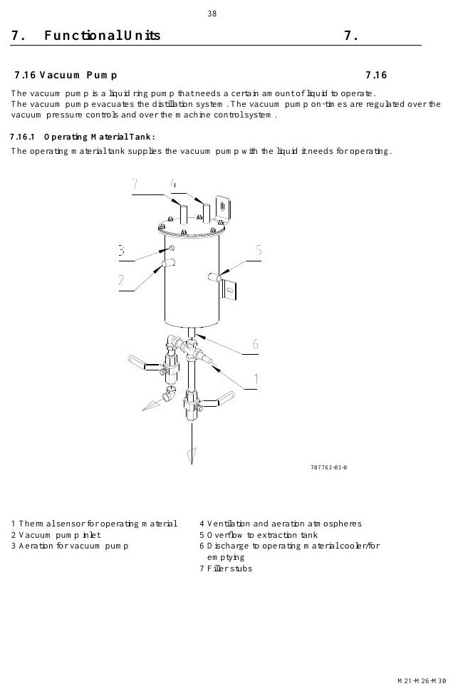
CONSTRUCTION
Slimline and Crossline layouts change access requirements
MACHINE / SYSTEM VIEW
Locate the machine area first, then connect the visible components to the operating sequence.
• Inspect fasteners, seals, supports, access and surrounding evidence.
• Confirm the exact installed variant before adjustment or replacement.
Machine / system reference • operating manual page 47
BÖWE M30 | Construction
048
Notes:
[Sources]
- BÖWE M21-M26-M30 Operating Manual (2018-02), pages 14-22: https://www.ziermann.com/wp-content/uploads/2021/03/BA-Instruction-manual-M21-M26-M30-2018-02.pdf
- BÖWE M21-M26-M30 Spare Parts Catalogue (2019-08): https://www.ziermann.com/wp-content/uploads/2021/03/Ersatzteile-M21-M30-2019-08.pdf
- Practical visual: BÖWE M21-M26-M30 Operating Manual (2018-02), PDF page 47
Training interpretation: confirm the installed machine, current OEM revision, approved site PTW/LOTO, SDS and approved risk assessment before work.

Slide 49
CONSTRUCTION
Optional equipment changes the installed configuration
WHY IT MATTERS
SAFE EXECUTION
Locate the relevant assembly and understand its interfaces.
• Inspect fasteners, seals, supports, access and surrounding evidence.
• Confirm the exact installed variant before adjustment or replacement.
BÖWE M30 | Construction
049
Notes:
[Sources]
- BÖWE M21-M26-M30 Operating Manual (2018-02), pages 14-22: https://www.ziermann.com/wp-content/uploads/2021/03/BA-Instruction-manual-M21-M26-M30-2018-02.pdf
- BÖWE M21-M26-M30 Spare Parts Catalogue (2019-08): https://www.ziermann.com/wp-content/uploads/2021/03/Ersatzteile-M21-M30-2019-08.pdf
Training interpretation: confirm the installed machine, current OEM revision, approved site PTW/LOTO, SDS and approved risk assessment before work.

Slide 50
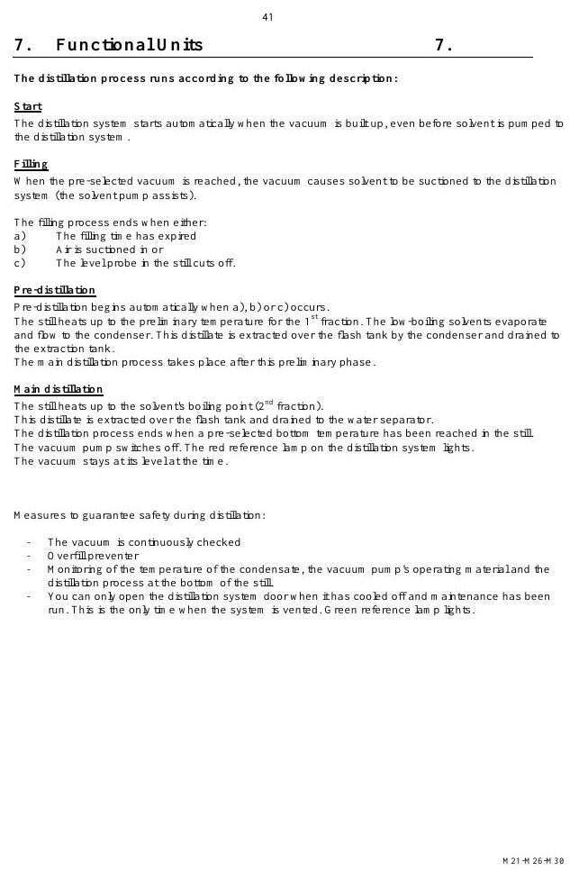
CONSTRUCTION
Nameplate data governs technical decisions
MACHINE / SYSTEM VIEW
Locate the machine area first, then connect the visible components to the operating sequence.
• Inspect fasteners, seals, supports, access and surrounding evidence.
• Confirm the exact installed variant before adjustment or replacement.
Machine / system reference • operating manual page 50
BÖWE M30 | Construction
050
Notes:
[Sources]
- BÖWE M21-M26-M30 Operating Manual (2018-02), pages 14-22: https://www.ziermann.com/wp-content/uploads/2021/03/BA-Instruction-manual-M21-M26-M30-2018-02.pdf
- BÖWE M21-M26-M30 Spare Parts Catalogue (2019-08): https://www.ziermann.com/wp-content/uploads/2021/03/Ersatzteile-M21-M30-2019-08.pdf
- Practical visual: BÖWE M21-M26-M30 Operating Manual (2018-02), PDF page 50
Training interpretation: confirm the installed machine, current OEM revision, approved site PTW/LOTO, SDS and approved risk assessment before work.

Slide 51
CONSTRUCTION
A clean machine makes defects easier to detect
Locate the relevant assembly and understand its interfaces.
WHAT TO VERIFY
01 Inspect fasteners, seals, supports, access and surrounding evidence.
02 Confirm the exact installed variant before adjustment or replacement.
BÖWE M30 | Construction
051
Notes:
[Sources]
- BÖWE M21-M26-M30 Operating Manual (2018-02), pages 14-22: https://www.ziermann.com/wp-content/uploads/2021/03/BA-Instruction-manual-M21-M26-M30-2018-02.pdf
- BÖWE M21-M26-M30 Spare Parts Catalogue (2019-08): https://www.ziermann.com/wp-content/uploads/2021/03/Ersatzteile-M21-M30-2019-08.pdf
Training interpretation: confirm the installed machine, current OEM revision, approved site PTW/LOTO, SDS and approved risk assessment before work.

Slide 52
SECTION 04
Materials & Utilities
Build understanding first; then apply it safely on the installed machine.
052
Notes:
[Sources]
- BÖWE M21-M26-M30 Operating Manual (2018-02), pages 4, 21-25: https://www.ziermann.com/wp-content/uploads/2021/03/BA-Instruction-manual-M21-M26-M30-2018-02.pdf
- BÖWE M21-M26-M30 Spare Parts Catalogue (2019-08): https://www.ziermann.com/wp-content/uploads/2021/03/Ersatzteile-M21-M30-2019-08.pdf
Training interpretation: confirm the installed machine, current OEM revision, approved site PTW/LOTO, SDS and approved risk assessment before work.

Slide 53
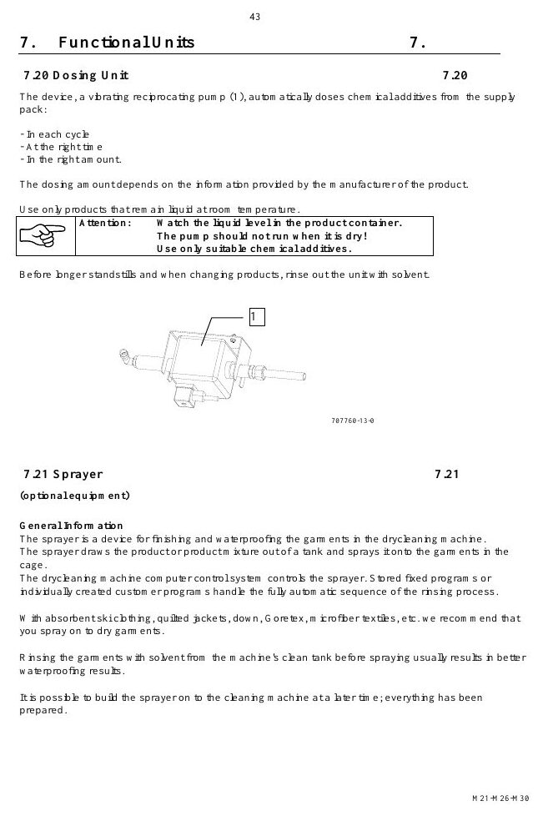
MATERIALS & UTILITIES
Solvent selection must match the approved machine configuration
MACHINE / SYSTEM VIEW
Locate the machine area first, then connect the visible components to the operating sequence.
• The operating manual requires periodic verification of solvent flash point.
• Do not use PERC or mix solvent systems in the M30.
Machine / system reference • operating manual page 52
BÖWE M30 | Materials & Utilities
053
Notes:
[Sources]
- BÖWE M21-M26-M30 Operating Manual (2018-02), pages 4, 21-25: https://www.ziermann.com/wp-content/uploads/2021/03/BA-Instruction-manual-M21-M26-M30-2018-02.pdf
- BÖWE M21-M26-M30 Spare Parts Catalogue (2019-08): https://www.ziermann.com/wp-content/uploads/2021/03/Ersatzteile-M21-M30-2019-08.pdf
- Practical visual: BÖWE M21-M26-M30 Operating Manual (2018-02), PDF page 52
Training interpretation: confirm the installed machine, current OEM revision, approved site PTW/LOTO, SDS and approved risk assessment before work.

Slide 54
MATERIALS & UTILITIES
Chemical additives must remain stable under process conditions
Use halogen-free additives approved for the installed solvent.
WHAT TO VERIFY
01 Additive flash point must exceed the nameplate requirement.
02 Do not allow additives to change the approved solvent safety characteristics.
BÖWE M30 | Materials & Utilities
054
Notes:
[Sources]
- BÖWE M21-M26-M30 Operating Manual (2018-02), pages 4, 21-25: https://www.ziermann.com/wp-content/uploads/2021/03/BA-Instruction-manual-M21-M26-M30-2018-02.pdf
- BÖWE M21-M26-M30 Spare Parts Catalogue (2019-08): https://www.ziermann.com/wp-content/uploads/2021/03/Ersatzteile-M21-M30-2019-08.pdf
Training interpretation: confirm the installed machine, current OEM revision, approved site PTW/LOTO, SDS and approved risk assessment before work.

Slide 55
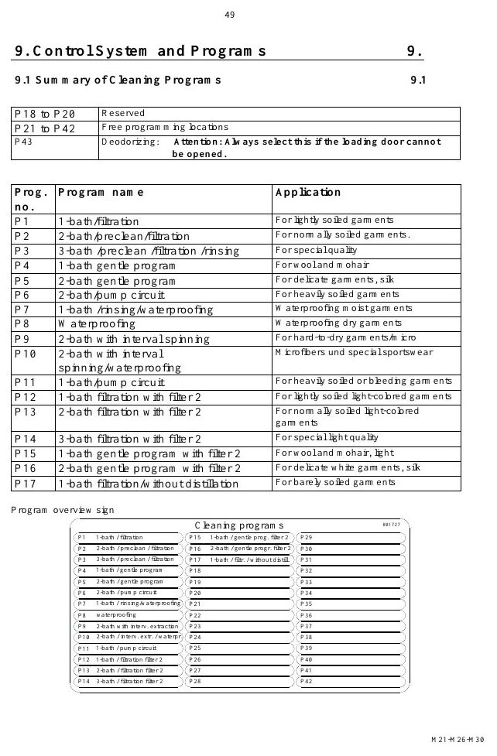
MATERIALS & UTILITIES
First filling requires configuration-specific quantities
MACHINE / SYSTEM VIEW
Locate the machine area first, then connect the visible components to the operating sequence.
• Tank I: 155 L minimum
• Additional filters increase the required quantity; verify the installed arrangement.
Machine / system reference • operating manual page 58
BÖWE M30 | Materials & Utilities
055
Notes:
[Sources]
- BÖWE M21-M26-M30 Operating Manual (2018-02), pages 4, 21-25: https://www.ziermann.com/wp-content/uploads/2021/03/BA-Instruction-manual-M21-M26-M30-2018-02.pdf
- BÖWE M21-M26-M30 Spare Parts Catalogue (2019-08): https://www.ziermann.com/wp-content/uploads/2021/03/Ersatzteile-M21-M30-2019-08.pdf
- Practical visual: BÖWE M21-M26-M30 Operating Manual (2018-02), PDF page 58
Training interpretation: confirm the installed machine, current OEM revision, approved site PTW/LOTO, SDS and approved risk assessment before work.

Slide 56
MATERIALS & UTILITIES
Tank minimum levels protect process stability
• Tank I: 155 L minimum
• Low level can disrupt transfer, filtration and process repeatability.
• Record unexplained solvent loss and investigate before topping up.
TECHNICIAN CHECK
Can I locate it?
Can I verify it?
Can I make it safe?
Can I document closure?
BÖWE M30 | Materials & Utilities
056
Notes:
[Sources]
- BÖWE M21-M26-M30 Operating Manual (2018-02), pages 4, 21-25: https://www.ziermann.com/wp-content/uploads/2021/03/BA-Instruction-manual-M21-M26-M30-2018-02.pdf
- BÖWE M21-M26-M30 Spare Parts Catalogue (2019-08): https://www.ziermann.com/wp-content/uploads/2021/03/Ersatzteile-M21-M30-2019-08.pdf
Training interpretation: confirm the installed machine, current OEM revision, approved site PTW/LOTO, SDS and approved risk assessment before work.

Slide 57

MATERIALS & UTILITIES
Steam quality affects heating and distillation
MACHINE / SYSTEM VIEW
Locate the machine area first, then connect the visible components to the operating sequence.
• Compare actual condition with the nameplate, OEM range and site standard.
• Trend deviations; do not normalize repeated abnormal readings.
Machine / system reference • operating manual page 60
BÖWE M30 | Materials & Utilities
057
Notes:
[Sources]
- BÖWE M21-M26-M30 Operating Manual (2018-02), pages 4, 21-25: https://www.ziermann.com/wp-content/uploads/2021/03/BA-Instruction-manual-M21-M26-M30-2018-02.pdf
- BÖWE M21-M26-M30 Spare Parts Catalogue (2019-08): https://www.ziermann.com/wp-content/uploads/2021/03/Ersatzteile-M21-M30-2019-08.pdf
- Practical visual: BÖWE M21-M26-M30 Operating Manual (2018-02), PDF page 60
Training interpretation: confirm the installed machine, current OEM revision, approved site PTW/LOTO, SDS and approved risk assessment before work.

Slide 58
MATERIALS & UTILITIES
Cooling-water condition affects recovery performance
WHY IT MATTERS
SAFE EXECUTION
Treat cooling-water condition affects recovery performance as a controlled operating parameter.
• Compare actual condition with the nameplate, OEM range and site standard.
• Trend deviations; do not normalize repeated abnormal readings.
BÖWE M30 | Materials & Utilities
058
Notes:
[Sources]
- BÖWE M21-M26-M30 Operating Manual (2018-02), pages 4, 21-25: https://www.ziermann.com/wp-content/uploads/2021/03/BA-Instruction-manual-M21-M26-M30-2018-02.pdf
- BÖWE M21-M26-M30 Spare Parts Catalogue (2019-08): https://www.ziermann.com/wp-content/uploads/2021/03/Ersatzteile-M21-M30-2019-08.pdf
Training interpretation: confirm the installed machine, current OEM revision, approved site PTW/LOTO, SDS and approved risk assessment before work.

Slide 59
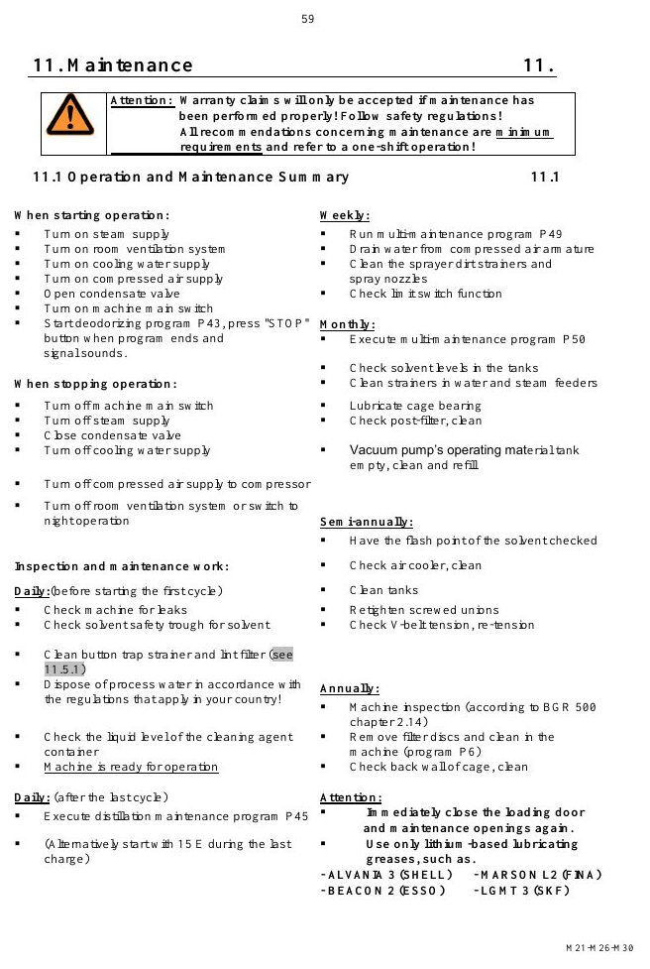
MATERIALS & UTILITIES
Compressed-air quality affects valve reliability
MACHINE / SYSTEM VIEW
Locate the machine area first, then connect the visible components to the operating sequence.
• Compare actual condition with the nameplate, OEM range and site standard.
• Trend deviations; do not normalize repeated abnormal readings.
Machine / system reference • operating manual page 68
BÖWE M30 | Materials & Utilities
059
Notes:
[Sources]
- BÖWE M21-M26-M30 Operating Manual (2018-02), pages 4, 21-25: https://www.ziermann.com/wp-content/uploads/2021/03/BA-Instruction-manual-M21-M26-M30-2018-02.pdf
- BÖWE M21-M26-M30 Spare Parts Catalogue (2019-08): https://www.ziermann.com/wp-content/uploads/2021/03/Ersatzteile-M21-M30-2019-08.pdf
- Practical visual: BÖWE M21-M26-M30 Operating Manual (2018-02), PDF page 68
Training interpretation: confirm the installed machine, current OEM revision, approved site PTW/LOTO, SDS and approved risk assessment before work.

Slide 60
MATERIALS & UTILITIES
Electrical supply must match the nameplate
Treat electrical supply must match the nameplate as a controlled operating parameter.
WHAT TO VERIFY
01 Compare actual condition with the nameplate, OEM range and site standard.
02 Trend deviations; do not normalize repeated abnormal readings.
BÖWE M30 | Materials & Utilities
060
Notes:
[Sources]
- BÖWE M21-M26-M30 Operating Manual (2018-02), pages 4, 21-25: https://www.ziermann.com/wp-content/uploads/2021/03/BA-Instruction-manual-M21-M26-M30-2018-02.pdf
- BÖWE M21-M26-M30 Spare Parts Catalogue (2019-08): https://www.ziermann.com/wp-content/uploads/2021/03/Ersatzteile-M21-M30-2019-08.pdf
Training interpretation: confirm the installed machine, current OEM revision, approved site PTW/LOTO, SDS and approved risk assessment before work.

Slide 61

MATERIALS & UTILITIES
Room temperature and ventilation affect performance
MACHINE / SYSTEM VIEW
Locate the machine area first, then connect the visible components to the operating sequence.
• Compare actual condition with the nameplate, OEM range and site standard.
• Trend deviations; do not normalize repeated abnormal readings.
Machine / system reference • operating manual page 76
BÖWE M30 | Materials & Utilities
061
Notes:
[Sources]
- BÖWE M21-M26-M30 Operating Manual (2018-02), pages 4, 21-25: https://www.ziermann.com/wp-content/uploads/2021/03/BA-Instruction-manual-M21-M26-M30-2018-02.pdf
- BÖWE M21-M26-M30 Spare Parts Catalogue (2019-08): https://www.ziermann.com/wp-content/uploads/2021/03/Ersatzteile-M21-M30-2019-08.pdf
- Practical visual: BÖWE M21-M26-M30 Operating Manual (2018-02), PDF page 76
Training interpretation: confirm the installed machine, current OEM revision, approved site PTW/LOTO, SDS and approved risk assessment before work.

Slide 62
MATERIALS & UTILITIES
Utility trends can reveal developing faults
• Treat utility trends can reveal developing faults as a controlled operating parameter.
• Compare actual condition with the nameplate, OEM range and site standard.
• Trend deviations; do not normalize repeated abnormal readings.
TECHNICIAN CHECK
Can I locate it?
Can I verify it?
Can I make it safe?
Can I document closure?
BÖWE M30 | Materials & Utilities
062
Notes:
[Sources]
- BÖWE M21-M26-M30 Operating Manual (2018-02), pages 4, 21-25: https://www.ziermann.com/wp-content/uploads/2021/03/BA-Instruction-manual-M21-M26-M30-2018-02.pdf
- BÖWE M21-M26-M30 Spare Parts Catalogue (2019-08): https://www.ziermann.com/wp-content/uploads/2021/03/Ersatzteile-M21-M30-2019-08.pdf
Training interpretation: confirm the installed machine, current OEM revision, approved site PTW/LOTO, SDS and approved risk assessment before work.

Slide 63
SECTION 05
Functional Systems
Build understanding first; then apply it safely on the installed machine.
063
Notes:
[Sources]
- BÖWE M21-M26-M30 Operating Manual (2018-02), pages 37-59: https://www.ziermann.com/wp-content/uploads/2021/03/BA-Instruction-manual-M21-M26-M30-2018-02.pdf
- BÖWE M21-M26-M30 Spare Parts Catalogue (2019-08): https://www.ziermann.com/wp-content/uploads/2021/03/Ersatzteile-M21-M30-2019-08.pdf
Training interpretation: confirm the installed machine, current OEM revision, approved site PTW/LOTO, SDS and approved risk assessment before work.

Slide 64
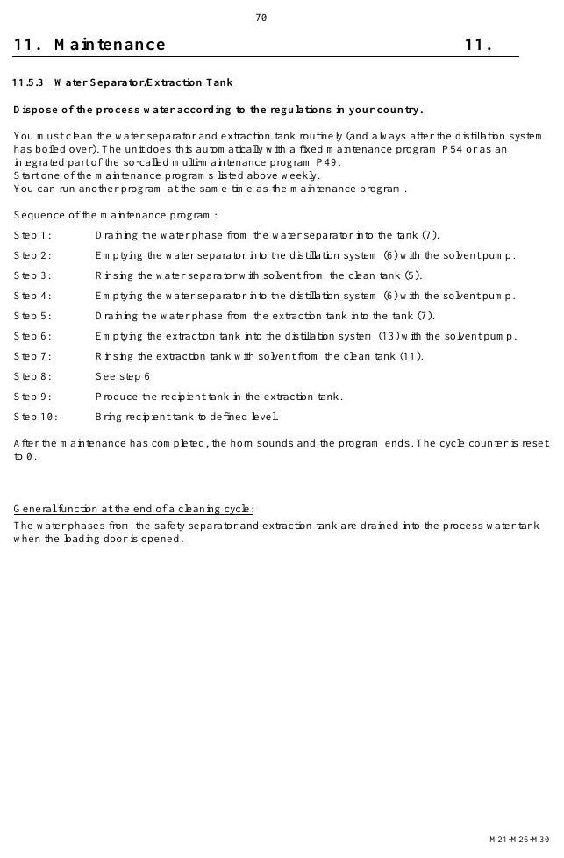
FUNCTIONAL SYSTEMS
The solvent pump drives the cleaning circuit
MACHINE / SYSTEM VIEW
Locate the machine area first, then connect the visible components to the operating sequence.
• Inspect the component, its upstream supply and downstream effect—not the part in isolation.
• Use leakage, temperature, pressure, noise and cycle data to identify deterioration.
Machine / system reference • operating manual page 79
BÖWE M30 | Functional Systems
064
Notes:
[Sources]
- BÖWE M21-M26-M30 Operating Manual (2018-02), pages 37-59: https://www.ziermann.com/wp-content/uploads/2021/03/BA-Instruction-manual-M21-M26-M30-2018-02.pdf
- BÖWE M21-M26-M30 Spare Parts Catalogue (2019-08): https://www.ziermann.com/wp-content/uploads/2021/03/Ersatzteile-M21-M30-2019-08.pdf
- Practical visual: BÖWE M21-M26-M30 Operating Manual (2018-02), PDF page 79
Training interpretation: confirm the installed machine, current OEM revision, approved site PTW/LOTO, SDS and approved risk assessment before work.

Slide 65
FUNCTIONAL SYSTEMS
Economy filters protect solvent quality
• Understand the system purpose and what must happen before, during and after operation.
• Inspect the component, its upstream supply and downstream effect—not the part in isolation.
• Use leakage, temperature, pressure, noise and cycle data to identify deterioration.
TECHNICIAN CHECK
Can I locate it?
Can I verify it?
Can I make it safe?
Can I document closure?
BÖWE M30 | Functional Systems
065
Notes:
[Sources]
- BÖWE M21-M26-M30 Operating Manual (2018-02), pages 37-59: https://www.ziermann.com/wp-content/uploads/2021/03/BA-Instruction-manual-M21-M26-M30-2018-02.pdf
- BÖWE M21-M26-M30 Spare Parts Catalogue (2019-08): https://www.ziermann.com/wp-content/uploads/2021/03/Ersatzteile-M21-M30-2019-08.pdf
Training interpretation: confirm the installed machine, current OEM revision, approved site PTW/LOTO, SDS and approved risk assessment before work.

Slide 66
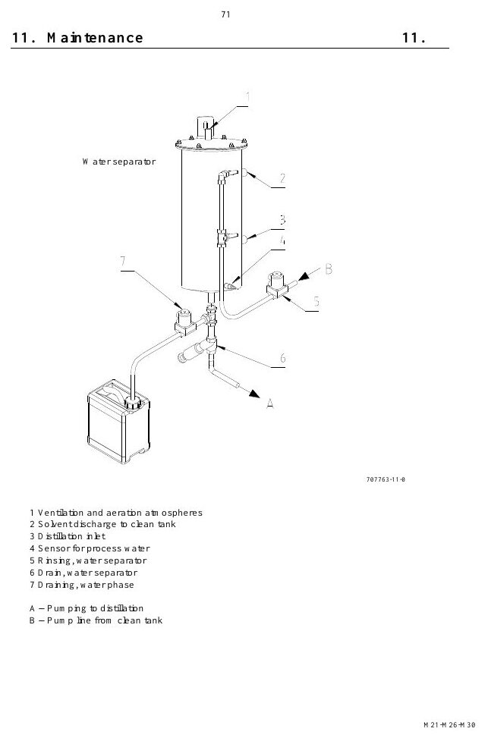
FUNCTIONAL SYSTEMS
Cartridge filters provide optional adsorption capacity
MACHINE / SYSTEM VIEW
Locate the machine area first, then connect the visible components to the operating sequence.
• Inspect the component, its upstream supply and downstream effect—not the part in isolation.
• Use leakage, temperature, pressure, noise and cycle data to identify deterioration.
Machine / system reference • operating manual page 80
BÖWE M30 | Functional Systems
066
Notes:
[Sources]
- BÖWE M21-M26-M30 Operating Manual (2018-02), pages 37-59: https://www.ziermann.com/wp-content/uploads/2021/03/BA-Instruction-manual-M21-M26-M30-2018-02.pdf
- BÖWE M21-M26-M30 Spare Parts Catalogue (2019-08): https://www.ziermann.com/wp-content/uploads/2021/03/Ersatzteile-M21-M30-2019-08.pdf
- Practical visual: BÖWE M21-M26-M30 Operating Manual (2018-02), PDF page 80
Training interpretation: confirm the installed machine, current OEM revision, approved site PTW/LOTO, SDS and approved risk assessment before work.

Slide 67
FUNCTIONAL SYSTEMS
The button trap captures foreign objects and lint
WHY IT MATTERS
SAFE EXECUTION
Understand the system purpose and what must happen before, during and after operation.
• Inspect the component, its upstream supply and downstream effect—not the part in isolation.
• Use leakage, temperature, pressure, noise and cycle data to identify deterioration.
BÖWE M30 | Functional Systems
067
Notes:
[Sources]
- BÖWE M21-M26-M30 Operating Manual (2018-02), pages 37-59: https://www.ziermann.com/wp-content/uploads/2021/03/BA-Instruction-manual-M21-M26-M30-2018-02.pdf
- BÖWE M21-M26-M30 Spare Parts Catalogue (2019-08): https://www.ziermann.com/wp-content/uploads/2021/03/Ersatzteile-M21-M30-2019-08.pdf
Training interpretation: confirm the installed machine, current OEM revision, approved site PTW/LOTO, SDS and approved risk assessment before work.

Slide 68
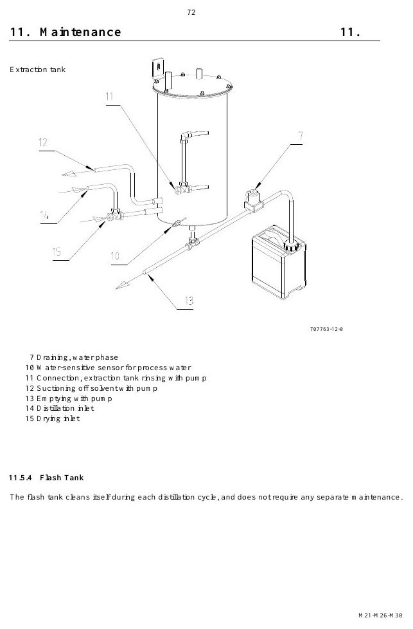
FUNCTIONAL SYSTEMS
The lint filter protects airflow and recovery
MACHINE / SYSTEM VIEW
Locate the machine area first, then connect the visible components to the operating sequence.
• Inspect the component, its upstream supply and downstream effect—not the part in isolation.
• Use leakage, temperature, pressure, noise and cycle data to identify deterioration.
Machine / system reference • operating manual page 81
BÖWE M30 | Functional Systems
068
Notes:
[Sources]
- BÖWE M21-M26-M30 Operating Manual (2018-02), pages 37-59: https://www.ziermann.com/wp-content/uploads/2021/03/BA-Instruction-manual-M21-M26-M30-2018-02.pdf
- BÖWE M21-M26-M30 Spare Parts Catalogue (2019-08): https://www.ziermann.com/wp-content/uploads/2021/03/Ersatzteile-M21-M30-2019-08.pdf
- Practical visual: BÖWE M21-M26-M30 Operating Manual (2018-02), PDF page 81
Training interpretation: confirm the installed machine, current OEM revision, approved site PTW/LOTO, SDS and approved risk assessment before work.

Slide 69
FUNCTIONAL SYSTEMS
The airshaft controls drying and solvent recovery
Understand the system purpose and what must happen before, during and after operation.
WHAT TO VERIFY
01 Inspect the component, its upstream supply and downstream effect—not the part in isolation.
02 Use leakage, temperature, pressure, noise and cycle data to identify deterioration.
BÖWE M30 | Functional Systems
069
Notes:
[Sources]
- BÖWE M21-M26-M30 Operating Manual (2018-02), pages 37-59: https://www.ziermann.com/wp-content/uploads/2021/03/BA-Instruction-manual-M21-M26-M30-2018-02.pdf
- BÖWE M21-M26-M30 Spare Parts Catalogue (2019-08): https://www.ziermann.com/wp-content/uploads/2021/03/Ersatzteile-M21-M30-2019-08.pdf
Training interpretation: confirm the installed machine, current OEM revision, approved site PTW/LOTO, SDS and approved risk assessment before work.

Slide 70

FUNCTIONAL SYSTEMS
The refrigeration unit condenses solvent vapour
MACHINE / SYSTEM VIEW
Locate the machine area first, then connect the visible components to the operating sequence.
• Inspect the component, its upstream supply and downstream effect—not the part in isolation.
• Use leakage, temperature, pressure, noise and cycle data to identify deterioration.
Machine / system reference • operating manual page 86
BÖWE M30 | Functional Systems
070
Notes:
[Sources]
- BÖWE M21-M26-M30 Operating Manual (2018-02), pages 37-59: https://www.ziermann.com/wp-content/uploads/2021/03/BA-Instruction-manual-M21-M26-M30-2018-02.pdf
- BÖWE M21-M26-M30 Spare Parts Catalogue (2019-08): https://www.ziermann.com/wp-content/uploads/2021/03/Ersatzteile-M21-M30-2019-08.pdf
- Practical visual: BÖWE M21-M26-M30 Operating Manual (2018-02), PDF page 86
Training interpretation: confirm the installed machine, current OEM revision, approved site PTW/LOTO, SDS and approved risk assessment before work.

Slide 71
FUNCTIONAL SYSTEMS
The heater battery supplies controlled drying energy
• Understand the system purpose and what must happen before, during and after operation.
• Inspect the component, its upstream supply and downstream effect—not the part in isolation.
• Use leakage, temperature, pressure, noise and cycle data to identify deterioration.
TECHNICIAN CHECK
Can I locate it?
Can I verify it?
Can I make it safe?
Can I document closure?
BÖWE M30 | Functional Systems
071
Notes:
[Sources]
- BÖWE M21-M26-M30 Operating Manual (2018-02), pages 37-59: https://www.ziermann.com/wp-content/uploads/2021/03/BA-Instruction-manual-M21-M26-M30-2018-02.pdf
- BÖWE M21-M26-M30 Spare Parts Catalogue (2019-08): https://www.ziermann.com/wp-content/uploads/2021/03/Ersatzteile-M21-M30-2019-08.pdf
Training interpretation: confirm the installed machine, current OEM revision, approved site PTW/LOTO, SDS and approved risk assessment before work.

Slide 72
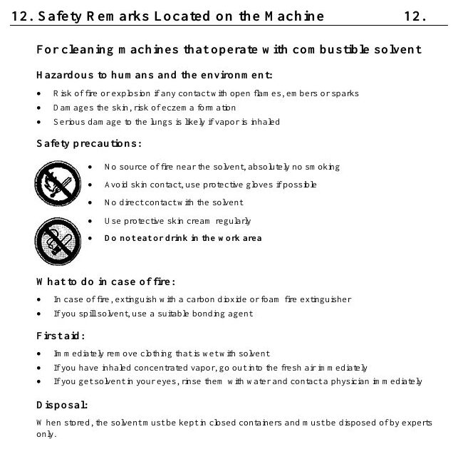
FUNCTIONAL SYSTEMS
The drying controller ends the cycle on evidence
MACHINE / SYSTEM VIEW
Locate the machine area first, then connect the visible components to the operating sequence.
• Inspect the component, its upstream supply and downstream effect—not the part in isolation.
• Use leakage, temperature, pressure, noise and cycle data to identify deterioration.
Machine / system reference • operating manual page 91
BÖWE M30 | Functional Systems
072
Notes:
[Sources]
- BÖWE M21-M26-M30 Operating Manual (2018-02), pages 37-59: https://www.ziermann.com/wp-content/uploads/2021/03/BA-Instruction-manual-M21-M26-M30-2018-02.pdf
- BÖWE M21-M26-M30 Spare Parts Catalogue (2019-08): https://www.ziermann.com/wp-content/uploads/2021/03/Ersatzteile-M21-M30-2019-08.pdf
- Practical visual: BÖWE M21-M26-M30 Operating Manual (2018-02), PDF page 91
Training interpretation: confirm the installed machine, current OEM revision, approved site PTW/LOTO, SDS and approved risk assessment before work.

Slide 73
FUNCTIONAL SYSTEMS
Loading-door venting reduces operator exposure
WHY IT MATTERS
SAFE EXECUTION
Understand the system purpose and what must happen before, during and after operation.
• Inspect the component, its upstream supply and downstream effect—not the part in isolation.
• Use leakage, temperature, pressure, noise and cycle data to identify deterioration.
BÖWE M30 | Functional Systems
073
Notes:
[Sources]
- BÖWE M21-M26-M30 Operating Manual (2018-02), pages 37-59: https://www.ziermann.com/wp-content/uploads/2021/03/BA-Instruction-manual-M21-M26-M30-2018-02.pdf
- BÖWE M21-M26-M30 Spare Parts Catalogue (2019-08): https://www.ziermann.com/wp-content/uploads/2021/03/Ersatzteile-M21-M30-2019-08.pdf
Training interpretation: confirm the installed machine, current OEM revision, approved site PTW/LOTO, SDS and approved risk assessment before work.

Slide 74

FUNCTIONAL SYSTEMS
The still separates solvent from residues
EXPLODED PARTS VIEW
Use the item numbers on the drawing to identify the exact assembly before ordering or removal.
• Inspect the component, its upstream supply and downstream effect—not the part in isolation.
• Use leakage, temperature, pressure, noise and cycle data to identify deterioration.
Exploded parts drawing • catalogue page 3
BÖWE M30 | Functional Systems
074
Notes:
[Sources]
- BÖWE M21-M26-M30 Operating Manual (2018-02), pages 37-59: https://www.ziermann.com/wp-content/uploads/2021/03/BA-Instruction-manual-M21-M26-M30-2018-02.pdf
- BÖWE M21-M26-M30 Spare Parts Catalogue (2019-08): https://www.ziermann.com/wp-content/uploads/2021/03/Ersatzteile-M21-M30-2019-08.pdf
- Practical visual: BÖWE M21-M26-M30 Spare Parts Catalogue (2019-08), PDF page 3
Training interpretation: confirm the installed machine, current OEM revision, approved site PTW/LOTO, SDS and approved risk assessment before work.

Slide 75
FUNCTIONAL SYSTEMS
Still overfill protection prevents an unsafe condition
Understand the system purpose and what must happen before, during and after operation.
WHAT TO VERIFY
01 Inspect the component, its upstream supply and downstream effect—not the part in isolation.
02 Use leakage, temperature, pressure, noise and cycle data to identify deterioration.
BÖWE M30 | Functional Systems
075
Notes:
[Sources]
- BÖWE M21-M26-M30 Operating Manual (2018-02), pages 37-59: https://www.ziermann.com/wp-content/uploads/2021/03/BA-Instruction-manual-M21-M26-M30-2018-02.pdf
- BÖWE M21-M26-M30 Spare Parts Catalogue (2019-08): https://www.ziermann.com/wp-content/uploads/2021/03/Ersatzteile-M21-M30-2019-08.pdf
Training interpretation: confirm the installed machine, current OEM revision, approved site PTW/LOTO, SDS and approved risk assessment before work.

Slide 76
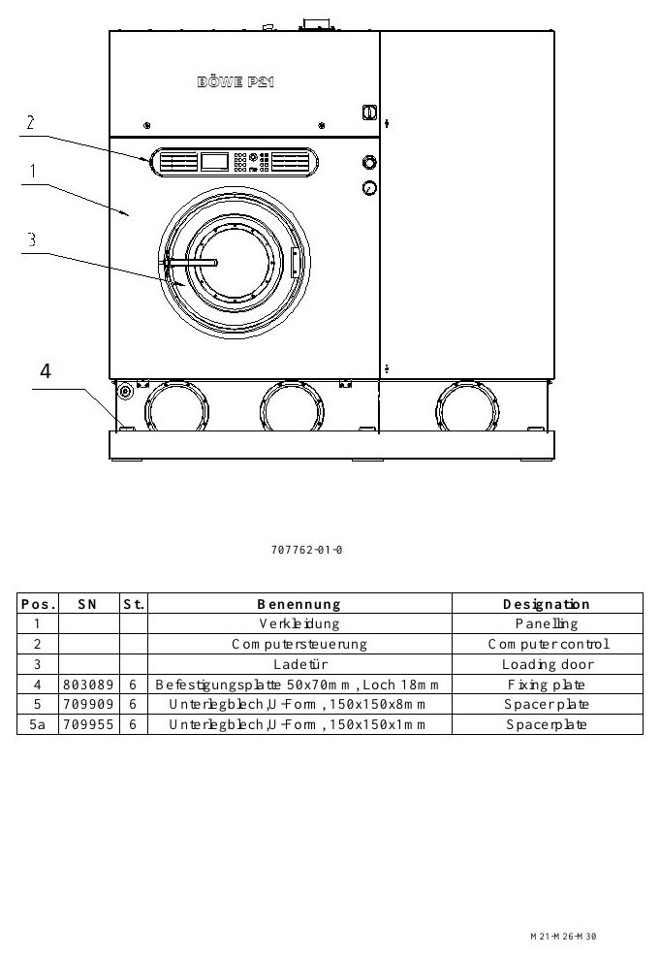
FUNCTIONAL SYSTEMS
Emission-free residue removal reduces open handling
EXPLODED PARTS VIEW
Use the item numbers on the drawing to identify the exact assembly before ordering or removal.
• Inspect the component, its upstream supply and downstream effect—not the part in isolation.
• Use leakage, temperature, pressure, noise and cycle data to identify deterioration.
Exploded parts drawing • catalogue page 5
BÖWE M30 | Functional Systems
076
Notes:
[Sources]
- BÖWE M21-M26-M30 Operating Manual (2018-02), pages 37-59: https://www.ziermann.com/wp-content/uploads/2021/03/BA-Instruction-manual-M21-M26-M30-2018-02.pdf
- BÖWE M21-M26-M30 Spare Parts Catalogue (2019-08): https://www.ziermann.com/wp-content/uploads/2021/03/Ersatzteile-M21-M30-2019-08.pdf
- Practical visual: BÖWE M21-M26-M30 Spare Parts Catalogue (2019-08), PDF page 5
Training interpretation: confirm the installed machine, current OEM revision, approved site PTW/LOTO, SDS and approved risk assessment before work.

Slide 77
FUNCTIONAL SYSTEMS
The condenser returns vapour to liquid solvent
• Understand the system purpose and what must happen before, during and after operation.
• Inspect the component, its upstream supply and downstream effect—not the part in isolation.
• Use leakage, temperature, pressure, noise and cycle data to identify deterioration.
TECHNICIAN CHECK
Can I locate it?
Can I verify it?
Can I make it safe?
Can I document closure?
BÖWE M30 | Functional Systems
077
Notes:
[Sources]
- BÖWE M21-M26-M30 Operating Manual (2018-02), pages 37-59: https://www.ziermann.com/wp-content/uploads/2021/03/BA-Instruction-manual-M21-M26-M30-2018-02.pdf
- BÖWE M21-M26-M30 Spare Parts Catalogue (2019-08): https://www.ziermann.com/wp-content/uploads/2021/03/Ersatzteile-M21-M30-2019-08.pdf
Training interpretation: confirm the installed machine, current OEM revision, approved site PTW/LOTO, SDS and approved risk assessment before work.

Slide 78
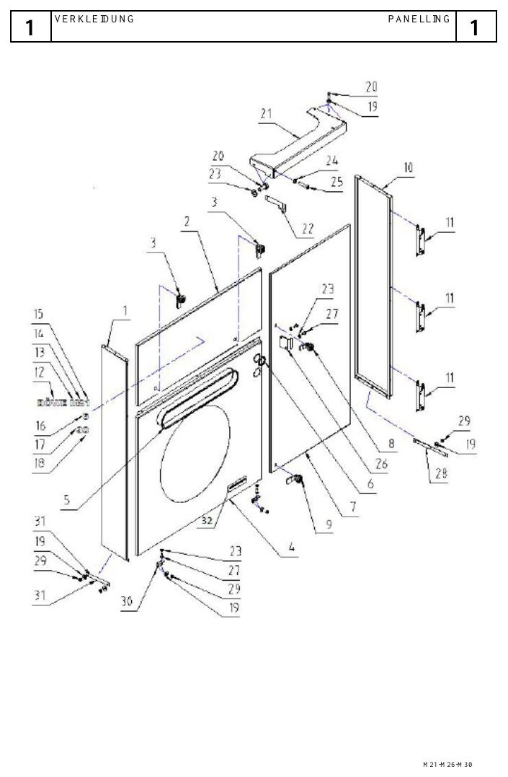
FUNCTIONAL SYSTEMS
The water separator divides solvent from process water
EXPLODED PARTS VIEW
Use the item numbers on the drawing to identify the exact assembly before ordering or removal.
• Inspect the component, its upstream supply and downstream effect—not the part in isolation.
• Use leakage, temperature, pressure, noise and cycle data to identify deterioration.
Exploded parts drawing • catalogue page 8
BÖWE M30 | Functional Systems
078
Notes:
[Sources]
- BÖWE M21-M26-M30 Operating Manual (2018-02), pages 37-59: https://www.ziermann.com/wp-content/uploads/2021/03/BA-Instruction-manual-M21-M26-M30-2018-02.pdf
- BÖWE M21-M26-M30 Spare Parts Catalogue (2019-08): https://www.ziermann.com/wp-content/uploads/2021/03/Ersatzteile-M21-M30-2019-08.pdf
- Practical visual: BÖWE M21-M26-M30 Spare Parts Catalogue (2019-08), PDF page 8
Training interpretation: confirm the installed machine, current OEM revision, approved site PTW/LOTO, SDS and approved risk assessment before work.

Slide 79
FUNCTIONAL SYSTEMS
The safety separator provides additional protection
WHY IT MATTERS
SAFE EXECUTION
Understand the system purpose and what must happen before, during and after operation.
• Inspect the component, its upstream supply and downstream effect—not the part in isolation.
• Use leakage, temperature, pressure, noise and cycle data to identify deterioration.
BÖWE M30 | Functional Systems
079
Notes:
[Sources]
- BÖWE M21-M26-M30 Operating Manual (2018-02), pages 37-59: https://www.ziermann.com/wp-content/uploads/2021/03/BA-Instruction-manual-M21-M26-M30-2018-02.pdf
- BÖWE M21-M26-M30 Spare Parts Catalogue (2019-08): https://www.ziermann.com/wp-content/uploads/2021/03/Ersatzteile-M21-M30-2019-08.pdf
Training interpretation: confirm the installed machine, current OEM revision, approved site PTW/LOTO, SDS and approved risk assessment before work.

Slide 80
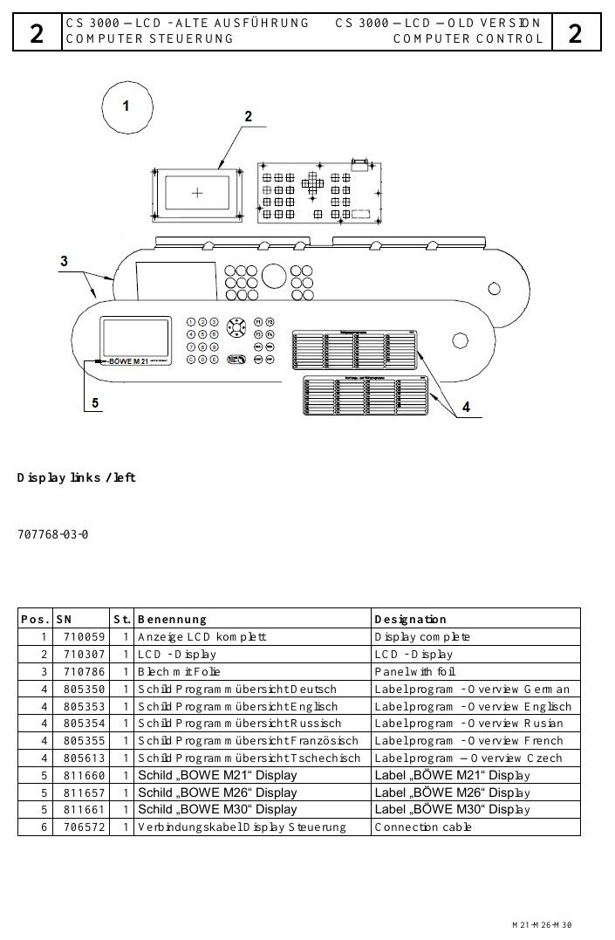
FUNCTIONAL SYSTEMS
The dosing unit introduces controlled additives
EXPLODED PARTS VIEW
Use the item numbers on the drawing to identify the exact assembly before ordering or removal.
• Inspect the component, its upstream supply and downstream effect—not the part in isolation.
• Use leakage, temperature, pressure, noise and cycle data to identify deterioration.
Exploded parts drawing • catalogue page 12
BÖWE M30 | Functional Systems
080
Notes:
[Sources]
- BÖWE M21-M26-M30 Operating Manual (2018-02), pages 37-59: https://www.ziermann.com/wp-content/uploads/2021/03/BA-Instruction-manual-M21-M26-M30-2018-02.pdf
- BÖWE M21-M26-M30 Spare Parts Catalogue (2019-08): https://www.ziermann.com/wp-content/uploads/2021/03/Ersatzteile-M21-M30-2019-08.pdf
- Practical visual: BÖWE M21-M26-M30 Spare Parts Catalogue (2019-08), PDF page 12
Training interpretation: confirm the installed machine, current OEM revision, approved site PTW/LOTO, SDS and approved risk assessment before work.

Slide 81
FUNCTIONAL SYSTEMS
The sprayer applies treatment to garments
Understand the system purpose and what must happen before, during and after operation.
WHAT TO VERIFY
01 Inspect the component, its upstream supply and downstream effect—not the part in isolation.
02 Use leakage, temperature, pressure, noise and cycle data to identify deterioration.
BÖWE M30 | Functional Systems
081
Notes:
[Sources]
- BÖWE M21-M26-M30 Operating Manual (2018-02), pages 37-59: https://www.ziermann.com/wp-content/uploads/2021/03/BA-Instruction-manual-M21-M26-M30-2018-02.pdf
- BÖWE M21-M26-M30 Spare Parts Catalogue (2019-08): https://www.ziermann.com/wp-content/uploads/2021/03/Ersatzteile-M21-M30-2019-08.pdf
Training interpretation: confirm the installed machine, current OEM revision, approved site PTW/LOTO, SDS and approved risk assessment before work.

Slide 82
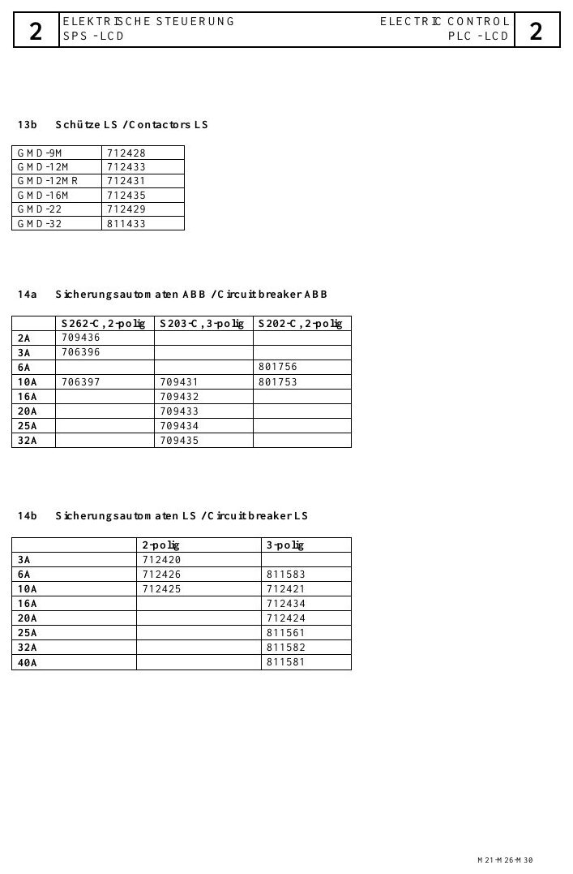
FUNCTIONAL SYSTEMS
Slimsorba reduces residual solvent concentration
EXPLODED PARTS VIEW
Use the item numbers on the drawing to identify the exact assembly before ordering or removal.
• Inspect the component, its upstream supply and downstream effect—not the part in isolation.
• Use leakage, temperature, pressure, noise and cycle data to identify deterioration.
Exploded parts drawing • catalogue page 16
BÖWE M30 | Functional Systems
082
Notes:
[Sources]
- BÖWE M21-M26-M30 Operating Manual (2018-02), pages 37-59: https://www.ziermann.com/wp-content/uploads/2021/03/BA-Instruction-manual-M21-M26-M30-2018-02.pdf
- BÖWE M21-M26-M30 Spare Parts Catalogue (2019-08): https://www.ziermann.com/wp-content/uploads/2021/03/Ersatzteile-M21-M30-2019-08.pdf
- Practical visual: BÖWE M21-M26-M30 Spare Parts Catalogue (2019-08), PDF page 16
Training interpretation: confirm the installed machine, current OEM revision, approved site PTW/LOTO, SDS and approved risk assessment before work.

Slide 83
FUNCTIONAL SYSTEMS
The solvent safety trough protects the floor and environment
• Understand the system purpose and what must happen before, during and after operation.
• Inspect the component, its upstream supply and downstream effect—not the part in isolation.
• Use leakage, temperature, pressure, noise and cycle data to identify deterioration.
TECHNICIAN CHECK
Can I locate it?
Can I verify it?
Can I make it safe?
Can I document closure?
BÖWE M30 | Functional Systems
083
Notes:
[Sources]
- BÖWE M21-M26-M30 Operating Manual (2018-02), pages 37-59: https://www.ziermann.com/wp-content/uploads/2021/03/BA-Instruction-manual-M21-M26-M30-2018-02.pdf
- BÖWE M21-M26-M30 Spare Parts Catalogue (2019-08): https://www.ziermann.com/wp-content/uploads/2021/03/Ersatzteile-M21-M30-2019-08.pdf
Training interpretation: confirm the installed machine, current OEM revision, approved site PTW/LOTO, SDS and approved risk assessment before work.

Slide 84
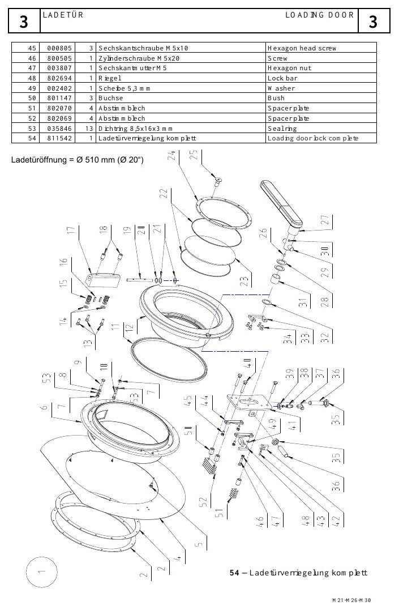
FUNCTIONAL SYSTEMS
Level sensors govern transfer decisions
EXPLODED PARTS VIEW
Use the item numbers on the drawing to identify the exact assembly before ordering or removal.
• Inspect the component, its upstream supply and downstream effect—not the part in isolation.
• Use leakage, temperature, pressure, noise and cycle data to identify deterioration.
Exploded parts drawing • catalogue page 20
BÖWE M30 | Functional Systems
084
Notes:
[Sources]
- BÖWE M21-M26-M30 Operating Manual (2018-02), pages 37-59: https://www.ziermann.com/wp-content/uploads/2021/03/BA-Instruction-manual-M21-M26-M30-2018-02.pdf
- BÖWE M21-M26-M30 Spare Parts Catalogue (2019-08): https://www.ziermann.com/wp-content/uploads/2021/03/Ersatzteile-M21-M30-2019-08.pdf
- Practical visual: BÖWE M21-M26-M30 Spare Parts Catalogue (2019-08), PDF page 20
Training interpretation: confirm the installed machine, current OEM revision, approved site PTW/LOTO, SDS and approved risk assessment before work.

Slide 85
FUNCTIONAL SYSTEMS
Pressure switches verify air and process conditions
WHY IT MATTERS
SAFE EXECUTION
Understand the system purpose and what must happen before, during and after operation.
• Inspect the component, its upstream supply and downstream effect—not the part in isolation.
• Use leakage, temperature, pressure, noise and cycle data to identify deterioration.
BÖWE M30 | Functional Systems
085
Notes:
[Sources]
- BÖWE M21-M26-M30 Operating Manual (2018-02), pages 37-59: https://www.ziermann.com/wp-content/uploads/2021/03/BA-Instruction-manual-M21-M26-M30-2018-02.pdf
- BÖWE M21-M26-M30 Spare Parts Catalogue (2019-08): https://www.ziermann.com/wp-content/uploads/2021/03/Ersatzteile-M21-M30-2019-08.pdf
Training interpretation: confirm the installed machine, current OEM revision, approved site PTW/LOTO, SDS and approved risk assessment before work.

Slide 86
SECTION 06
Operation & Control
Build understanding first; then apply it safely on the installed machine.
086
Notes:
[Sources]
- BÖWE M21-M26-M30 Operating Manual (2018-02), pages 60-75: https://www.ziermann.com/wp-content/uploads/2021/03/BA-Instruction-manual-M21-M26-M30-2018-02.pdf
- BÖWE M21-M26-M30 Spare Parts Catalogue (2019-08): https://www.ziermann.com/wp-content/uploads/2021/03/Ersatzteile-M21-M30-2019-08.pdf
Training interpretation: confirm the installed machine, current OEM revision, approved site PTW/LOTO, SDS and approved risk assessment before work.

Slide 87
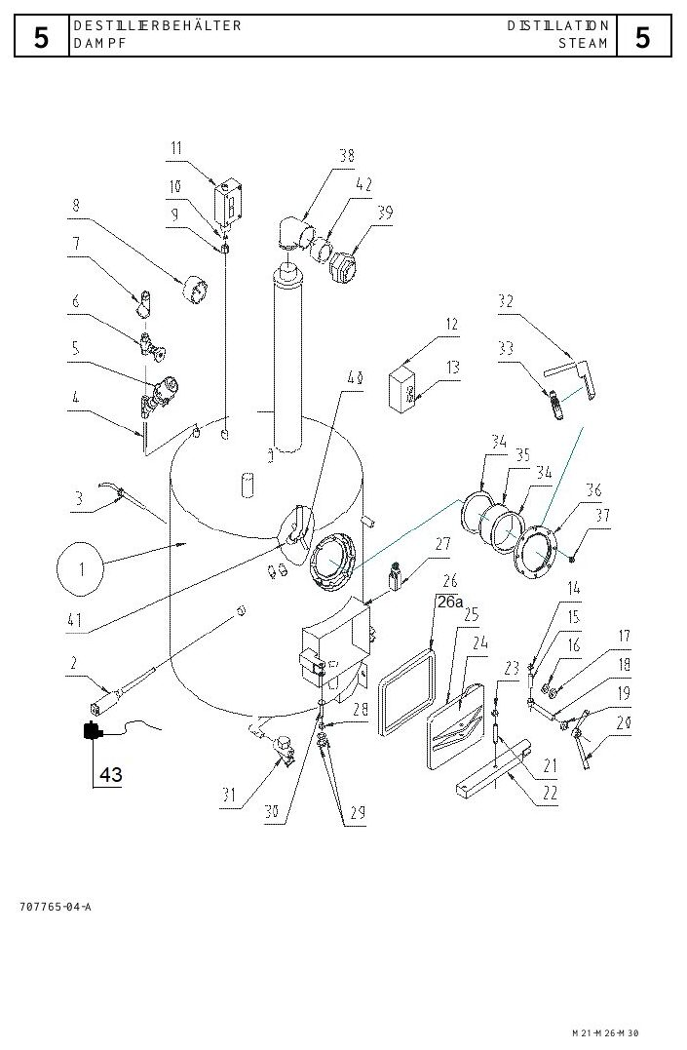
OPERATION & CONTROL
Pre-start inspection determines whether operation is allowed
EXPLODED PARTS VIEW
Use the item numbers on the drawing to identify the exact assembly before ordering or removal.
• Use display information and physical evidence together.
• If the sequence deviates, preserve the evidence and place the machine in a safe condition.
Exploded parts drawing • catalogue page 24
BÖWE M30 | Operation & Control
087
Notes:
[Sources]
- BÖWE M21-M26-M30 Operating Manual (2018-02), pages 60-75: https://www.ziermann.com/wp-content/uploads/2021/03/BA-Instruction-manual-M21-M26-M30-2018-02.pdf
- BÖWE M21-M26-M30 Spare Parts Catalogue (2019-08): https://www.ziermann.com/wp-content/uploads/2021/03/Ersatzteile-M21-M30-2019-08.pdf
- Practical visual: BÖWE M21-M26-M30 Spare Parts Catalogue (2019-08), PDF page 24
Training interpretation: confirm the installed machine, current OEM revision, approved site PTW/LOTO, SDS and approved risk assessment before work.

Slide 88
OPERATION & CONTROL
Garment checks protect both load and machine
WHY IT MATTERS
SAFE EXECUTION
Build garment checks protect both load and machine into the approved operating sequence.
• Use display information and physical evidence together.
• If the sequence deviates, preserve the evidence and place the machine in a safe condition.
BÖWE M30 | Operation & Control
088
Notes:
[Sources]
- BÖWE M21-M26-M30 Operating Manual (2018-02), pages 60-75: https://www.ziermann.com/wp-content/uploads/2021/03/BA-Instruction-manual-M21-M26-M30-2018-02.pdf
- BÖWE M21-M26-M30 Spare Parts Catalogue (2019-08): https://www.ziermann.com/wp-content/uploads/2021/03/Ersatzteile-M21-M30-2019-08.pdf
Training interpretation: confirm the installed machine, current OEM revision, approved site PTW/LOTO, SDS and approved risk assessment before work.

Slide 89
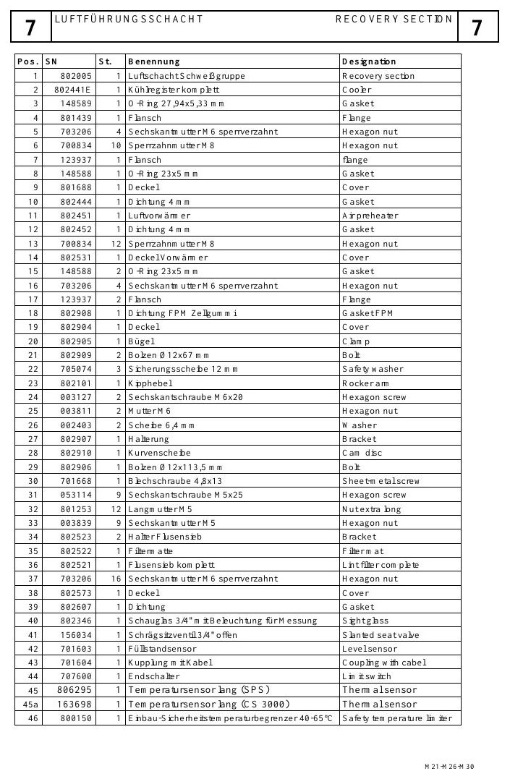
OPERATION & CONTROL
Correct loading prevents imbalance and poor cleaning
EXPLODED PARTS VIEW
Use the item numbers on the drawing to identify the exact assembly before ordering or removal.
• Use display information and physical evidence together.
• If the sequence deviates, preserve the evidence and place the machine in a safe condition.
Exploded parts drawing • catalogue page 28
BÖWE M30 | Operation & Control
089
Notes:
[Sources]
- BÖWE M21-M26-M30 Operating Manual (2018-02), pages 60-75: https://www.ziermann.com/wp-content/uploads/2021/03/BA-Instruction-manual-M21-M26-M30-2018-02.pdf
- BÖWE M21-M26-M30 Spare Parts Catalogue (2019-08): https://www.ziermann.com/wp-content/uploads/2021/03/Ersatzteile-M21-M30-2019-08.pdf
- Practical visual: BÖWE M21-M26-M30 Spare Parts Catalogue (2019-08), PDF page 28
Training interpretation: confirm the installed machine, current OEM revision, approved site PTW/LOTO, SDS and approved risk assessment before work.

Slide 90
OPERATION & CONTROL
Program selection must follow garment requirements
Build program selection must follow garment requirements into the approved operating sequence.
WHAT TO VERIFY
01 Use display information and physical evidence together.
02 If the sequence deviates, preserve the evidence and place the machine in a safe condition.
BÖWE M30 | Operation & Control
090
Notes:
[Sources]
- BÖWE M21-M26-M30 Operating Manual (2018-02), pages 60-75: https://www.ziermann.com/wp-content/uploads/2021/03/BA-Instruction-manual-M21-M26-M30-2018-02.pdf
- BÖWE M21-M26-M30 Spare Parts Catalogue (2019-08): https://www.ziermann.com/wp-content/uploads/2021/03/Ersatzteile-M21-M30-2019-08.pdf
Training interpretation: confirm the installed machine, current OEM revision, approved site PTW/LOTO, SDS and approved risk assessment before work.

Slide 91
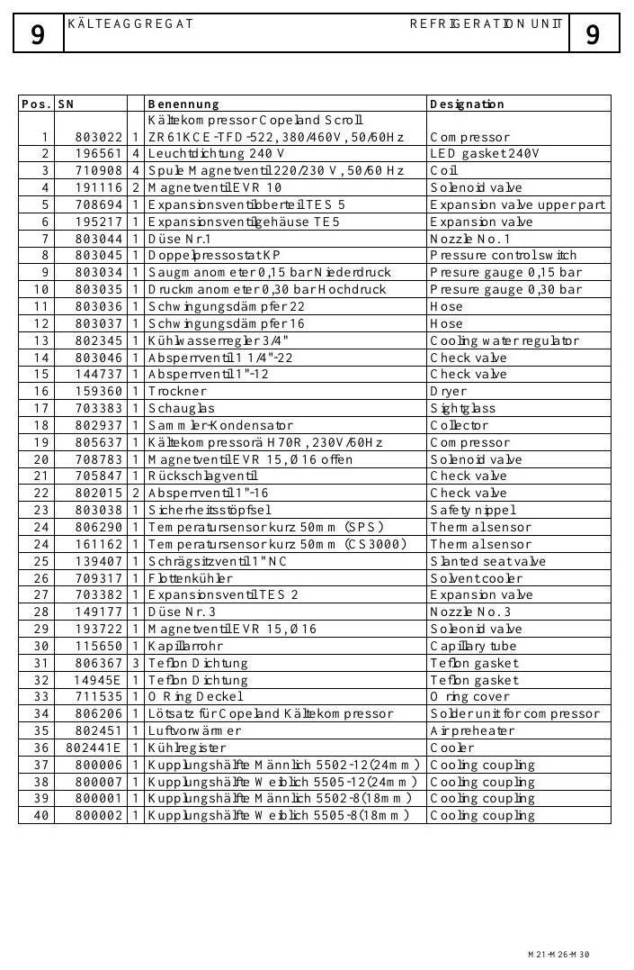
OPERATION & CONTROL
Automatic operation still requires active monitoring
EXPLODED PARTS VIEW
Use the item numbers on the drawing to identify the exact assembly before ordering or removal.
• Use display information and physical evidence together.
• If the sequence deviates, preserve the evidence and place the machine in a safe condition.
Exploded parts drawing • catalogue page 32
BÖWE M30 | Operation & Control
091
Notes:
[Sources]
- BÖWE M21-M26-M30 Operating Manual (2018-02), pages 60-75: https://www.ziermann.com/wp-content/uploads/2021/03/BA-Instruction-manual-M21-M26-M30-2018-02.pdf
- BÖWE M21-M26-M30 Spare Parts Catalogue (2019-08): https://www.ziermann.com/wp-content/uploads/2021/03/Ersatzteile-M21-M30-2019-08.pdf
- Practical visual: BÖWE M21-M26-M30 Spare Parts Catalogue (2019-08), PDF page 32
Training interpretation: confirm the installed machine, current OEM revision, approved site PTW/LOTO, SDS and approved risk assessment before work.

Slide 92
OPERATION & CONTROL
Temperature display supports evidence-based decisions
• Build temperature display supports evidence-based decisions into the approved operating sequence.
• Use display information and physical evidence together.
• If the sequence deviates, preserve the evidence and place the machine in a safe condition.
TECHNICIAN CHECK
Can I locate it?
Can I verify it?
Can I make it safe?
Can I document closure?
BÖWE M30 | Operation & Control
092
Notes:
[Sources]
- BÖWE M21-M26-M30 Operating Manual (2018-02), pages 60-75: https://www.ziermann.com/wp-content/uploads/2021/03/BA-Instruction-manual-M21-M26-M30-2018-02.pdf
- BÖWE M21-M26-M30 Spare Parts Catalogue (2019-08): https://www.ziermann.com/wp-content/uploads/2021/03/Ersatzteile-M21-M30-2019-08.pdf
Training interpretation: confirm the installed machine, current OEM revision, approved site PTW/LOTO, SDS and approved risk assessment before work.

Slide 93
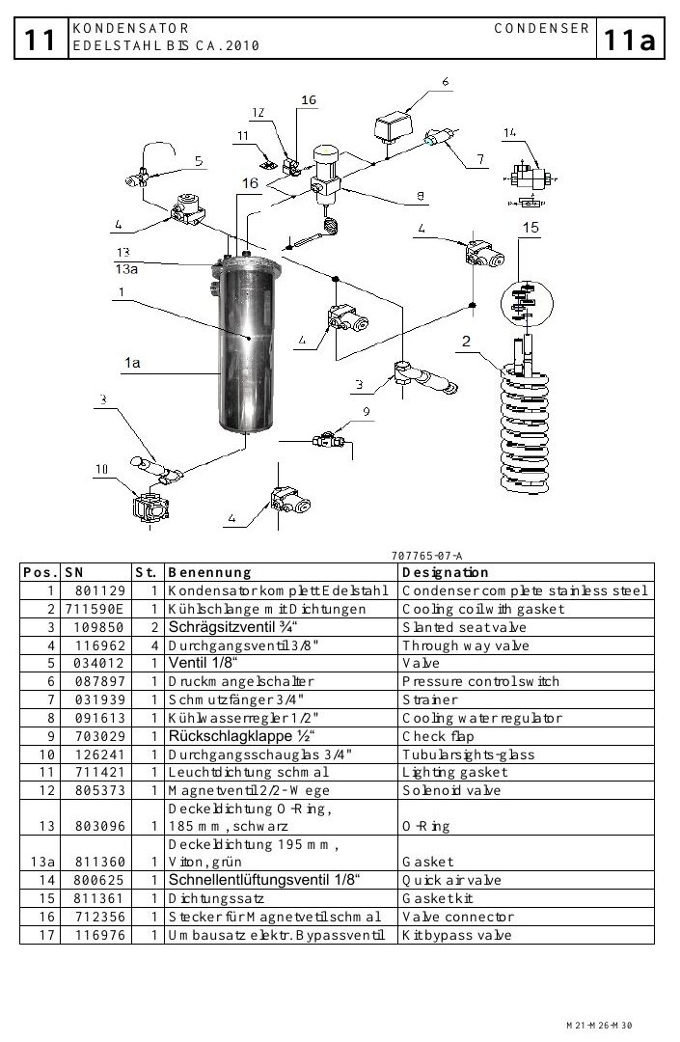
OPERATION & CONTROL
Operating data provides a performance history
EXPLODED PARTS VIEW
Use the item numbers on the drawing to identify the exact assembly before ordering or removal.
• Use display information and physical evidence together.
• If the sequence deviates, preserve the evidence and place the machine in a safe condition.
Exploded parts drawing • catalogue page 36
BÖWE M30 | Operation & Control
093
Notes:
[Sources]
- BÖWE M21-M26-M30 Operating Manual (2018-02), pages 60-75: https://www.ziermann.com/wp-content/uploads/2021/03/BA-Instruction-manual-M21-M26-M30-2018-02.pdf
- BÖWE M21-M26-M30 Spare Parts Catalogue (2019-08): https://www.ziermann.com/wp-content/uploads/2021/03/Ersatzteile-M21-M30-2019-08.pdf
- Practical visual: BÖWE M21-M26-M30 Spare Parts Catalogue (2019-08), PDF page 36
Training interpretation: confirm the installed machine, current OEM revision, approved site PTW/LOTO, SDS and approved risk assessment before work.

Slide 94
OPERATION & CONTROL
Error messages and notices require different responses
WHY IT MATTERS
SAFE EXECUTION
Build error messages and notices require different responses into the approved operating sequence.
• Use display information and physical evidence together.
• If the sequence deviates, preserve the evidence and place the machine in a safe condition.
BÖWE M30 | Operation & Control
094
Notes:
[Sources]
- BÖWE M21-M26-M30 Operating Manual (2018-02), pages 60-75: https://www.ziermann.com/wp-content/uploads/2021/03/BA-Instruction-manual-M21-M26-M30-2018-02.pdf
- BÖWE M21-M26-M30 Spare Parts Catalogue (2019-08): https://www.ziermann.com/wp-content/uploads/2021/03/Ersatzteile-M21-M30-2019-08.pdf
Training interpretation: confirm the installed machine, current OEM revision, approved site PTW/LOTO, SDS and approved risk assessment before work.

Slide 95
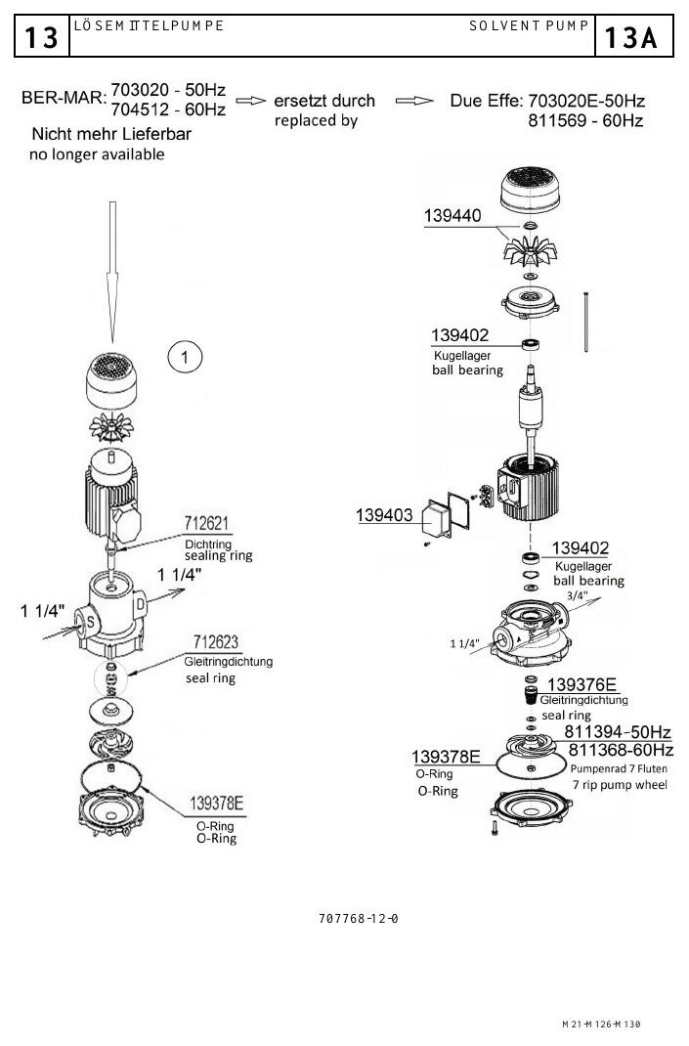
OPERATION & CONTROL
A test run confirms safe return to service
EXPLODED PARTS VIEW
Use the item numbers on the drawing to identify the exact assembly before ordering or removal.
• Use display information and physical evidence together.
• If the sequence deviates, preserve the evidence and place the machine in a safe condition.
Exploded parts drawing • catalogue page 40
BÖWE M30 | Operation & Control
095
Notes:
[Sources]
- BÖWE M21-M26-M30 Operating Manual (2018-02), pages 60-75: https://www.ziermann.com/wp-content/uploads/2021/03/BA-Instruction-manual-M21-M26-M30-2018-02.pdf
- BÖWE M21-M26-M30 Spare Parts Catalogue (2019-08): https://www.ziermann.com/wp-content/uploads/2021/03/Ersatzteile-M21-M30-2019-08.pdf
- Practical visual: BÖWE M21-M26-M30 Spare Parts Catalogue (2019-08), PDF page 40
Training interpretation: confirm the installed machine, current OEM revision, approved site PTW/LOTO, SDS and approved risk assessment before work.

Slide 96
OPERATION & CONTROL
Deodorizing is the safe response when the door cannot open
Select the OEM deodorizing program when the loading door cannot be opened.
WHAT TO VERIFY
01 Do not force or bypass the door lock.
02 Investigate the initiating fault after the machine reaches a safe condition.
BÖWE M30 | Operation & Control
096
Notes:
[Sources]
- BÖWE M21-M26-M30 Operating Manual (2018-02), pages 60-75: https://www.ziermann.com/wp-content/uploads/2021/03/BA-Instruction-manual-M21-M26-M30-2018-02.pdf
- BÖWE M21-M26-M30 Spare Parts Catalogue (2019-08): https://www.ziermann.com/wp-content/uploads/2021/03/Ersatzteile-M21-M30-2019-08.pdf
Training interpretation: confirm the installed machine, current OEM revision, approved site PTW/LOTO, SDS and approved risk assessment before work.

Slide 97
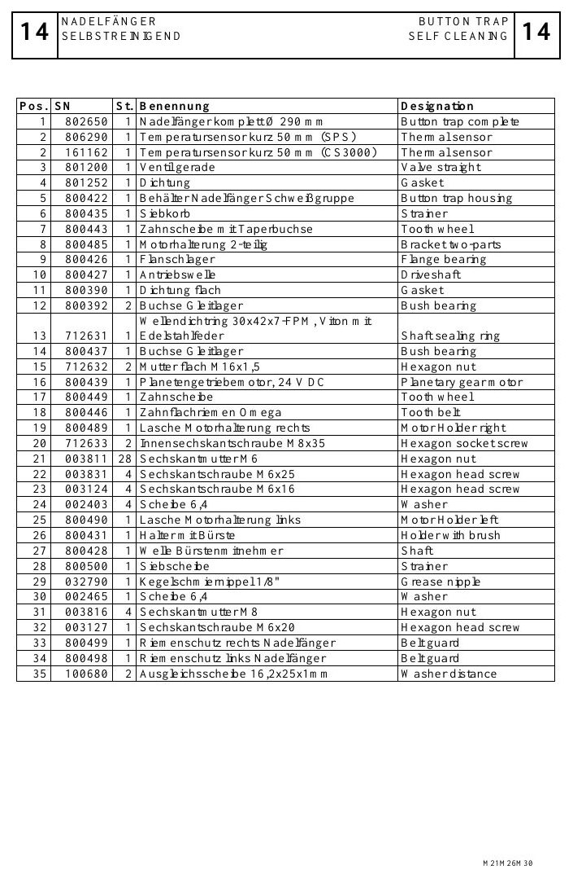
OPERATION & CONTROL
Maintenance programs automate defined process sequences
EXPLODED PARTS VIEW
Use the item numbers on the drawing to identify the exact assembly before ordering or removal.
• Confirm tanks, valves and disposal arrangements before starting.
• Monitor the complete sequence; automation does not remove operator responsibility.
Exploded parts drawing • catalogue page 44
BÖWE M30 | Operation & Control
097
Notes:
[Sources]
- BÖWE M21-M26-M30 Operating Manual (2018-02), pages 60-75: https://www.ziermann.com/wp-content/uploads/2021/03/BA-Instruction-manual-M21-M26-M30-2018-02.pdf
- BÖWE M21-M26-M30 Spare Parts Catalogue (2019-08): https://www.ziermann.com/wp-content/uploads/2021/03/Ersatzteile-M21-M30-2019-08.pdf
- Practical visual: BÖWE M21-M26-M30 Spare Parts Catalogue (2019-08), PDF page 44
Training interpretation: confirm the installed machine, current OEM revision, approved site PTW/LOTO, SDS and approved risk assessment before work.

Slide 98
OPERATION & CONTROL
Shift handover preserves unresolved technical information
• Build shift handover preserves unresolved technical information into the approved operating sequence.
• Use display information and physical evidence together.
• If the sequence deviates, preserve the evidence and place the machine in a safe condition.
TECHNICIAN CHECK
Can I locate it?
Can I verify it?
Can I make it safe?
Can I document closure?
BÖWE M30 | Operation & Control
098
Notes:
[Sources]
- BÖWE M21-M26-M30 Operating Manual (2018-02), pages 60-75: https://www.ziermann.com/wp-content/uploads/2021/03/BA-Instruction-manual-M21-M26-M30-2018-02.pdf
- BÖWE M21-M26-M30 Spare Parts Catalogue (2019-08): https://www.ziermann.com/wp-content/uploads/2021/03/Ersatzteile-M21-M30-2019-08.pdf
Training interpretation: confirm the installed machine, current OEM revision, approved site PTW/LOTO, SDS and approved risk assessment before work.

Slide 99
SECTION 07
Preventive Maintenance
Build understanding first; then apply it safely on the installed machine.
099
Notes:
[Sources]
- BÖWE M21-M26-M30 Operating Manual (2018-02), pages 76-100: https://www.ziermann.com/wp-content/uploads/2021/03/BA-Instruction-manual-M21-M26-M30-2018-02.pdf
- BÖWE M21-M26-M30 Spare Parts Catalogue (2019-08): https://www.ziermann.com/wp-content/uploads/2021/03/Ersatzteile-M21-M30-2019-08.pdf
Training interpretation: confirm the installed machine, current OEM revision, approved site PTW/LOTO, SDS and approved risk assessment before work.

Slide 100
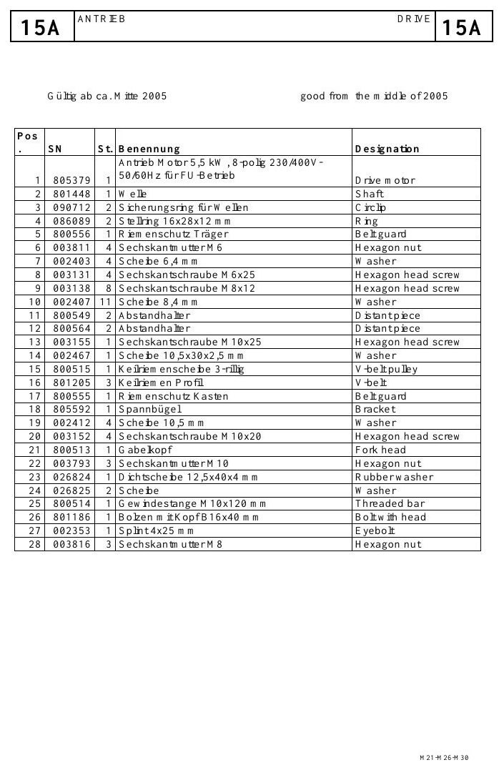
PREVENTIVE MAINTENANCE
Daily maintenance protects safety and throughput
EXPLODED PARTS VIEW
Use the item numbers on the drawing to identify the exact assembly before ordering or removal.
• Define condition, acceptance criteria, frequency and evidence required.
• Raise corrective work for deterioration; a signed checklist alone is not completion.
Exploded parts drawing • catalogue page 48
BÖWE M30 | Preventive Maintenance
100
Notes:
[Sources]
- BÖWE M21-M26-M30 Operating Manual (2018-02), pages 76-100: https://www.ziermann.com/wp-content/uploads/2021/03/BA-Instruction-manual-M21-M26-M30-2018-02.pdf
- BÖWE M21-M26-M30 Spare Parts Catalogue (2019-08): https://www.ziermann.com/wp-content/uploads/2021/03/Ersatzteile-M21-M30-2019-08.pdf
- Practical visual: BÖWE M21-M26-M30 Spare Parts Catalogue (2019-08), PDF page 48
Training interpretation: confirm the installed machine, current OEM revision, approved site PTW/LOTO, SDS and approved risk assessment before work.

Slide 101
PREVENTIVE MAINTENANCE
Inspect operating safety and liquid levels before startup
• Include inspect operating safety and liquid levels before startup in the controlled PPM checklist.
• Define condition, acceptance criteria, frequency and evidence required.
• Raise corrective work for deterioration; a signed checklist alone is not completion.
TECHNICIAN CHECK
Can I locate it?
Can I verify it?
Can I make it safe?
Can I document closure?
BÖWE M30 | Preventive Maintenance
101
Notes:
[Sources]
- BÖWE M21-M26-M30 Operating Manual (2018-02), pages 76-100: https://www.ziermann.com/wp-content/uploads/2021/03/BA-Instruction-manual-M21-M26-M30-2018-02.pdf
- BÖWE M21-M26-M30 Spare Parts Catalogue (2019-08): https://www.ziermann.com/wp-content/uploads/2021/03/Ersatzteile-M21-M30-2019-08.pdf
Training interpretation: confirm the installed machine, current OEM revision, approved site PTW/LOTO, SDS and approved risk assessment before work.

Slide 102
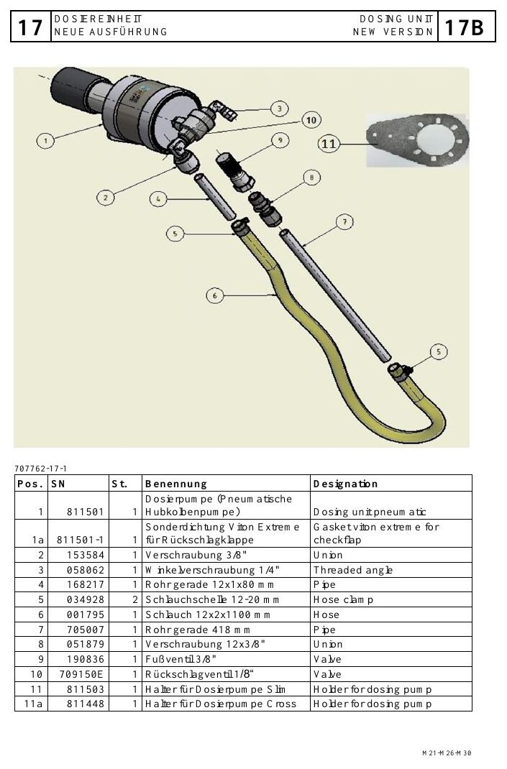
PREVENTIVE MAINTENANCE
Clean the lint filter daily or more often when required
EXPLODED PARTS VIEW
Use the item numbers on the drawing to identify the exact assembly before ordering or removal.
• Inspect sealing and correct seating before restarting.
• A restricted lint filter increases drying time and thermal stress.
Exploded parts drawing • catalogue page 52
BÖWE M30 | Preventive Maintenance
102
Notes:
[Sources]
- BÖWE M21-M26-M30 Operating Manual (2018-02), pages 76-100: https://www.ziermann.com/wp-content/uploads/2021/03/BA-Instruction-manual-M21-M26-M30-2018-02.pdf
- BÖWE M21-M26-M30 Spare Parts Catalogue (2019-08): https://www.ziermann.com/wp-content/uploads/2021/03/Ersatzteile-M21-M30-2019-08.pdf
- Practical visual: BÖWE M21-M26-M30 Spare Parts Catalogue (2019-08), PDF page 52
Training interpretation: confirm the installed machine, current OEM revision, approved site PTW/LOTO, SDS and approved risk assessment before work.

Slide 103
PREVENTIVE MAINTENANCE
Clean the button-trap strainer every day
WHY IT MATTERS
SAFE EXECUTION
Remove captured objects and lint at least daily.
• Check the strainer and seal for damage.
• Account for sharp objects and solvent exposure during handling.
BÖWE M30 | Preventive Maintenance
103
Notes:
[Sources]
- BÖWE M21-M26-M30 Operating Manual (2018-02), pages 76-100: https://www.ziermann.com/wp-content/uploads/2021/03/BA-Instruction-manual-M21-M26-M30-2018-02.pdf
- BÖWE M21-M26-M30 Spare Parts Catalogue (2019-08): https://www.ziermann.com/wp-content/uploads/2021/03/Ersatzteile-M21-M30-2019-08.pdf
Training interpretation: confirm the installed machine, current OEM revision, approved site PTW/LOTO, SDS and approved risk assessment before work.

Slide 104
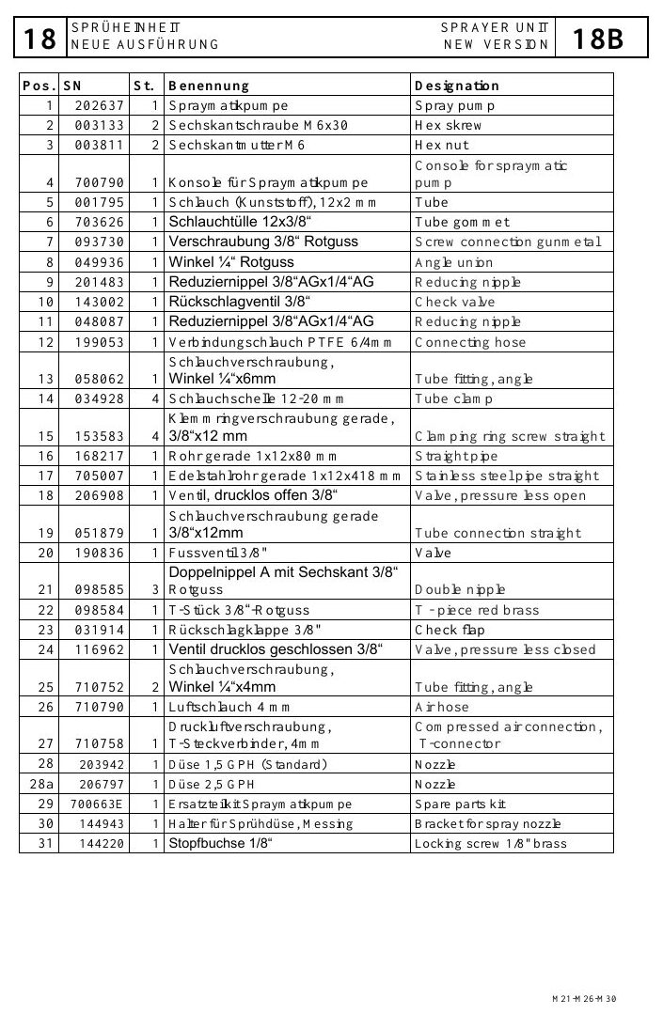
PREVENTIVE MAINTENANCE
Inspect door sealing and locking condition
EXPLODED PARTS VIEW
Use the item numbers on the drawing to identify the exact assembly before ordering or removal.
• Define condition, acceptance criteria, frequency and evidence required.
• Raise corrective work for deterioration; a signed checklist alone is not completion.
Exploded parts drawing • catalogue page 56
BÖWE M30 | Preventive Maintenance
104
Notes:
[Sources]
- BÖWE M21-M26-M30 Operating Manual (2018-02), pages 76-100: https://www.ziermann.com/wp-content/uploads/2021/03/BA-Instruction-manual-M21-M26-M30-2018-02.pdf
- BÖWE M21-M26-M30 Spare Parts Catalogue (2019-08): https://www.ziermann.com/wp-content/uploads/2021/03/Ersatzteile-M21-M30-2019-08.pdf
- Practical visual: BÖWE M21-M26-M30 Spare Parts Catalogue (2019-08), PDF page 56
Training interpretation: confirm the installed machine, current OEM revision, approved site PTW/LOTO, SDS and approved risk assessment before work.

Slide 105
PREVENTIVE MAINTENANCE
Check sight-glasses for visibility and abnormal condition
Include check sight-glasses for visibility and abnormal condition in the controlled PPM checklist.
WHAT TO VERIFY
01 Define condition, acceptance criteria, frequency and evidence required.
02 Raise corrective work for deterioration; a signed checklist alone is not completion.
BÖWE M30 | Preventive Maintenance
105
Notes:
[Sources]
- BÖWE M21-M26-M30 Operating Manual (2018-02), pages 76-100: https://www.ziermann.com/wp-content/uploads/2021/03/BA-Instruction-manual-M21-M26-M30-2018-02.pdf
- BÖWE M21-M26-M30 Spare Parts Catalogue (2019-08): https://www.ziermann.com/wp-content/uploads/2021/03/Ersatzteile-M21-M30-2019-08.pdf
Training interpretation: confirm the installed machine, current OEM revision, approved site PTW/LOTO, SDS and approved risk assessment before work.

Slide 106
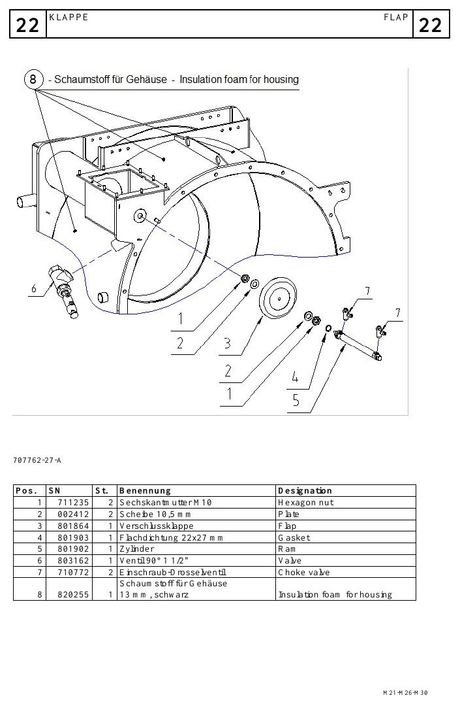
PREVENTIVE MAINTENANCE
Inspect solvent and water separation quality
EXPLODED PARTS VIEW
Use the item numbers on the drawing to identify the exact assembly before ordering or removal.
• Define condition, acceptance criteria, frequency and evidence required.
• Raise corrective work for deterioration; a signed checklist alone is not completion.
Exploded parts drawing • catalogue page 60
BÖWE M30 | Preventive Maintenance
106
Notes:
[Sources]
- BÖWE M21-M26-M30 Operating Manual (2018-02), pages 76-100: https://www.ziermann.com/wp-content/uploads/2021/03/BA-Instruction-manual-M21-M26-M30-2018-02.pdf
- BÖWE M21-M26-M30 Spare Parts Catalogue (2019-08): https://www.ziermann.com/wp-content/uploads/2021/03/Ersatzteile-M21-M30-2019-08.pdf
- Practical visual: BÖWE M21-M26-M30 Spare Parts Catalogue (2019-08), PDF page 60
Training interpretation: confirm the installed machine, current OEM revision, approved site PTW/LOTO, SDS and approved risk assessment before work.

Slide 107
PREVENTIVE MAINTENANCE
Monitor unusual noise, heat and vibration
• Include monitor unusual noise, heat and vibration in the controlled PPM checklist.
• Define condition, acceptance criteria, frequency and evidence required.
• Raise corrective work for deterioration; a signed checklist alone is not completion.
TECHNICIAN CHECK
Can I locate it?
Can I verify it?
Can I make it safe?
Can I document closure?
BÖWE M30 | Preventive Maintenance
107
Notes:
[Sources]
- BÖWE M21-M26-M30 Operating Manual (2018-02), pages 76-100: https://www.ziermann.com/wp-content/uploads/2021/03/BA-Instruction-manual-M21-M26-M30-2018-02.pdf
- BÖWE M21-M26-M30 Spare Parts Catalogue (2019-08): https://www.ziermann.com/wp-content/uploads/2021/03/Ersatzteile-M21-M30-2019-08.pdf
Training interpretation: confirm the installed machine, current OEM revision, approved site PTW/LOTO, SDS and approved risk assessment before work.

Slide 108
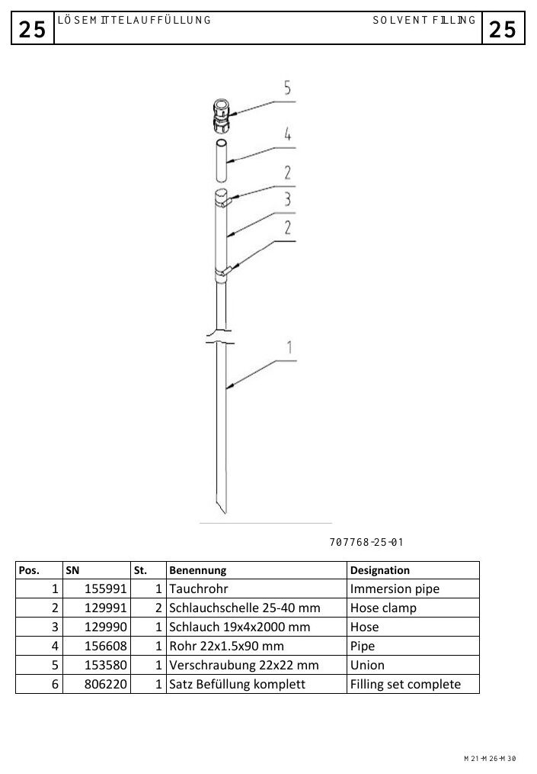
PREVENTIVE MAINTENANCE
Weekly maintenance prevents hidden degradation
EXPLODED PARTS VIEW
Use the item numbers on the drawing to identify the exact assembly before ordering or removal.
• Define condition, acceptance criteria, frequency and evidence required.
• Raise corrective work for deterioration; a signed checklist alone is not completion.
Exploded parts drawing • catalogue page 64
BÖWE M30 | Preventive Maintenance
108
Notes:
[Sources]
- BÖWE M21-M26-M30 Operating Manual (2018-02), pages 76-100: https://www.ziermann.com/wp-content/uploads/2021/03/BA-Instruction-manual-M21-M26-M30-2018-02.pdf
- BÖWE M21-M26-M30 Spare Parts Catalogue (2019-08): https://www.ziermann.com/wp-content/uploads/2021/03/Ersatzteile-M21-M30-2019-08.pdf
- Practical visual: BÖWE M21-M26-M30 Spare Parts Catalogue (2019-08), PDF page 64
Training interpretation: confirm the installed machine, current OEM revision, approved site PTW/LOTO, SDS and approved risk assessment before work.

Slide 109
PREVENTIVE MAINTENANCE
Drain water from the compressed-air service unit
WHY IT MATTERS
SAFE EXECUTION
Include drain water from the compressed-air service unit in the controlled PPM checklist.
• Define condition, acceptance criteria, frequency and evidence required.
• Raise corrective work for deterioration; a signed checklist alone is not completion.
BÖWE M30 | Preventive Maintenance
109
Notes:
[Sources]
- BÖWE M21-M26-M30 Operating Manual (2018-02), pages 76-100: https://www.ziermann.com/wp-content/uploads/2021/03/BA-Instruction-manual-M21-M26-M30-2018-02.pdf
- BÖWE M21-M26-M30 Spare Parts Catalogue (2019-08): https://www.ziermann.com/wp-content/uploads/2021/03/Ersatzteile-M21-M30-2019-08.pdf
Training interpretation: confirm the installed machine, current OEM revision, approved site PTW/LOTO, SDS and approved risk assessment before work.

Slide 110
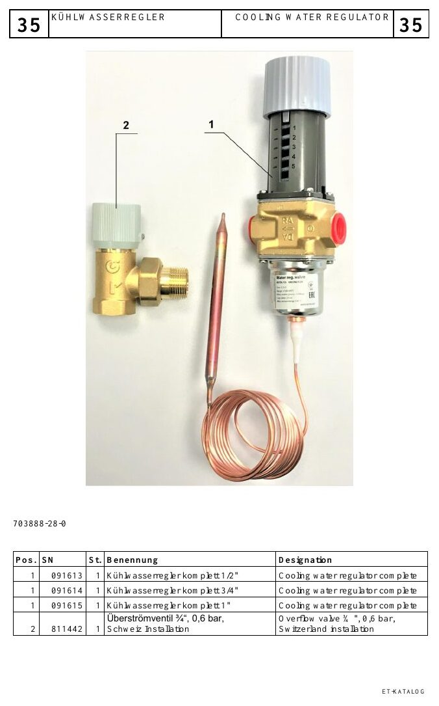
PREVENTIVE MAINTENANCE
Run filter maintenance at the specified interval
EXPLODED PARTS VIEW
Use the item numbers on the drawing to identify the exact assembly before ordering or removal.
• Define condition, acceptance criteria, frequency and evidence required.
• Raise corrective work for deterioration; a signed checklist alone is not completion.
Exploded parts drawing • catalogue page 68
BÖWE M30 | Preventive Maintenance
110
Notes:
[Sources]
- BÖWE M21-M26-M30 Operating Manual (2018-02), pages 76-100: https://www.ziermann.com/wp-content/uploads/2021/03/BA-Instruction-manual-M21-M26-M30-2018-02.pdf
- BÖWE M21-M26-M30 Spare Parts Catalogue (2019-08): https://www.ziermann.com/wp-content/uploads/2021/03/Ersatzteile-M21-M30-2019-08.pdf
- Practical visual: BÖWE M21-M26-M30 Spare Parts Catalogue (2019-08), PDF page 68
Training interpretation: confirm the installed machine, current OEM revision, approved site PTW/LOTO, SDS and approved risk assessment before work.

Slide 111
PREVENTIVE MAINTENANCE
Clean the Slimsorba air-filter insert when fitted
Include clean the Slimsorba air-filter insert when fitted in the controlled PPM checklist.
WHAT TO VERIFY
01 Define condition, acceptance criteria, frequency and evidence required.
02 Raise corrective work for deterioration; a signed checklist alone is not completion.
BÖWE M30 | Preventive Maintenance
111
Notes:
[Sources]
- BÖWE M21-M26-M30 Operating Manual (2018-02), pages 76-100: https://www.ziermann.com/wp-content/uploads/2021/03/BA-Instruction-manual-M21-M26-M30-2018-02.pdf
- BÖWE M21-M26-M30 Spare Parts Catalogue (2019-08): https://www.ziermann.com/wp-content/uploads/2021/03/Ersatzteile-M21-M30-2019-08.pdf
Training interpretation: confirm the installed machine, current OEM revision, approved site PTW/LOTO, SDS and approved risk assessment before work.

Slide 112
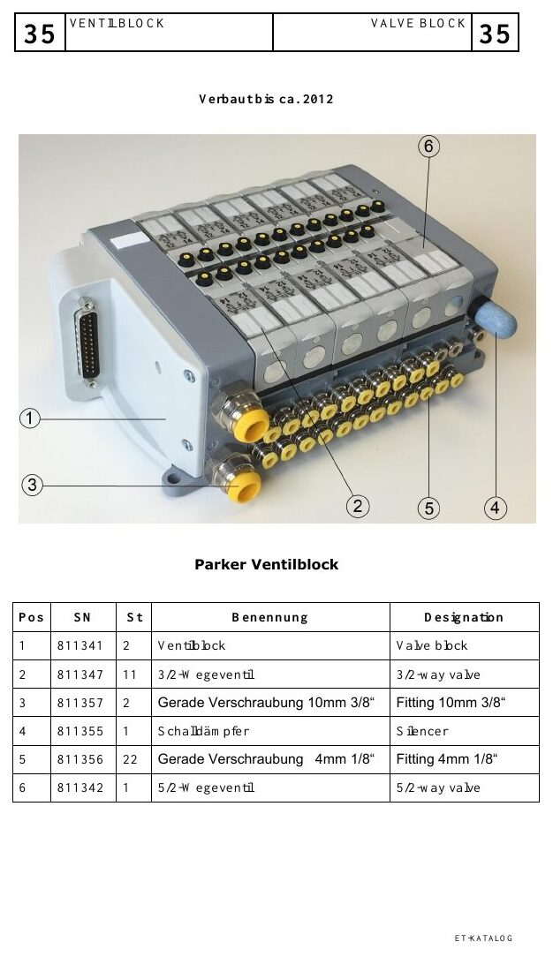
PREVENTIVE MAINTENANCE
Check overfill-sensor function at the required interval
EXPLODED PARTS VIEW
Use the item numbers on the drawing to identify the exact assembly before ordering or removal.
• Define condition, acceptance criteria, frequency and evidence required.
• Raise corrective work for deterioration; a signed checklist alone is not completion.
Exploded parts drawing • catalogue page 72
BÖWE M30 | Preventive Maintenance
112
Notes:
[Sources]
- BÖWE M21-M26-M30 Operating Manual (2018-02), pages 76-100: https://www.ziermann.com/wp-content/uploads/2021/03/BA-Instruction-manual-M21-M26-M30-2018-02.pdf
- BÖWE M21-M26-M30 Spare Parts Catalogue (2019-08): https://www.ziermann.com/wp-content/uploads/2021/03/Ersatzteile-M21-M30-2019-08.pdf
- Practical visual: BÖWE M21-M26-M30 Spare Parts Catalogue (2019-08), PDF page 72
Training interpretation: confirm the installed machine, current OEM revision, approved site PTW/LOTO, SDS and approved risk assessment before work.

Slide 113
PREVENTIVE MAINTENANCE
Monthly lubrication protects the cage bearing
• Use the specified lubricant, quantity and point.
• Prevent contamination at the grease nipple.
• Record date, technician and abnormal bearing observations.
TECHNICIAN CHECK
Can I locate it?
Can I verify it?
Can I make it safe?
Can I document closure?
BÖWE M30 | Preventive Maintenance
113
Notes:
[Sources]
- BÖWE M21-M26-M30 Operating Manual (2018-02), pages 76-100: https://www.ziermann.com/wp-content/uploads/2021/03/BA-Instruction-manual-M21-M26-M30-2018-02.pdf
- BÖWE M21-M26-M30 Spare Parts Catalogue (2019-08): https://www.ziermann.com/wp-content/uploads/2021/03/Ersatzteile-M21-M30-2019-08.pdf
Training interpretation: confirm the installed machine, current OEM revision, approved site PTW/LOTO, SDS and approved risk assessment before work.

Slide 114

PREVENTIVE MAINTENANCE
Check drive belts for wear, tension and alignment
EXPLODED PARTS VIEW
Use the item numbers on the drawing to identify the exact assembly before ordering or removal.
• The P-series manual identifies a semi-annual belt check; adopt the current OEM interval.
• Repeated belt wear is a symptom—correct alignment, loading or bearing causes.
Exploded parts drawing • catalogue page 76
BÖWE M30 | Preventive Maintenance
114
Notes:
[Sources]
- BÖWE M21-M26-M30 Operating Manual (2018-02), pages 76-100: https://www.ziermann.com/wp-content/uploads/2021/03/BA-Instruction-manual-M21-M26-M30-2018-02.pdf
- BÖWE M21-M26-M30 Spare Parts Catalogue (2019-08): https://www.ziermann.com/wp-content/uploads/2021/03/Ersatzteile-M21-M30-2019-08.pdf
- Practical visual: BÖWE M21-M26-M30 Spare Parts Catalogue (2019-08), PDF page 76
Training interpretation: confirm the installed machine, current OEM revision, approved site PTW/LOTO, SDS and approved risk assessment before work.

Slide 115
PREVENTIVE MAINTENANCE
Inspect sensor faces, cables and mountings
WHY IT MATTERS
SAFE EXECUTION
Include inspect sensor faces, cables and mountings in the controlled PPM checklist.
• Define condition, acceptance criteria, frequency and evidence required.
• Raise corrective work for deterioration; a signed checklist alone is not completion.
BÖWE M30 | Preventive Maintenance
115
Notes:
[Sources]
- BÖWE M21-M26-M30 Operating Manual (2018-02), pages 76-100: https://www.ziermann.com/wp-content/uploads/2021/03/BA-Instruction-manual-M21-M26-M30-2018-02.pdf
- BÖWE M21-M26-M30 Spare Parts Catalogue (2019-08): https://www.ziermann.com/wp-content/uploads/2021/03/Ersatzteile-M21-M30-2019-08.pdf
Training interpretation: confirm the installed machine, current OEM revision, approved site PTW/LOTO, SDS and approved risk assessment before work.

Slide 116

PREVENTIVE MAINTENANCE
Keep cooling and heat-transfer surfaces clean
EXPLODED PARTS VIEW
Use the item numbers on the drawing to identify the exact assembly before ordering or removal.
• Define condition, acceptance criteria, frequency and evidence required.
• Raise corrective work for deterioration; a signed checklist alone is not completion.
Exploded parts drawing • catalogue page 80
BÖWE M30 | Preventive Maintenance
116
Notes:
[Sources]
- BÖWE M21-M26-M30 Operating Manual (2018-02), pages 76-100: https://www.ziermann.com/wp-content/uploads/2021/03/BA-Instruction-manual-M21-M26-M30-2018-02.pdf
- BÖWE M21-M26-M30 Spare Parts Catalogue (2019-08): https://www.ziermann.com/wp-content/uploads/2021/03/Ersatzteile-M21-M30-2019-08.pdf
- Practical visual: BÖWE M21-M26-M30 Spare Parts Catalogue (2019-08), PDF page 80
Training interpretation: confirm the installed machine, current OEM revision, approved site PTW/LOTO, SDS and approved risk assessment before work.

Slide 117
PREVENTIVE MAINTENANCE
Inspect hoses, pipes, unions and valves for leakage
Include inspect hoses, pipes, unions and valves for leakage in the controlled PPM checklist.
WHAT TO VERIFY
01 Define condition, acceptance criteria, frequency and evidence required.
02 Raise corrective work for deterioration; a signed checklist alone is not completion.
BÖWE M30 | Preventive Maintenance
117
Notes:
[Sources]
- BÖWE M21-M26-M30 Operating Manual (2018-02), pages 76-100: https://www.ziermann.com/wp-content/uploads/2021/03/BA-Instruction-manual-M21-M26-M30-2018-02.pdf
- BÖWE M21-M26-M30 Spare Parts Catalogue (2019-08): https://www.ziermann.com/wp-content/uploads/2021/03/Ersatzteile-M21-M30-2019-08.pdf
Training interpretation: confirm the installed machine, current OEM revision, approved site PTW/LOTO, SDS and approved risk assessment before work.

Slide 118

PREVENTIVE MAINTENANCE
Clean tanks only through the approved maintenance sequence
EXPLODED PARTS VIEW
Use the item numbers on the drawing to identify the exact assembly before ordering or removal.
• Define condition, acceptance criteria, frequency and evidence required.
• Raise corrective work for deterioration; a signed checklist alone is not completion.
Exploded parts drawing • catalogue page 84
BÖWE M30 | Preventive Maintenance
118
Notes:
[Sources]
- BÖWE M21-M26-M30 Operating Manual (2018-02), pages 76-100: https://www.ziermann.com/wp-content/uploads/2021/03/BA-Instruction-manual-M21-M26-M30-2018-02.pdf
- BÖWE M21-M26-M30 Spare Parts Catalogue (2019-08): https://www.ziermann.com/wp-content/uploads/2021/03/Ersatzteile-M21-M30-2019-08.pdf
- Practical visual: BÖWE M21-M26-M30 Spare Parts Catalogue (2019-08), PDF page 84
Training interpretation: confirm the installed machine, current OEM revision, approved site PTW/LOTO, SDS and approved risk assessment before work.

Slide 119
PREVENTIVE MAINTENANCE
Maintenance records must show evidence and closure
• Include maintenance records must show evidence and closure in the controlled PPM checklist.
• Define condition, acceptance criteria, frequency and evidence required.
• Raise corrective work for deterioration; a signed checklist alone is not completion.
TECHNICIAN CHECK
Can I locate it?
Can I verify it?
Can I make it safe?
Can I document closure?
BÖWE M30 | Preventive Maintenance
119
Notes:
[Sources]
- BÖWE M21-M26-M30 Operating Manual (2018-02), pages 76-100: https://www.ziermann.com/wp-content/uploads/2021/03/BA-Instruction-manual-M21-M26-M30-2018-02.pdf
- BÖWE M21-M26-M30 Spare Parts Catalogue (2019-08): https://www.ziermann.com/wp-content/uploads/2021/03/Ersatzteile-M21-M30-2019-08.pdf
Training interpretation: confirm the installed machine, current OEM revision, approved site PTW/LOTO, SDS and approved risk assessment before work.

Slide 120
SECTION 08
Troubleshooting & Spares
Build understanding first; then apply it safely on the installed machine.
120
Notes:
[Sources]
- BÖWE M21-M26-M30 Operating Manual (2018-02), pages 60-100: https://www.ziermann.com/wp-content/uploads/2021/03/BA-Instruction-manual-M21-M26-M30-2018-02.pdf
- BÖWE M21-M26-M30 Spare Parts Catalogue (2019-08): https://www.ziermann.com/wp-content/uploads/2021/03/Ersatzteile-M21-M30-2019-08.pdf
Training interpretation: confirm the installed machine, current OEM revision, approved site PTW/LOTO, SDS and approved risk assessment before work.

Slide 121
TROUBLESHOOTING & SPARES
Start diagnosis with the first abnormal evidence
WHY IT MATTERS
SAFE EXECUTION
Use start diagnosis with the first abnormal evidence to narrow the fault without unsafe trial-and-error.
• Confirm the cause with repeatable evidence before replacing components.
• Document the repair, functional test and lessons for future prevention.
BÖWE M30 | Troubleshooting & Spares
121
Notes:
[Sources]
- BÖWE M21-M26-M30 Operating Manual (2018-02), pages 60-100: https://www.ziermann.com/wp-content/uploads/2021/03/BA-Instruction-manual-M21-M26-M30-2018-02.pdf
- BÖWE M21-M26-M30 Spare Parts Catalogue (2019-08): https://www.ziermann.com/wp-content/uploads/2021/03/Ersatzteile-M21-M30-2019-08.pdf
Training interpretation: confirm the installed machine, current OEM revision, approved site PTW/LOTO, SDS and approved risk assessment before work.

Slide 122
TROUBLESHOOTING & SPARES
Do not reset repeatedly without finding the cause
• Use do not reset repeatedly without finding the cause to narrow the fault without unsafe trial-and-error.
• Confirm the cause with repeatable evidence before replacing components.
• Document the repair, functional test and lessons for future prevention.
TECHNICIAN CHECK
Can I locate it?
Can I verify it?
Can I make it safe?
Can I document closure?
BÖWE M30 | Troubleshooting & Spares
122
Notes:
[Sources]
- BÖWE M21-M26-M30 Operating Manual (2018-02), pages 60-100: https://www.ziermann.com/wp-content/uploads/2021/03/BA-Instruction-manual-M21-M26-M30-2018-02.pdf
- BÖWE M21-M26-M30 Spare Parts Catalogue (2019-08): https://www.ziermann.com/wp-content/uploads/2021/03/Ersatzteile-M21-M30-2019-08.pdf
Training interpretation: confirm the installed machine, current OEM revision, approved site PTW/LOTO, SDS and approved risk assessment before work.

Slide 123
TROUBLESHOOTING & SPARES
Separate process faults from component faults
Use separate process faults from component faults to narrow the fault without unsafe trial-and-error.
WHAT TO VERIFY
01 Confirm the cause with repeatable evidence before replacing components.
02 Document the repair, functional test and lessons for future prevention.
BÖWE M30 | Troubleshooting & Spares
123
Notes:
[Sources]
- BÖWE M21-M26-M30 Operating Manual (2018-02), pages 60-100: https://www.ziermann.com/wp-content/uploads/2021/03/BA-Instruction-manual-M21-M26-M30-2018-02.pdf
- BÖWE M21-M26-M30 Spare Parts Catalogue (2019-08): https://www.ziermann.com/wp-content/uploads/2021/03/Ersatzteile-M21-M30-2019-08.pdf
Training interpretation: confirm the installed machine, current OEM revision, approved site PTW/LOTO, SDS and approved risk assessment before work.

Slide 124
TROUBLESHOOTING & SPARES
Use trends to confirm intermittent failures
WHY IT MATTERS
SAFE EXECUTION
Use use trends to confirm intermittent failures to narrow the fault without unsafe trial-and-error.
• Confirm the cause with repeatable evidence before replacing components.
• Document the repair, functional test and lessons for future prevention.
BÖWE M30 | Troubleshooting & Spares
124
Notes:
[Sources]
- BÖWE M21-M26-M30 Operating Manual (2018-02), pages 60-100: https://www.ziermann.com/wp-content/uploads/2021/03/BA-Instruction-manual-M21-M26-M30-2018-02.pdf
- BÖWE M21-M26-M30 Spare Parts Catalogue (2019-08): https://www.ziermann.com/wp-content/uploads/2021/03/Ersatzteile-M21-M30-2019-08.pdf
Training interpretation: confirm the installed machine, current OEM revision, approved site PTW/LOTO, SDS and approved risk assessment before work.

Slide 125
TROUBLESHOOTING & SPARES
Verify repair effectiveness with a controlled test
• Use verify repair effectiveness with a controlled test to narrow the fault without unsafe trial-and-error.
• Confirm the cause with repeatable evidence before replacing components.
• Document the repair, functional test and lessons for future prevention.
TECHNICIAN CHECK
Can I locate it?
Can I verify it?
Can I make it safe?
Can I document closure?
BÖWE M30 | Troubleshooting & Spares
125
Notes:
[Sources]
- BÖWE M21-M26-M30 Operating Manual (2018-02), pages 60-100: https://www.ziermann.com/wp-content/uploads/2021/03/BA-Instruction-manual-M21-M26-M30-2018-02.pdf
- BÖWE M21-M26-M30 Spare Parts Catalogue (2019-08): https://www.ziermann.com/wp-content/uploads/2021/03/Ersatzteile-M21-M30-2019-08.pdf
Training interpretation: confirm the installed machine, current OEM revision, approved site PTW/LOTO, SDS and approved risk assessment before work.

Slide 126
TROUBLESHOOTING & SPARES
Order spare parts using model, serial number and year
State BÖWE M30, machine serial number and manufacturing year.
WHAT TO VERIFY
01 Confirm installed options and modification status.
02 Use the OEM designation and part number; retain traceability after installation.
BÖWE M30 | Troubleshooting & Spares
126
Notes:
[Sources]
- BÖWE M21-M26-M30 Operating Manual (2018-02), pages 60-100: https://www.ziermann.com/wp-content/uploads/2021/03/BA-Instruction-manual-M21-M26-M30-2018-02.pdf
- BÖWE M21-M26-M30 Spare Parts Catalogue (2019-08): https://www.ziermann.com/wp-content/uploads/2021/03/Ersatzteile-M21-M30-2019-08.pdf
Training interpretation: confirm the installed machine, current OEM revision, approved site PTW/LOTO, SDS and approved risk assessment before work.

Slide 127
TROUBLESHOOTING & SPARES
Configuration and modification status control compatibility
WHY IT MATTERS
SAFE EXECUTION
Use configuration and modification status control compatibility to narrow the fault without unsafe trial-and-error.
• Confirm the cause with repeatable evidence before replacing components.
• Document the repair, functional test and lessons for future prevention.
BÖWE M30 | Troubleshooting & Spares
127
Notes:
[Sources]
- BÖWE M21-M26-M30 Operating Manual (2018-02), pages 60-100: https://www.ziermann.com/wp-content/uploads/2021/03/BA-Instruction-manual-M21-M26-M30-2018-02.pdf
- BÖWE M21-M26-M30 Spare Parts Catalogue (2019-08): https://www.ziermann.com/wp-content/uploads/2021/03/Ersatzteile-M21-M30-2019-08.pdf
Training interpretation: confirm the installed machine, current OEM revision, approved site PTW/LOTO, SDS and approved risk assessment before work.

Slide 128
TROUBLESHOOTING & SPARES
Competency is demonstrated by safe repeatable execution
• Use competency is demonstrated by safe repeatable execution to narrow the fault without unsafe trial-and-error.
• Confirm the cause with repeatable evidence before replacing components.
• Document the repair, functional test and lessons for future prevention.
TECHNICIAN CHECK
Can I locate it?
Can I verify it?
Can I make it safe?
Can I document closure?
BÖWE M30 | Troubleshooting & Spares
128
Notes:
[Sources]
- BÖWE M21-M26-M30 Operating Manual (2018-02), pages 60-100: https://www.ziermann.com/wp-content/uploads/2021/03/BA-Instruction-manual-M21-M26-M30-2018-02.pdf
- BÖWE M21-M26-M30 Spare Parts Catalogue (2019-08): https://www.ziermann.com/wp-content/uploads/2021/03/Ersatzteile-M21-M30-2019-08.pdf
Training interpretation: confirm the installed machine, current OEM revision, approved site PTW/LOTO, SDS and approved risk assessment before work.

Slide 129
Competence is safe, repeatable execution
Before independent work, the technician should demonstrate:
01
Correct machine and document identification
02
Hazard recognition and verified isolation
03
Systematic inspection and evidence-based diagnosis
04
OEM-compliant maintenance and parts control
05
Controlled functional test and complete handover
BÖWE M30 | Competency
129
Notes:
[Sources]
- BÖWE M21-M26-M30 Operating Manual (2018-02), pages 60-100: https://www.ziermann.com/wp-content/uploads/2021/03/BA-Instruction-manual-M21-M26-M30-2018-02.pdf
- BÖWE M21-M26-M30 Spare Parts Catalogue (2019-08): https://www.ziermann.com/wp-content/uploads/2021/03/Ersatzteile-M21-M30-2019-08.pdf
Training interpretation: confirm the installed machine, current OEM revision, approved site PTW/LOTO, SDS and approved risk assessment before work.

