Slide 1
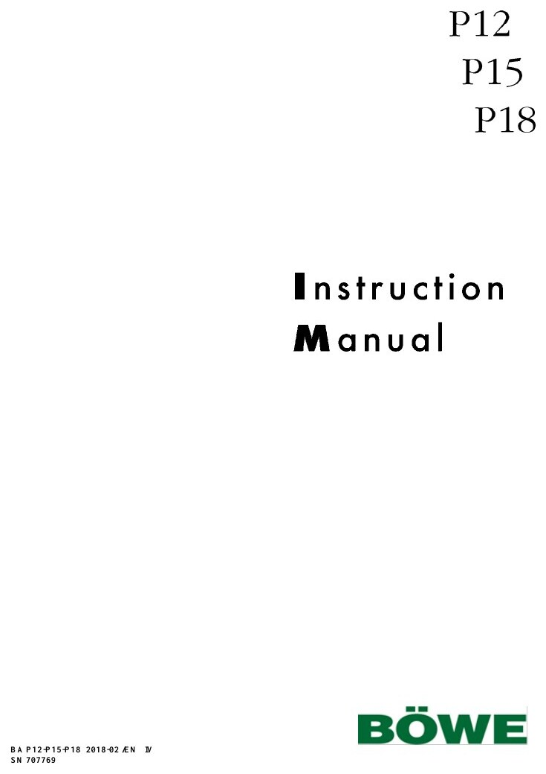
BÖWE TECHNICAL TRAINING
P18
PERC dry-cleaning machine
Operation • Safety • Functional Systems • Preventive Maintenance • Troubleshooting • Spare Parts
Sajjad's Engineering Academy
114 SLIDES
Notes:
[Sources]
- BÖWE P12-P15-P18 Operating Manual (2018-02), pages 5-7: https://www.ziermann.com/wp-content/uploads/2021/03/BA-Instruction-manual-BOeWE-P12-P15-P18-2018-02.pdf
- BÖWE P12-P15-P18 Spare Parts Catalogue: https://www.bowe-webshop.com/images/P12-P15-P18%20ET%20D%2BE%202003-06%20eckiger%20Luftschacht.pdf
- Practical visual: BÖWE P12-P15-P18 Operating Manual (2018-02), cover page
Training interpretation: confirm the installed machine, current OEM revision, approved site PTW/LOTO, SDS and approved risk assessment before work.

Slide 2
PHYSICAL MACHINE & PARTS
Photo atlas
Real BÖWE machine and component photographs for technician orientation
002
Notes:
[Sources]
- Physical machine/component photograph: BÖWE OEM product pages and cited equipment listings
- BÖWE PremiumLine product information: https://bowe-germany.de/en/premiumline-multisolvent/
- BÖWE P12-P15-P18 Operating Manual (2018-02): https://www.ziermann.com/wp-content/uploads/2021/03/BA-Instruction-manual-BOeWE-P12-P15-P18-2018-02.pdf
Physical-photo reference only. Confirm the installed P18 configuration, serial number, OEM parts catalogue, approved site PTW/LOTO and approved risk assessment before work.

Slide 3
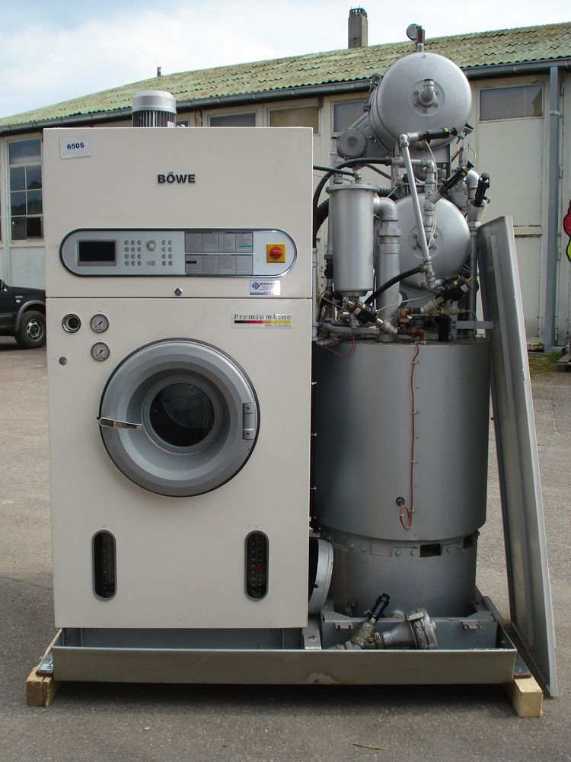
PHYSICAL MACHINE & PARTS
BÖWE P18 — complete physical machine
WHAT TO IDENTIFY
• Front drum module and CrossLine distillation section
• Control panel, gauges and loading-door position
• Use nameplate and serial number to confirm this installed variant
Physical-photo reference • verify installed configuration
BÖWE P18 | Physical Parts Atlas
003
Notes:
[Sources]
- Physical machine/component photograph: https://www.wotol.com/product/bowe-p-18-d-cl-dry-cleaning-machines/1687942
- BÖWE PremiumLine product information: https://bowe-germany.de/en/premiumline-multisolvent/
- BÖWE P12-P15-P18 Operating Manual (2018-02): https://www.ziermann.com/wp-content/uploads/2021/03/BA-Instruction-manual-BOeWE-P12-P15-P18-2018-02.pdf
Physical-photo reference only. Confirm the installed P18 configuration, serial number, OEM parts catalogue, approved site PTW/LOTO and approved risk assessment before work.

Slide 4
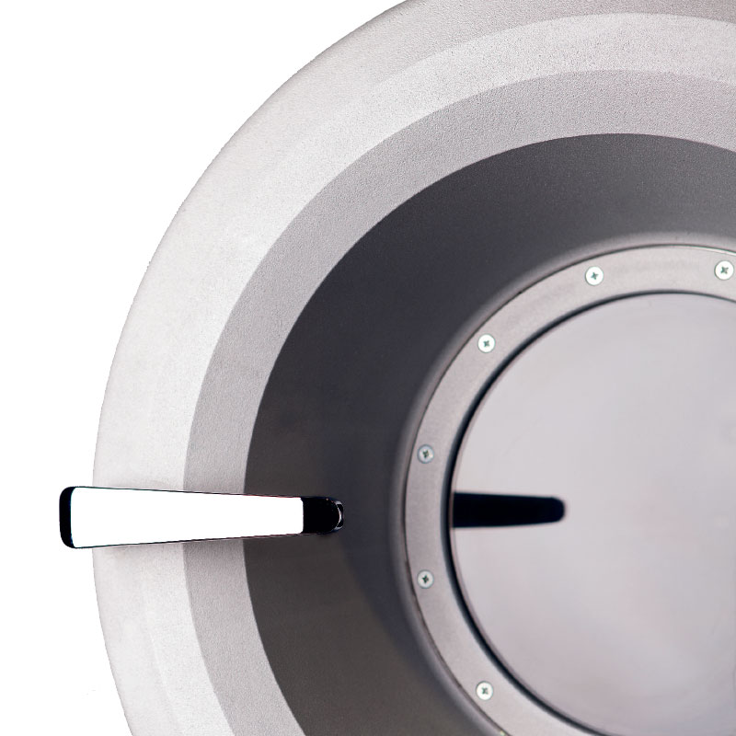
PHYSICAL MACHINE & PARTS
Loading door, seal and drum opening
WHAT TO IDENTIFY
• Inspect gasket condition and seating surface
• Check hinge, handle and interlock operation
• Never bypass the loading-door safety circuit
Physical-photo reference • verify installed configuration
BÖWE P18 | Physical Parts Atlas
004
Notes:
[Sources]
- Physical machine/component photograph: https://bowe-germany.de/en/premiumline-multisolvent/
- BÖWE PremiumLine product information: https://bowe-germany.de/en/premiumline-multisolvent/
- BÖWE P12-P15-P18 Operating Manual (2018-02): https://www.ziermann.com/wp-content/uploads/2021/03/BA-Instruction-manual-BOeWE-P12-P15-P18-2018-02.pdf
Physical-photo reference only. Confirm the installed P18 configuration, serial number, OEM parts catalogue, approved site PTW/LOTO and approved risk assessment before work.

Slide 5
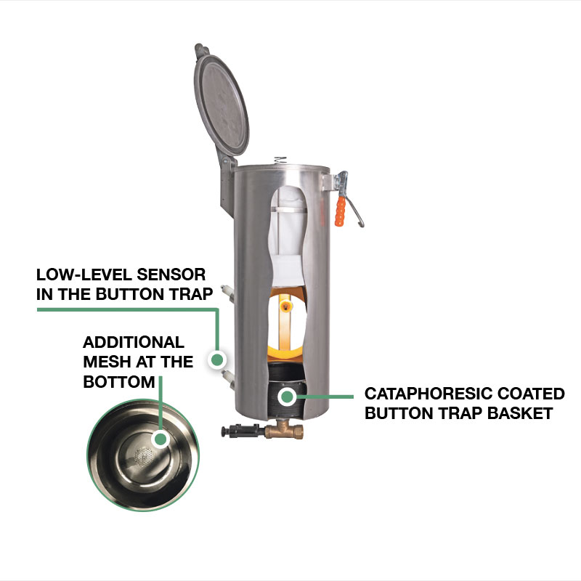
PHYSICAL MACHINE & PARTS
Lint filter — physical maintenance component
WHAT TO IDENTIFY
• Remove lint at the OEM/site interval
• Inspect mesh, seals and correct seating
• Restriction increases drying time and thermal load
Physical-photo reference • verify installed configuration
BÖWE P18 | Physical Parts Atlas
005
Notes:
[Sources]
- Physical machine/component photograph: https://bowe-germany.de/bowe-produkte/flusenfilter-und-nadelfaenger/
- BÖWE PremiumLine product information: https://bowe-germany.de/en/premiumline-multisolvent/
- BÖWE P12-P15-P18 Operating Manual (2018-02): https://www.ziermann.com/wp-content/uploads/2021/03/BA-Instruction-manual-BOeWE-P12-P15-P18-2018-02.pdf
Physical-photo reference only. Confirm the installed P18 configuration, serial number, OEM parts catalogue, approved site PTW/LOTO and approved risk assessment before work.

Slide 6
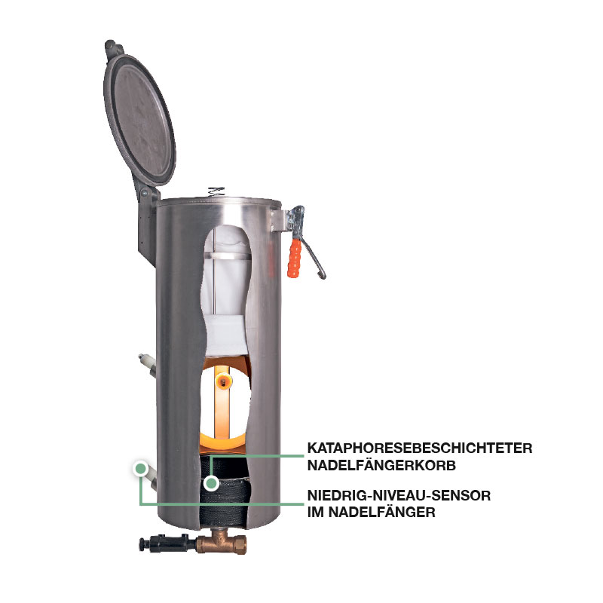
PHYSICAL MACHINE & PARTS
Button trap basket and low-level sensor
WHAT TO IDENTIFY
• Remove coins, needles, buttons and lint safely
• Inspect the additional bottom mesh
• Confirm basket seating and sensor condition before restart
Physical-photo reference • verify installed configuration
BÖWE P18 | Physical Parts Atlas
006
Notes:
[Sources]
- Physical machine/component photograph: https://bowe-germany.de/bowe-produkte/flusenfilter-und-nadelfaenger/
- BÖWE PremiumLine product information: https://bowe-germany.de/en/premiumline-multisolvent/
- BÖWE P12-P15-P18 Operating Manual (2018-02): https://www.ziermann.com/wp-content/uploads/2021/03/BA-Instruction-manual-BOeWE-P12-P15-P18-2018-02.pdf
Physical-photo reference only. Confirm the installed P18 configuration, serial number, OEM parts catalogue, approved site PTW/LOTO and approved risk assessment before work.

Slide 7
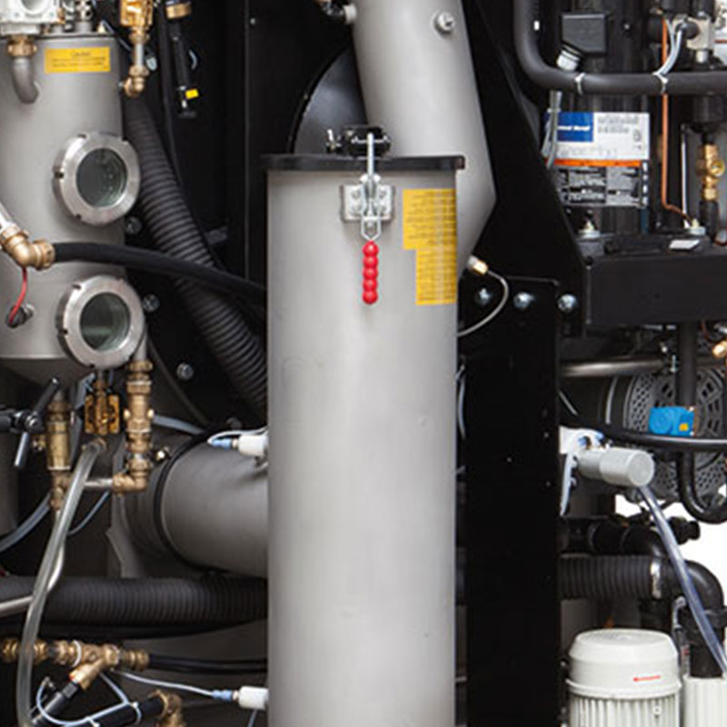
PHYSICAL MACHINE & PARTS
Lint filter and button-trap installed position
WHAT TO IDENTIFY
• Locate the assembly on the actual machine
• Identify connected hoses, valves and access clearances
• Isolate and verify safe condition before opening
Physical-photo reference • verify installed configuration
BÖWE P18 | Physical Parts Atlas
007
Notes:
[Sources]
- Physical machine/component photograph: https://bowe-germany.de/bowe-produkte/flusenfilter-und-nadelfaenger/
- BÖWE PremiumLine product information: https://bowe-germany.de/en/premiumline-multisolvent/
- BÖWE P12-P15-P18 Operating Manual (2018-02): https://www.ziermann.com/wp-content/uploads/2021/03/BA-Instruction-manual-BOeWE-P12-P15-P18-2018-02.pdf
Physical-photo reference only. Confirm the installed P18 configuration, serial number, OEM parts catalogue, approved site PTW/LOTO and approved risk assessment before work.

Slide 8
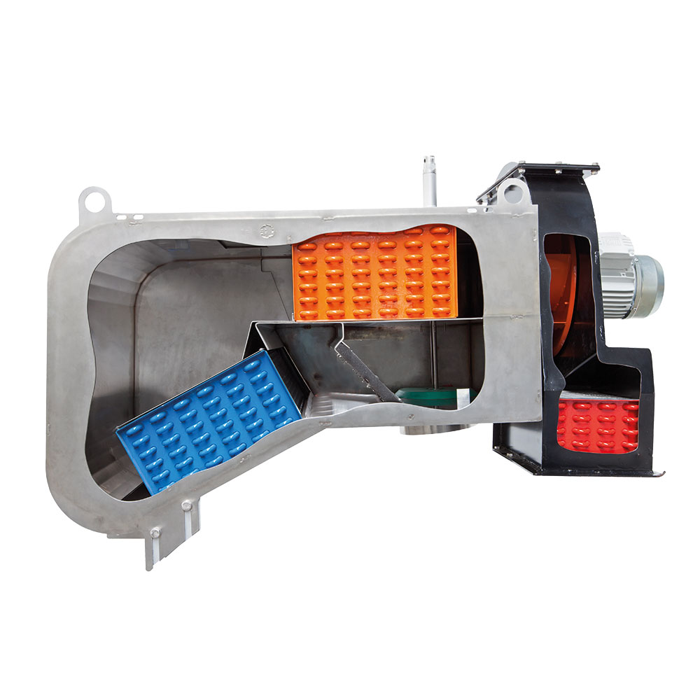
PHYSICAL MACHINE & PARTS
Air blower and drive assembly
WHAT TO IDENTIFY
• Inspect motor, fan housing and mountings
• Check abnormal noise, heat and vibration
• Verify guards and isolation before access
Physical-photo reference • verify installed configuration
BÖWE P18 | Physical Parts Atlas
008
Notes:
[Sources]
- Physical machine/component photograph: https://bowe-germany.de/en/premiumline-multisolvent/
- BÖWE PremiumLine product information: https://bowe-germany.de/en/premiumline-multisolvent/
- BÖWE P12-P15-P18 Operating Manual (2018-02): https://www.ziermann.com/wp-content/uploads/2021/03/BA-Instruction-manual-BOeWE-P12-P15-P18-2018-02.pdf
Physical-photo reference only. Confirm the installed P18 configuration, serial number, OEM parts catalogue, approved site PTW/LOTO and approved risk assessment before work.

Slide 9
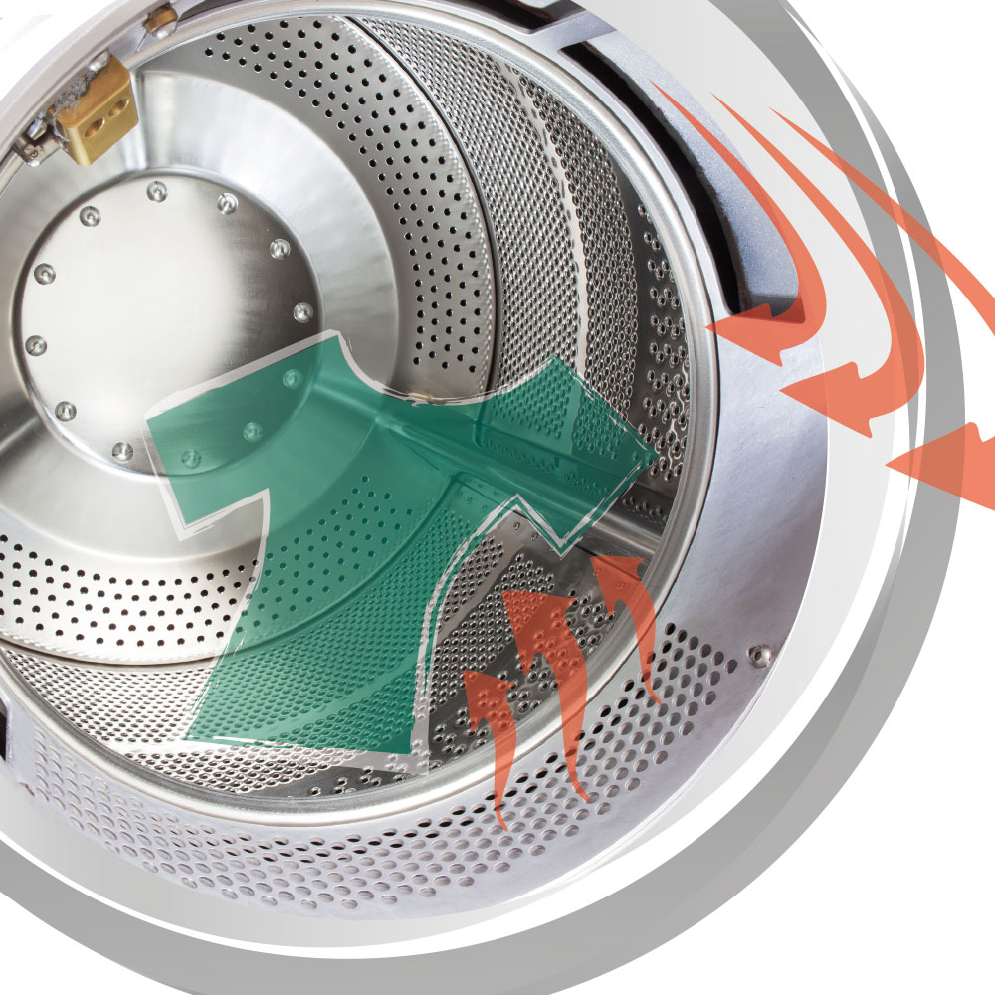
PHYSICAL MACHINE & PARTS
Dynamic drying-airflow components
WHAT TO IDENTIFY
• Trace airflow through filter, heater and recovery path
• Inspect flexible connections and sealing
• Poor airflow extends drying and solvent-recovery time
Physical-photo reference • verify installed configuration
BÖWE P18 | Physical Parts Atlas
009
Notes:
[Sources]
- Physical machine/component photograph: https://bowe-germany.de/en/premiumline-multisolvent/
- BÖWE PremiumLine product information: https://bowe-germany.de/en/premiumline-multisolvent/
- BÖWE P12-P15-P18 Operating Manual (2018-02): https://www.ziermann.com/wp-content/uploads/2021/03/BA-Instruction-manual-BOeWE-P12-P15-P18-2018-02.pdf
Physical-photo reference only. Confirm the installed P18 configuration, serial number, OEM parts catalogue, approved site PTW/LOTO and approved risk assessment before work.

Slide 10
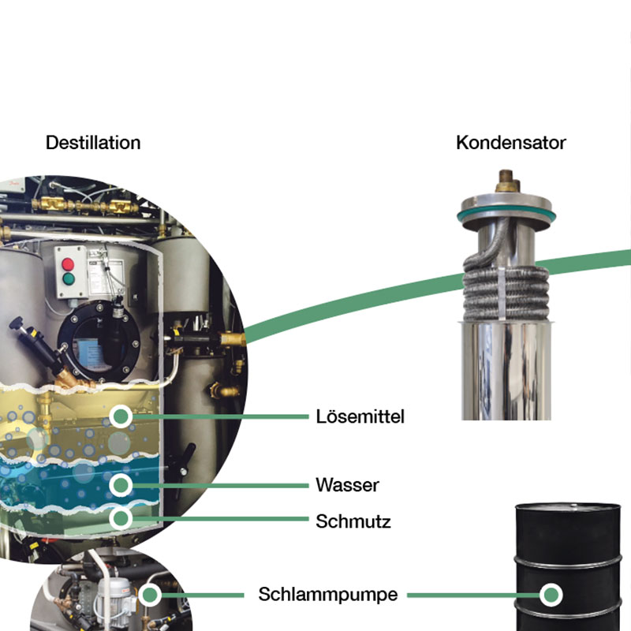
PHYSICAL MACHINE & PARTS
Distillation unit — physical assembly
WHAT TO IDENTIFY
• Identify still body, access and connected pipework
• Allow complete cooling before maintenance
• Residues require controlled hazardous-waste handling
Physical-photo reference • verify installed configuration
BÖWE P18 | Physical Parts Atlas
010
Notes:
[Sources]
- Physical machine/component photograph: https://bowe-germany.de/en/premiumline-multisolvent/
- BÖWE PremiumLine product information: https://bowe-germany.de/en/premiumline-multisolvent/
- BÖWE P12-P15-P18 Operating Manual (2018-02): https://www.ziermann.com/wp-content/uploads/2021/03/BA-Instruction-manual-BOeWE-P12-P15-P18-2018-02.pdf
Physical-photo reference only. Confirm the installed P18 configuration, serial number, OEM parts catalogue, approved site PTW/LOTO and approved risk assessment before work.

Slide 11
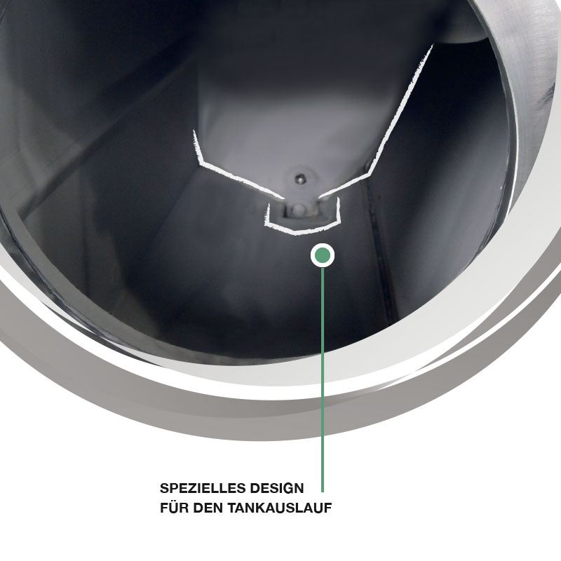
PHYSICAL MACHINE & PARTS
Self-cleaning solvent tank design
WHAT TO IDENTIFY
• Confirm tank duty using the installed schematic
• Inspect sight-glass, level sensing and leakage evidence
• Do not open or enter a tank without the approved procedure
Physical-photo reference • verify installed configuration
BÖWE P18 | Physical Parts Atlas
011
Notes:
[Sources]
- Physical machine/component photograph: https://bowe-germany.de/en/premiumline-multisolvent/
- BÖWE PremiumLine product information: https://bowe-germany.de/en/premiumline-multisolvent/
- BÖWE P12-P15-P18 Operating Manual (2018-02): https://www.ziermann.com/wp-content/uploads/2021/03/BA-Instruction-manual-BOeWE-P12-P15-P18-2018-02.pdf
Physical-photo reference only. Confirm the installed P18 configuration, serial number, OEM parts catalogue, approved site PTW/LOTO and approved risk assessment before work.

Slide 12
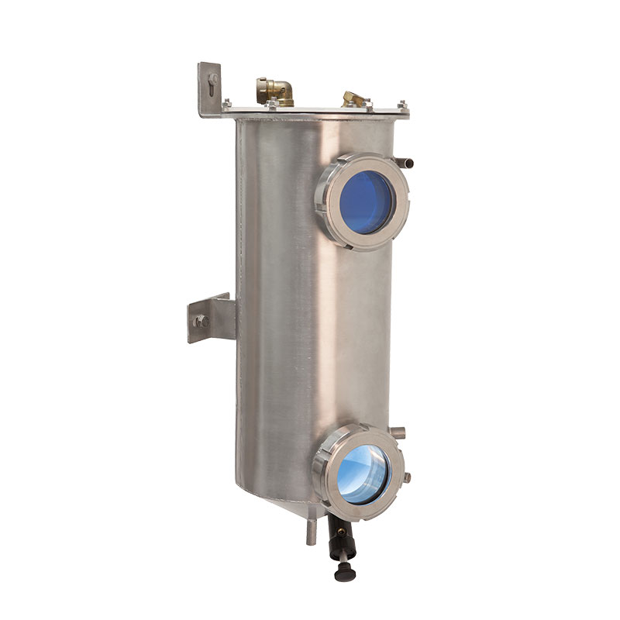
PHYSICAL MACHINE & PARTS
Water separator — physical component
WHAT TO IDENTIFY
• Inspect phase separation through the viewing area
• Check hoses, valves, sensor and signs of contamination
• Follow the automatic/manual maintenance sequence exactly
Physical-photo reference • verify installed configuration
BÖWE P18 | Physical Parts Atlas
012
Notes:
[Sources]
- Physical machine/component photograph: https://bowe-germany.de/en/premiumline-multisolvent/
- BÖWE PremiumLine product information: https://bowe-germany.de/en/premiumline-multisolvent/
- BÖWE P12-P15-P18 Operating Manual (2018-02): https://www.ziermann.com/wp-content/uploads/2021/03/BA-Instruction-manual-BOeWE-P12-P15-P18-2018-02.pdf
Physical-photo reference only. Confirm the installed P18 configuration, serial number, OEM parts catalogue, approved site PTW/LOTO and approved risk assessment before work.

Slide 13
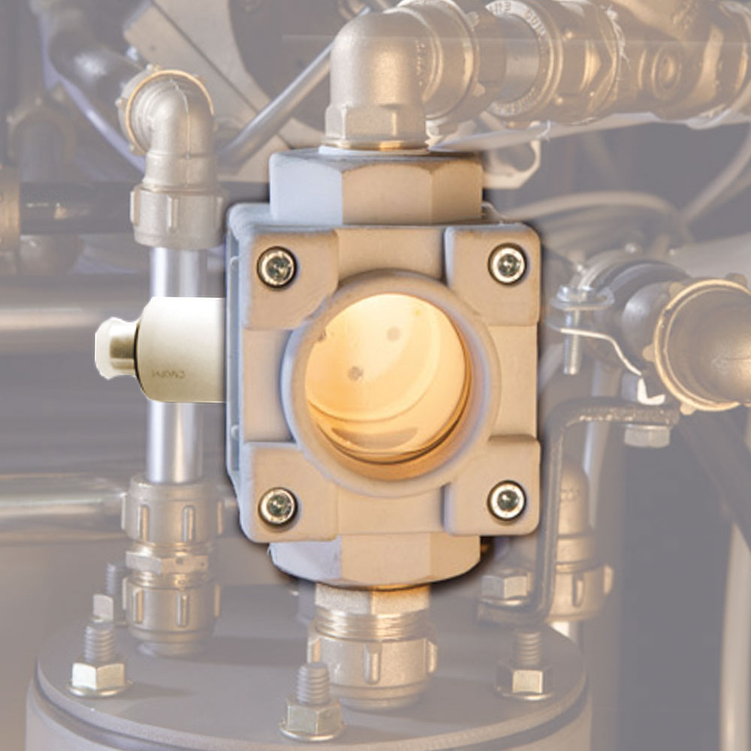
PHYSICAL MACHINE & PARTS
Drying controller capacitive sensor
WHAT TO IDENTIFY
• Keep the sensor face clean and correctly positioned
• Inspect cable and connector condition
• Confirm readings against cycle behaviour before replacement
Physical-photo reference • verify installed configuration
BÖWE P18 | Physical Parts Atlas
013
Notes:
[Sources]
- Physical machine/component photograph: https://bowe-germany.de/en/premiumline-multisolvent/
- BÖWE PremiumLine product information: https://bowe-germany.de/en/premiumline-multisolvent/
- BÖWE P12-P15-P18 Operating Manual (2018-02): https://www.ziermann.com/wp-content/uploads/2021/03/BA-Instruction-manual-BOeWE-P12-P15-P18-2018-02.pdf
Physical-photo reference only. Confirm the installed P18 configuration, serial number, OEM parts catalogue, approved site PTW/LOTO and approved risk assessment before work.

Slide 14
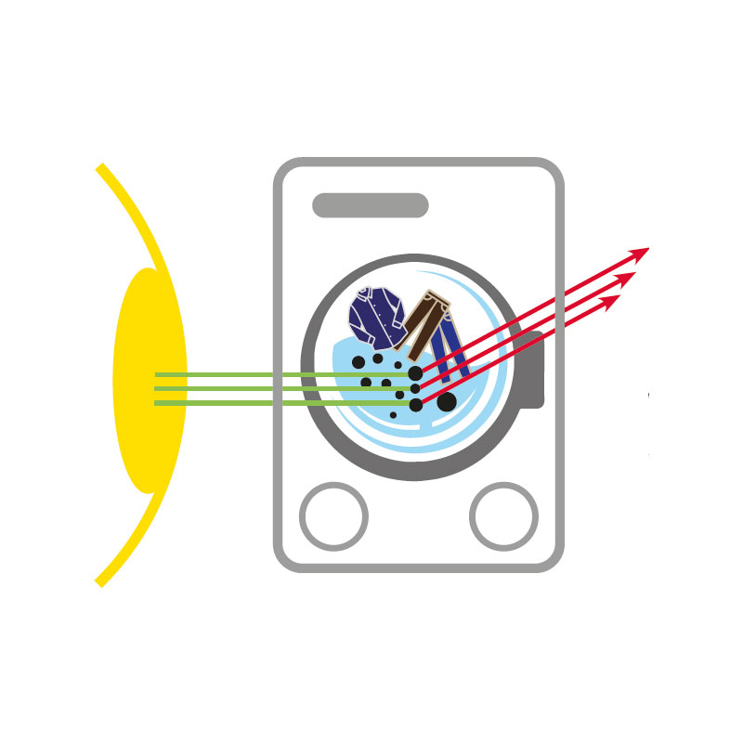
PHYSICAL MACHINE & PARTS
Solvent turbidity measurement component
WHAT TO IDENTIFY
• Keep optical surfaces clean
• Trend readings with solvent condition and filtration
• Verify calibration/diagnostic evidence before condemning the sensor
Physical-photo reference • verify installed configuration
BÖWE P18 | Physical Parts Atlas
014
Notes:
[Sources]
- Physical machine/component photograph: https://bowe-germany.de/en/premiumline-multisolvent/
- BÖWE PremiumLine product information: https://bowe-germany.de/en/premiumline-multisolvent/
- BÖWE P12-P15-P18 Operating Manual (2018-02): https://www.ziermann.com/wp-content/uploads/2021/03/BA-Instruction-manual-BOeWE-P12-P15-P18-2018-02.pdf
Physical-photo reference only. Confirm the installed P18 configuration, serial number, OEM parts catalogue, approved site PTW/LOTO and approved risk assessment before work.

Slide 15
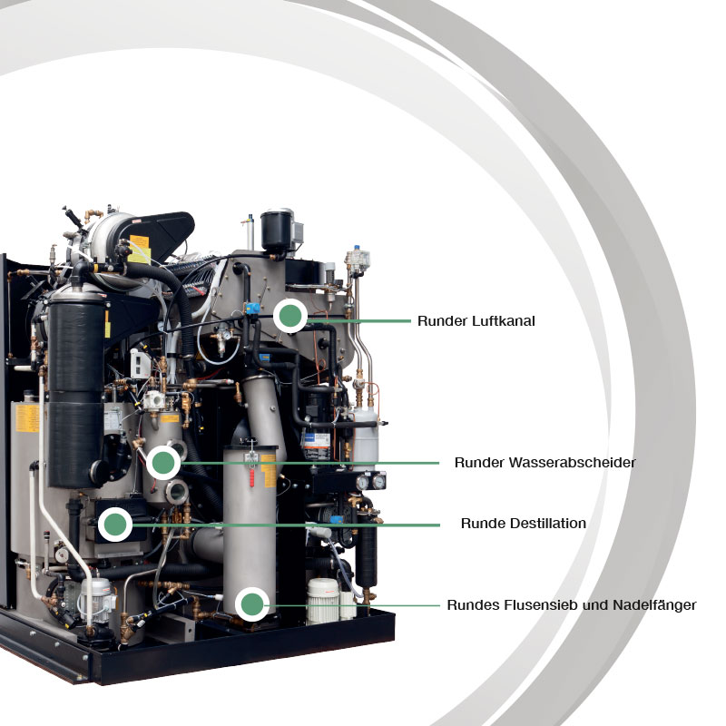
PHYSICAL MACHINE & PARTS
Maintenance access — components behind panels
WHAT TO IDENTIFY
• Remove panels only after verified isolation
• Maintain clear access and good housekeeping
• Reinstall guards, covers and fasteners before test run
Physical-photo reference • verify installed configuration
BÖWE P18 | Physical Parts Atlas
015
Notes:
[Sources]
- Physical machine/component photograph: https://bowe-germany.de/en/premiumline-multisolvent/
- BÖWE PremiumLine product information: https://bowe-germany.de/en/premiumline-multisolvent/
- BÖWE P12-P15-P18 Operating Manual (2018-02): https://www.ziermann.com/wp-content/uploads/2021/03/BA-Instruction-manual-BOeWE-P12-P15-P18-2018-02.pdf
Physical-photo reference only. Confirm the installed P18 configuration, serial number, OEM parts catalogue, approved site PTW/LOTO and approved risk assessment before work.

Slide 16
SECTION 01
Orientation
Build understanding first; then apply it safely on the installed machine.
016
Notes:
[Sources]
- BÖWE P12-P15-P18 Operating Manual (2018-02), pages 5-7: https://www.ziermann.com/wp-content/uploads/2021/03/BA-Instruction-manual-BOeWE-P12-P15-P18-2018-02.pdf
- BÖWE P12-P15-P18 Spare Parts Catalogue: https://www.bowe-webshop.com/images/P12-P15-P18%20ET%20D%2BE%202003-06%20eckiger%20Luftschacht.pdf
Training interpretation: confirm the installed machine, current OEM revision, approved site PTW/LOTO, SDS and approved risk assessment before work.

Slide 17
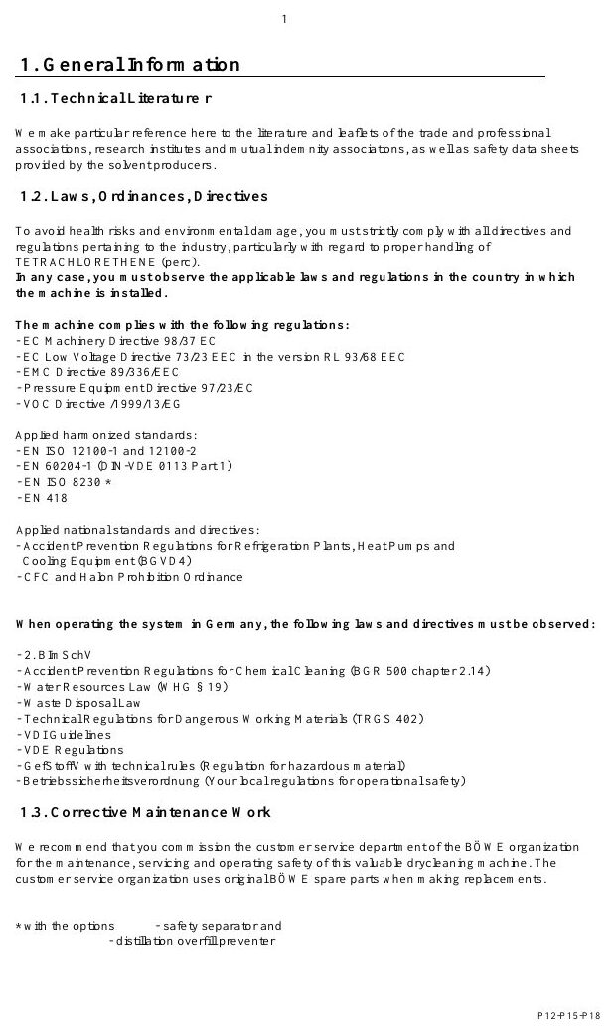
ORIENTATION
How to use this training deck
MACHINE / SYSTEM VIEW
Locate the machine area first, then connect the visible components to the operating sequence.
• Validate all decisions against the installed machine and current controlled documents.
• Capture questions and configuration gaps before practical assessment.
Machine / system reference • operating manual page 9
BÖWE P18 | Orientation
017
Notes:
[Sources]
- BÖWE P12-P15-P18 Operating Manual (2018-02), pages 5-7: https://www.ziermann.com/wp-content/uploads/2021/03/BA-Instruction-manual-BOeWE-P12-P15-P18-2018-02.pdf
- BÖWE P12-P15-P18 Spare Parts Catalogue: https://www.bowe-webshop.com/images/P12-P15-P18%20ET%20D%2BE%202003-06%20eckiger%20Luftschacht.pdf
- Practical visual: BÖWE P12-P15-P18 Operating Manual (2018-02), PDF page 9
Training interpretation: confirm the installed machine, current OEM revision, approved site PTW/LOTO, SDS and approved risk assessment before work.

Slide 18
ORIENTATION
Learning outcomes for technicians
Use this topic to connect learning outcomes for technicians with safe daily work.
WHAT TO VERIFY
01 Validate all decisions against the installed machine and current controlled documents.
02 Capture questions and configuration gaps before practical assessment.
BÖWE P18 | Orientation
018
Notes:
[Sources]
- BÖWE P12-P15-P18 Operating Manual (2018-02), pages 5-7: https://www.ziermann.com/wp-content/uploads/2021/03/BA-Instruction-manual-BOeWE-P12-P15-P18-2018-02.pdf
- BÖWE P12-P15-P18 Spare Parts Catalogue: https://www.bowe-webshop.com/images/P12-P15-P18%20ET%20D%2BE%202003-06%20eckiger%20Luftschacht.pdf
Training interpretation: confirm the installed machine, current OEM revision, approved site PTW/LOTO, SDS and approved risk assessment before work.

Slide 19

ORIENTATION
Training scope and limitations
MACHINE / SYSTEM VIEW
Locate the machine area first, then connect the visible components to the operating sequence.
• Validate all decisions against the installed machine and current controlled documents.
• Capture questions and configuration gaps before practical assessment.
Machine / system reference • operating manual page 14
BÖWE P18 | Orientation
019
Notes:
[Sources]
- BÖWE P12-P15-P18 Operating Manual (2018-02), pages 5-7: https://www.ziermann.com/wp-content/uploads/2021/03/BA-Instruction-manual-BOeWE-P12-P15-P18-2018-02.pdf
- BÖWE P12-P15-P18 Spare Parts Catalogue: https://www.bowe-webshop.com/images/P12-P15-P18%20ET%20D%2BE%202003-06%20eckiger%20Luftschacht.pdf
- Practical visual: BÖWE P12-P15-P18 Operating Manual (2018-02), PDF page 14
Training interpretation: confirm the installed machine, current OEM revision, approved site PTW/LOTO, SDS and approved risk assessment before work.

Slide 20
ORIENTATION
Machine identity and serial-number control
• Use this topic to connect machine identity and serial-number control with safe daily work.
• Validate all decisions against the installed machine and current controlled documents.
• Capture questions and configuration gaps before practical assessment.
TECHNICIAN CHECK
Can I locate it?
Can I verify it?
Can I make it safe?
Can I document closure?
BÖWE P18 | Orientation
020
Notes:
[Sources]
- BÖWE P12-P15-P18 Operating Manual (2018-02), pages 5-7: https://www.ziermann.com/wp-content/uploads/2021/03/BA-Instruction-manual-BOeWE-P12-P15-P18-2018-02.pdf
- BÖWE P12-P15-P18 Spare Parts Catalogue: https://www.bowe-webshop.com/images/P12-P15-P18%20ET%20D%2BE%202003-06%20eckiger%20Luftschacht.pdf
Training interpretation: confirm the installed machine, current OEM revision, approved site PTW/LOTO, SDS and approved risk assessment before work.

Slide 21
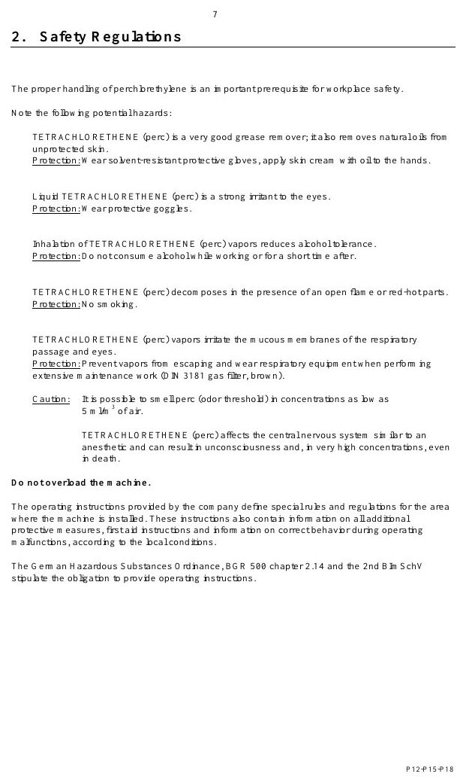
ORIENTATION
Documentation hierarchy and revision control
MACHINE / SYSTEM VIEW
Locate the machine area first, then connect the visible components to the operating sequence.
• Validate all decisions against the installed machine and current controlled documents.
• Capture questions and configuration gaps before practical assessment.
Machine / system reference • operating manual page 15
BÖWE P18 | Orientation
021
Notes:
[Sources]
- BÖWE P12-P15-P18 Operating Manual (2018-02), pages 5-7: https://www.ziermann.com/wp-content/uploads/2021/03/BA-Instruction-manual-BOeWE-P12-P15-P18-2018-02.pdf
- BÖWE P12-P15-P18 Spare Parts Catalogue: https://www.bowe-webshop.com/images/P12-P15-P18%20ET%20D%2BE%202003-06%20eckiger%20Luftschacht.pdf
- Practical visual: BÖWE P12-P15-P18 Operating Manual (2018-02), PDF page 15
Training interpretation: confirm the installed machine, current OEM revision, approved site PTW/LOTO, SDS and approved risk assessment before work.

Slide 22
SECTION 02
Safety
Build understanding first; then apply it safely on the installed machine.
022
Notes:
[Sources]
- BÖWE P12-P15-P18 Operating Manual (2018-02), pages 8-13: https://www.ziermann.com/wp-content/uploads/2021/03/BA-Instruction-manual-BOeWE-P12-P15-P18-2018-02.pdf
- BÖWE P12-P15-P18 Spare Parts Catalogue: https://www.bowe-webshop.com/images/P12-P15-P18%20ET%20D%2BE%202003-06%20eckiger%20Luftschacht.pdf
Training interpretation: confirm the installed machine, current OEM revision, approved site PTW/LOTO, SDS and approved risk assessment before work.

Slide 23
SAFETY
Safety begins before the machine starts
• Recognize how safety begins before the machine starts can affect people, equipment and the environment.
• Apply the hierarchy of controls: eliminate exposure, isolate energy, verify and protect.
• Stop and escalate whenever the safe condition cannot be confirmed.
TECHNICIAN CHECK
Can I locate it?
Can I verify it?
Can I make it safe?
Can I document closure?
BÖWE P18 | Safety
023
Notes:
[Sources]
- BÖWE P12-P15-P18 Operating Manual (2018-02), pages 8-13: https://www.ziermann.com/wp-content/uploads/2021/03/BA-Instruction-manual-BOeWE-P12-P15-P18-2018-02.pdf
- BÖWE P12-P15-P18 Spare Parts Catalogue: https://www.bowe-webshop.com/images/P12-P15-P18%20ET%20D%2BE%202003-06%20eckiger%20Luftschacht.pdf
Training interpretation: confirm the installed machine, current OEM revision, approved site PTW/LOTO, SDS and approved risk assessment before work.

Slide 24
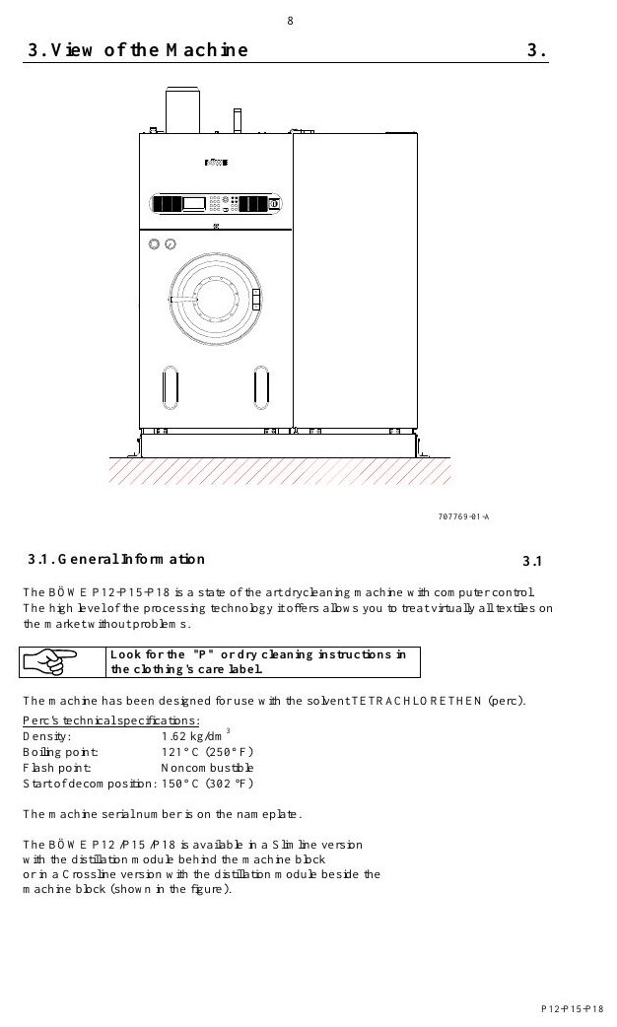
SAFETY
Authorized use defines the safe operating envelope
MACHINE / SYSTEM VIEW
Locate the machine area first, then connect the visible components to the operating sequence.
• Apply the hierarchy of controls: eliminate exposure, isolate energy, verify and protect.
• Stop and escalate whenever the safe condition cannot be confirmed.
Machine / system reference • operating manual page 16
BÖWE P18 | Safety
024
Notes:
[Sources]
- BÖWE P12-P15-P18 Operating Manual (2018-02), pages 8-13: https://www.ziermann.com/wp-content/uploads/2021/03/BA-Instruction-manual-BOeWE-P12-P15-P18-2018-02.pdf
- BÖWE P12-P15-P18 Spare Parts Catalogue: https://www.bowe-webshop.com/images/P12-P15-P18%20ET%20D%2BE%202003-06%20eckiger%20Luftschacht.pdf
- Practical visual: BÖWE P12-P15-P18 Operating Manual (2018-02), PDF page 16
Training interpretation: confirm the installed machine, current OEM revision, approved site PTW/LOTO, SDS and approved risk assessment before work.

Slide 25
SAFETY
Only trained personnel may operate or maintain the machine
WHY IT MATTERS
SAFE EXECUTION
Recognize how only trained personnel may operate or maintain the machine can affect people, equipment and the environment.
• Apply the hierarchy of controls: eliminate exposure, isolate energy, verify and protect.
• Stop and escalate whenever the safe condition cannot be confirmed.
BÖWE P18 | Safety
025
Notes:
[Sources]
- BÖWE P12-P15-P18 Operating Manual (2018-02), pages 8-13: https://www.ziermann.com/wp-content/uploads/2021/03/BA-Instruction-manual-BOeWE-P12-P15-P18-2018-02.pdf
- BÖWE P12-P15-P18 Spare Parts Catalogue: https://www.bowe-webshop.com/images/P12-P15-P18%20ET%20D%2BE%202003-06%20eckiger%20Luftschacht.pdf
Training interpretation: confirm the installed machine, current OEM revision, approved site PTW/LOTO, SDS and approved risk assessment before work.

Slide 26
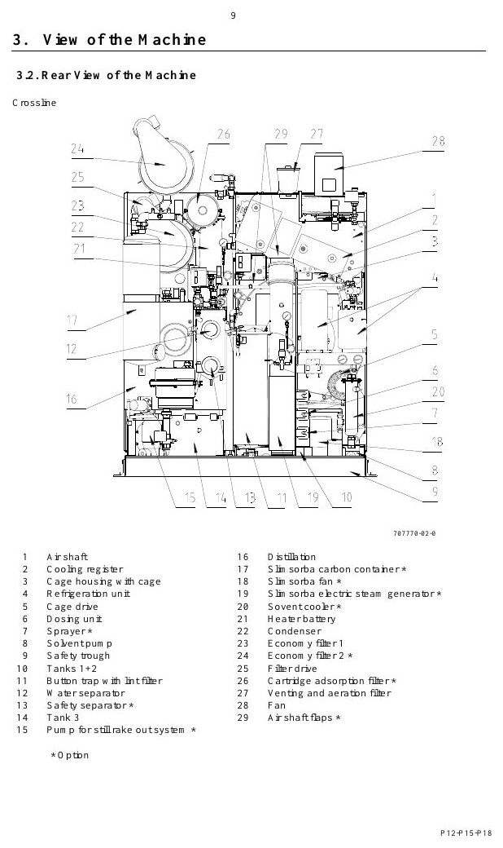
SAFETY
PPE must match the solvent and task
MACHINE / SYSTEM VIEW
Locate the machine area first, then connect the visible components to the operating sequence.
• Apply the hierarchy of controls: eliminate exposure, isolate energy, verify and protect.
• Stop and escalate whenever the safe condition cannot be confirmed.
Machine / system reference • operating manual page 17
BÖWE P18 | Safety
026
Notes:
[Sources]
- BÖWE P12-P15-P18 Operating Manual (2018-02), pages 8-13: https://www.ziermann.com/wp-content/uploads/2021/03/BA-Instruction-manual-BOeWE-P12-P15-P18-2018-02.pdf
- BÖWE P12-P15-P18 Spare Parts Catalogue: https://www.bowe-webshop.com/images/P12-P15-P18%20ET%20D%2BE%202003-06%20eckiger%20Luftschacht.pdf
- Practical visual: BÖWE P12-P15-P18 Operating Manual (2018-02), PDF page 17
Training interpretation: confirm the installed machine, current OEM revision, approved site PTW/LOTO, SDS and approved risk assessment before work.

Slide 27
SAFETY
Ventilation controls routine solvent exposure
Recognize how ventilation controls routine solvent exposure can affect people, equipment and the environment.
WHAT TO VERIFY
01 Apply the hierarchy of controls: eliminate exposure, isolate energy, verify and protect.
02 Stop and escalate whenever the safe condition cannot be confirmed.
BÖWE P18 | Safety
027
Notes:
[Sources]
- BÖWE P12-P15-P18 Operating Manual (2018-02), pages 8-13: https://www.ziermann.com/wp-content/uploads/2021/03/BA-Instruction-manual-BOeWE-P12-P15-P18-2018-02.pdf
- BÖWE P12-P15-P18 Spare Parts Catalogue: https://www.bowe-webshop.com/images/P12-P15-P18%20ET%20D%2BE%202003-06%20eckiger%20Luftschacht.pdf
Training interpretation: confirm the installed machine, current OEM revision, approved site PTW/LOTO, SDS and approved risk assessment before work.

Slide 28
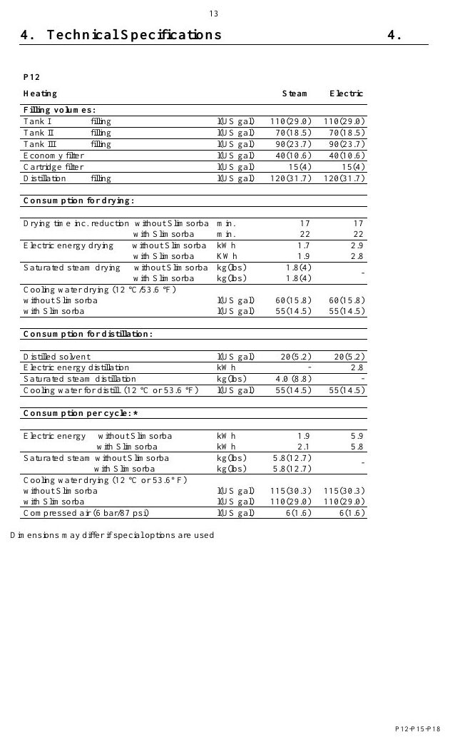
SAFETY
Loading-door venting protects the operator
MACHINE / SYSTEM VIEW
Locate the machine area first, then connect the visible components to the operating sequence.
• Apply the hierarchy of controls: eliminate exposure, isolate energy, verify and protect.
• Stop and escalate whenever the safe condition cannot be confirmed.
Machine / system reference • operating manual page 21
BÖWE P18 | Safety
028
Notes:
[Sources]
- BÖWE P12-P15-P18 Operating Manual (2018-02), pages 8-13: https://www.ziermann.com/wp-content/uploads/2021/03/BA-Instruction-manual-BOeWE-P12-P15-P18-2018-02.pdf
- BÖWE P12-P15-P18 Spare Parts Catalogue: https://www.bowe-webshop.com/images/P12-P15-P18%20ET%20D%2BE%202003-06%20eckiger%20Luftschacht.pdf
- Practical visual: BÖWE P12-P15-P18 Operating Manual (2018-02), PDF page 21
Training interpretation: confirm the installed machine, current OEM revision, approved site PTW/LOTO, SDS and approved risk assessment before work.

Slide 29
SAFETY
Guards and interlocks must never be bypassed
• Recognize how guards and interlocks must never be bypassed can affect people, equipment and the environment.
• Apply the hierarchy of controls: eliminate exposure, isolate energy, verify and protect.
• Stop and escalate whenever the safe condition cannot be confirmed.
TECHNICIAN CHECK
Can I locate it?
Can I verify it?
Can I make it safe?
Can I document closure?
BÖWE P18 | Safety
029
Notes:
[Sources]
- BÖWE P12-P15-P18 Operating Manual (2018-02), pages 8-13: https://www.ziermann.com/wp-content/uploads/2021/03/BA-Instruction-manual-BOeWE-P12-P15-P18-2018-02.pdf
- BÖWE P12-P15-P18 Spare Parts Catalogue: https://www.bowe-webshop.com/images/P12-P15-P18%20ET%20D%2BE%202003-06%20eckiger%20Luftschacht.pdf
Training interpretation: confirm the installed machine, current OEM revision, approved site PTW/LOTO, SDS and approved risk assessment before work.

Slide 30
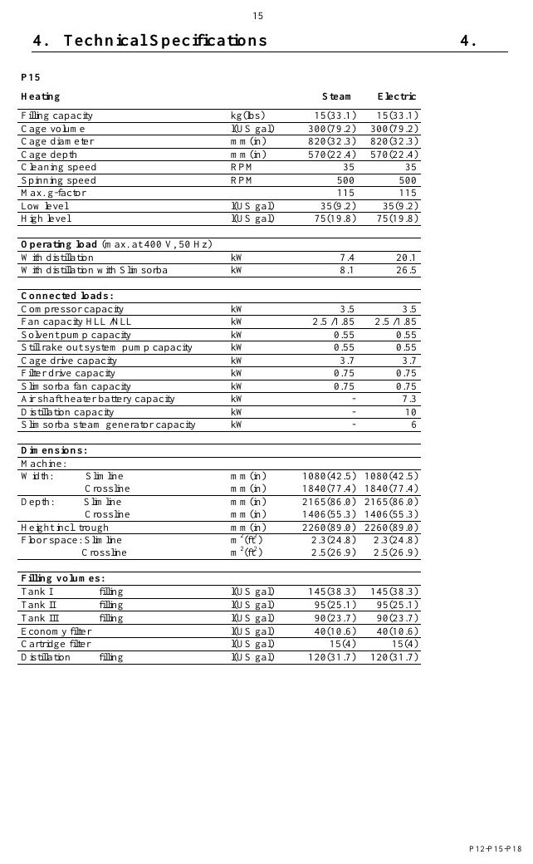
SAFETY
Electrical isolation requires lockout and verification
MACHINE / SYSTEM VIEW
Locate the machine area first, then connect the visible components to the operating sequence.
• Apply the hierarchy of controls: eliminate exposure, isolate energy, verify and protect.
• Stop and escalate whenever the safe condition cannot be confirmed.
Machine / system reference • operating manual page 23
BÖWE P18 | Safety
030
Notes:
[Sources]
- BÖWE P12-P15-P18 Operating Manual (2018-02), pages 8-13: https://www.ziermann.com/wp-content/uploads/2021/03/BA-Instruction-manual-BOeWE-P12-P15-P18-2018-02.pdf
- BÖWE P12-P15-P18 Spare Parts Catalogue: https://www.bowe-webshop.com/images/P12-P15-P18%20ET%20D%2BE%202003-06%20eckiger%20Luftschacht.pdf
- Practical visual: BÖWE P12-P15-P18 Operating Manual (2018-02), PDF page 23
Training interpretation: confirm the installed machine, current OEM revision, approved site PTW/LOTO, SDS and approved risk assessment before work.

Slide 31
SAFETY
Steam isolation must remove pressure and heat
WHY IT MATTERS
SAFE EXECUTION
Recognize how steam isolation must remove pressure and heat can affect people, equipment and the environment.
• Apply the hierarchy of controls: eliminate exposure, isolate energy, verify and protect.
• Stop and escalate whenever the safe condition cannot be confirmed.
BÖWE P18 | Safety
031
Notes:
[Sources]
- BÖWE P12-P15-P18 Operating Manual (2018-02), pages 8-13: https://www.ziermann.com/wp-content/uploads/2021/03/BA-Instruction-manual-BOeWE-P12-P15-P18-2018-02.pdf
- BÖWE P12-P15-P18 Spare Parts Catalogue: https://www.bowe-webshop.com/images/P12-P15-P18%20ET%20D%2BE%202003-06%20eckiger%20Luftschacht.pdf
Training interpretation: confirm the installed machine, current OEM revision, approved site PTW/LOTO, SDS and approved risk assessment before work.

Slide 32
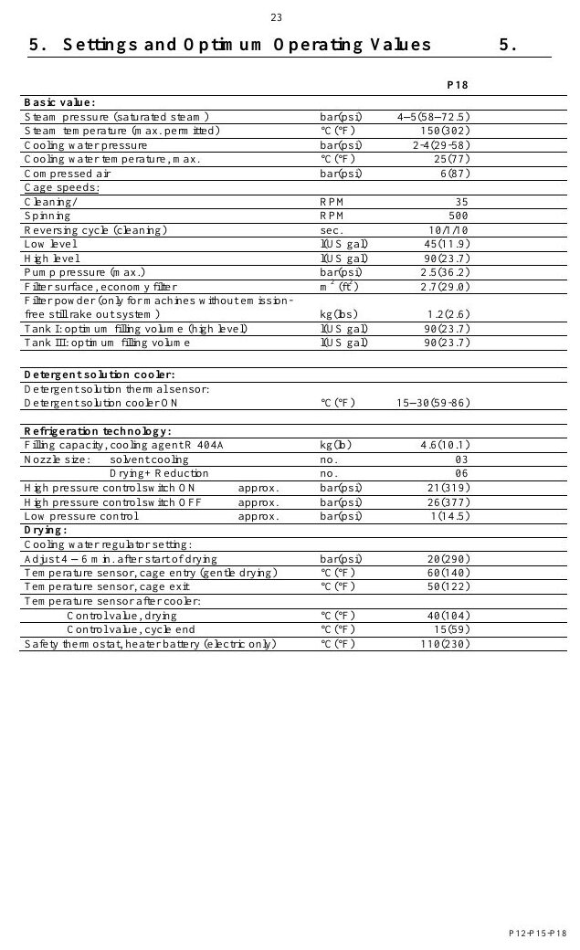
SAFETY
Compressed air stores hazardous energy
MACHINE / SYSTEM VIEW
Locate the machine area first, then connect the visible components to the operating sequence.
• Apply the hierarchy of controls: eliminate exposure, isolate energy, verify and protect.
• Stop and escalate whenever the safe condition cannot be confirmed.
Machine / system reference • operating manual page 31
BÖWE P18 | Safety
032
Notes:
[Sources]
- BÖWE P12-P15-P18 Operating Manual (2018-02), pages 8-13: https://www.ziermann.com/wp-content/uploads/2021/03/BA-Instruction-manual-BOeWE-P12-P15-P18-2018-02.pdf
- BÖWE P12-P15-P18 Spare Parts Catalogue: https://www.bowe-webshop.com/images/P12-P15-P18%20ET%20D%2BE%202003-06%20eckiger%20Luftschacht.pdf
- Practical visual: BÖWE P12-P15-P18 Operating Manual (2018-02), PDF page 31
Training interpretation: confirm the installed machine, current OEM revision, approved site PTW/LOTO, SDS and approved risk assessment before work.

Slide 33
SAFETY
Refrigeration circuits require specialist competence
Recognize how refrigeration circuits require specialist competence can affect people, equipment and the environment.
WHAT TO VERIFY
01 Apply the hierarchy of controls: eliminate exposure, isolate energy, verify and protect.
02 Stop and escalate whenever the safe condition cannot be confirmed.
BÖWE P18 | Safety
033
Notes:
[Sources]
- BÖWE P12-P15-P18 Operating Manual (2018-02), pages 8-13: https://www.ziermann.com/wp-content/uploads/2021/03/BA-Instruction-manual-BOeWE-P12-P15-P18-2018-02.pdf
- BÖWE P12-P15-P18 Spare Parts Catalogue: https://www.bowe-webshop.com/images/P12-P15-P18%20ET%20D%2BE%202003-06%20eckiger%20Luftschacht.pdf
Training interpretation: confirm the installed machine, current OEM revision, approved site PTW/LOTO, SDS and approved risk assessment before work.

Slide 34
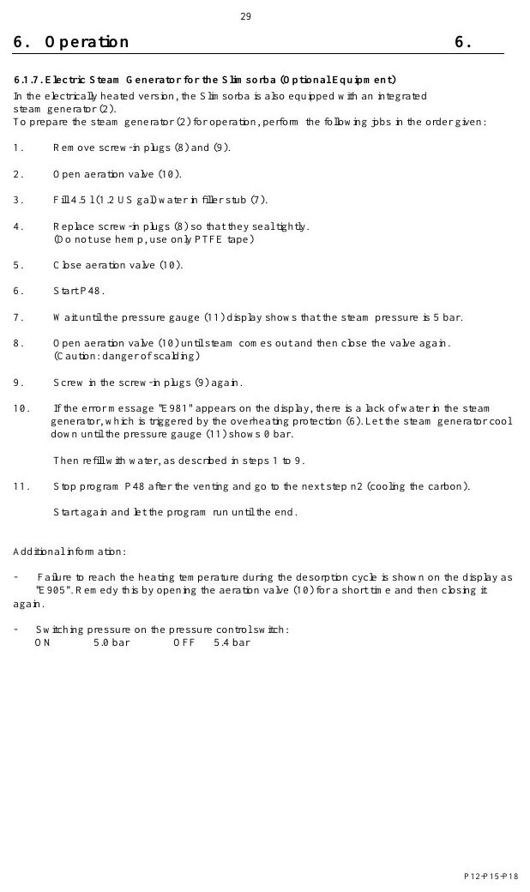
SAFETY
Hot surfaces remain hazardous after shutdown
MACHINE / SYSTEM VIEW
Locate the machine area first, then connect the visible components to the operating sequence.
• Apply the hierarchy of controls: eliminate exposure, isolate energy, verify and protect.
• Stop and escalate whenever the safe condition cannot be confirmed.
Machine / system reference • operating manual page 37
BÖWE P18 | Safety
034
Notes:
[Sources]
- BÖWE P12-P15-P18 Operating Manual (2018-02), pages 8-13: https://www.ziermann.com/wp-content/uploads/2021/03/BA-Instruction-manual-BOeWE-P12-P15-P18-2018-02.pdf
- BÖWE P12-P15-P18 Spare Parts Catalogue: https://www.bowe-webshop.com/images/P12-P15-P18%20ET%20D%2BE%202003-06%20eckiger%20Luftschacht.pdf
- Practical visual: BÖWE P12-P15-P18 Operating Manual (2018-02), PDF page 37
Training interpretation: confirm the installed machine, current OEM revision, approved site PTW/LOTO, SDS and approved risk assessment before work.

Slide 35
SAFETY
Solvent spills require immediate controlled response
• Recognize how solvent spills require immediate controlled response can affect people, equipment and the environment.
• Apply the hierarchy of controls: eliminate exposure, isolate energy, verify and protect.
• Stop and escalate whenever the safe condition cannot be confirmed.
TECHNICIAN CHECK
Can I locate it?
Can I verify it?
Can I make it safe?
Can I document closure?
BÖWE P18 | Safety
035
Notes:
[Sources]
- BÖWE P12-P15-P18 Operating Manual (2018-02), pages 8-13: https://www.ziermann.com/wp-content/uploads/2021/03/BA-Instruction-manual-BOeWE-P12-P15-P18-2018-02.pdf
- BÖWE P12-P15-P18 Spare Parts Catalogue: https://www.bowe-webshop.com/images/P12-P15-P18%20ET%20D%2BE%202003-06%20eckiger%20Luftschacht.pdf
Training interpretation: confirm the installed machine, current OEM revision, approved site PTW/LOTO, SDS and approved risk assessment before work.

Slide 36
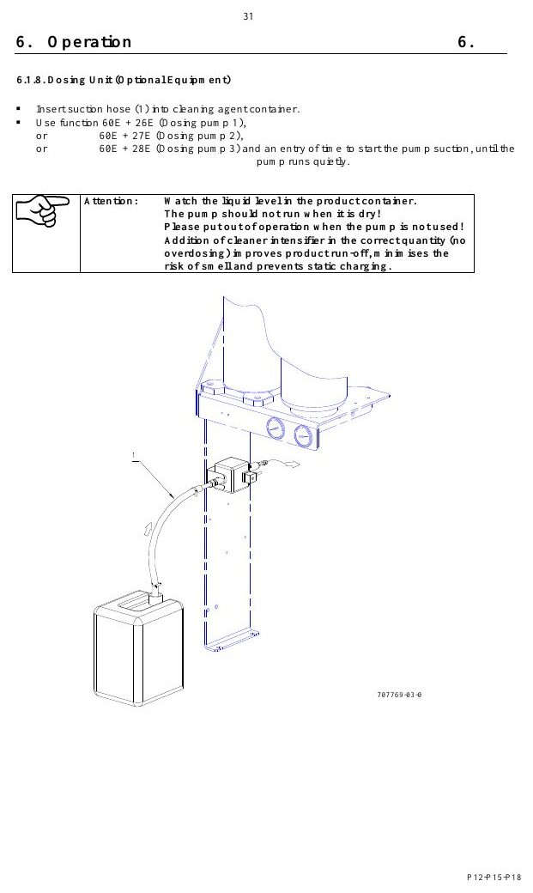
SAFETY
Still residues and process water need compliant disposal
MACHINE / SYSTEM VIEW
Locate the machine area first, then connect the visible components to the operating sequence.
• Apply the hierarchy of controls: eliminate exposure, isolate energy, verify and protect.
• Stop and escalate whenever the safe condition cannot be confirmed.
Machine / system reference • operating manual page 39
BÖWE P18 | Safety
036
Notes:
[Sources]
- BÖWE P12-P15-P18 Operating Manual (2018-02), pages 8-13: https://www.ziermann.com/wp-content/uploads/2021/03/BA-Instruction-manual-BOeWE-P12-P15-P18-2018-02.pdf
- BÖWE P12-P15-P18 Spare Parts Catalogue: https://www.bowe-webshop.com/images/P12-P15-P18%20ET%20D%2BE%202003-06%20eckiger%20Luftschacht.pdf
- Practical visual: BÖWE P12-P15-P18 Operating Manual (2018-02), PDF page 39
Training interpretation: confirm the installed machine, current OEM revision, approved site PTW/LOTO, SDS and approved risk assessment before work.

Slide 37
SAFETY
Emergency response must be understood before work
WHY IT MATTERS
SAFE EXECUTION
Recognize how emergency response must be understood before work can affect people, equipment and the environment.
• Apply the hierarchy of controls: eliminate exposure, isolate energy, verify and protect.
• Stop and escalate whenever the safe condition cannot be confirmed.
BÖWE P18 | Safety
037
Notes:
[Sources]
- BÖWE P12-P15-P18 Operating Manual (2018-02), pages 8-13: https://www.ziermann.com/wp-content/uploads/2021/03/BA-Instruction-manual-BOeWE-P12-P15-P18-2018-02.pdf
- BÖWE P12-P15-P18 Spare Parts Catalogue: https://www.bowe-webshop.com/images/P12-P15-P18%20ET%20D%2BE%202003-06%20eckiger%20Luftschacht.pdf
Training interpretation: confirm the installed machine, current OEM revision, approved site PTW/LOTO, SDS and approved risk assessment before work.

Slide 38
SECTION 03
Construction
Build understanding first; then apply it safely on the installed machine.
038
Notes:
[Sources]
- BÖWE P12-P15-P18 Operating Manual (2018-02), pages 14-22: https://www.ziermann.com/wp-content/uploads/2021/03/BA-Instruction-manual-BOeWE-P12-P15-P18-2018-02.pdf
- BÖWE P12-P15-P18 Spare Parts Catalogue: https://www.bowe-webshop.com/images/P12-P15-P18%20ET%20D%2BE%202003-06%20eckiger%20Luftschacht.pdf
Training interpretation: confirm the installed machine, current OEM revision, approved site PTW/LOTO, SDS and approved risk assessment before work.

Slide 39
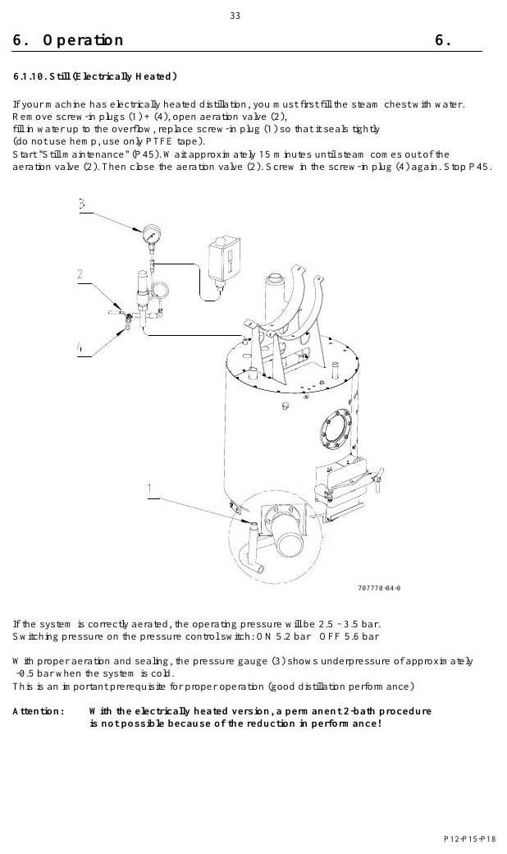
CONSTRUCTION
Read the machine as connected functional systems
MACHINE / SYSTEM VIEW
Locate the machine area first, then connect the visible components to the operating sequence.
• Inspect fasteners, seals, supports, access and surrounding evidence.
• Confirm the exact installed variant before adjustment or replacement.
Machine / system reference • operating manual page 41
BÖWE P18 | Construction
039
Notes:
[Sources]
- BÖWE P12-P15-P18 Operating Manual (2018-02), pages 14-22: https://www.ziermann.com/wp-content/uploads/2021/03/BA-Instruction-manual-BOeWE-P12-P15-P18-2018-02.pdf
- BÖWE P12-P15-P18 Spare Parts Catalogue: https://www.bowe-webshop.com/images/P12-P15-P18%20ET%20D%2BE%202003-06%20eckiger%20Luftschacht.pdf
- Practical visual: BÖWE P12-P15-P18 Operating Manual (2018-02), PDF page 41
Training interpretation: confirm the installed machine, current OEM revision, approved site PTW/LOTO, SDS and approved risk assessment before work.

Slide 40
CONSTRUCTION
Front-side components support operation and monitoring
WHY IT MATTERS
SAFE EXECUTION
Locate the relevant assembly and understand its interfaces.
• Inspect fasteners, seals, supports, access and surrounding evidence.
• Confirm the exact installed variant before adjustment or replacement.
BÖWE P18 | Construction
040
Notes:
[Sources]
- BÖWE P12-P15-P18 Operating Manual (2018-02), pages 14-22: https://www.ziermann.com/wp-content/uploads/2021/03/BA-Instruction-manual-BOeWE-P12-P15-P18-2018-02.pdf
- BÖWE P12-P15-P18 Spare Parts Catalogue: https://www.bowe-webshop.com/images/P12-P15-P18%20ET%20D%2BE%202003-06%20eckiger%20Luftschacht.pdf
Training interpretation: confirm the installed machine, current OEM revision, approved site PTW/LOTO, SDS and approved risk assessment before work.

Slide 41
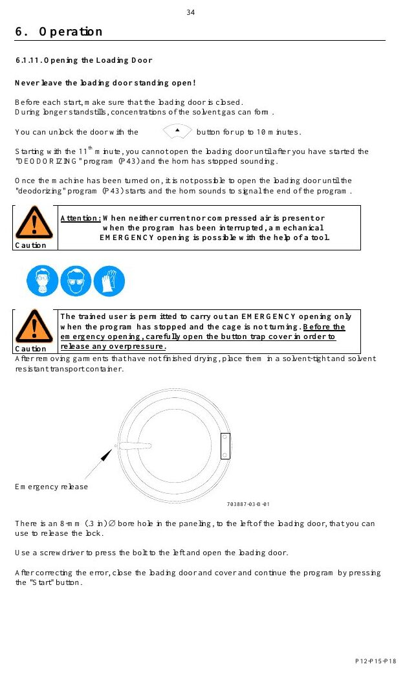
CONSTRUCTION
Rear-side components carry most service interfaces
MACHINE / SYSTEM VIEW
Locate the machine area first, then connect the visible components to the operating sequence.
• Inspect fasteners, seals, supports, access and surrounding evidence.
• Confirm the exact installed variant before adjustment or replacement.
Machine / system reference • operating manual page 42
BÖWE P18 | Construction
041
Notes:
[Sources]
- BÖWE P12-P15-P18 Operating Manual (2018-02), pages 14-22: https://www.ziermann.com/wp-content/uploads/2021/03/BA-Instruction-manual-BOeWE-P12-P15-P18-2018-02.pdf
- BÖWE P12-P15-P18 Spare Parts Catalogue: https://www.bowe-webshop.com/images/P12-P15-P18%20ET%20D%2BE%202003-06%20eckiger%20Luftschacht.pdf
- Practical visual: BÖWE P12-P15-P18 Operating Manual (2018-02), PDF page 42
Training interpretation: confirm the installed machine, current OEM revision, approved site PTW/LOTO, SDS and approved risk assessment before work.

Slide 42
CONSTRUCTION
The cage and housing contain the process load
Locate the relevant assembly and understand its interfaces.
WHAT TO VERIFY
01 Inspect fasteners, seals, supports, access and surrounding evidence.
02 Confirm the exact installed variant before adjustment or replacement.
BÖWE P18 | Construction
042
Notes:
[Sources]
- BÖWE P12-P15-P18 Operating Manual (2018-02), pages 14-22: https://www.ziermann.com/wp-content/uploads/2021/03/BA-Instruction-manual-BOeWE-P12-P15-P18-2018-02.pdf
- BÖWE P12-P15-P18 Spare Parts Catalogue: https://www.bowe-webshop.com/images/P12-P15-P18%20ET%20D%2BE%202003-06%20eckiger%20Luftschacht.pdf
Training interpretation: confirm the installed machine, current OEM revision, approved site PTW/LOTO, SDS and approved risk assessment before work.

Slide 43
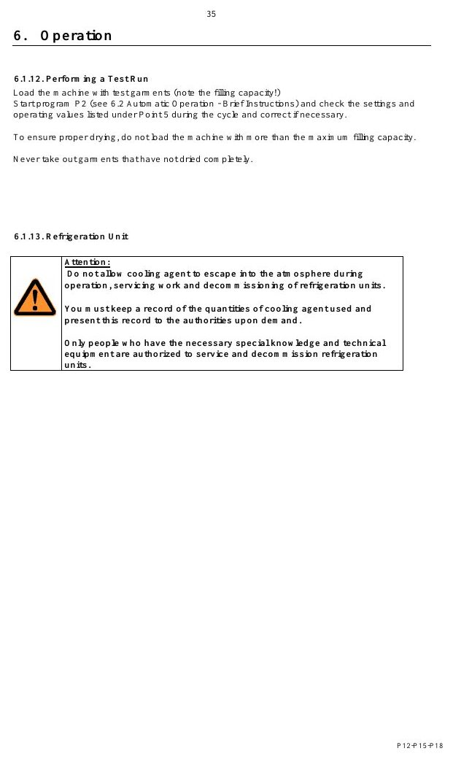
CONSTRUCTION
The cage drive converts motor power into controlled rotation
MACHINE / SYSTEM VIEW
Locate the machine area first, then connect the visible components to the operating sequence.
• Inspect fasteners, seals, supports, access and surrounding evidence.
• Confirm the exact installed variant before adjustment or replacement.
Machine / system reference • operating manual page 43
BÖWE P18 | Construction
043
Notes:
[Sources]
- BÖWE P12-P15-P18 Operating Manual (2018-02), pages 14-22: https://www.ziermann.com/wp-content/uploads/2021/03/BA-Instruction-manual-BOeWE-P12-P15-P18-2018-02.pdf
- BÖWE P12-P15-P18 Spare Parts Catalogue: https://www.bowe-webshop.com/images/P12-P15-P18%20ET%20D%2BE%202003-06%20eckiger%20Luftschacht.pdf
- Practical visual: BÖWE P12-P15-P18 Operating Manual (2018-02), PDF page 43
Training interpretation: confirm the installed machine, current OEM revision, approved site PTW/LOTO, SDS and approved risk assessment before work.

Slide 44
CONSTRUCTION
The loading door forms a pressure and solvent boundary
• Locate the relevant assembly and understand its interfaces.
• Inspect fasteners, seals, supports, access and surrounding evidence.
• Confirm the exact installed variant before adjustment or replacement.
TECHNICIAN CHECK
Can I locate it?
Can I verify it?
Can I make it safe?
Can I document closure?
BÖWE P18 | Construction
044
Notes:
[Sources]
- BÖWE P12-P15-P18 Operating Manual (2018-02), pages 14-22: https://www.ziermann.com/wp-content/uploads/2021/03/BA-Instruction-manual-BOeWE-P12-P15-P18-2018-02.pdf
- BÖWE P12-P15-P18 Spare Parts Catalogue: https://www.bowe-webshop.com/images/P12-P15-P18%20ET%20D%2BE%202003-06%20eckiger%20Luftschacht.pdf
Training interpretation: confirm the installed machine, current OEM revision, approved site PTW/LOTO, SDS and approved risk assessment before work.

Slide 45
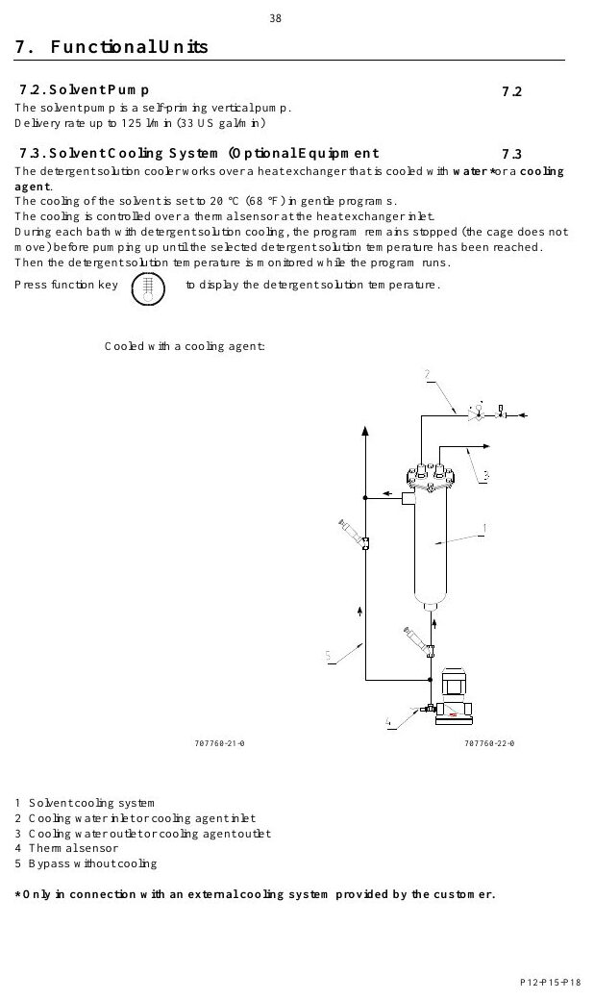
CONSTRUCTION
Tanks separate work, clean and extra solvent duties
MACHINE / SYSTEM VIEW
Locate the machine area first, then connect the visible components to the operating sequence.
• Inspect fasteners, seals, supports, access and surrounding evidence.
• Confirm the exact installed variant before adjustment or replacement.
Machine / system reference • operating manual page 46
BÖWE P18 | Construction
045
Notes:
[Sources]
- BÖWE P12-P15-P18 Operating Manual (2018-02), pages 14-22: https://www.ziermann.com/wp-content/uploads/2021/03/BA-Instruction-manual-BOeWE-P12-P15-P18-2018-02.pdf
- BÖWE P12-P15-P18 Spare Parts Catalogue: https://www.bowe-webshop.com/images/P12-P15-P18%20ET%20D%2BE%202003-06%20eckiger%20Luftschacht.pdf
- Practical visual: BÖWE P12-P15-P18 Operating Manual (2018-02), PDF page 46
Training interpretation: confirm the installed machine, current OEM revision, approved site PTW/LOTO, SDS and approved risk assessment before work.

Slide 46
CONSTRUCTION
Safety troughs contain unintended liquid release
WHY IT MATTERS
SAFE EXECUTION
Locate the relevant assembly and understand its interfaces.
• Inspect fasteners, seals, supports, access and surrounding evidence.
• Confirm the exact installed variant before adjustment or replacement.
BÖWE P18 | Construction
046
Notes:
[Sources]
- BÖWE P12-P15-P18 Operating Manual (2018-02), pages 14-22: https://www.ziermann.com/wp-content/uploads/2021/03/BA-Instruction-manual-BOeWE-P12-P15-P18-2018-02.pdf
- BÖWE P12-P15-P18 Spare Parts Catalogue: https://www.bowe-webshop.com/images/P12-P15-P18%20ET%20D%2BE%202003-06%20eckiger%20Luftschacht.pdf
Training interpretation: confirm the installed machine, current OEM revision, approved site PTW/LOTO, SDS and approved risk assessment before work.

Slide 47
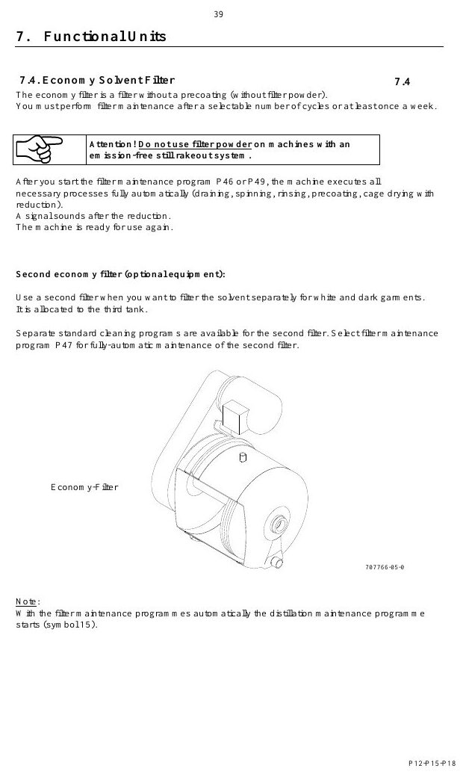
CONSTRUCTION
Slimline and Crossline layouts change access requirements
MACHINE / SYSTEM VIEW
Locate the machine area first, then connect the visible components to the operating sequence.
• Inspect fasteners, seals, supports, access and surrounding evidence.
• Confirm the exact installed variant before adjustment or replacement.
Machine / system reference • operating manual page 47
BÖWE P18 | Construction
047
Notes:
[Sources]
- BÖWE P12-P15-P18 Operating Manual (2018-02), pages 14-22: https://www.ziermann.com/wp-content/uploads/2021/03/BA-Instruction-manual-BOeWE-P12-P15-P18-2018-02.pdf
- BÖWE P12-P15-P18 Spare Parts Catalogue: https://www.bowe-webshop.com/images/P12-P15-P18%20ET%20D%2BE%202003-06%20eckiger%20Luftschacht.pdf
- Practical visual: BÖWE P12-P15-P18 Operating Manual (2018-02), PDF page 47
Training interpretation: confirm the installed machine, current OEM revision, approved site PTW/LOTO, SDS and approved risk assessment before work.

Slide 48
CONSTRUCTION
Optional equipment changes the installed configuration
Locate the relevant assembly and understand its interfaces.
WHAT TO VERIFY
01 Inspect fasteners, seals, supports, access and surrounding evidence.
02 Confirm the exact installed variant before adjustment or replacement.
BÖWE P18 | Construction
048
Notes:
[Sources]
- BÖWE P12-P15-P18 Operating Manual (2018-02), pages 14-22: https://www.ziermann.com/wp-content/uploads/2021/03/BA-Instruction-manual-BOeWE-P12-P15-P18-2018-02.pdf
- BÖWE P12-P15-P18 Spare Parts Catalogue: https://www.bowe-webshop.com/images/P12-P15-P18%20ET%20D%2BE%202003-06%20eckiger%20Luftschacht.pdf
Training interpretation: confirm the installed machine, current OEM revision, approved site PTW/LOTO, SDS and approved risk assessment before work.

Slide 49
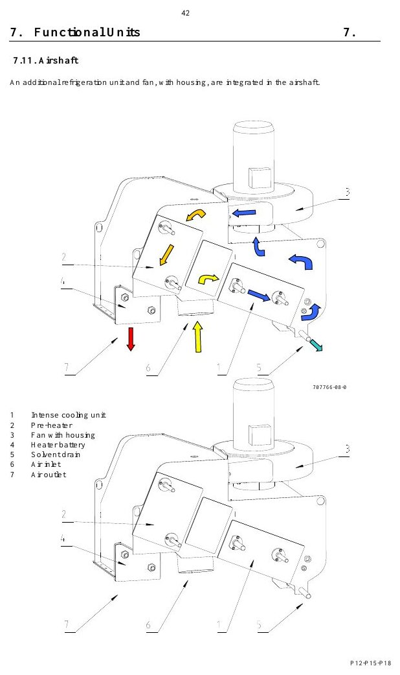
CONSTRUCTION
Nameplate data governs technical decisions
MACHINE / SYSTEM VIEW
Locate the machine area first, then connect the visible components to the operating sequence.
• Inspect fasteners, seals, supports, access and surrounding evidence.
• Confirm the exact installed variant before adjustment or replacement.
Machine / system reference • operating manual page 50
BÖWE P18 | Construction
049
Notes:
[Sources]
- BÖWE P12-P15-P18 Operating Manual (2018-02), pages 14-22: https://www.ziermann.com/wp-content/uploads/2021/03/BA-Instruction-manual-BOeWE-P12-P15-P18-2018-02.pdf
- BÖWE P12-P15-P18 Spare Parts Catalogue: https://www.bowe-webshop.com/images/P12-P15-P18%20ET%20D%2BE%202003-06%20eckiger%20Luftschacht.pdf
- Practical visual: BÖWE P12-P15-P18 Operating Manual (2018-02), PDF page 50
Training interpretation: confirm the installed machine, current OEM revision, approved site PTW/LOTO, SDS and approved risk assessment before work.

Slide 50
CONSTRUCTION
A clean machine makes defects easier to detect
• Locate the relevant assembly and understand its interfaces.
• Inspect fasteners, seals, supports, access and surrounding evidence.
• Confirm the exact installed variant before adjustment or replacement.
TECHNICIAN CHECK
Can I locate it?
Can I verify it?
Can I make it safe?
Can I document closure?
BÖWE P18 | Construction
050
Notes:
[Sources]
- BÖWE P12-P15-P18 Operating Manual (2018-02), pages 14-22: https://www.ziermann.com/wp-content/uploads/2021/03/BA-Instruction-manual-BOeWE-P12-P15-P18-2018-02.pdf
- BÖWE P12-P15-P18 Spare Parts Catalogue: https://www.bowe-webshop.com/images/P12-P15-P18%20ET%20D%2BE%202003-06%20eckiger%20Luftschacht.pdf
Training interpretation: confirm the installed machine, current OEM revision, approved site PTW/LOTO, SDS and approved risk assessment before work.

Slide 51
SECTION 04
Materials & Utilities
Build understanding first; then apply it safely on the installed machine.
051
Notes:
[Sources]
- BÖWE P12-P15-P18 Operating Manual (2018-02), pages 4, 21-25: https://www.ziermann.com/wp-content/uploads/2021/03/BA-Instruction-manual-BOeWE-P12-P15-P18-2018-02.pdf
- BÖWE P12-P15-P18 Spare Parts Catalogue: https://www.bowe-webshop.com/images/P12-P15-P18%20ET%20D%2BE%202003-06%20eckiger%20Luftschacht.pdf
Training interpretation: confirm the installed machine, current OEM revision, approved site PTW/LOTO, SDS and approved risk assessment before work.

Slide 52
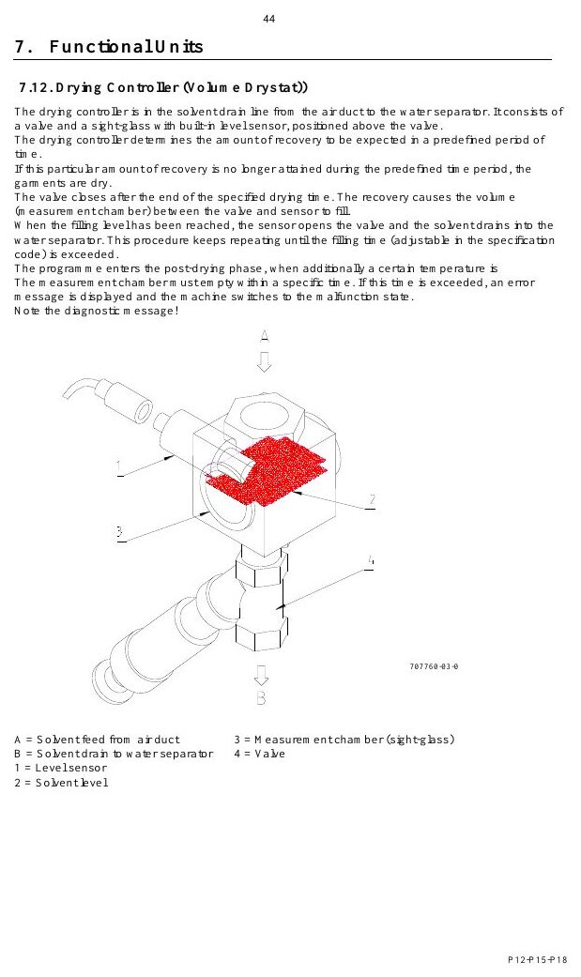
MATERIALS & UTILITIES
Solvent selection must match the approved machine configuration
MACHINE / SYSTEM VIEW
Locate the machine area first, then connect the visible components to the operating sequence.
• Machine family: P12 / P15 / P18.
• Confirm the solvent against the nameplate before filling, changing product or commissioning.
Machine / system reference • operating manual page 52
BÖWE P18 | Materials & Utilities
052
Notes:
[Sources]
- BÖWE P12-P15-P18 Operating Manual (2018-02), pages 4, 21-25: https://www.ziermann.com/wp-content/uploads/2021/03/BA-Instruction-manual-BOeWE-P12-P15-P18-2018-02.pdf
- BÖWE P12-P15-P18 Spare Parts Catalogue: https://www.bowe-webshop.com/images/P12-P15-P18%20ET%20D%2BE%202003-06%20eckiger%20Luftschacht.pdf
- Practical visual: BÖWE P12-P15-P18 Operating Manual (2018-02), PDF page 52
Training interpretation: confirm the installed machine, current OEM revision, approved site PTW/LOTO, SDS and approved risk assessment before work.

Slide 53
MATERIALS & UTILITIES
Chemical additives must remain stable under process conditions
• Treat chemical additives must remain stable under process conditions as a controlled operating parameter.
• Compare actual condition with the nameplate, OEM range and site standard.
• Trend deviations; do not normalize repeated abnormal readings.
TECHNICIAN CHECK
Can I locate it?
Can I verify it?
Can I make it safe?
Can I document closure?
BÖWE P18 | Materials & Utilities
053
Notes:
[Sources]
- BÖWE P12-P15-P18 Operating Manual (2018-02), pages 4, 21-25: https://www.ziermann.com/wp-content/uploads/2021/03/BA-Instruction-manual-BOeWE-P12-P15-P18-2018-02.pdf
- BÖWE P12-P15-P18 Spare Parts Catalogue: https://www.bowe-webshop.com/images/P12-P15-P18%20ET%20D%2BE%202003-06%20eckiger%20Luftschacht.pdf
Training interpretation: confirm the installed machine, current OEM revision, approved site PTW/LOTO, SDS and approved risk assessment before work.

Slide 54
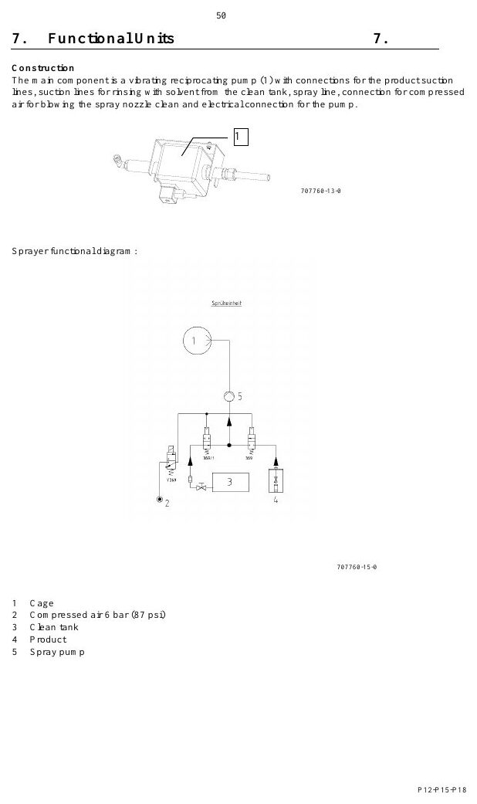
MATERIALS & UTILITIES
First filling requires configuration-specific quantities
MACHINE / SYSTEM VIEW
Locate the machine area first, then connect the visible components to the operating sequence.
• Tank I and Tank III: 90 L minimum each
• Additional filters increase the required quantity; verify the installed arrangement.
Machine / system reference • operating manual page 58
BÖWE P18 | Materials & Utilities
054
Notes:
[Sources]
- BÖWE P12-P15-P18 Operating Manual (2018-02), pages 4, 21-25: https://www.ziermann.com/wp-content/uploads/2021/03/BA-Instruction-manual-BOeWE-P12-P15-P18-2018-02.pdf
- BÖWE P12-P15-P18 Spare Parts Catalogue: https://www.bowe-webshop.com/images/P12-P15-P18%20ET%20D%2BE%202003-06%20eckiger%20Luftschacht.pdf
- Practical visual: BÖWE P12-P15-P18 Operating Manual (2018-02), PDF page 58
Training interpretation: confirm the installed machine, current OEM revision, approved site PTW/LOTO, SDS and approved risk assessment before work.

Slide 55
MATERIALS & UTILITIES
Tank minimum levels protect process stability
WHY IT MATTERS
SAFE EXECUTION
Tank I and Tank III: 90 L minimum each
• Low level can disrupt transfer, filtration and process repeatability.
• Record unexplained solvent loss and investigate before topping up.
BÖWE P18 | Materials & Utilities
055
Notes:
[Sources]
- BÖWE P12-P15-P18 Operating Manual (2018-02), pages 4, 21-25: https://www.ziermann.com/wp-content/uploads/2021/03/BA-Instruction-manual-BOeWE-P12-P15-P18-2018-02.pdf
- BÖWE P12-P15-P18 Spare Parts Catalogue: https://www.bowe-webshop.com/images/P12-P15-P18%20ET%20D%2BE%202003-06%20eckiger%20Luftschacht.pdf
Training interpretation: confirm the installed machine, current OEM revision, approved site PTW/LOTO, SDS and approved risk assessment before work.

Slide 56
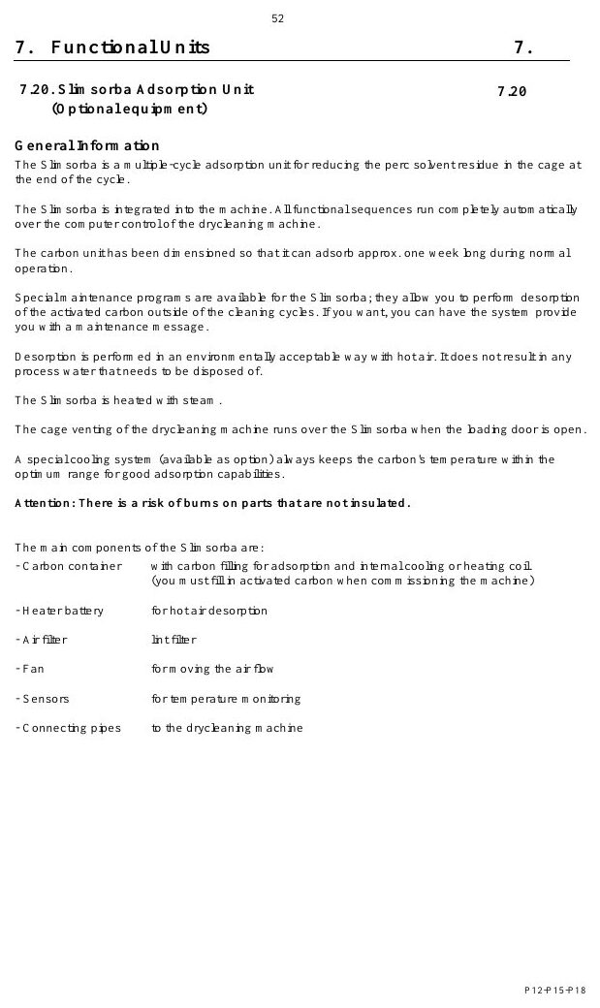
MATERIALS & UTILITIES
Steam quality affects heating and distillation
MACHINE / SYSTEM VIEW
Locate the machine area first, then connect the visible components to the operating sequence.
• Compare actual condition with the nameplate, OEM range and site standard.
• Trend deviations; do not normalize repeated abnormal readings.
Machine / system reference • operating manual page 60
BÖWE P18 | Materials & Utilities
056
Notes:
[Sources]
- BÖWE P12-P15-P18 Operating Manual (2018-02), pages 4, 21-25: https://www.ziermann.com/wp-content/uploads/2021/03/BA-Instruction-manual-BOeWE-P12-P15-P18-2018-02.pdf
- BÖWE P12-P15-P18 Spare Parts Catalogue: https://www.bowe-webshop.com/images/P12-P15-P18%20ET%20D%2BE%202003-06%20eckiger%20Luftschacht.pdf
- Practical visual: BÖWE P12-P15-P18 Operating Manual (2018-02), PDF page 60
Training interpretation: confirm the installed machine, current OEM revision, approved site PTW/LOTO, SDS and approved risk assessment before work.

Slide 57
MATERIALS & UTILITIES
Cooling-water condition affects recovery performance
Treat cooling-water condition affects recovery performance as a controlled operating parameter.
WHAT TO VERIFY
01 Compare actual condition with the nameplate, OEM range and site standard.
02 Trend deviations; do not normalize repeated abnormal readings.
BÖWE P18 | Materials & Utilities
057
Notes:
[Sources]
- BÖWE P12-P15-P18 Operating Manual (2018-02), pages 4, 21-25: https://www.ziermann.com/wp-content/uploads/2021/03/BA-Instruction-manual-BOeWE-P12-P15-P18-2018-02.pdf
- BÖWE P12-P15-P18 Spare Parts Catalogue: https://www.bowe-webshop.com/images/P12-P15-P18%20ET%20D%2BE%202003-06%20eckiger%20Luftschacht.pdf
Training interpretation: confirm the installed machine, current OEM revision, approved site PTW/LOTO, SDS and approved risk assessment before work.

Slide 58
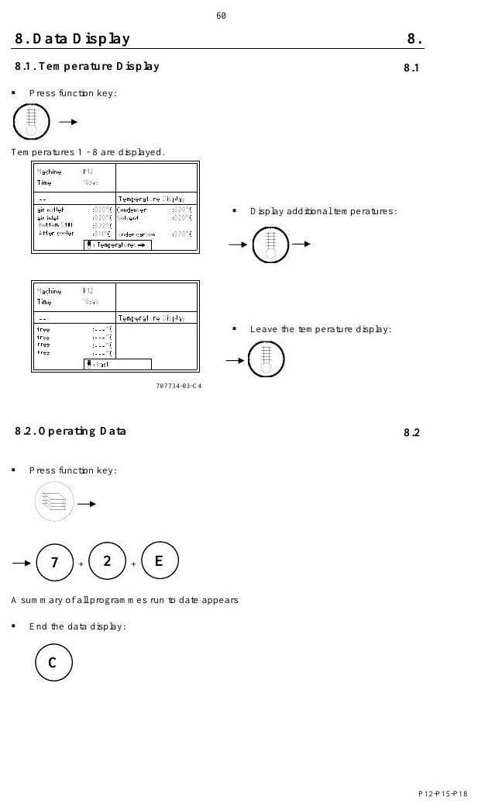
MATERIALS & UTILITIES
Compressed-air quality affects valve reliability
MACHINE / SYSTEM VIEW
Locate the machine area first, then connect the visible components to the operating sequence.
• Compare actual condition with the nameplate, OEM range and site standard.
• Trend deviations; do not normalize repeated abnormal readings.
Machine / system reference • operating manual page 68
BÖWE P18 | Materials & Utilities
058
Notes:
[Sources]
- BÖWE P12-P15-P18 Operating Manual (2018-02), pages 4, 21-25: https://www.ziermann.com/wp-content/uploads/2021/03/BA-Instruction-manual-BOeWE-P12-P15-P18-2018-02.pdf
- BÖWE P12-P15-P18 Spare Parts Catalogue: https://www.bowe-webshop.com/images/P12-P15-P18%20ET%20D%2BE%202003-06%20eckiger%20Luftschacht.pdf
- Practical visual: BÖWE P12-P15-P18 Operating Manual (2018-02), PDF page 68
Training interpretation: confirm the installed machine, current OEM revision, approved site PTW/LOTO, SDS and approved risk assessment before work.

Slide 59
MATERIALS & UTILITIES
Electrical supply must match the nameplate
• Treat electrical supply must match the nameplate as a controlled operating parameter.
• Compare actual condition with the nameplate, OEM range and site standard.
• Trend deviations; do not normalize repeated abnormal readings.
TECHNICIAN CHECK
Can I locate it?
Can I verify it?
Can I make it safe?
Can I document closure?
BÖWE P18 | Materials & Utilities
059
Notes:
[Sources]
- BÖWE P12-P15-P18 Operating Manual (2018-02), pages 4, 21-25: https://www.ziermann.com/wp-content/uploads/2021/03/BA-Instruction-manual-BOeWE-P12-P15-P18-2018-02.pdf
- BÖWE P12-P15-P18 Spare Parts Catalogue: https://www.bowe-webshop.com/images/P12-P15-P18%20ET%20D%2BE%202003-06%20eckiger%20Luftschacht.pdf
Training interpretation: confirm the installed machine, current OEM revision, approved site PTW/LOTO, SDS and approved risk assessment before work.

Slide 60
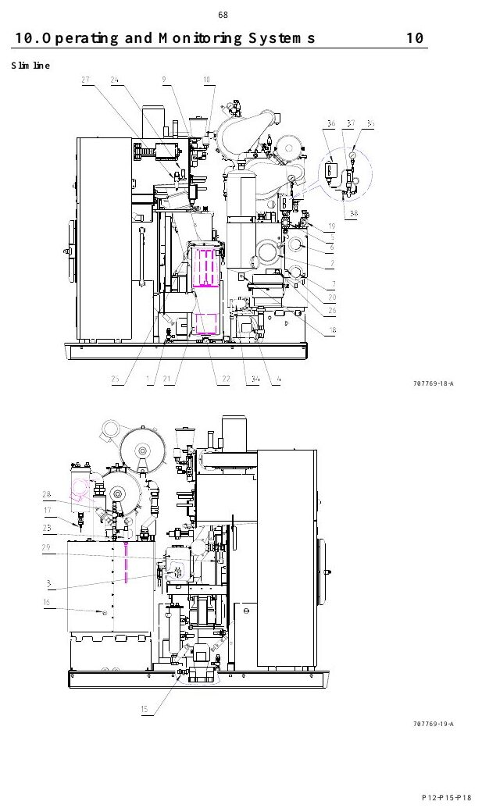
MATERIALS & UTILITIES
Room temperature and ventilation affect performance
MACHINE / SYSTEM VIEW
Locate the machine area first, then connect the visible components to the operating sequence.
• Compare actual condition with the nameplate, OEM range and site standard.
• Trend deviations; do not normalize repeated abnormal readings.
Machine / system reference • operating manual page 76
BÖWE P18 | Materials & Utilities
060
Notes:
[Sources]
- BÖWE P12-P15-P18 Operating Manual (2018-02), pages 4, 21-25: https://www.ziermann.com/wp-content/uploads/2021/03/BA-Instruction-manual-BOeWE-P12-P15-P18-2018-02.pdf
- BÖWE P12-P15-P18 Spare Parts Catalogue: https://www.bowe-webshop.com/images/P12-P15-P18%20ET%20D%2BE%202003-06%20eckiger%20Luftschacht.pdf
- Practical visual: BÖWE P12-P15-P18 Operating Manual (2018-02), PDF page 76
Training interpretation: confirm the installed machine, current OEM revision, approved site PTW/LOTO, SDS and approved risk assessment before work.

Slide 61
MATERIALS & UTILITIES
Utility trends can reveal developing faults
WHY IT MATTERS
SAFE EXECUTION
Treat utility trends can reveal developing faults as a controlled operating parameter.
• Compare actual condition with the nameplate, OEM range and site standard.
• Trend deviations; do not normalize repeated abnormal readings.
BÖWE P18 | Materials & Utilities
061
Notes:
[Sources]
- BÖWE P12-P15-P18 Operating Manual (2018-02), pages 4, 21-25: https://www.ziermann.com/wp-content/uploads/2021/03/BA-Instruction-manual-BOeWE-P12-P15-P18-2018-02.pdf
- BÖWE P12-P15-P18 Spare Parts Catalogue: https://www.bowe-webshop.com/images/P12-P15-P18%20ET%20D%2BE%202003-06%20eckiger%20Luftschacht.pdf
Training interpretation: confirm the installed machine, current OEM revision, approved site PTW/LOTO, SDS and approved risk assessment before work.

Slide 62
SECTION 05
Functional Systems
Build understanding first; then apply it safely on the installed machine.
062
Notes:
[Sources]
- BÖWE P12-P15-P18 Operating Manual (2018-02), pages 37-59: https://www.ziermann.com/wp-content/uploads/2021/03/BA-Instruction-manual-BOeWE-P12-P15-P18-2018-02.pdf
- BÖWE P12-P15-P18 Spare Parts Catalogue: https://www.bowe-webshop.com/images/P12-P15-P18%20ET%20D%2BE%202003-06%20eckiger%20Luftschacht.pdf
Training interpretation: confirm the installed machine, current OEM revision, approved site PTW/LOTO, SDS and approved risk assessment before work.

Slide 63
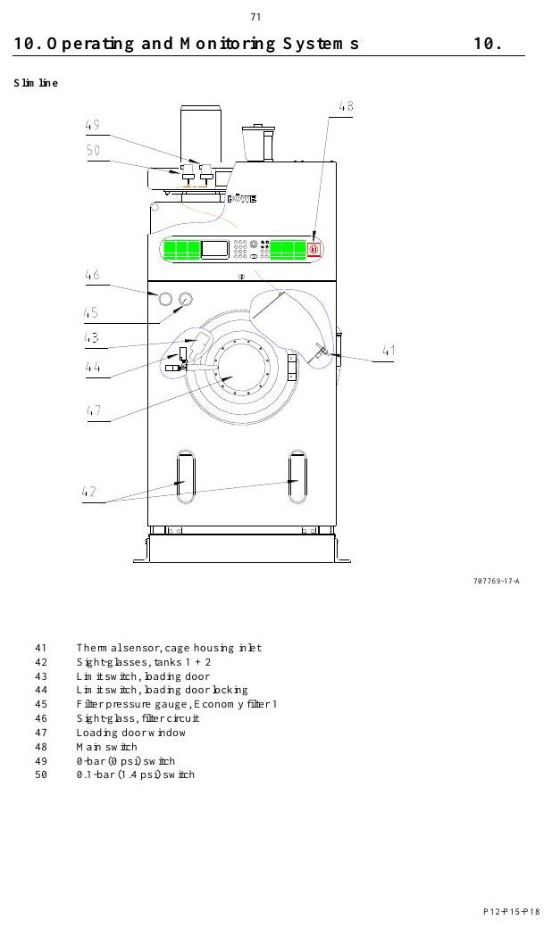
FUNCTIONAL SYSTEMS
The solvent pump drives the cleaning circuit
MACHINE / SYSTEM VIEW
Locate the machine area first, then connect the visible components to the operating sequence.
• Inspect the component, its upstream supply and downstream effect—not the part in isolation.
• Use leakage, temperature, pressure, noise and cycle data to identify deterioration.
Machine / system reference • operating manual page 79
BÖWE P18 | Functional Systems
063
Notes:
[Sources]
- BÖWE P12-P15-P18 Operating Manual (2018-02), pages 37-59: https://www.ziermann.com/wp-content/uploads/2021/03/BA-Instruction-manual-BOeWE-P12-P15-P18-2018-02.pdf
- BÖWE P12-P15-P18 Spare Parts Catalogue: https://www.bowe-webshop.com/images/P12-P15-P18%20ET%20D%2BE%202003-06%20eckiger%20Luftschacht.pdf
- Practical visual: BÖWE P12-P15-P18 Operating Manual (2018-02), PDF page 79
Training interpretation: confirm the installed machine, current OEM revision, approved site PTW/LOTO, SDS and approved risk assessment before work.

Slide 64
FUNCTIONAL SYSTEMS
Economy filters protect solvent quality
WHY IT MATTERS
SAFE EXECUTION
Understand the system purpose and what must happen before, during and after operation.
• Inspect the component, its upstream supply and downstream effect—not the part in isolation.
• Use leakage, temperature, pressure, noise and cycle data to identify deterioration.
BÖWE P18 | Functional Systems
064
Notes:
[Sources]
- BÖWE P12-P15-P18 Operating Manual (2018-02), pages 37-59: https://www.ziermann.com/wp-content/uploads/2021/03/BA-Instruction-manual-BOeWE-P12-P15-P18-2018-02.pdf
- BÖWE P12-P15-P18 Spare Parts Catalogue: https://www.bowe-webshop.com/images/P12-P15-P18%20ET%20D%2BE%202003-06%20eckiger%20Luftschacht.pdf
Training interpretation: confirm the installed machine, current OEM revision, approved site PTW/LOTO, SDS and approved risk assessment before work.

Slide 65
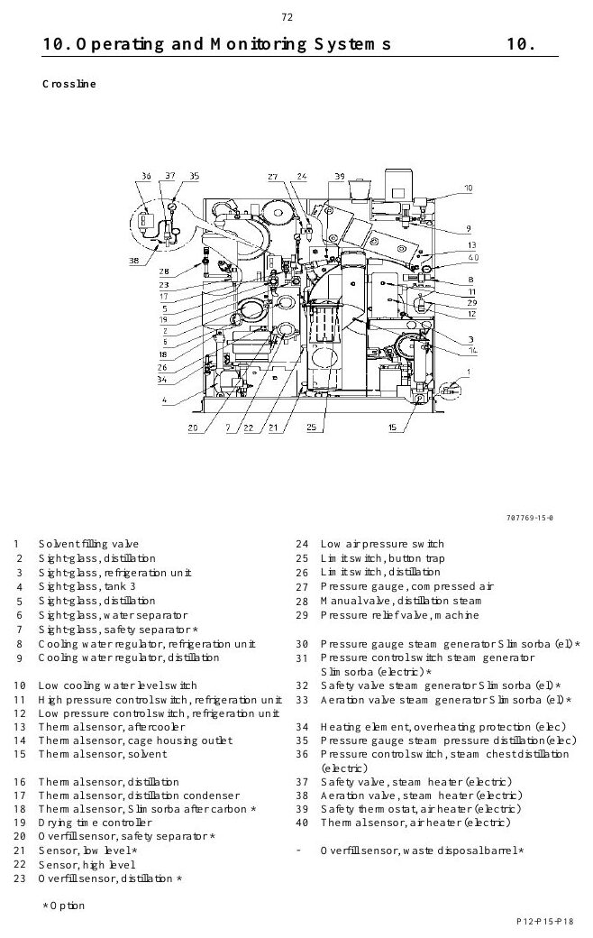
FUNCTIONAL SYSTEMS
Cartridge filters provide optional adsorption capacity
MACHINE / SYSTEM VIEW
Locate the machine area first, then connect the visible components to the operating sequence.
• Inspect the component, its upstream supply and downstream effect—not the part in isolation.
• Use leakage, temperature, pressure, noise and cycle data to identify deterioration.
Machine / system reference • operating manual page 80
BÖWE P18 | Functional Systems
065
Notes:
[Sources]
- BÖWE P12-P15-P18 Operating Manual (2018-02), pages 37-59: https://www.ziermann.com/wp-content/uploads/2021/03/BA-Instruction-manual-BOeWE-P12-P15-P18-2018-02.pdf
- BÖWE P12-P15-P18 Spare Parts Catalogue: https://www.bowe-webshop.com/images/P12-P15-P18%20ET%20D%2BE%202003-06%20eckiger%20Luftschacht.pdf
- Practical visual: BÖWE P12-P15-P18 Operating Manual (2018-02), PDF page 80
Training interpretation: confirm the installed machine, current OEM revision, approved site PTW/LOTO, SDS and approved risk assessment before work.

Slide 66
FUNCTIONAL SYSTEMS
The button trap captures foreign objects and lint
Understand the system purpose and what must happen before, during and after operation.
WHAT TO VERIFY
01 Inspect the component, its upstream supply and downstream effect—not the part in isolation.
02 Use leakage, temperature, pressure, noise and cycle data to identify deterioration.
BÖWE P18 | Functional Systems
066
Notes:
[Sources]
- BÖWE P12-P15-P18 Operating Manual (2018-02), pages 37-59: https://www.ziermann.com/wp-content/uploads/2021/03/BA-Instruction-manual-BOeWE-P12-P15-P18-2018-02.pdf
- BÖWE P12-P15-P18 Spare Parts Catalogue: https://www.bowe-webshop.com/images/P12-P15-P18%20ET%20D%2BE%202003-06%20eckiger%20Luftschacht.pdf
Training interpretation: confirm the installed machine, current OEM revision, approved site PTW/LOTO, SDS and approved risk assessment before work.

Slide 67
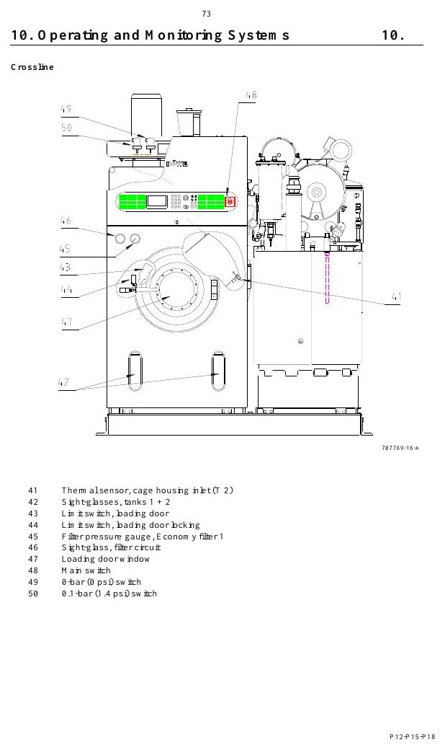
FUNCTIONAL SYSTEMS
The lint filter protects airflow and recovery
MACHINE / SYSTEM VIEW
Locate the machine area first, then connect the visible components to the operating sequence.
• Inspect the component, its upstream supply and downstream effect—not the part in isolation.
• Use leakage, temperature, pressure, noise and cycle data to identify deterioration.
Machine / system reference • operating manual page 81
BÖWE P18 | Functional Systems
067
Notes:
[Sources]
- BÖWE P12-P15-P18 Operating Manual (2018-02), pages 37-59: https://www.ziermann.com/wp-content/uploads/2021/03/BA-Instruction-manual-BOeWE-P12-P15-P18-2018-02.pdf
- BÖWE P12-P15-P18 Spare Parts Catalogue: https://www.bowe-webshop.com/images/P12-P15-P18%20ET%20D%2BE%202003-06%20eckiger%20Luftschacht.pdf
- Practical visual: BÖWE P12-P15-P18 Operating Manual (2018-02), PDF page 81
Training interpretation: confirm the installed machine, current OEM revision, approved site PTW/LOTO, SDS and approved risk assessment before work.

Slide 68
FUNCTIONAL SYSTEMS
The airshaft controls drying and solvent recovery
• Understand the system purpose and what must happen before, during and after operation.
• Inspect the component, its upstream supply and downstream effect—not the part in isolation.
• Use leakage, temperature, pressure, noise and cycle data to identify deterioration.
TECHNICIAN CHECK
Can I locate it?
Can I verify it?
Can I make it safe?
Can I document closure?
BÖWE P18 | Functional Systems
068
Notes:
[Sources]
- BÖWE P12-P15-P18 Operating Manual (2018-02), pages 37-59: https://www.ziermann.com/wp-content/uploads/2021/03/BA-Instruction-manual-BOeWE-P12-P15-P18-2018-02.pdf
- BÖWE P12-P15-P18 Spare Parts Catalogue: https://www.bowe-webshop.com/images/P12-P15-P18%20ET%20D%2BE%202003-06%20eckiger%20Luftschacht.pdf
Training interpretation: confirm the installed machine, current OEM revision, approved site PTW/LOTO, SDS and approved risk assessment before work.

Slide 69
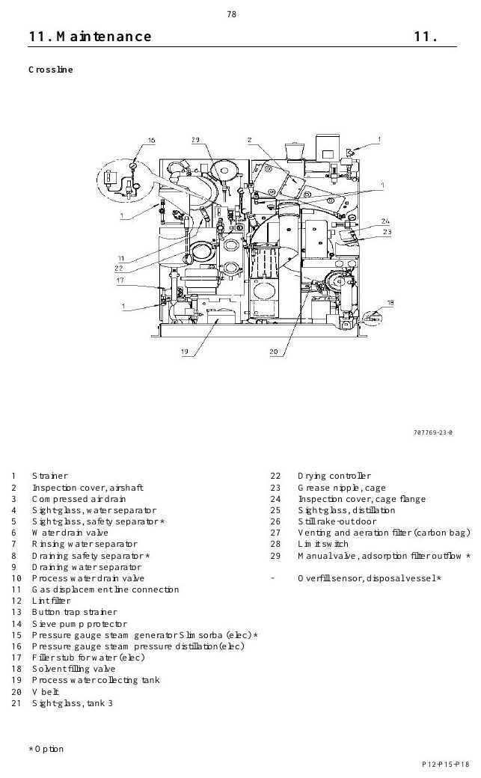
FUNCTIONAL SYSTEMS
The refrigeration unit condenses solvent vapour
MACHINE / SYSTEM VIEW
Locate the machine area first, then connect the visible components to the operating sequence.
• Inspect the component, its upstream supply and downstream effect—not the part in isolation.
• Use leakage, temperature, pressure, noise and cycle data to identify deterioration.
Machine / system reference • operating manual page 86
BÖWE P18 | Functional Systems
069
Notes:
[Sources]
- BÖWE P12-P15-P18 Operating Manual (2018-02), pages 37-59: https://www.ziermann.com/wp-content/uploads/2021/03/BA-Instruction-manual-BOeWE-P12-P15-P18-2018-02.pdf
- BÖWE P12-P15-P18 Spare Parts Catalogue: https://www.bowe-webshop.com/images/P12-P15-P18%20ET%20D%2BE%202003-06%20eckiger%20Luftschacht.pdf
- Practical visual: BÖWE P12-P15-P18 Operating Manual (2018-02), PDF page 86
Training interpretation: confirm the installed machine, current OEM revision, approved site PTW/LOTO, SDS and approved risk assessment before work.

Slide 70
FUNCTIONAL SYSTEMS
The heater battery supplies controlled drying energy
WHY IT MATTERS
SAFE EXECUTION
Understand the system purpose and what must happen before, during and after operation.
• Inspect the component, its upstream supply and downstream effect—not the part in isolation.
• Use leakage, temperature, pressure, noise and cycle data to identify deterioration.
BÖWE P18 | Functional Systems
070
Notes:
[Sources]
- BÖWE P12-P15-P18 Operating Manual (2018-02), pages 37-59: https://www.ziermann.com/wp-content/uploads/2021/03/BA-Instruction-manual-BOeWE-P12-P15-P18-2018-02.pdf
- BÖWE P12-P15-P18 Spare Parts Catalogue: https://www.bowe-webshop.com/images/P12-P15-P18%20ET%20D%2BE%202003-06%20eckiger%20Luftschacht.pdf
Training interpretation: confirm the installed machine, current OEM revision, approved site PTW/LOTO, SDS and approved risk assessment before work.

Slide 71
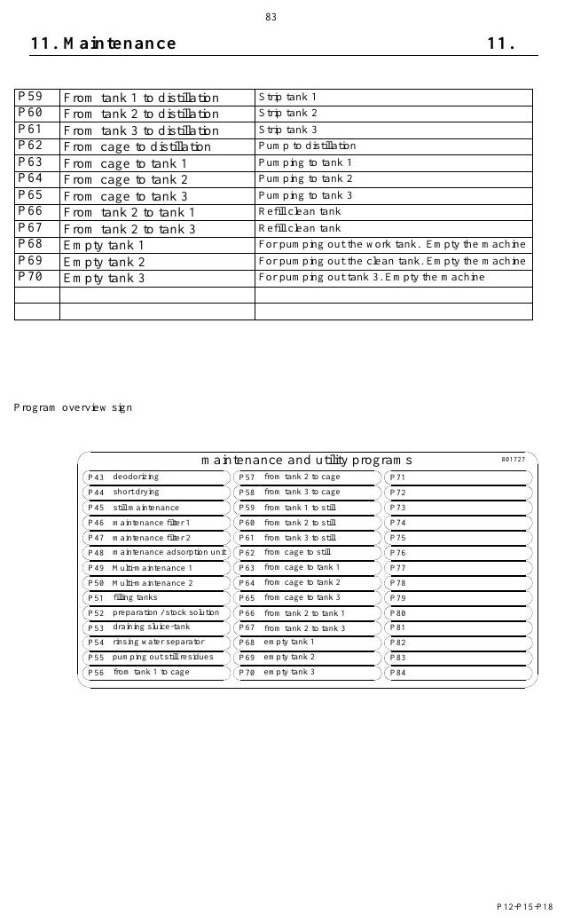
FUNCTIONAL SYSTEMS
The drying controller ends the cycle on evidence
MACHINE / SYSTEM VIEW
Locate the machine area first, then connect the visible components to the operating sequence.
• Inspect the component, its upstream supply and downstream effect—not the part in isolation.
• Use leakage, temperature, pressure, noise and cycle data to identify deterioration.
Machine / system reference • operating manual page 91
BÖWE P18 | Functional Systems
071
Notes:
[Sources]
- BÖWE P12-P15-P18 Operating Manual (2018-02), pages 37-59: https://www.ziermann.com/wp-content/uploads/2021/03/BA-Instruction-manual-BOeWE-P12-P15-P18-2018-02.pdf
- BÖWE P12-P15-P18 Spare Parts Catalogue: https://www.bowe-webshop.com/images/P12-P15-P18%20ET%20D%2BE%202003-06%20eckiger%20Luftschacht.pdf
- Practical visual: BÖWE P12-P15-P18 Operating Manual (2018-02), PDF page 91
Training interpretation: confirm the installed machine, current OEM revision, approved site PTW/LOTO, SDS and approved risk assessment before work.

Slide 72
FUNCTIONAL SYSTEMS
Loading-door venting reduces operator exposure
Understand the system purpose and what must happen before, during and after operation.
WHAT TO VERIFY
01 Inspect the component, its upstream supply and downstream effect—not the part in isolation.
02 Use leakage, temperature, pressure, noise and cycle data to identify deterioration.
BÖWE P18 | Functional Systems
072
Notes:
[Sources]
- BÖWE P12-P15-P18 Operating Manual (2018-02), pages 37-59: https://www.ziermann.com/wp-content/uploads/2021/03/BA-Instruction-manual-BOeWE-P12-P15-P18-2018-02.pdf
- BÖWE P12-P15-P18 Spare Parts Catalogue: https://www.bowe-webshop.com/images/P12-P15-P18%20ET%20D%2BE%202003-06%20eckiger%20Luftschacht.pdf
Training interpretation: confirm the installed machine, current OEM revision, approved site PTW/LOTO, SDS and approved risk assessment before work.

Slide 73
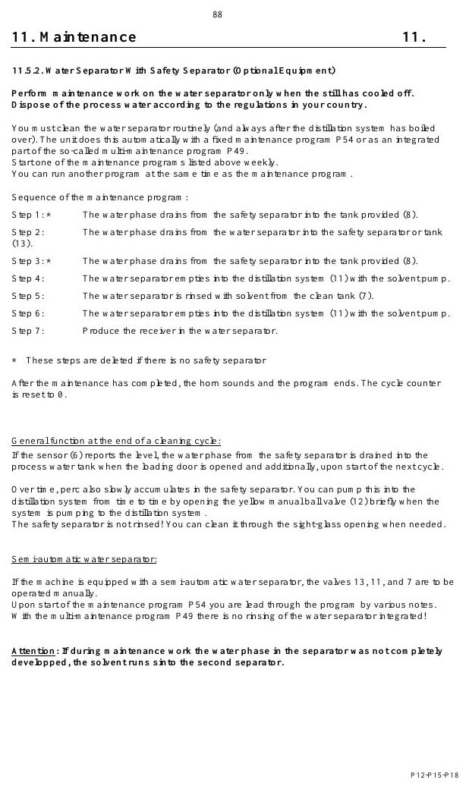
FUNCTIONAL SYSTEMS
The still separates solvent from residues
MACHINE / SYSTEM VIEW
Locate the machine area first, then connect the visible components to the operating sequence.
• Inspect the component, its upstream supply and downstream effect—not the part in isolation.
• Use leakage, temperature, pressure, noise and cycle data to identify deterioration.
Machine / system reference • operating manual page 96
BÖWE P18 | Functional Systems
073
Notes:
[Sources]
- BÖWE P12-P15-P18 Operating Manual (2018-02), pages 37-59: https://www.ziermann.com/wp-content/uploads/2021/03/BA-Instruction-manual-BOeWE-P12-P15-P18-2018-02.pdf
- BÖWE P12-P15-P18 Spare Parts Catalogue: https://www.bowe-webshop.com/images/P12-P15-P18%20ET%20D%2BE%202003-06%20eckiger%20Luftschacht.pdf
- Practical visual: BÖWE P12-P15-P18 Operating Manual (2018-02), PDF page 96
Training interpretation: confirm the installed machine, current OEM revision, approved site PTW/LOTO, SDS and approved risk assessment before work.

Slide 74
FUNCTIONAL SYSTEMS
Still overfill protection prevents an unsafe condition
• Understand the system purpose and what must happen before, during and after operation.
• Inspect the component, its upstream supply and downstream effect—not the part in isolation.
• Use leakage, temperature, pressure, noise and cycle data to identify deterioration.
TECHNICIAN CHECK
Can I locate it?
Can I verify it?
Can I make it safe?
Can I document closure?
BÖWE P18 | Functional Systems
074
Notes:
[Sources]
- BÖWE P12-P15-P18 Operating Manual (2018-02), pages 37-59: https://www.ziermann.com/wp-content/uploads/2021/03/BA-Instruction-manual-BOeWE-P12-P15-P18-2018-02.pdf
- BÖWE P12-P15-P18 Spare Parts Catalogue: https://www.bowe-webshop.com/images/P12-P15-P18%20ET%20D%2BE%202003-06%20eckiger%20Luftschacht.pdf
Training interpretation: confirm the installed machine, current OEM revision, approved site PTW/LOTO, SDS and approved risk assessment before work.

Slide 75
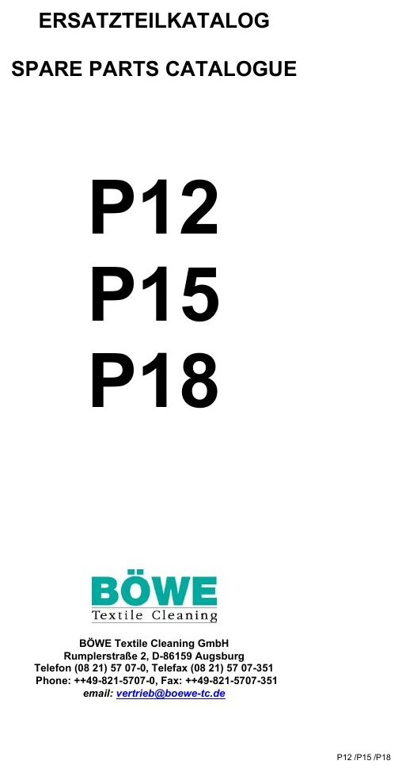
FUNCTIONAL SYSTEMS
Emission-free residue removal reduces open handling
EXPLODED PARTS VIEW
Use the item numbers on the drawing to identify the exact assembly before ordering or removal.
• Inspect the component, its upstream supply and downstream effect—not the part in isolation.
• Use leakage, temperature, pressure, noise and cycle data to identify deterioration.
Exploded parts drawing • catalogue page 3
BÖWE P18 | Functional Systems
075
Notes:
[Sources]
- BÖWE P12-P15-P18 Operating Manual (2018-02), pages 37-59: https://www.ziermann.com/wp-content/uploads/2021/03/BA-Instruction-manual-BOeWE-P12-P15-P18-2018-02.pdf
- BÖWE P12-P15-P18 Spare Parts Catalogue: https://www.bowe-webshop.com/images/P12-P15-P18%20ET%20D%2BE%202003-06%20eckiger%20Luftschacht.pdf
- Practical visual: BÖWE P12-P15-P18 Spare Parts Catalogue, PDF page 3
Training interpretation: confirm the installed machine, current OEM revision, approved site PTW/LOTO, SDS and approved risk assessment before work.

Slide 76
FUNCTIONAL SYSTEMS
The condenser returns vapour to liquid solvent
WHY IT MATTERS
SAFE EXECUTION
Understand the system purpose and what must happen before, during and after operation.
• Inspect the component, its upstream supply and downstream effect—not the part in isolation.
• Use leakage, temperature, pressure, noise and cycle data to identify deterioration.
BÖWE P18 | Functional Systems
076
Notes:
[Sources]
- BÖWE P12-P15-P18 Operating Manual (2018-02), pages 37-59: https://www.ziermann.com/wp-content/uploads/2021/03/BA-Instruction-manual-BOeWE-P12-P15-P18-2018-02.pdf
- BÖWE P12-P15-P18 Spare Parts Catalogue: https://www.bowe-webshop.com/images/P12-P15-P18%20ET%20D%2BE%202003-06%20eckiger%20Luftschacht.pdf
Training interpretation: confirm the installed machine, current OEM revision, approved site PTW/LOTO, SDS and approved risk assessment before work.

Slide 77
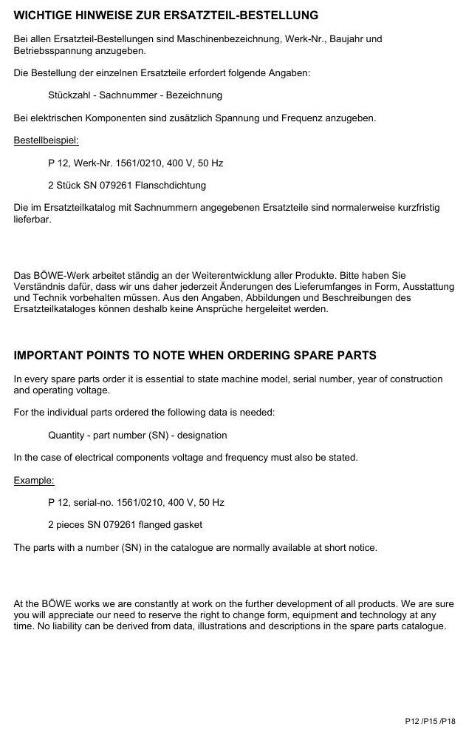
FUNCTIONAL SYSTEMS
The water separator divides solvent from process water
EXPLODED PARTS VIEW
Use the item numbers on the drawing to identify the exact assembly before ordering or removal.
• Inspect the component, its upstream supply and downstream effect—not the part in isolation.
• Use leakage, temperature, pressure, noise and cycle data to identify deterioration.
Exploded parts drawing • catalogue page 5
BÖWE P18 | Functional Systems
077
Notes:
[Sources]
- BÖWE P12-P15-P18 Operating Manual (2018-02), pages 37-59: https://www.ziermann.com/wp-content/uploads/2021/03/BA-Instruction-manual-BOeWE-P12-P15-P18-2018-02.pdf
- BÖWE P12-P15-P18 Spare Parts Catalogue: https://www.bowe-webshop.com/images/P12-P15-P18%20ET%20D%2BE%202003-06%20eckiger%20Luftschacht.pdf
- Practical visual: BÖWE P12-P15-P18 Spare Parts Catalogue, PDF page 5
Training interpretation: confirm the installed machine, current OEM revision, approved site PTW/LOTO, SDS and approved risk assessment before work.

Slide 78
FUNCTIONAL SYSTEMS
The safety separator provides additional protection
Understand the system purpose and what must happen before, during and after operation.
WHAT TO VERIFY
01 Inspect the component, its upstream supply and downstream effect—not the part in isolation.
02 Use leakage, temperature, pressure, noise and cycle data to identify deterioration.
BÖWE P18 | Functional Systems
078
Notes:
[Sources]
- BÖWE P12-P15-P18 Operating Manual (2018-02), pages 37-59: https://www.ziermann.com/wp-content/uploads/2021/03/BA-Instruction-manual-BOeWE-P12-P15-P18-2018-02.pdf
- BÖWE P12-P15-P18 Spare Parts Catalogue: https://www.bowe-webshop.com/images/P12-P15-P18%20ET%20D%2BE%202003-06%20eckiger%20Luftschacht.pdf
Training interpretation: confirm the installed machine, current OEM revision, approved site PTW/LOTO, SDS and approved risk assessment before work.

Slide 79
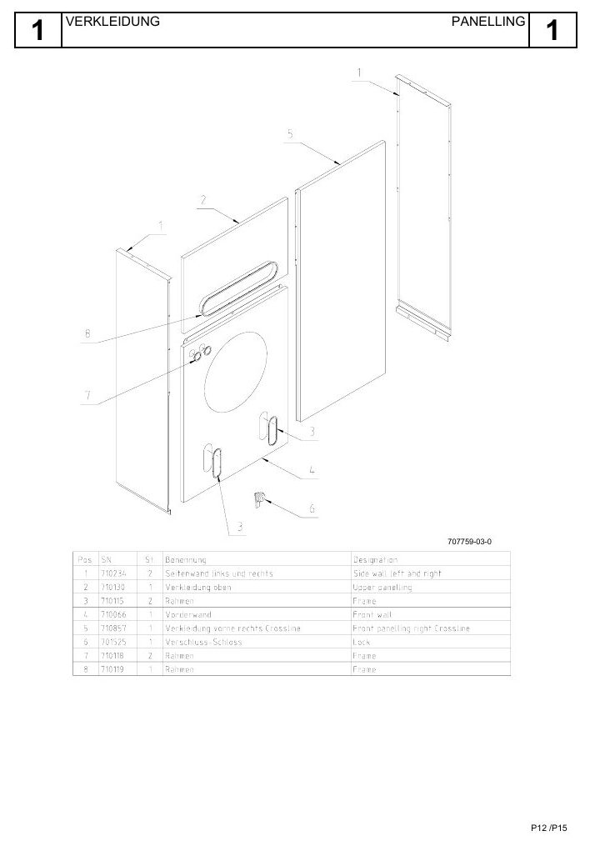
FUNCTIONAL SYSTEMS
The dosing unit introduces controlled additives
EXPLODED PARTS VIEW
Use the item numbers on the drawing to identify the exact assembly before ordering or removal.
• Inspect the component, its upstream supply and downstream effect—not the part in isolation.
• Use leakage, temperature, pressure, noise and cycle data to identify deterioration.
Exploded parts drawing • catalogue page 8
BÖWE P18 | Functional Systems
079
Notes:
[Sources]
- BÖWE P12-P15-P18 Operating Manual (2018-02), pages 37-59: https://www.ziermann.com/wp-content/uploads/2021/03/BA-Instruction-manual-BOeWE-P12-P15-P18-2018-02.pdf
- BÖWE P12-P15-P18 Spare Parts Catalogue: https://www.bowe-webshop.com/images/P12-P15-P18%20ET%20D%2BE%202003-06%20eckiger%20Luftschacht.pdf
- Practical visual: BÖWE P12-P15-P18 Spare Parts Catalogue, PDF page 8
Training interpretation: confirm the installed machine, current OEM revision, approved site PTW/LOTO, SDS and approved risk assessment before work.

Slide 80
FUNCTIONAL SYSTEMS
The sprayer applies treatment to garments
• Understand the system purpose and what must happen before, during and after operation.
• Inspect the component, its upstream supply and downstream effect—not the part in isolation.
• Use leakage, temperature, pressure, noise and cycle data to identify deterioration.
TECHNICIAN CHECK
Can I locate it?
Can I verify it?
Can I make it safe?
Can I document closure?
BÖWE P18 | Functional Systems
080
Notes:
[Sources]
- BÖWE P12-P15-P18 Operating Manual (2018-02), pages 37-59: https://www.ziermann.com/wp-content/uploads/2021/03/BA-Instruction-manual-BOeWE-P12-P15-P18-2018-02.pdf
- BÖWE P12-P15-P18 Spare Parts Catalogue: https://www.bowe-webshop.com/images/P12-P15-P18%20ET%20D%2BE%202003-06%20eckiger%20Luftschacht.pdf
Training interpretation: confirm the installed machine, current OEM revision, approved site PTW/LOTO, SDS and approved risk assessment before work.

Slide 81
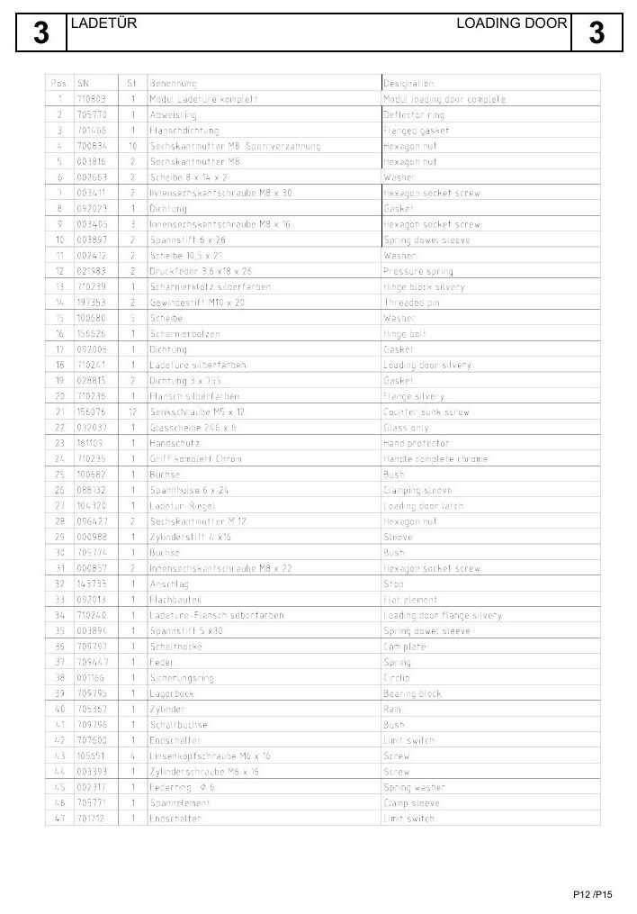
FUNCTIONAL SYSTEMS
Slimsorba reduces residual solvent concentration
EXPLODED PARTS VIEW
Use the item numbers on the drawing to identify the exact assembly before ordering or removal.
• Inspect the component, its upstream supply and downstream effect—not the part in isolation.
• Use leakage, temperature, pressure, noise and cycle data to identify deterioration.
Exploded parts drawing • catalogue page 12
BÖWE P18 | Functional Systems
081
Notes:
[Sources]
- BÖWE P12-P15-P18 Operating Manual (2018-02), pages 37-59: https://www.ziermann.com/wp-content/uploads/2021/03/BA-Instruction-manual-BOeWE-P12-P15-P18-2018-02.pdf
- BÖWE P12-P15-P18 Spare Parts Catalogue: https://www.bowe-webshop.com/images/P12-P15-P18%20ET%20D%2BE%202003-06%20eckiger%20Luftschacht.pdf
- Practical visual: BÖWE P12-P15-P18 Spare Parts Catalogue, PDF page 12
Training interpretation: confirm the installed machine, current OEM revision, approved site PTW/LOTO, SDS and approved risk assessment before work.

Slide 82
FUNCTIONAL SYSTEMS
The solvent safety trough protects the floor and environment
WHY IT MATTERS
SAFE EXECUTION
Understand the system purpose and what must happen before, during and after operation.
• Inspect the component, its upstream supply and downstream effect—not the part in isolation.
• Use leakage, temperature, pressure, noise and cycle data to identify deterioration.
BÖWE P18 | Functional Systems
082
Notes:
[Sources]
- BÖWE P12-P15-P18 Operating Manual (2018-02), pages 37-59: https://www.ziermann.com/wp-content/uploads/2021/03/BA-Instruction-manual-BOeWE-P12-P15-P18-2018-02.pdf
- BÖWE P12-P15-P18 Spare Parts Catalogue: https://www.bowe-webshop.com/images/P12-P15-P18%20ET%20D%2BE%202003-06%20eckiger%20Luftschacht.pdf
Training interpretation: confirm the installed machine, current OEM revision, approved site PTW/LOTO, SDS and approved risk assessment before work.

Slide 83
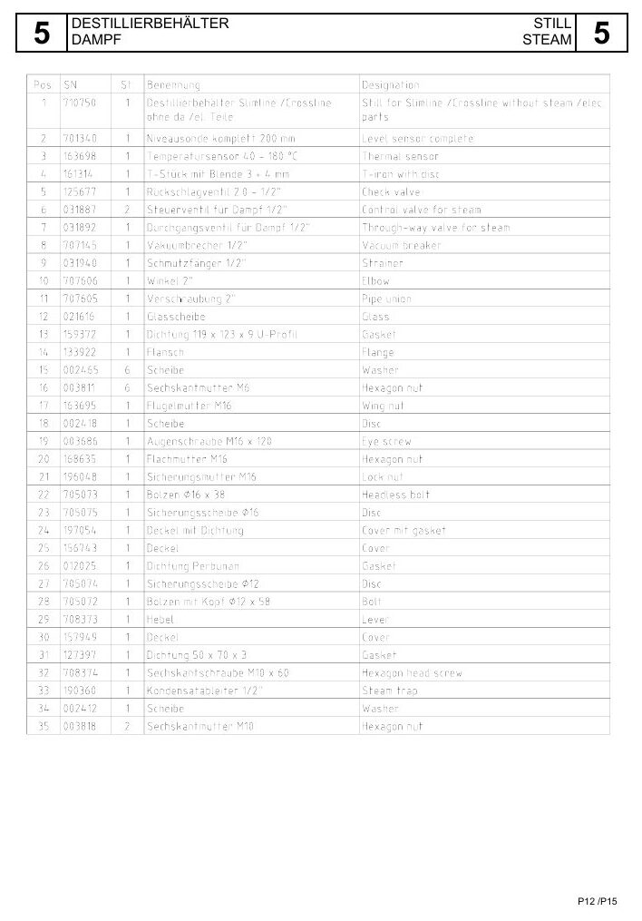
FUNCTIONAL SYSTEMS
Level sensors govern transfer decisions
EXPLODED PARTS VIEW
Use the item numbers on the drawing to identify the exact assembly before ordering or removal.
• Inspect the component, its upstream supply and downstream effect—not the part in isolation.
• Use leakage, temperature, pressure, noise and cycle data to identify deterioration.
Exploded parts drawing • catalogue page 16
BÖWE P18 | Functional Systems
083
Notes:
[Sources]
- BÖWE P12-P15-P18 Operating Manual (2018-02), pages 37-59: https://www.ziermann.com/wp-content/uploads/2021/03/BA-Instruction-manual-BOeWE-P12-P15-P18-2018-02.pdf
- BÖWE P12-P15-P18 Spare Parts Catalogue: https://www.bowe-webshop.com/images/P12-P15-P18%20ET%20D%2BE%202003-06%20eckiger%20Luftschacht.pdf
- Practical visual: BÖWE P12-P15-P18 Spare Parts Catalogue, PDF page 16
Training interpretation: confirm the installed machine, current OEM revision, approved site PTW/LOTO, SDS and approved risk assessment before work.

Slide 84
FUNCTIONAL SYSTEMS
Pressure switches verify air and process conditions
Understand the system purpose and what must happen before, during and after operation.
WHAT TO VERIFY
01 Inspect the component, its upstream supply and downstream effect—not the part in isolation.
02 Use leakage, temperature, pressure, noise and cycle data to identify deterioration.
BÖWE P18 | Functional Systems
084
Notes:
[Sources]
- BÖWE P12-P15-P18 Operating Manual (2018-02), pages 37-59: https://www.ziermann.com/wp-content/uploads/2021/03/BA-Instruction-manual-BOeWE-P12-P15-P18-2018-02.pdf
- BÖWE P12-P15-P18 Spare Parts Catalogue: https://www.bowe-webshop.com/images/P12-P15-P18%20ET%20D%2BE%202003-06%20eckiger%20Luftschacht.pdf
Training interpretation: confirm the installed machine, current OEM revision, approved site PTW/LOTO, SDS and approved risk assessment before work.

Slide 85
SECTION 06
Operation & Control
Build understanding first; then apply it safely on the installed machine.
085
Notes:
[Sources]
- BÖWE P12-P15-P18 Operating Manual (2018-02), pages 60-75: https://www.ziermann.com/wp-content/uploads/2021/03/BA-Instruction-manual-BOeWE-P12-P15-P18-2018-02.pdf
- BÖWE P12-P15-P18 Spare Parts Catalogue: https://www.bowe-webshop.com/images/P12-P15-P18%20ET%20D%2BE%202003-06%20eckiger%20Luftschacht.pdf
Training interpretation: confirm the installed machine, current OEM revision, approved site PTW/LOTO, SDS and approved risk assessment before work.

Slide 86
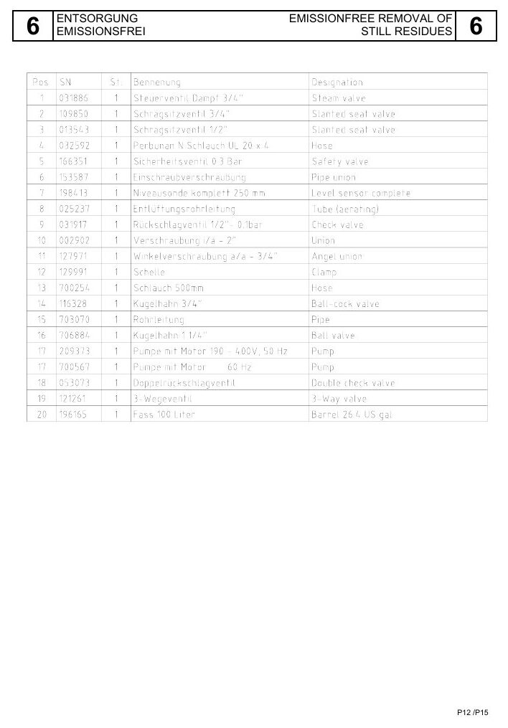
OPERATION & CONTROL
Pre-start inspection determines whether operation is allowed
EXPLODED PARTS VIEW
Use the item numbers on the drawing to identify the exact assembly before ordering or removal.
• Use display information and physical evidence together.
• If the sequence deviates, preserve the evidence and place the machine in a safe condition.
Exploded parts drawing • catalogue page 20
BÖWE P18 | Operation & Control
086
Notes:
[Sources]
- BÖWE P12-P15-P18 Operating Manual (2018-02), pages 60-75: https://www.ziermann.com/wp-content/uploads/2021/03/BA-Instruction-manual-BOeWE-P12-P15-P18-2018-02.pdf
- BÖWE P12-P15-P18 Spare Parts Catalogue: https://www.bowe-webshop.com/images/P12-P15-P18%20ET%20D%2BE%202003-06%20eckiger%20Luftschacht.pdf
- Practical visual: BÖWE P12-P15-P18 Spare Parts Catalogue, PDF page 20
Training interpretation: confirm the installed machine, current OEM revision, approved site PTW/LOTO, SDS and approved risk assessment before work.

Slide 87
OPERATION & CONTROL
Garment checks protect both load and machine
Build garment checks protect both load and machine into the approved operating sequence.
WHAT TO VERIFY
01 Use display information and physical evidence together.
02 If the sequence deviates, preserve the evidence and place the machine in a safe condition.
BÖWE P18 | Operation & Control
087
Notes:
[Sources]
- BÖWE P12-P15-P18 Operating Manual (2018-02), pages 60-75: https://www.ziermann.com/wp-content/uploads/2021/03/BA-Instruction-manual-BOeWE-P12-P15-P18-2018-02.pdf
- BÖWE P12-P15-P18 Spare Parts Catalogue: https://www.bowe-webshop.com/images/P12-P15-P18%20ET%20D%2BE%202003-06%20eckiger%20Luftschacht.pdf
Training interpretation: confirm the installed machine, current OEM revision, approved site PTW/LOTO, SDS and approved risk assessment before work.

Slide 88

OPERATION & CONTROL
Correct loading prevents imbalance and poor cleaning
EXPLODED PARTS VIEW
Use the item numbers on the drawing to identify the exact assembly before ordering or removal.
• Use display information and physical evidence together.
• If the sequence deviates, preserve the evidence and place the machine in a safe condition.
Exploded parts drawing • catalogue page 24
BÖWE P18 | Operation & Control
088
Notes:
[Sources]
- BÖWE P12-P15-P18 Operating Manual (2018-02), pages 60-75: https://www.ziermann.com/wp-content/uploads/2021/03/BA-Instruction-manual-BOeWE-P12-P15-P18-2018-02.pdf
- BÖWE P12-P15-P18 Spare Parts Catalogue: https://www.bowe-webshop.com/images/P12-P15-P18%20ET%20D%2BE%202003-06%20eckiger%20Luftschacht.pdf
- Practical visual: BÖWE P12-P15-P18 Spare Parts Catalogue, PDF page 24
Training interpretation: confirm the installed machine, current OEM revision, approved site PTW/LOTO, SDS and approved risk assessment before work.

Slide 89
OPERATION & CONTROL
Program selection must follow garment requirements
• Build program selection must follow garment requirements into the approved operating sequence.
• Use display information and physical evidence together.
• If the sequence deviates, preserve the evidence and place the machine in a safe condition.
TECHNICIAN CHECK
Can I locate it?
Can I verify it?
Can I make it safe?
Can I document closure?
BÖWE P18 | Operation & Control
089
Notes:
[Sources]
- BÖWE P12-P15-P18 Operating Manual (2018-02), pages 60-75: https://www.ziermann.com/wp-content/uploads/2021/03/BA-Instruction-manual-BOeWE-P12-P15-P18-2018-02.pdf
- BÖWE P12-P15-P18 Spare Parts Catalogue: https://www.bowe-webshop.com/images/P12-P15-P18%20ET%20D%2BE%202003-06%20eckiger%20Luftschacht.pdf
Training interpretation: confirm the installed machine, current OEM revision, approved site PTW/LOTO, SDS and approved risk assessment before work.

Slide 90
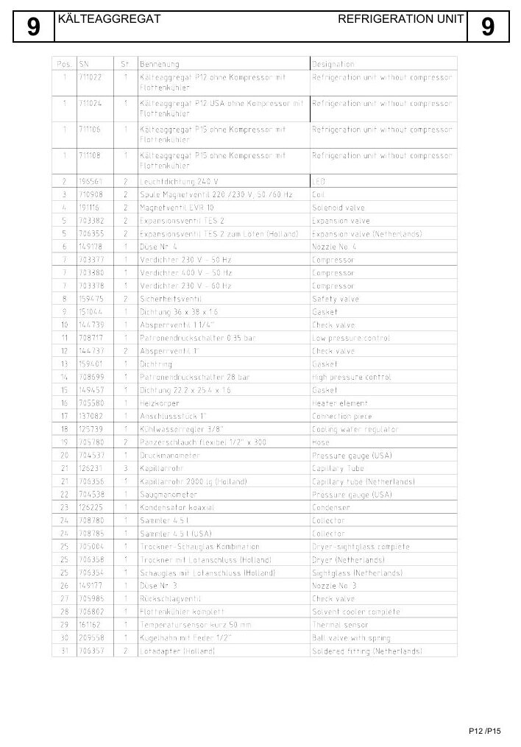
OPERATION & CONTROL
Automatic operation still requires active monitoring
EXPLODED PARTS VIEW
Use the item numbers on the drawing to identify the exact assembly before ordering or removal.
• Use display information and physical evidence together.
• If the sequence deviates, preserve the evidence and place the machine in a safe condition.
Exploded parts drawing • catalogue page 28
BÖWE P18 | Operation & Control
090
Notes:
[Sources]
- BÖWE P12-P15-P18 Operating Manual (2018-02), pages 60-75: https://www.ziermann.com/wp-content/uploads/2021/03/BA-Instruction-manual-BOeWE-P12-P15-P18-2018-02.pdf
- BÖWE P12-P15-P18 Spare Parts Catalogue: https://www.bowe-webshop.com/images/P12-P15-P18%20ET%20D%2BE%202003-06%20eckiger%20Luftschacht.pdf
- Practical visual: BÖWE P12-P15-P18 Spare Parts Catalogue, PDF page 28
Training interpretation: confirm the installed machine, current OEM revision, approved site PTW/LOTO, SDS and approved risk assessment before work.

Slide 91
OPERATION & CONTROL
Temperature display supports evidence-based decisions
WHY IT MATTERS
SAFE EXECUTION
Build temperature display supports evidence-based decisions into the approved operating sequence.
• Use display information and physical evidence together.
• If the sequence deviates, preserve the evidence and place the machine in a safe condition.
BÖWE P18 | Operation & Control
091
Notes:
[Sources]
- BÖWE P12-P15-P18 Operating Manual (2018-02), pages 60-75: https://www.ziermann.com/wp-content/uploads/2021/03/BA-Instruction-manual-BOeWE-P12-P15-P18-2018-02.pdf
- BÖWE P12-P15-P18 Spare Parts Catalogue: https://www.bowe-webshop.com/images/P12-P15-P18%20ET%20D%2BE%202003-06%20eckiger%20Luftschacht.pdf
Training interpretation: confirm the installed machine, current OEM revision, approved site PTW/LOTO, SDS and approved risk assessment before work.

Slide 92
OPERATION & CONTROL
Operating data provides a performance history
EXPLODED PARTS VIEW
Use the item numbers on the drawing to identify the exact assembly before ordering or removal.
• Use display information and physical evidence together.
• If the sequence deviates, preserve the evidence and place the machine in a safe condition.
Exploded parts drawing • catalogue page 32
BÖWE P18 | Operation & Control
092
Notes:
[Sources]
- BÖWE P12-P15-P18 Operating Manual (2018-02), pages 60-75: https://www.ziermann.com/wp-content/uploads/2021/03/BA-Instruction-manual-BOeWE-P12-P15-P18-2018-02.pdf
- BÖWE P12-P15-P18 Spare Parts Catalogue: https://www.bowe-webshop.com/images/P12-P15-P18%20ET%20D%2BE%202003-06%20eckiger%20Luftschacht.pdf
- Practical visual: BÖWE P12-P15-P18 Spare Parts Catalogue, PDF page 32
Training interpretation: confirm the installed machine, current OEM revision, approved site PTW/LOTO, SDS and approved risk assessment before work.

Slide 93
OPERATION & CONTROL
Error messages and notices require different responses
Build error messages and notices require different responses into the approved operating sequence.
WHAT TO VERIFY
01 Use display information and physical evidence together.
02 If the sequence deviates, preserve the evidence and place the machine in a safe condition.
BÖWE P18 | Operation & Control
093
Notes:
[Sources]
- BÖWE P12-P15-P18 Operating Manual (2018-02), pages 60-75: https://www.ziermann.com/wp-content/uploads/2021/03/BA-Instruction-manual-BOeWE-P12-P15-P18-2018-02.pdf
- BÖWE P12-P15-P18 Spare Parts Catalogue: https://www.bowe-webshop.com/images/P12-P15-P18%20ET%20D%2BE%202003-06%20eckiger%20Luftschacht.pdf
Training interpretation: confirm the installed machine, current OEM revision, approved site PTW/LOTO, SDS and approved risk assessment before work.

Slide 94
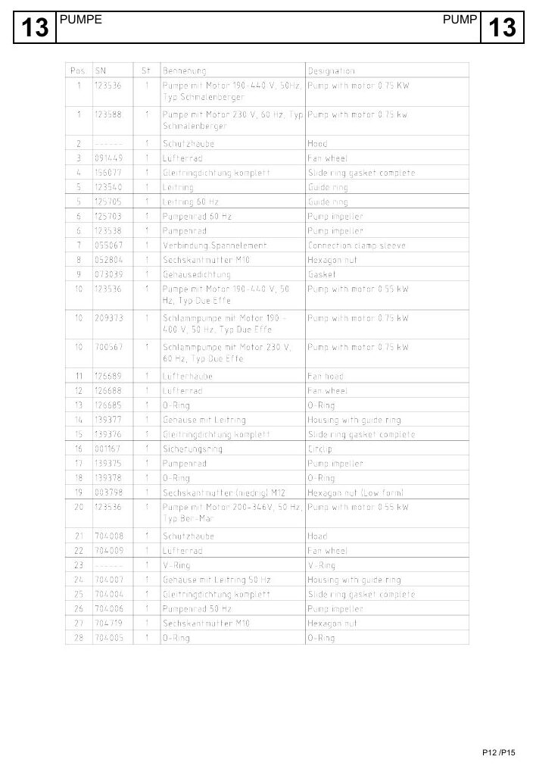
OPERATION & CONTROL
A test run confirms safe return to service
EXPLODED PARTS VIEW
Use the item numbers on the drawing to identify the exact assembly before ordering or removal.
• Use display information and physical evidence together.
• If the sequence deviates, preserve the evidence and place the machine in a safe condition.
Exploded parts drawing • catalogue page 36
BÖWE P18 | Operation & Control
094
Notes:
[Sources]
- BÖWE P12-P15-P18 Operating Manual (2018-02), pages 60-75: https://www.ziermann.com/wp-content/uploads/2021/03/BA-Instruction-manual-BOeWE-P12-P15-P18-2018-02.pdf
- BÖWE P12-P15-P18 Spare Parts Catalogue: https://www.bowe-webshop.com/images/P12-P15-P18%20ET%20D%2BE%202003-06%20eckiger%20Luftschacht.pdf
- Practical visual: BÖWE P12-P15-P18 Spare Parts Catalogue, PDF page 36
Training interpretation: confirm the installed machine, current OEM revision, approved site PTW/LOTO, SDS and approved risk assessment before work.

Slide 95
OPERATION & CONTROL
Deodorizing is the safe response when the door cannot open
• Select the OEM deodorizing program when the loading door cannot be opened.
• Do not force or bypass the door lock.
• Investigate the initiating fault after the machine reaches a safe condition.
TECHNICIAN CHECK
Can I locate it?
Can I verify it?
Can I make it safe?
Can I document closure?
BÖWE P18 | Operation & Control
095
Notes:
[Sources]
- BÖWE P12-P15-P18 Operating Manual (2018-02), pages 60-75: https://www.ziermann.com/wp-content/uploads/2021/03/BA-Instruction-manual-BOeWE-P12-P15-P18-2018-02.pdf
- BÖWE P12-P15-P18 Spare Parts Catalogue: https://www.bowe-webshop.com/images/P12-P15-P18%20ET%20D%2BE%202003-06%20eckiger%20Luftschacht.pdf
Training interpretation: confirm the installed machine, current OEM revision, approved site PTW/LOTO, SDS and approved risk assessment before work.

Slide 96
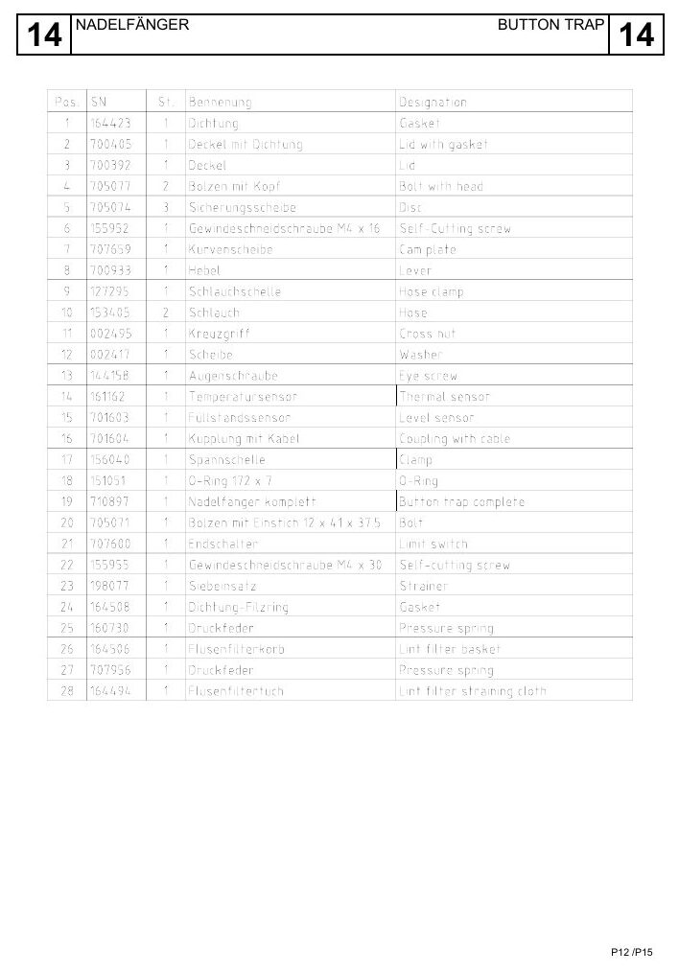
OPERATION & CONTROL
Maintenance programs automate defined process sequences
EXPLODED PARTS VIEW
Use the item numbers on the drawing to identify the exact assembly before ordering or removal.
• Confirm tanks, valves and disposal arrangements before starting.
• Monitor the complete sequence; automation does not remove operator responsibility.
Exploded parts drawing • catalogue page 40
BÖWE P18 | Operation & Control
096
Notes:
[Sources]
- BÖWE P12-P15-P18 Operating Manual (2018-02), pages 60-75: https://www.ziermann.com/wp-content/uploads/2021/03/BA-Instruction-manual-BOeWE-P12-P15-P18-2018-02.pdf
- BÖWE P12-P15-P18 Spare Parts Catalogue: https://www.bowe-webshop.com/images/P12-P15-P18%20ET%20D%2BE%202003-06%20eckiger%20Luftschacht.pdf
- Practical visual: BÖWE P12-P15-P18 Spare Parts Catalogue, PDF page 40
Training interpretation: confirm the installed machine, current OEM revision, approved site PTW/LOTO, SDS and approved risk assessment before work.

Slide 97
OPERATION & CONTROL
Shift handover preserves unresolved technical information
WHY IT MATTERS
SAFE EXECUTION
Build shift handover preserves unresolved technical information into the approved operating sequence.
• Use display information and physical evidence together.
• If the sequence deviates, preserve the evidence and place the machine in a safe condition.
BÖWE P18 | Operation & Control
097
Notes:
[Sources]
- BÖWE P12-P15-P18 Operating Manual (2018-02), pages 60-75: https://www.ziermann.com/wp-content/uploads/2021/03/BA-Instruction-manual-BOeWE-P12-P15-P18-2018-02.pdf
- BÖWE P12-P15-P18 Spare Parts Catalogue: https://www.bowe-webshop.com/images/P12-P15-P18%20ET%20D%2BE%202003-06%20eckiger%20Luftschacht.pdf
Training interpretation: confirm the installed machine, current OEM revision, approved site PTW/LOTO, SDS and approved risk assessment before work.

Slide 98
SECTION 07
Preventive Maintenance
Build understanding first; then apply it safely on the installed machine.
098
Notes:
[Sources]
- BÖWE P12-P15-P18 Operating Manual (2018-02), pages 76-100: https://www.ziermann.com/wp-content/uploads/2021/03/BA-Instruction-manual-BOeWE-P12-P15-P18-2018-02.pdf
- BÖWE P12-P15-P18 Spare Parts Catalogue: https://www.bowe-webshop.com/images/P12-P15-P18%20ET%20D%2BE%202003-06%20eckiger%20Luftschacht.pdf
Training interpretation: confirm the installed machine, current OEM revision, approved site PTW/LOTO, SDS and approved risk assessment before work.

Slide 99
PREVENTIVE MAINTENANCE
Daily maintenance protects safety and throughput
EXPLODED PARTS VIEW
Use the item numbers on the drawing to identify the exact assembly before ordering or removal.
• Define condition, acceptance criteria, frequency and evidence required.
• Raise corrective work for deterioration; a signed checklist alone is not completion.
Exploded parts drawing • catalogue page 44
BÖWE P18 | Preventive Maintenance
099
Notes:
[Sources]
- BÖWE P12-P15-P18 Operating Manual (2018-02), pages 76-100: https://www.ziermann.com/wp-content/uploads/2021/03/BA-Instruction-manual-BOeWE-P12-P15-P18-2018-02.pdf
- BÖWE P12-P15-P18 Spare Parts Catalogue: https://www.bowe-webshop.com/images/P12-P15-P18%20ET%20D%2BE%202003-06%20eckiger%20Luftschacht.pdf
- Practical visual: BÖWE P12-P15-P18 Spare Parts Catalogue, PDF page 44
Training interpretation: confirm the installed machine, current OEM revision, approved site PTW/LOTO, SDS and approved risk assessment before work.

Slide 100
PREVENTIVE MAINTENANCE
Inspect operating safety and liquid levels before startup
WHY IT MATTERS
SAFE EXECUTION
Include inspect operating safety and liquid levels before startup in the controlled PPM checklist.
• Define condition, acceptance criteria, frequency and evidence required.
• Raise corrective work for deterioration; a signed checklist alone is not completion.
BÖWE P18 | Preventive Maintenance
100
Notes:
[Sources]
- BÖWE P12-P15-P18 Operating Manual (2018-02), pages 76-100: https://www.ziermann.com/wp-content/uploads/2021/03/BA-Instruction-manual-BOeWE-P12-P15-P18-2018-02.pdf
- BÖWE P12-P15-P18 Spare Parts Catalogue: https://www.bowe-webshop.com/images/P12-P15-P18%20ET%20D%2BE%202003-06%20eckiger%20Luftschacht.pdf
Training interpretation: confirm the installed machine, current OEM revision, approved site PTW/LOTO, SDS and approved risk assessment before work.

Slide 101
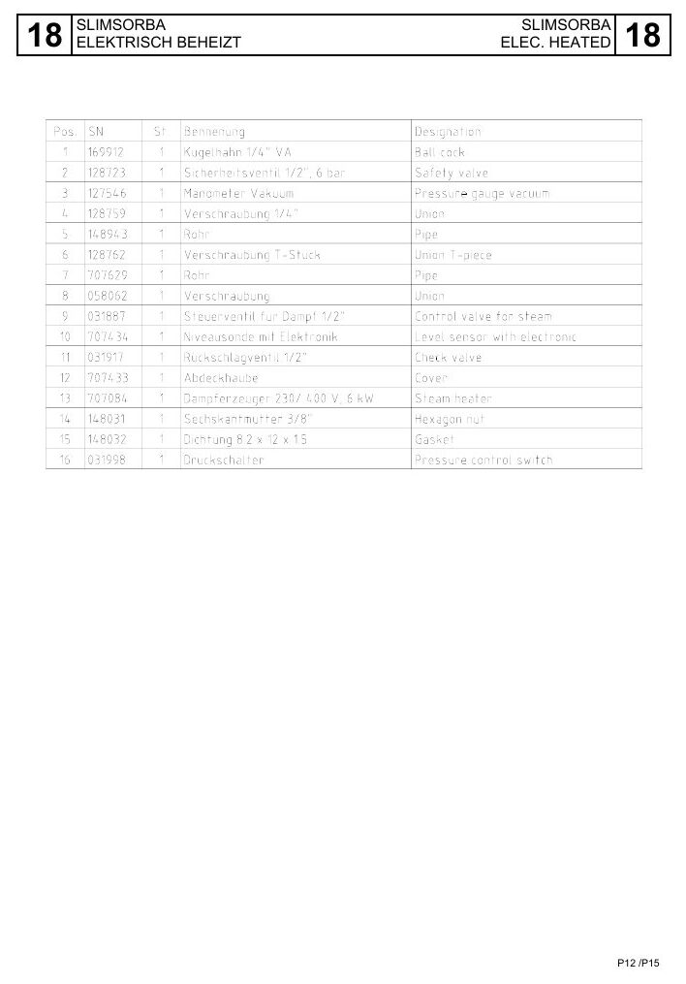
PREVENTIVE MAINTENANCE
Clean the lint filter daily or more often when required
EXPLODED PARTS VIEW
Use the item numbers on the drawing to identify the exact assembly before ordering or removal.
• Inspect sealing and correct seating before restarting.
• A restricted lint filter increases drying time and thermal stress.
Exploded parts drawing • catalogue page 48
BÖWE P18 | Preventive Maintenance
101
Notes:
[Sources]
- BÖWE P12-P15-P18 Operating Manual (2018-02), pages 76-100: https://www.ziermann.com/wp-content/uploads/2021/03/BA-Instruction-manual-BOeWE-P12-P15-P18-2018-02.pdf
- BÖWE P12-P15-P18 Spare Parts Catalogue: https://www.bowe-webshop.com/images/P12-P15-P18%20ET%20D%2BE%202003-06%20eckiger%20Luftschacht.pdf
- Practical visual: BÖWE P12-P15-P18 Spare Parts Catalogue, PDF page 48
Training interpretation: confirm the installed machine, current OEM revision, approved site PTW/LOTO, SDS and approved risk assessment before work.

Slide 102
PREVENTIVE MAINTENANCE
Clean the button-trap strainer every day
Remove captured objects and lint at least daily.
WHAT TO VERIFY
01 Check the strainer and seal for damage.
02 Account for sharp objects and solvent exposure during handling.
BÖWE P18 | Preventive Maintenance
102
Notes:
[Sources]
- BÖWE P12-P15-P18 Operating Manual (2018-02), pages 76-100: https://www.ziermann.com/wp-content/uploads/2021/03/BA-Instruction-manual-BOeWE-P12-P15-P18-2018-02.pdf
- BÖWE P12-P15-P18 Spare Parts Catalogue: https://www.bowe-webshop.com/images/P12-P15-P18%20ET%20D%2BE%202003-06%20eckiger%20Luftschacht.pdf
Training interpretation: confirm the installed machine, current OEM revision, approved site PTW/LOTO, SDS and approved risk assessment before work.

Slide 103

PREVENTIVE MAINTENANCE
Inspect door sealing and locking condition
EXPLODED PARTS VIEW
Use the item numbers on the drawing to identify the exact assembly before ordering or removal.
• Define condition, acceptance criteria, frequency and evidence required.
• Raise corrective work for deterioration; a signed checklist alone is not completion.
Exploded parts drawing • catalogue page 52
BÖWE P18 | Preventive Maintenance
103
Notes:
[Sources]
- BÖWE P12-P15-P18 Operating Manual (2018-02), pages 76-100: https://www.ziermann.com/wp-content/uploads/2021/03/BA-Instruction-manual-BOeWE-P12-P15-P18-2018-02.pdf
- BÖWE P12-P15-P18 Spare Parts Catalogue: https://www.bowe-webshop.com/images/P12-P15-P18%20ET%20D%2BE%202003-06%20eckiger%20Luftschacht.pdf
- Practical visual: BÖWE P12-P15-P18 Spare Parts Catalogue, PDF page 52
Training interpretation: confirm the installed machine, current OEM revision, approved site PTW/LOTO, SDS and approved risk assessment before work.

Slide 104
PREVENTIVE MAINTENANCE
Check sight-glasses for visibility and abnormal condition
• Include check sight-glasses for visibility and abnormal condition in the controlled PPM checklist.
• Define condition, acceptance criteria, frequency and evidence required.
• Raise corrective work for deterioration; a signed checklist alone is not completion.
TECHNICIAN CHECK
Can I locate it?
Can I verify it?
Can I make it safe?
Can I document closure?
BÖWE P18 | Preventive Maintenance
104
Notes:
[Sources]
- BÖWE P12-P15-P18 Operating Manual (2018-02), pages 76-100: https://www.ziermann.com/wp-content/uploads/2021/03/BA-Instruction-manual-BOeWE-P12-P15-P18-2018-02.pdf
- BÖWE P12-P15-P18 Spare Parts Catalogue: https://www.bowe-webshop.com/images/P12-P15-P18%20ET%20D%2BE%202003-06%20eckiger%20Luftschacht.pdf
Training interpretation: confirm the installed machine, current OEM revision, approved site PTW/LOTO, SDS and approved risk assessment before work.

Slide 105

PREVENTIVE MAINTENANCE
Inspect solvent and water separation quality
EXPLODED PARTS VIEW
Use the item numbers on the drawing to identify the exact assembly before ordering or removal.
• Define condition, acceptance criteria, frequency and evidence required.
• Raise corrective work for deterioration; a signed checklist alone is not completion.
Exploded parts drawing • catalogue page 56
BÖWE P18 | Preventive Maintenance
105
Notes:
[Sources]
- BÖWE P12-P15-P18 Operating Manual (2018-02), pages 76-100: https://www.ziermann.com/wp-content/uploads/2021/03/BA-Instruction-manual-BOeWE-P12-P15-P18-2018-02.pdf
- BÖWE P12-P15-P18 Spare Parts Catalogue: https://www.bowe-webshop.com/images/P12-P15-P18%20ET%20D%2BE%202003-06%20eckiger%20Luftschacht.pdf
- Practical visual: BÖWE P12-P15-P18 Spare Parts Catalogue, PDF page 56
Training interpretation: confirm the installed machine, current OEM revision, approved site PTW/LOTO, SDS and approved risk assessment before work.

Slide 106
PREVENTIVE MAINTENANCE
Monitor unusual noise, heat and vibration
WHY IT MATTERS
SAFE EXECUTION
Include monitor unusual noise, heat and vibration in the controlled PPM checklist.
• Define condition, acceptance criteria, frequency and evidence required.
• Raise corrective work for deterioration; a signed checklist alone is not completion.
BÖWE P18 | Preventive Maintenance
106
Notes:
[Sources]
- BÖWE P12-P15-P18 Operating Manual (2018-02), pages 76-100: https://www.ziermann.com/wp-content/uploads/2021/03/BA-Instruction-manual-BOeWE-P12-P15-P18-2018-02.pdf
- BÖWE P12-P15-P18 Spare Parts Catalogue: https://www.bowe-webshop.com/images/P12-P15-P18%20ET%20D%2BE%202003-06%20eckiger%20Luftschacht.pdf
Training interpretation: confirm the installed machine, current OEM revision, approved site PTW/LOTO, SDS and approved risk assessment before work.

Slide 107

PREVENTIVE MAINTENANCE
Weekly maintenance prevents hidden degradation
EXPLODED PARTS VIEW
Use the item numbers on the drawing to identify the exact assembly before ordering or removal.
• Define condition, acceptance criteria, frequency and evidence required.
• Raise corrective work for deterioration; a signed checklist alone is not completion.
Exploded parts drawing • catalogue page 60
BÖWE P18 | Preventive Maintenance
107
Notes:
[Sources]
- BÖWE P12-P15-P18 Operating Manual (2018-02), pages 76-100: https://www.ziermann.com/wp-content/uploads/2021/03/BA-Instruction-manual-BOeWE-P12-P15-P18-2018-02.pdf
- BÖWE P12-P15-P18 Spare Parts Catalogue: https://www.bowe-webshop.com/images/P12-P15-P18%20ET%20D%2BE%202003-06%20eckiger%20Luftschacht.pdf
- Practical visual: BÖWE P12-P15-P18 Spare Parts Catalogue, PDF page 60
Training interpretation: confirm the installed machine, current OEM revision, approved site PTW/LOTO, SDS and approved risk assessment before work.

Slide 108
PREVENTIVE MAINTENANCE
Drain water from the compressed-air service unit
Include drain water from the compressed-air service unit in the controlled PPM checklist.
WHAT TO VERIFY
01 Define condition, acceptance criteria, frequency and evidence required.
02 Raise corrective work for deterioration; a signed checklist alone is not completion.
BÖWE P18 | Preventive Maintenance
108
Notes:
[Sources]
- BÖWE P12-P15-P18 Operating Manual (2018-02), pages 76-100: https://www.ziermann.com/wp-content/uploads/2021/03/BA-Instruction-manual-BOeWE-P12-P15-P18-2018-02.pdf
- BÖWE P12-P15-P18 Spare Parts Catalogue: https://www.bowe-webshop.com/images/P12-P15-P18%20ET%20D%2BE%202003-06%20eckiger%20Luftschacht.pdf
Training interpretation: confirm the installed machine, current OEM revision, approved site PTW/LOTO, SDS and approved risk assessment before work.

Slide 109

PREVENTIVE MAINTENANCE
Run filter maintenance at the specified interval
EXPLODED PARTS VIEW
Use the item numbers on the drawing to identify the exact assembly before ordering or removal.
• Define condition, acceptance criteria, frequency and evidence required.
• Raise corrective work for deterioration; a signed checklist alone is not completion.
Exploded parts drawing • catalogue page 64
BÖWE P18 | Preventive Maintenance
109
Notes:
[Sources]
- BÖWE P12-P15-P18 Operating Manual (2018-02), pages 76-100: https://www.ziermann.com/wp-content/uploads/2021/03/BA-Instruction-manual-BOeWE-P12-P15-P18-2018-02.pdf
- BÖWE P12-P15-P18 Spare Parts Catalogue: https://www.bowe-webshop.com/images/P12-P15-P18%20ET%20D%2BE%202003-06%20eckiger%20Luftschacht.pdf
- Practical visual: BÖWE P12-P15-P18 Spare Parts Catalogue, PDF page 64
Training interpretation: confirm the installed machine, current OEM revision, approved site PTW/LOTO, SDS and approved risk assessment before work.

Slide 110
PREVENTIVE MAINTENANCE
Clean the Slimsorba air-filter insert when fitted
• Include clean the Slimsorba air-filter insert when fitted in the controlled PPM checklist.
• Define condition, acceptance criteria, frequency and evidence required.
• Raise corrective work for deterioration; a signed checklist alone is not completion.
TECHNICIAN CHECK
Can I locate it?
Can I verify it?
Can I make it safe?
Can I document closure?
BÖWE P18 | Preventive Maintenance
110
Notes:
[Sources]
- BÖWE P12-P15-P18 Operating Manual (2018-02), pages 76-100: https://www.ziermann.com/wp-content/uploads/2021/03/BA-Instruction-manual-BOeWE-P12-P15-P18-2018-02.pdf
- BÖWE P12-P15-P18 Spare Parts Catalogue: https://www.bowe-webshop.com/images/P12-P15-P18%20ET%20D%2BE%202003-06%20eckiger%20Luftschacht.pdf
Training interpretation: confirm the installed machine, current OEM revision, approved site PTW/LOTO, SDS and approved risk assessment before work.

Slide 111

PREVENTIVE MAINTENANCE
Check overfill-sensor function at the required interval
EXPLODED PARTS VIEW
Use the item numbers on the drawing to identify the exact assembly before ordering or removal.
• Define condition, acceptance criteria, frequency and evidence required.
• Raise corrective work for deterioration; a signed checklist alone is not completion.
Exploded parts drawing • catalogue page 68
BÖWE P18 | Preventive Maintenance
111
Notes:
[Sources]
- BÖWE P12-P15-P18 Operating Manual (2018-02), pages 76-100: https://www.ziermann.com/wp-content/uploads/2021/03/BA-Instruction-manual-BOeWE-P12-P15-P18-2018-02.pdf
- BÖWE P12-P15-P18 Spare Parts Catalogue: https://www.bowe-webshop.com/images/P12-P15-P18%20ET%20D%2BE%202003-06%20eckiger%20Luftschacht.pdf
- Practical visual: BÖWE P12-P15-P18 Spare Parts Catalogue, PDF page 68
Training interpretation: confirm the installed machine, current OEM revision, approved site PTW/LOTO, SDS and approved risk assessment before work.

Slide 112
PREVENTIVE MAINTENANCE
Monthly lubrication protects the cage bearing
WHY IT MATTERS
SAFE EXECUTION
Use the specified lubricant, quantity and point.
• Prevent contamination at the grease nipple.
• Record date, technician and abnormal bearing observations.
BÖWE P18 | Preventive Maintenance
112
Notes:
[Sources]
- BÖWE P12-P15-P18 Operating Manual (2018-02), pages 76-100: https://www.ziermann.com/wp-content/uploads/2021/03/BA-Instruction-manual-BOeWE-P12-P15-P18-2018-02.pdf
- BÖWE P12-P15-P18 Spare Parts Catalogue: https://www.bowe-webshop.com/images/P12-P15-P18%20ET%20D%2BE%202003-06%20eckiger%20Luftschacht.pdf
Training interpretation: confirm the installed machine, current OEM revision, approved site PTW/LOTO, SDS and approved risk assessment before work.

Slide 113

PREVENTIVE MAINTENANCE
Check drive belts for wear, tension and alignment
EXPLODED PARTS VIEW
Use the item numbers on the drawing to identify the exact assembly before ordering or removal.
• The P-series manual identifies a semi-annual belt check; adopt the current OEM interval.
• Repeated belt wear is a symptom—correct alignment, loading or bearing causes.
Exploded parts drawing • catalogue page 72
BÖWE P18 | Preventive Maintenance
113
Notes:
[Sources]
- BÖWE P12-P15-P18 Operating Manual (2018-02), pages 76-100: https://www.ziermann.com/wp-content/uploads/2021/03/BA-Instruction-manual-BOeWE-P12-P15-P18-2018-02.pdf
- BÖWE P12-P15-P18 Spare Parts Catalogue: https://www.bowe-webshop.com/images/P12-P15-P18%20ET%20D%2BE%202003-06%20eckiger%20Luftschacht.pdf
- Practical visual: BÖWE P12-P15-P18 Spare Parts Catalogue, PDF page 72
Training interpretation: confirm the installed machine, current OEM revision, approved site PTW/LOTO, SDS and approved risk assessment before work.

Slide 114
PREVENTIVE MAINTENANCE
Inspect sensor faces, cables and mountings
Include inspect sensor faces, cables and mountings in the controlled PPM checklist.
WHAT TO VERIFY
01 Define condition, acceptance criteria, frequency and evidence required.
02 Raise corrective work for deterioration; a signed checklist alone is not completion.
BÖWE P18 | Preventive Maintenance
114
Notes:
[Sources]
- BÖWE P12-P15-P18 Operating Manual (2018-02), pages 76-100: https://www.ziermann.com/wp-content/uploads/2021/03/BA-Instruction-manual-BOeWE-P12-P15-P18-2018-02.pdf
- BÖWE P12-P15-P18 Spare Parts Catalogue: https://www.bowe-webshop.com/images/P12-P15-P18%20ET%20D%2BE%202003-06%20eckiger%20Luftschacht.pdf
Training interpretation: confirm the installed machine, current OEM revision, approved site PTW/LOTO, SDS and approved risk assessment before work.

Slide 115

PREVENTIVE MAINTENANCE
Keep cooling and heat-transfer surfaces clean
EXPLODED PARTS VIEW
Use the item numbers on the drawing to identify the exact assembly before ordering or removal.
• Define condition, acceptance criteria, frequency and evidence required.
• Raise corrective work for deterioration; a signed checklist alone is not completion.
Exploded parts drawing • catalogue page 76
BÖWE P18 | Preventive Maintenance
115
Notes:
[Sources]
- BÖWE P12-P15-P18 Operating Manual (2018-02), pages 76-100: https://www.ziermann.com/wp-content/uploads/2021/03/BA-Instruction-manual-BOeWE-P12-P15-P18-2018-02.pdf
- BÖWE P12-P15-P18 Spare Parts Catalogue: https://www.bowe-webshop.com/images/P12-P15-P18%20ET%20D%2BE%202003-06%20eckiger%20Luftschacht.pdf
- Practical visual: BÖWE P12-P15-P18 Spare Parts Catalogue, PDF page 76
Training interpretation: confirm the installed machine, current OEM revision, approved site PTW/LOTO, SDS and approved risk assessment before work.

Slide 116
PREVENTIVE MAINTENANCE
Inspect hoses, pipes, unions and valves for leakage
• Include inspect hoses, pipes, unions and valves for leakage in the controlled PPM checklist.
• Define condition, acceptance criteria, frequency and evidence required.
• Raise corrective work for deterioration; a signed checklist alone is not completion.
TECHNICIAN CHECK
Can I locate it?
Can I verify it?
Can I make it safe?
Can I document closure?
BÖWE P18 | Preventive Maintenance
116
Notes:
[Sources]
- BÖWE P12-P15-P18 Operating Manual (2018-02), pages 76-100: https://www.ziermann.com/wp-content/uploads/2021/03/BA-Instruction-manual-BOeWE-P12-P15-P18-2018-02.pdf
- BÖWE P12-P15-P18 Spare Parts Catalogue: https://www.bowe-webshop.com/images/P12-P15-P18%20ET%20D%2BE%202003-06%20eckiger%20Luftschacht.pdf
Training interpretation: confirm the installed machine, current OEM revision, approved site PTW/LOTO, SDS and approved risk assessment before work.

Slide 117

PREVENTIVE MAINTENANCE
Clean tanks only through the approved maintenance sequence
EXPLODED PARTS VIEW
Use the item numbers on the drawing to identify the exact assembly before ordering or removal.
• Define condition, acceptance criteria, frequency and evidence required.
• Raise corrective work for deterioration; a signed checklist alone is not completion.
Exploded parts drawing • catalogue page 80
BÖWE P18 | Preventive Maintenance
117
Notes:
[Sources]
- BÖWE P12-P15-P18 Operating Manual (2018-02), pages 76-100: https://www.ziermann.com/wp-content/uploads/2021/03/BA-Instruction-manual-BOeWE-P12-P15-P18-2018-02.pdf
- BÖWE P12-P15-P18 Spare Parts Catalogue: https://www.bowe-webshop.com/images/P12-P15-P18%20ET%20D%2BE%202003-06%20eckiger%20Luftschacht.pdf
- Practical visual: BÖWE P12-P15-P18 Spare Parts Catalogue, PDF page 80
Training interpretation: confirm the installed machine, current OEM revision, approved site PTW/LOTO, SDS and approved risk assessment before work.

Slide 118
PREVENTIVE MAINTENANCE
Maintenance records must show evidence and closure
WHY IT MATTERS
SAFE EXECUTION
Include maintenance records must show evidence and closure in the controlled PPM checklist.
• Define condition, acceptance criteria, frequency and evidence required.
• Raise corrective work for deterioration; a signed checklist alone is not completion.
BÖWE P18 | Preventive Maintenance
118
Notes:
[Sources]
- BÖWE P12-P15-P18 Operating Manual (2018-02), pages 76-100: https://www.ziermann.com/wp-content/uploads/2021/03/BA-Instruction-manual-BOeWE-P12-P15-P18-2018-02.pdf
- BÖWE P12-P15-P18 Spare Parts Catalogue: https://www.bowe-webshop.com/images/P12-P15-P18%20ET%20D%2BE%202003-06%20eckiger%20Luftschacht.pdf
Training interpretation: confirm the installed machine, current OEM revision, approved site PTW/LOTO, SDS and approved risk assessment before work.

Slide 119
SECTION 08
Troubleshooting & Spares
Build understanding first; then apply it safely on the installed machine.
119
Notes:
[Sources]
- BÖWE P12-P15-P18 Operating Manual (2018-02), pages 60-100: https://www.ziermann.com/wp-content/uploads/2021/03/BA-Instruction-manual-BOeWE-P12-P15-P18-2018-02.pdf
- BÖWE P12-P15-P18 Spare Parts Catalogue: https://www.bowe-webshop.com/images/P12-P15-P18%20ET%20D%2BE%202003-06%20eckiger%20Luftschacht.pdf
Training interpretation: confirm the installed machine, current OEM revision, approved site PTW/LOTO, SDS and approved risk assessment before work.

Slide 120

TROUBLESHOOTING & SPARES
Start diagnosis with the first abnormal evidence
EXPLODED PARTS VIEW
Use the item numbers on the drawing to identify the exact assembly before ordering or removal.
• Confirm the cause with repeatable evidence before replacing components.
• Document the repair, functional test and lessons for future prevention.
Exploded parts drawing • catalogue page 84
BÖWE P18 | Troubleshooting & Spares
120
Notes:
[Sources]
- BÖWE P12-P15-P18 Operating Manual (2018-02), pages 60-100: https://www.ziermann.com/wp-content/uploads/2021/03/BA-Instruction-manual-BOeWE-P12-P15-P18-2018-02.pdf
- BÖWE P12-P15-P18 Spare Parts Catalogue: https://www.bowe-webshop.com/images/P12-P15-P18%20ET%20D%2BE%202003-06%20eckiger%20Luftschacht.pdf
- Practical visual: BÖWE P12-P15-P18 Spare Parts Catalogue, PDF page 84
Training interpretation: confirm the installed machine, current OEM revision, approved site PTW/LOTO, SDS and approved risk assessment before work.

Slide 121
TROUBLESHOOTING & SPARES
Do not reset repeatedly without finding the cause
WHY IT MATTERS
SAFE EXECUTION
Use do not reset repeatedly without finding the cause to narrow the fault without unsafe trial-and-error.
• Confirm the cause with repeatable evidence before replacing components.
• Document the repair, functional test and lessons for future prevention.
BÖWE P18 | Troubleshooting & Spares
121
Notes:
[Sources]
- BÖWE P12-P15-P18 Operating Manual (2018-02), pages 60-100: https://www.ziermann.com/wp-content/uploads/2021/03/BA-Instruction-manual-BOeWE-P12-P15-P18-2018-02.pdf
- BÖWE P12-P15-P18 Spare Parts Catalogue: https://www.bowe-webshop.com/images/P12-P15-P18%20ET%20D%2BE%202003-06%20eckiger%20Luftschacht.pdf
Training interpretation: confirm the installed machine, current OEM revision, approved site PTW/LOTO, SDS and approved risk assessment before work.

Slide 122
TROUBLESHOOTING & SPARES
Separate process faults from component faults
• Use separate process faults from component faults to narrow the fault without unsafe trial-and-error.
• Confirm the cause with repeatable evidence before replacing components.
• Document the repair, functional test and lessons for future prevention.
TECHNICIAN CHECK
Can I locate it?
Can I verify it?
Can I make it safe?
Can I document closure?
BÖWE P18 | Troubleshooting & Spares
122
Notes:
[Sources]
- BÖWE P12-P15-P18 Operating Manual (2018-02), pages 60-100: https://www.ziermann.com/wp-content/uploads/2021/03/BA-Instruction-manual-BOeWE-P12-P15-P18-2018-02.pdf
- BÖWE P12-P15-P18 Spare Parts Catalogue: https://www.bowe-webshop.com/images/P12-P15-P18%20ET%20D%2BE%202003-06%20eckiger%20Luftschacht.pdf
Training interpretation: confirm the installed machine, current OEM revision, approved site PTW/LOTO, SDS and approved risk assessment before work.

Slide 123
TROUBLESHOOTING & SPARES
Use trends to confirm intermittent failures
Use use trends to confirm intermittent failures to narrow the fault without unsafe trial-and-error.
WHAT TO VERIFY
01 Confirm the cause with repeatable evidence before replacing components.
02 Document the repair, functional test and lessons for future prevention.
BÖWE P18 | Troubleshooting & Spares
123
Notes:
[Sources]
- BÖWE P12-P15-P18 Operating Manual (2018-02), pages 60-100: https://www.ziermann.com/wp-content/uploads/2021/03/BA-Instruction-manual-BOeWE-P12-P15-P18-2018-02.pdf
- BÖWE P12-P15-P18 Spare Parts Catalogue: https://www.bowe-webshop.com/images/P12-P15-P18%20ET%20D%2BE%202003-06%20eckiger%20Luftschacht.pdf
Training interpretation: confirm the installed machine, current OEM revision, approved site PTW/LOTO, SDS and approved risk assessment before work.

Slide 124
TROUBLESHOOTING & SPARES
Verify repair effectiveness with a controlled test
WHY IT MATTERS
SAFE EXECUTION
Use verify repair effectiveness with a controlled test to narrow the fault without unsafe trial-and-error.
• Confirm the cause with repeatable evidence before replacing components.
• Document the repair, functional test and lessons for future prevention.
BÖWE P18 | Troubleshooting & Spares
124
Notes:
[Sources]
- BÖWE P12-P15-P18 Operating Manual (2018-02), pages 60-100: https://www.ziermann.com/wp-content/uploads/2021/03/BA-Instruction-manual-BOeWE-P12-P15-P18-2018-02.pdf
- BÖWE P12-P15-P18 Spare Parts Catalogue: https://www.bowe-webshop.com/images/P12-P15-P18%20ET%20D%2BE%202003-06%20eckiger%20Luftschacht.pdf
Training interpretation: confirm the installed machine, current OEM revision, approved site PTW/LOTO, SDS and approved risk assessment before work.

Slide 125
TROUBLESHOOTING & SPARES
Order spare parts using model, serial number and year
• State BÖWE P18, machine serial number and manufacturing year.
• Confirm installed options and modification status.
• Use the OEM designation and part number; retain traceability after installation.
TECHNICIAN CHECK
Can I locate it?
Can I verify it?
Can I make it safe?
Can I document closure?
BÖWE P18 | Troubleshooting & Spares
125
Notes:
[Sources]
- BÖWE P12-P15-P18 Operating Manual (2018-02), pages 60-100: https://www.ziermann.com/wp-content/uploads/2021/03/BA-Instruction-manual-BOeWE-P12-P15-P18-2018-02.pdf
- BÖWE P12-P15-P18 Spare Parts Catalogue: https://www.bowe-webshop.com/images/P12-P15-P18%20ET%20D%2BE%202003-06%20eckiger%20Luftschacht.pdf
Training interpretation: confirm the installed machine, current OEM revision, approved site PTW/LOTO, SDS and approved risk assessment before work.

Slide 126
TROUBLESHOOTING & SPARES
Configuration and modification status control compatibility
Use configuration and modification status control compatibility to narrow the fault without unsafe trial-and-error.
WHAT TO VERIFY
01 Confirm the cause with repeatable evidence before replacing components.
02 Document the repair, functional test and lessons for future prevention.
BÖWE P18 | Troubleshooting & Spares
126
Notes:
[Sources]
- BÖWE P12-P15-P18 Operating Manual (2018-02), pages 60-100: https://www.ziermann.com/wp-content/uploads/2021/03/BA-Instruction-manual-BOeWE-P12-P15-P18-2018-02.pdf
- BÖWE P12-P15-P18 Spare Parts Catalogue: https://www.bowe-webshop.com/images/P12-P15-P18%20ET%20D%2BE%202003-06%20eckiger%20Luftschacht.pdf
Training interpretation: confirm the installed machine, current OEM revision, approved site PTW/LOTO, SDS and approved risk assessment before work.

Slide 127
TROUBLESHOOTING & SPARES
Competency is demonstrated by safe repeatable execution
WHY IT MATTERS
SAFE EXECUTION
Use competency is demonstrated by safe repeatable execution to narrow the fault without unsafe trial-and-error.
• Confirm the cause with repeatable evidence before replacing components.
• Document the repair, functional test and lessons for future prevention.
BÖWE P18 | Troubleshooting & Spares
127
Notes:
[Sources]
- BÖWE P12-P15-P18 Operating Manual (2018-02), pages 60-100: https://www.ziermann.com/wp-content/uploads/2021/03/BA-Instruction-manual-BOeWE-P12-P15-P18-2018-02.pdf
- BÖWE P12-P15-P18 Spare Parts Catalogue: https://www.bowe-webshop.com/images/P12-P15-P18%20ET%20D%2BE%202003-06%20eckiger%20Luftschacht.pdf
Training interpretation: confirm the installed machine, current OEM revision, approved site PTW/LOTO, SDS and approved risk assessment before work.

Slide 128
Competence is safe, repeatable execution
Before independent work, the technician should demonstrate:
01
Correct machine and document identification
02
Hazard recognition and verified isolation
03
Systematic inspection and evidence-based diagnosis
04
OEM-compliant maintenance and parts control
05
Controlled functional test and complete handover
BÖWE P18 | Competency
128
Notes:
[Sources]
- BÖWE P12-P15-P18 Operating Manual (2018-02), pages 60-100: https://www.ziermann.com/wp-content/uploads/2021/03/BA-Instruction-manual-BOeWE-P12-P15-P18-2018-02.pdf
- BÖWE P12-P15-P18 Spare Parts Catalogue: https://www.bowe-webshop.com/images/P12-P15-P18%20ET%20D%2BE%202003-06%20eckiger%20Luftschacht.pdf
Training interpretation: confirm the installed machine, current OEM revision, approved site PTW/LOTO, SDS and approved risk assessment before work.

