Slide 1
Tour Management System

Slide 2
Problem & Sub-Problems :
We want to provide a platform which will help the tourists to visit or tour the place where they want to go.
In which they can filter the best country to tour according to their budget and suitable month. OR In which they can ask the country tour according to their choice not according to their budget.
In which they can have multiple options of packages like :
>> Stay duration.
>> Different amount for each package.
>> Different places to visit.
>> Hotel, food & other necessities.

Slide 3
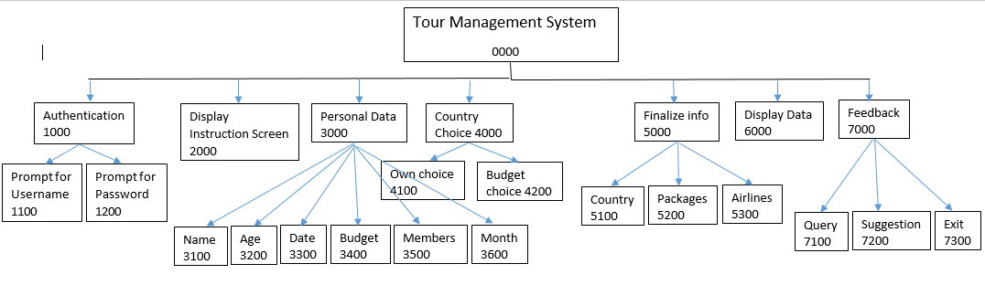
HIPO Chart :

Slide 4
Solution of the Problem
In our program we have solve the problem, a tourist can visit to the places he wants under the reasonable price.
A tourist have both the options :
>> Customer can select the country according to their choice
>> Customer can choose a country according to their budget.
The program is offering 3 packages in each country for our customers.
The program is offering discount for 5 members, 10 members and more.
The program is offering five star hotels to stay.
The program is offering most attractive and famous places to visit.

Slide 5
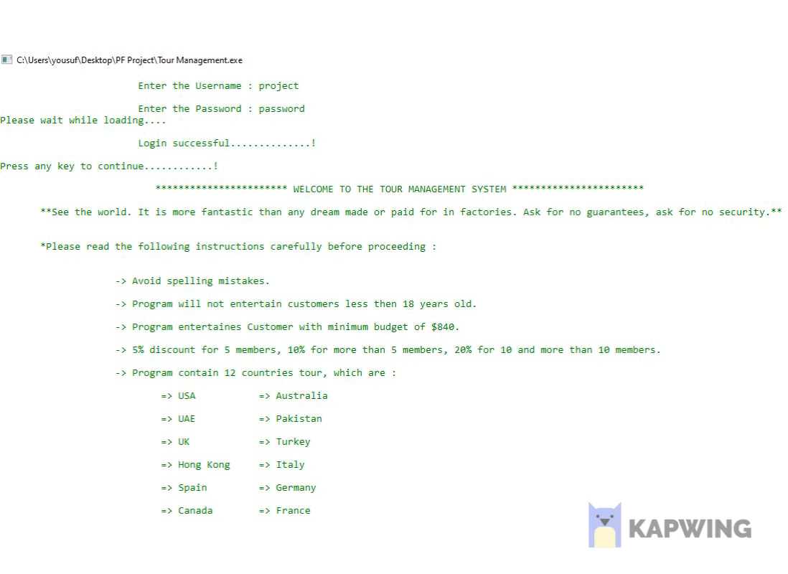
The Snap Shots of Project

Slide 6
Limitations
The program offering tour for only 12 countries from all over the world.
The program contain tour packages for only 12 countries, it can go to all over the world.
We are convincing the customer through discount, packages and famous places to visit, but we can try more methods to convince the customers.
The program can take the queries and suggestions from the customer but can not reply it, so it can also be added into this.

Slide 7
Software Inputs and Outputs
Firstly, enter the username i.e. “project” and then password “password.”
After the authentication the instructions for the program will print.
Then program will ask about personal data name, age and current date, it will be good if date is in this format (2-2-2020) other formats are also good.
Then it will ask tour information, your budget, total members and suitable month for you.
The program will ask your choice you can enter 1 for your own choice in which you will enter country name yourself (enter country name which are mentioned in instructions as we have only 12 countries tour packages), in option 2 you can enter 2 for country according to your budget and month.
For option 2 program will filter the countries according to your budget and the month which is good to tour in that country.
Then you will finalize your information by entering country name then the packages of that country will be printed, after that you will enter package number and airlines to reach that country.

Slide 8
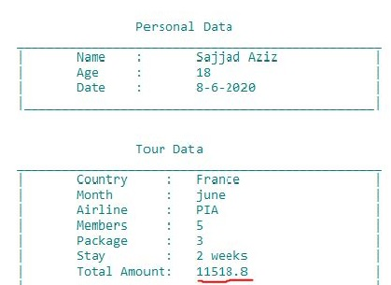
Software Inputs and Outputs continue……
The program will print the summary of your data, it will also print the total amount by deducting the discount if customer have any.
After showing the summary of your data program will ask for your query, suggestion, you can enter 1 for query, 2 for suggestion or you can exit by entering 3.
Your query or suggestion will be saved in file so the admin can read it.

