Slide 1
Tour management system

Slide 2
Problem
We want to provide a platform which will help the tourists to visit or explore the place where they please.
In which they can filter the tour countries according to their budget and selected month. OR they can select tour country according to their own preferences.
In which they can have much facilities according to their requirements.

Slide 3
Solution of the Problem
In our project we have solved the problem by providing the customer best tour under consideration of his budget and preferences.
A tourist will have both the options; tour according to their month and duration and second one is tourist’s own preferences, from which he can choose either of it,
Also, the program is offering three distinct packages for each countries.

Slide 4
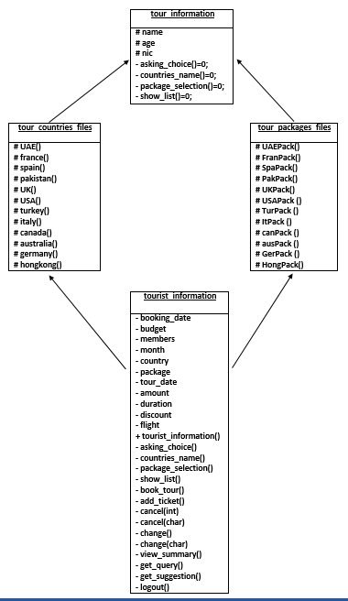
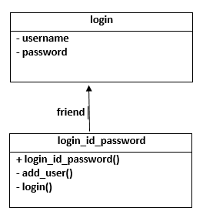

Slide 5
Software Inputs & Outputs
Firstly, the program will prompt user to login, if the user had an account then he may login but if not then first he has to add him as a user and then he will be able to log in.
After authentication of user, the program will print the instructions related to the software.
Then it will prompt user to give his personal information and about tour.
After providing all the necessary information, it will give two options either to see countries name according to customer’s budget and month, or to choose according to his own preference.
After viewing country information, program will ask to finalize the rest of information, like country name and package number.
From package number, program will calculate the amount and if there is any discount, it will deduct from total amount.

Slide 6
Software Inputs & Outputs continue…
After finalizing, program will print the list of options and to do them user can simply enter the corresponding number of the option.
Option 1 is for booking of tour, in which user can enter a year and it will print the whole calendar of the respective year from which user can look for a tour date.
In option 2 and 3 user can add or cancel the tickets as he please.
Option 4, 5 and 6 are for changing of country package and to cancel tour.
Option 7 is to view whole summary of tour, and option 8 and 9 is to submit user queries and suggestion.
Option 10 is for log out.

Slide 7
Topics Covered
Data Abstraction.
Encapsulation.
Constructor.
Multiple Inheritance.
Function overloading.
Friend class.
Diamond problem.
Virtual Inheritance.
Abstract class and interface.
Filing.
Exception Handling.

Slide 8
Limitations
From all over the world the program is offering tour for just only twelve countries, it can go to all over the world.
We are trying to convince customers through offering them discounts, packages and accessories but we can try more methods to attracts people attention.
In the end the program is asking for customer’s suggestion and queries but aren’t responded, which can be responded.

