Slide 1
Sajjad Dehnoei
B. Eng., M.Sc.

Slide 2
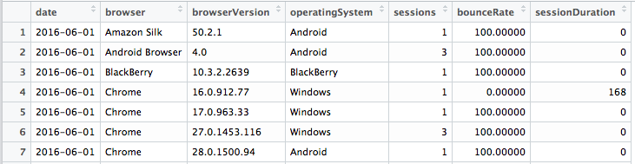





Data
~ 1’000’000 records
Understanding customers --- Creating customer profiles --- Sales trend & prediction

Slide 3
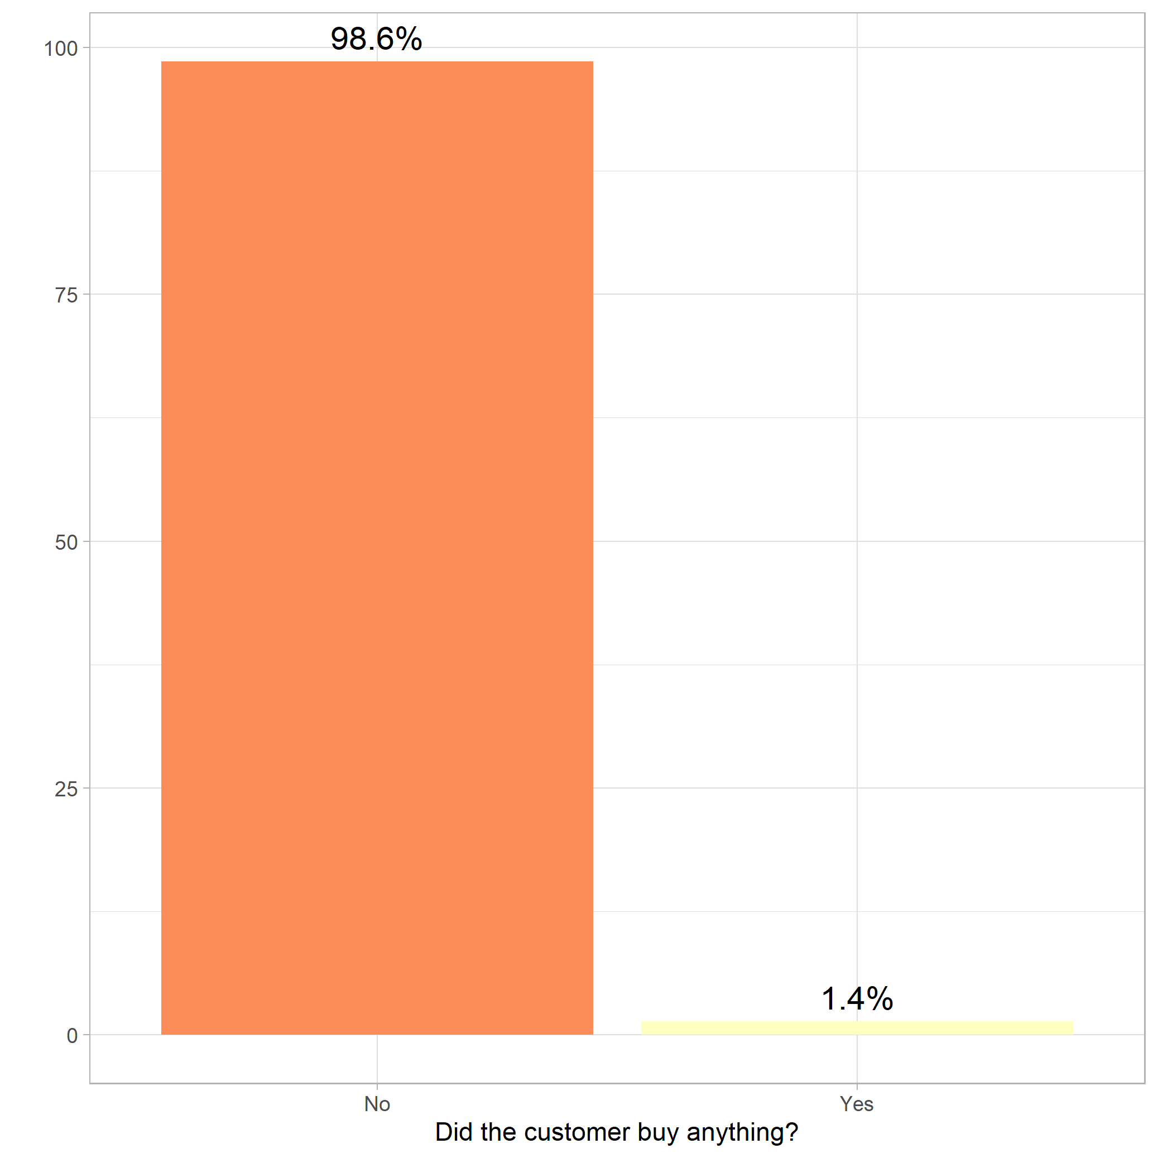
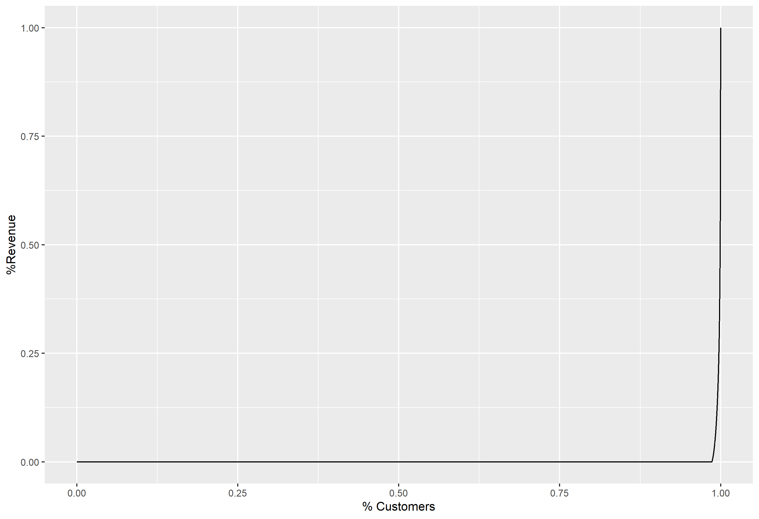
Who are our Customers? (Revenue)

Slide 4
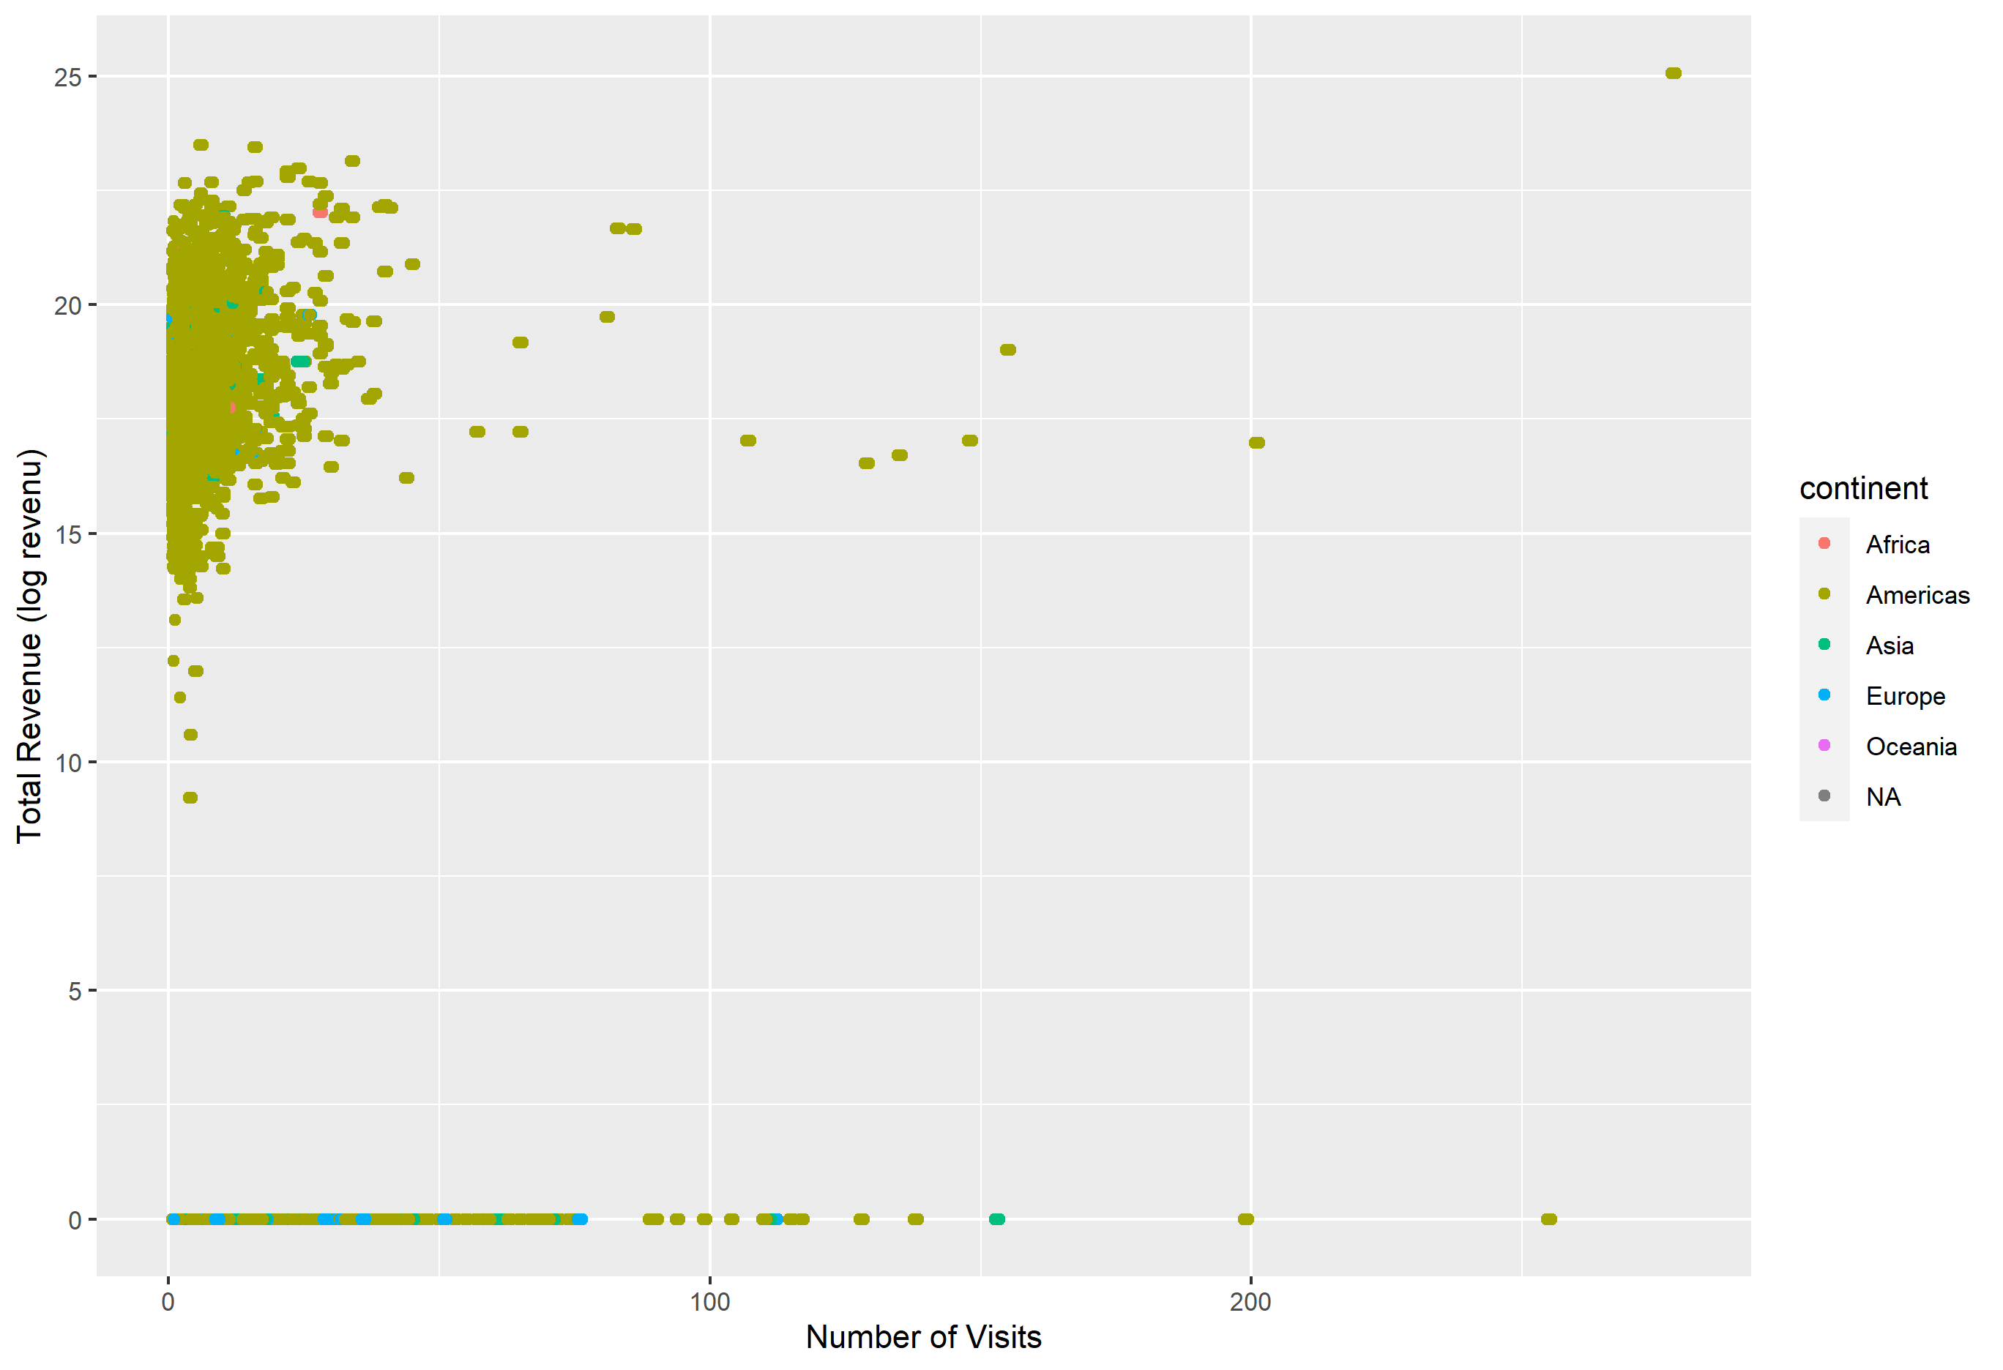
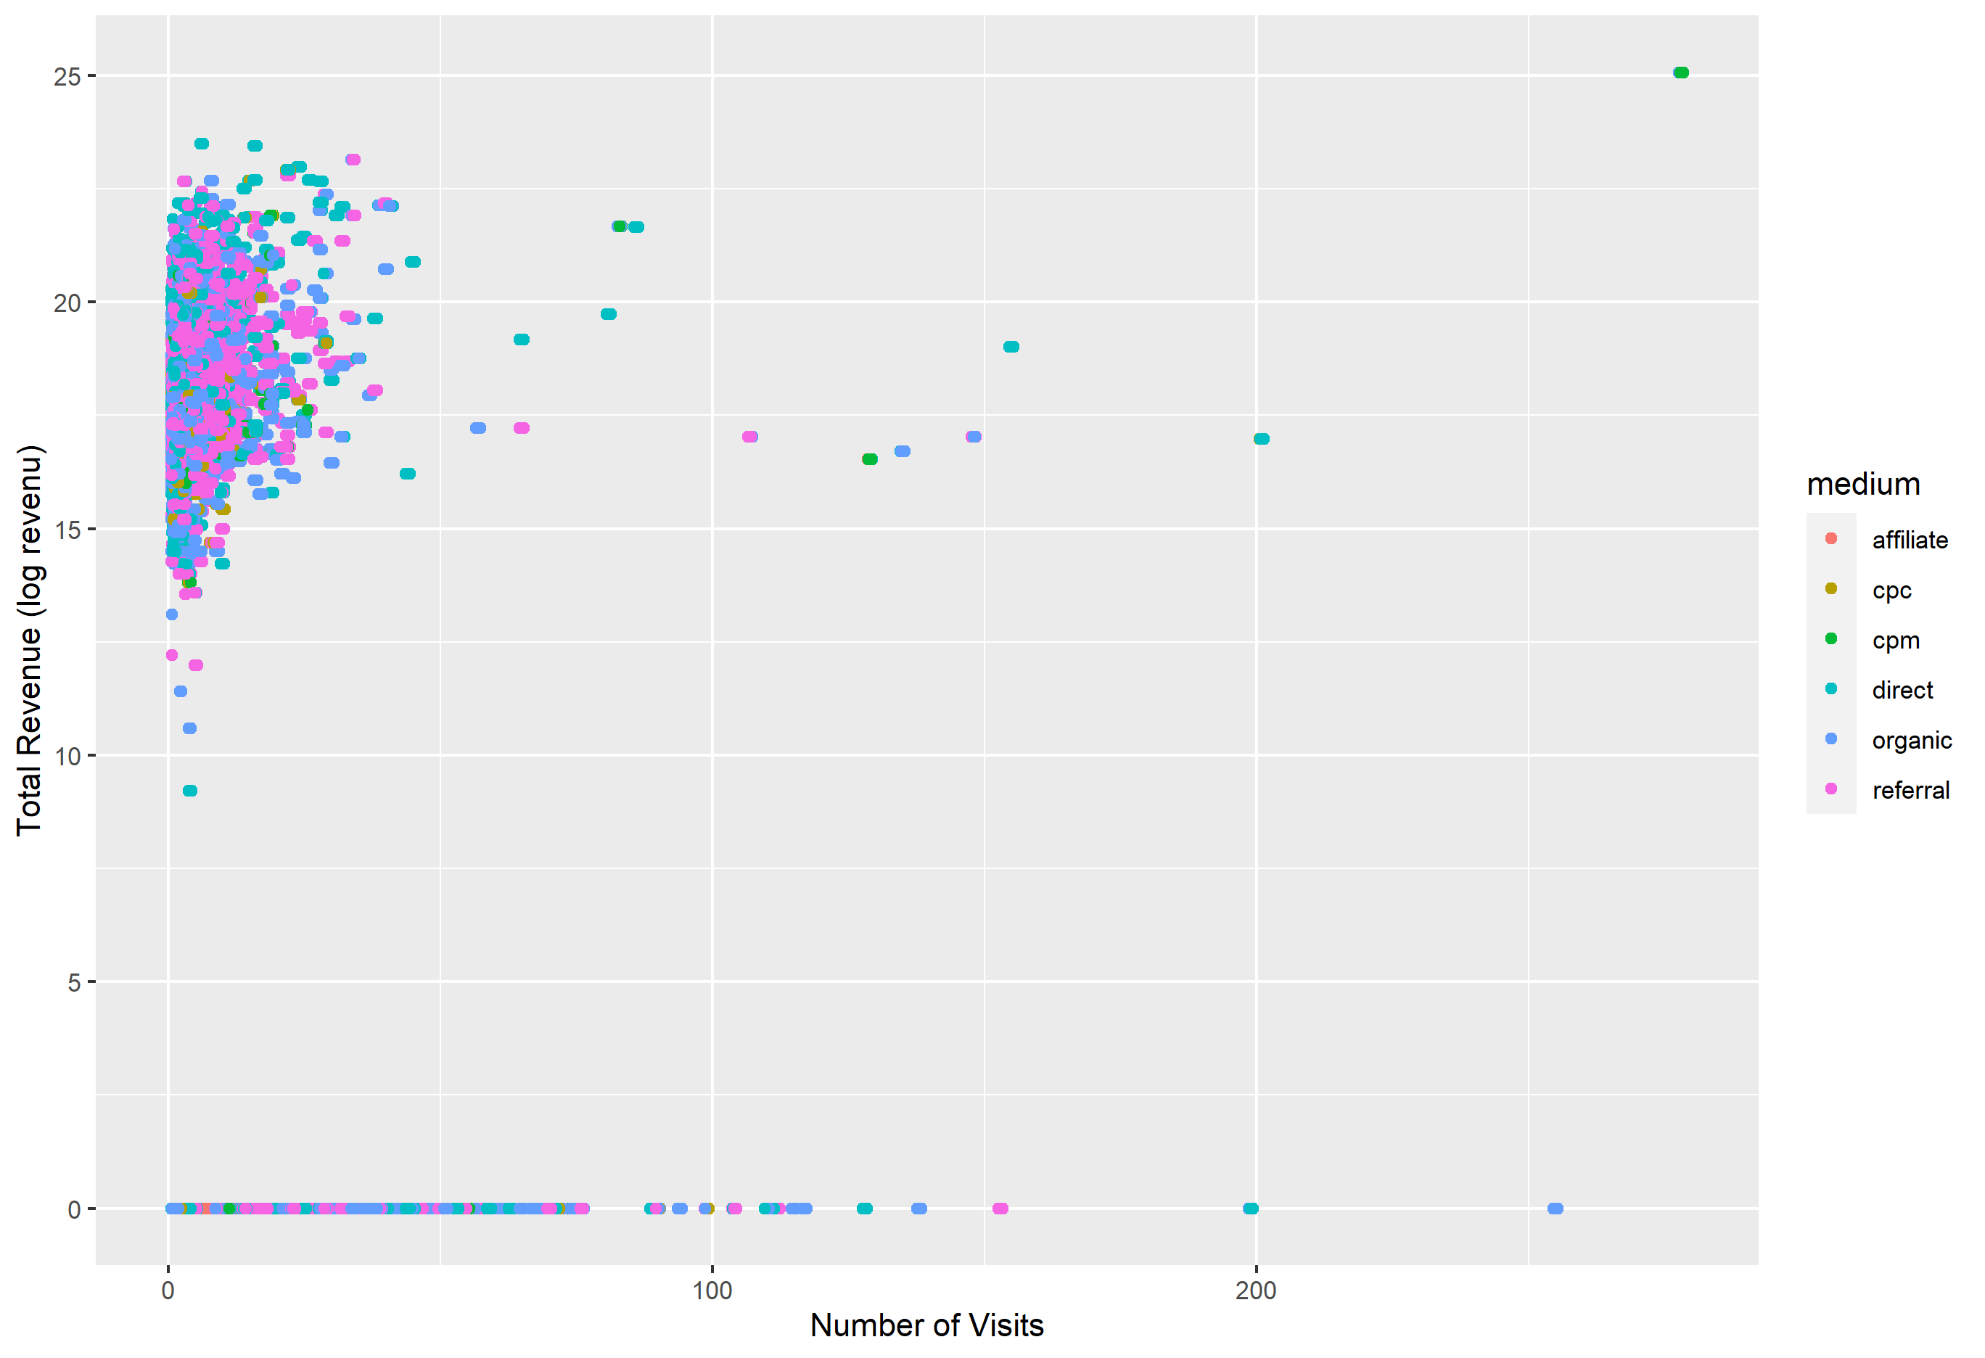
Who are our Customers? (Demographics)

Slide 5
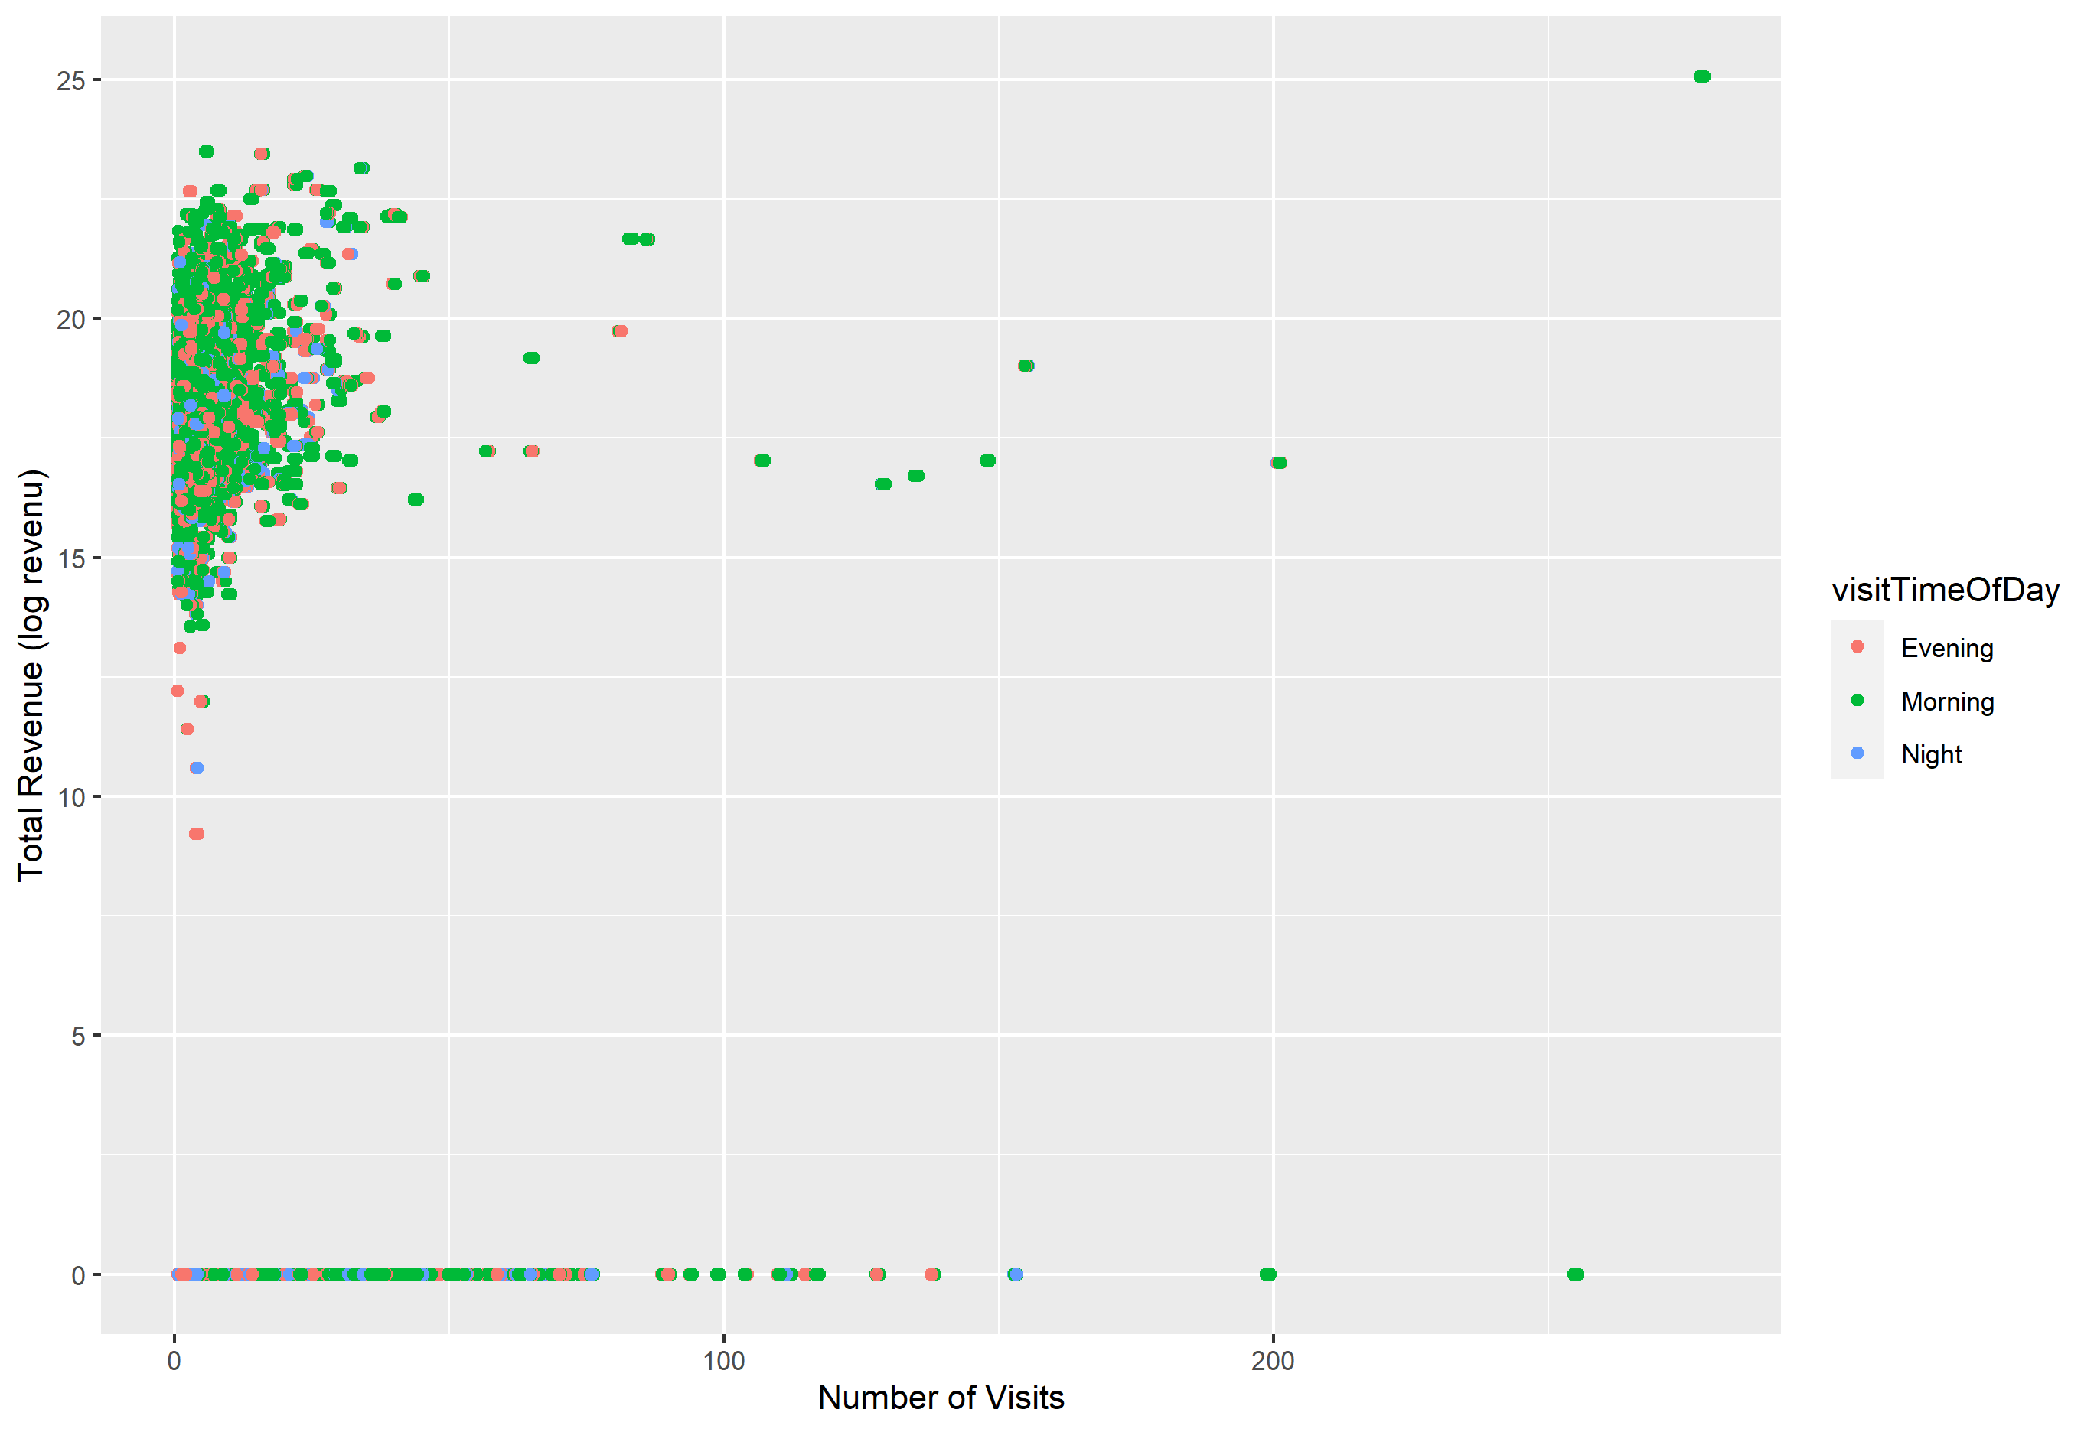
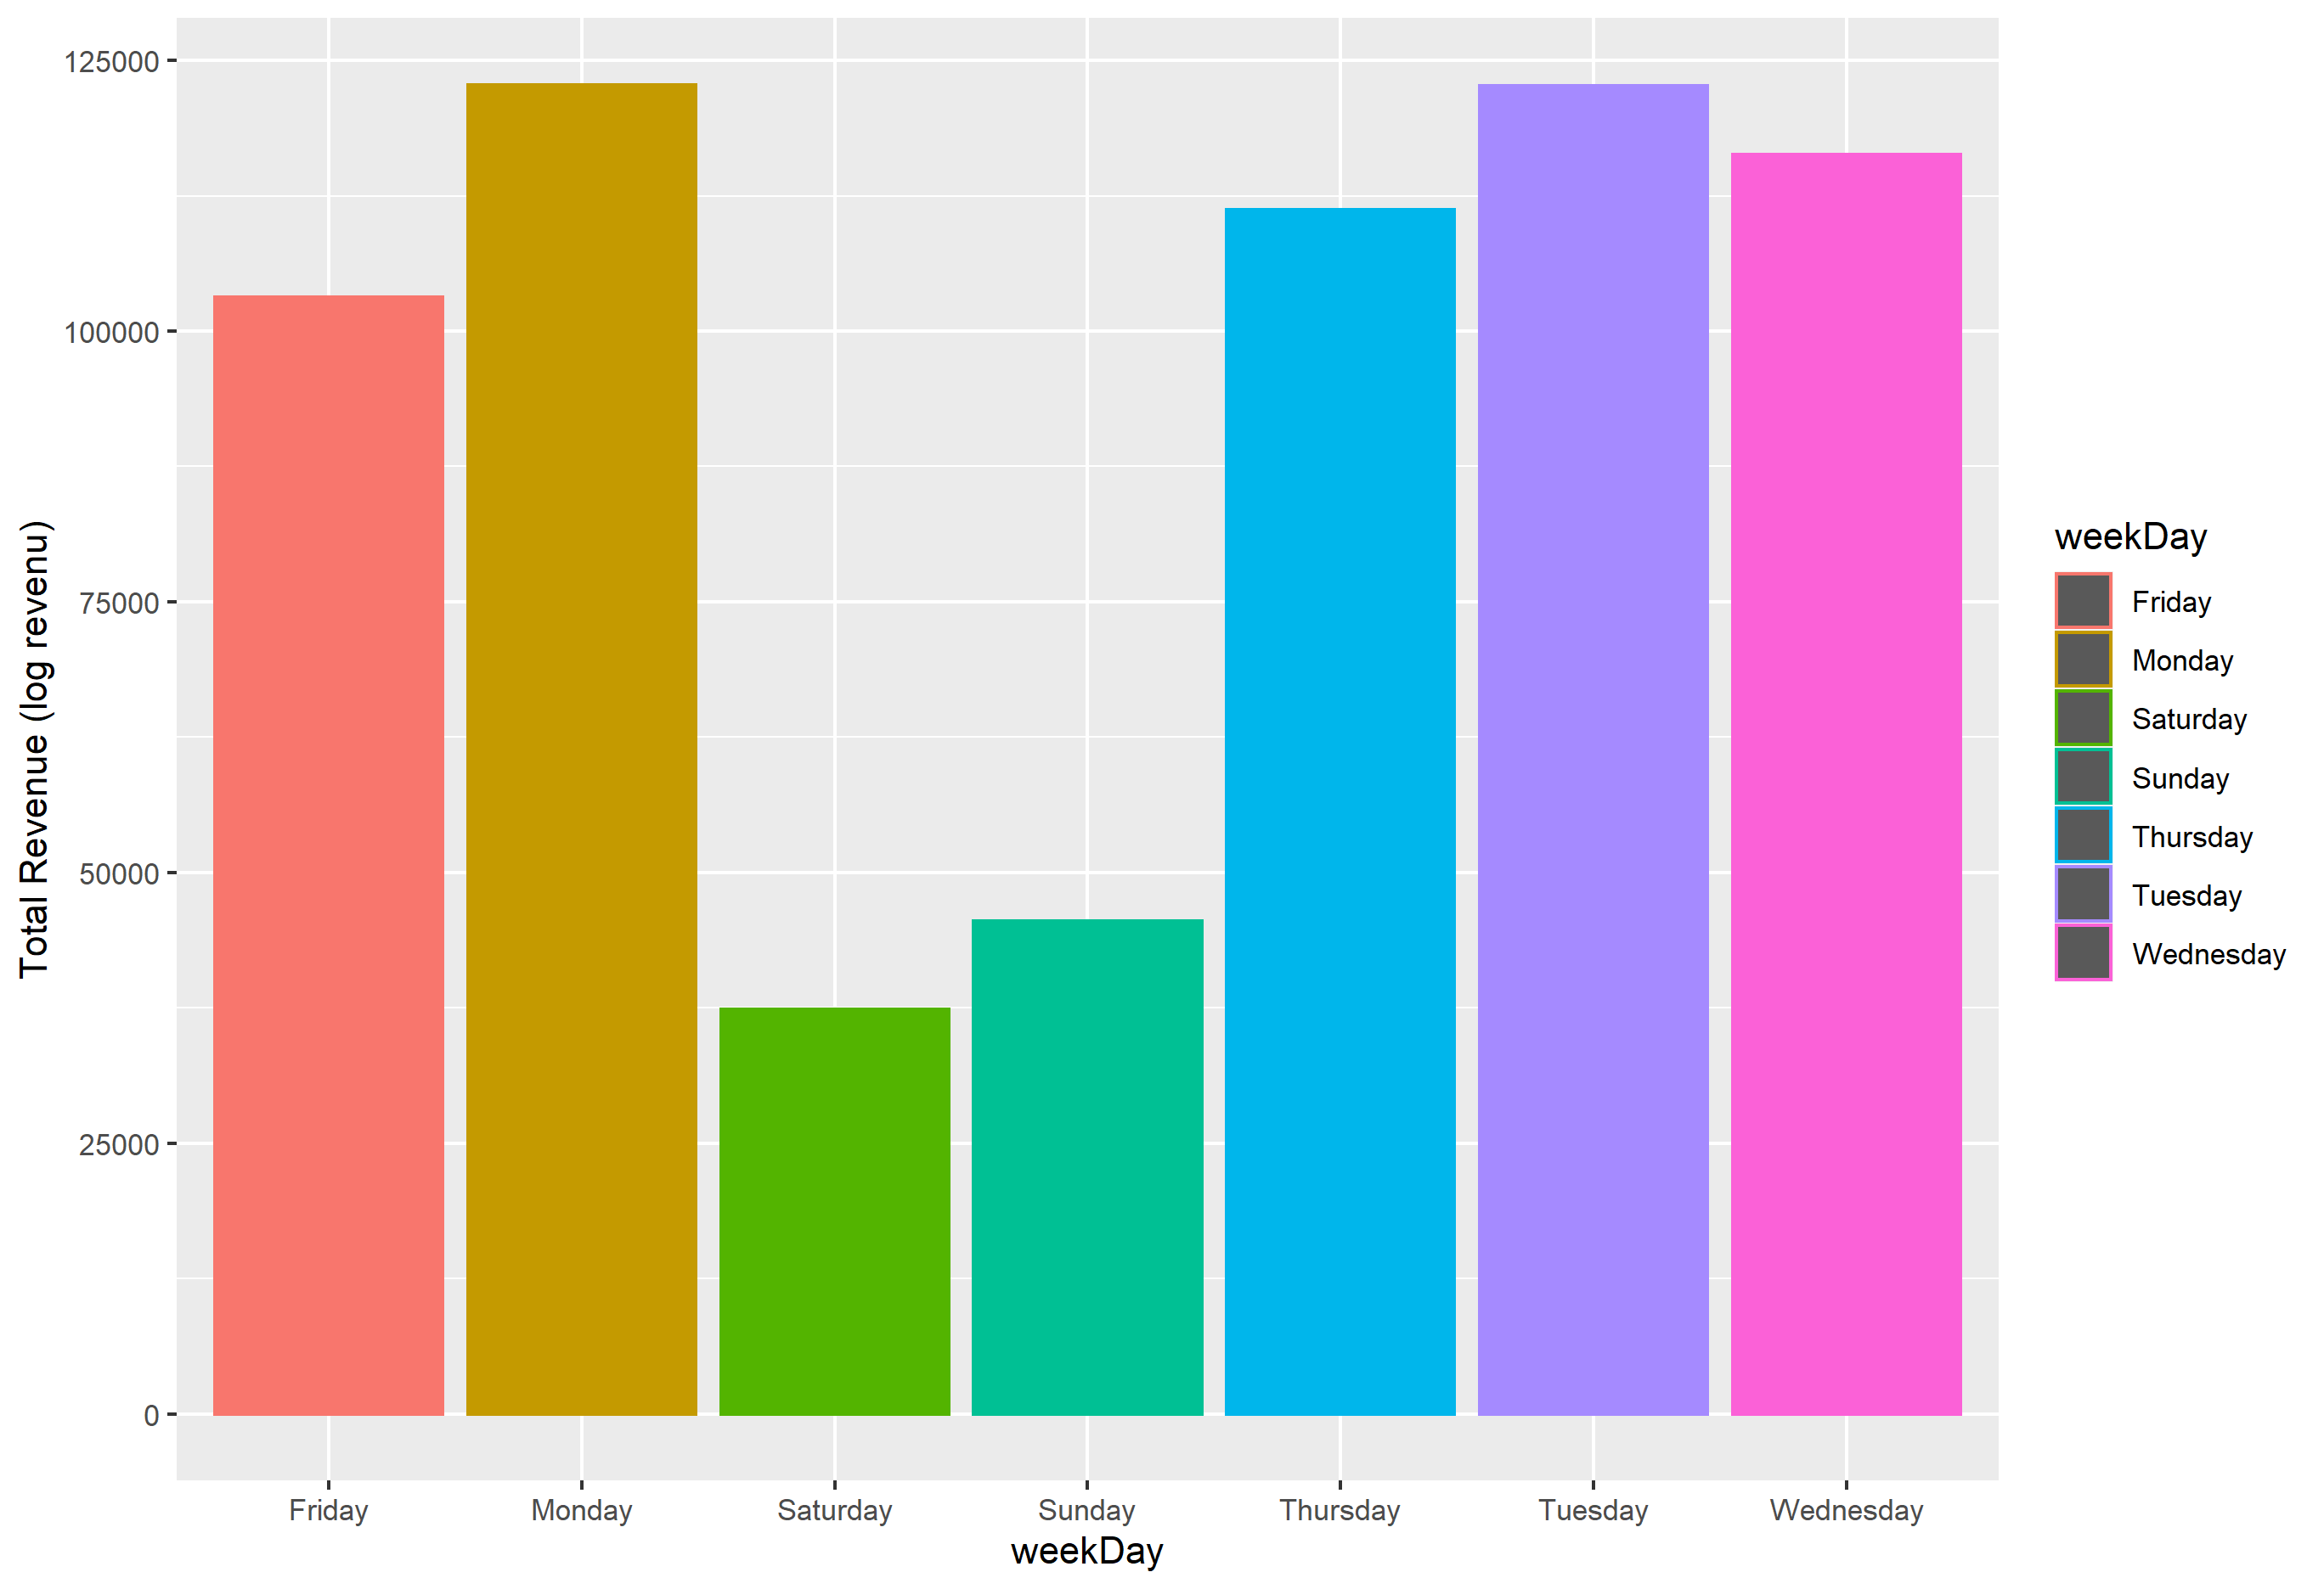
Who are our Customers? (Date and time of Visit)

Slide 6
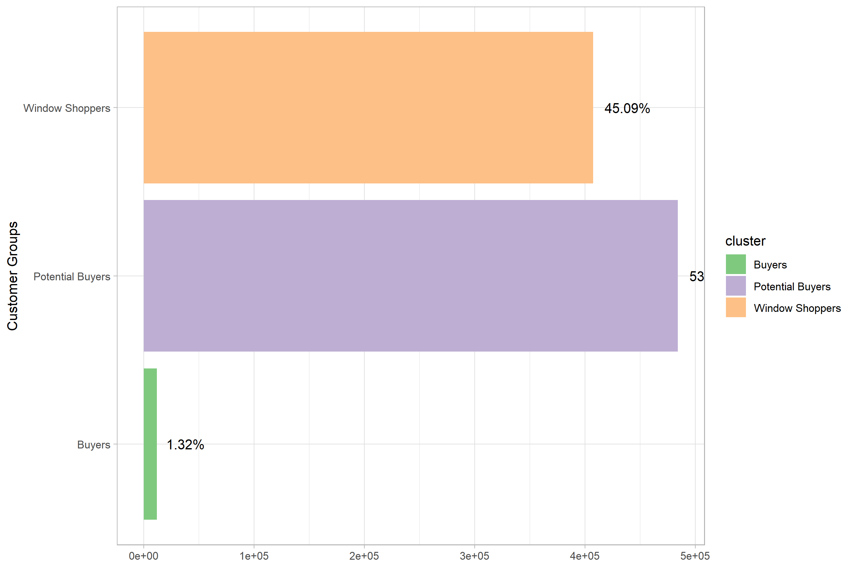



Customer groups
Window Shoppers
Potential Buyers
Buyers

Slide 7
Group 1 - Buyers:
more likely to be directed to the website.
more likely to use a desktop computer instead of a mobile phone.
more likely to have had previous visits to the store.
have more hits than the average.
more likely to come from a referral medium.
slightly more likely to come from cost per click or cost per impression channels.
more likely to shop in the morning or evening and less likely to shop at night.

Slide 8
Group 2 - Potential Buyers:
slightly more likely to be directed to the website.
slightly more likely to use a desktop computer instead of a mobile phone.
slightly more likely to have had previous visits to the store.
had fewer hits than the average.
less likely to come from a referral but
slightly more likely to come from an organic or direct source.
slightly more likely to shop in the morning or evening .

Slide 9
Group 3 - Window Shoppers:
less likely to be directed to the website.
less likely to use a desktop computer and more likely to use a mobile phone.
less likely to have had previous visits to the store.
had fewer hits than the average.
more likely to shop in the evening or night.

Slide 10
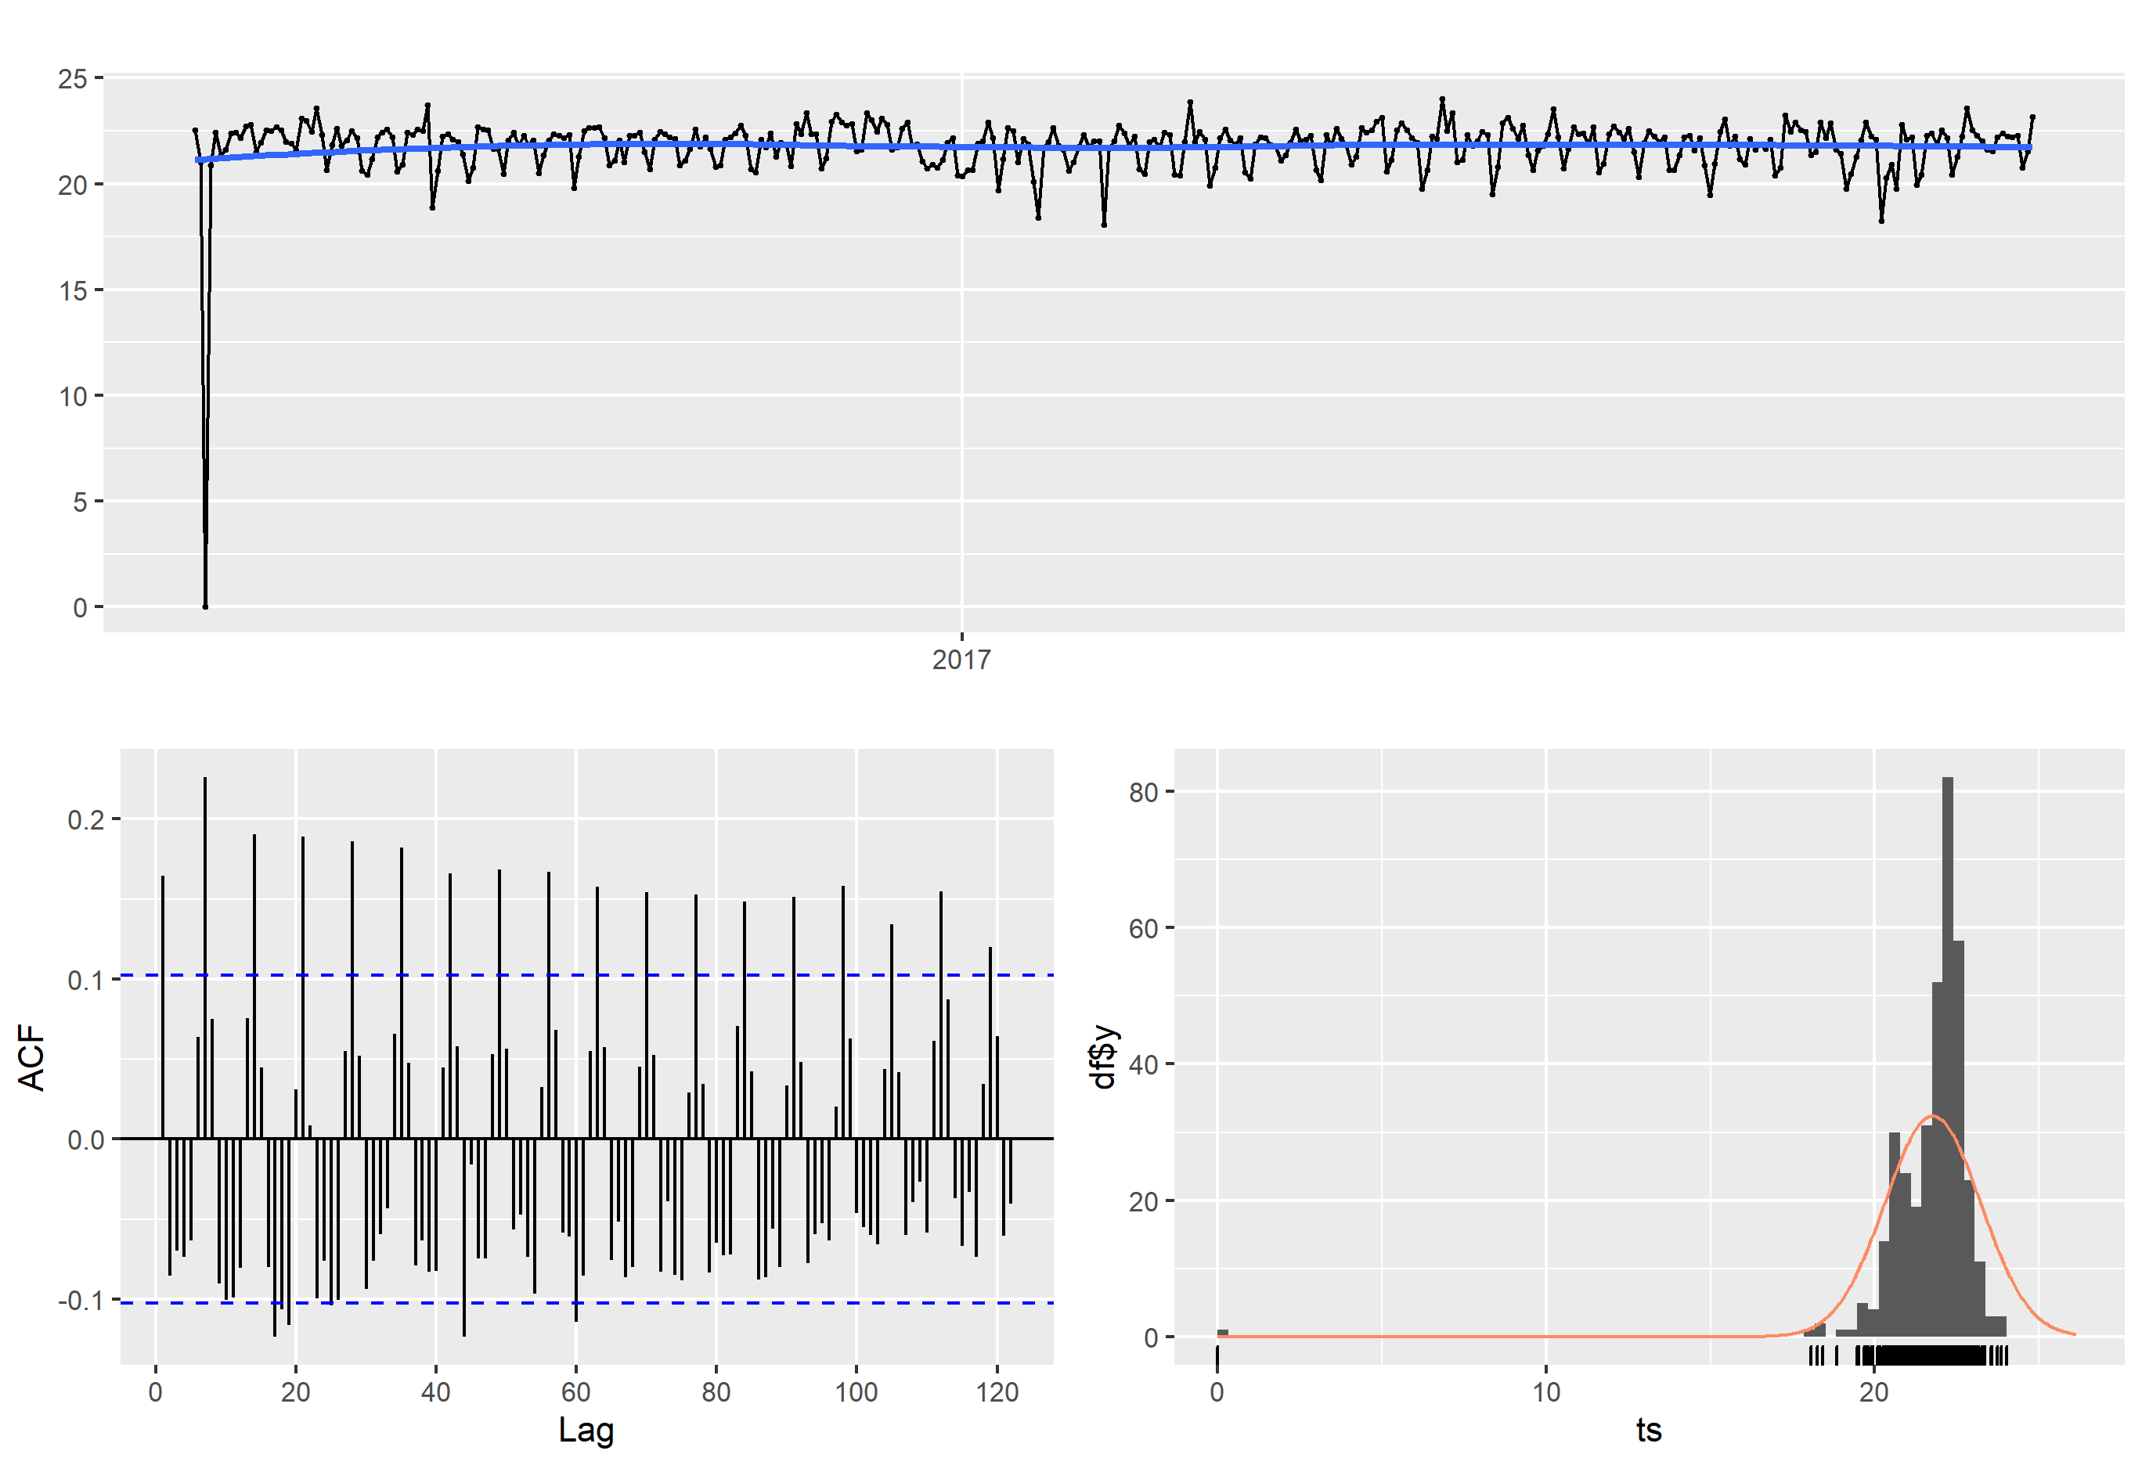
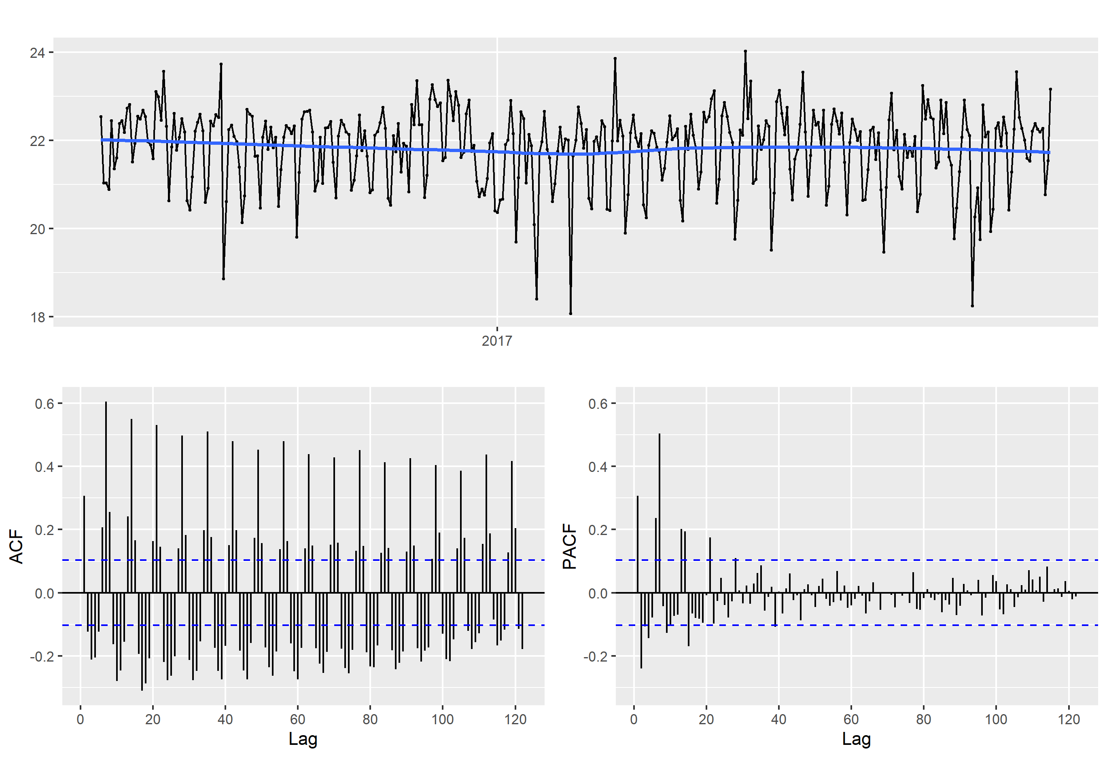
Sales trends and Forecast

Slide 11
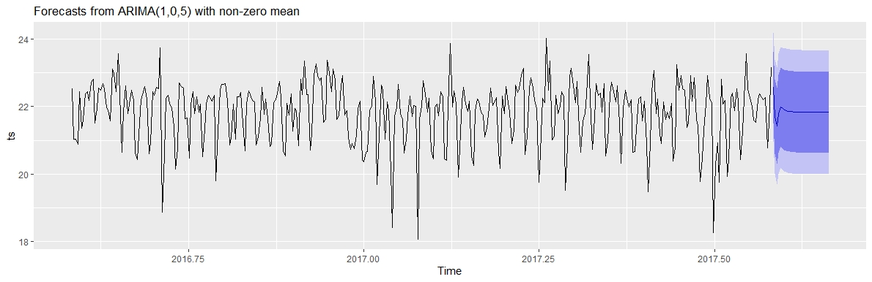
Sales Forecast (30 days)

