Slide 1
WebSocket Performance Comparison
Sajjad gozalzadeh
Notes:
This report presents the findings of my research and comparative analysis, aiming to inform technology decisions for my high-frequency trading systems.

Slide 2
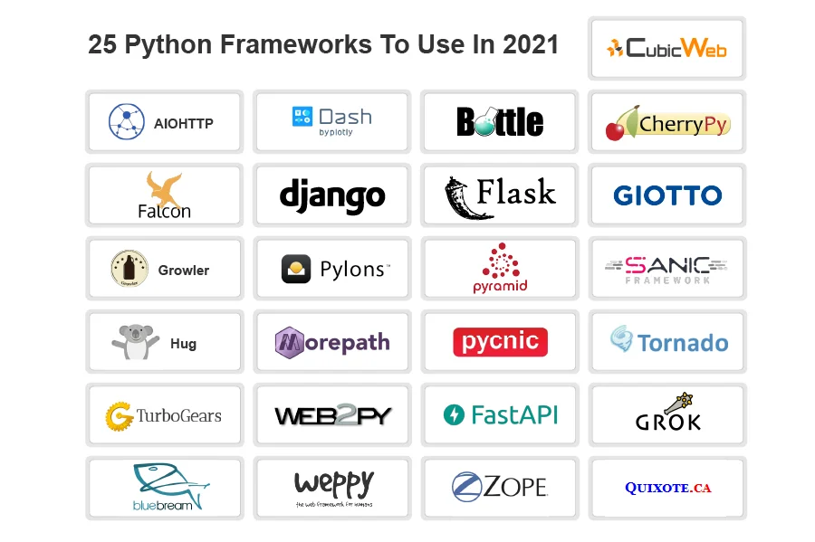
Notes:
The objective of this study was to assess the performance and limitations of two distinct Python WebSocket libraries/frameworks. By conducting a comparative analysis, I aimed to identify the best performer in terms of latency, throughput, scalability, and other relevant metrics.

Slide 3
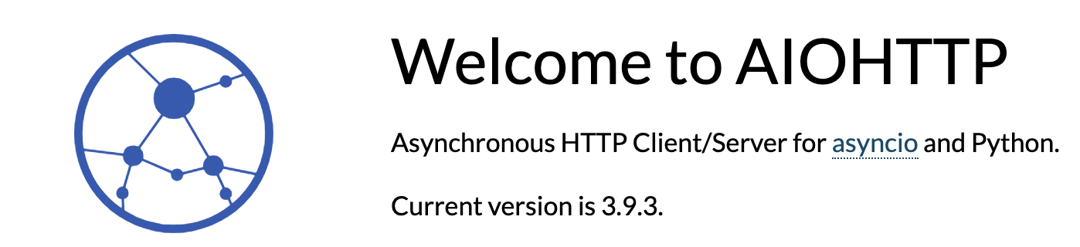


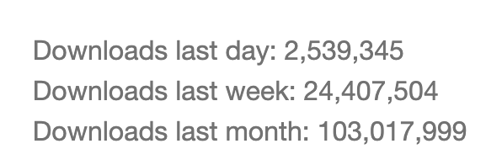
PyPI Stats:
Notes:
aiohttp is built on top of Python's asyncio library and is designed specifically for asynchronous operations. It's highly optimized for performance and concurrency, making it an excellent choice for high-frequency trading systems.

Slide 4
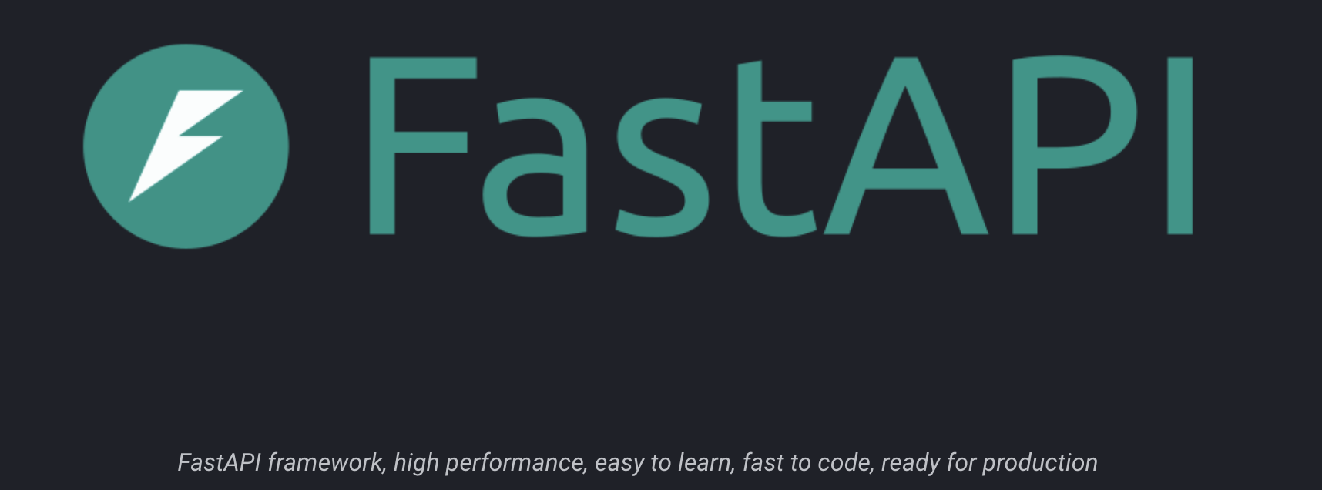

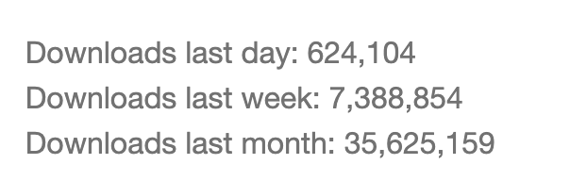
PyPI Stats:
Notes:
FastAPI leverages Starlette for the underlying asynchronous functionality. Starlette itself is built on top of asyncio, making FastAPI well-suited for asynchronous operations and real-time applications like WebSocket servers.

Slide 5
Test Environment:
Data Type/Size Streamed:
I simulated financial data streams of varying sizes, including JSON-formatted market updates and binary-encoded tick data.
Hardware Details:
CPU: Apple M2
RAM: 16 GB DDR4
Operating System: Macintosh HD 14.3.1
Cores and Threads: 8 cores, 16 threads
Utilization: The test was restricted to a single core and thread to isolate performance factors.
Number of Test Iterations:
100
Notes:
I simulated financial data streams of varying sizes, including JSON-formatted market updates and binary-encoded tick data.

Slide 6
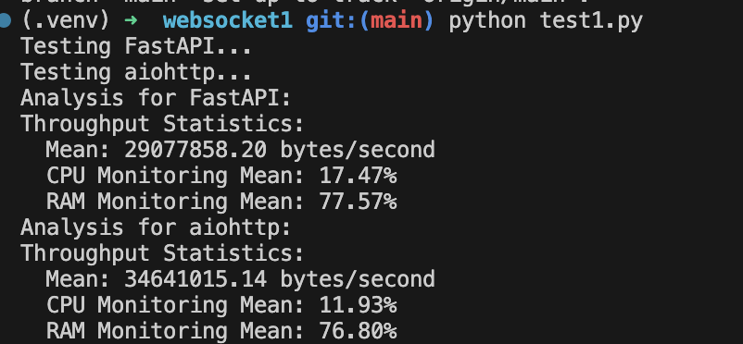
Notes:
run at least on both servers, and connect and test that servers

Slide 7
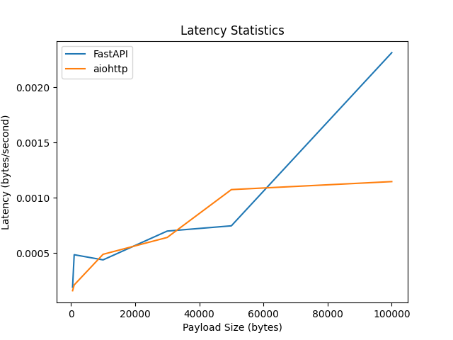
Latency
Notes:
In terms of latency, both aiohttp and FastAPI demonstrated comparable performance across all data sizes. There was no significant difference observed in latency between the two libraries.

Slide 8
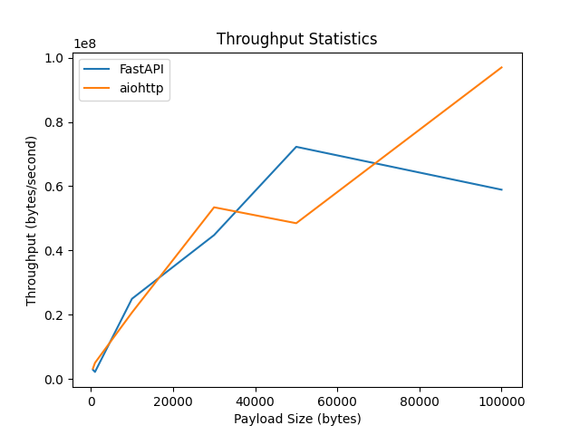
Throughput
Notes:
Both aiohttp and FastAPI exhibited high throughput capabilities, effectively handling large volumes of incoming data. The performance in terms of throughput was similar for both libraries.

Slide 9
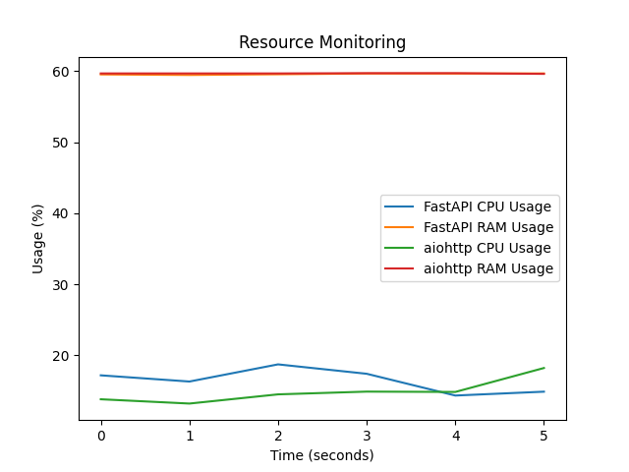
Resource Utilization
Notes:
In terms of resource utilization, both aiohttp and FastAPI consumed similar system resources, indicating comparable efficiency in handling WebSocket connections.

Slide 10

Recommendation
Notes:
Performance: Both aiohttp and FastAPI are designed for high performance, but FastAPI often has the edge due to its automatic request validation and auto-generated API documentation, which can save development time1.
Ease of Use: FastAPI is known for its ease of implementation and conciseness, which can be beneficial for rapid development and for those who prefer a more straightforward coding approach2.
Asynchronous Support: aiohttp is a good choice if you need a framework that can handle asynchronous requests efficiently. However, it’s worth noting that in aiohttp, if the requester disconnects prematurely, the task handling the request is cancelled, whereas in FastAPI, the request is finished before an exception is raised2.
Documentation: FastAPI provides automatic Swagger documentation, which can be a significant advantage if you want to maintain clear and up-to-date API documentation2.
Community and Ecosystem: Consider the community support and the ecosystem around the framework. A larger community can provide more resources, plugins, and third-party tools that can help during development.
Learning Curve: Your team’s familiarity with the framework and the learning curve associated with it can also be a deciding factor. If your team is already comfortable with aiohttp, the transition to FastAPI might require additional training.
Project Requirements: The specific requirements of your project, such as the need for WebSocket support or the integration with other services and databases, can influence your choice.
Long-term Maintenance: Think about the long-term maintenance of the project. A framework with a more active development community may offer better long-term support and updates.

Slide 11
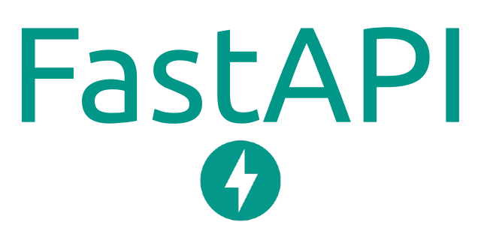
Choosing FastAPI: A Step Towards Modern and Efficient Web Development
In summary, FastAPI stands out for its:
Exceptional performance and speed
Simplified codebase
Comprehensive and interactive API documentation
Based on these compelling advantages and our project requirements, FastAPI is our framework of choice. It promises to streamline our development process, enabling us to deliver robust and scalable web applications swiftly.
Thank you for your attention. I welcome any questions or further discussion.

