Slide 1
Oracle - Day 5
Long Cycle
Notes:
Welcome to the day 4 of Oracle

Slide 2
Recap
How to create a Trigger and Packages?
Various features of SQL like MERGE and Flash Back Queries.

Slide 3
Session Plan
  Data Transfer Utilities
  Concurrency Control – Introduction
  Database Recovery in Oracle

Slide 4
Objectives
To understand the various Data transfer utilities in Oracle.
To understand the locking mechanism and types of locking in Oracle.
To understand the basic concepts of database recovery.

Slide 5
Data Transfer Utilities

Slide 6
Export & Import utilities
Complementary utilities which allow one to write data in an ORACLE-binary format from the database into operating system files and to read data back from those.
EXPORT, IMPORT are used for the following tasks:
  backup Oracle data in operating system files
  restore tables that were dropped
  save space or reduce fragmentation in the database
  move data from one owner to another
Notes:
Export, Import are complementary utilities which allow one to write data in an ORACLE-binary format from the database into operating system files and to read data back from those operating system files.
Export, Import are complementary utilities which allow one to write data in an ORACLE-binary format from the database into operating system files and to read data back from those operating system files.

Slide 7
Export Utility - Invoking Export
Interactive dialogue:
Simply type exp on command prompt.
Controlled through by passing parameters:
One may pass parameters when one export data from the database.
  Type the following at command prompt
C:\>exp scott/tiger@training file=empdept.expdat tables=(EMP,DEPT) log=empdept.log
Parameterfile controlled:
One may use a parameter file where the parameters are stored.
  Type the following at command prompt
C:\>exp <userid/password> parfile=<filename>
Notes:
To get familiar with EXPORT parameters type:
exp help=y
One will get a short description and the default settings will be shown.
The EXPORT utility may be used in three ways:
Interactive dialogue:
Simply type exp. One will be prompted for Oracle userid, password. All other prompts answer by pressing the return key. This is the easiest way to export all data one stored in the Oraclce database. One may assign other values than the defaults to the parameters but in most cases it is unnecessary.
Controlled through by passing parameters:
One may pass parameters while exporting data from the database. Type:
exp <userid/password> <parameter>=<value>,<parameter>=<value>,...
Example of exporting scott's tables EMP and DEPT to file empdept.expdat and storing all messages to file empdept.log:
exp scott/tiger file=empdept.expdat tables=(EMP,DEPT) log=empdept.log
Parameterfile controlled:
Instead of typing the parameters on the commandline one may use a parameter file where the parameters are stored. The syntax for this method is:
exp <userid/password> parfile=<filename>

Slide 8
Import Utility - Invoking Import
Interactive dialogue:
Simply type imp on command prompt.
Controlled through by passing parameters:
One may pass parameters when one import data.
  Type the following at command prompt
C:\>imp <userid/password> tables=(table1,table2)
Parameterfile controlled:
One may use a parameter file where the parameters are stored.
  Type the following at command prompt
C:\>imp <userid/password> parfile=<filename>
Notes:
To get familiar with IMPORT parameters type:
imp help=y
One will get a short description and the default settings will be shown.
The IMPORT utility may be used in three ways:
Interactive dialogue:
To start IMPORT simply type imp. One will be prompted for Oracle userid, password. The next prompts depend on what one answer. In most cases one may answer the prompts by pressing the return key.
Controlled through by passing parameters:
Instead of the dialogue method one may use parameters. This is analogous to the methods described for EXPORT.
Examples:
imp <userid/password> tables=(table1,table2)
Tables table1, table2 will be imported from the default file export.dmp into the database.
Parameterfile controlled:
Instead of typing the parameters on the commandline one may use a parameter file where the parameters are stored. The syntax for this method is:
imp <userid/password> parfile=<filename>

Slide 9
SQL * Loader
SQL*Loader is Oracle’s utility program for loading data into an Oracle table.
SQL*Loader takes two input files – a control file and a data file – and loads the data into a single Oracle table.
Notes:
SQL*Loader is an Oracle-supplied utility that allows one to load data from a flat file into one or more database tables.
The data file contains data, and the control file contains information about the data -- where to load it, what to do if something goes wrong, etc.
The SQL*Loader control file is a text file into which one place a description of the data to be loaded. One also use the control file to tell SQL*Loader which database tables and columns should receive the data that one is loading.
Do not confuse SQL*Loader control files with database control files. Database control files are binary files containing information about the physical structure of your database. They have nothing to do with SQL*Loader. SQL*Loader control files, on the other hand, are text files containing commands that control SQL*Loader's operation.

Slide 10
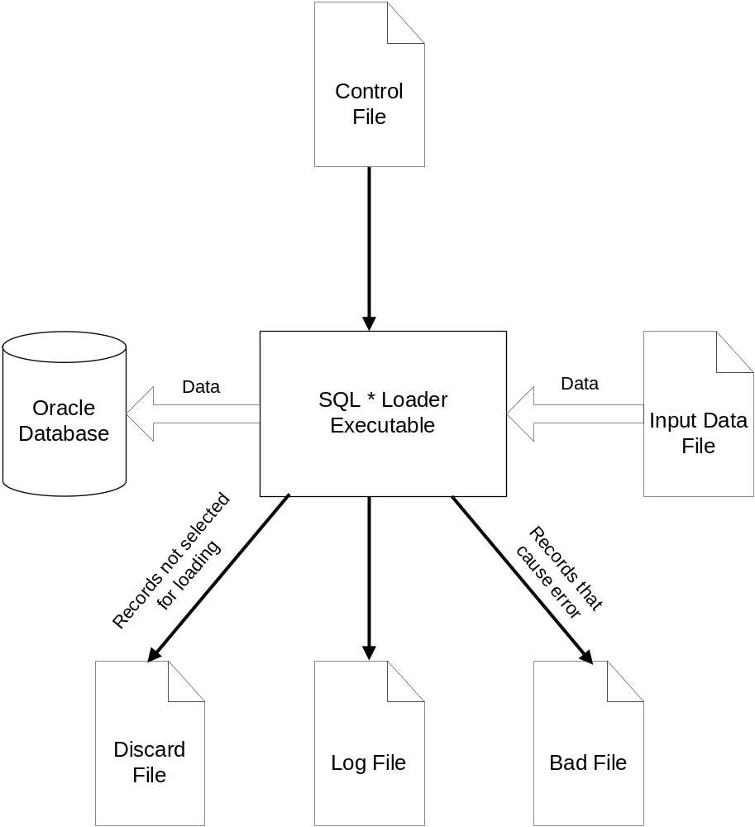
The SQL * Loader environment
Notes:
Find the explanation of each component in the following slides.

Slide 11
The SQL * Loader Control file
Key to any load process. The control file provides the following information
to SQL*Loader:
The name and location of the input data file
The format of the records in the input data file
The name of the table or tables to be loaded
The correspondence between the fields in the input record and the columns in the database tables being loaded
Selection criteria defining which records from the input file contain data to be inserted into the destination database tables.
The names and locations of the bad file and the discard file (Explained later)
Notes:
Please note that some of the items shown in this list may also be passed to SQL*Loader as command-line parameters.
The name and location of the input file, for example, may be passed on the command line instead of in the control file.
The same goes for the names and locations of the bad files and the discard files.

Slide 12
The SQL * Loader Log file
The log file is a record of SQL*Loader's activities during a load session. It contains information such as the following:
  The names of the control file, log file, bad file, discard file, and data file
  The values of several command-line parameters
  A detailed breakdown of the fields and datatypes in the data file that was loaded
  Error messages for records that cause errors
  Messages indicating when records have been discarded
  A summary of the load that includes the number of logical records read from the data file, the number of rows rejected because of errors, the number of rows discarded because of selection criteria, and the elapsed time of the load
Notes:
Always review the log file after a load to be sure that no errors occurred, or at least that no unexpected errors occurred.
This type of information is written to the log file, but is not displayed on the terminal screen.

Slide 13
The SQL * Loader Bad file
Whenever SQL*Loader encounters a database error while trying to load a record, it writes that record to a file known as the bad file.
Common scenarios are:
  insert failing because of some type of error. Integrity constraint violations
  lack of free space in a tablespace, can also cause insert operations to fail.
Bad files are mandatory.
Notes:
The only way to avoid having a bad file generated is to run a load that results in no errors. If even one error occurs, SQL*Loader will create a bad file and write the offending input record (or records) to that file.
The format of your bad files will exactly match the format of your input files. That's because SQL*Loader writes the exact records that cause errors to those files. If one is running a load with multiple input files, one will get a distinct set of bad files for each input file.

Slide 14
The SQL * Loader Discard file
Used to hold records that do not meet selection criteria specified in the SQL*Loader control file.
Discard files are optional.
Notes:
By default, SQL*Loader will attempt to load all the records contained in the input file. One have the option, though, in your control file, of specifying selection criteria that a record must meet before it is loaded. Records that do not meet the specified criteria are not loaded, and are instead written to a file known as the discard file.
The format of your discard files will exactly match the format of your input files. That's because SQL*Loader writes the exact records that results in discarding the data to those files. If one is running a load with multiple input files, one will get a distinct set of discard files for each input file.

Slide 15
An example on usage of SQL * Loader
The following slides contains a short example showing how SQL*Loader is used.
For this example, we'll be loading a Unix module mark sheet (XLS) of a FP batch taken from perception server (examination server) into Oracle
Notes:
One have to be ready with the following table in your/Scotts schema (destination):
create table marks(
empid number,
quiz1 number,
quiz2 number,
test number,
total number,
grade char(1));
Please follow the steps in the following slides to load your data from XLS into Oracle using SQL * Loader.

Slide 16

Creating Data file
Save your Excel spreadsheet data as a Comma-Separated-Variable (*.csv) file.
Click on the icon below to get the sample CSV file
Notes:
Assume one have saved this file in the following path:
E:\workarea
This will automatically put commas between each of the four data elements. In addition, if any of the data elements already contain a comma, the Save AS *.csv step will optionally and automatically enclose that data in double quotes.

Slide 17
Creating Control file
Using any text editor, create a file (say, e:\workarea\marksheet.ctl) containing these lines:
LOAD DATA
INFILE 'E:\workarea\marksheet.csv'
REPLACE
INTO TABLE scott.marks
FIELDS TERMINATED BY ',' OPTIONALLY ENCLOSED BY '"'
TRAILING NULLCOLS
(empid INTEGER EXTERNAL,
quiz1 INTEGER EXTERNAL,
quiz2 INTEGER EXTERNAL,
test INTEGER EXTERNAL,
total INTEGER EXTERNAL,
grade
)
Notes:
The REPLACE keyword says, "remove any existing rows before starting the load."
There's also:
An INSERT [into empty table] and
APPEND [to existing rows] option.
Empid, quiz1, quiz2, test, total and grade are the actual column names defined in the scott.marks table.
Because the last item is of character datatype, it was not necessary to further describe them – character is the default.
The first five columns are numeric data. The INTEGER EXTERNAL describes the datatype in the e:\workarea\marksheet.csv input file.
The TRAILING NULLCOLS statement handles the missing data; it tells SQL*Loader to load any missing data as NULL values.

Slide 18
Running SQL * Loader
At an MS-DOS prompt (or the Start, Run menu) , execute SQL*Loader as follows:
C:\>sqlldr scott/tiger@training control=e:\workarea\marksheet.ctl
One can see your loaded data with your favorite:
SQL>Select * from marks;
Notes:
Prerequisites:
One must have SQL*Loader and SQL*Net installed on the machine.
The SQL*Loader program may have a version number included as part of its name, something like sqlldr73.exe or sqlldr80.exe. Or maybe it will be just sqlldr.exe. One can look for it in your ORAWIN95 or ORANT \BIN directory.
If it's not installed, one can get the Oracle Client Software installation CD and install "UTILITIES".
One must have the target database (say, it’s called ‘training’) configured as SQL*Net service in your local tnsnames.ora file. This is pretty standard stuff; it’s probably already there.
One must have authorization to modify the scott.marks table (INSERT, or DELETE and INSERT if one is using the REPLACE option in the control file. One can try the same in your schema with the required modifications (Change scott and tiger with your user name and password respectively). If required change the host string as well.

Slide 19
Export-Import vs. SQL * Loader
Export and Import tools are primarily used to maintain ORACLE database objects.
Because of the special binary format, files which had been created by the EXPORT utility can only be read by IMPORT utility.
To load data from other systems into the database one have to use SQL*LOADER.

Slide 20
Can you answer these questions?
What is the need of Export & Import Utilities?
What is the need of SQL Loader?
What are the components of SQL loader?

Slide 21
Concurrency Control
Notes:
Welcome to the day 4 of Oracle

Slide 22
Locking mechanism
The smallest unit that can be locked in oracle is the row
For each SQL statement oracle acquires the appropriate lock automatically.
Programmers cannot acquire locks at the row level explicitly
The smallest unit at which programmers can explicitly acquire locks is the table
Locks are released when transaction commits or rolls back
Oracle does not acquire locks for reading
Notes:
Oracle follows locking techniques and read consistency model to achieve concurrency of database.
First we will see locking mechanism and later on we will learn the read consistency model.
For each SQL statement oracle acquires the appropriate lock automatically.
The smallest unit that can be locked in oracle is the row but programmers cannot acquire locks at the row level explicitly. The smallest unit at which programmers can explicitly acquire locks is the table.
Locks are released when transaction commits or rolls back.

Slide 23
Types of locks
When Oracle acquires locks at the row level, it automatically acquires locks at the table level also
There are 5 different modes of locking at the table level
  row share
  row exclusive
  share row exclusive
  share
  exclusive
Notes:
The default locking in Oracle is exclusive at row level.
At table level, programmer can acquire five different kinds of lock, depending on the situation.

Slide 24
Locking
Mode of
table lock
Row lock
SQL Statement
Select .... from table
none
none
insert,delete,update
RX
X
Select .... for update of RS
X
Lock table in rowshare mode RS
Lock table in rowx mode RX
Lock table in share mode S
Lock table in exclusive mode X
Lock table in SIX mode SRX
Notes:
Here is the matrix which depicts the kind of lock acquired in different situations at row and table level.

Slide 25
Failure & Recovery in Oracle

Slide 26
Possible causes of failure
Process failure
  User/Server Process
  Background Process
Database Instance failure
Media failure
Notes:
Database may fail because of following reasons:
Process failure: User, Server or background process may lead to process failure.
Database Instance failure: The failure of memory copy of database leads to database instance failure.
Media failure: Hard disk failure leads to media failure.

Slide 27
Process recovery
Process recovery
  to be done when user/server process failed
  Failure detected by PMON which rolls back the transaction and release resources
  If process is a background process, generally instance cannot function correctly
Notes:
Process recovery is required to be done when user/server process failed.
It is not required for background process failure (See the next slide).
Process recovery is done by Process Monitor (PMON), which rolls back the transaction and release resources.

Slide 28
Instance recovery
Need
  Required because DBWR writes data to disk only when buffer is nearly full
  Some data which is committed may not be present in database
  Database may contain uncommitted data also
Performed by SMON when database is restarted
Roll forward using Redo Log to record data not present in data files
Rolls back transactions that did not commit/were explicitly rolled back
Release locks held by transactions in process at time of failure
Notes:
Instance recovery is required to be done when primary memory fails or background process is not running properly.
Instance recovery is performed by System Monitor (SMON). It is performed once database is restarted.
Data is Roll forwarded using Redo Log to record data not present in data files.
Data is Rolled back for those transactions that did not commit/were explicitly rolled back.
Locks are released which were held by transactions in process at time of failure.

Slide 29
Media recovery
Initiated by DBA
Complete Media recovery
  Restore backup data files
  Start recovery program using SQL *DBA
  Retrieve archived log files to roll forward and roll back using generated roll back segments
Notes:
Media recovery is required in case of secondary memory failure.
This is initiated by DBA.
In the process data is restored from backup files and archived log files.

Slide 30
Can you answer these questions?
What are the different types of Locking Oracle supports?
What are the reasons for database failure?
How the database is recovered from various failures?

Slide 31
Summary
Data Transfer Utilities
Concurrency Control in Oracle
Reasons of failure and various recovery mechanisms.

Slide 32
Thank You
“The contents of this document are proprietary and confidential to Infosys Technologies Ltd. and may not be disclosed in whole or in part at any time, to any third party without the prior written consent of
Infosys Technologies Ltd.”
“© 2008 Infosys Technologies Ltd. All rights reserved. Copyright in the whole and any part of this document belongs to Infosys Technologies Ltd. This work may not be used, sold, transferred, adapted, abridged, copied or reproduced in whole or in part, in any manner or form, or in any media, without the prior written consent of Infosys Technologies Ltd.”

