Slide 1
Title: Comparative Study of Chest X-Ray Report Generation Models using IU-Xray Dataset

Slide 2

Problem Statement:
Manual radiology reporting is time-consuming and prone to variability.
Need for automated, clinically accurate report generation.
Dataset:
Indiana University Chest X-ray (IU-Xray) dataset:
Contains X-ray images paired with free-text reports.
Objective:
Compare 3 deep learning architectures for image-to-text generation:
EffiGPT (EfficientNet + GPT-2)
Multimodal Clinical-Aware Hybrid Model (Swin/EVA-02 + T5)
CLIP-Based Baseline
Slide 2: Introduction

Slide 3

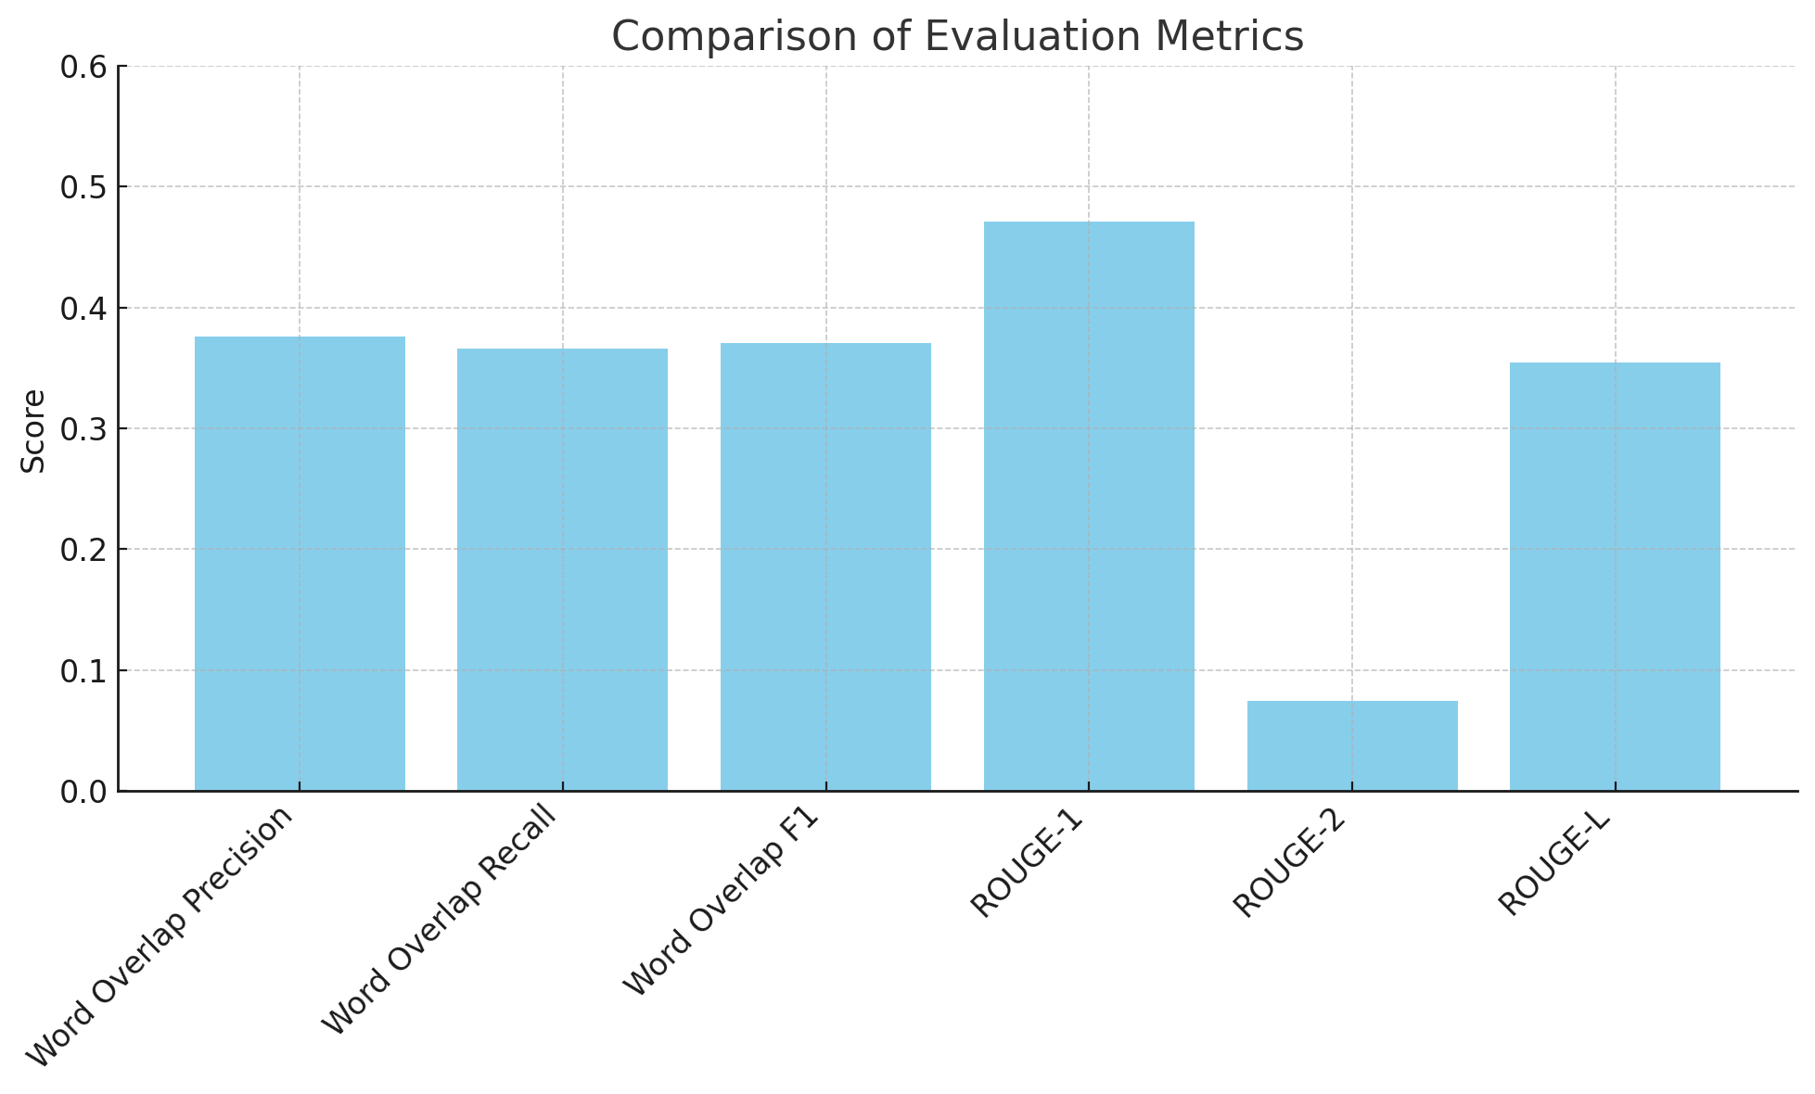

Slide 3: EffiGPT (EfficientNet + GPT-2)
Architecture Diagram:
Image Encoder: EfficientNet → Feature embeddings.
Text Decoder: GPT-2 autoregressive generation.
Flow: Image → Encoder → GPT-2 → Report.
Metrics:
Word Overlap Precision: 0.3758
Word Overlap Recall: 0.3662
Word Overlap F1: 0.3708
ROUGE-1: 0.4706
ROUGE-2: 0.0743
ROUGE-L: 0.3547

Slide 4
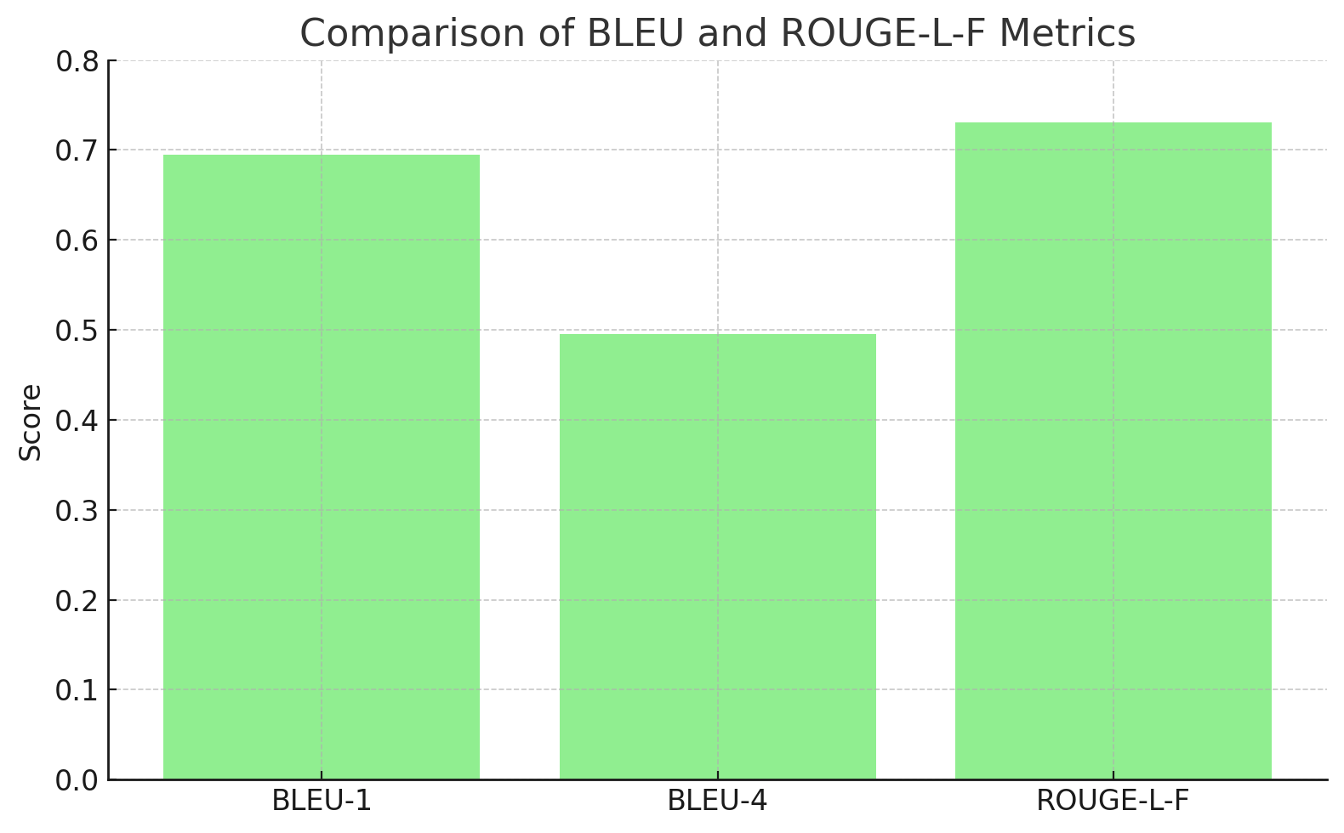
Slide 4: Multimodal Clinical-Aware Hybrid Model (Proposed)
Training Techniques:
Staged fine-tuning (PEFT, LoRA).
3 Stages training strategy
Example Comparisons:
Reference vs. Generated Report text blocks (e.g., "Heart size normal...").
Image Encoder:
Sin/EVA=02
Text Encoder:
Clinical BERT
Fusion Module:
Cross-attention + Adaptive gating
Decoder:
T5

Slide 5

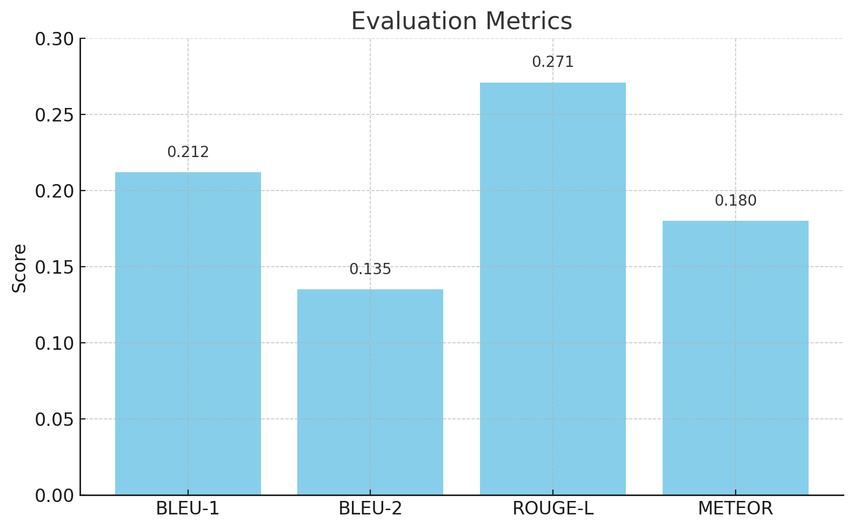
Slide 5: CLIP-Based Baseline
Architecture Overview:
Image Encoder: CLIP ViT-B/32 → Visual embeddings.
Text Decoder: Linear/GRU → Report generation.

Slide 6
Slide 6: Model Comparison Overview
Model | Image Encoder | Text Decoder | Key Metrics
EffiGPT | EfficientNet | GPT-2 | ROUGE-1: 0.4706, Word-F1: 0.3708
Hybrid Model | Swin/EVA-02 | T5 Transformer | BLEU-1: 0.6946, ROUGE-L-F: 0.7306
CLIP-Based Baseline | CLIP (ViT-B/32) | Linear/GRU | BLEU-1: 0.212, ROUGE-L: 0.271

Slide 7
Slide 7: Why the Hybrid Model Was Chosen
Highest BLEU/ROUGE:
Scores: Clinically accurate text generation.
01
Domain-Aware Fusion:
Cross-modal alignment (image + text + knowledge graph).
02
Structured Training:
Contrastive learning + reinforcement rewards.
03

Slide 8
Outcome:
Hybrid model outperforms EffiGPT and CLIP baselines.
Clinical Potential:
Reduces radiologist workload; ensures consistency.
Future Improvements:
Larger knowledge graphs, real-world deployment testing
Slide 8: Conclusion & Future Work

