Slide 1
Welcome to our presentation

Slide 2


IoT Based Medical Diagnosis Trough User Interaction Prepared For: Thesis committee of IUBAT, Dept. of CSE
Supervisor:
Rubayea Ferdows
Senior Lecturer & Assistant proctor
Senior Lecturer Department of CSE, IUBAT.
Presented By
Name | ID
MD. Mahadi Hossain | 16103039
Sajjat Hossain | 18103072

Slide 3
Table of Content
Introduction
Literature Review
Problem Statement
Significance of Study
Research Question
Methods and Sources
Result and Discussion
Conclusion
Future work
References

Slide 4
Introduction
What is IOT?
The Internet of things describes physical objects that are embedded with sensors, processing ability, software, and other technologies that connect and exchange data with other devices and systems over the Internet or other communications networks
What is medical diagnosis system?
Medical diagnosis is basically a pattern classification phenomena: based on some input provided by a patient, an expert gives a conclusion on the basis of its knowledge, which is normally stored in a binary form, and finally the result is calculated i.e. either the patient suffering from a certain disease or not

Slide 5
Literature Review
Paper- Mobile Health: Revolutionizing Healthcare Through Transdisciplinary Research
Authors: Santosh Kumar, Wendy Nilsen, Misha Pavel, Mani Srivastava
Published in 2013
mHealth technologies offer real-time monitoring and detection of changes in health status.
Support the adoption and maintenance of a healthy lifestyle
Provide rapid diagnosis of health conditions
Facilitate the implementation of interventions ranging from promoting patient self-care to providing remote healthcare services.
mHealth builds upon earlier work in telehealth, mobile computing, and persuasive technology in healthcare settings

Slide 6
Literature Review
Paper: Internet of Things for a Smart and Ubiquitous eHealth System
Authors: Parag Chatterjee and Ricardo L. Armentano
Published in 2015
One of the main jobs in a smart environment is to gather data from various sources and use it to develop intelligence.
The Internet of Things is vital in eHealth because it allows for more efficient and complete patient treatment.
The first step toward reciprocal knowledge sharing would be to virtually store patient data and make it widely accessible to healthcare staff.
Using connected data, create an intelligent clinical decision support system that helps doctors throughout therapy.
Unifying the Internet of Things in eHealth to create a smart medical environment with best-in-class services has been proposed.

Slide 7
Literature review
Paper: Enabling Health Monitoring as a Service in the Cloud
Authors: Yang Li, Li Guo, Yike Guo
Published in 2014
Way for the development of new services for next-generation healthcare systems.
Enable superior communication between healthcare professionals.
Presents key components of the Wiki-Health Analysis Framework.
Enabling an ecosystem to support scientists.
Supported by an ECG-based health monitoring service application

Slide 8
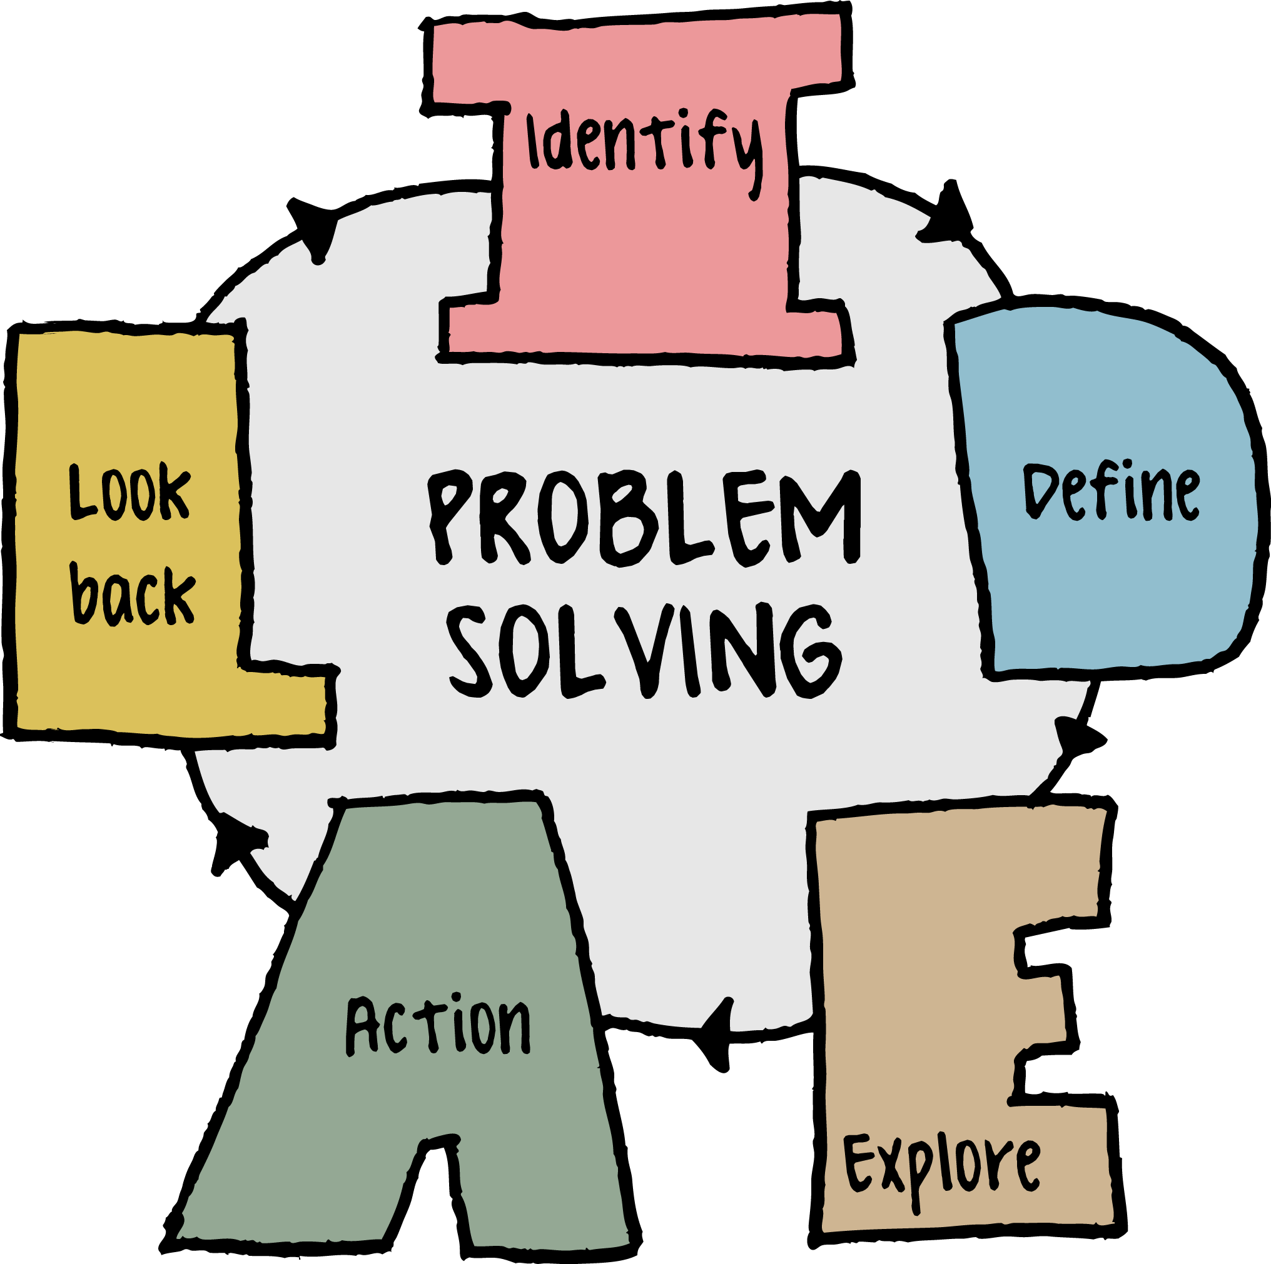
Problem Statement
Changes communication processes with staff.
Training of staff is quite time-consuming.
Lack of evidence‐based research.
Physical disability of the elderly.
Quality of e‐health.
Lack of education.

Slide 9
Significance of study
Try to give the best solution for these kinds of problem.
Give some way for users to quick check their diseases syndrome and possibilities
Give always update about this topic.

Slide 10

Research Question
What is the benefit of this thesis for the perspective in our country?
How is this thesis work?
What are the difficulties over here for applying this thesis?
Is this easy to use for everyone?

Slide 11
Research Objective
To obtain an overall understanding of the IoT based medical diagnosis
Finding some issues related to medical diagnosis
To Analyze the issue in details
To find some solution for better performance.

Slide 12
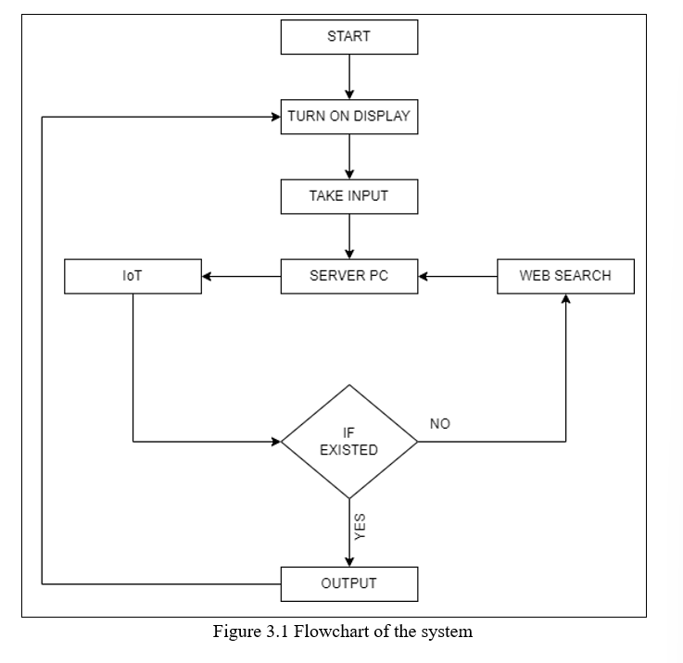
Research Methodology
Figure: Flowchart of our proposed system

Slide 13
Research Methodology (Contd.)
Data provider module
Master Classifier agent module
Interface module

Slide 14
Research Methodology (Contd.)
Data provider module
Take input from the user
Transfer inputted information to the next module
Show the outputs

Slide 15
Research Methodology (Contd.)
Master Classifier agent module
Received data from the DP module.
Check into the database (to find out the appropriate outcome).
If not found into database then data will transfer into the next module.
If found it will show the resulte.

Slide 16
Research Methodology (Contd.)
Interface module
Get data from the CA module.
Search into the web
Transfer data to the CA module

Slide 17
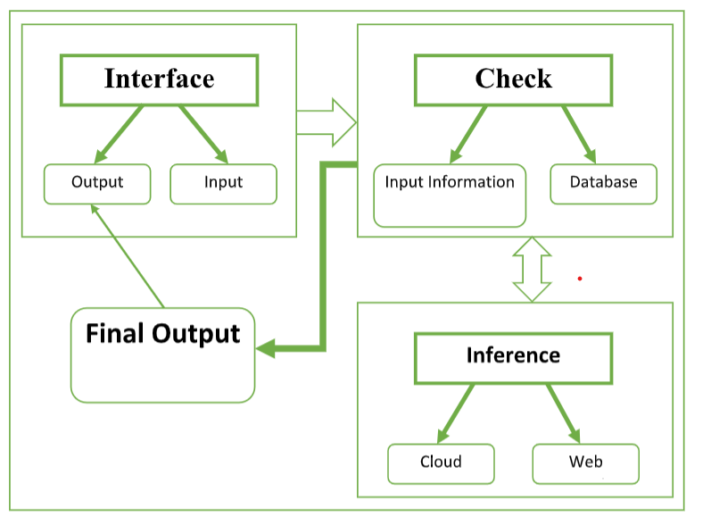
Research Methodology (Contd.)
Figure: working procedure of our proposed system

Slide 18
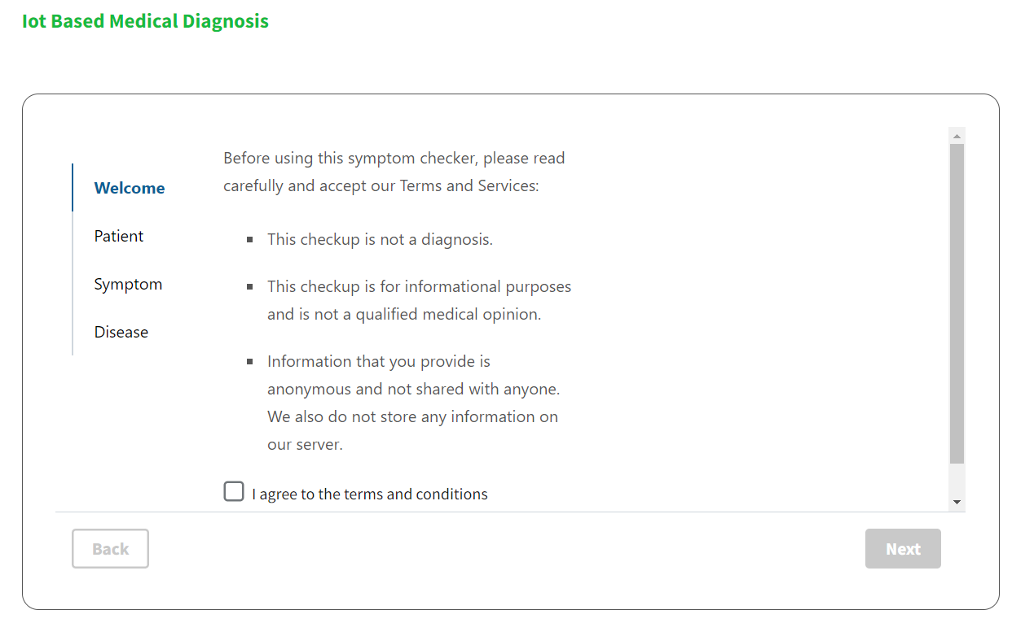
Result and Discussion
Get accepted from the user on a apps terms and condition

Slide 19
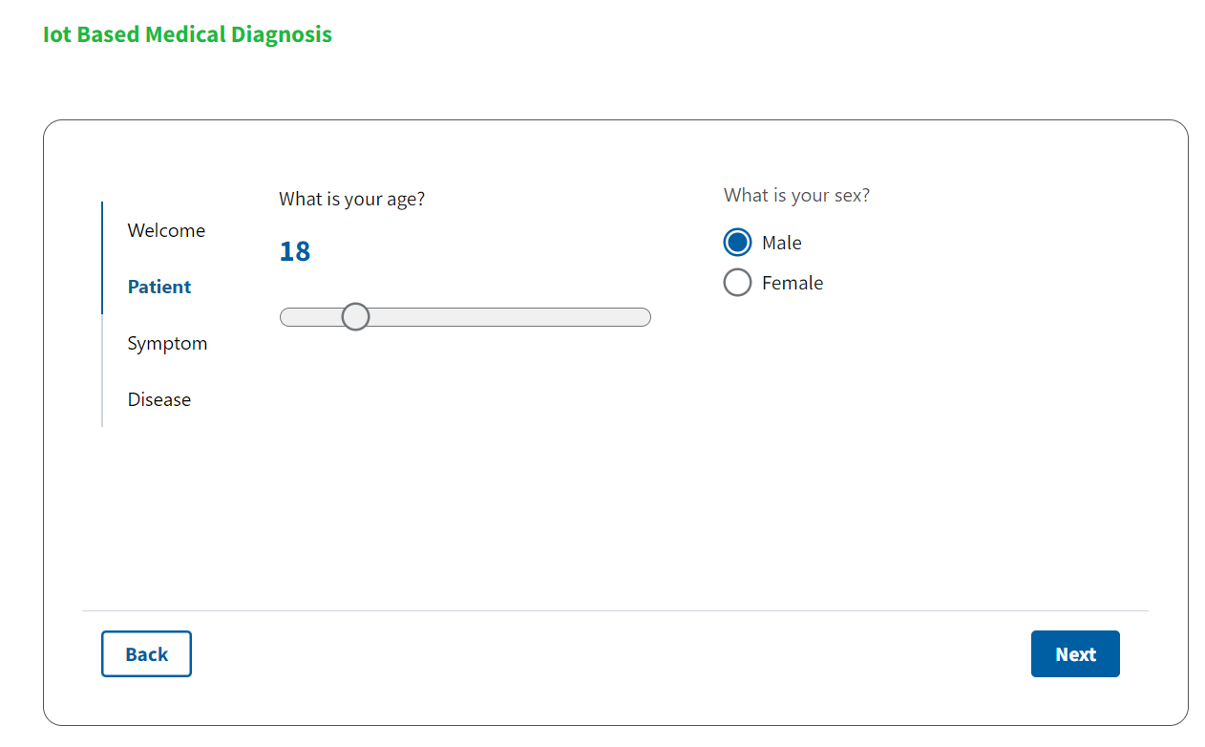
Result and Discussion
Get patient details by the user on a apps

Slide 20
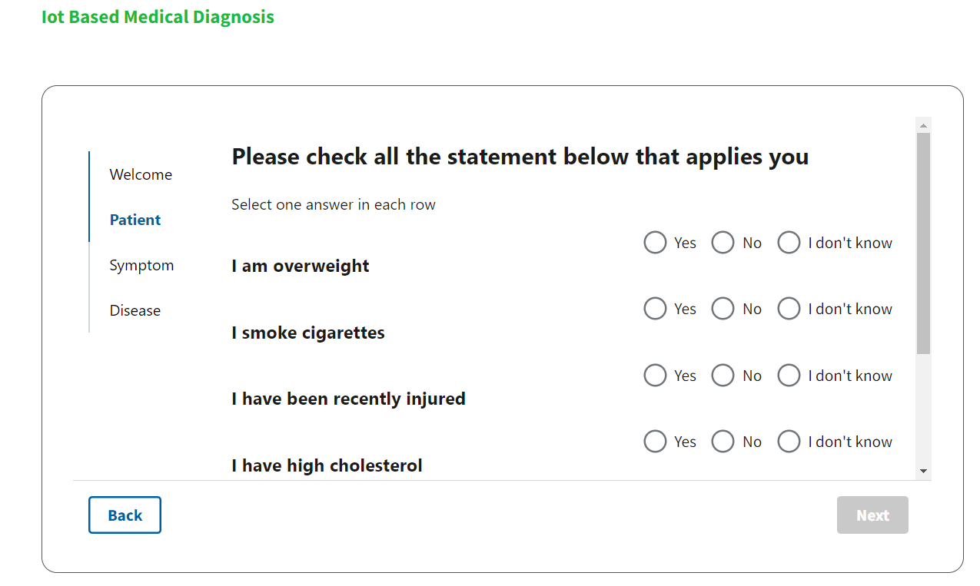
Result and Discussion
Get patient medical history by the user on the apps

Slide 21
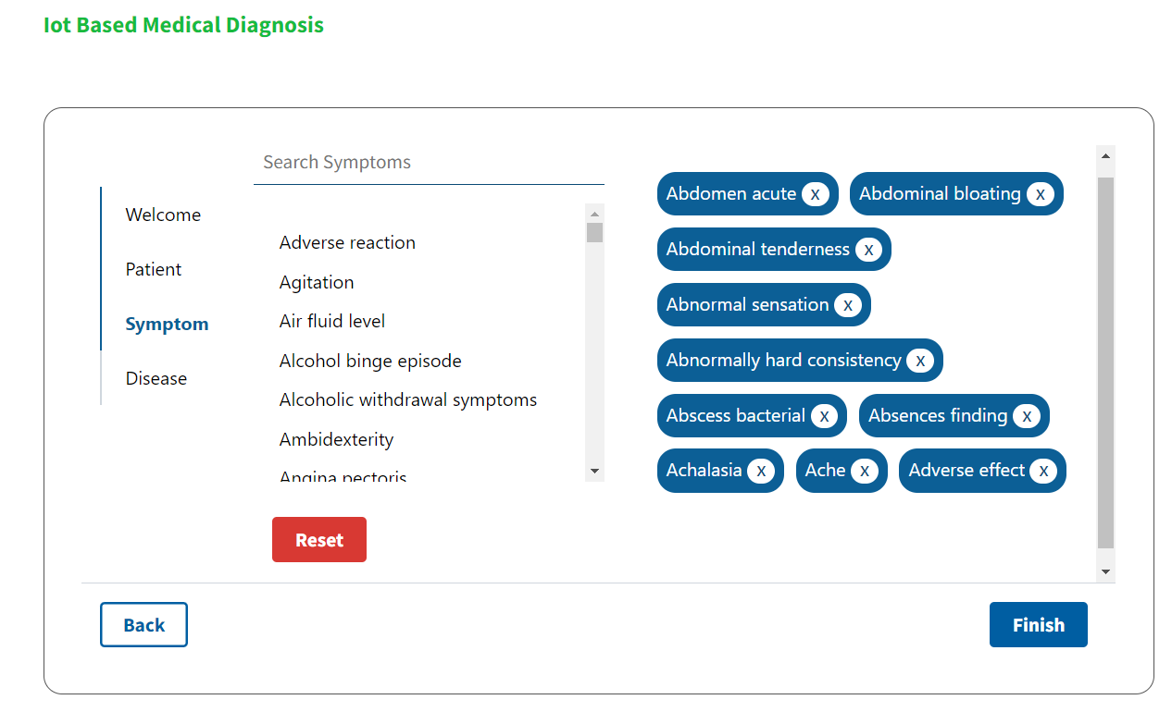
Result and Discussion
Get patient medical symptom's details

Slide 22
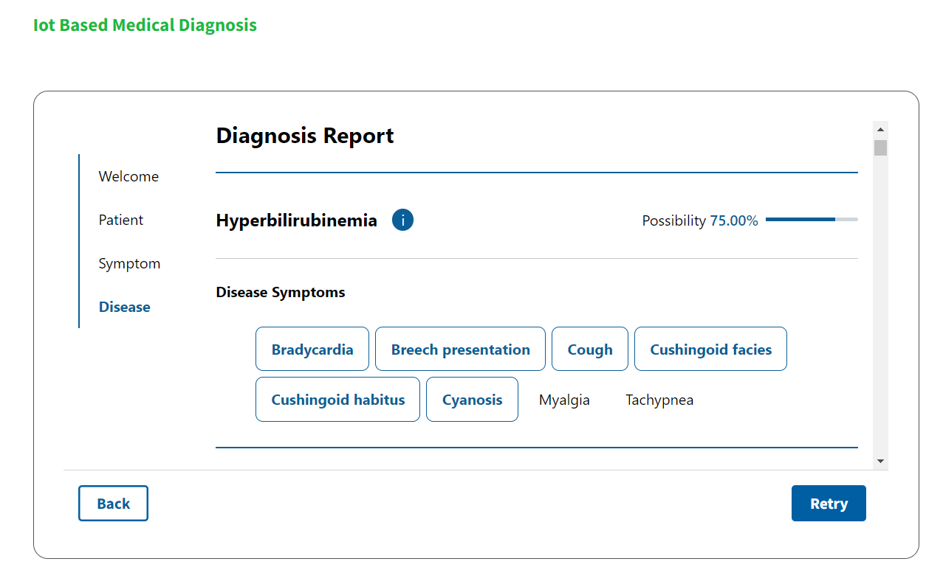
Result and Discussion
Serve patient diseases by from the app

Slide 23
Limitation
The financial barrier in procurement
Cost challenges in common
Shortage of IT and clinical resources
Trouble in learning and using the software
Systematizing of all health information systems, from the time when the content and arrangement of all health information systems should be standardized
It might be time-consuming to bring up-to-date the EHR comprehensively
The unavailability or lack of the basic infrastructure, such as internet connection

Slide 24
Future work
Work with IoT based devices
Increasing more features
Improving system quality

Slide 25

Conclusion
Concentrate on providing information and services guarantee the best outcome for the patient care.
To keep the management part of the hospital in a high standard level
This personnel will play an important role in the system design, system implementation and evaluation of the system.

Slide 26
Reference
D. Hailey, et al., “A review of guidelines for referral of patients to sleep laboratories,” Technical report, Ottawa: Canadian Coordinating Oﬃce for Health Technology Assessment, 2005.
H. Oh, et al., “What is eHealth : A systematic review of published deﬁnitions,” Journal of Medical Internet Research, vol. 7, no. 1, pp. 1-11, 2005.
L. Hu, et al., “Software deﬁned healthcare networks,” in IEEE Wireless Communications, vol. 22, no. 6, pp. 67-75, 2015.
O. Vermesan and P. Friess, “Digitizing the Industry Internet of Things Connecting the Physical, Digital and Virtual Worlds,” River Publishers, 2016.
P. Chatterjee and R. L. Armentano, “Internet of things for a smart and ubiquitous e-health system, “in 7th International Conference on Computational Intelligence and Communication Networks (CICN), Jabalpur, India, pp. 178-183, 2015.

Slide 27
Reference
P. Verma and S. K. Sood, “Cloud-centric IoT based disease diagnosis healthcare framework,” Journal of Ambient Intelligence and Humanized Computing, vol. 9, no. 5, pp. 1293-1309, 2017.
S. Kumar, et al., “Mobile health: Revolutionizing healthcare through transdisciplinary research, “Computer, vol. 46, no. 1, pp. 28-35, 2013.
W. Lin, W. Dou, Z. Zhou and C. Liuc. A cloud-based framework for homediagnosis service over big medical data. The Journal of Systems and Software, Elsevier, vol. 102, pp 192–206, 2014.
Y. Li, et al., “Enabling health monitoring as a service in the cloud,” in IEEE/ACM 7th International Conference on Utility and Cloud Computing, London, UK, pp. 127-137, 2014.

Slide 28
Thank You

