Slide 1
MicroServices Architecture
Microservices architecture is an approach to create small services.
Microservices architecture decompose a big application into multiple small services. Each small service is a Microservice.
Each microservice running in their own space.
Microservices are independent services directly calling their own database.
Microservices are can communicate each other.
All microservices in a project get deployed in production at their own pace, on-premise on the cloud, independently, living side by side.

Slide 2
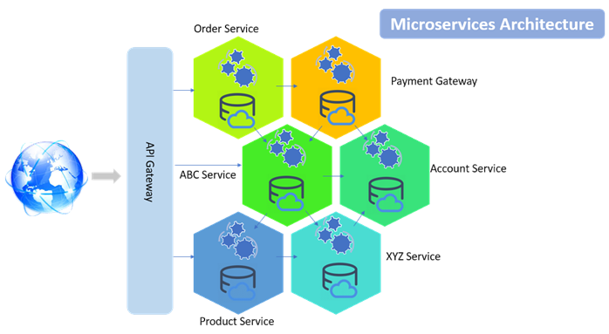
MicroServices Architecture

Slide 3
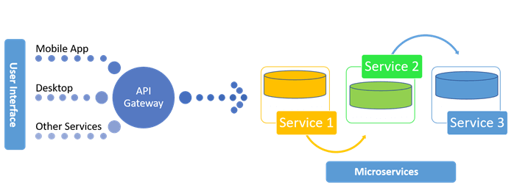
MicroServices Architecture

Slide 4
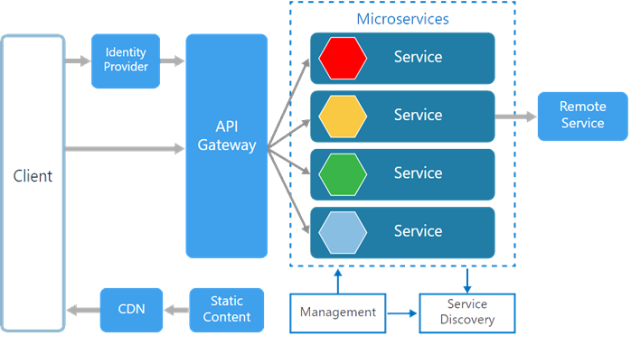
MicroServices Architecture
There are various components in a microservices architecture apart from microservices themselves.

Slide 5
MicroServices Architecture
Identity Provider. Manages the identity information and provides authentication services within a distributed network.
Service Discovery. Keeps track of services and service addresses and endpoints.
Management. Maintains the nodes for the service.
API Gateway. Serves as client’s entry point. Single point of contact from the client which in turn returns responses from underlying microservices and sometimes an aggregated response from multiple underlying microservices.
CDN. A content delivery network to serve static resources for e.g. pages and web content in a distributed network
Static Content The static resources like pages and web content

Slide 6
Advantages of Microservices Architecture
Microservices are smaller in size. So easier to develop, deploy, and debug.
Every Microservices can be written in different programming language, databases, and tools for each service.
Microservices are independent of each other, meaning that if one of the microservices goes down, there is little risk of the full application shutting down
Microservices can be scaled quickly and can be reused among different projects
Microservices work well with containers like Docker
Microservices are Support for continuous integration and delivery
Microservices can be deployed to different servers or even different datacentres.
Microservices can communicate each other

Slide 7
Microservice Benefits
Benefit 1
As in monolithic software, you only develop in one language, say .Net or Java, as the code base. But with microservices, as each service is independent and each service is a new project, each service can be developed in any language that is best fits for the requirement.
Benefit 2
The developer is only concentrated on a particular service, so the code base will be very small, and the developer will know the code very well.
Benefit 3
When one service needs to talk with another service, they can talk via API, specifically by a REST service. A REST service is the medium to communicate through, so there is little transformation
Benefit 4
There is no centralized database. Each module has its own, so there's data decentralization. You can use NoSQL or a relational database depending on the module, which introduces that polyglot persistence.

Slide 8
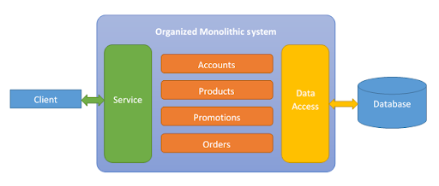
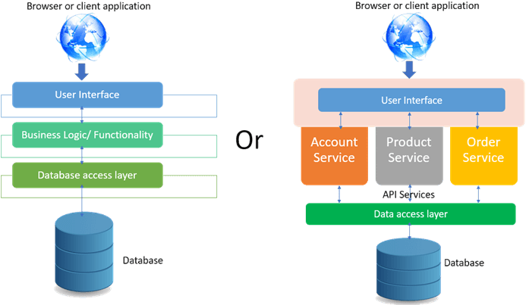
Monolithic Architecture
Monolithic applications are more of a single complete package having all the related needed components and services encapsulated in one package.
Following is the diagrammatic representation of monolithic architecture being package completely or being service based.

Slide 9
problems with a monolithic system
Problem 1
As there is one codebase, it grows gradually. Every programmer, whether it's a UI Developer or a business layer developer, commits in same code base, which becomes very inefficient to manage. Suppose one developer only works in the JMS module, but he has to pull the whole codebase to his local and configure the whole module in order to run it on a local server. Why? He should only concentrate on the JMS module, but the current scenario doesn't allow for that.
Problem 2
As there is one code base and modules are dependent on each other, minimal change in one module needs to generate all artifacts and needs to deploy in each server pool in a distributed environment.
Suppose in a multi-module project that the JMS module and business module are dependent on the data access module. A simple change in the data access module means we need to re-package the JMS module and business module and deploy them in their server pool.

Slide 10
problems with a monolithic system
Problem 3
As monolithic software uses a three-tier architecture, three cross-functional teams are involved in developing a feature. Even though a three-tier architecture allows for separation of responsibility, in the long-run, the boundaries are crossed and the layers lose their fluidity and become rigid.
Suppose an inventory management feature has been developed. The UI, business layer, and data access layer have their own jobs. But everyone wants to take control of the main business part so that when defects come up, they can solve them and are not dependent on another layer's developer. Due to this competition, those boundaries end up being crossed, which results in inefficient architecture.
Problem 4
As our system is monolithic, so is our team management. Often, we create teams base on the tier — UI developers, backend developers, database programmers, etc. They are experts in their domains, but they have little knowledge about other layers. So when there's a critical problem, it encompasses each layer, and the blame game starts. Not only that, but it takes additional time to decide which layer's problem it is and who needs to solve the issue

Slide 11
Monolithic vs Microservices Architecture
Monolithic | Microservices
Dependent & compounded project development of User Interface, Business functional Components, and Database Logics. | Multiple Services are developed with a single purpose each.
Single Database due to complex coupled development | Dedicated Database for each microservice due to modularity.
Single programming Language dependency for the Backend (Business logic) | Ability to choose multiple technologies/languages for each microservice.
The solution has to be deployed into a single Server. Physical Separation of deployment and maintenance is complex. | Each of the Microservice can be deployed anywhere on the web with ease.
Different business functionalities technically called modules or components will be tightly coupled to the application itself. | Loosely Coupled Architecture because of the modular approach.

