Slide 1
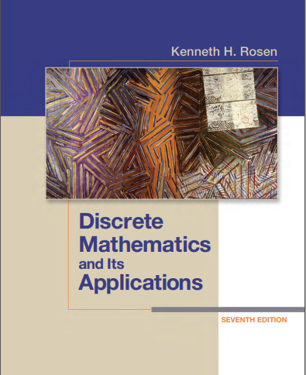
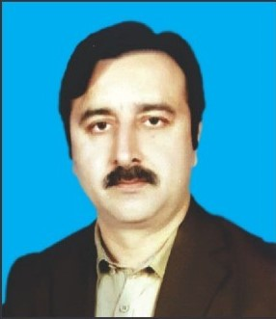
Discrete structures
By Dr. sajid iqbal
Course Reference Book

Slide 2
Propositional equivalence
Chapter - 1

Slide 3
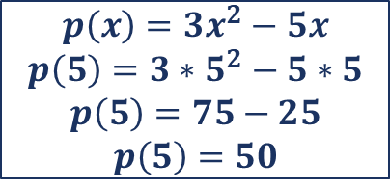
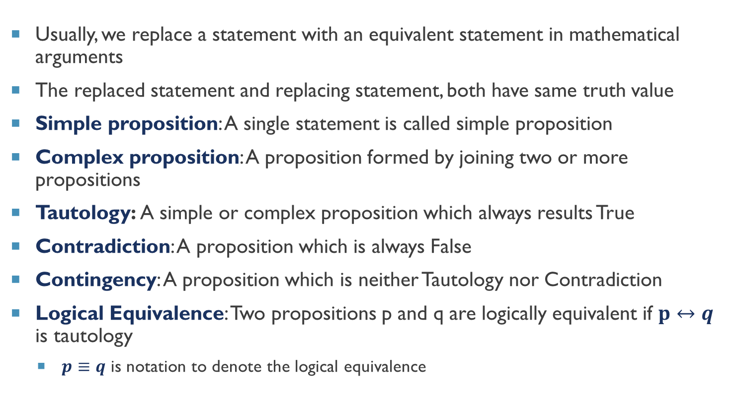
Background
Usually, we replace a statement with an equivalent statement in mathematical arguments
The replaced statement and replacing statement, both have same truth value
Simple proposition: A single statement is called simple proposition
Complex proposition: A proposition formed by joining two or more propositions
Tautology: A simple or complex proposition which always results True
Contradiction: A proposition which is always False
Contingency: A proposition which is neither Tautology nor Contradiction
Logical Equivalence: Two propositions p and q are logically equivalent if $p↔q$ is tautology
$p≡q$ is notation to denote the logical equivalence
Prop. Equivalence
$$p\left(x\right)=3x^{2}−5x$$
$$p\left(5\right)=3∗5^{2}−5∗5$$
$$p\left(5\right)=75−25$$
$$p\left(5\right)=50$$

Slide 4
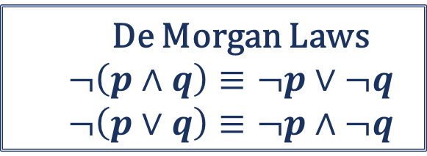
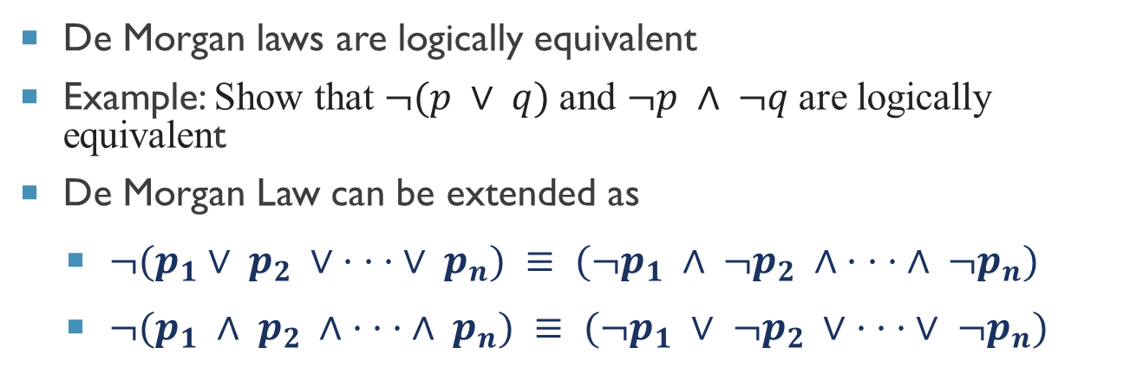
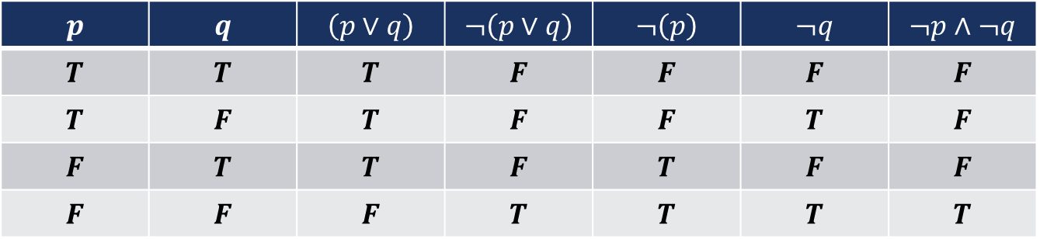
Logical equivalence examples
De Morgan laws are logically equivalent
Example: Show that $¬(p ∨ q)$and $¬p ∧ ¬q$are logically equivalent
De Morgan Law can be extended as
$¬(p_{1}∨ p_{2} ∨ · · · ∨ p_{n}) ≡ (¬p_{1} ∧ ¬p_{2} ∧ · · · ∧ ¬p_{n})$
$¬(p_{1} ∧ p_{2} ∧ · · · ∧ p_{n}) ≡ (¬p_{1} ∨ ¬p_{2} ∨ · · · ∨ ¬p_{n})$
De Morgan Laws
$$¬\left(p∧q\right)≡¬p∨¬q$$
$$¬\left(p∨q\right)≡¬p∧¬q$$
$$p$$ | $$q$$ | $$\left(p∨q\right)$$ | $$¬\left(p∨q\right)$$ | $$¬\left(p\right)$$ | $$¬q$$ | $$¬p∧¬q$$
$$T$$ | $$T$$ | $$T$$ | $$F$$ | $$F$$ | $$F$$ | $$F$$
$$T$$ | $$F$$ | $$T$$ | $$F$$ | $$F$$ | $$T$$ | $$F$$
$$F$$ | $$T$$ | $$T$$ | $$F$$ | $$T$$ | $$F$$ | $$F$$
$$F$$ | $$F$$ | $$F$$ | $$T$$ | $$T$$ | $$T$$ | $$T$$

Slide 5
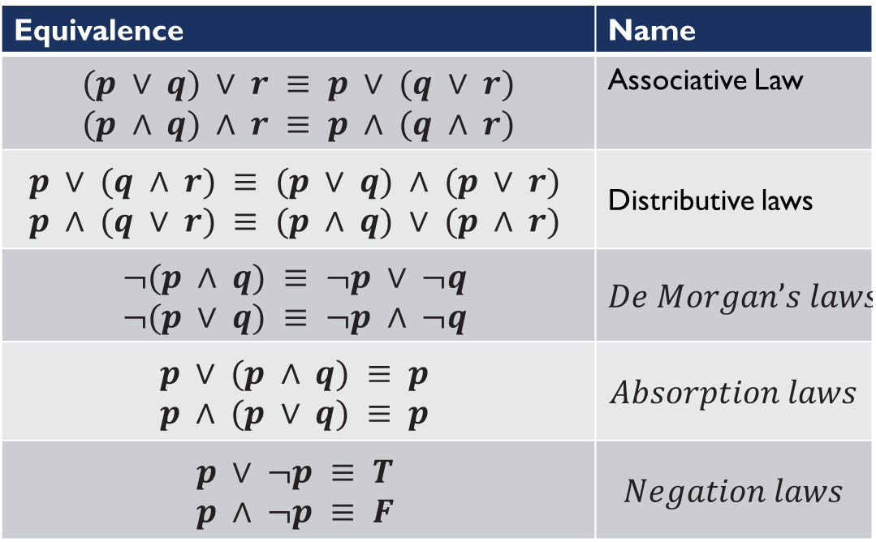
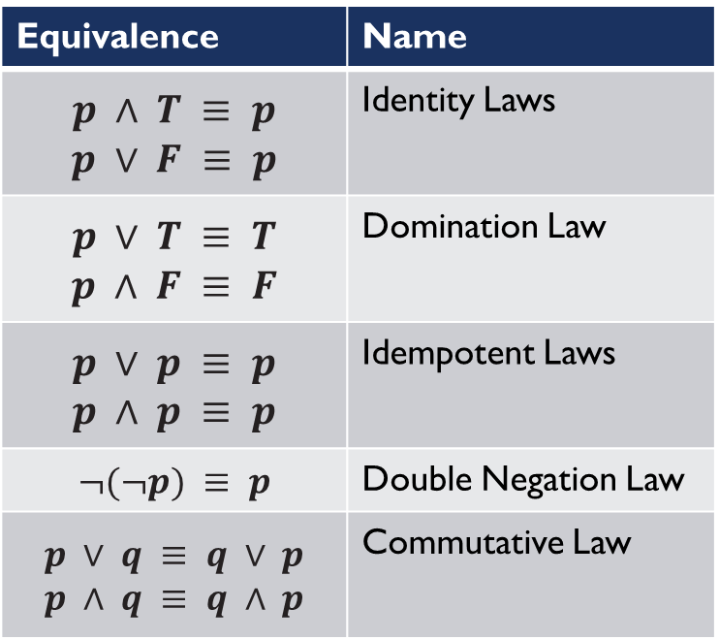
Logical equivalences
Equivalence | Name
$$p ∧ T ≡ p$$ $$p ∨ F ≡ p$$ | Identity Laws
$$p ∨ T ≡ T$$ $$p ∧ F ≡ F$$ | Domination Law
$$p ∨ p ≡ p$$ $$p ∧ p ≡ p$$ | Idempotent Laws
$$¬(¬p) ≡ p$$ | Double Negation Law
$$p ∨ q ≡ q ∨ p$$ $$p ∧ q ≡ q ∧ p$$ | Commutative Law
Equivalence | Name
$$(p ∨ q) ∨ r ≡ p ∨ (q ∨ r)$$ $$(p ∧ q) ∧ r ≡ p ∧ (q ∧ r)$$ | Associative Law
$$p ∨ (q ∧ r) ≡ (p ∨ q) ∧ (p ∨ r) \\ p ∧ (q ∨ r) ≡ (p ∧ q) ∨ (p ∧ r)$$ | Distributive laws
$$¬(p ∧ q) ≡ ¬p ∨ ¬q \\ ¬(p ∨ q) ≡ ¬p ∧ ¬q$$ | $$De Morgan’s laws$$
$$p ∨ (p ∧ q) ≡ p \\ p ∧ (p ∨ q) ≡ p$$ | $$Absorption laws$$
$$p ∨ ¬p ≡ T \\ p ∧ ¬p ≡ F$$ | $$Negation laws$$

Slide 6
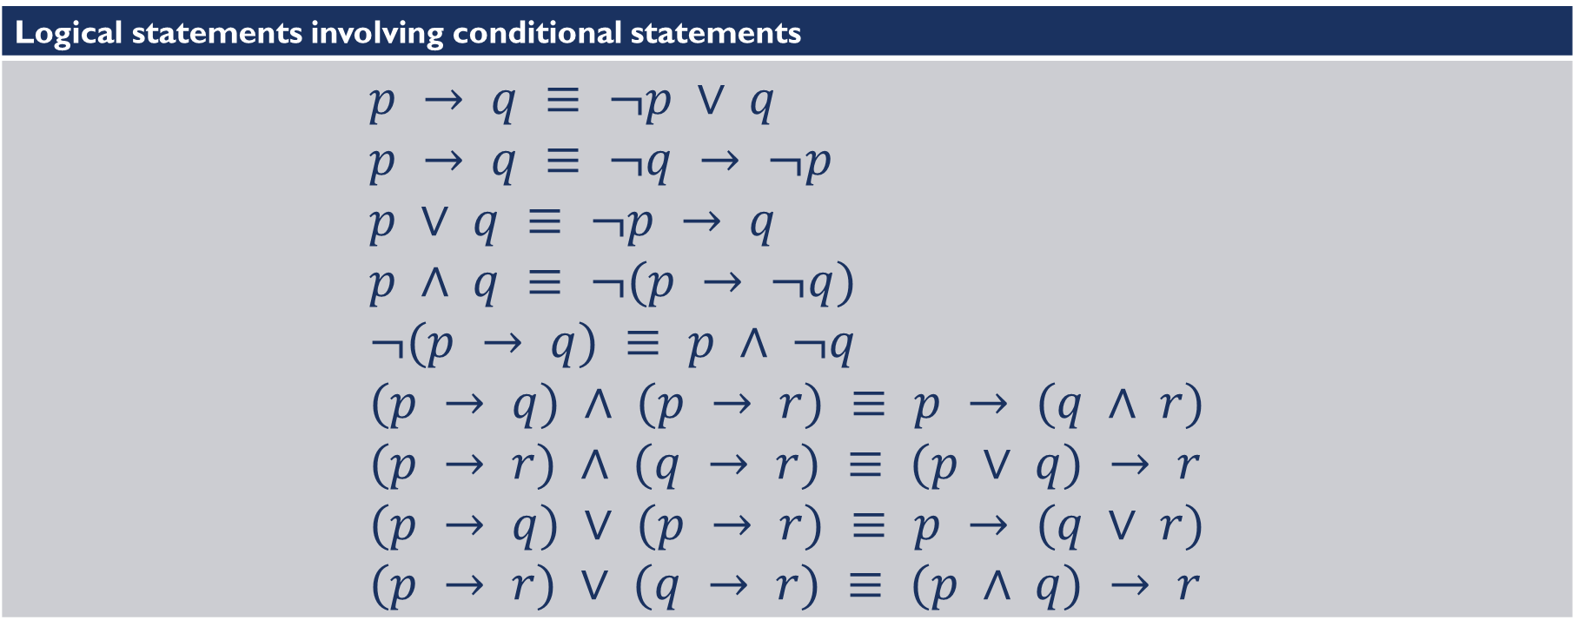
Logical equivalence
Logical statements involving conditional statements
$$p → q ≡ ¬p ∨ q \\ p → q ≡ ¬q → ¬p \\ p ∨ q ≡ ¬p → q \\ p ∧ q ≡ ¬(p → ¬q) \\ ¬(p → q) ≡ p ∧ ¬q \\ (p → q) ∧ (p → r) ≡ p → (q ∧ r) \\ (p → r) ∧ (q → r) ≡ (p ∨ q) → r \\ (p → q) ∨ (p → r) ≡ p → (q ∨ r) \\ (p → r) ∨ (q → r) ≡ (p ∧ q) → r$$

Slide 7
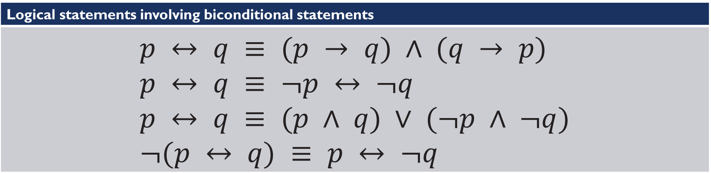
Logical equivalence
Logical statements involving biconditional statements
$$p ↔ q ≡ (p → q) ∧ (q → p) \\ p ↔ q ≡ ¬p ↔ ¬q \\ p ↔ q ≡ (p ∧ q) ∨ (¬p ∧ ¬q) \\ ¬(p ↔ q) ≡ p ↔ ¬q$$

Slide 8
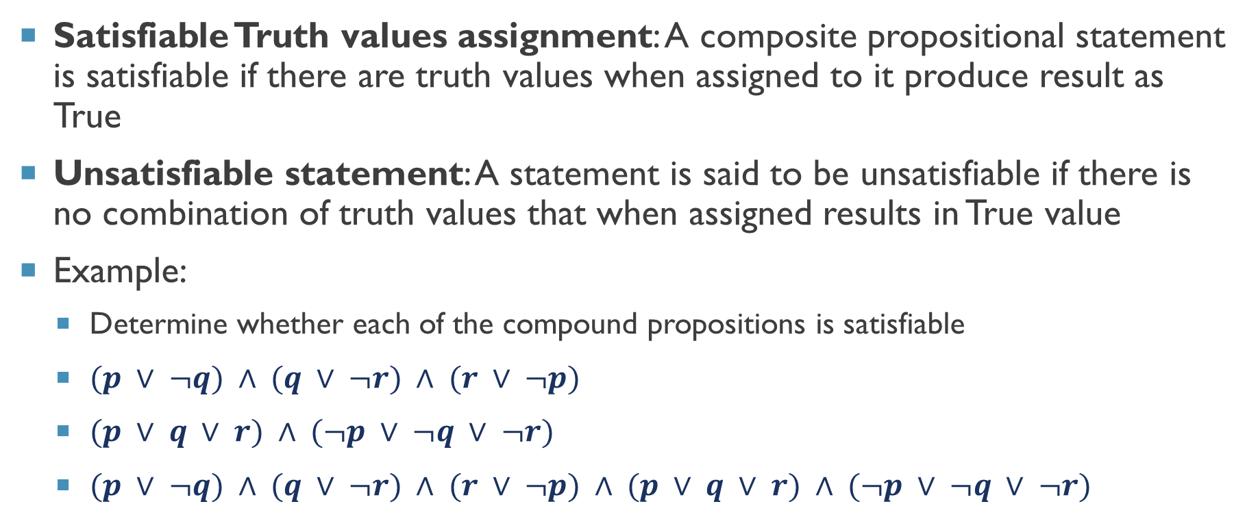
Propositional satisfiability
Satisfiable Truth values assignment: A composite propositional statement is satisfiable if there are truth values when assigned to it produce result as True
Unsatisfiable statement: A statement is said to be unsatisfiable if there is no combination of truth values that when assigned results in True value
Example:
Determine whether each of the compound propositions is satisfiable
$(p ∨ ¬q) ∧ (q ∨ ¬r) ∧ (r ∨ ¬p)$
$(p ∨ q ∨ r) ∧ (¬p ∨ ¬q ∨ ¬r)$
$(p ∨ ¬q) ∧ (q ∨ ¬r) ∧ (r ∨ ¬p) ∧ (p ∨ q ∨ r) ∧ (¬p ∨ ¬q ∨ ¬r)$

Slide 9
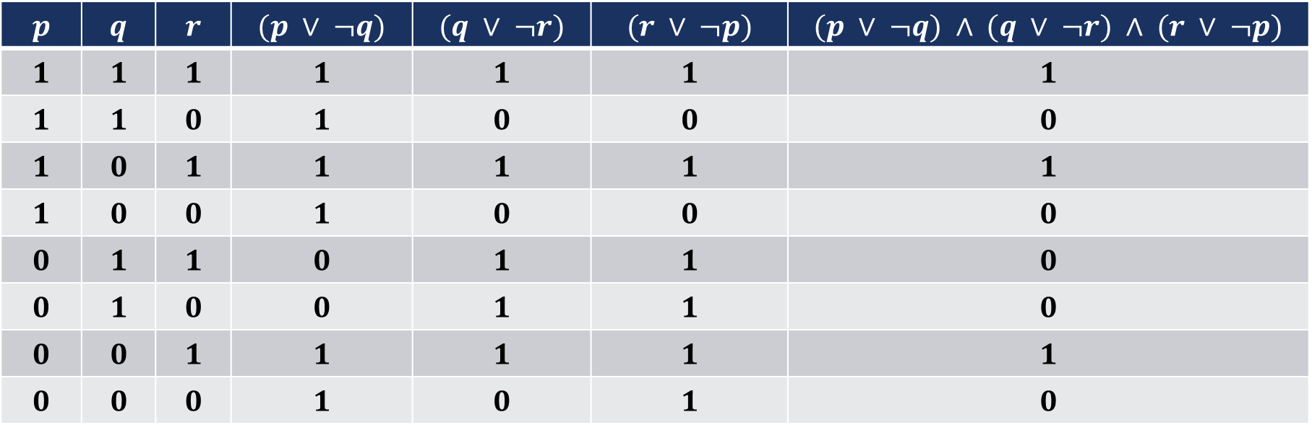
$$(p ∨ ¬q) ∧ (q ∨ ¬r) ∧ (r ∨ ¬p)$$
$$p$$ | $$q$$ | $$r$$ | $$(p ∨ ¬q)$$ | $$(q ∨ ¬r)$$ | $$(r ∨ ¬p)$$ | $$(p ∨ ¬q) ∧ (q ∨ ¬r) ∧ (r ∨ ¬p)$$
$$1$$ | $$1$$ | $$1$$ | $$1$$ | $$1$$ | $$1$$ | $$1$$
$$1$$ | $$1$$ | $$0$$ | $$1$$ | $$0$$ | $$0$$ | $$0$$
$$1$$ | $$0$$ | $$1$$ | $$1$$ | $$1$$ | $$1$$ | $$1$$
$$1$$ | $$0$$ | $$0$$ | $$1$$ | $$0$$ | $$0$$ | $$0$$
$$0$$ | $$1$$ | $$1$$ | $$0$$ | $$1$$ | $$1$$ | $$0$$
$$0$$ | $$1$$ | $$0$$ | $$0$$ | $$1$$ | $$1$$ | $$0$$
$$0$$ | $$0$$ | $$1$$ | $$1$$ | $$1$$ | $$1$$ | $$1$$
$$0$$ | $$0$$ | $$0$$ | $$1$$ | $$0$$ | $$1$$ | $$0$$
This expression is satisfiable and it has three solutions

Slide 10
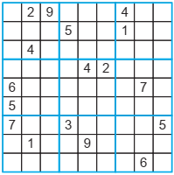
Application of satisfiability
Sudoku puzzle
SQL Statements and database management systems
A 9 × 9 Sudoku puzzle

Slide 11
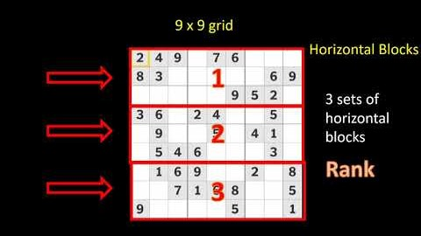

Slide 12
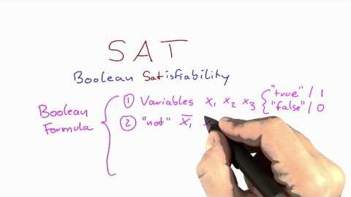

Slide 13



Thanks for watching
Dr. Sajid Iqbal
Assistant Professor
Department of Computer Science
Bahauddin Zakariya University, Multan
sajidiqbal.pk@gmail.com
https://github.com/sajjo79/DiscreteMathematics
Allah Hafiz
COMEDXD

