Slide 1
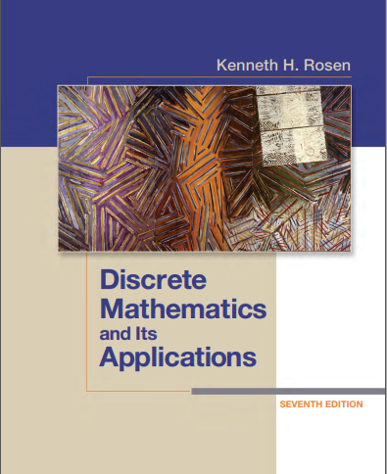

Discrete structures
By Dr. sajid iqbal
Course Reference Book

Slide 2
Sets
Chapter - 2

Slide 3
Background
Discrete Mathematics deals with discrete structures like integers
Many discrete structures are built using sets (collections of objects)
Discrete structures built from sets are
Combinations
Unordered collections of objects used in counting
Relations
Sets of ordered pairs that represent relationships between objects
Graphs (sets of vertices and edges that connect vertices)
Finite state machines, used to model computing machines

Slide 4
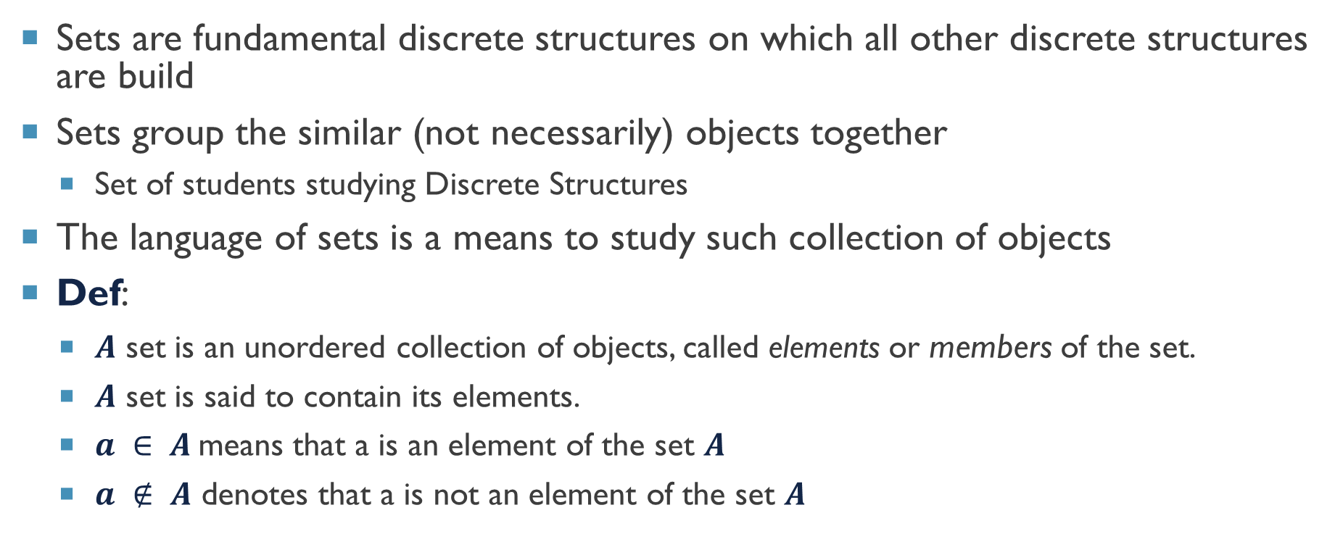
Sets are fundamental discrete structures on which all other discrete structures are build
Sets group the similar (not necessarily) objects together
Set of students studying Discrete Structures
The language of sets is a means to study such collection of objects
Def:
$A$ set is an unordered collection of objects, called elements or members of the set.
$A$ set is said to contain its elements.
$a ∈ A$means that a is an element of the set $A$
$a ∉ A$ denotes that a is not an element of the set $A$

Slide 5
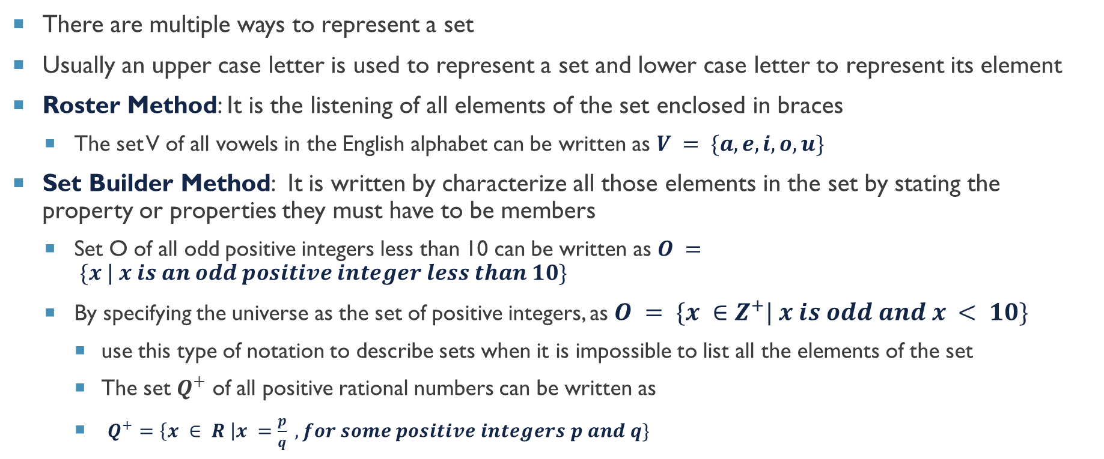
Representing the set
There are multiple ways to represent a set
Usually an upper case letter is used to represent a set and lower case letter to represent its element
Roster Method: It is the listening of all elements of the set enclosed in braces
The set V of all vowels in the English alphabet can be written as $V = \{a, e, i, o, u\}$
Set Builder Method: It is written by characterize all those elements in the set by stating the property or properties they must have to be members
Set O of all odd positive integers less than 10 can be written as $O = \{x | x is an odd positive integer less than 10\}$
By specifying the universe as the set of positive integers, as $O = \{x ∈Z^{+}| x is odd and x < 10\}$
use this type of notation to describe sets when it is impossible to list all the elements of the set
The set $Q^{+}$ of all positive rational numbers can be written as
$Q^{+}=\left\{x ∈ R \right|x =\frac{p}{q} , for some positive integers p and q\}$

Slide 6
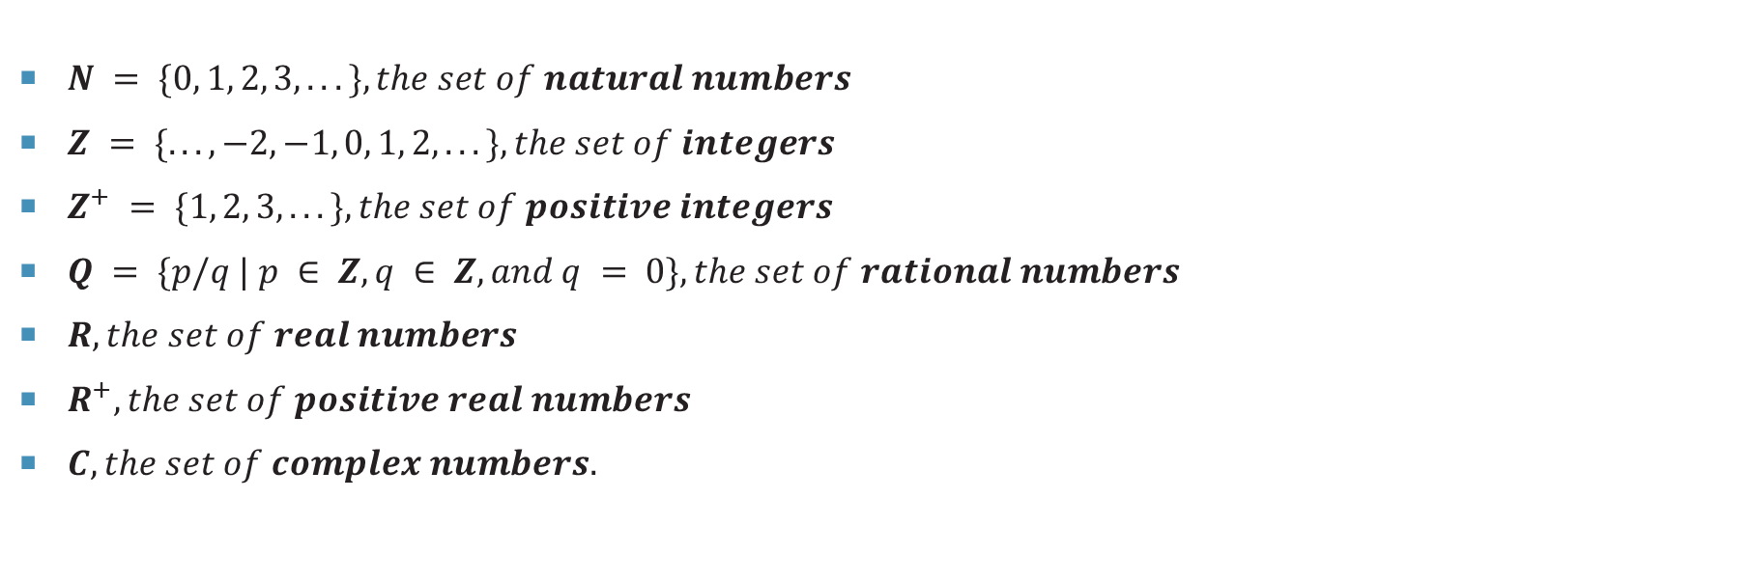
Some Common Sets
$N = \{0, 1, 2, 3, . . .\}, the set of natural numbers$
$Z = \{. . . , −2, −1, 0, 1, 2, . . .\}, the set of integers$
$Z^{+} = \{1, 2, 3, . . .\}, the set of positive integers$
$Q = \{p/q | p ∈ Z, q ∈ Z, and q = 0\}, the set of rational numbers$
$R, the set of real numbers$
$R^{+}, the set of positive real numbers$
$C, the set of complex numbers.$

Slide 7
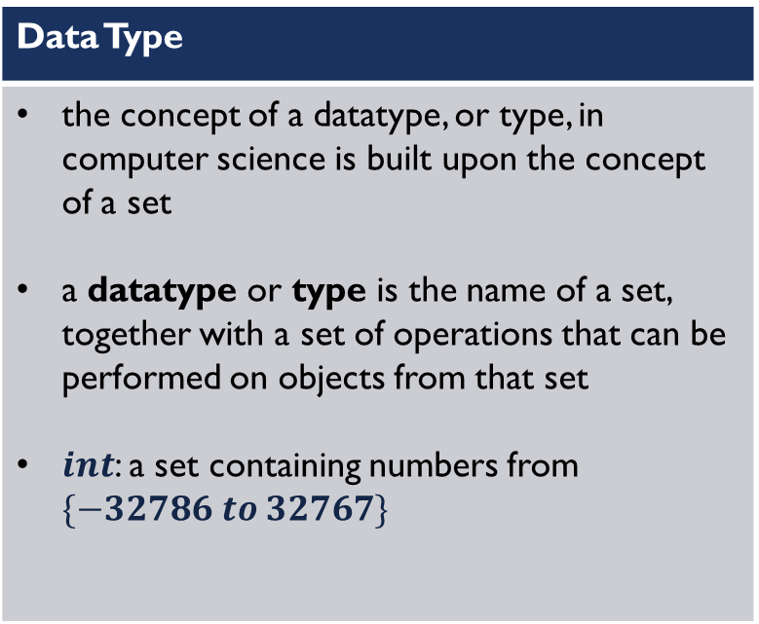
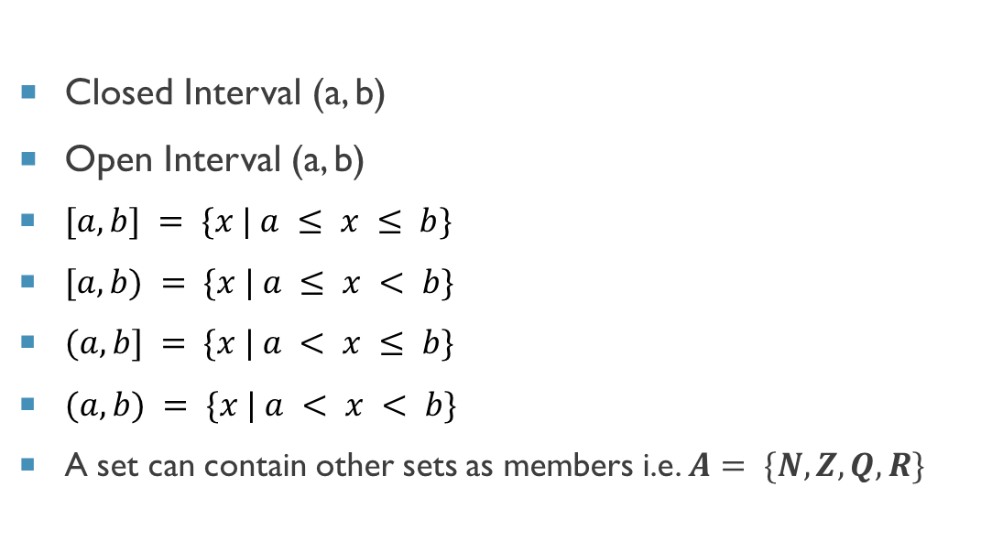
Intervals of real numbers
Closed Interval (a, b)
Open Interval (a, b)
$[a, b] = \{x | a ≤ x ≤ b\}$
$[a, b) = \{x | a ≤ x < b\}$
$(a, b] = \{x | a < x ≤ b\}$
$(a, b) = \{x | a < x < b\}$
A set can contain other sets as members i.e. $A= \{N, Z, Q, R\}$
Data Type
the concept of a datatype, or type, in computer science is built upon the concept of a set a datatype or type is the name of a set, together with a set of operations that can be performed on objects from that set $int$: a set containing numbers from $\{−32786 to 32767\}$

Slide 8
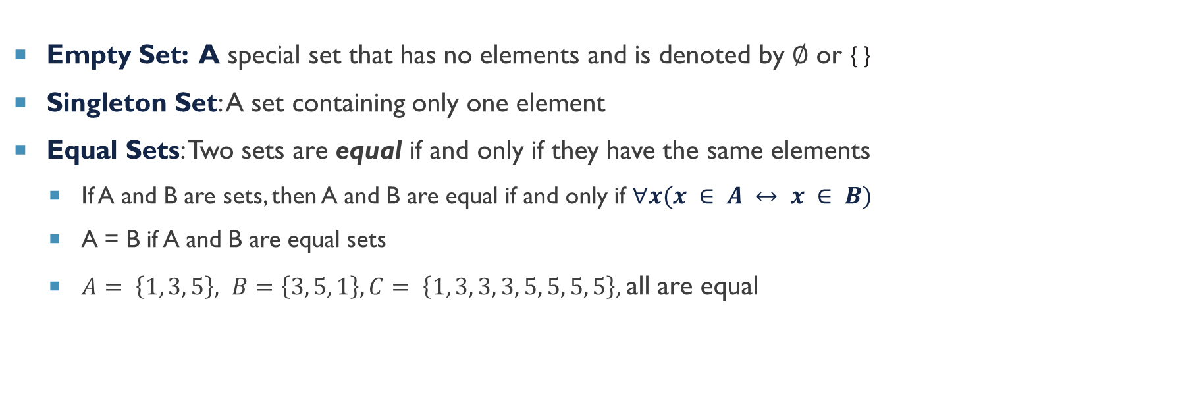
Some definitions
Empty Set: A special set that has no elements and is denoted by ∅ or { }
Singleton Set: A set containing only one element
Equal Sets: Two sets are equal if and only if they have the same elements
If A and B are sets, then A and B are equal if and only if $∀x(x ∈ A ↔ x ∈ B)$
A = B if A and B are equal sets
$A= \left\{1, 3, 5\right\}, B=\left\{3, 5, 1\right\}, C= \left\{1, 3, 3, 3, 5, 5, 5, 5\right\},$all are equal

Slide 9
Naïve set theory
A set consists of similar objects
The definition of objects is not clear in this definition
This can produce logical inconsistencies called paradoxes
These logical inconsistencies can be avoided by building set theory beginning with axioms known as naïve set theory presented by George Cantor.

Slide 10
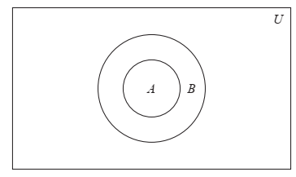
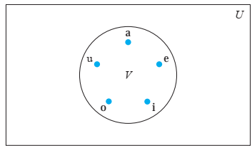
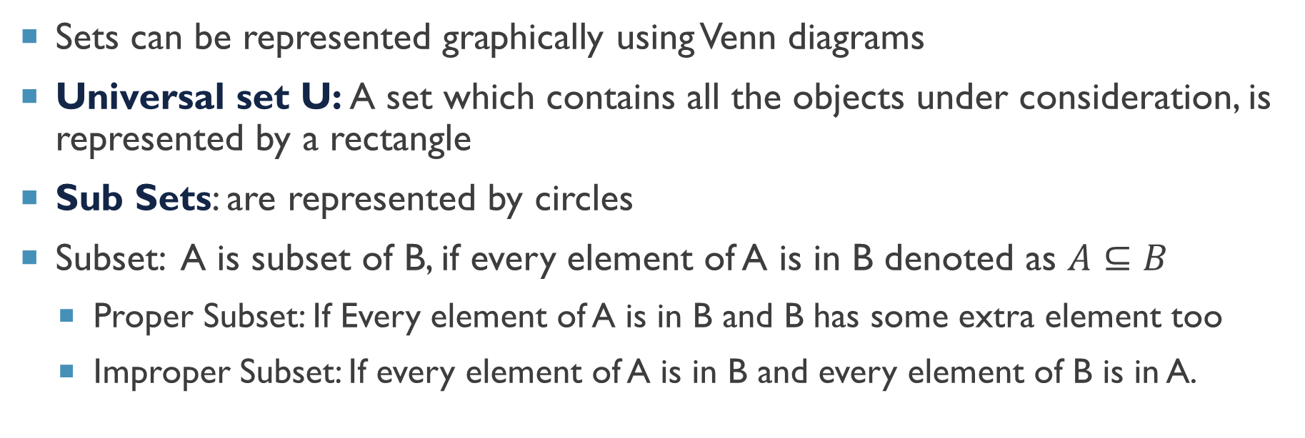
Venn diagrams
Sets can be represented graphically using Venn diagrams
Universal set U: A set which contains all the objects under consideration, is represented by a rectangle
Sub Sets: are represented by circles
Subset: A is subset of B, if every element of A is in B denoted as $A⊆B$
Proper Subset: If Every element of A is in B and B has some extra element too
Improper Subset: If every element of A is in B and every element of B is in A.
Proper subset $∀x(x∈A→x∈B)∧∃x(x∈B∧x∈A)$

Slide 11
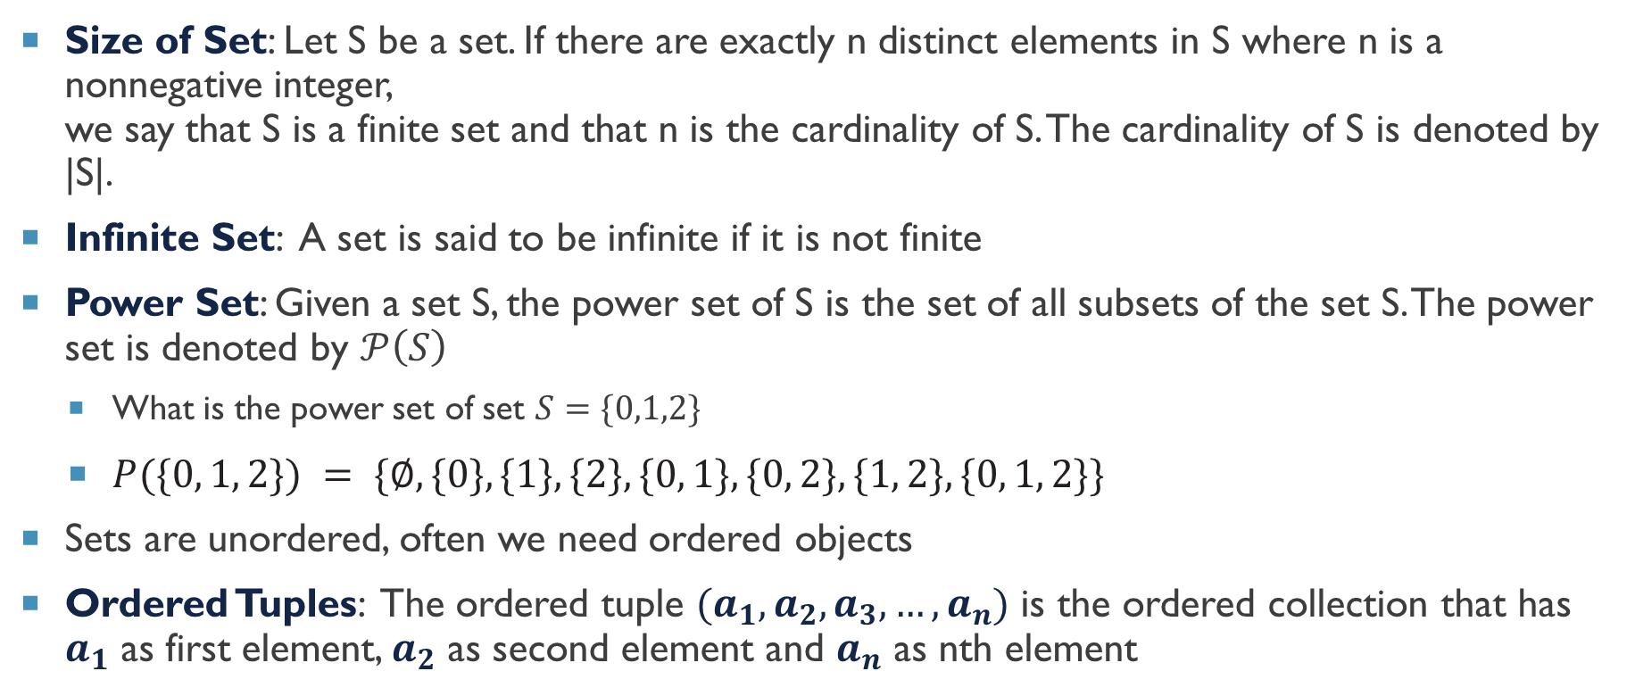
Definitions
Size of Set: Let S be a set. If there are exactly n distinct elements in S where n is a nonnegative integer, we say that S is a finite set and that n is the cardinality of S. The cardinality of S is denoted by |S|.
Infinite Set: A set is said to be infinite if it is not finite
Power Set: Given a set S, the power set of S is the set of all subsets of the set S. The power set is denoted by $𝒫\left(S\right)$
What is the power set of set $S=\{0,1,2\}$
$P(\{0, 1, 2\}) = \{∅, \{0\}, \{1\}, \{2\}, \{0, 1\}, \{0, 2\}, \{1, 2\}, \{0, 1, 2\}\}$
Sets are unordered, often we need ordered objects
Ordered Tuples: The ordered tuple $(a_{1},a_{2},a_{3},…,a_{n})$ is the ordered collection that has $a_{1}$ as first element, $a_{2}$ as second element and $a_{n}$ as nth element

Slide 12
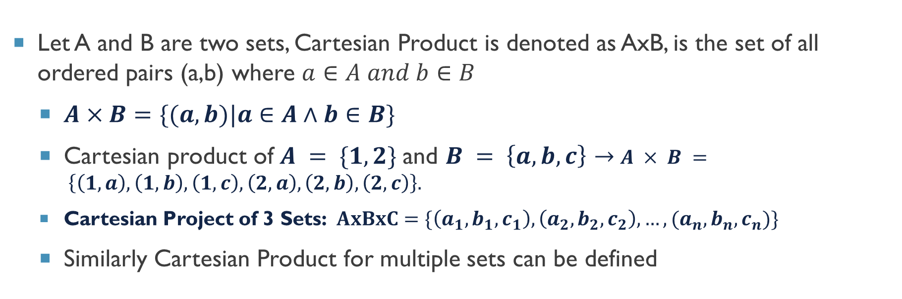
Cartesian Product
Let A and B are two sets, Cartesian Product is denoted as AxB, is the set of all ordered pairs (a,b) where $a∈A and b∈B$
$A×B=\{(a, b)|a∈A∧b∈B\}$
Cartesian product of $A = \{1, 2\}$and $B = \left\{a, b, c\right\}→$ $A × B = \left\{\left(1, a\right), \left(1, b\right), \left(1, c\right), \left(2, a\right), \left(2, b\right), \left(2, c\right)\right\}.$
Cartesian Project of 3 Sets: $AxBxC=\{\left(a_{1},b_{1},c_{1}\right),\left(a_{2},b_{2},c_{2}\right),…,(a_{n},b_{n},c_{n})\}$
Similarly Cartesian Product for multiple sets can be defined

Slide 13
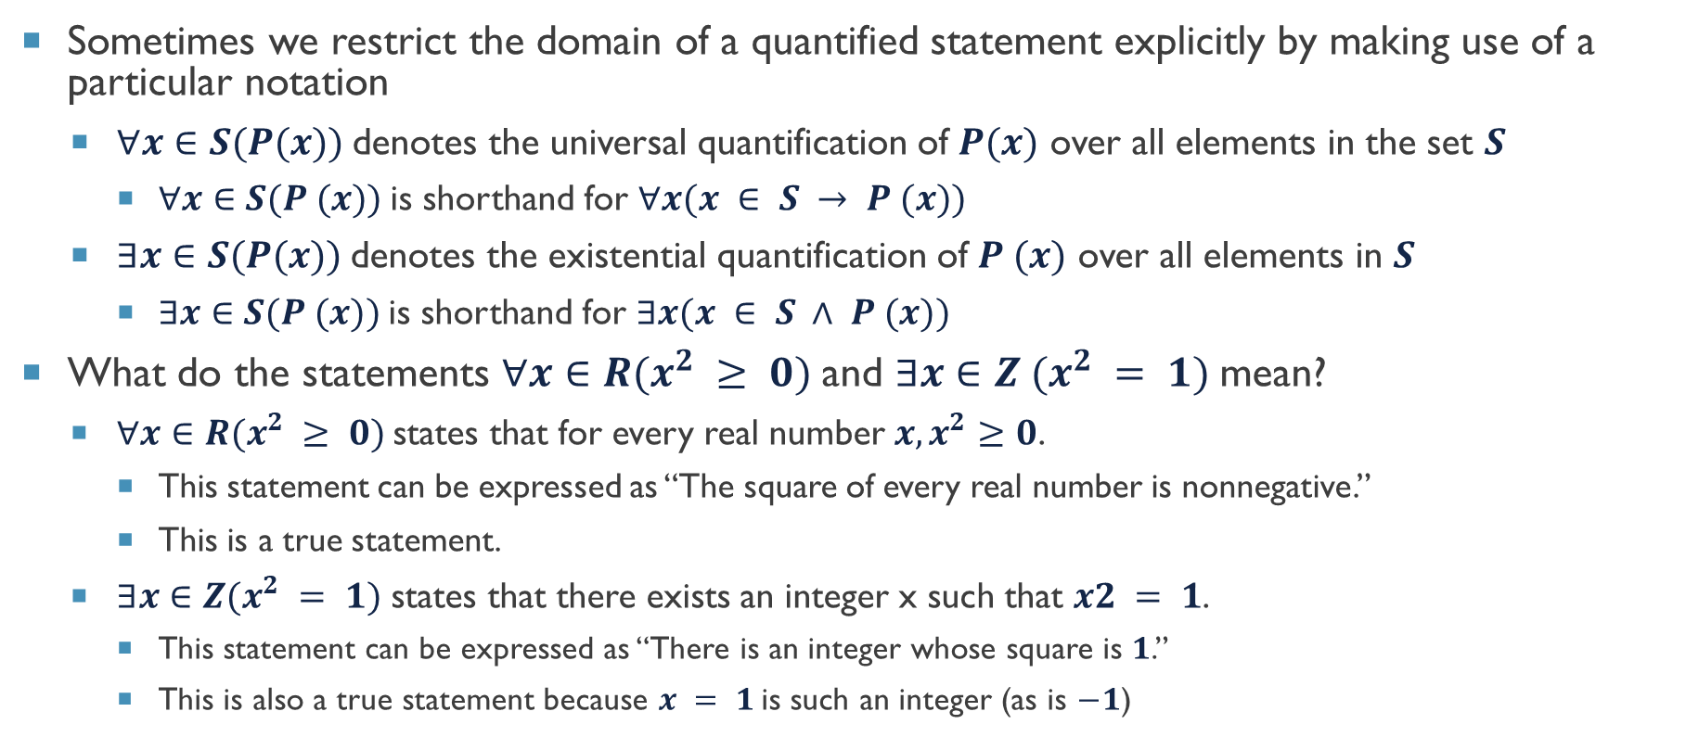
Set notations with quantifiers
Sometimes we restrict the domain of a quantified statement explicitly by making use of a particular notation
$∀x∈S(P(x))$denotes the universal quantification of $P(x)$ over all elements in the set $S$
$∀x∈S(P (x))$is shorthand for $∀x(x ∈ S → P (x))$
$∃x∈S(P(x))$denotes the existential quantification of $P (x)$ over all elements in $S$
$∃x∈S(P (x))$is shorthand for $∃x(x ∈ S ∧ P (x))$
What do the statements $∀x∈R(x^{2} ≥ 0)$and $∃x∈Z (x^{2} = 1)$mean?
$∀x∈R(x^{2} ≥ 0)$states that for every real number $x, x^{2}≥0$.
This statement can be expressed as “The square of every real number is nonnegative.”
This is a true statement.
$∃x∈Z(x^{2} = 1)$ states that there exists an integer x such that $x2 = 1$.
This statement can be expressed as “There is an integer whose square is $1$.”
This is also a true statement because $x = 1$is such an integer (as is $−1$)

Slide 14
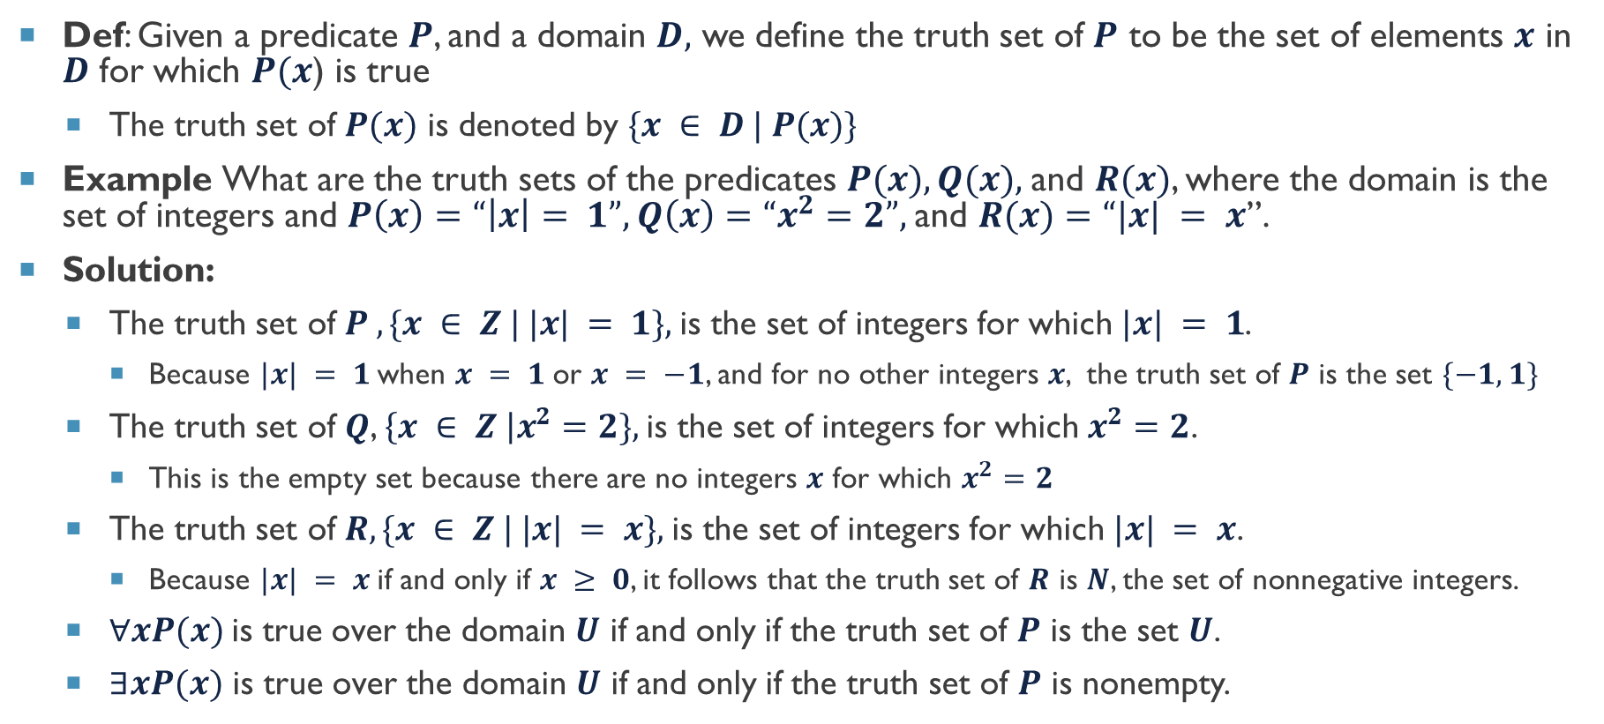
Truth sets and quantifiers
Def: Given a predicate $P$, and a domain $D,$ we define the truth set of $P$ to be the set of elements $x$ in $D$ for which $P(x$) is true
The truth set of $P(x)$ is denoted by $\{x ∈ D | P(x)\}$
Example What are the truth sets of the predicates $P(x), Q(x),$and $R(x)$, where the domain is the set of integers and $P\left(x\right)=“\left|x\right|= 1”, Q\left(x\right)=“x^{2}=2”,$and $R(x)=“|x| = x$”.
Solution:
The truth set of $P , \{x ∈ Z | |x| = 1\},$is the set of integers for which $|x| = 1$.
Because $|x| = 1$when $x = 1$or $x = −1$, and for no other integers $x$, the truth set of $P$ is the set $\{−1, 1\}$
The truth set of $Q$, $\left\{x ∈ Z \right|x^{2}=2\},$is the set of integers for which $x^{2}=2$.
This is the empty set because there are no integers $x$ for which $x^{2}=2$
The truth set of $R, \{x ∈ Z | |x| = x\},$is the set of integers for which $|x| = x$.
Because $|x| = x$if and only if $x ≥ 0$, it follows that the truth set of $R$ is $N$, the set of nonnegative integers.
$∀xP(x)$is true over the domain $U$ if and only if the truth set of $P$ is the set $U$.
$∃xP(x)$ is true over the domain $U$ if and only if the truth set of $P$ is nonempty.

Slide 15



Thanks for watching
Dr. Sajid Iqbal
Assistant Professor
Department of Computer Science
Bahauddin Zakariya University, Multan
sajidiqbal.pk@gmail.com
https://github.com/sajjo79/DiscreteMathematics
Allah Hafiz
COMEDXD

