Slide 1
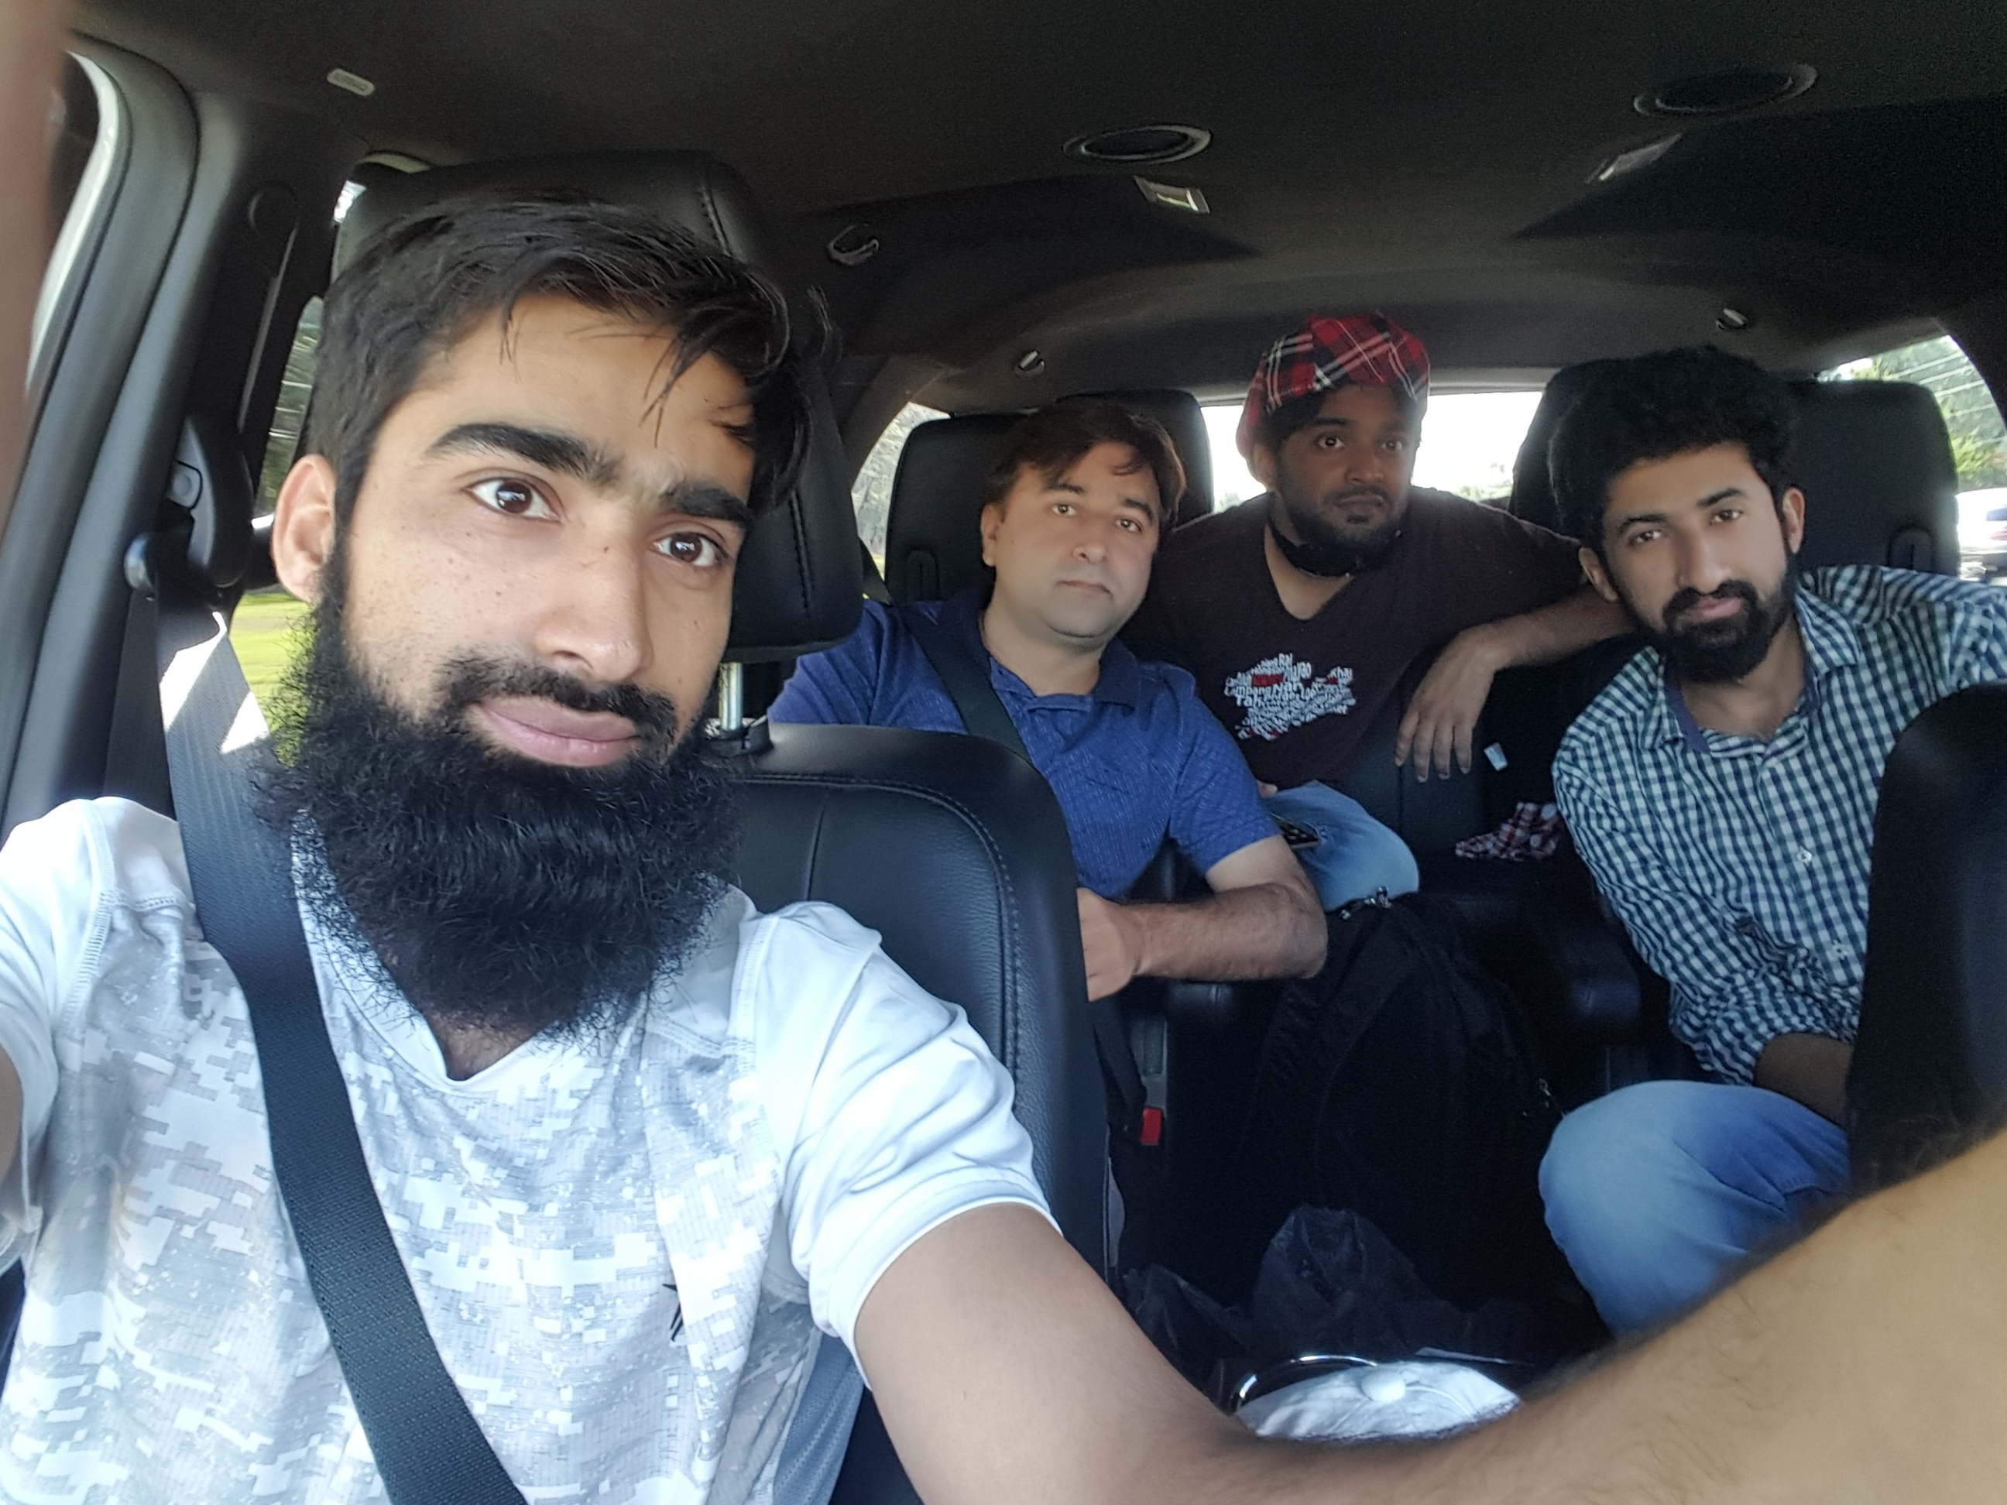
Dr. Sajid Iqbal
Department of Computer Science
Bahauddin Zakariya University, Multan

Slide 2
Lecture Contents
What is Number System
Different Number Systems
Direct Conversion of Number Systems
Electrical Components and Binary Number System
Fractional numbers in Binary
Interconversion of Number Systems

Slide 3
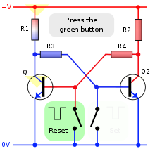
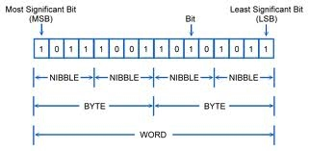
Bits and Bytes
The bit is a basic unit of information in computing and digital communications
A bit has two values: 0 or 1
It represents two states of any thing
Two states of circuit: if Q=+5v then 1, if Q’=+5V then 0
For a magnet N-S configuration is 1 and S-N is 0
If a bulb is on it is 1 else 0
Nibble: set of four bits
Byte: Set of 8 bits
Word: set of 16 bits (usually)
Nibble

Slide 4

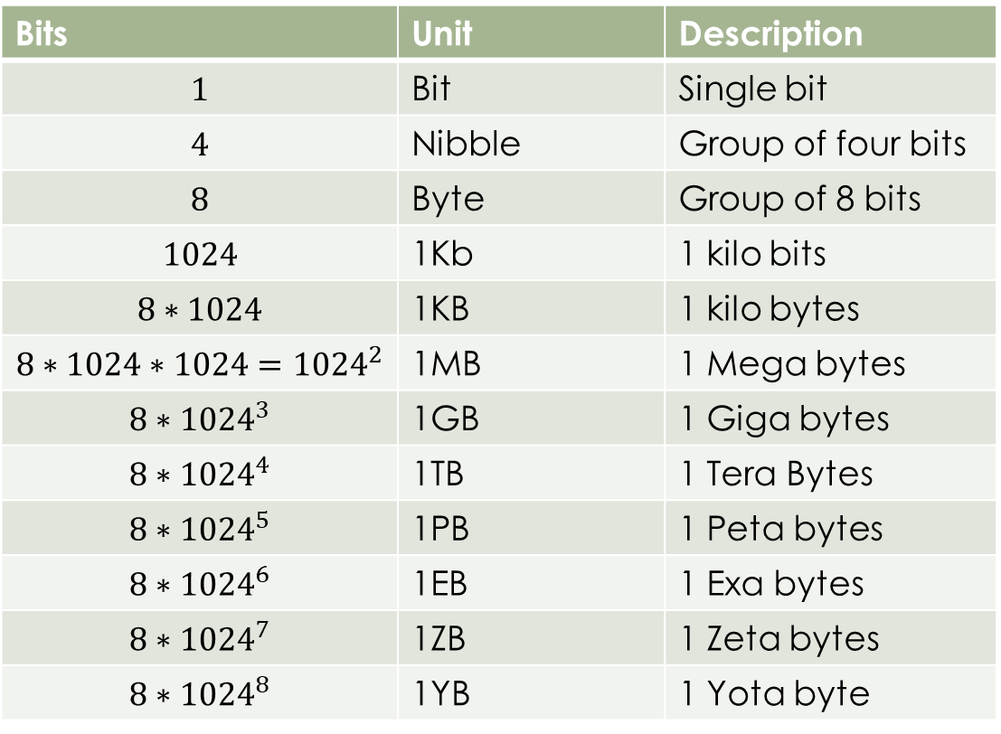


Memory Measuring Units
Bits | Unit | Description
$$1$$ | Bit | Single bit
$$4$$ | Nibble | Group of four bits
$$8$$ | Byte | Group of 8 bits
$$1024$$ | 1Kb | 1 kilo bits
$$8∗1024$$ | 1KB | 1 kilo bytes
$$8∗1024∗1024={1024}^{2}$$ | 1MB | 1 Mega bytes
$${8∗1024}^{3}$$ | 1GB | 1 Giga bytes
$${8∗1024}^{4}$$ | 1TB | 1 Tera Bytes
$${8∗1024}^{5}$$ | 1PB | 1 Peta bytes
$${8∗1024}^{6}$$ | 1EB | 1 Exa bytes
$${8∗1024}^{7}$$ | 1ZB | 1 Zeta bytes
$${8∗1024}^{8}$$ | 1YB | 1 Yota byte
$$1YB=8∗1024^{8}=2^{80}$$
$$1YB=8∗{\left({10}^{3}\right)}^{8}=8∗{10}^{24}$$
$$=800,000,000,000,00,000,000,000,00$$
$$bits$$
You must be able to convert among different units

Slide 5

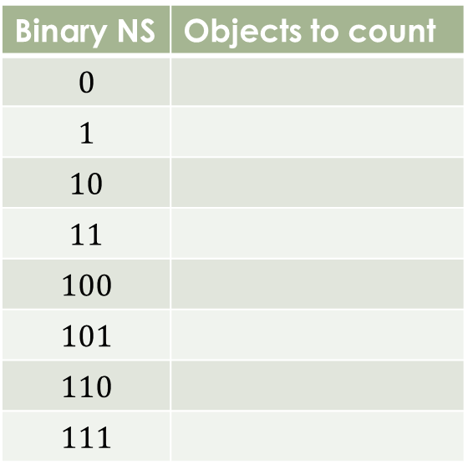
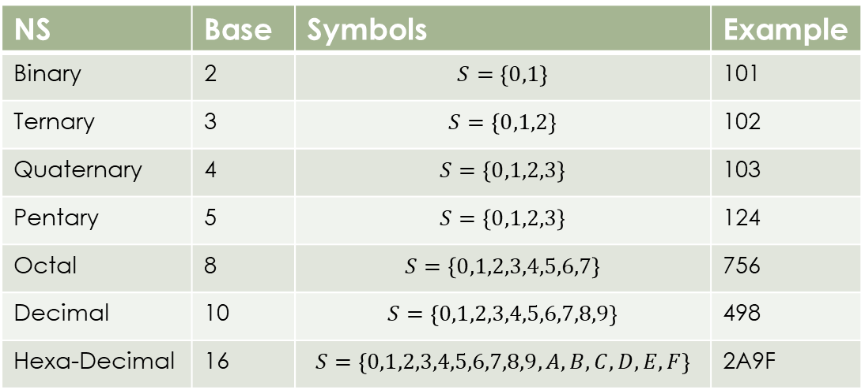
The Number Systems
A number system consists of two things
A set of symbols
A set of operations defined on the symbols
NS | Base | Symbols | Example
Binary | 2 | $$S=\left\{0,1\right\}$$ | 101
Ternary | 3 | $$S=\left\{0,1,2\right\}$$ | 102
Quaternary | 4 | $$S=\left\{0,1,2,3\right\}$$ | 103
Pentary | 5 | $$S=\left\{0,1,2,3\right\}$$ | 124
Octal | 8 | $$S=\left\{0,1,2,3,4,5,6,7\right\}$$ | 756
Decimal | 10 | $$S=\left\{0,1,2,3,4,5,6,7,8,9\right\}$$ | 498
Hexa-Decimal | 16 | $$S=\left\{0,1,2,3,4,5,6,7,8,9,A,B,C,D,E,F\right\}$$ | 2A9F
Binary NS | Objects to count
$$0$$
$$1$$
$$10$$
$$11$$
$$100$$
$$101$$
$$110$$
$$111$$

Slide 6
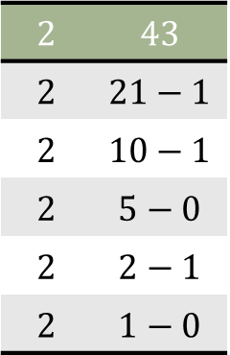


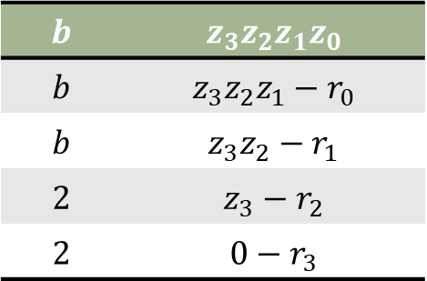


Interconversion of Number Systems
Binary to Decimal
Example: ${\left(101011\right)}_{2}→2^{5}∗1+2^{4}∗0+2^{3}∗1+2^{2}∗0+2^{1}∗1+2^{0}∗1$
$=32+0+8+0+2+1={\left(43\right)}_{10}$
Decimal to Binary
General Form
Example: ${\left(z_{3}z_{2}z_{1}z_{0}\right)}_{b}→{b^{3}z}_{3}+b^{2}z_{2}+b^{1}z_{1}+b^{0}z_{0}→\sum_{i=0}^{n}{b^{i}z_{i}}$
$${\left(43\right)}_{10}=$$
$$2$$ | $$43$$
$$2$$ | $$21−1$$
$$2$$ | $$10−1$$
$$2$$ | $$5−0$$
$$2$$ | $$2−1$$
$$2$$ | $$1−0$$
$$101011$$
$$b$$ | $$z_{3}z_{2}z_{1}z_{0}$$
$$b$$ | $$z_{3}z_{2}z_{1}−r_{0}$$
$$b$$ | $$z_{3}z_{2}−r_{1}$$
$$2$$ | $$z_{3}−r_{2}$$
$$2$$ | $$0−r_{3}$$
$$=r_{3}r_{2}r_{1}r_{0}$$

Slide 7
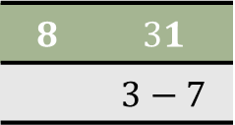


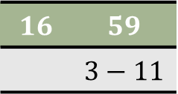

Other NS Conversions
$\left(37\right)8 =81×3+80×7 = 24+7 ={\left(31\right)}_{10}$
${\left(3B\right)}_{16} ={16}^{1}×3+{16}^{0}×11 = 48+11 ={\left(59\right)}_{10}$
$$8$$ | $$31$$
 | $$3−7$$
$$(37)8$$
$$16$$ | $$59$$
 | $$3−11$$
$${\left(3B\right)}_{16}$$

Slide 8
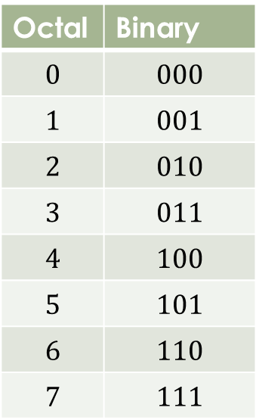
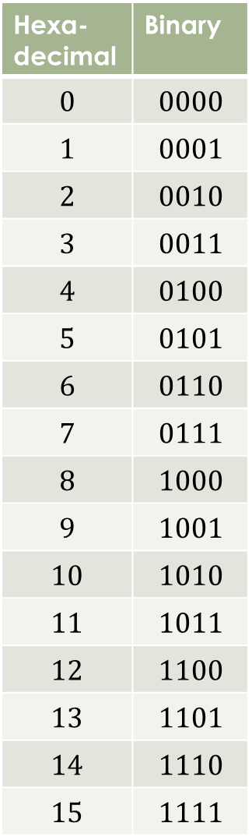

Direct Conversion Binary, Octal, Hexadecimal
For binary to octal conversion, make groups of 3 of binary bits and convert them
${\left(101 011 010 111\right)}_{2}→{\left(6327\right)}_{8}$
${\left(456\right)}_{8}→{\left(100 101 110\right)}_{2}$
For binary to hexadecimal conversion make groups of four bits
${\left(1010 1101 0111\right)}_{2}→{\left(6327\right)}_{8}$
${\left(456\right)}_{8}→{\left(100 101 110\right)}_{2}$

Slide 9
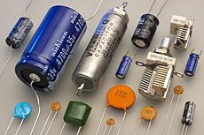
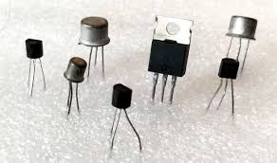
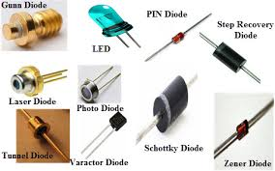
Why Binary Number System in Computers
A computer uses electrical components which can have distinct two states
So one state is used to represent 1 and other as 0.
Electrical Component | States
Capacitor | Electrical energy stored or not
Transistor | Active, inactive
Resistors | Current flowing or not
Diodes | Current is flowing or not
… | …

Slide 10
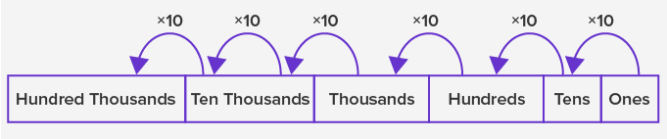

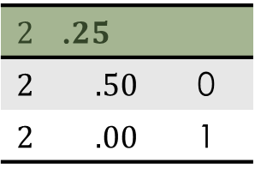
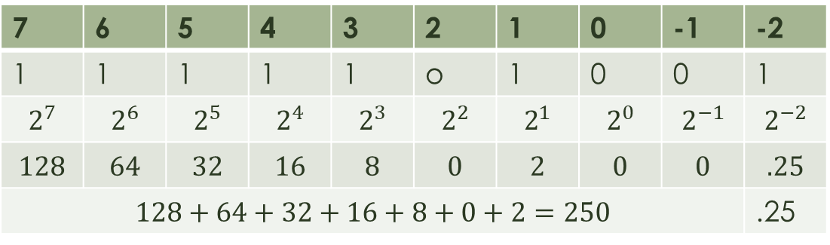
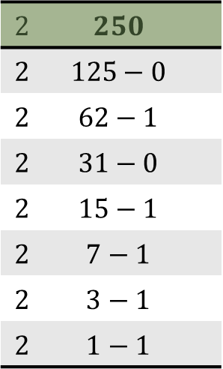
Fractional number representation
We use the concept of local value of each digit and its base to find the value of number
The value of a numb er is found by multiplying each digit with base raised to digit position number
Example:
${\left(250.25\right)}_{10}→2∗{10}^{2}+5∗{10}^{1}+0∗{10}^{0}+2∗{10}^{−1}+5∗{10}^{−2}$
${\left(250.25\right)}_{10}$ to binary is $11111010.01$
$$2$$ | $$250$$
$$2$$ | $$125−0$$
$$2$$ | $$62−1$$
$$2$$ | $$31−0$$
$$2$$ | $$15−1$$
$$2$$ | $$7−1$$
$$2$$ | $$3−1$$
$$2$$ | $$1−1$$
$$2$$ | .$25$
$$2$$ | $$.50$$ | 0
$$2$$ | $$.00$$ | 1
7 | 6 | 5 | 4 | 3 | 2 | 1 | 0 | -1 | -2
1 | 1 | 1 | 1 | 1 | o | 1 | 0 | 0 | 1
$$2^{7}$$ | $$2^{6}$$ | $$2^{5}$$ | $$2^{4}$$ | $$2^{3}$$ | $$2^{2}$$ | $$2^{1}$$ | $$2^{0}$$ | $$2^{−1}$$ | $$2^{−2}$$
$$128$$ | $$64$$ | $$32$$ | $$16$$ | $$8$$ | $$0$$ | $$2$$ | $$0$$ | $$0$$ | $$.25$$
$$128+64+32+16+8+0+2=250$$ |  |  |  |  |  |  |  |  | .25

Slide 11



Thanks for watching
Dr. Sajid Iqbal
Assistant Professor
Department of Computer Science
Bahauddin Zakariya University, Multan
sajidiqbal.pk@gmail.com
https://github.com/sajjo79/Introduction-to-Computers
Allah Hafiz
COMEDXD

