Slide 1

Dr. Sajid Iqbal
Department of Computer Science
Bahauddin Zakariya University, Multan

Slide 2
Lecture Contents
What are output devices
Text output devices
Voice output devices
Virtual Reality Output
Biometric Output Devices
Image and Video Input Devices

Slide 3
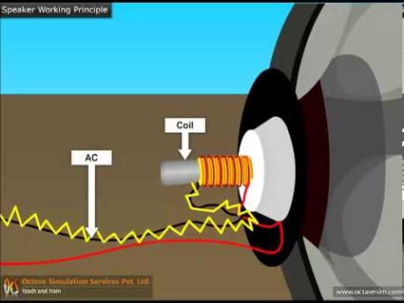
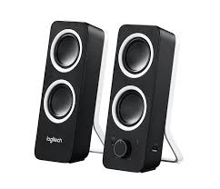
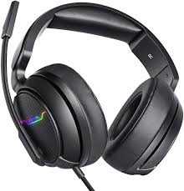
Sound Output
Speakers and Headsets:
These are the output devices that produce the data in form of voice

Slide 4
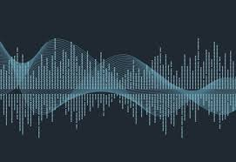
Sound Output Devices
Speech Generating Devices (SGD)/Voice Output Communication Aids (VOCA)
Portable electronic devices that allow people to create a message and produce speech
These are augmentative and alternative communication (AAC) methods
These are used as a communication system for people with little or no speech
They can assist both language comprehension and expression, helping to enable communication access for all
A variety of systems are available, varying from simple to highly sophisticated and offering different features, including:
Digitized (human quality recorded) or synthesized ( computer generated) speech output
Access methods and alternative access options including direct, switch and eye-gaze access
Spelling and / or symbol systems to represent language
Physical characteristics like weight and size which affect portability
Connectivity to other technologies like the internet and social media

Slide 5
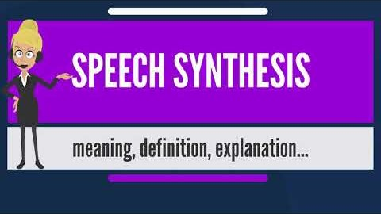
Speech Synthesizer

Slide 6
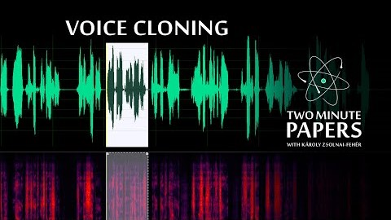
Voice Cloning

Slide 7

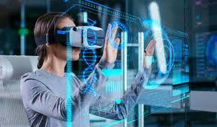
Virtual Reality
It is a simulated experience that can be similar to or completely different from the real world
Standard virtual reality systems use either virtual reality headsets or multi-projected environments to generate realistic images, sounds and other sensations that simulate a user's physical presence in a virtual environment
A person using virtual reality equipment is able to look around the artificial world, move around in it, and interact with virtual features or items
The effect is commonly created in two ways
By VR headsets consisting of a head-mounted display with a small screen in front of the eyes,
Through specially designed rooms with multiple large screens.
Virtual reality typically incorporates auditory and video feedback, but may also allow other types of sensory and force feedback through haptic technology.
Applications
Architecture and Urban Design
Healthcare
Digital Marketing
Education and Training
Engineering and Robotics
Entertainment
And many more

Slide 8
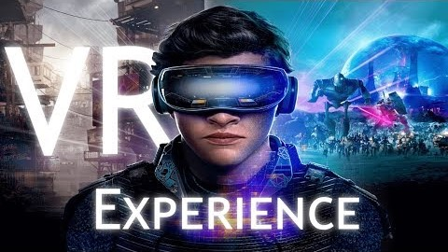
Virtual Reality

Slide 9
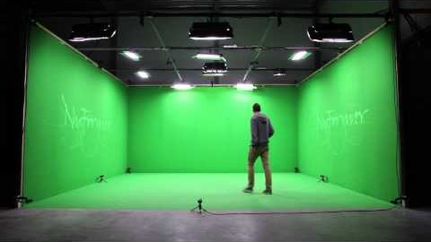
Virtual Reality

Slide 10
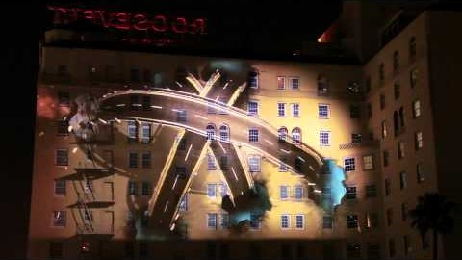
3D wall projection

Slide 11
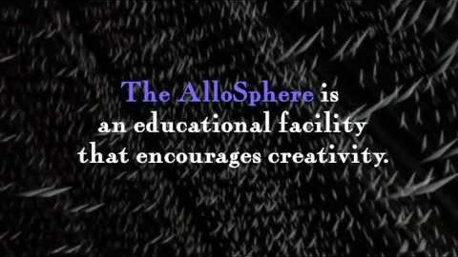
AlloSphere

Slide 12
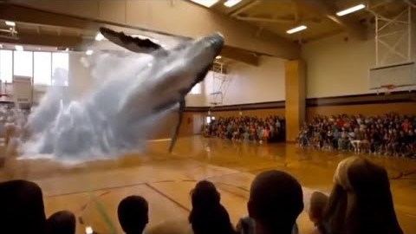
Holography

Slide 13
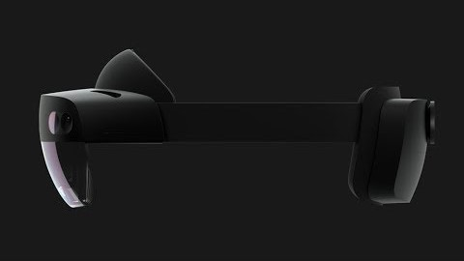
Hollo Lenses
It is a pair of mixed reality smart glasses developed and manufactured by Microsoft.
HoloLens was the first head-mounted display running the Windows Mixed Reality platform under the Windows 10 computer operating system
The tracking technology used in HoloLens can trace its lineage to Kinect, an add-on for Microsoft's Xbox game console that was introduced in 2010

Slide 14
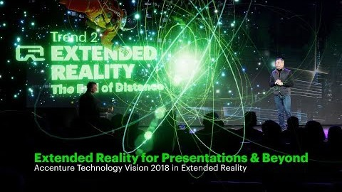
Extended Reality

Slide 15
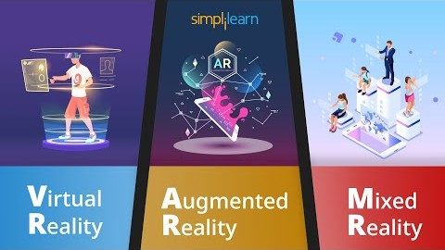
Immersive Technology

Slide 16



Thanks for watching
Dr. Sajid Iqbal
Assistant Professor
Department of Computer Science
Bahauddin Zakariya University, Multan
sajidiqbal.pk@gmail.com
https://github.com/sajjo79/Introduction-to-Computers
Allah Hafiz
COMEDXD

