Slide 1
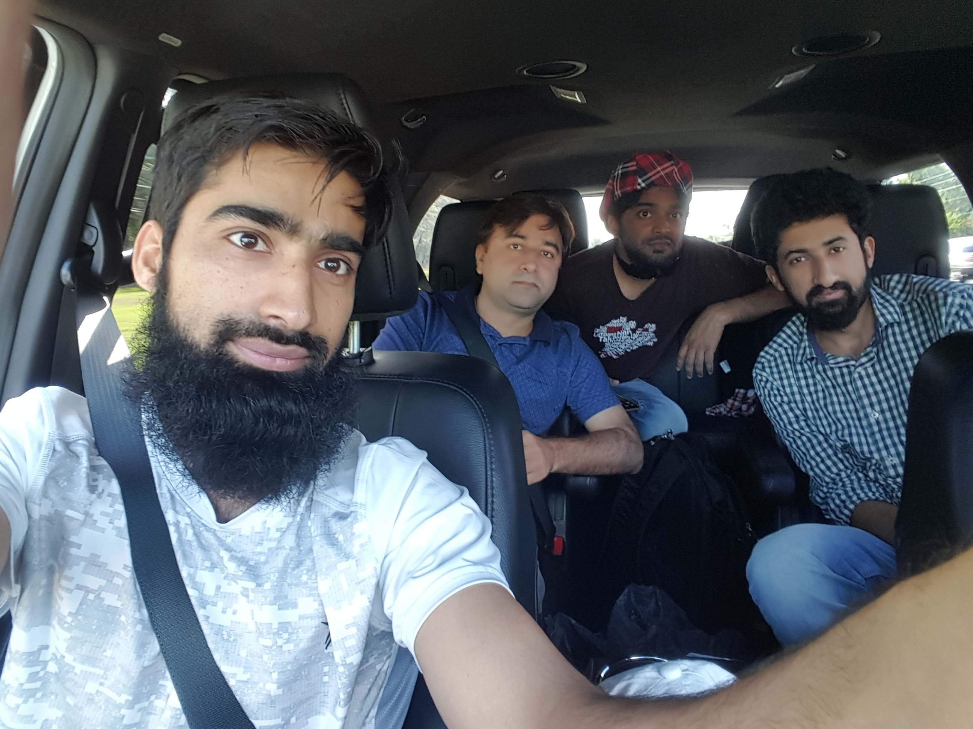
Dr. Sajid Iqbal
Department of Computer Science
Bahauddin Zakariya University, Multan

Slide 2
Computer Programming
Loops – Loops in python

Slide 3
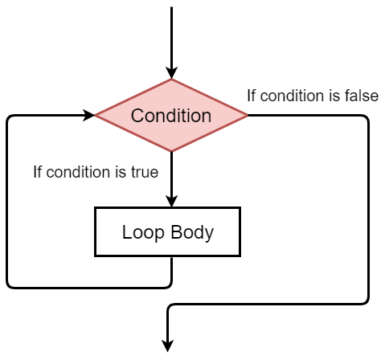
Python Loops
There are two types of loops in python
While loop
For loop
These are two different methods to apply repetitions of instructions in our program
While is the simplest loop in python
While(condition):
<Body of while loop>

Slide 4
While Loop: Example
Body of loop in python is described by indenting the instructions
Find the factorial of a user given number
a=5 fact=1 while(a>1): fact=fact*a a=a-1 print(fact)
count = 0
while (count < 9):
print(“The count is:”,count )
count = count + 1
print "Good bye!"
Draw their flow charts

Slide 5
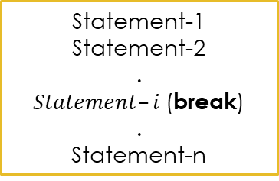
break statement
“break” statement is used to change the normal flow of while loop
condition
condition
True
True
Loop Body
Statement-1
Statement-2
.
.
.
Statement-n
Loop Body
false
Statement-1
Statement-2
.
$Statement–i$(break)
.
Statement-n
false
Statement-1
Statement-2
.
Statement-n
Statement-1
Statement-2
.
Statement-n
Out of Loop Body
Out of Loop Body
Normal Loop Flow
Changed Loop Flow

Slide 6
break statement - Example
Normal Flow Loop
Changed Flow Loop
count=0 sum=0 while(count<5): sum=sum+count; count=count+1 print("the value is", count) print("The sum is ",sum) print("after the while loop body")
count=0 sum=0 while(count<5): sum=sum+count; count=count+1 print("the value is", count)
break print("The sum is ",sum) print("after the while loop body")
the value is 1
The sum is 0
the value is 2
The sum is 1
the value is 3
The sum is 3
the value is 4
The sum is 6
the value is 5
The sum is 10
after the while loop body
the value is 1
after the while loop body

Slide 7
break statement - Example
Write a program that reads a number from user and displays it until user enters a negative value
count=0 sum=0 while(True): a=input("Please enter a number::") a=int(a) if(a<0): break print("You have entered the value:",a) print("after the while loop body")
Exercises:
Write a program to read names of students until user enters empty string (no name is entered)
Write a program to read name of subjects from user until user enters “botany”
Write a program to read GPA of students until more than 4 gpa is entered.
Run this program and
Draw its flowchart

Slide 8
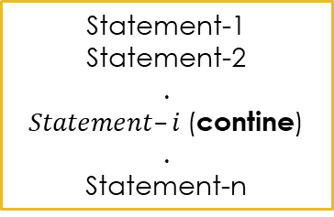
continue statement
“continue” statement is used to change the normal flow of while loop
condition
condition
True
True
Loop Body
Statement-1
Statement-2
.
.
.
Statement-n
Loop Body
false
Statement-1
Statement-2
.
$Statement–i$(contine)
.
Statement-n
false
Statement-1
Statement-2
.
Statement-n
Statement-1
Statement-2
.
Statement-n
Out of Loop Body
Out of Loop Body
Normal Loop Flow
Changed Loop Flow

Slide 9
continue statement - Example
Normal Flow
Modified Flow
Modified Flow
count=0 sum=0 while(count<5): sum=sum+count; count=count+1 print("the value is", count) print("The sum is ",sum) print("after the while loop body")
count=0 sum=0 while(count<5): sum=sum+count; count=count+1 print("the value is", count) continue print("The sum is ",sum) print("after the while loop body")
count=0 sum=0 while(count<5): sum=sum+count; count=count+1 print("the value is", count) if(count%2==0): continue print("The sum is ",sum) print("after the while loop body")
the value is 1
The sum is 0
the value is 2
The sum is 1
the value is 3
The sum is 3
the value is 4
The sum is 6
the value is 5
The sum is 10
after the while loop body
the value is 1
the value is 2
the value is 3
the value is 4
the value is 5
after the while loop body
the value is 1
The sum is 0
the value is 2
the value is 3
The sum is 3
the value is 4
the value is 5
The sum is 10
after the while loop body

Slide 10
continue - Exercises
Write a program that runs a loop from 1 to 100 and prints only even integers
Write a program that runs a loop from 1 to 100 and prints only odd integers
Write a program that runs a loop from 1-100 and prints only those values which are divisible by 5

Slide 11



Thanks for watching
Dr. Sajid Iqbal
Assistant Professor
Department of Computer Science
Bahauddin Zakariya University, Multan
sajidiqbal.pk@gmail.com
https://github.com/sajjo79/Introduction-to-Computers
Allah Hafiz
COMEDXD

