Slide 1
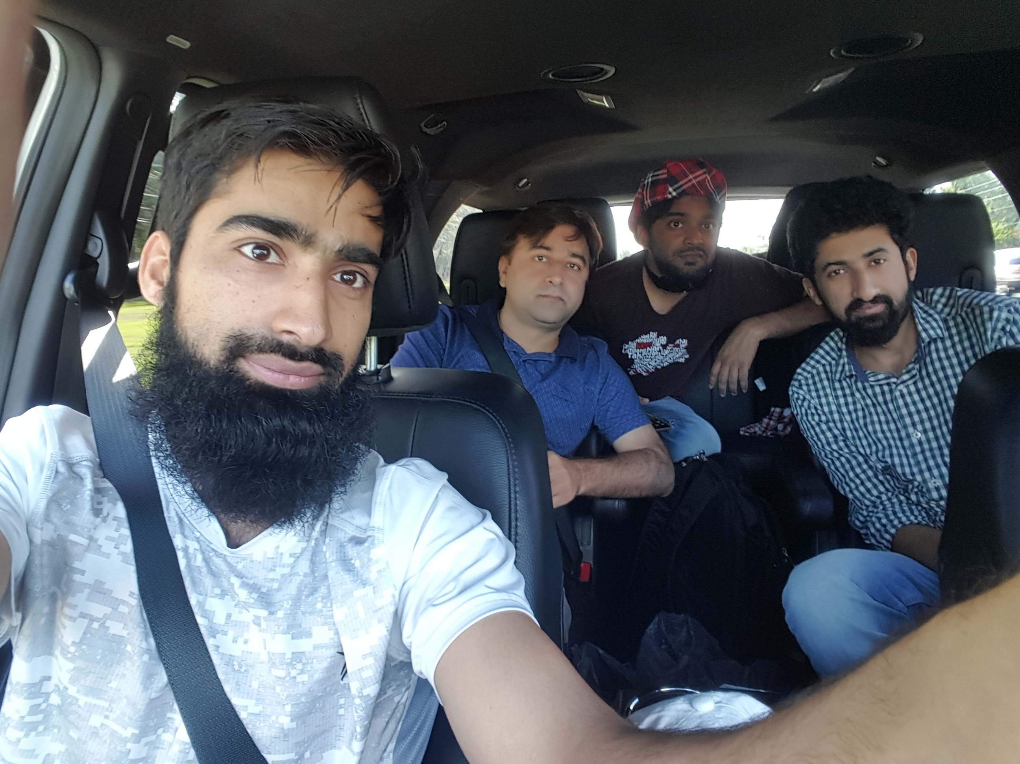
Dr. Sajid Iqbal
Department of Computer Science
Bahauddin Zakariya University, Multan

Slide 2
Computer Programming
Loops – The Repetition

Slide 3

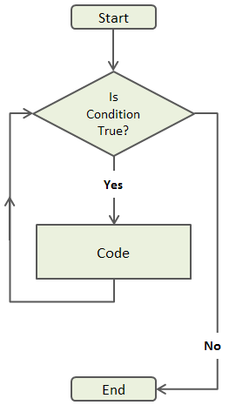
What is loop
A loop is defined as
“a curving or doubling of a line so as to form a closed or partly open curve within itself through which another line can be passed or into which a hook may be hooked”
In programming
It is set of instructions that is repeated continuously until a condition is reached
Flowchart
A visual representation of the algorithm is called flow chart
A flow chart is shown on right side of this slide for loop construct

Slide 4

Loop Example
Algorithm
Go to your university class in morning
Attend the lecture of introduction to computers
Ask a questions from your teacher $until$ you understand the topic
Statements → $loop$→ condition
Ask Questions
If not understood
Understand the topic?
If understood successfully

Slide 5
Programming Example of Loop
mycourse="Introduction to Computers" count=0 while(count<4): print(mycourse) count=count+1
Introduction to Computers
Introduction to Computers
Introduction to Computers
Introduction to Computers
mycourse="Introduction to Computers" count=0
while(count<4):
print(mycourse) count=count+1
….

Slide 6

Another Loop Example
Write a program to find the sum of first ten integers
1+2+3+4+5+6+7+8+9+10
$$\sum_{i=1}^{10}{i}$$
i=0
sum=0
i=0 sum=0 while(i<10): sum=sum+i i=i+1 print(sum)
i<=10?
No
Yes
sum=sum+i
i=i+1
45
Print(sum)

Slide 7

Program to write table
i=1 num=3 while(i<=10): print("3*"+str(i)+"=",num*i) i=i+1
Exercises
Draw the flow chart for this program
Write the table of 5,6 and 7
Extend the table upto 20, 30, 40
Print the table in reverse order i.e. from $3∗10=30 to 3∗1=3$
3*1= 3
3*2= 6
3*3= 9
3*4= 12
3*5= 15
3*6= 18
3*7= 21
3*8= 24
3*9= 27
3*10= 30

Slide 8



Thanks for watching
Dr. Sajid Iqbal
Assistant Professor
Department of Computer Science
Bahauddin Zakariya University, Multan
sajidiqbal.pk@gmail.com
https://github.com/sajjo79/Introduction-to-Computers
Allah Hafiz
COMEDXD

