Slide 1

Dr. Sajid Iqbal
Department of Computer Science
Bahauddin Zakariya University, Multan

Slide 2
Lecture Contents
What are output devices
Text output devices
Voice output devices
Virtual Reality Output
Image and Video Output Devices

Slide 3
What are output devices
An output device is a piece of computer hardware that receives data from a computer and then translates that data into another form.
That form may be audio, visual, textual, or hard copy such as a printed document.
Peripheral: A device that is used to get data into computer or out of computer
Computer
Output Signals
Translate it to suitable understandable form
Send Translated signals to output device
Output Device

Slide 4
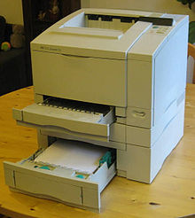
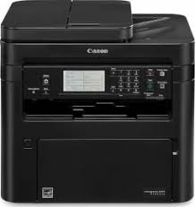
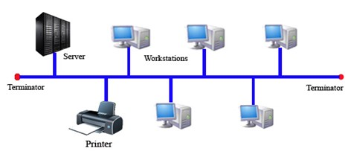
Printers
A peripheral device which makes a persistent representation of graphics or text, usually on paper
There are different types of printers
Personal Printers:
These are the printers that are used to support individual users
Easy to install, mostly desktop
These support slow printing, small amount of printing and can support up to 6-25 pages per minute (ppm)
Cost per page is relatively high
Out to printers can be provided through multiple sources i.e. Flash drive, Memory Card or directly from computer
Networked or shared printers:
These are designed for high-volume, high-speed printing
They are usually shared by many users on a network and can print at speeds of 45-100 ppm

Slide 5
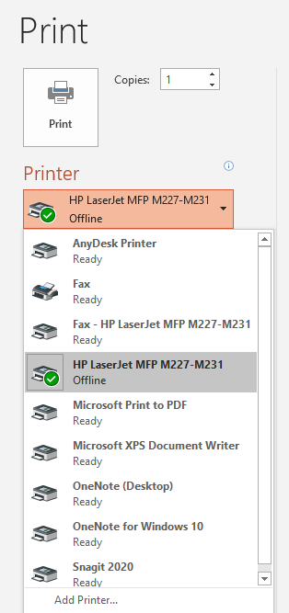
Printers
Virtual printer:
It is a piece of computer software whose user interface resembles that of a printer driver, but it is not connected with a physical computer printer
A virtual printer can be used to create a file which is an image of the data which would be printed, for archival purposes
Example
Pdf virtual printer

Slide 6
Printers Categorization
The choice of print technology has a great effect on the cost of the printer and cost of operation, speed, quality and permanence of documents, and noise
Printers
Impact Printers
Dot Matrix Printers
Daisy Wheel Printers
Non-Impact Printers
Toner Based Printers
Liquid Inkjet Printers
Solid Ink Printers
Dye-Sublime Printers
Thermal Printers
Plotters
Minilab Printers
Line Printers

Slide 7
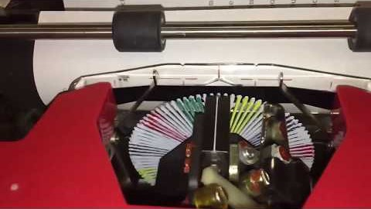
Impact Printers
Printers that work by striking a head or needle against an ink ribbon to make a mark on the paper
Dot Matrix Printers: A type of printer that produces characters and illustrations by striking pins against an ink ribbon to print closely spaced dots in the appropriate shape.
Daisy Wheel Printers:
The daisy wheel is a disk made of plastic or metal on which characters stand out in relief along the outer edge
To print a character, the printer rotates the disk until the desired letter is facing the paper
Then a hammer strikes the disk, forcing the character to hit an ink ribbon, leaving an impression of the character on the paper.

Slide 8
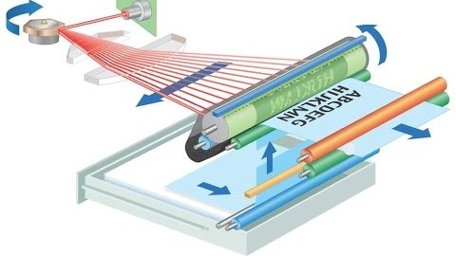
Non-Impact Printers
Toner based Printers
Laser printer:
It rapidly produces high quality prints
Laser printing is an electrostatic digital printing process
It repeatedly passes a laser beam back and forth over a negatively charged cylinder called a “drum” to make a differentially charged image

Slide 9
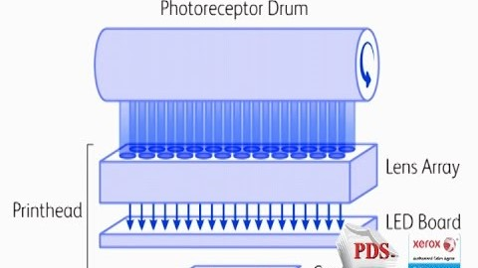
Non-Impact Printers
LED Printers
This type of printers use a light-emitting diode (LED) array as a light source in the printhead instead of the laser used in laser printers

Slide 10
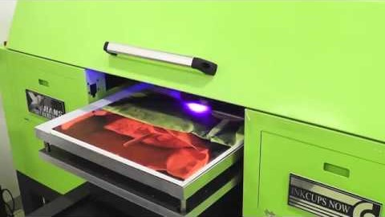
Non-Impact Printers
Liquid Inkjet Printers (LIP):
LIP creates a digital image by propelling droplets of ink onto paper and plastic substrates

Slide 11
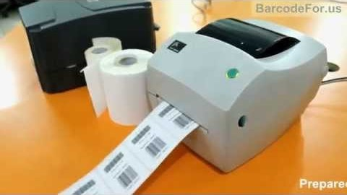
Non-Impact Printers
Solid Ink Printers (SIP):
They use solid sticks, crayons, pearls or granular ink materials.
A Thermal transfer printhead jets the liquid ink on a rotating, oil coated drum
The paper then passes over the print drum, at which time the image is immediately transferred, or transfixed, to the page
Solid ink printers are most commonly used as color office printers and are excellent at printing on transparencies and other non-porous media

Slide 12
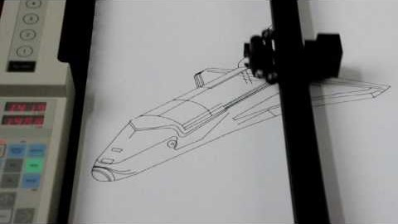
Plotters
A plotter produces vector graphics drawings
Plotters draw lines on paper using a pen

Slide 13
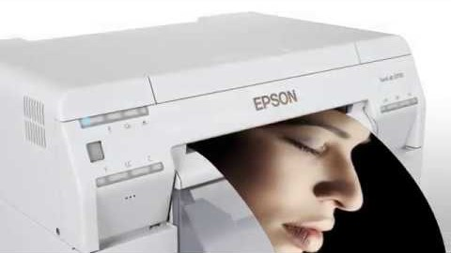
Minilab Printers
A minilab is a small photographic developing and printing system or machine
Many retail stores use film or digital minilabs to provide on-site photo finishing services

Slide 14
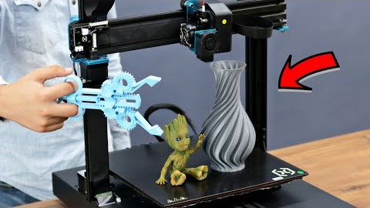
3D Printers
3D printing is the construction of a three-dimensional object from a CAD model or a digital 3D model
"3D printing" refers to a variety of processes in which material is deposited, joined or solidified under computer control to create a three-dimensional object
The material is added together (such as liquid molecules or powder grains being fused together), typically layer by layer

Slide 15
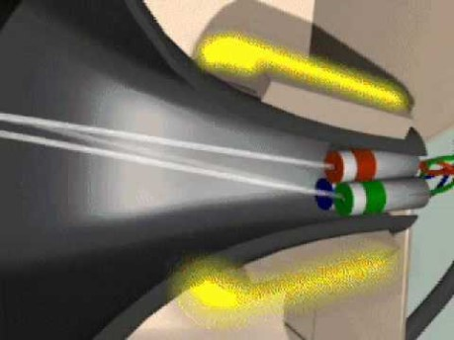
Visual Output Device
There are number of such devices
Monitor:
A monitor consists of a screen, circuitry, a power supply, buttons to adjust screen settings, and a casing that contains all of these components
A monitor displays data from a computer onto a screen so the user can interact with the data via a digital interface.

Slide 16
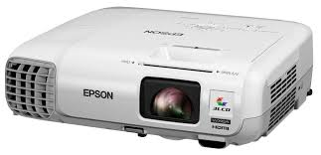
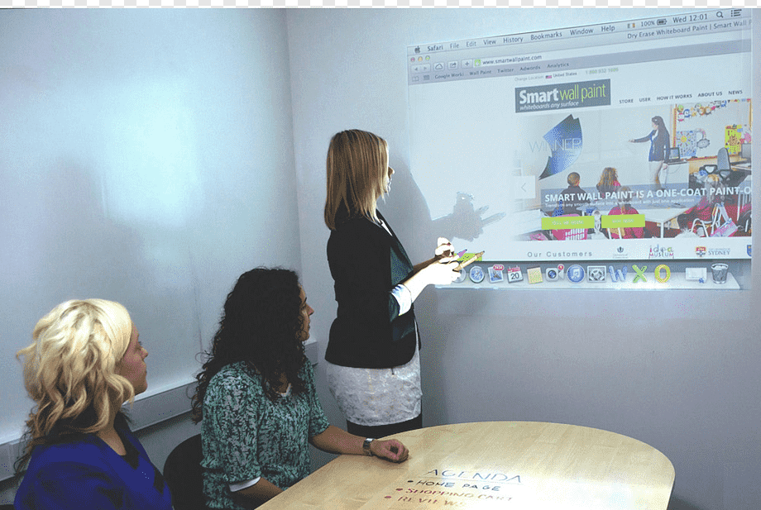
Multimedia Projector
It is a compact, high resolution, full-color projector capable of projecting text, images, video and audio content
At its most basic, a multimedia projector simply projects an image on a screen and are mostly used for presenting lectures etc.
Some multimedia projectors can be configured to project a computer's video signal, outputs from DVD players, and also direct connections from cable and satellite systems
Depending on the needs of the user and their project, there is a projection device designed for almost every application, level of quality, and size of audience

Slide 17
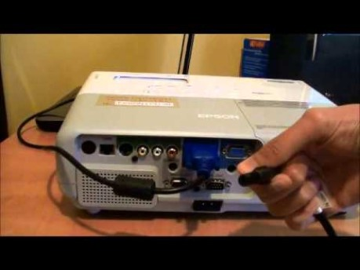
Multimedia Projector

Slide 18
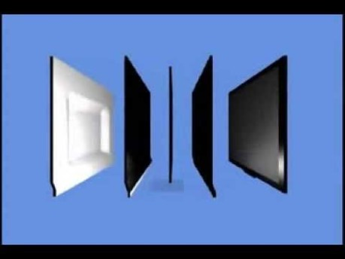
LCD Monitor
Liquid crystals do not emit light directly
These use a backlight or reflector to produce images in color or monochrome

Slide 19
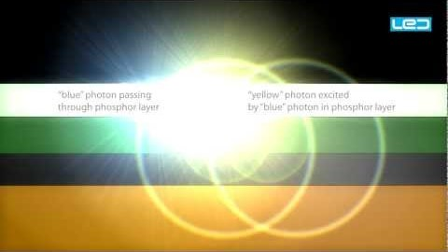
Light Emitting Diode Monitor - LED
Light-emitting diode monitor, is a flat screen, flat-panel computer monitor or television
It has a very short depth and is light in terms of weight
The actual difference between this and a typical LCD monitor is the backlighting

Slide 20
3D Monitors
3-dimensional images are really attempts to imitate how physical objects are seen be our eyes
Out both eyes are at small distance from each other. When we see an image, each eye gets a different picture
Well your brain sort of puts those images together
All 3D technology shows you two different sets of images to try to replicate this effect
The three main types of 3D technology used in modern displays are
Passive
Active Shutter
Glasses Free

Slide 21
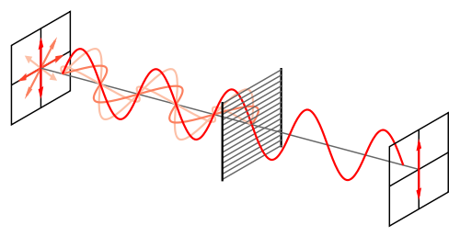
Passive 3D
It’s a glasses-based technology that works by polarization of light
Light travels in waves, and in most cases, they are polarized
This means that the direction in which the waves oscillate are perpendicular to the direction they travel in
Picture how snakes slide left and right as they move forward and you’ve got the idea
Now, light can slither in all sorts of directions, not just side-to-side

Slide 22
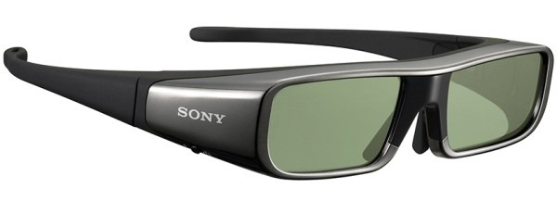
Active Shutter
Active shutter is newer than passive technology
The glasses are not simple plastic filters, they are battery powered devices
Th display alternates images from each of the two perspectives, and your glasses synchronize with the refresh rate
When the image for your right eye is displayed, the glasses use a shutter over your left eye
When the image for your left eye is displayed, the glasses move the shutter on your right eye
In this way, each eye is getting an image

Slide 23
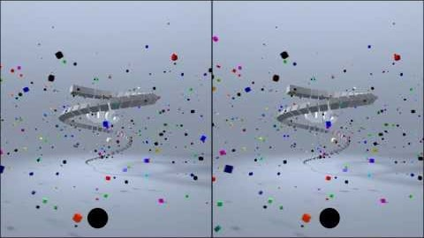
Glass free 3D
Glasses-free displays are very new on the market
There are a few different ways these TVs and monitors work

Slide 24



Thanks for watching
Dr. Sajid Iqbal
Assistant Professor
Department of Computer Science
Bahauddin Zakariya University, Multan
sajidiqbal.pk@gmail.com
https://github.com/sajjo79/Introduction-to-Computers
Allah Hafiz
COMEDXD

