Slide 1
Lecture Contents
Special Purpose Processors
Video and Graphic Cards
GPU History
CPUs vs GPUs

Slide 2
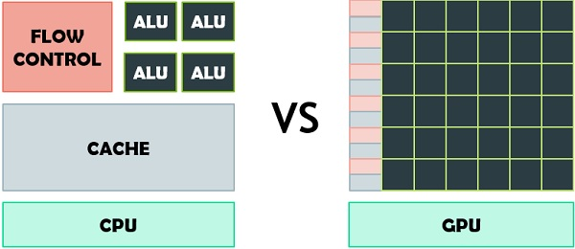
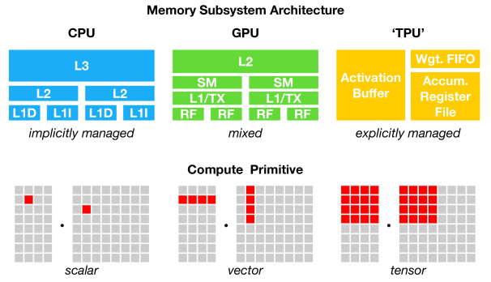
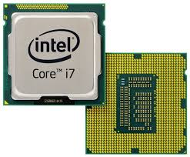
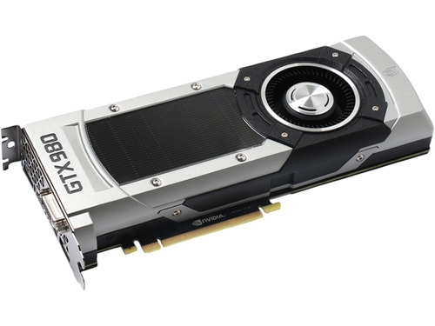
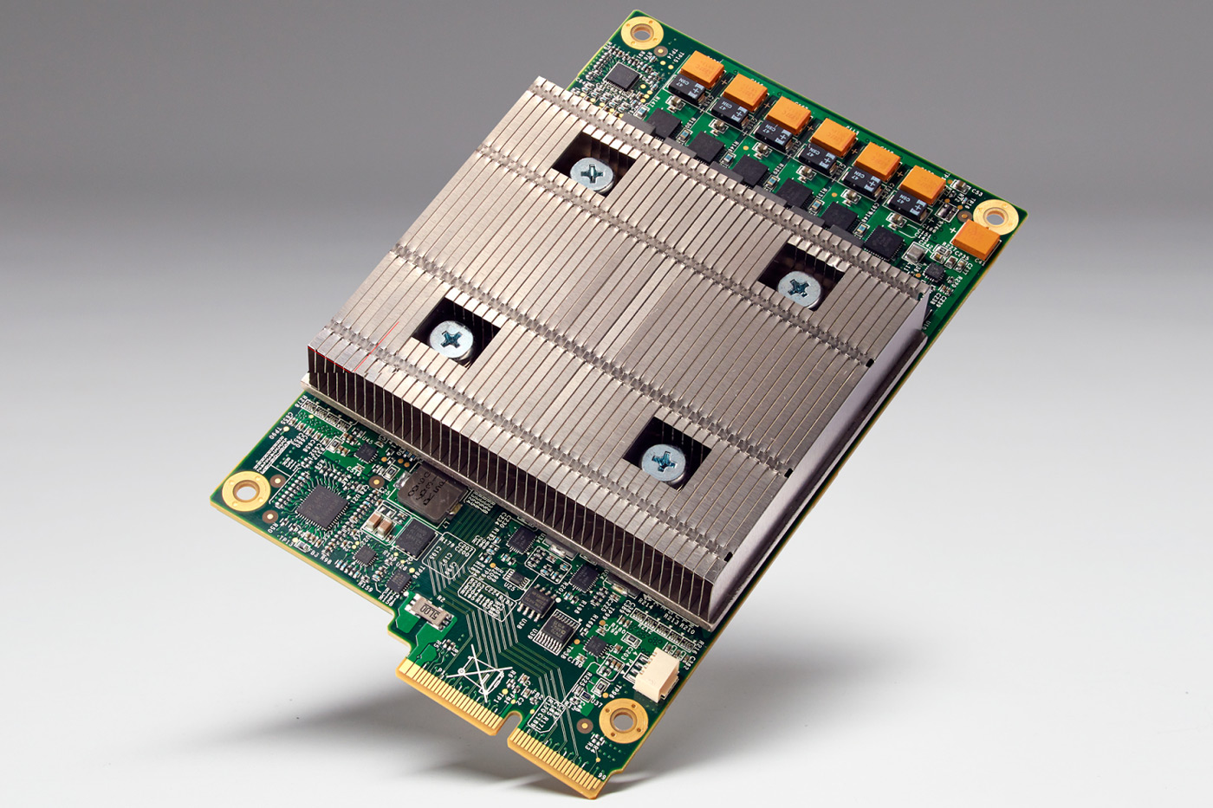
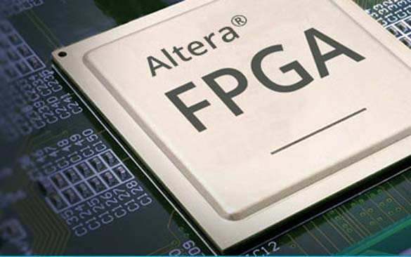
Special Purpose Processors
Specialized processors entertain and keep us connected
Application Specific System Processor (ASSP)
Application Specific Instruction Processors (ASIPs)
Graphic Processing Units (GPU)
Modern GPUs have more ALUs
Field programmable graphics array (FPGA)

Slide 3

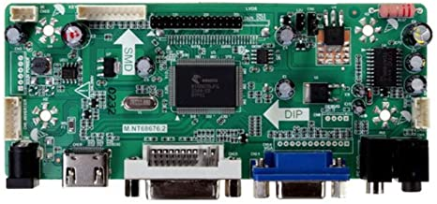
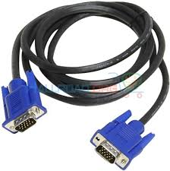
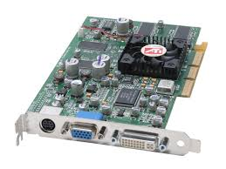
Video and Graphics Cards Special Purpose Processors
A video graphics adapter (VGA) is a video graphics controller
It implements video modes and text modes
Video modes are also known as graphics modes
They define the resolution of the output screen
Some of the Graphics modes are listed here
There are number of variants of VGA
i.e. EGA, XGA
Built-in vs addon card
Video Modes
Text Modes
640×480
640×350
640×200
320×200
320×200
640×480
…×…
80×25
40×25
360×400
80×43
80×50

Slide 4
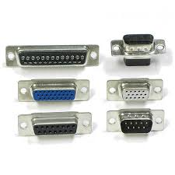
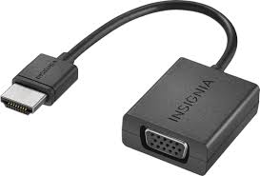
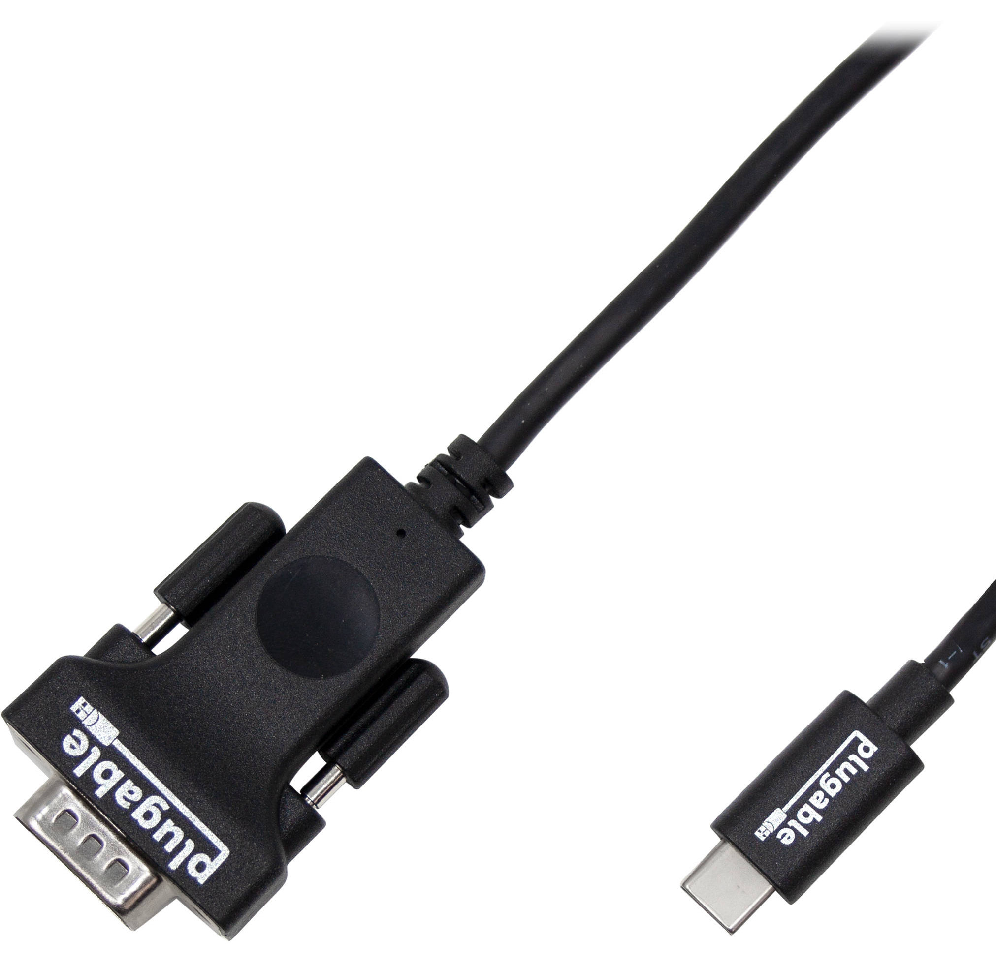
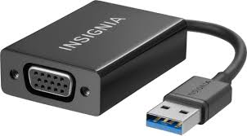
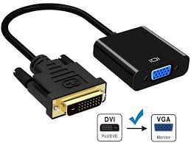
Video and Graphics Cards Connectors
There are number of interfaces and each interface has its own connectors
VGA to HDMI
VGA to USB

Slide 5
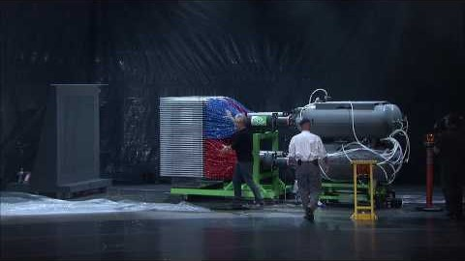
CPU vs GPU
Thanks to the YouTube video provider

Slide 6
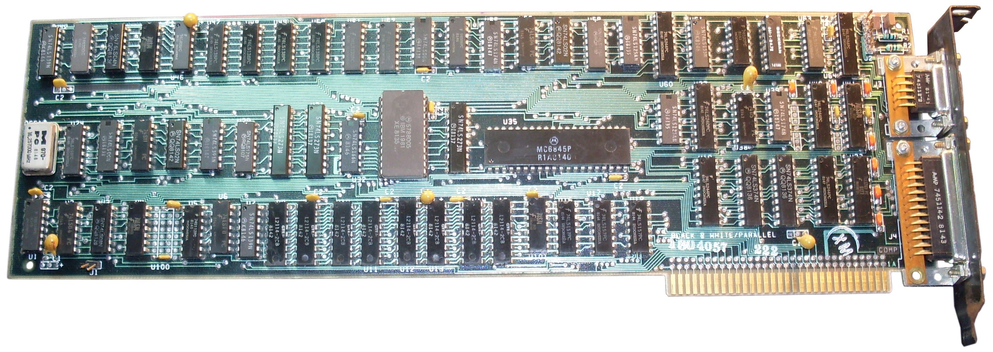
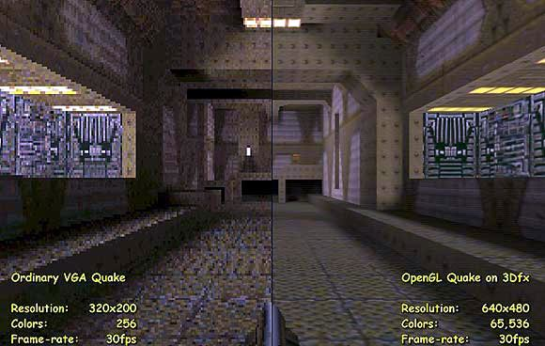
GPU History
1976 – 1995 : The Early Days of 3D Consumer Graphics
1951, MIT built the Whirlwind
1995 – 1999: 3Dfx Voodoo: The Game-changer
2000 – 2006: The Nvidia vs. ATI Era Begins
2006 – date: The Modern GPU: Stream and tensor processing units
There are now games that only run using GPUs
Black Desert Online
Project Cars
Monochrome Display Adapter (IBM, 1981)

Slide 7
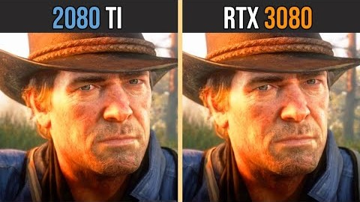
NVIDIA 2080Ti vs NVIDIA 3090
Nvidia 2080 ti has 4352 CUDA Cores
Nvidia 3090
10496 CUDA cores
Thanks to YouTube video provider

Slide 8


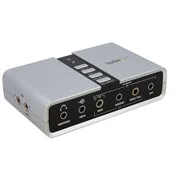
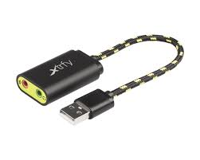
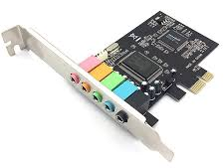
Special Purpose Processors Sound Card
A sound card (processor) allows the computer to produce sound
No music is possible without sound card
The first computers did not have sound cards
Built-in on mother board or add on card

Slide 9



Thanks for watching
Dr. Sajid Iqbal
Assistant Professor
Department of Computer Science
Bahauddin Zakariya University, Multan
sajidiqbal.pk@gmail.com
https://github.com/sajjo79/Introduction-to-Computers
Allah Hafiz
COMEDXD

