Slide 1
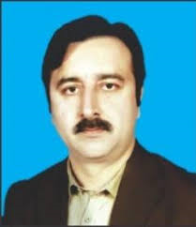
Dr. Sajid Iqbal
Department of Computer Science
Bahauddin Zakariya University, Multan

Slide 2
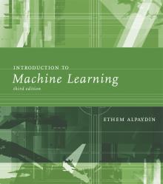
INTRODUCTION TO Machine Learning 3rd Edition
ETHEM ALPAYDIN
© The MIT Press, 2014
alpaydin@boun.edu.tr
http://www.cmpe.boun.edu.tr/~ethem/i2ml3e

Slide 3
Bayesian Decision Theory
Chapter Three

Slide 4
3.5 Association Rules

Slide 5
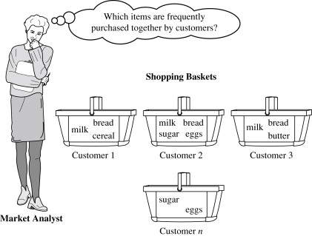
Association Rule Mining
Frequent patterns (FPs): The are patterns that appear frequently in a given data set i.e. shopping patterns, course selection patterns
There are different substructures of FPs i.e. frequent sequential patterns, sub-graphs, sub-trees
FPs are also known as frequent structured patterns
Example: Market Basket Analysis
The analysis can lead to increased sales by helping retailers do selective marketing and plan their shelf space
Each item is a Boolean variable (present/absent)
Notes:
Using FPs, can you find association rules in a code written by a student

Slide 6
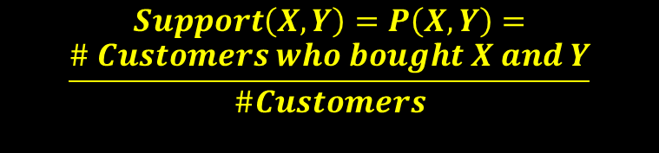


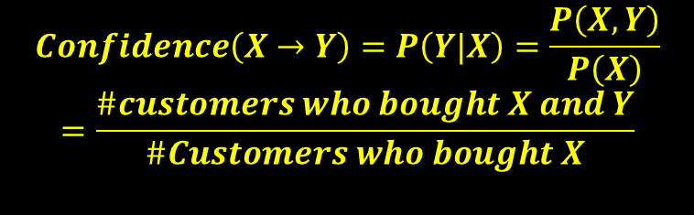
Association Rules
Association rule defines the relationship between two things $X→Y$
Example: Basket Analysis
In learning association rules, three measures are frequently calculated
Support of the association rule X → Y
Confidence of the association rule X → Y
Lift, also known as interest of the association rule X → Y
$$Support\left(X,Y\right)=P\left(X,Y\right)=$$
$$\frac{\# Customers who bought X and Y}{\#Customers}$$
$$Confidence\left(X→Y\right)=P\left(Y|X\right)=\frac{P\left(X,Y\right)}{P\left(X\right)}$$
$$=\frac{\#customers who bought X and Y}{\#Customers who bought X}$$
$$Lift\left(X→Y\right)=\frac{P\left(X,Y\right)}{P\left(X\right)P\left(Y\right)}=\frac{P\left(Y | X\right)}{P\left(Y\right)}$$

Slide 7

Basket Analysis Example
Let $I=\left\{I_{1},I_{2},…,I_{n}\right\}$be an itemset
Let $D=\{T_{1},T_{2},….,T_{n}\}$ be the set of transactions made by customers of type $T_{i}=\{TID,I_{i1},I_{i2},…I_{in}\}$ where $T⊆I$
An association rule can be described as
$A⇒B such that A⊂I, B⊂I, A≠∅, B≠∅, A⋂B=∅$
Support s: For a transaction set D, s is the percentage of transactions in D that contain $A ⋃ B$
$\begin{aligned}Support\left(A⇒B\right)=P\left(AUB\right)\#\end{aligned}$
Confidence c: for a transaction set D, c is the percentage of transactions in D containing $A that also contains B$
$Confidence\left(A⇒B\right)=P(B|A)$

Slide 8

Example: Market Basket Analysis
Strong Rules: Rules that satisfy a minimum support threshold ($min⁡_sup⁡$) and minimum confidence threshold ($min⁡_conf$)
Itemset: set of items
K-itemset: a set that contains k items
Frequency: The time an item set occurs in transaction set.
Also known as support count or count of item set
Absolute support: item set occurring frequency
Relative support: $\begin{aligned}Support\left(A⇒B\right)=P\left(AUB\right)\#\end{aligned}$
Frequent itemset: An item set is frequent itemset if
$\begin{aligned}Support\left(A⇒B\right)=P\left(AUB\right)\#\end{aligned}>min_support_threshold$

Slide 9

Market Basket Analysis
$Confidence\left(A⇒B\right)=P\left(B | A\right)=\frac{support\left(A∪B\right)}{support\left(A\right)}=\frac{supportCount\left(A∪B\right)}{supportCount\left(A\right)}$
The problem of mining association rules can be reduced to that of mining frequent item sets
Finding association rules is two step process
Find all frequent item sets
Generate association rules using frequent item sets
Count of item sets is given by $2^{s}$ and processing all item-sets takes time and processing power
For example: 100-elements, number of item-sets will be $2^{100},$a big number

Slide 10
Closed Itemset: An itemset X is closed in a data set D if there exists no proper super-itemset Y such that Y has the same support count as X in D
There is no larger set Y than D with same support
Closed Frequent Itemset: If an item set is closed and frequent
Maximal Frequent Itemset: If X is frequent and no super-itemset of X is frequent in D.

Slide 11
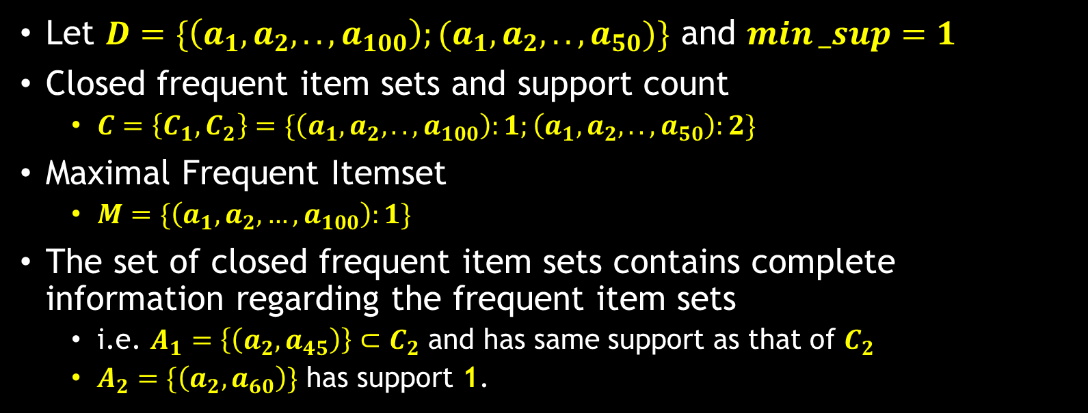
Example: Closed and Frequent Item sets
Let $D=\{\left(a_{1},a_{2},..,a_{100}\right);(a_{1},a_{2},..,a_{50})\}$ and $min⁡_sup=1$
Closed frequent item sets and support count
$C=\left\{C_{1},C_{2}\right\}=\{\left(a_{1},a_{2},..,a_{100}\right):1;\left(a_{1},a_{2},..,a_{50}\right):2\}$
Maximal Frequent Itemset
$M=\{\left(a_{1},a_{2}, …,a_{100}\right):1\}$
The set of closed frequent item sets contains complete information regarding the frequent item sets
i.e. $A_{1}=\left\{\left(a_{2},a_{45}\right)\right\}⊂C_{2}$ and has same support as that of $C_{2}$
$A_{2}=\{\left(a_{2},a_{60}\right)\}$ has support 1.

Slide 12

Apriori Algorithm: Finding Frequent Item sets by Confined Candidate Generation
The algorithm uses prior knowledge of frequent itemset properties hence its name comes
Level-wise search: Apriori uses an iterative approach to explore $k+1$ itemsets using $k$-itemsets
Let $L_{k}$ is the set of frequent $k$-itemsets (set of sets)
First by scanning database, $L_{1}$ is found, then $L_{2}$ and this way $L_{k}$
Apriori property: All non-empty subsets of a frequent item set must also be frequent
If $I_{1}$ is not frequent itemset, then $I_{2}=I_{1}∪X$ cannot be more frequent than $I_{1}$
Antimonotonicity: if a set cannot pass a test, all of its supersets will fail the same test

Slide 13

Level-wise Search
The join step:
Apriori assumes that items within a transaction or itemset are sorted in lexicographic order
Let $I_{1}$ and $I_{2}$ be item-sets in $L_{k−1}$.
The $Join(L_{k−1},L_{k−1})$, is performed, where members of $L_{k−1}$ are joinable if their first $K−2$ items are in common.
$I_{1},I_{2}εL_{k−1}$ are joined if $\bigvee_{i=1}^{k−1}{I_{1}\left[i\right]=I_{2}[i]}$
The prune step:
$C_{k}$ is superset of $L_{k}$. All of the frequent k-item-sets are included in it.
Any $(k − 1)$-itemset that is not frequent cannot be a subset of a frequent k-itemset

Slide 14

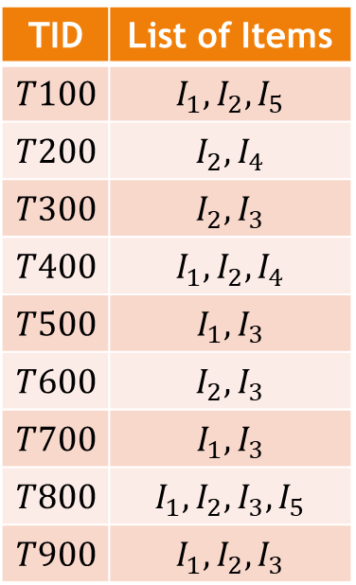
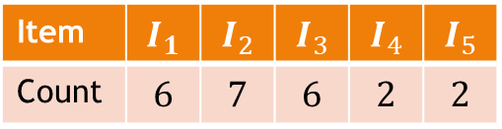
Example
Let $abs_min⁡_sup=2$, $relative_min⁡_sup=2/9$=22%
Step-1
Scan all database to find $L_{1}$ item-sets. Count the occurrences of each item to find C1
Step-2
All items fulfill the min-sup.
Step-3
Use $join(L1,L1)$to generate candidate sets for 2-item-sets to get C2.
C2 consists of $\left({\left|L_{1}\right| \atop 2}\right)=\frac{L_{1}!}{{(L}_{1}−2)!2!}$
Each candidate set is frequent so no pruning
TID | List of Items
$$T100$$ | $$I_{1},I_{2},I_{5}$$
$$T200$$ | $$I_{2},I_{4}$$
$$T300$$ | $$I_{2},I_{3}$$
$$T400$$ | $$I_{1},I_{2},I_{4}$$
$$T500$$ | $$I_{1},I_{3}$$
$$T600$$ | $$I_{2},I_{3}$$
$$T700$$ | $$I_{1},I_{3}$$
$$T800$$ | $$I_{1},I_{2},I_{3},I_{5}$$
$$T900$$ | $$I_{1},I_{2},I_{3}$$
Item | $$I_{1}$$ | $$I_{2}$$ | $$I_{3}$$ | $$I_{4}$$ | $$I_{5}$$
Count | $$6$$ | $$7$$ | $$6$$ | $$2$$ | $$2$$

Slide 15
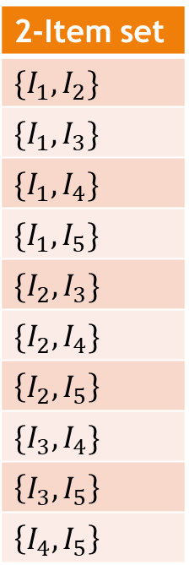
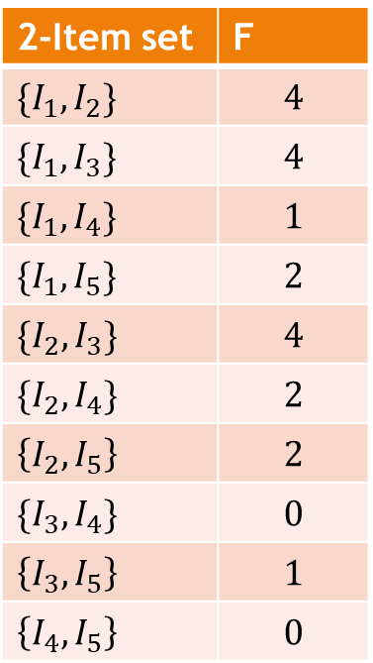



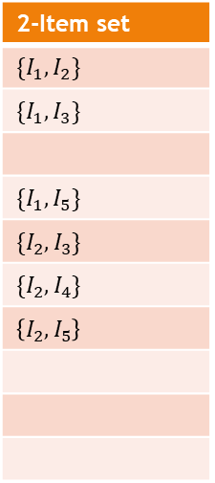


$L_{1}xL_{1}=\{\left\{I_{1},I_{1}\right\},\{I_{1},I_{2}\}$, $\{I_{1},I_{3}\}$, $\{I_{1},I_{4}\}$, $\{I_{1},I_{5}\}$,
$\{I_{2},I_{1}\}$, $\{I_{2},I_{2}\}$, $\{I_{2},I_{3}\}$, $\{I_{2},I_{4}\}$, $\left\{I_{2},I_{5}\right\},$
$\{I_{3},I_{1}\}$, $\{I_{3},I_{2}\}$, $\{I_{3},I_{3}\}$, $\{I_{3},I_{4}\}$, $\left\{I_{3},I_{5}\right\},$
$\left\{I_{4},I_{1}\right\}\text{, }\left\{I_{4},I_{2}\right\}\text{,}\left\{I_{4},I_{3}\right\}\text{, }\left\{I_{4},I_{4}\right\}\text{, }\left\{I_{4},I_{5}\right\},$
$\left\{I_{5},I_{1}\right\}\text{, }\left\{I_{5},I_{2}\right\}\text{,}\left\{I_{5},I_{3}\right\}\text{, }\left\{I_{5},I_{4}\right\}\text{, }\left\{I_{5},I_{5}\right\},$
D
$$L_{1}xL_{2}$$
$$C_{2}$$
$$L_{2}$$
2-Item set
$\{I_{1},I_{2}\}$
$\{I_{1},I_{3}\}$
$\{I_{1},I_{5}\}$
$\{I_{2},I_{3}\}$
$\{I_{2},I_{4}\}$
$$\left\{I_{2},I_{5}\right\}$$
$L_{2}=L_{1}xL_{1}=\{\{I_{1},I_{2}\}$, $\{I_{1},I_{3}\}$, $\{I_{1},I_{4}\}$, $\{I_{1},I_{5}\}$,
$\{I_{2},I_{3}\}$, $\{I_{2},I_{4}\}$, $\left\{I_{2},I_{5}\right\},$
$\{I_{3},I_{4}\}$, $\left\{I_{3},I_{5}\right\},$
$\left\{I_{4},I_{5}\right\}$}

Slide 16

Step-4:
the transactions in $D$ are scanned and the support count of each candidate itemset in $C2$ is accumulated
Step-5
The set of frequent 2-itemsets, $L2$, is then determined, consisting of those candidate 2-itemsets in $C2$ having minimum support
Step-6
Generation of set of candidates of 3-itemsets
C3=$L2xL2$= {{I1, I2, I3}, {I1, I2, I5}, {I1, I3, I5},{I2, I3, I4}, {I2, I3, I5}, {I2, I4, I5}}
Based on the Apriori property we can determine that the four latter candidates cannot possibly be frequent
Hence, L3= {{I1, I2, I3}, {I1, I2, I5}}

Slide 17
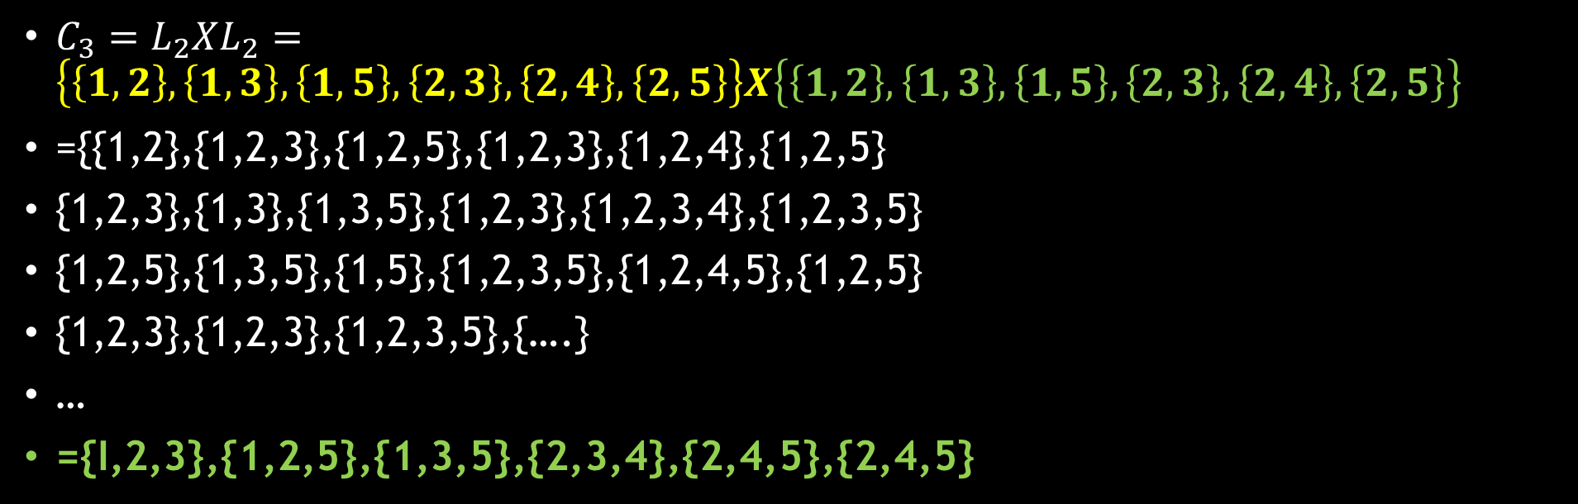
Step-6
$C_{3}=L_{2}XL_{2}=\left\{\left\{1,2\right\},\left\{1,3\right\},\left\{1,5\right\},\left\{2,3\right\},\left\{2,4\right\},\left\{2,5\right\}\right\}X\left\{\left\{1,2\right\},\left\{1,3\right\},\left\{1,5\right\},\left\{2,3\right\},\left\{2,4\right\},\left\{2,5\right\}\right\}$
={{1,2},{1,2,3},{1,2,5},{1,2,3},{1,2,4},{1,2,5}
{1,2,3},{1,3},{1,3,5},{1,2,3},{1,2,3,4},{1,2,3,5}
{1,2,5},{1,3,5},{1,5},{1,2,3,5},{1,2,4,5},{1,2,5}
{1,2,3},{1,2,3},{1,2,3,5},{….}
…
={I,2,3},{1,2,5},{1,3,5},{2,3,4},{2,4,5},{2,4,5}

Slide 18
Prune the Set
={I,2,3},{1,2,5},{1,3,5},{2,3,4},{2,3,5},{2,4,5}
Prune using the Apriori property:
All nonempty subsets of a frequent itemset must also be frequent. Do any of the candidates have a subset that is not frequent?
$$L_{2}=\left\{\left\{1,2\right\},\left\{1,3\right\},\left\{1,5\right\},\left\{2,3\right\},\left\{2,4\right\},\left\{2,5\right\}\right\}$$
Set | Subsets | Keep
A1={I1,I2,I3} | {I1,I2},{I1,I3},{I2,I3} | All subsets are member of L2, so keep the set A1
A2={I1,I2,I5} | {I1,I2},{I1,I5},{I2,I5} | All subsets are members of L2, so keep the set A2
A3={I1,I3,I5} | {I1,I3},{I1,I5},{I3,I5} | {I3,I5} is not in L2. so it is not frequent. Remove A3
A4={2,3,4} | {2,3},{2,4},{3,4} | {3,4} not in L2, so remove A4
A5={2,3,5} | {2,3},{2,5},{3,5} | {3,5} not in L2, so remove A5
A6={2,4,5} | {2,4},{2,5},{4,5} | {4,5} not in L2, so remove A6

Slide 19

Step-7
The transactions in D are scanned to determine L3. [{1,2,3},{1,2,5}], out of these keep only those which have minimum support
Step-8
Find $L_{3}xL_{3}$ to generate a candidate set of 4-itemsets, C4.
All those subsets whose subsets are not frequent are pruned.
C4 is empty set and algorithm terminates

Slide 20
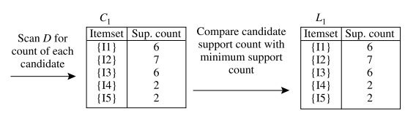
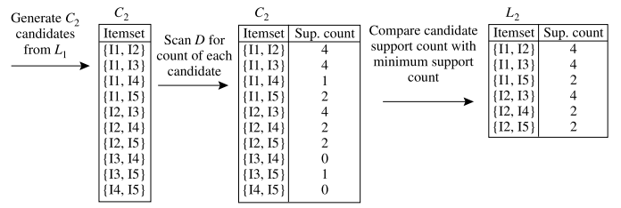
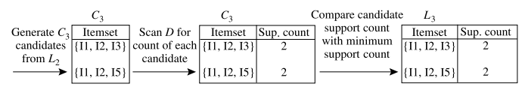

Slide 21
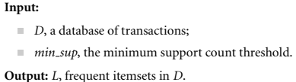
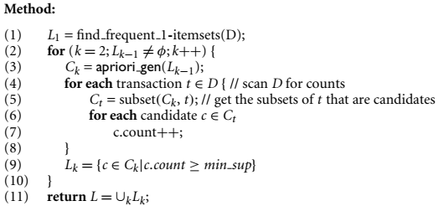
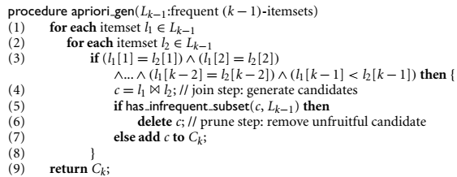
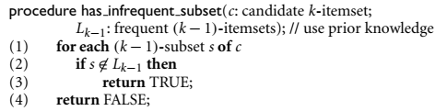

Slide 22
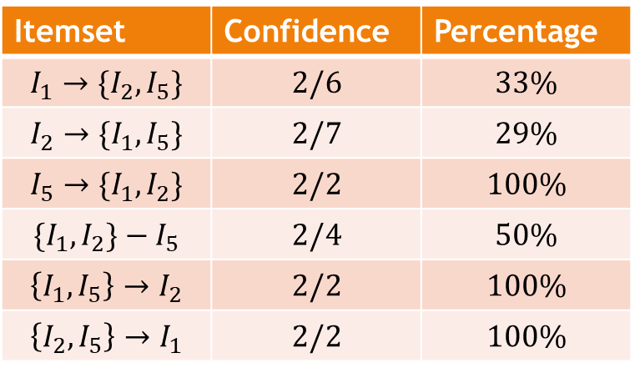
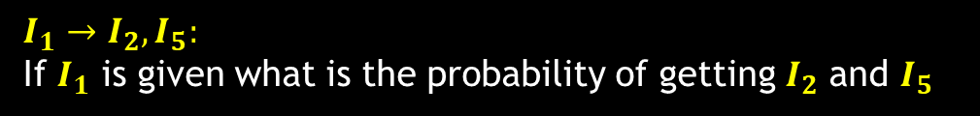

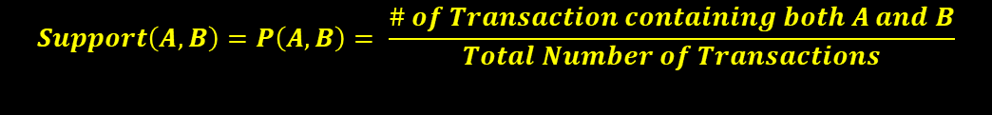
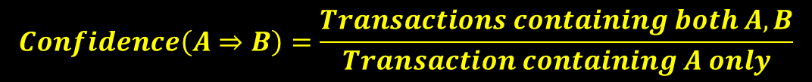
Finding Association Rules
Let frequent data set is $X=\{I_{1},I_{2},I_{5}\}$
$Subsets=\left[\left\{I_{1}\right\},\left\{I_{2}\right\},\left\{I_{5}\right\},\left\{I_{1},I_{2}\right\},\left\{I_{1},I_{5}\right\},\left\{I_{2},I_{5}\right\},\left\{I_{1},I_{2},I_{5}\right\}\right]$
$$Support\left(A,B\right)=P\left(A,B\right)= \frac{\# of Transaction containing both A and B}{Total Number of Transactions}$$
A1={I1,I2,I3}
A2={I1,I2,I5}
$$Confidence\left(A⇒B\right)=\frac{Transactions containing both A,B}{Transaction containing A only}$$
Itemset | Confidence | Percentage
$$I_{1}→\{I_{2},I_{5}\}$$ | $$2/6$$ | $$33\%$$
$$I_{2}→\{I_{1},I_{5}\}$$ | $$2/7$$ | $$29\%$$
$$I_{5}→\{I_{1},I_{2}\}$$ | $$2/2$$ | $$100\%$$
$$\{I_{1},I_{2}\}−I_{5}$$ | $$2/4$$ | $$50\%$$
$$\left\{I_{1},I_{5}\right\}→I_{2}$$ | $$2/2$$ | $$100\%$$
$$\left\{I_{2},I_{5}\right\}→I_{1}$$ | $$2/2$$ | $$100\%$$
$$I_{1}→I_{2},I_{5}:$$
If $I_{1}$ is given what is the probability of getting $I_{2}$ and $I_{5}$

Slide 23
Hidden Variables
The rule X → Y need not imply causality but just an association
In a problem, there may also be hidden variables whose values are never known through evidence
The advantage of using hidden variables is that the dependency structure can be more easily defined

Slide 24



Thanks for watching
Dr. Sajid Iqbal
Assistant Professor
Department of Computer Science
Bahauddin Zakariya University, Multan
sajidiqbal.pk@gmail.com
https://github.com/sajjo79/Design_and_Analysis_of_Algorithms
Allah Hafiz
COMEDXD

Slide 25
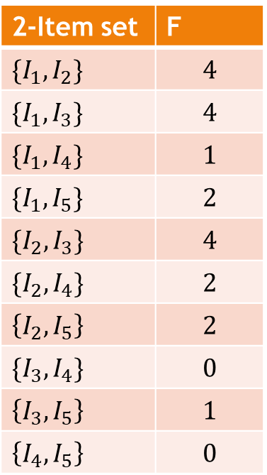
Assignments
2-Item set | F
$\{I_{1},I_{2}\}$ | $$4$$
$\{I_{1},I_{3}\}$ | $$4$$
$\{I_{1},I_{4}\}$ | $$1$$
$\{I_{1},I_{5}\}$ | $$2$$
$\{I_{2},I_{3}\}$ | $$4$$
$\{I_{2},I_{4}\}$ | $$2$$
$$\left\{I_{2},I_{5}\right\}$$ | $$2$$
$\{I_{3},I_{4}\}$ | $$0$$
$$\left\{I_{3},I_{5}\right\}$$ | $$1$$
$$\left\{I_{4},I_{5}\right\}$$ | $$0$$

